Slide 1

Planning Training using Anthology
Assessment and Research

Slide 2
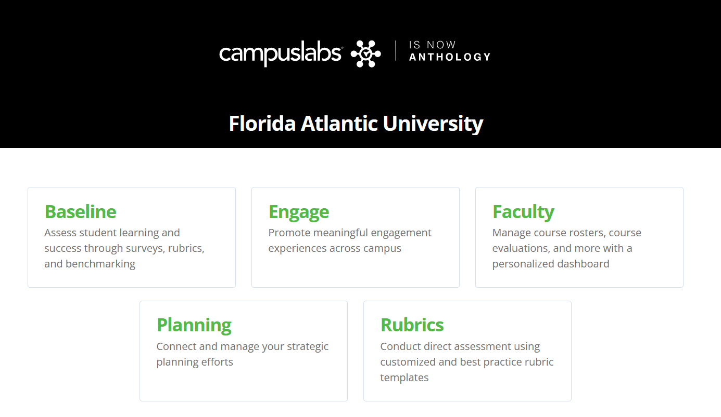
Page in Anthology
https://fau.campuslabs.com/home/

Slide 3
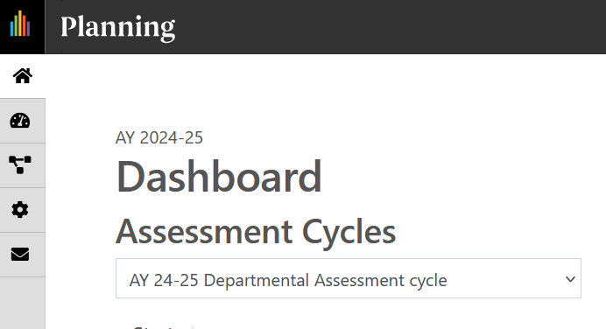
Select Planning Icon

Slide 4
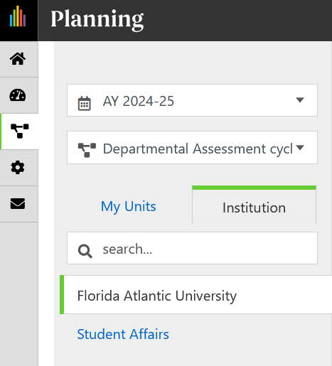

Select AY and Division

Slide 5

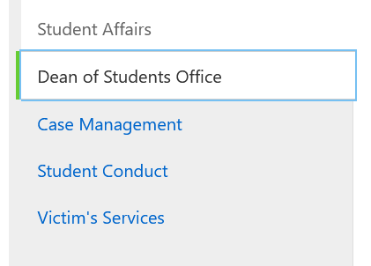
Select Department

Slide 6
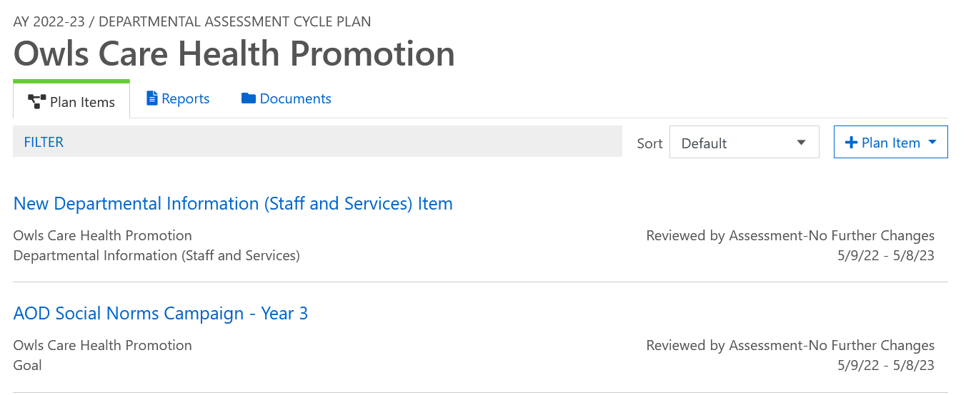

Need all 3 types (Dept. Info, Goal, Notable Moments or ES)

Slide 7
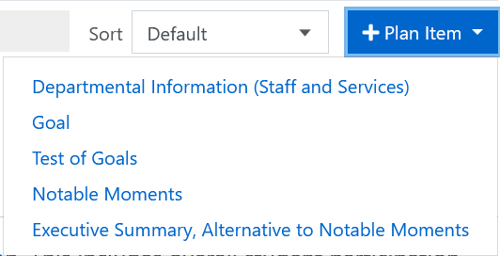
Add New Plan Item

Slide 8
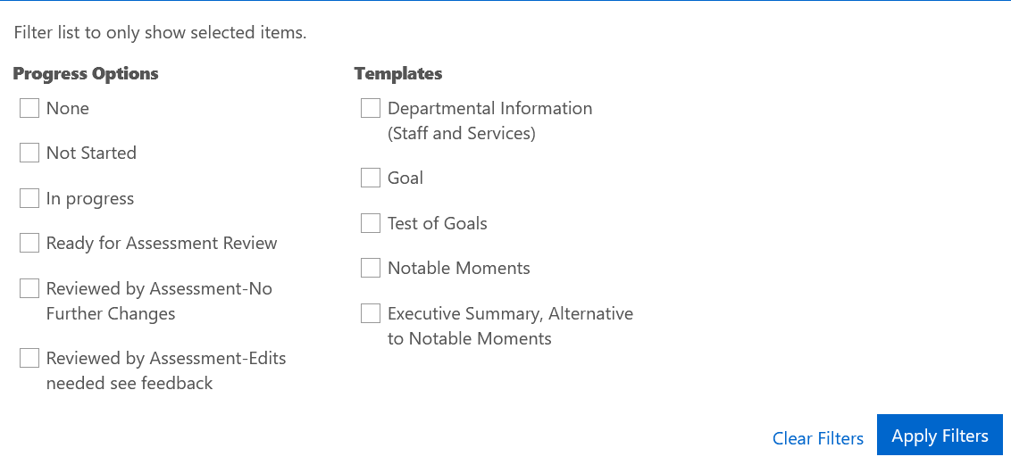
Filtering Plan Items

Slide 9
Departmental Information (Staff and Services)
Required | If Applicable
Department Name | List all Services / Programs that were removed / stopped in the current year
Mission | List all Services / Programs that will be stopped in the upcoming year
Vision | Staff Accomplishments from this year
Values
List All Employees / Roles for the Current Year
List all Services / Programs delivered in the current year
List all Services / Programs that were new in the current year

Slide 10
Goals- 3 IEA Goals and At Least 4 Total
Required | If Applicable
Title | BOG Metrics
IEA Goal | FAU Pillars and Platforms
Divisional Priorities | Divisional Goals
Assessment Type | Divisional Core Values
Goal Description | Personal and Professional Skills
Implementing Strategies
Assessment Method
Criterion for Success
Goal Met
Data Summary
Program Improvement

Slide 11
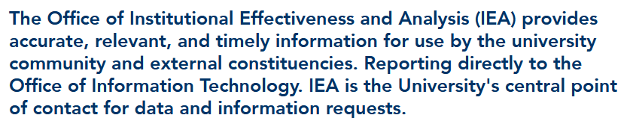
IEA Goals
https://www.fau.edu/iea/
Required | Example
1 Goal Related to Direct Student Learning | Test of Knowledge
1 Goal Related to Strategic Plan | Sense of Belonging
1 Goal Related to Either Listed Above | Career Readiness

Slide 12
3+ Notable Moments
Required | If Applicable
Title | BOG Metrics
Moment Type | FAU Pillars and Platforms
What happened?
Why is this notable?
What should we know about it?

Slide 13
Executive Summary, Alternative to Notable Moments
Required | Notes:
Name | Needs to be incredibly detailed
Executive Summary | Must encompass everything that would be in a Notable Moments
Contributions to Metrics | Contains (3+) topics
FAU Strategic Plan
Division of Student Affairs Strategic Plan

Slide 14
Contact Information
Dr. Rebecca Goldstein
Director for Assessment and Research
rgoldstein@fau.edu

