Slide 1


SharePoint Training for KPIs
Assessment and Research

Slide 2
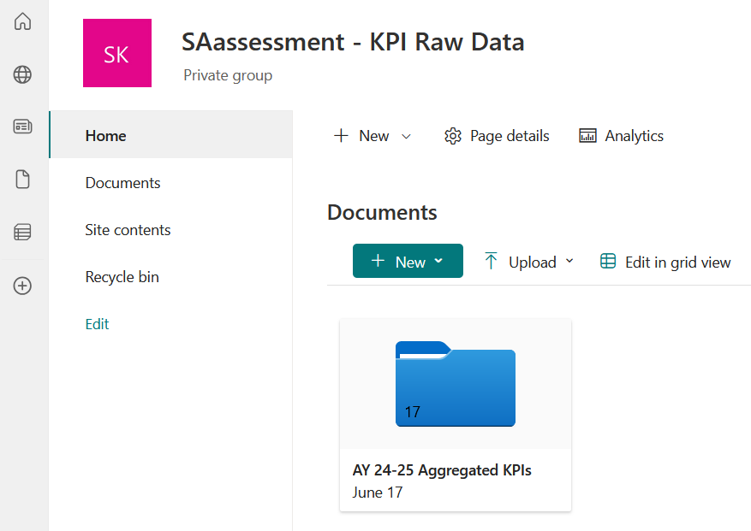

Only Aggregated Data
https://fau.sharepoint.com/sites/SAassessment-KPIRawData

Slide 3
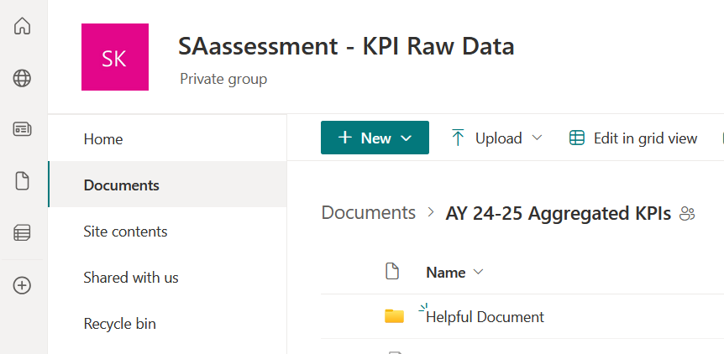

Help!
Contains the FAU + Division strategic plans, data dictionary, and more!

Slide 4
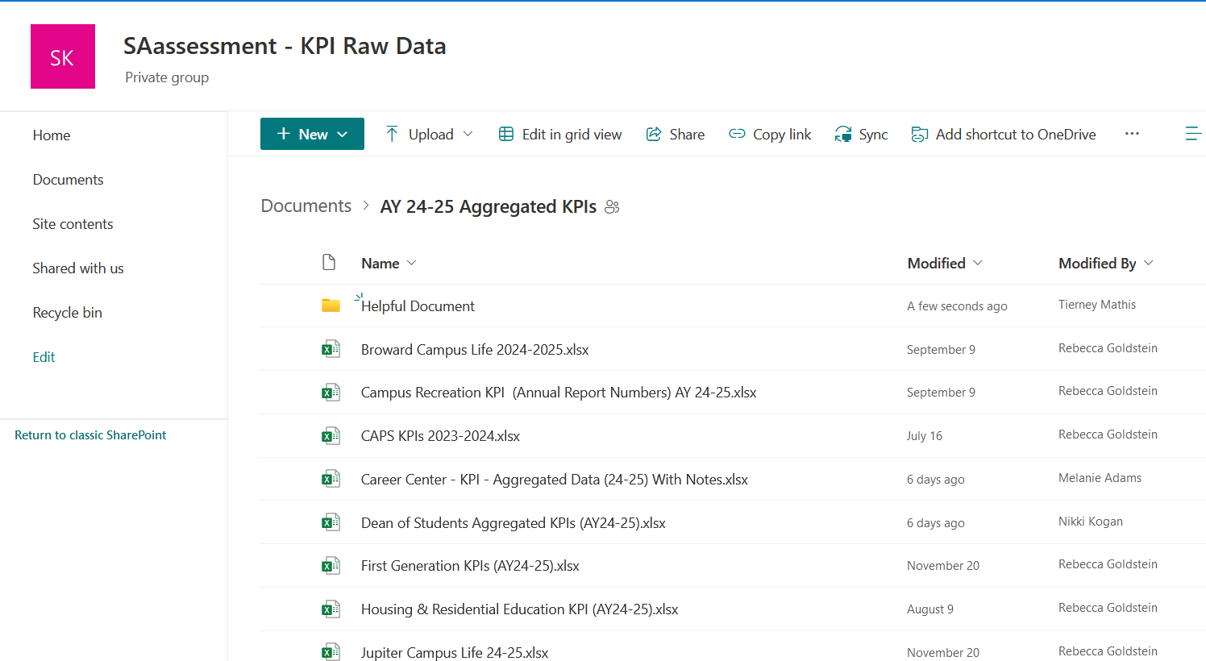

Add to Department Excel File

Slide 5
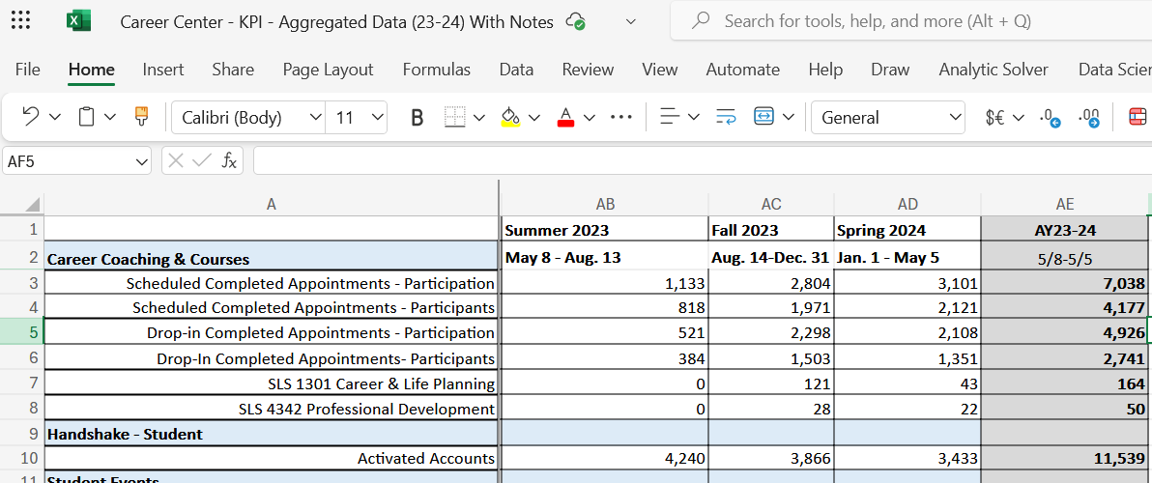

Breakdown of the Year
Participation = All Data Points: Count is combined at the end
Participants = Unique Count: Count is NOT combined
AY calculation is required and needs to consider the unique participants

Slide 6

Contact Information
Dr. Rebecca Goldstein
Director for Assessment and Research
rgoldstein@fau.edu

