Slide 1
AutoRegressive Modeling of Directed Functional
Connectivity in the Brain
Steven L. Bressler, PhD
Director, Cognitive Neurodynamics Laboratory
Center for Complex Systems & Brain Sciences
Florida Atlantic University

Slide 2
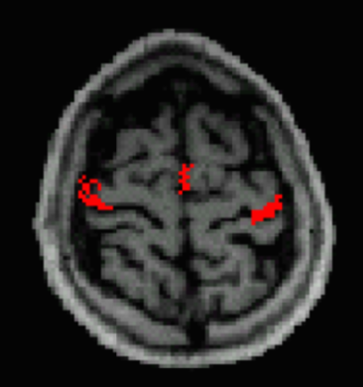
Correlation vs Causal Influence
Correlation
Causal Influence

Slide 3

Wiener Causality
For two simultaneous time series, one series is called causal to the other if we can better predict the second series by incorporating knowledge of the first one.
Norbert Wiener
The Theory of Prediction, 1956

Slide 4
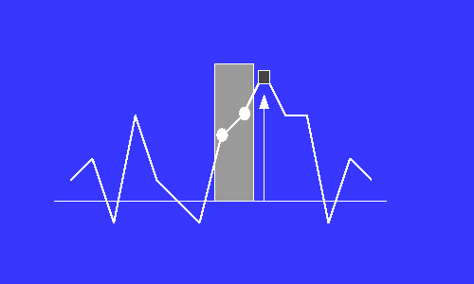
The AutoRegressive Model
X_{t}= [a₁X_{t-1} + a₂X_{t-2} + a₃X_{t-3} + … + a_{m}X_{t-m}] + ε_{t}
where X is a zero-mean stationary stochastic process, a_{i} are model coefficients, m is the model order, and ε_{t} is the white noise residual error process.

Slide 5
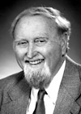
Wiener-Granger Causality
Granger (1969): Let x₁, x₂, …, x_{t} and y₁, y₂, …, y_{t} represent two time series.
Compare two linear autoregressive models:
x_{t} = a₁x_{t-1} + … + a_{m}x_{t-m} + ε_{t}
and
x_{t} = b₁x_{t-1} + … + b_{m}x_{t-m}
+ c₁y_{t-1} + … + c_{m}y_{t-m} + η_{t}
If var(η_{t}) is significantly less than var(ε_{t}), then the y time series significantly contributes to the x time series, and the y is said to have a casual influence on x.
Restricted Model
Unrestricted Model

Slide 6
Possible W-G Causality Relations Between Network Node Pairs
Unidirectional causality from x to y
Unidirectional causality from y to x
Bidirectional causality
Independence

Slide 7
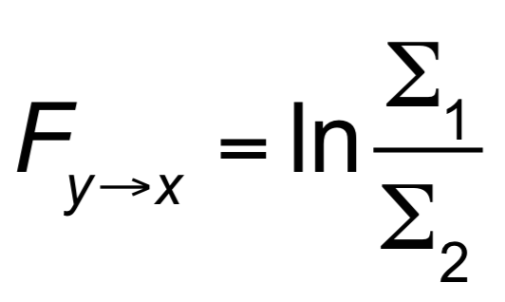
Time-Domain Weiner-Granger Causality
where F_{y→x} is Weiner-Granger Causality, and
Σ₁ and Σ₂ are the variances of ε_{t} and η_{t} , respectively.

Slide 8
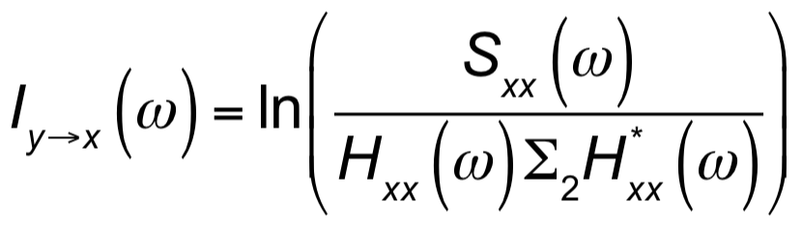
Frequency-Domain Weiner-Granger Causality
Geweke (1982) found a frequency-domain (spectral) representation of W-G Causality, called I_{y→x}(ω ):
Spectral W-G Causality from y to x is:
where ω is frequency in rads/sec, S_{xx} is the autospectrum of x, H_{xx}(ω) is an element of the transfer function H(ω)=A⁻¹(ω), Σ₂ is the residual variance of the unrestricted model of x, and * denotes complex conjugation and matrix transposition.

Slide 9
W-G Causality as Explained Power
We see that spectral W-G Causality is defined based on the part of the total power of process x that is explained by process y.

Slide 10
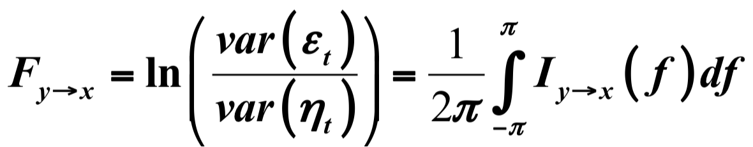
Relation of Time-Domain & Frequency-Domain Weiner-Granger Causality
W-G Causality from y to x in the time domain equals the sum of Spectral W-G Causalities from y to x over all frequencies.

Slide 11

Examples of W-G Spectra of Macaque Cortical Task-Related LFPs Indicating Beta-Frequency Unidirectional Causality

Slide 12
The MultiVariate AutoRegressive (MVAR) Model
X_{i,t}= a_{i,1,1}X_{1,t-1} + a_{i,1,2}X_{1,t-2} + … + a_{i,1,m}X_{1,t-m}
+ a_{i,2,1}X_{2,t-1} + a_{i,2,2}X_{2,t-2} + … + a_{i,2,m}X_{2,t-m}
+ …
+ a_{i,p,1}X_{p,t-1} + a_{i,p,2}X_{p,t-2} + … + a_{i,p,m} X_{p,t-m}
+ e_{i,t}
X_{t} = A₁X_{t-1} + … + A_{m}X_{t-m} + E_{t}
where: X_{t} = [x_{1t} , x_{2t} , …, x_{pt} ]^{T} are p data channels, m is the model order, A_{k} are p x p coefficient matrices, & E_{t} is the white noise residual error process vector.

Slide 13
MVAR Modeling of Event-Related LFP Time Series
LFP time series from repeated task trials are treated as realizations of a stationary stochastic process.
A_{k} are obtained by solving the multivariate Yule-Walker equations (of size mp²), using the Levinson, Wiggens, Robinson algorithm, as implemented by Morf et al. (1978).
Morf M, Vieira A, Lee D, Kailath T (1978) Recursive multichannel maximum
entropy spectral estimation. IEEE Trans Geoscience Electronics 16: 85-94)
The model order is determined by parametric testing.

Slide 14
W-G Causality Graphs
A set of network nodes may be analyzed for directed functional connectivity by computing W-G Causality in both directions between all node pairs.
The statistical significance of each W-G Causality is computed by comparison to a “permutation distribution”.
Significant W-G Causalities are plotted as arrows between nodes on a network graph, with arrow direction indicating the direction of W-G causal influence and arrow thickness representing the magnitude of W-G causal influence.

Slide 15
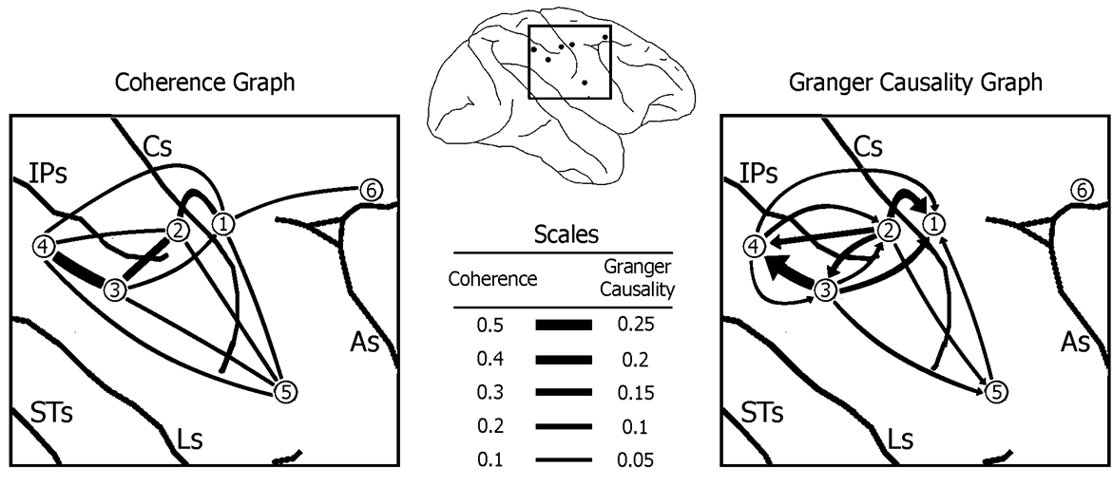
Example of a W-G Causality Graph from Macaque Cortical Task-Related LFPs
(from Brovelli et al., PNAS, 2004)

Slide 16
Adaptive MultiVariate AutoRegressive (AMVAR) Modeling
(Ding, Bressler et al., Biological Cybernetics, 2000)
AMVAR modeling captures the dynamics of AR processes with high temporal precision.
MVAR modeling is performed in a short time window, sliding with a high degree of overlap.
When spectral analysis is performed on the model at each time step, a time-frequency plot is obtained.

Slide 17
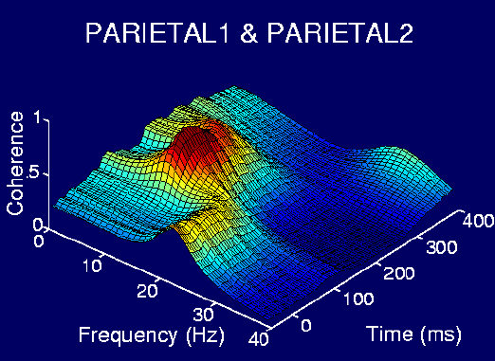
Example of AMVAR Time-Frequency Coherence Plot from Macaque Cortical Task-Related LFPs

Slide 18
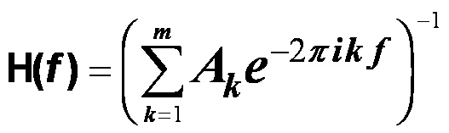
Spectral Analysis by MVAR Modeling
The Spectral Matrix is defined as:
S( f ) = <X (f ) X (f )*> = H(f ) Σ H*(f )
where * denotes matrix transposition & complex conjugation; Σ is the covariance matrix of E_{t} ; and
is the transfer function of the system.
The Power Spectrum of channel k is S_{kk} ( f )
which is the k ^{th} diagonal element of the spectral matrix.

Slide 19
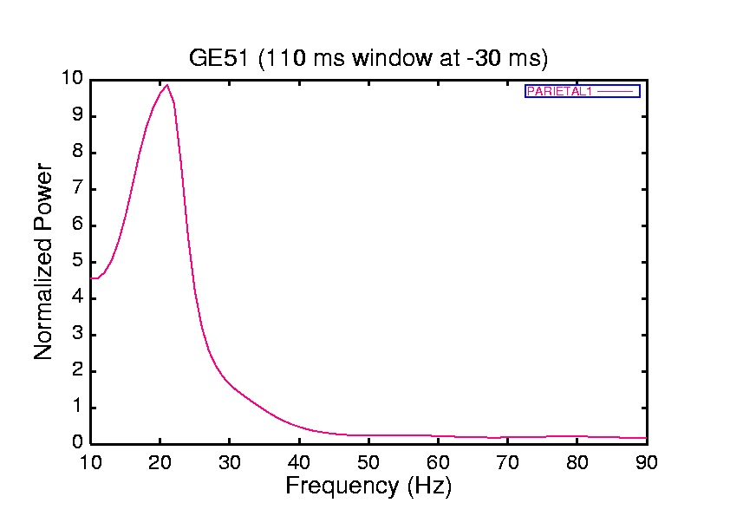
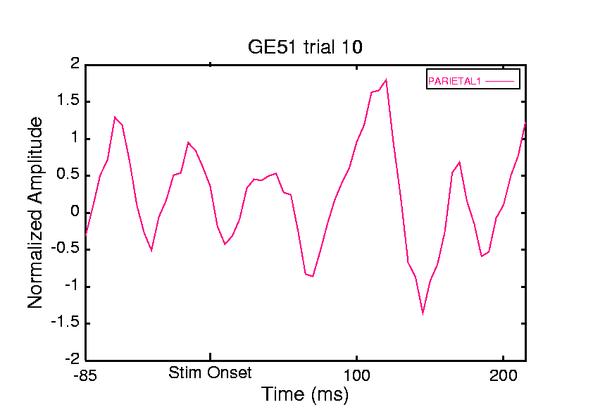
Example of Power Spectrum of a Macaque Cortical Task-Related LFP Indicating Beta-Frequency Oscillatory Activity

Slide 20
Cross-Spectral Analysis by MVAR Modeling
The Cross-Spectrum of channels k & l is S_{kl} ( f ).
The (squared) Coherence Spectrum of channels k & l is the magnitude of the cross-spectrum normalized by the two auto-spectra:
C_{kl} ( f ) = |S_{kl} ( f )|² / S_{kk} ( f ) S_{ll} ( f ).
The value of coherence at frequency f can range from 1, indicating maximum interdependence, down to 0, indicating no interdependence. The phase of the cross spectrum plotted as a function of f gives the phase spectrum.

Slide 21
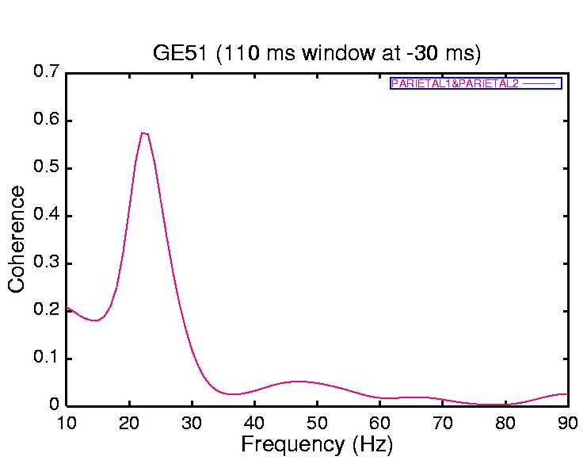
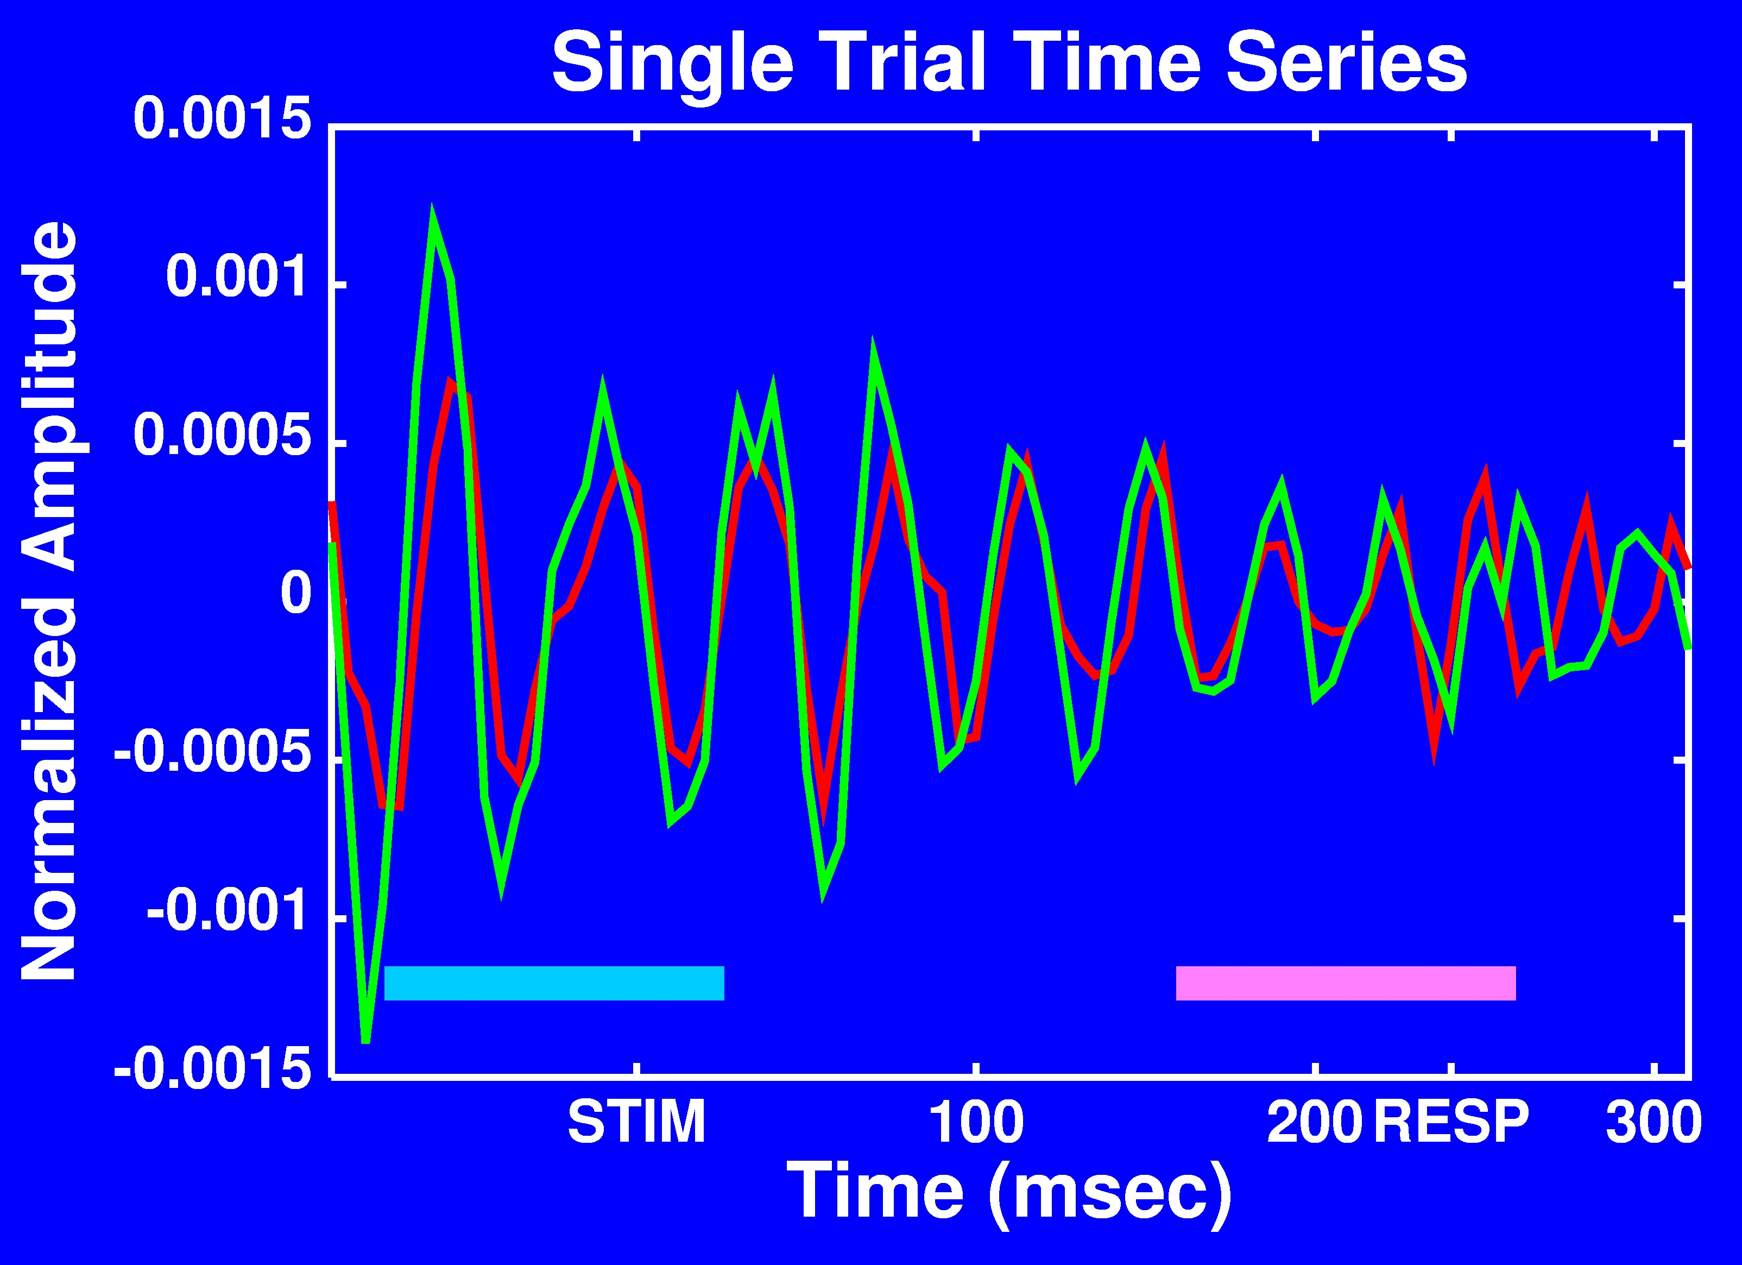
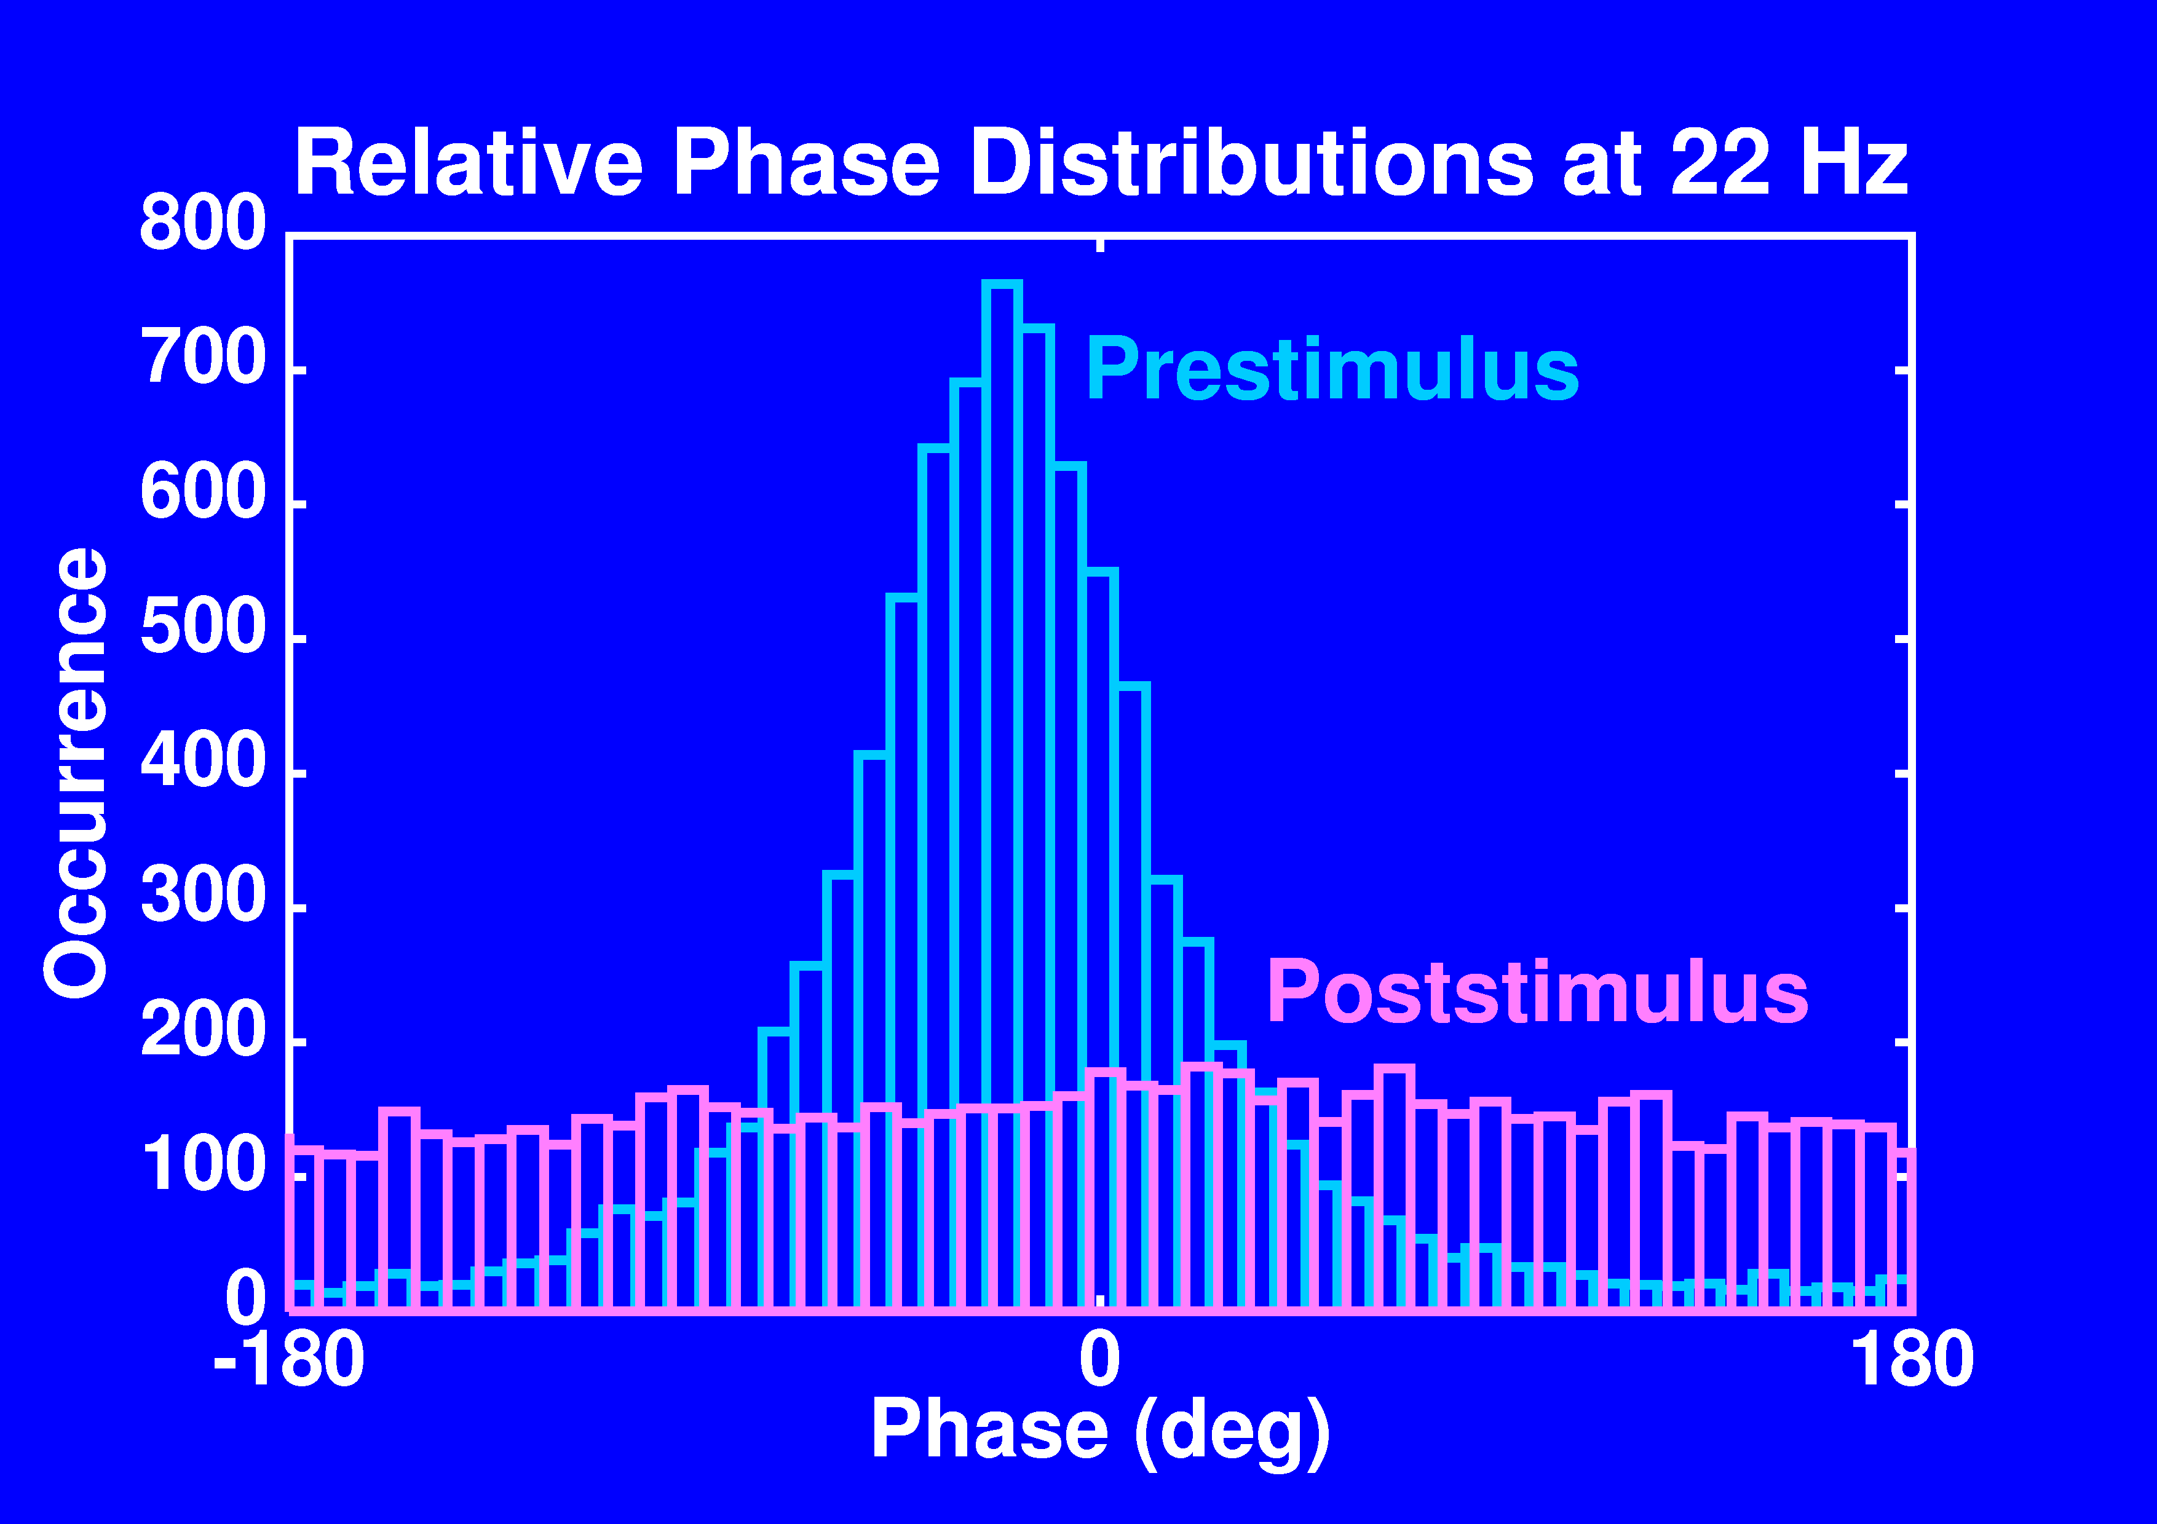
Example of Coherence Spectrum of Macaque Cortical Task-Related LFPs Indicating Beta-Frequency Synchronization

Slide 22
Take-Home Message
The study of Directed Functional Connectivity (DFC) is an important approach to understanding brain function.
DFC can effectively be computed from neural data by AutoRegressive (AR) modeling.
AR modeling is especially useful for revealing the spectral profile of DFC in the brain on a short timescale.
Spectral analysis of neural data by AR modeling also reveals short-time brain network dynamics and graph properties.

