Slide 1
Source-Resolved
Connectivity Analysis
Steven L. Bressler
Director, Cognitive Neurodynamics Lab
Center for Complex Systems & Brain Sciences
Florida Atlantic University

Slide 2
The goal: to characterize the large-scale brain networks responsible for cognition
The approach: apply functional connectivity analysis to source-resolved neural data
Source-resolved neural data: unit activity, LFP, iEEG, ECoG [extensions of connectivity analysis to source-unresolved data (EEG, MEG, fMRI) require additional assumptions and procedures, and they are controversial ]

Slide 3
Functional connectivity estimators:
Undirected: correlation, mutual information,
spectral coherence
Directed: mvar coefficient, transfer entropy,
Granger causality, directed transfer function,
partial directed coherence
Network science: compute network nodes, edges, and other network metrics, e.g., efficiency
Network configuration comparison: use pattern classification to test whether network metrics categorize cognitive state

Slide 4
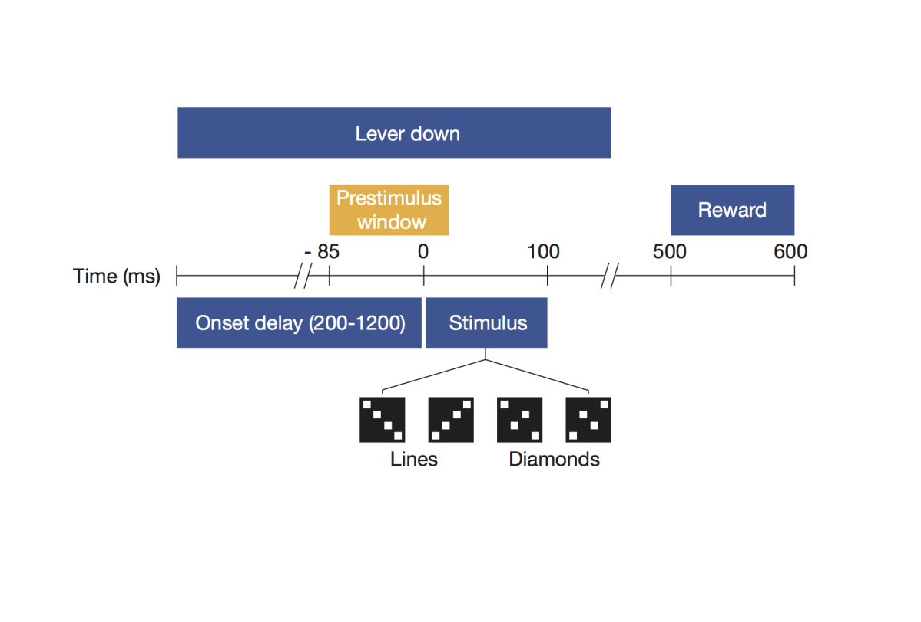
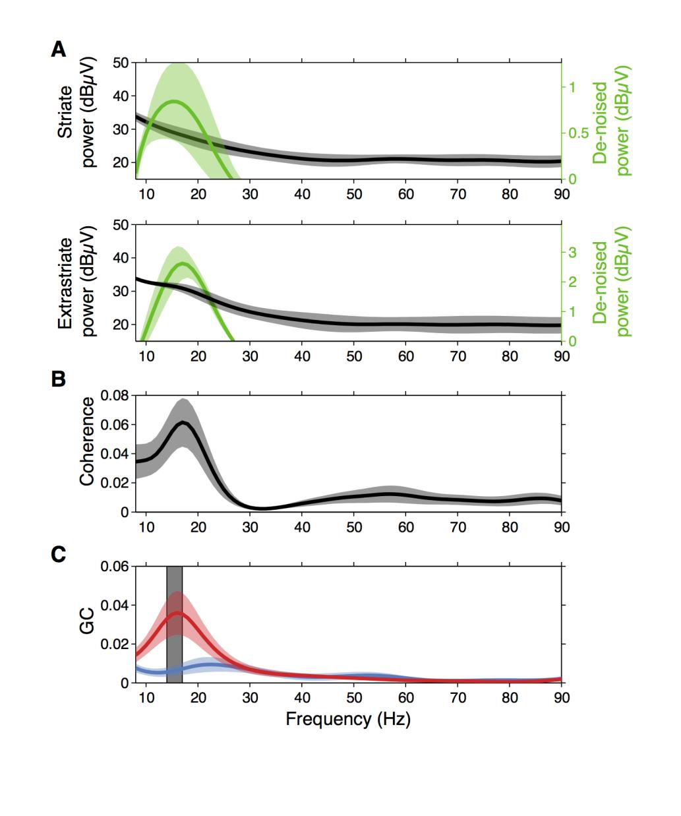
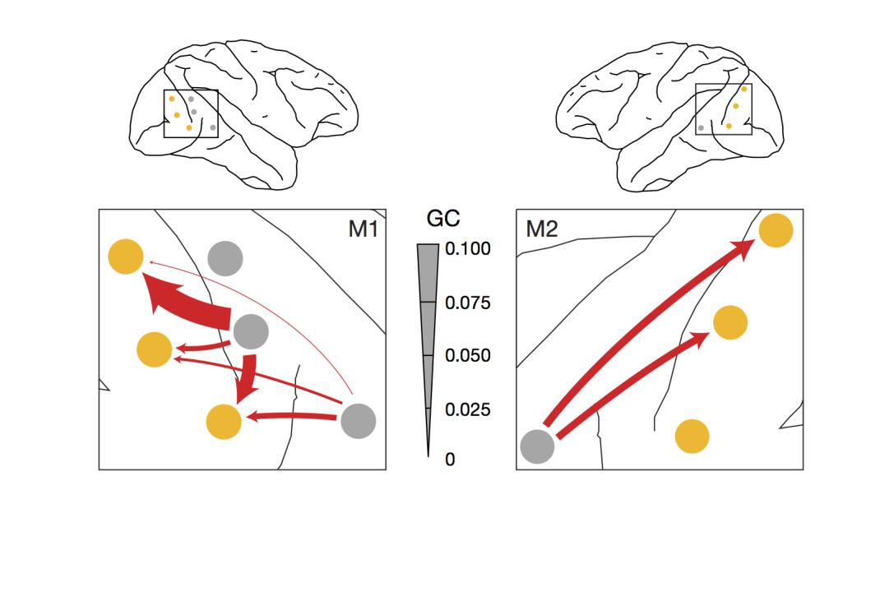
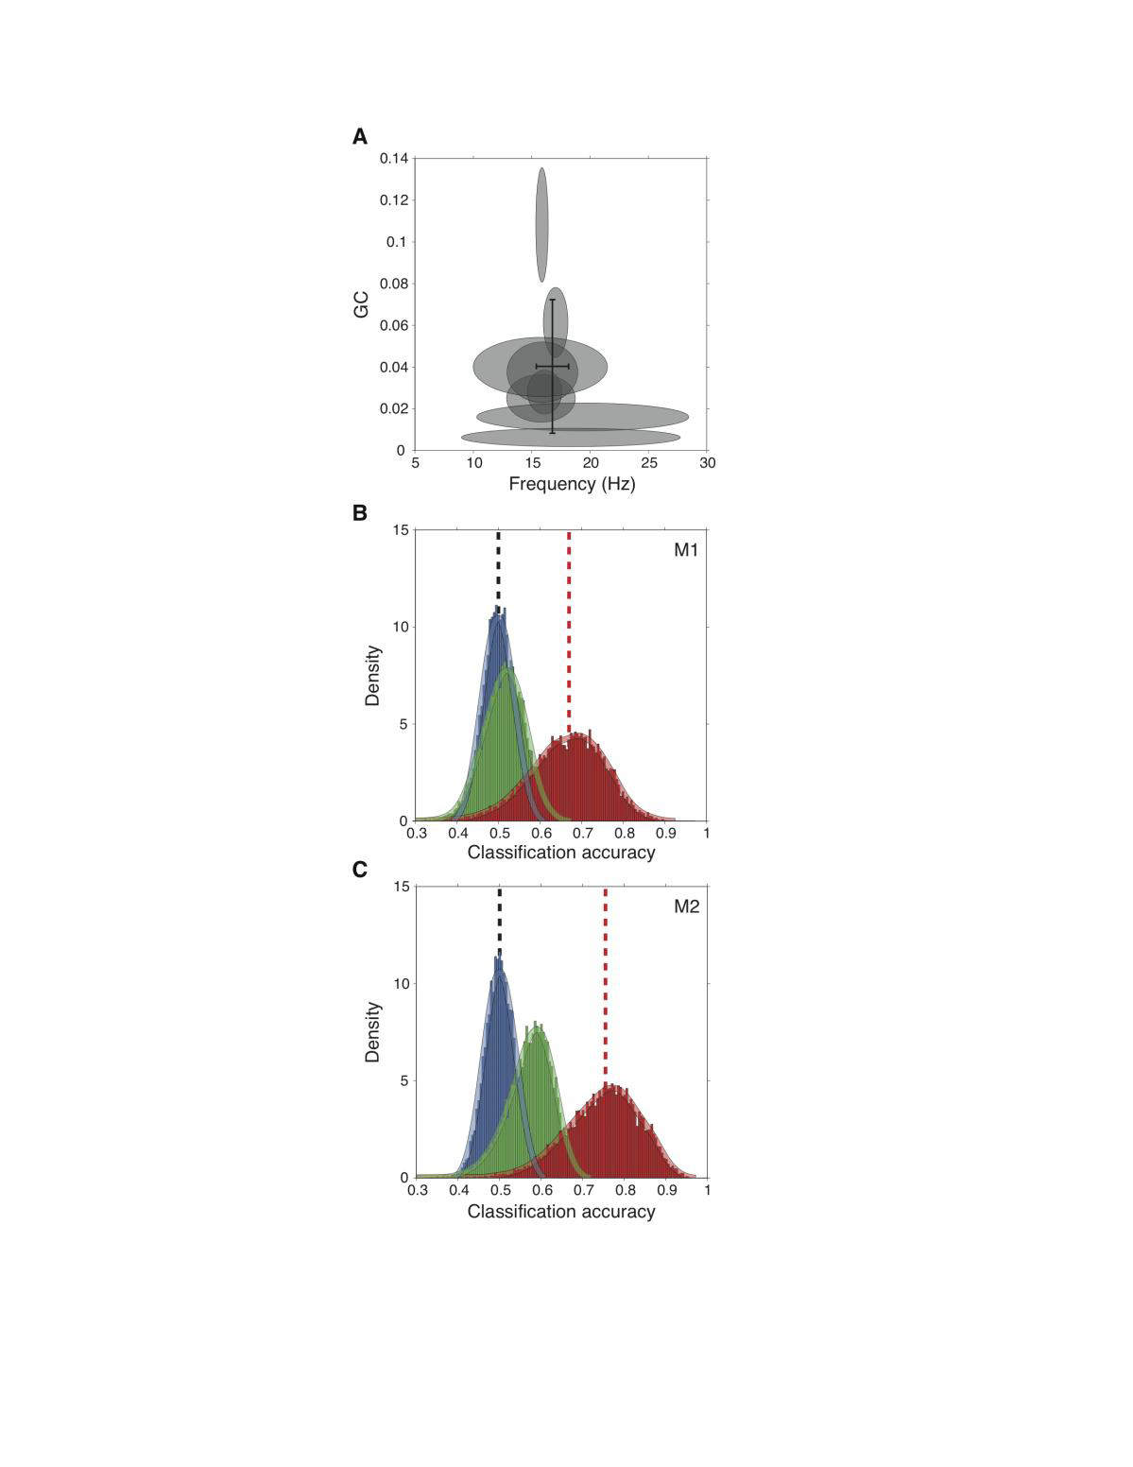
Nodes and edges (both undirected and directed) based on beta oscillations in prestimulus LFPs from visual cortex.
Spatial pattern of top-down peak spectral Granger causality from extrastriate cortex (V4, TEO) to V1.
A visuo-motor task performed by macaque monkeys
Categorization of task rule by SVM pattern classification: feature is spatial pattern of top-down beta-frequency peak spectral Granger causality

Slide 5
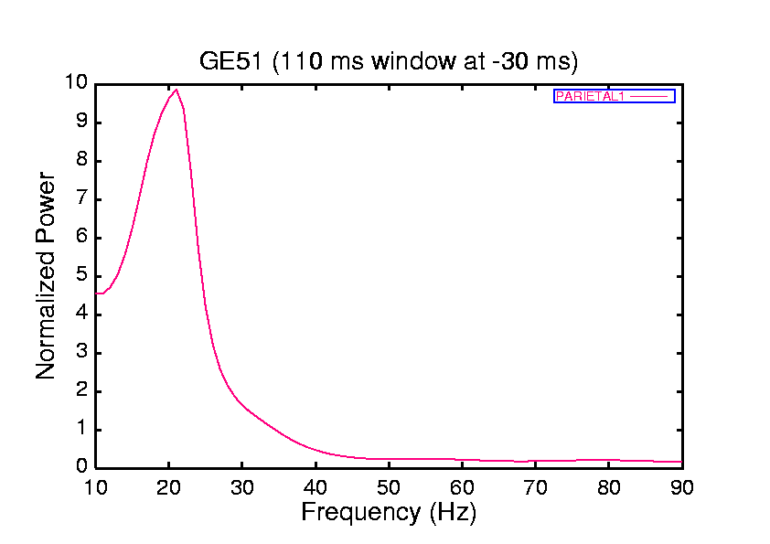
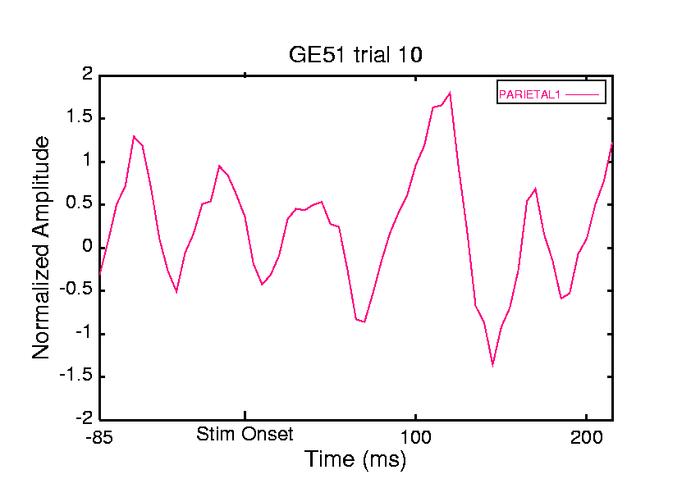
Identification of Oscillatory Activity from Power Spectra

Slide 6
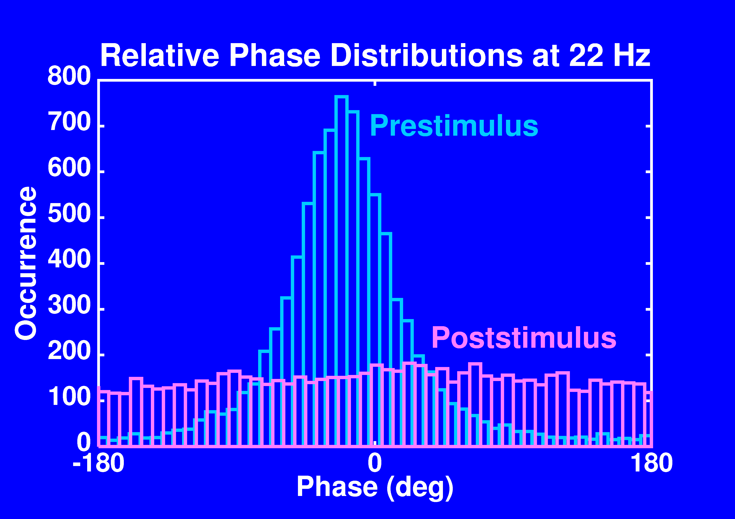
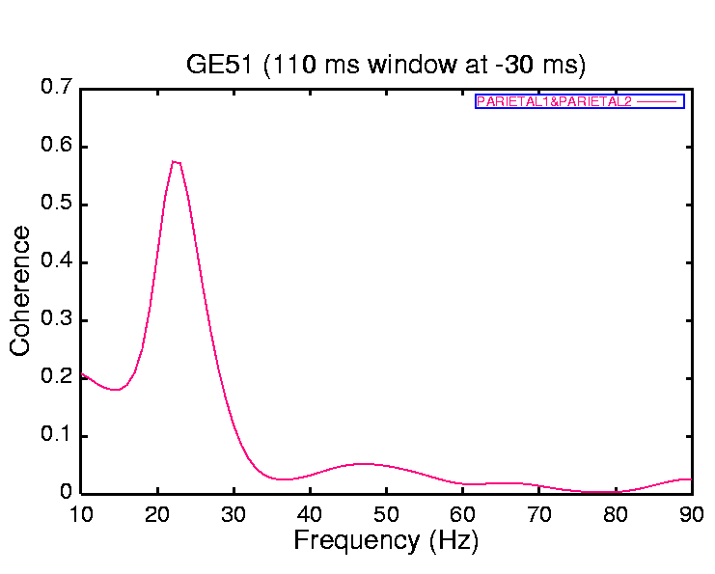
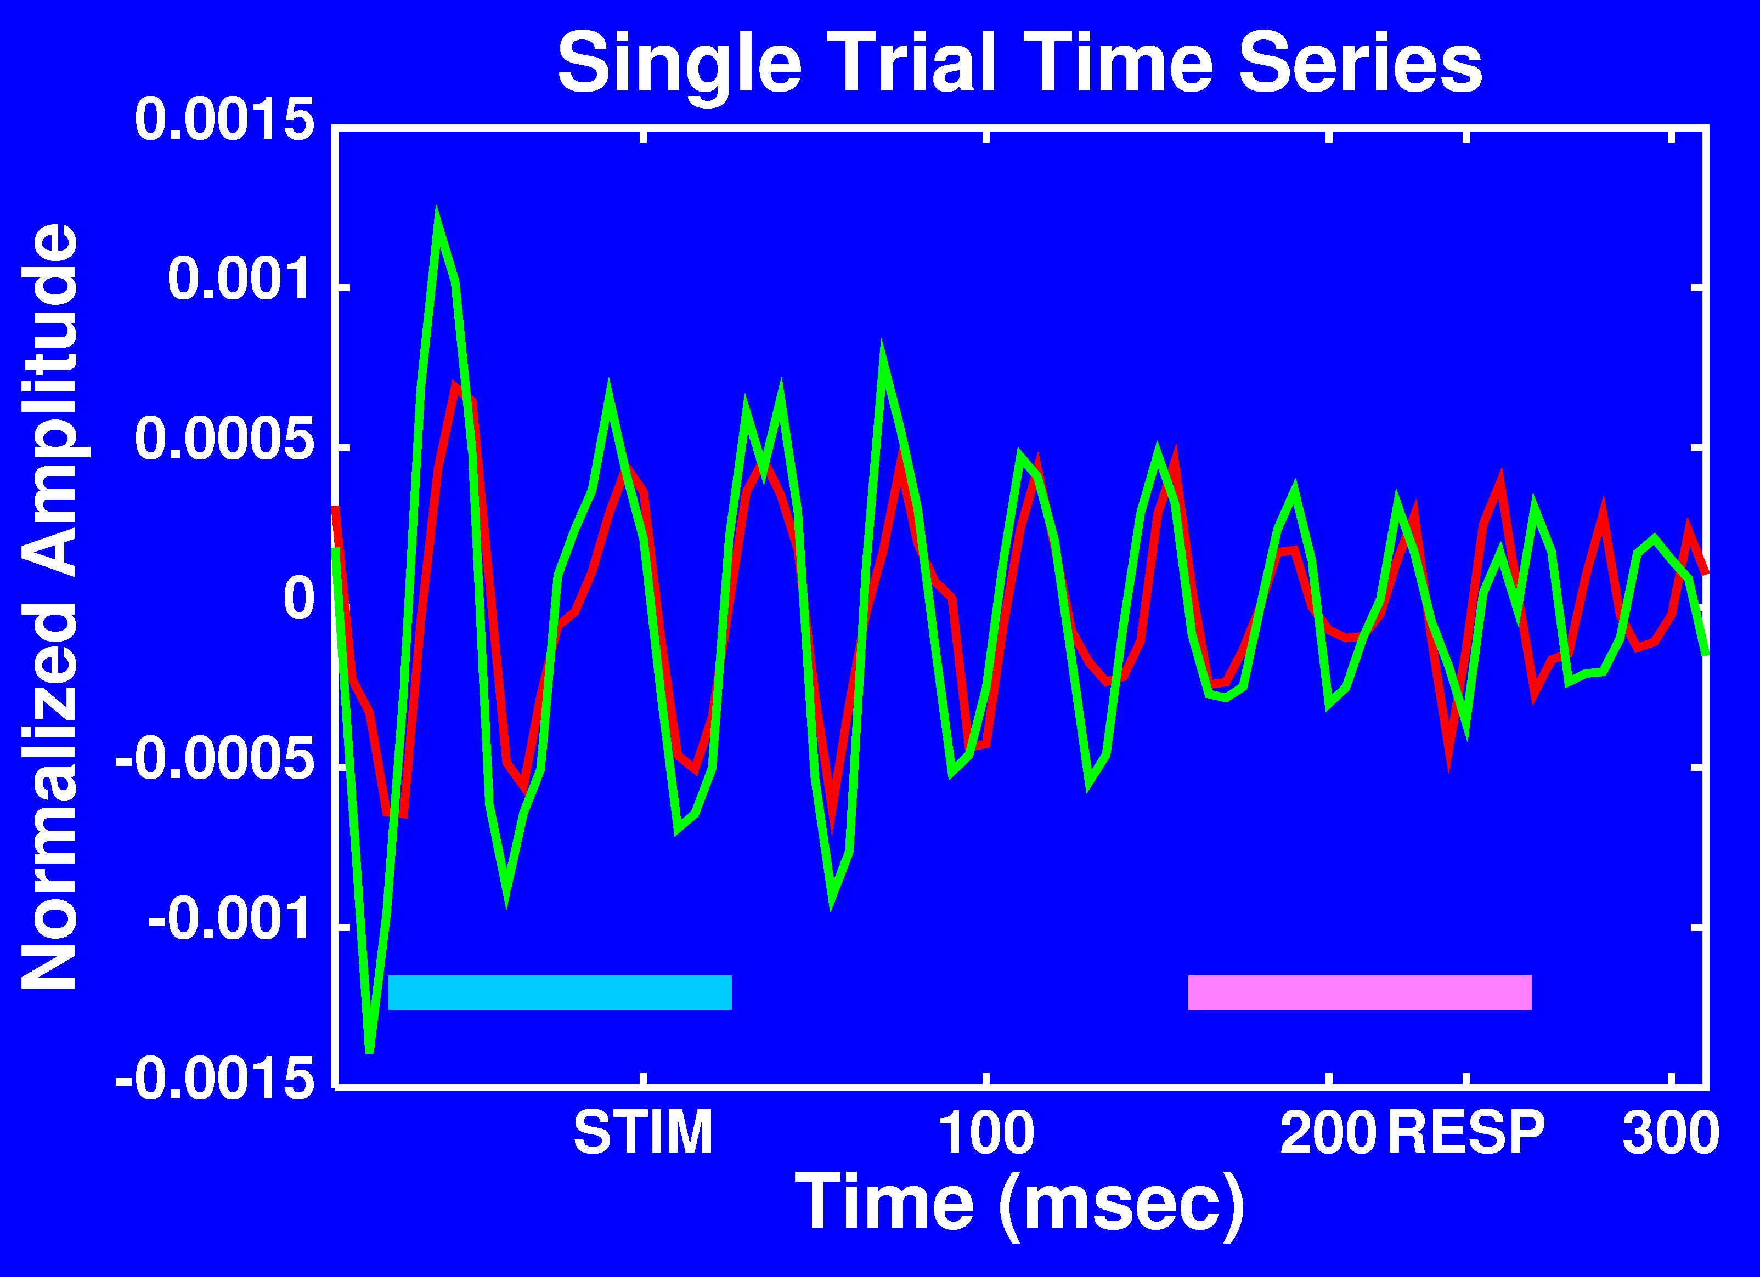
Identification of Undirected Network Edge by Coherence Spectra

Slide 7
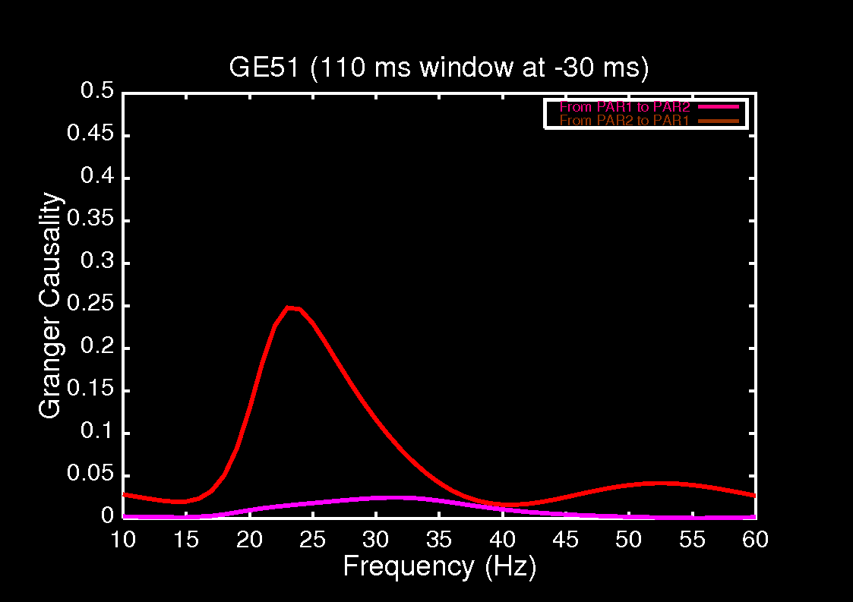
Identification of Directed Network Edge by Granger Causality Spectra

