Slide 1
Awards ceremony 2021 Southeast Regional tournament Feb 27, 2021 hosted by fau

Slide 2
UNDERGRADUATE RESEARCH AT FAU
OURI
OFFICE OF UNDERGRADUATE RESEARCH AND INQUIRY

Slide 3
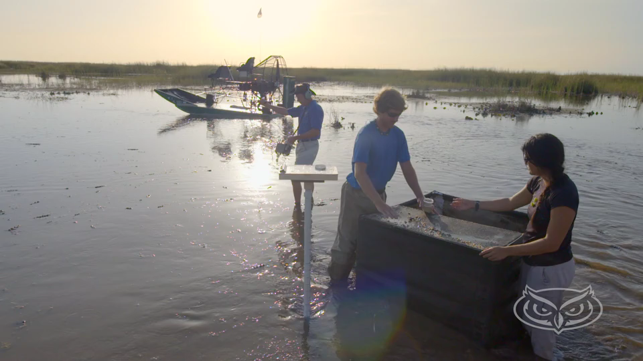
ouri@fau.edu
www.fau.edu/ouri

Slide 4
OFFICE OF UNDERGRADUATE RESEARCH
AND INQUIRY
Curricular Initiatives
Co-Curricular URI student opportunities
Faculty and Student Support and Recognition
CULTURE: Undergraduate Research and Inquiry

Slide 5
Office of Undergraduate Research and Inquiry
OURI serves as a centralized support office for FAU faculty, staff and students who are engaged in undergraduate research, scholarship, and creative activities.
We offer university wide programs such as
undergraduate research grants
undergraduate research symposium
undergraduate research journal
support for faculty and students through our Peer Mentor program
“Undergraduate Research for All!”

Slide 6
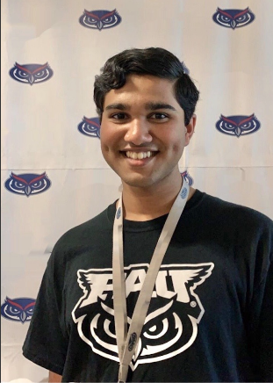
Student Spotlight
Vivek Sreejithkumar, OURI Peer Mentor
Faculty Mentor: Michael Smirnov, Ph.D., MPFI for Neuroscience
Email: vsreejithkum2018@fau.edu
Undergraduate Researcher, FAUHS
Mathematical Modeling of Infectious Diseases
H1N1 Influenza
COVID-19
PEACE: Protecting the Elderly with AI for Clinical Emergencies
Machine Learning Fall Detection project in MPCR Lab
Bolton Lab at the Max Planck Florida Institute for Neuroscience

Slide 7
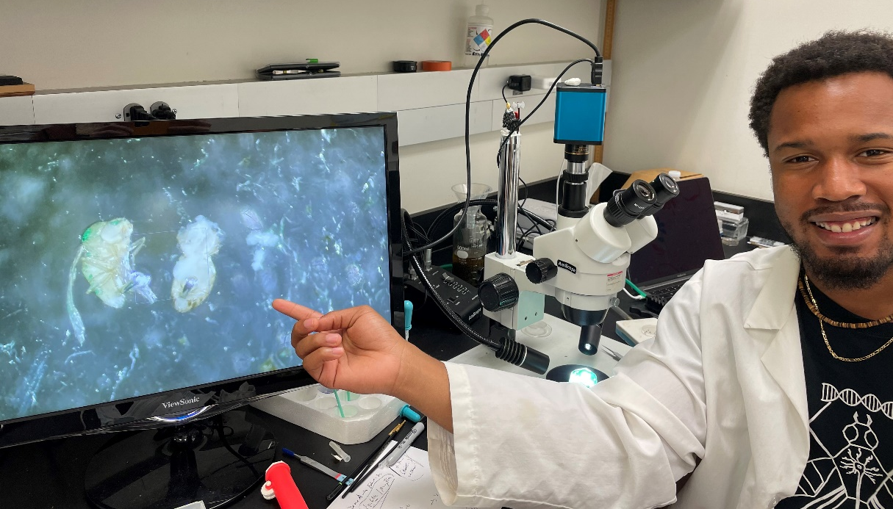
Student Spotlight
Wayne Robinson, FAU Brain Institute
Faculty Mentor: Tanja Godenschwege, Ph.D. and Alex Keene, Ph.D.
Email: wrobinson2018@fau.edu
Undergraduate Researcher
Testing the effects of cellular stress and how it affects the death of cells and death of humans
Used towards understanding cellular basis of neurological diseases such as Alzheimer’s and Parkinson’s
Investigating genetic differences in surface and cave fish to analyze what behavioral and morphological changes may occur as a result
Used towards understanding genetic and environmental differences for which behavior may be altered

Slide 8
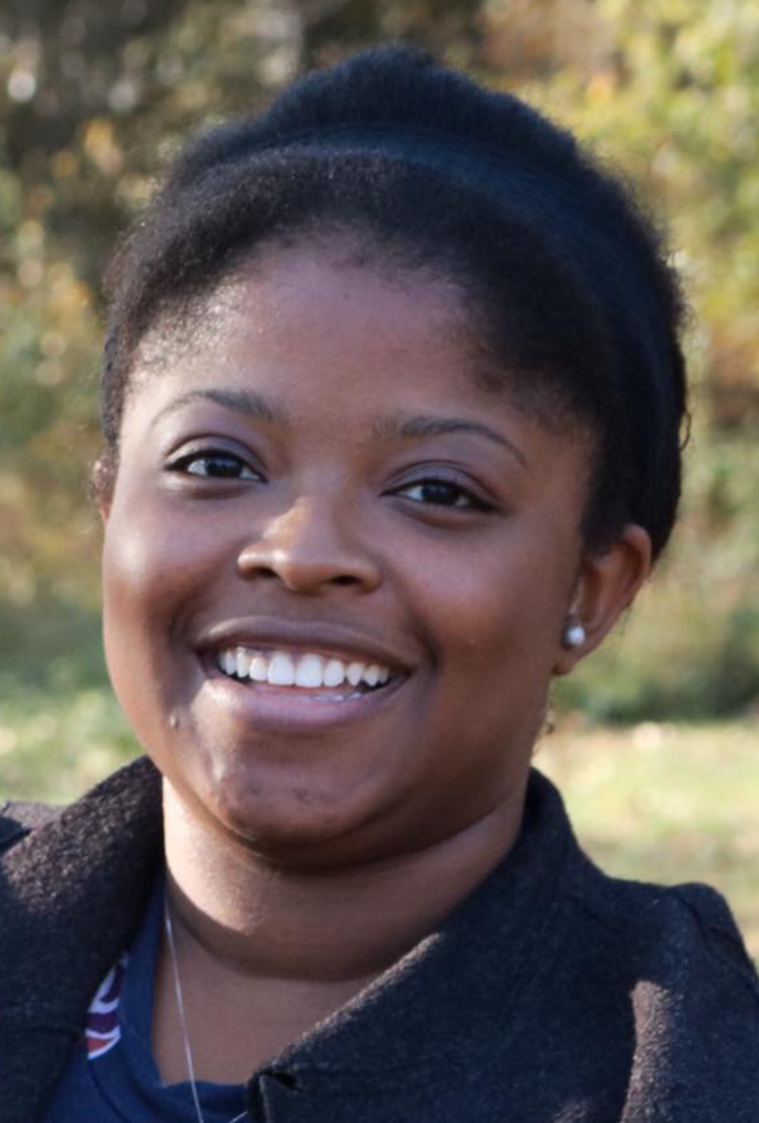
Student Spotlight
Vanessa Stubbs
Faculty Mentor: Ceylan Isgor Ph.D.
Email: vstubbs2014@fau.edu
Undergraduate Researcher, Epilepsy Lab, NSF-LEARN
Compares the brains of mice who have not experienced seizures, mice who are seizure prone, and mice who will not experience seizures
Uses a mouse model that overexpresses BDNF, a protein associated with seizures
Utilizes a confocal microscope to obtain 3-D images of the specific areas in the brain.

Slide 9
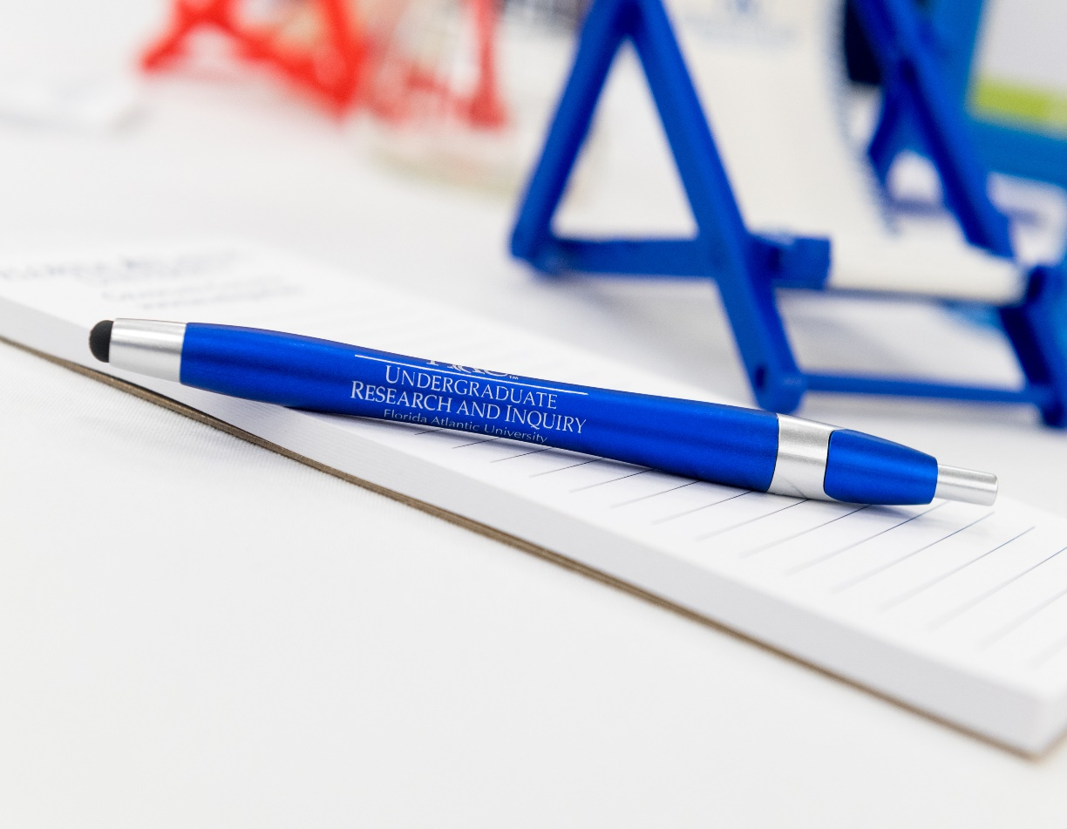
Office of Undergraduate Research and Inquiry
How can I learn more?
Visit OURI Website: https://www.fau.edu/ouri/
Meet with a Peer Mentor: https://www.fau.edu/ouri/meet_our_mentors.php
Join our mailing list: email ouri@fau.edu to request
Follow/Like us on Social Media:
Facebook: FAU OURI
Instagram: fau_ouri
Twitter: @fauouri

Slide 10
Awards ceremony 2021 Southeast Regional tournament Feb 27, 2021 hosted by fau

Slide 11
Reminder: medals and trophies will be mailed within the next few weeks to the address that you provided
If you have not provided an address, please do so ASAP
Package will contain medals only, no list of which teams / students get which medal(s)
Advancement to state:
Division B—8 Teams
Division C—18 Teams
Watch for an email invite from Valerie in the state office

Slide 12
Division B - Anatomy & Physiology
1. American Heritage Plantation - Team Gold (B02)
2. New Springs Schools - NSS (B20)
3. Archimedean Middle Conservatory - Archie Owls Beta (B04)
4. American Heritage Plantation - Team Black (B01)
5. Archimedean Middle Conservatory - Archie Owls Alpha (B03)
6. Broward Math and Science Schools - BMSS (B05)

Slide 13
Division C - Anatomy & Physiology
1. Archimedean Upper Conservatory - Beta Archimedean (C03)
2. American Heritage Plantation - AHS (C38)
3. Boca Raton Community - Boca Raton Team 1 (C06)
4. St. Thomas Aquinas - STAHS SO (C22)
5. Everglades - Gators (C13)
6. Archimedean Upper Conservatory - Alpha Archimedean (C02)

Slide 14
Division B - Boomilever
1. American Heritage Plantation - Team Gold (B02)
2. Archimedean Middle Conservatory - Archie Owls Alpha (B03)
3. American Heritage Plantation - Team Black (B01)

Slide 15
Division C - Astronomy
1. Boca Raton Community - Boca Raton Team 1 (C06)
2. Archimedean Upper Conservatory - Alpha Archimedean (C02)
3. Florida Atlantic University - FAU High School A (C14)
4. American Heritage Boca-Delray - AHS Boca/Delray (C01)
5. West Broward - WeBro Blue (C35)
6. St. Thomas Aquinas - STAHS SO2 (C23)

Slide 16
Division B - Circuit Lab
1. American Heritage Plantation - Team Gold (B02)
2. Archimedean Middle Conservatory - Archie Owls Beta (B04)
3. American Heritage Plantation - Team Black (B01)
4. Archimedean Middle Conservatory - Archie Owls Alpha (B03)
5. New Springs Schools - NSS (B20)
6. Rise Academy - RISE Academy (B07)

Slide 17
Division C - Boomilever
1. Boca Raton Community - Boca Raton Team 2 (C07)
2. Boca Raton Community - Boca Raton Team 1 (C06)
3. Archimedean Upper Conservatory - Beta Archimedean (C03)
4. Archimedean Upper Conservatory - Alpha Archimedean (C02)
5. Archimedean Upper Conservatory - Gamma Archimedean (C04)
6. Florida Atlantic University - FAU High School A (C14)

Slide 18
Division B - Crime Busters
1. American Heritage Plantation - Team Gold (B02)
2. St. Joan of Arc Catholic School - SJA (B17)
3. All Saints Catholic School - All Saints Eagles (B18)
4. American Heritage Plantation - Team Black (B01)
5. OLSEN MIDDLE SCHOOL - Vikings Gold Team (B09)
6. Archimedean Middle Conservatory - Archie Owls Alpha (B03)

Slide 19
Division C - Chemistry Lab
1. Archimedean Upper Conservatory - Alpha Archimedean (C02)
2. Boca Raton Community - Boca Raton Team 1 (C06)
3. Archimedean Upper Conservatory - Beta Archimedean (C03)
4. American Heritage Boca-Delray - AHS Boca/Delray (C01)
5. Doral Academy - Firebirds (C30)
6. American Heritage Plantation - AHS (C38)

Slide 20
Division B - Density Lab
1. Archimedean Middle Conservatory - Archie Owls Alpha (B03)
2. OLSEN MIDDLE SCHOOL - Vikings Red Team (B10)
3. St. Joan of Arc Catholic School - SJA (B17)
4. American Heritage Plantation - Team Gold (B02)
5. Broward Math and Science Schools - BMSS (B05)
6. American Heritage Plantation - Team Black (B01)

Slide 21
Division C - Circuit Lab
1. American Heritage Boca-Delray - AHS Boca/Delray (C01)
2. Doral Academy - Firebirds (C30)
3. Suncoast - Suncoast B (C25)
4. Suncoast - Suncoast A (C24)
5. Florida Atlantic University - FAU High School A (C14)
6. American Heritage Plantation - AHS (C38)

Slide 22
Division B - Disease Detectives
1. Archimedean Middle Conservatory - Archie Owls Alpha (B03)
2. Archimedean Middle Conservatory - Archie Owls Beta (B04)
3. St. Joan of Arc Catholic School - SJA (B17)
4. OLSEN MIDDLE SCHOOL - Vikings Red Team (B10)
5. American Heritage Plantation - Team Black (B01)
6. American Heritage Plantation - Team Gold (B02)

Slide 23
Division C - Codebusters
1. American Heritage Plantation - AHS (C38)
2. Archimedean Upper Conservatory - Beta Archimedean (C03)
3. St. Thomas Aquinas - STAHS SO (C22)
4. Archimedean Upper Conservatory - Alpha Archimedean (C02)
5. Florida Atlantic University - FAU High School A (C14)
6. Boca Raton Community - Boca Raton Team 3 (C08)

Slide 24
Division B - Dynamic Planet
1. Archimedean Middle Conservatory - Archie Owls Alpha (B03)
2. American Heritage Plantation - Team Gold (B02)
3. American Heritage Plantation - Team Black (B01)
4. St. Joan of Arc Catholic School - SJA (B17)
5. OLSEN MIDDLE SCHOOL - Vikings Gold Team (B09)
6. Broward Math and Science Schools - BMSS (B05)

Slide 25
Division C - Designer Genes
1. Boca Raton Community - Boca Raton Team 1 (C06)
2. Everglades - Gators (C13)
3. Archimedean Upper Conservatory - Alpha Archimedean (C02)
4. Boca Raton Community - Boca Raton Team 3 (C08)
5. Archimedean Upper Conservatory - Beta Archimedean (C03)
6. American Heritage Plantation - AHS (C38)

Slide 26
Division B - Elastic Launched Gliders *
1. American Heritage Plantation - Team Gold (B02)
2. Archimedean Middle Conservatory - Archie Owls Alpha (B03)
3. Archimedean Middle Conservatory - Archie Owls Beta (B04)
4. Saint Andrew Catholic School - SACS (B08)
5. All Saints Catholic School - All Saints Eagles (B18)

Slide 27
Division C - Detector Building
1. Archimedean Upper Conservatory - Alpha Archimedean (C02)
2. Archimedean Upper Conservatory - Beta Archimedean (C03)
3. Spanish River - SRHS Team B (C33)
4. Boca Raton Community - Boca Raton Team 1 (C06)
5. Florida Atlantic University - FAU High School A (C14)
6. Boca Raton Community - Boca Raton Team 4 (C09)

Slide 28
Division B - Experimental Design
1. Archimedean Middle Conservatory - Archie Owls Alpha (B03)
2. Archimedean Middle Conservatory - Archie Owls Beta (B04)
3. American Heritage Plantation - Team Gold (B02)
4. American Heritage Plantation - Team Black (B01)
5. OLSEN MIDDLE SCHOOL - Vikings Gold Team (B09)
6. New Springs Schools - NSS (B20)

Slide 29
Division C - Disease Detectives
1. Boca Raton Community - Boca Raton Team 1 (C06)
2. Archimedean Upper Conservatory - Alpha Archimedean (C02)
3. American Heritage Plantation - AHS (C38)
4. Archimedean Upper Conservatory - Beta Archimedean (C03)
5. Florida Atlantic University - FAU High School Team B (C15)
6. Doral Academy - Firebirds (C30)

Slide 30
Division B - Food Science
1. American Heritage Plantation - Team Gold (B02)
2. Archimedean Middle Conservatory - Archie Owls Alpha (B03)
3. American Heritage Plantation - Team Black (B01)
4. Archimedean Middle Conservatory - Archie Owls Beta (B04)
5. St. Joan of Arc Catholic School - SJA (B17)
6. OLSEN MIDDLE SCHOOL - Vikings Gold Team (B09)

Slide 31
Division C - Dynamic Planet
1. Boca Raton Community - Boca Raton Team 2 (C07)
2. Archimedean Upper Conservatory - Beta Archimedean (C03)
3. American Heritage Boca-Delray - AHS Boca/Delray (C01)
4. Florida Atlantic University - FAU High School Team B (C15)
5. Archimedean Upper Conservatory - Alpha Archimedean (C02)
6. Everglades - Gators (C13)

Slide 32
Division B - Fossils
1. American Heritage Plantation - Team Gold (B02)
2. American Heritage Plantation - Team Black (B01)
3. Archimedean Middle Conservatory - Archie Owls Alpha (B03)
4. Archimedean Middle Conservatory - Archie Owls Beta (B04)
5. New Springs Schools - NSS (B20)
6. Saint Andrew Catholic School - SACS (B08)

Slide 33
Division C - Experimental Design
1. Boca Raton Community - Boca Raton Team 1 (C06)
2. Archimedean Upper Conservatory - Alpha Archimedean (C02)
3. Archimedean Upper Conservatory - Gamma Archimedean (C04)
4. Florida Atlantic University - FAU High School Team B (C15)
5. American Heritage Plantation - AHS (C38)
6. Archimedean Upper Conservatory - Beta Archimedean (C03)

Slide 34
Division B - Game On
1. Archimedean Middle Conservatory - Archie Owls Alpha (B03)
2. Archimedean Middle Conservatory - Archie Owls Beta (B04)
3. American Heritage Plantation - Team Black (B01)
4. Rise Academy - RISE Academy (B07)
5. Saint Andrew Catholic School - SACS (B08)
6. OLSEN MIDDLE SCHOOL - Vikings Gold Team (B09)

Slide 35
Division C - Forensics
1. Boca Raton Community - Boca Raton Team 1 (C06)
2. Archimedean Upper Conservatory - Alpha Archimedean (C02)
3. Archimedean Upper Conservatory - Beta Archimedean (C03)
4. Everglades - Gators (C13)
5. Boca Raton Community - Boca Raton Team 4 (C09)
6. Archimedean Upper Conservatory - Gamma Archimedean (C04)

Slide 36
Division B - Heredity
1. Archimedean Middle Conservatory - Archie Owls Alpha (B03)
2. Archimedean Middle Conservatory - Archie Owls Beta (B04)
3. American Heritage Plantation - Team Black (B01)
4. New Springs Schools - NSS (B20)
5. All Saints Catholic School - All Saints Eagles (B18)
6. American Heritage Plantation - Team Gold (B02)

Slide 37
Division C - Fossils
1. Archimedean Upper Conservatory - Alpha Archimedean (C02)
2. Boca Raton Community - Boca Raton Team 1 (C06)
3. Archimedean Upper Conservatory - Gamma Archimedean (C04)
4. Archbishop McCarthy - AMHS (C26)
5. St. Thomas Aquinas - STAHS SO (C22)
6. American Heritage Plantation - AHS (C38)

Slide 38
Division B - Machines
1. American Heritage Plantation - Team Gold (B02)
2. Archimedean Middle Conservatory - Archie Owls Alpha (B03)
3. New Springs Schools - NSS (B20)
4. Archimedean Middle Conservatory - Archie Owls Beta (B04)
5. American Heritage Plantation - Team Black (B01)
6. All Saints Catholic School - All Saints Eagles (B18)

Slide 39
Division C - Geologic Mapping
1. Everglades - Gators (C13)
2. Archimedean Upper Conservatory - Beta Archimedean (C03)
3. Everglades - Chompers (C12)
4. St. Thomas Aquinas - STAHS SO (C22)
5. Doral Academy - Glenn (C31)
6. Boca Raton Community - Boca Raton Team 2 (C07)

Slide 40
Division B - Meteorology
1. American Heritage Plantation - Team Gold (B02)
2. OLSEN MIDDLE SCHOOL - Vikings Gold Team (B09)
3. American Heritage Plantation - Team Black (B01)
4. Broward Math and Science Schools - BMSS (B05)
5. Archimedean Middle Conservatory - Archie Owls Alpha (B03)
6. St. Joan of Arc Catholic School - SJA (B17)

Slide 41
Division C - Gravity Vehicle
1. Archimedean Upper Conservatory - Beta Archimedean (C03)
2. Archimedean Upper Conservatory - Alpha Archimedean (C02)
3. Archimedean Upper Conservatory - Gamma Archimedean (C04)
4. Boca Raton Community - Boca Raton Team 1 (C06)
5. Florida Atlantic University - FAU High School A (C14)
6. Boca Raton Community - Boca Raton Team 4 (C09)

Slide 42
Division B - Mission Possible
1. American Heritage Plantation - Team Gold (B02)
2. American Heritage Plantation - Team Black (B01)
3. Archimedean Middle Conservatory - Archie Owls Alpha (B03)
4. Archimedean Middle Conservatory - Archie Owls Beta (B04)
5. Saint Andrew Catholic School - SACS (B08)
6. All Saints Catholic School - All Saints Eagles (B18)

Slide 43
Division C - Machines
1. Florida Atlantic University - FAU High School A (C14)
2. Archimedean Upper Conservatory - Alpha Archimedean (C02)
3. American Heritage Boca-Delray - AHS Boca/Delray (C01)
4. Archimedean Upper Conservatory - Beta Archimedean (C03)
5. Everglades - Gators (C13)
6. Suncoast - Suncoast A (C24)

Slide 44
Division B - Mousetrap Vehicle
1. American Heritage Plantation - Team Gold (B02)
2. American Heritage Plantation - Team Black (B01)
3. Archimedean Middle Conservatory - Archie Owls Alpha (B03)
4. Saint Andrew Catholic School - SACS (B08)
5. All Saints Catholic School - All Saints Eagles (B18)
6. New Springs Schools - NSS (B20)

Slide 45
Division C - Ornithology
1. Florida Atlantic University - FAU High School A (C14)
2. Doral Academy - Firebirds (C30)
3. Boca Raton Community - Boca Raton Team 1 (C06)
4. Archimedean Upper Conservatory - Gamma Archimedean (C04)
5. South Broward - SBHS (C21)
6. Suncoast - Suncoast A (C24)

Slide 46
Division B - Ornithology
1. American Heritage Plantation - Team Gold (B02)
2. Archimedean Middle Conservatory - Archie Owls Alpha (B03)
3. New Springs Schools - NSS (B20)
4. American Heritage Plantation - Team Black (B01)
5. Archimedean Middle Conservatory - Archie Owls Beta (B04)
6. OLSEN MIDDLE SCHOOL - Vikings Gold Team (B09)

Slide 47
Division C - Ping-Pong Parachute * CORRECTED
1. Archimedean Upper Conservatory - Beta Archimedean (C03)
2. Archimedean Upper Conservatory - Alpha Archimedean (C02)
3. Archimedean Upper Conservatory - Theta Archimedean (C05)
4. Archimedean Upper Conservatory - Gamma Archimedean (C04)
5. West Broward - WeBro Silver (C36)
6. Florida Atlantic University - FAU High School A (C14)

Slide 48
Division B - Ping-Pong Parachute * corrected
1. American Heritage Plantation - Team Gold (B02)
2. American Heritage Plantation - Team Black (B01)
3. All Saints Catholic School - All Saints Eagles (B18)
4. Saint Andrew Catholic School - SACS (B08)
5. Archimedean Middle Conservatory - Archie Owls Beta (B04)
6. Archimedean Middle Conservatory - Archie Owls Alpha (B03)

Slide 49
Division C - Protein Modeling
1. Boca Raton Community - Boca Raton Team 1 (C06)
1. Everglades - Gators (C13)
3. Archimedean Upper Conservatory - Beta Archimedean (C03)
4. Archimedean Upper Conservatory - Gamma Archimedean (C04)
5. Boca Raton Community - Boca Raton Team 4 (C09)
6. Archimedean Upper Conservatory - Alpha Archimedean (C02)

Slide 50
Division B - Reach for the Stars
1. American Heritage Plantation - Team Gold (B02)
2. Archimedean Middle Conservatory - Archie Owls Alpha (B03)
3. American Heritage Plantation - Team Black (B01)
4. Archimedean Middle Conservatory - Archie Owls Beta (B04)
5. St. Joan of Arc Catholic School - SJA (B17)
6. OLSEN MIDDLE SCHOOL - Vikings Gold Team (B09)

Slide 51
Division C - Sounds of Music
1. Boca Raton Community - Boca Raton Team 1 (C06)
2. Archimedean Upper Conservatory - Alpha Archimedean (C02)
3. Archimedean Upper Conservatory - Beta Archimedean (C03)
4. South Broward - SBHS (C21)
5. Florida Atlantic University - FAU High School A (C14)
6. Boca Raton Community - Boca Raton Team 2 (C07)

Slide 52
Division B - Road Scholar
1. American Heritage Plantation - Team Gold (B02)
2. Archimedean Middle Conservatory - Archie Owls Beta (B04)
3. New Springs Schools - NSS (B20)
4. Archimedean Middle Conservatory - Archie Owls Alpha (B03)
5. American Heritage Plantation - Team Black (B01)
6. OLSEN MIDDLE SCHOOL - Vikings Gold Team (B09)

Slide 53
Division C - Water Quality
1. Archimedean Upper Conservatory - Alpha Archimedean (C02)
2. Boca Raton Community - Boca Raton Team 1 (C06)
3. Florida Atlantic University - FAU High School A (C14)
4. Archimedean Upper Conservatory - Beta Archimedean (C03)
5. St. Thomas Aquinas - STAHS SO (C22)
6. Everglades - Gators (C13)

Slide 54
Division B - Water Quality
1. American Heritage Plantation - Team Gold (B02)
2. Archimedean Middle Conservatory - Archie Owls Beta (B04)
3. Archimedean Middle Conservatory - Archie Owls Alpha (B03)
4. American Heritage Plantation - Team Black (B01)
5. New Springs Schools - NSS (B20)
6. All Saints Catholic School - All Saints Eagles (B18)

Slide 55
Division C - Wright Stuff *
1. Archimedean Upper Conservatory - Beta Archimedean (C03)
2. Navarre - Florida - NHS Team A (C17)
3. Florida Atlantic University - FAU High School Team C (C16)
4. Archimedean Upper Conservatory - Alpha Archimedean (C02)
5. Coral Glades - Coral Glades (C27)
6. Florida Atlantic University - FAU High School A (C14)

Slide 56
Division B - Write It, CAD It
1. Saint Andrew Catholic School - SACS (B08)
2. American Heritage Plantation - Team Gold (B02)
3. Archimedean Middle Conservatory - Archie Owls Alpha (B03)
4. American Heritage Plantation - Team Black (B01)
5. New Springs Schools - NSS (B20)
6. Archimedean Middle Conservatory - Archie Owls Beta (B04)

Slide 57
Division C - Write It, CAD It
1. Suncoast - Suncoast A (C24)
2. Archimedean Upper Conservatory - Beta Archimedean (C03)
3. Archimedean Upper Conservatory - Alpha Archimedean (C02)
4. Navarre - Florida - NHS Team A (C17)
5. Boca Raton Community - Boca Raton Team 2 (C07)
6. Everglades - Chompers (C12)

Slide 58
Division B Trophies
1. American Heritage Plantation (B02)
2. Archimedean Middle Conservatory (B03)
3. New Springs Schools (B20)
and
3. American Heritage Plantation - Team Black (B01)

Slide 59
Division C Trophies
1. Archimedean Upper Conservatory (C02)
2. Boca Raton Community High School (C06)
3. Everglades High School (C13)
and
3. Archimedean Upper Conservatory - Beta Archimedean (C03)

