Slide 1

Data Integrity
Research Roundtable February 2024
Florida Atlantic University Research Integrity Office

Slide 2
Data Integrity vs Data Management
Data Integrity:
The accuracy, reliability, and consistency of data over its entire life-cycle.
Ensures the accuracy, completeness, consistency, and validity of data.
Data Management:
The practice of collecting, organizing, and accessing data to support productivity, efficiency, and decision- making.

Slide 3

Research Data
FAU DOR Policy 10.1.6
Recorded factual information commonly accepted in the scientific community as necessary to reconstruct, evaluate, and validate research findings and results, regardless of the media on which it may be recorded.
Examples of Research Data include, but are not limited to, laboratory notebooks, notes of any type including printouts, specimens of any type including organisms, photographs, reagents, digital images, protocols, numbers, graphs, charts, numerical raw experimental results, instrumental outputs from which Research Data can be derived and other deliverables under sponsored agreements.

Slide 4
Publish and Reuse
Plan and Design
Share and Disseminate
Data Integrity
Collect and Create
Evaluate and Archive
Analyze and Collaborate
Image adapted from https://datamanagement.hms.harvard.edu/plan-design/biomedical-data-lifecycle

Slide 5
Plan and Design
Publish and Reuse
Plan and Design
Data Management Plans
Data Policies and Compliance
Directory Structures
Roles and Responsibilities
File Naming Conventions
Share and Disseminate
Collect and Create
https://dmptool.org/
Evaluate and Archive
Analyze and Collaborate

Slide 6
Collect and Create
Publish and Reuse
Plan and Design
FAU DOR Policy 10.1.6:
Collecting project data in a consistent and systematic manner.
Requirements for the recording and storage of Research Data and material will vary by discipline.
PIs should always adhere to requirements of funding agencies, standards of the applicable industry, professional guidance where available, any principles set out on the College level as well as FAU recommendation as outlined in compliance documents.
Collect and Create
Share and Disseminate
Evaluate and Archive
Analyze and Collaborate

Slide 7
Analyze and Collaborate
Publish and Reuse
Plan and Design
Inspecting, cleaning, transforming, and modeling data with the goal of discovering useful information, informing conclusions and supporting decision-making.
Collaborative tools and software
Documentation and Metadata
Reproducibility
Analysis ready datasets
Image management
Version control
Share and Disseminate
Collect and Create
Evaluate and Archive
Analyze and Collaborate

Slide 8
Evaluate and Archive
Publish and Reuse
Plan and Design
Security,
Retention,
Destruction,
Archive/ records management
FAU DOR Policy 10.1.6:
Research Data should be stored using a method that permits a complete retrospective audit if necessary.
The PI will have access to the Research Data generated by the project. Any other faculty, staff, student or person involved in the creation of Research Data may have the ability to review that portion of the Research Data that they created.
Report any Research Data integrity breaches to the appropriate FAU oversight entity.
Share and Disseminate
Collect and Create
Evaluate and Archive
Analyze and Collaborate

Slide 9
Share and Disseminate
Publish and Reuse
Plan and Design
Data sharing
Open access
DUAs
Intellectual property
FAU DOR Policy 10.1.6:
Details on how, when, to and by whom data will be shared with other researchers and for generalizable knowledge should be detailed in research plans, including but not limited to protocols, data sharing plans, consent documents, and data use agreements.
Share and Disseminate
Collect and Create
Evaluate and Archive
Analyze and Collaborate

Slide 10
Publish and Reuse
Publish and Reuse
Plan and Design
Scholarly products
Preprints and publishing
Data repositories
Data accessibility is the degree to which other researchers, and you yourself can use data.
Data isn’t just available, but also usable. Make your data accessible by ensuring it:
Share and Disseminate
Collect and Create
Is in a reliable storage location
Is retrievable online using standardized protocols
Has restrictions in place as
necessary
Evaluate and Archive
Analyze and Collaborate

Slide 11
Resources
NIH: https://grants.nih.gov/grants/guide/notice-files/NOT-OD-21-
013.html
NSF: https://new.nsf.gov/funding/data-management-plan#nsfs- data-sharing-policy-1c8
NOAA: https://nosc.noaa.gov/EDMC/PD.DSP.php
FAU DOR Policies: https://www.fau.edu/research/policies-and- procedures/

Slide 12

Questions and Discussion
FAU Office of Information Technology https://www.fau.edu/oit/
FAU Human Research Protection Program researchintegrity@fau.edu
FAU Responsible Conduct of Research
https://www.fau.edu/research- admin/research-integrity/responsible- conduct-of-research/
https://www.fau.edu/research- admin/research-integrity/human-subjects-irb/

Slide 13
FAU Research Computing
RESEARCH COMPUTING AT FLORIDA ATLANTIC UNIVERSITY
OFFICE OF INFORMATION TECHNOLOGY

Slide 14

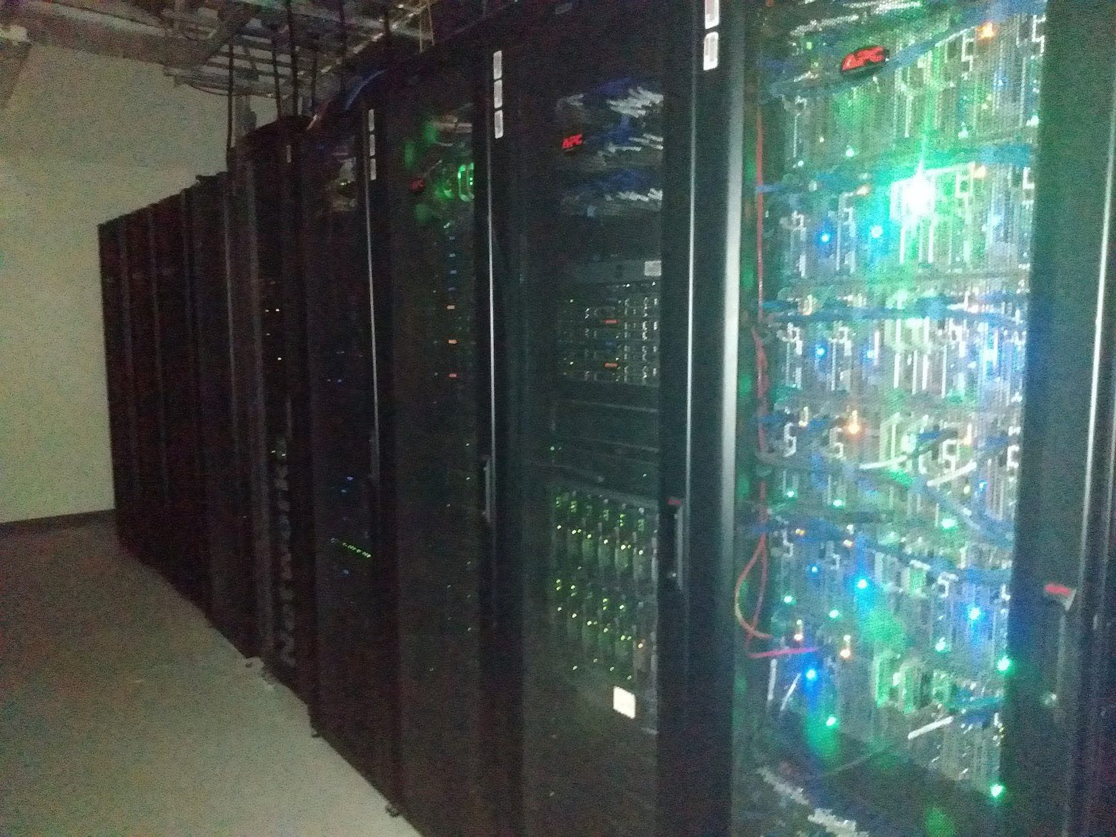
Services
General
HPC Cluster KOKO
10 Gbps Network Uplink to Florida Lambda Rail
100 Gbps Core
Various Intel CPU’s
AMD – EPYC (6,500 cores)
NVIDIA A100 - ~18
NVIDIA V100 - 48
SLURM SCHEDULING
Open OnDemand
SSH Console Access
OFFICE OF INFORMATION TECHNOLOGY

Slide 15
Team
James Mauser Systems Administrator
Skyler Paulus
Systems Administrator
Bahareh Yaseen Saadatmand-Mashhadi Research Facilitator, BioInformatics
Chris Johnson
Form Development
Rhian Resnick Director
OFFICE OF INFORMATION TECHNOLOGY

Slide 16
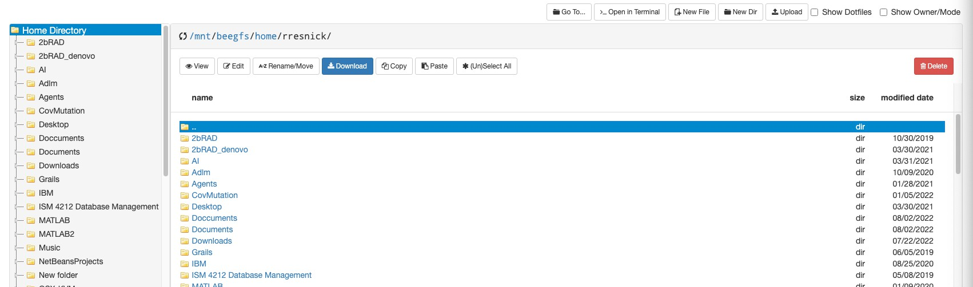
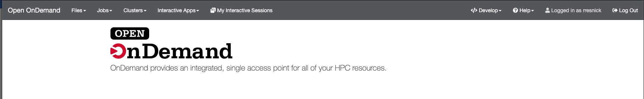
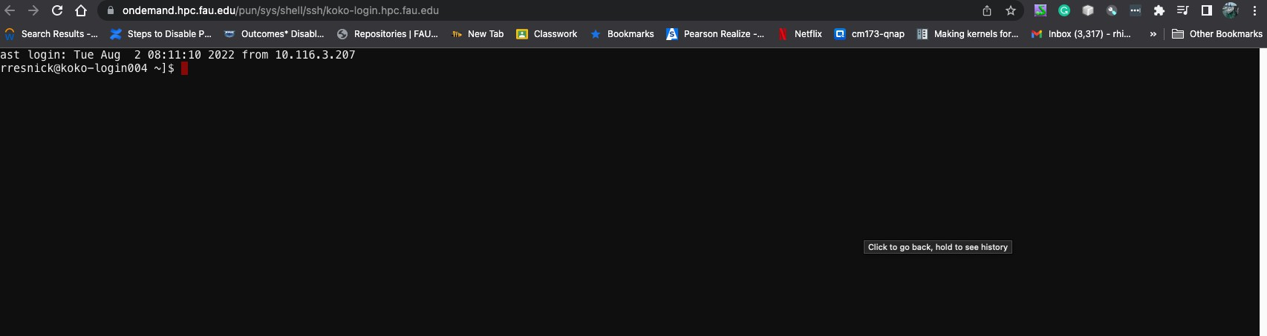
Open OnDemand
Provides a web UI to the clusters.
OFFICE OF INFORMATION TECHNOLOGY

Slide 17

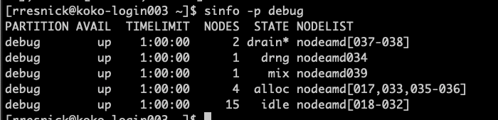
SSH
OFFICE OF INFORMATION TECHNOLOGY

Slide 18
Storage (PowerScale)
Home & Scratch
  60TB NVME
Archive
  822 TB of storage
Users – 50 GB quota
Scratch – 300 GB quota deleted after 90 days
OFFICE OF INFORMATION TECHNOLOGY

Slide 19
Storage (Cloud Nas)
Archive
  60TB NVME
  Basically Unlimited Cloud Storage
Archive
  No Backups: $13.33 / TB / Month
  With Backups: $31.50 / TB / Month
  With Backups and Replication: $63 / TB / Month
Most users will receive 300 GB of complimentary storage on archive as long as they are connected to a new or funded research activity. (as determined by the Research Computing Team, we are very liberal with this definition, it just protects our storage system from abuse)
OFFICE OF INFORMATION TECHNOLOGY

Slide 20
Software
Machine Learning
Big Data
Intel Compilers
MPI
OpenMP
HPC, HTC, Graphics
Install to your home directory
Install to your group directory
Install to entire cluster for sharing with others (upon request)
OFFICE OF INFORMATION TECHNOLOGY

Slide 21
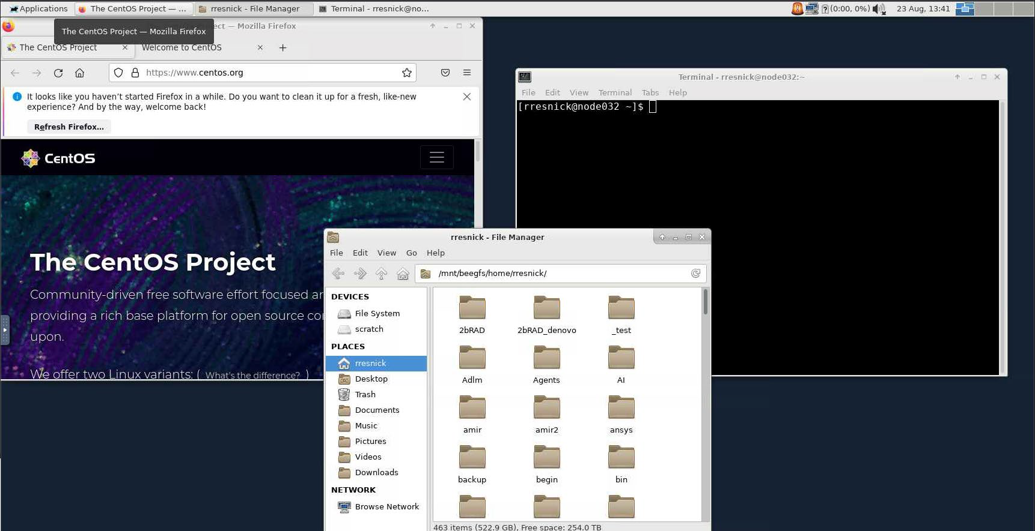
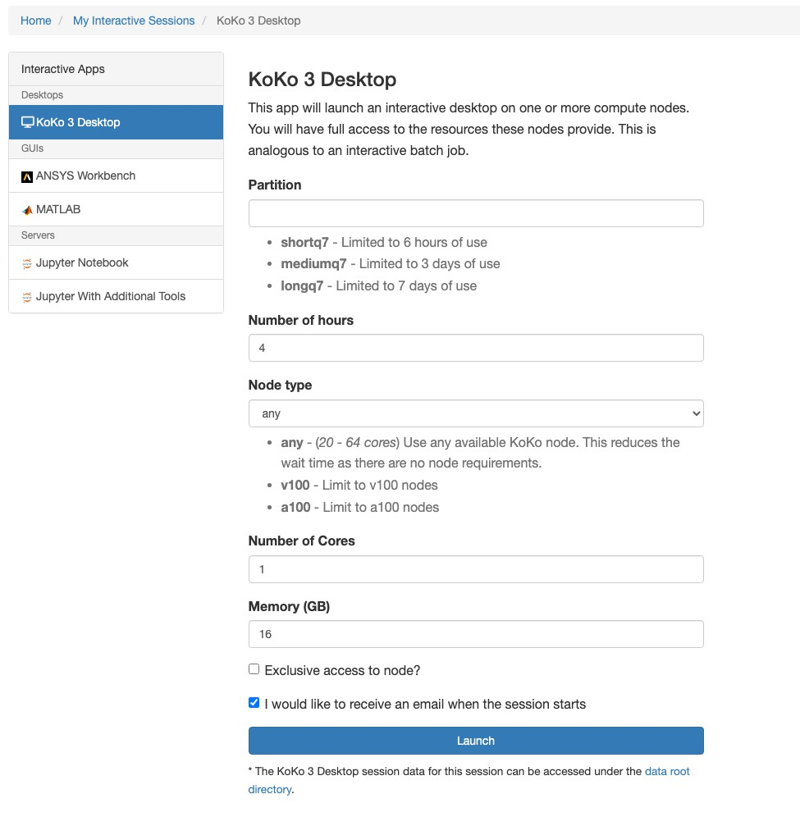
Remote Desktop via OnDemand
OFFICE OF INFORMATION TECHNOLOGY

Slide 22
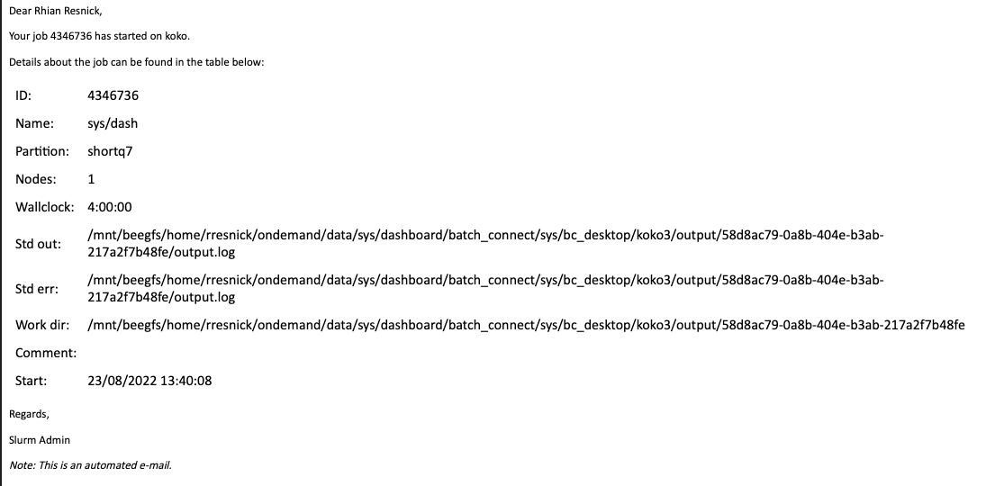
Email Notifications
OFFICE OF INFORMATION TECHNOLOGY

Slide 23
Costs
Everything we offer has a free introductory tier to help spring board research.
But some things have a cost regardless.
Secure Virtual Deskop at the cost of $168.50 per core per year (Includes 4GB of memory per core)
Storage over 300 GB $160 / TB / Year
Prioritized Compute $116 / CPU Core / Year
Prioritized GPU $1,024 / GPU Per / Year (this gets interesting when comparing models, so reach out to us. Our model is based on UF’s GPU unit model, more information on request)
Consultation: $60 per hour
Data Center Hosting: $16 per U minimum of 4U
OFFICE OF INFORMATION TECHNOLOGY

Slide 24
Links and Disclaimers
Cyber Infrastructure Plan 2017-2022: https://helpdesk.fau.edu/TDClient/2061/Portal/KB/ArticleDet?ID=141 481
Services: https://helpdesk.fau.edu/TDClient/2061/Portal/KB/ArticleDet?ID=142 149
All costs were FAU internal costs, fees are ~20% higher for external entities.
We are working on new grant funded research pricing. This is still a work in progress.
Docs: https://hpc.fau.edu
OFFICE OF INFORMATION TECHNOLOGY

