Slide 1
Research Roundtable: Rigor in Research
NIH Rigor, Reproducibility, and Gold Standard Science
Alice Espinosa Miehl, Ph.D.
Director, FAU Office of Research Development
February 25, 2026

Slide 2
Historical Context – NIH Rigor and Reproducibility
  For NIH applications due on January 25, 2019 and following, application instructions and review criteria were updated to replace the term “scientific premise” with the term "rigor of the prior research." Applicants were also required to discuss the rigor of prior research and describe plans to address any weaknesses in that rigor within the Research Strategy section.
  According to the NIH guidance referred to above (https://grants.nih.gov/policy-and-compliance/policy-topics/reproducibility/guidance) Rigor and Reproducibility focuses on:
    “1) the rigor of the prior research
    2) rigorous experimental design for robust and unbiased results
    3) consideration of relevant biological variables
    4) authentication of key biological and/or chemical resources”

Slide 3
Current Guidance
  Instead of rigor and reproducibility, NIH language now reflects “Replication and Reproducibility.”
  However, rigor and reproducibility policies still remain in place.
  https://www.nih.gov/replicationandreproducibility

Slide 4
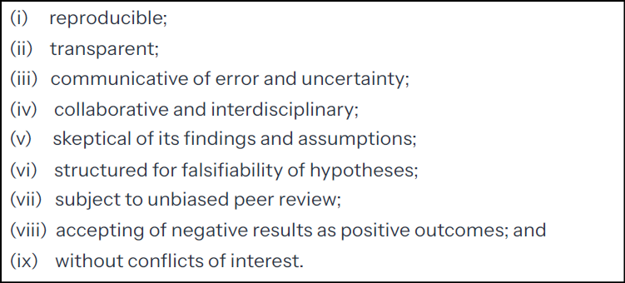
Gold Standard Science – Executive Order
  The White House released in May 2025 an executive order titled “Restoring Gold Standard Science” (https://www.whitehouse.gov/presidential-actions/2025/05/restoring-gold-standard-science/)
  The executive order presents Gold Standard Science (GSS) as ensuring scientific integrity and outlined nine tenets.
  Federal agencies were instructed, within 60 days of the Executive Order, to report to the Office of Science and Technology director the actions that their agency was taking to adhere to the EO.
The nine tenets of GSS, as outlined in EO “Restoring Gold Standard Science”:

Slide 5
Gold Standard Science – Memo
  Thirty days after the EO, the Office of Science and Technology Policy (OSTP) issued a guidance memo.
  This memo directs federal agencies to ensure that federally-supported research adheres to Gold Standard Science
  Agency plans need to detail how they are going to:
    Integrate GSS tenets into the agency’s culture, funding opportunities, budget/resource allocations, award selection/reporting, and other actions related to scientific activities.
    Support GSS tenets through evaluation, training and resources, technology, and assessment of challenges, with annual reports due.

Slide 6
Gold Standard Science - NIH
  To adhere to the EO and memo, NIH released its plan, titled “Leading in Gold Standard Science, an NIH Implementation Plan” on August 22, 2025. PDF available here: https://www.nih.gov/replicationandreproducibility
  The plan addresses NIH’s current and planned efforts in relation to GSS
  The plan refers to its FY 16 implementation of rigor and reproducibility. NIH characterizes its current efforts as an extension of those earlier policies, with definitions for reproducibility and replicability:
    “Reproducibility: the ability of independent researchers to test a hypothesis through multiple methods and consistently achieve results that confirm or refute it, ensuring findings are generalizable and robust across different approaches.
    Replicability: the ability to perform the same experiment or study using the same methods and conditions to achieve the same result.”

Slide 7
Gold Standard Science – NIH (cont.)
  The NIH plan does not provide new guidance or guidelines.
  Mainly, the plan outlines the steps that NIH has already taken to support GSS and future exploration of topics.
  My takeaway:
    As long as researchers are adhering to current NIH guidelines (and future ones, when released), work should be in line with GSS.
    However, the plan could reveal what researchers may want to emphasize further in grant applications or award reports, as these are prepared.

Slide 8
NIH Plan – Tenet 1: Reproducible
  Examples of Current Efforts
    NIH Common Fund’s Replication Initiative, policies related to data sharing (Data Management and Sharing Policy, Genomic Data Sharing Policy, etc.), data standardization and interoperability (repository of common data elements).
  Examples of Planned Efforts
    Human-based research technologies, strengthening methodological design and rigor of NIH-funded dietary supplement research

Slide 9
NIH Plan – Tenet 2: Transparent
  Examples of Current Efforts
    Peer review policies, databases (NIH Report), public access policy
  Examples of Planned Efforts
    Biosafety and biosecurity of life sciences research, recommendations for rigor and transparency of animal research (ARRIVE guidelines), Common Form

Slide 10
NIH Plan – Tenet 3: Communicative of Error and Uncertainty
  Examples of Current Efforts
    Disseminated information about meeting standards of quality, guidelines and policies for the conduct of research
  Examples of Planned Efforts
    In guidelines and policies for the conduct of research a new chapter is planned on GSS, further promotion of academic freedom, NIH process for scholarly works moving from scientific content/findings to reviewing exclusively for policy/regulatory compliance

Slide 11
NIH Plan – Tenet 4: Collaborative and Interdisciplinary
  Examples of Current Efforts
    Encouragement of interdisciplinary teams, collaboration with clinicians
  Examples of Planned Efforts
    NIH and Centers for Medicaid and Medicare Services (root causes of autism spectrum disorder), Real World Data Network, Nutrition Regulatory Science Program

Slide 12
NIH Plan – Tenet 5: Skeptical of its Findings and Assumptions
  Examples of Current Efforts
    Institute and center strategic plans, Public Access Policy, Replication Initiative (independent contractors replicate results)
  Examples of Planned Efforts
    Review of policies and practices, Pilot NIH Science of Science Scholars program (analyze internal administrative NIH data)

Slide 13
NIH Plan – Tenet 6: Structured for Falsifiability of Hypotheses
  Examples of Current Efforts
    Rigor and reproducibility policies, training in the responsible conduct of research, NIH Preprint Pilot (make preprints available)
  Examples of Planned Efforts
    Modernizing Research and Evidence (MoRE) Glossary (FDA and NIH - 40 clinical research terms and their definitions)

Slide 14
NIH Plan – Tenet 7: Subject to Unbiased Peer Review
  Examples of Current Efforts
    Simplified Framework for NIH Peer Review Criteria, reviewer integrity and fairness
  Examples of Planned Efforts
    Centralized peer review within CSR, developing a conflict of interest tool for screening NIH reviewers

Slide 15
NIH Plan – Tenet 8: Accepting of Negative Results as Positive Outcomes
  Examples of Current Efforts
    Data management and sharing
  Examples of Planned Efforts
    Already released a Request for information on this topic; reviewing responses to launch a new initiative

Slide 16
NIH Plan – Tenet 9: Without Conflicts of Interest
  Examples of Current Efforts
    Financial COI requirements
  Examples of Planned Efforts
    Strengthening financial reporting requirements

Slide 17
Final Takeaways
  As previously mentioned, the plan points to current NIH guidelines that support GSS, but may also be viewed as an indication of future trends.
  Agencies are required each year to report to the OSTP how they are implementing GSS.
  In the final section of NIH’s plan, “Evaluation Structure,” an example table is provided, with the “Reproducible” tenet as an example.
  For evaluating adherence to the “Reproducible” tenet, under “Methods,” it is written “Content analysis of grant applications, peer review comments/scores, published research, training programs for researchers and reviewers, and related validation studies.”

