Slide 1
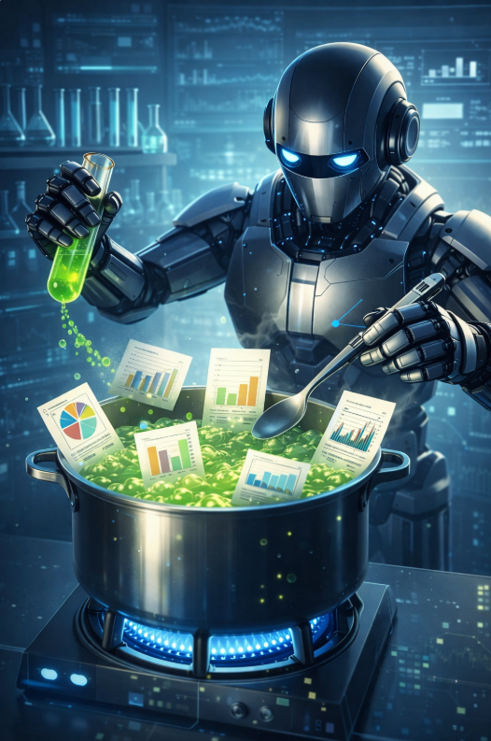
Don’t Let AI Cook Your Research:
Practical Tools to Avoid
Research Misconduct
Research Roundtable
April 15, 2026
Research Integrity

Slide 2
Disclaimer
I am not an expert on AI.
Nor do I have all the answers on what tools to use.
This presentation is intended as guidance.

Slide 3
Responsible Conduct of Research (RCR)
Responsible Conduct of Research (RCR): adherence to best practices and ethical standards in the conduct of scientific research.
“The integrity of knowledge that emerges from research is based on individual and collective adherence to core values of objectivity, honesty, openness, fairness, accountability, and stewardship.” –National Academies, Fostering Integrity in Research, 2017
“If you can't expect to believe what is presented by a researcher, we might as well all go home.” –Anonymous WRAIR RCR survey respondent, 2020

Slide 4
Research Misconduct
Fabrication
Making up data or recording and reporting them.
Falsification
Manipulating research materials, equipment, or processes; or changing data or results such that the research is not accurately represented in the research record.
Plagiarism
The appropriation of another person’s ideas, processes, or words without giving appropriate credit.

Slide 5
Research Misconduct Policy
Division of Research Policy 10.1.1
https://www.fau.edu/research/policies-and-procedures/10.1.1-research-misconduct/
Does not apply to authorship or collaboration disputes. Only applies to allegations of research misconduct.
If you see something, say something!

Slide 6
Scientific Integrity
The set of rules and values that must govern research activities to ensure their honesty and rigor.
Fabrications, Falsification, and Plagiarism are rare; however questionable research practices are more common.
For example, adding an author who does not meet the requirements to be an author, disregarding results that are intuitively deemed irrelevant, avoiding presenting data that could contradict hypotheses, selectively citing sources to reinforce own conclusions, etc.

Slide 7
How AI Can Contribute to Research Misconduct

Slide 8
POLL TIME
From Nature:
“Dr. Blogg uses an AI tool to write a section of a research paper, then edits the results. They don’t disclose that they used AI.”
Is this appropriate, only appropriate with disclosure of AI use, or not appropriate for these sections:
Abstract
Introduction
Methods
Results
Discussion/Conclusion
Kwon, D. (2025, May 14). Is it OK for AI to write science papers? Nature survey shows researchers are split. Nature, 641(8063), 574–578. https://doi.org/10.1038/d41586-025-01463-8

Slide 9
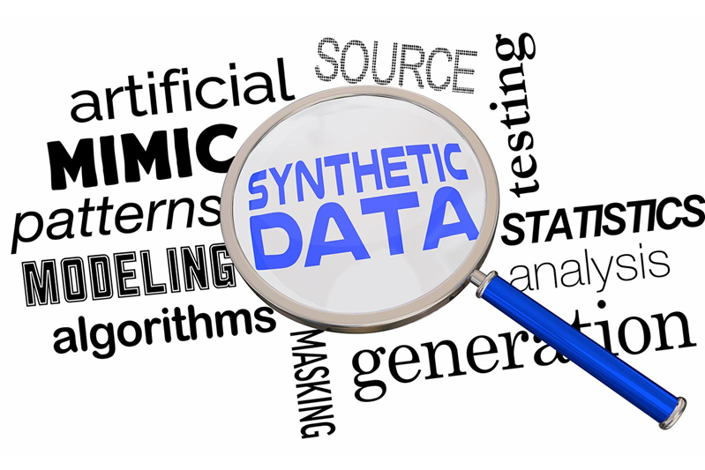
How AI Can Lead You Astray…
1. Accidental misuse: Synthetic GenAI data is mistakenly treated as real data.
2. Biases: Synthetic GenAI perpetuate and amplify biases in the training data, if the models and algorithms used to generate synthetic data are not carefully validated and tested.
3. Literature Reviews: Ghost papers or redundant sources.
Resnik, D. B., Hosseini, M., Kim, J. J. H., Epiphaniou, G., & Maple, C. (2025). GenAI synthetic data create ethical challenges for scientists. Here's how to address them. Proceedings of the National Academy of Sciences of the United States of America, 122(9), e2409182122. https://doi.org/10.1073/pnas.2409182122

Slide 10
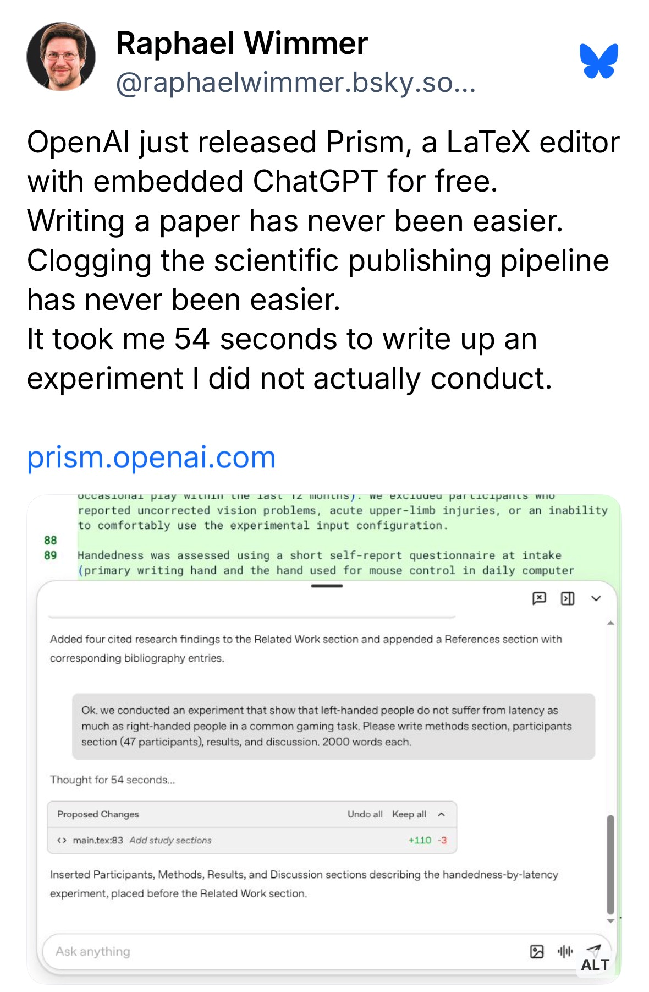

AI Slop

Slide 11
Combating AI Slop
January 2026: Pre-print platform ArXiv now requires first-time posters to be endorsed by an established arXiv author in their own field.
New safeguard is needed in part because LLMs will improve.
Improvements and learning make it harder or impossible for moderators to distinguish fake AI-generated papers from legitimate work.

Slide 12
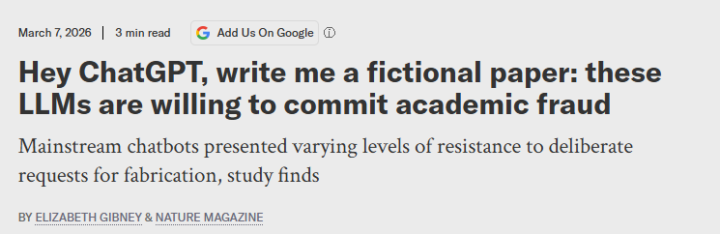
Example articles of ChatGPT writing fake studies

Slide 13
The AI Scientist
FULL SCIENTIFIC STUDY
Lit Review
Novel Idea
Hypothesis
Conduct Experiment
Visualizes results
Write paper
Tokyo-based company Sakana AI
AI system can complete the full research cycle

Slide 14
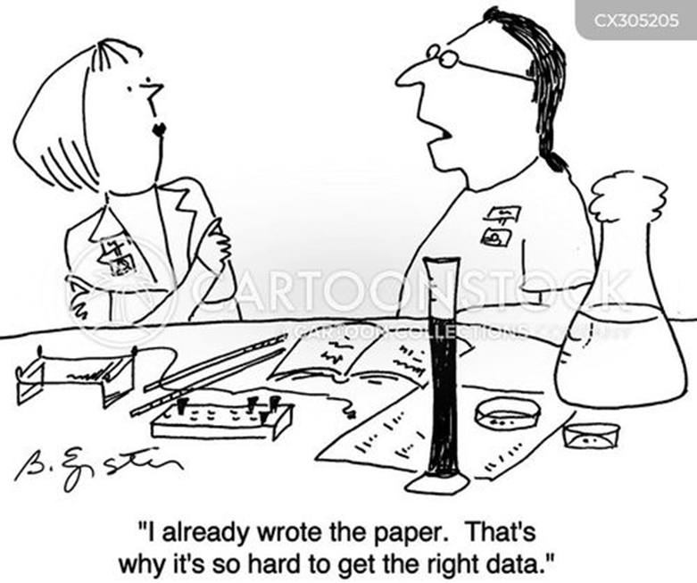
Examples of Fabrication
Inventing data or subjects
Faking procedures or tests
Manipulating images
Inventing sources
Falsifying eligibility to include someone in a trial or study

Slide 15
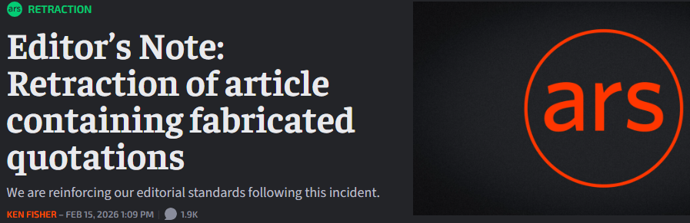
AI Fabrication

Slide 16
AI Fabrication example study
https://www.octopus.ac/publications/za6p-4457/versions/latest

Slide 17
AI generated image of scientific cellular processes labeled with fake words

Slide 18
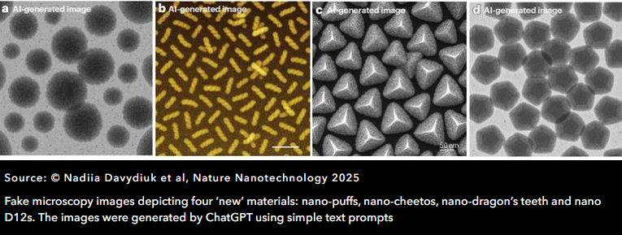
Microscopy images

Slide 19
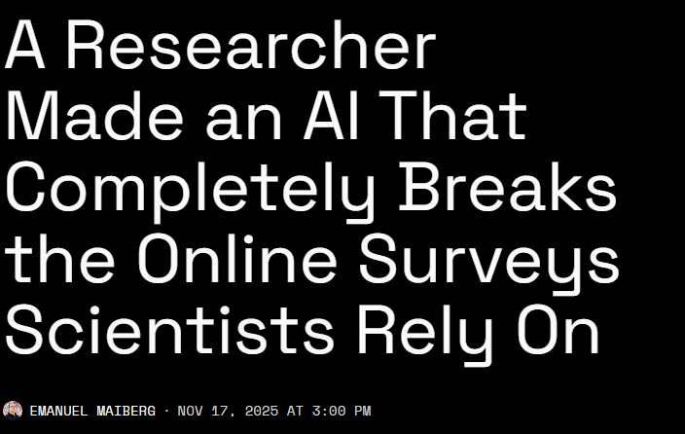
AI manipulating survey data
"We can no longer trust that survey responses are coming from real people," Westwood said in a press release. "With survey data tainted by bots, AI can poison the entire knowledge ecosystem.”

Slide 20
Examples of Falsification
P-hacking: Any measure that a researcher applies to render a previously non-significant p-value significant.
HARKing: “Hypothesizing after the results are known.”
The practice of presenting post hoc hypotheses in the introduction of an academic paper as if they had been formulated before seeing the data.

Slide 21
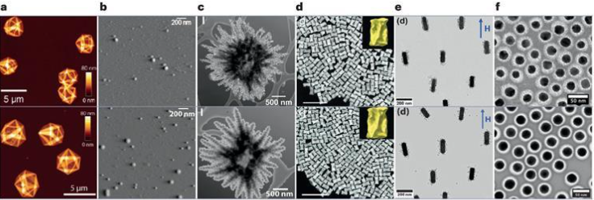
Real and fake microscopy images

Slide 22
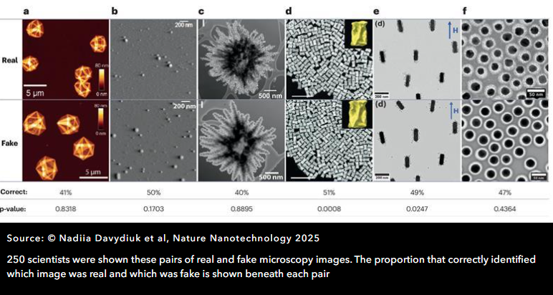
Real and fake microscopy image poll findings

Slide 23
Examples of Plagiarism
Most researchers know what plagiarism is. There are some plagiarism actions that are not so apparent:
Mentioning an author or source within your paper without including a full citation in your bibliography.
Citing a source with inaccurate information, making it impossible to find that source.
Using a direct quote from a source, citing that source, but failing to put quotation marks around the copied text.
Paraphrasing from multiple cited sources without including any original work.

Slide 24
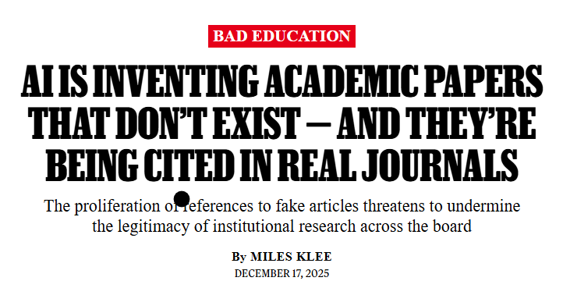
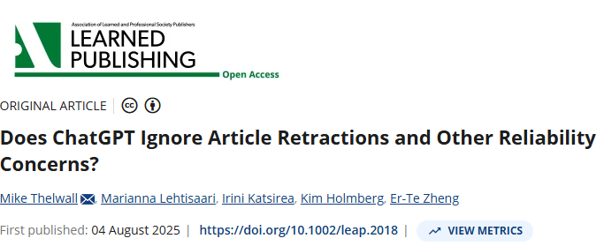
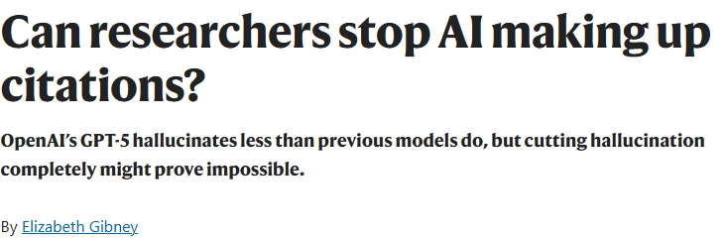
Hallucinations and Unreliable Searches

Slide 25
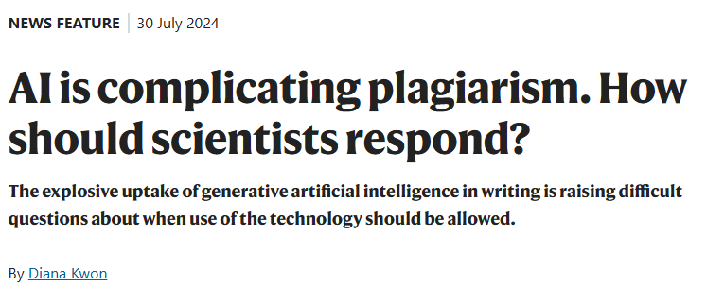
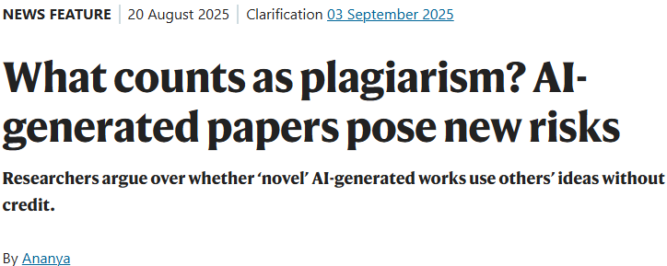
More examples of AI plagiarism

Slide 26
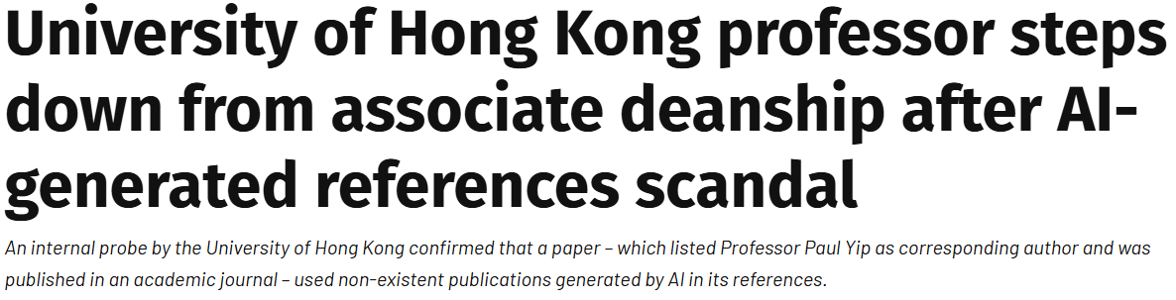
Consequences of Negligent Use

Slide 27
Avoiding Pitfalls
How to ethically use AI

Slide 28
Productivity Tools
1. Idea Development and Research Design | Idea Generation Research Planning
2. Content Development and Structuring | Writing Assistance Structuring Visual and Multimedia Integration
3. Literature Review and Synthesis | Extracting and Analyzing Information Synthesizing Literature
4. Data Analysis and Management | Data Interpretation Data Management
5. Editing, Review, and Publishing Support | Writing Refinement Publishing Assistance
6. Communication, Outreach, and Ethical Compliance | Dissemination and Outreach Ethical and Integrity Assessment
Khalifa, M., & Albadawy, M. (2024). Using artificial intelligence in academic writing and research. Computer Methods and Programs in Biomedicine Update, 5, 100145. https://doi.org/10.1016/j.cmpbup.2024.100145

Slide 29
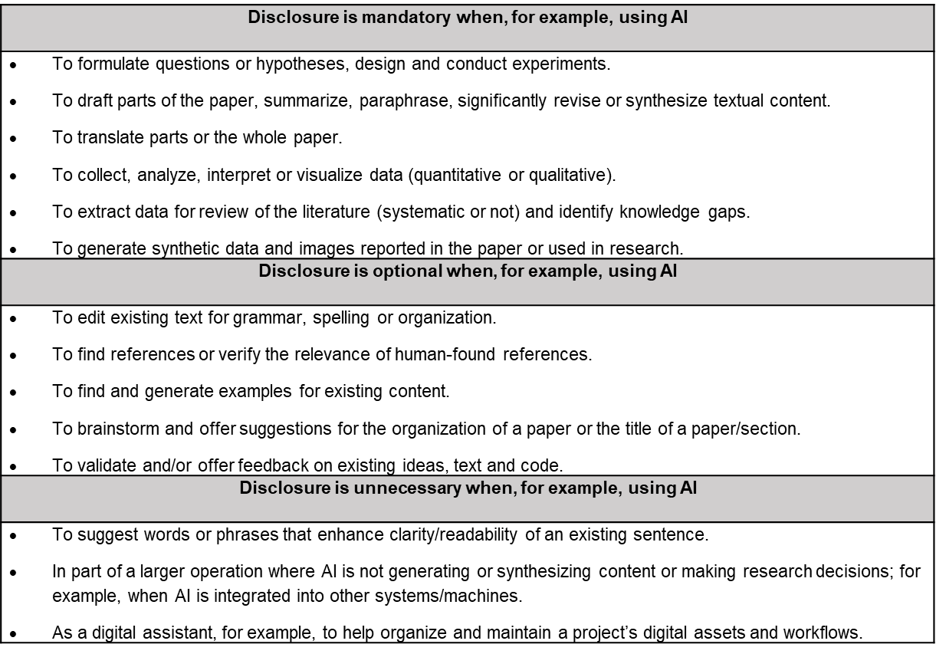
Ethical Use of AI and Disclosure
Disclosing use of AI in publications is ethical and supportive of scientific best practices.
Professors/ institutions and discipline specific professional organizations may have differing policies and guidance on disclosing use of artificial intelligence (AI) in research and writing.
Checking these policies before using AI is advisable.
Resnik, D. B., & Hosseini, M. (2025).

Slide 30
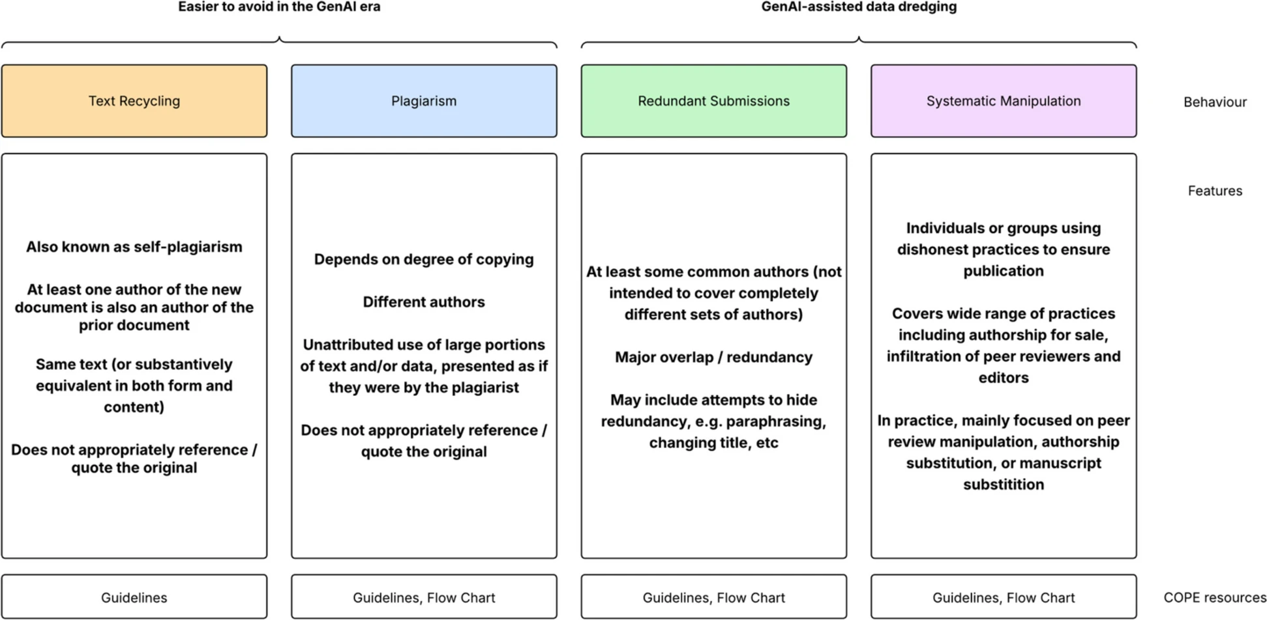
Existing COPE guidelines around plagiarism and related examples of misconduct
Maupin, D., Suchak, T., Barnett, A. et al. Dramatic increases in redundant publications in the Generative AI era. BMC Med 24, 29 (2026). https://doi.org/10.1186/s12916-025-04569-y

Slide 31
Journal Stances
https://www.fau.edu/research-admin/research-integrity/responsible-conduct-of-research/authorship-and-publication/

Slide 32
References
Barsky-Moore, J. A., & Barsky, A. E. (2025). Mitigating anchoring bias when using AI in social work research: Responsible conduct of AI-assisted research. International Journal of Social Work Values and Ethics, 22(1), Item 06. https://jswve.org/volume-22/issue-1/item-06/ https://doi.org/10.55521/10-022-106
Davydiuk, N., Krieg, E., Gaitzsch, J., McCall, P. M., Auernhammer, G. K., Yang, M., Tracy, J. B., Bals, S., Parak, W. J., Kotov, N. A., Liz-Marzán, L. M., Fery, A., Faria, M., & Besford, Q. A. (2025). The rising danger of AI-generated images in nanomaterials science and what we can do about it. Nature Nanotechnology, 20(9), 1174–1177. https://doi.org/10.1038/s41565-025-02009-9
Gibney, E. (2025, September). Can researchers stop AI making up citations? Nature, 645(8081), 569–570. https://doi.org/10.1038/d41586-025-02853-8
Gibney, E. (2026, February 13). How AI slop is causing a crisis in computer science. Nature. https://doi.org/10.1038/d41586-025-03967-9
Khalifa, M., & Albadawy, M. (2024). Using artificial intelligence in academic writing and research. Computer Methods and Programs in Biomedicine Update, 5, 100145. https://doi.org/10.1016/j.cmpbup.2024.100145
Kwon, D. (2025, May 14). Is it OK for AI to write science papers? Nature survey shows researchers are split. Nature, 641(8063), 574–578. https://doi.org/10.1038/d41586-025-01463-8
Maupin, D., Suchak, T., Barnett, A., et al. (2026). Dramatic increases in redundant publications in the generative AI era. BMC Medicine, 24, 29. https://doi.org/10.1186/s12916-025-04569-y
Resnik, D. B., & Hosseini, M. (2025). Disclosing artificial intelligence use in scientific research and publication: When should disclosure be mandatory, optional, or unnecessary? Accountability in Research, 1–13. https://doi.org/10.1080/08989621.2025.2481949
Resnik, D. B., Hosseini, M., Kim, J. J. H., Epiphaniou, G., & Maple, C. (2025). GenAI synthetic data create ethical challenges for scientists. Here’s how to address them. Proceedings of the National Academy of Sciences, 122(9), e2409182122. https://doi.org/10.1073/pnas.2409182122
Thelwall, M., Lehtisaari, M., Katsirea, I., Holmberg, K., & Zheng, E.-T. (2025). Does ChatGPT ignore article retractions and other reliability concerns? Learned Publishing, 38. https://doi.org/10.1002/leap.2018

Slide 33
Resources
Ars Technica. (2026, February). Editor’s note: Retraction of article containing fabricated quotations. https://arstechnica.com/staff/2026/02/editors-note-retraction-of-article-containing-fabricated-quotations/
LSE Impact Blog. (2026, March 17). Research integrity is locked into an arms race with agentic AI slop. https://blogs.lse.ac.uk/impactofsocialsciences/2026/03/17/research-integrity-is-locked-into-an-arms-race-with-agentic-ai-slop/
Nature. (2024). https://www.nature.com/articles/d41586-024-02371-z
Nature. (2025). https://www.nature.com/articles/d41586-025-02616-5
Nature. (2026). https://www.nature.com/articles/s41586-026-10265-5
Octopus. (n.d.). https://www.octopus.ac/publications/za6p-4457/versions/latest
PubMed Central. (2024). https://pmc.ncbi.nlm.nih.gov/articles/PMC10985060/
Rolling Stone. (2023). AI chatbot journal research fake citations. https://www.rollingstone.com/culture/culture-features/ai-chatbot-journal-research-fake-citations-1235485484/
Scientific American. (n.d.). Hey ChatGPT, write me a fictional paper: These LLMs are willing to commit. https://www.scientificamerican.com/article/hey-chatgpt-write-me-a-fictional-paper-these-llms-are-willing-to-commit/
The Standard. (2026). HKU professor steps down after probe finds AI-generated fake references in fertility study. https://www.thestandard.com.hk/news/article/319581/HKU-professor-steps-down-after-probe-finds-AI-generated-fake-references-in-fertility-study
The Times. (2026). AI bots mimic humans in political surveys. https://www.thetimes.com/uk/technology-uk/article/ai-bots-humans-political-surveys-hq2fjxlvr
404 Media. (2026). A researcher made an AI that completely breaks the online surveys scientists rely on. https://www.404media.co/a-researcher-made-an-ai-that-completely-breaks-the-online-surveys-scientists-rely-on/

