Slide 1

FACULTY ORIENTATION
Fall 2025
Payroll Operations Monday, August 11, 2025

Slide 2

Introduction
Annie Yahinian Head Director of Payroll Operations & Taxation/Compliance Phone: 561-297-4273 Email: ayahinia@fau.edu
Anely Cabrera Assistant Director of Time & Absence Phone: 561-297-2862 Email: cabrera@fau.edu
Payroll Department Phone: 561-297-6401 Email: payroll@fau.edu https://www.fau.edu/controllers-office/payroll/

Slide 3

Table of Contents
Payroll Schedules
Payslips
Payment and Withholding Elections
Deferred and Non-Deferred Pay
Model My Pay
Tax Documents
Absence Plans and Balances
Requesting and Correcting Time Off
The payroll and timekeeping job aids are available in Workday – click on MENU → FAU Job Aids → FAU's Library of Workday Job Aids

Slide 4
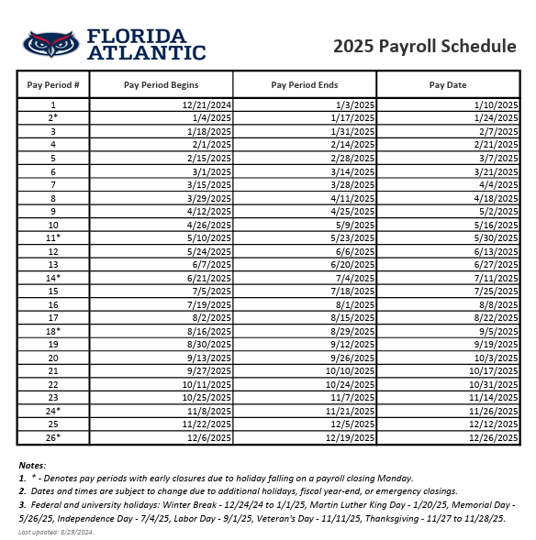
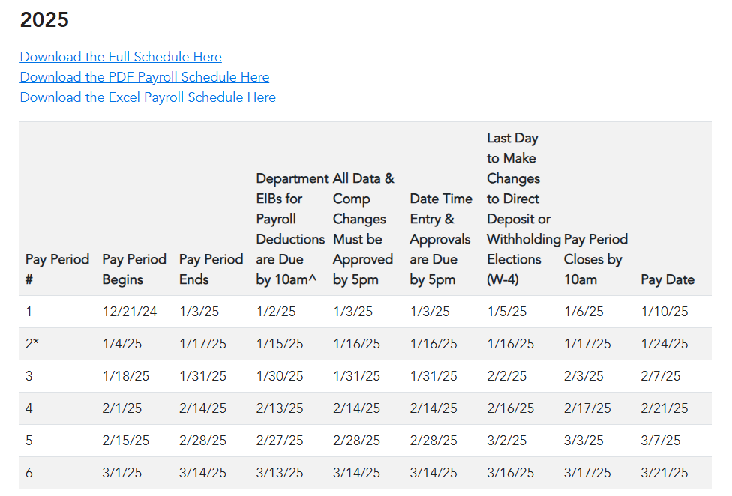
Payroll Schedules
→

Slide 5
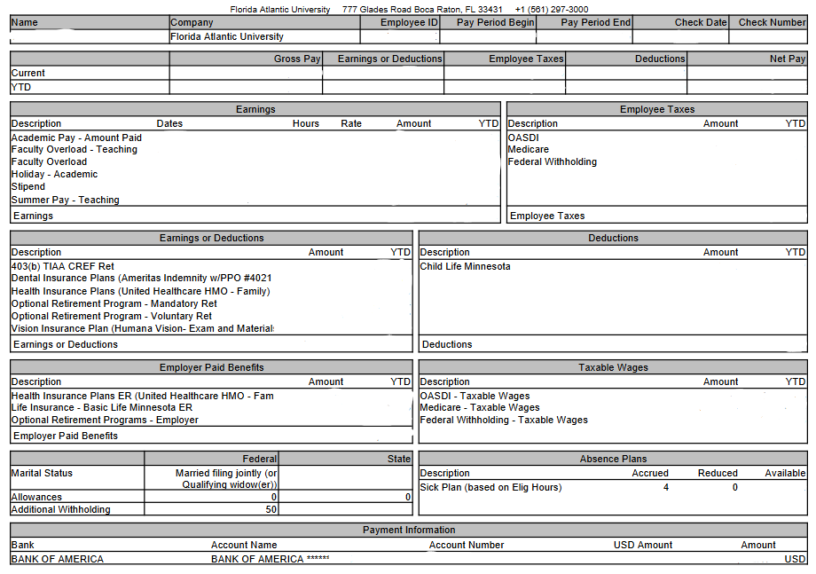
Payslips
Access your payslips by clicking on MENU on the Workday homepage → Pay
Under View click on Payslips
To calculate bi-weekly pay:
  12-month faculty divide annual salary by 26.1
  9-month faculty divide annual salary by 19.5
  10-month faculty divide annual salary by 21.57

Slide 6
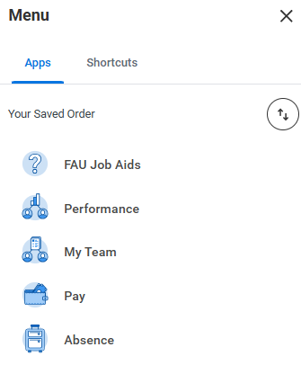
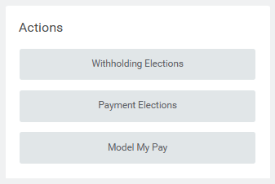

Payment and Withholding Elections
Access your payment and withholding elections by clicking on MENU → Pay
  Under Actions, click
  Withholding Elections to
  change or update your
  W-4 IRS tax withholdings
  Click on Payment Elections
  to change or update your
  banking and direct deposit
  information

Slide 7
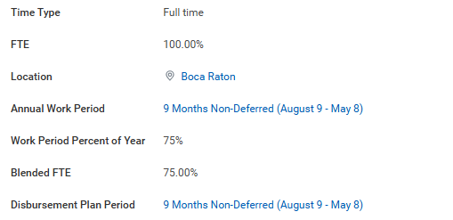
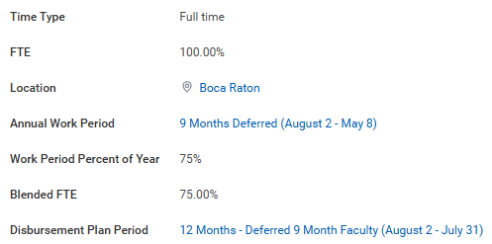
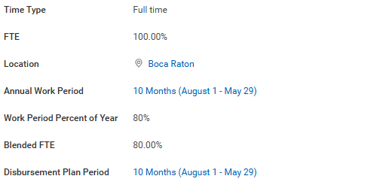
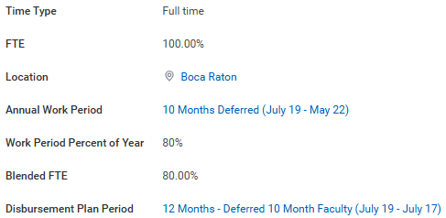
Deferred and Non-Deferred Pay
9-month and 10-month faculty employees have the option to receive their salary over their academic period (non-deferred)
or over 12-months (deferred)
Deferred Pay Option calculator - (https://www.fau.edu/provost/for-faculty/deferred-payment-plan)
9-month Faculty
10-month Faculty

Slide 8
Model My Pay
This feature allows employees to make hypothetical changes to their pay and view their results
Make adjustments to:
  Earnings—your regular wages, hourly pay, and additional earnings
  Earnings or Deductions—your health and retirement benefits (pre-tax)
  Deductions—optional retirement (Roth plans) and other voluntary deductions (post-tax)
9-month and 10-month faculty must only select pay results corresponding to their annual work period; not summer pay results
Limitations:
  Insurance plans (dental, health, vision, disability, etc.), mandatory retirement plans are not editable for modeling
  Not all states are available for modeling
  Deferred faculty employees cannot make adjustments to earnings on primary position; changes can be made to additional earnings (overload, bonus, awards)

Slide 9
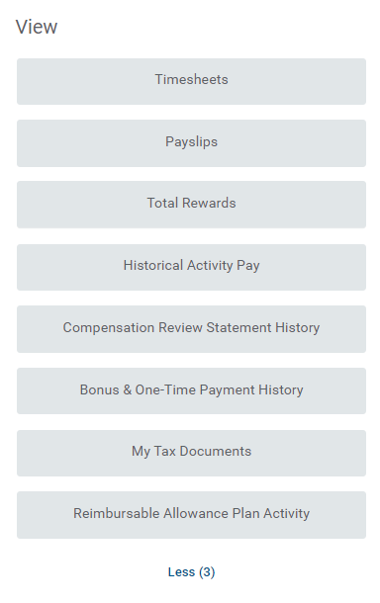
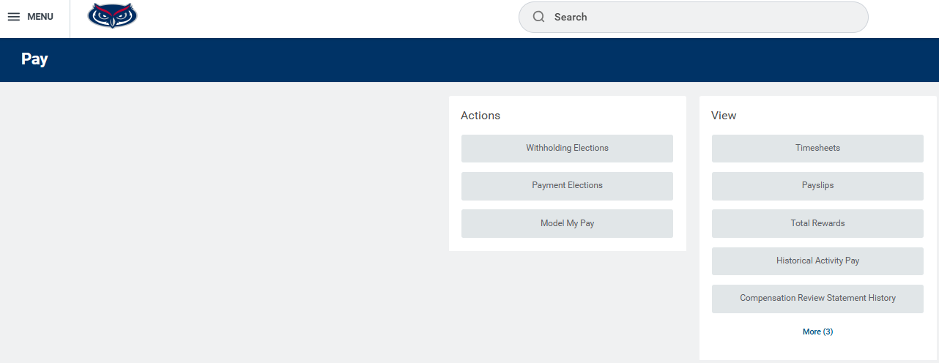
Tax Documents
To access your W-2 tax documents, click on MENU → Pay
Under the View section click on More (3)
Click on My Tax Documents

Slide 10
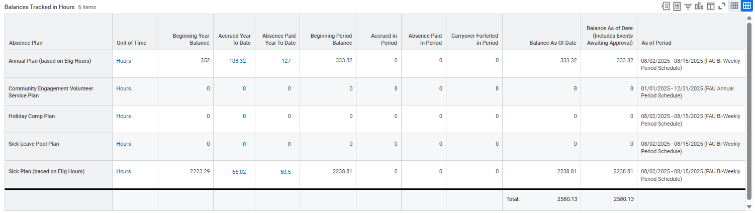
Absence Plans and Balances

Slide 11
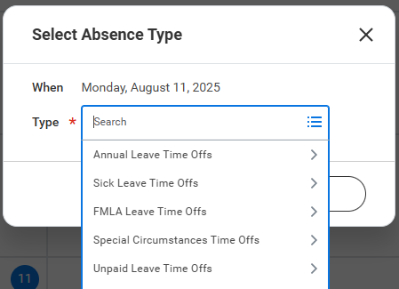
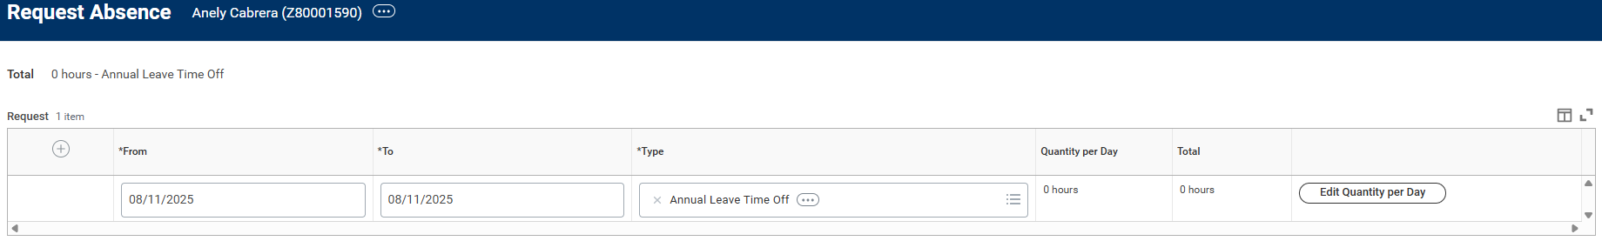
Requesting Time Off
To request time off, click on MENU → Absence, click on Request Absence under the Request Column
Leave balances will appear on the left; change the “Balance as of” date to see forecasted available balances
Click on the day(s) you would like to request time off, then click on the request Absence button
Select the leave type, click Next
On the next screen, click on Edit Quantity per Day and enter the number of leave hours you are requesting
Click Done, then Submit

Slide 12
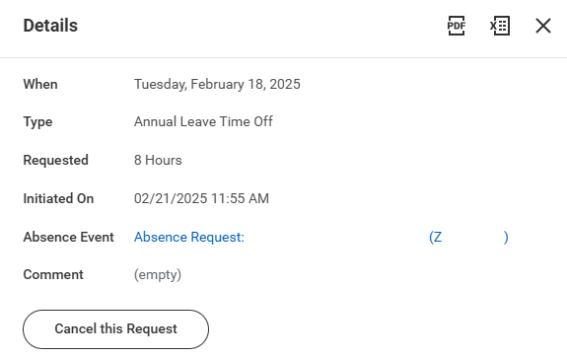
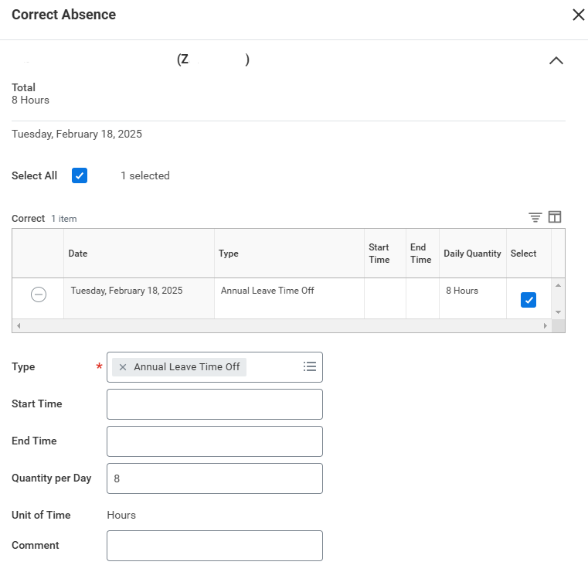
Correcting Time Off
To correct time off in submitted status:
  Click on the request and then on the Cancel this Request button
  Enter a comment and click Submit
To correct approved time off:
  Click on the request
  Change the absence type or
  the quantity per day, as
  applicable
To cancel or delete approved
time off:
  Click on the request
  Change the Quantity per Day
  to zero

Slide 13

Questions?
Thank you!

