Slide 1

OFFICE OF CIVIL RIGHTS AND TITLE IX (OCR9)
MEET AND GREET OCR9

Slide 2

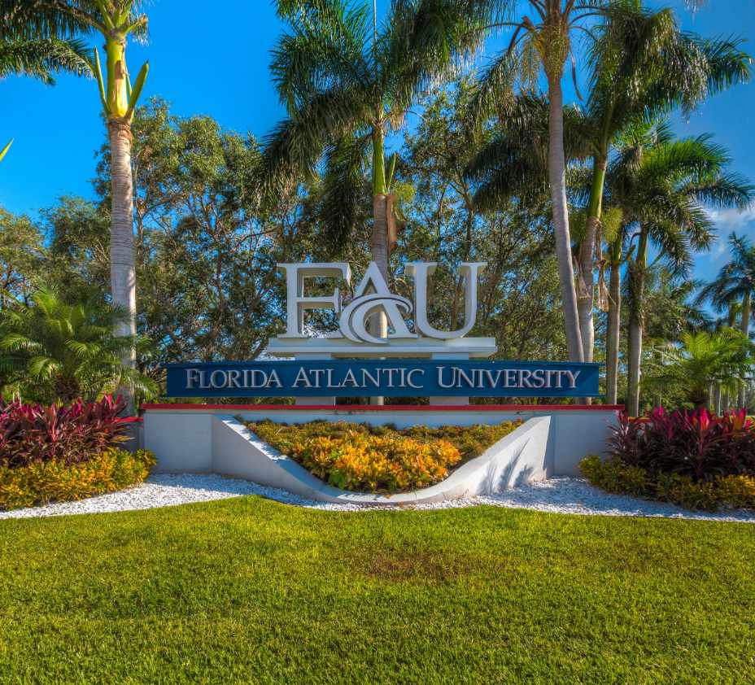
What are FAU’s Applicable Regulation and Policy?
FAU complies with applicable federal, state, and local discrimination/harassment laws
FAU Regulation applies to:
  Students
  Student Organizations
  Faculty/Staff
  Volunteers
  Third Parties Providing Services to FAU
FAU Regulation 7.008
FAU Applicable Policies: Policy 7.10 (Title IX Compliance); Policy 7.12 (Disabilities and Accommodations); and Policy 7.14 (Prohibited Discrimination and Harassment)
  The Regulation and Policy provides information about the reporting procedures, investigating procedures, requesting accommodations, and defines what types of conduct are prohibited.
Source: Florida Atlantic University – Regulations and Policies www.fau.edu/policies/policies-regulations/

Slide 3

APPLICABLE FEDERAL LAWS
Applicable Federal Laws: Title VI and Title VII, Title IX, Pregnancy Act, Fair Housing Act, Clery Act, VAWA, and Campus SaVE Act.
Title VI prohibits discrimination based on race, color, and national origin in programs and activities receiving federal financial assistance.
Title VII prohibits employment discrimination based on race, religion, national origin, color, and sex.
Title IX prohibits discrimination based on sex in educational programs and activities.
The Pregnancy Act amended the Civil Rights Act and prohibits sex discrimination based on pregnancy.
The Americans with Disabilities Act prohibits discrimination based on disability.
The Fair Housing Act protects people from discrimination when engaging in housing-related activities.
The Clery Act requires reporting crimes, disclosure of crime statistics, and timely warnings.
Violence Against Women Act Reauthorization Act 2022 (VAWA) addresses sexual assault and gender-based violence, access to safety and support for survivors, and prevention efforts.
Campus SAVE Act (Sexual Violence Elimination Act) requires transparency, guarantees rights for victims of sexual violence, provides certain accommodations, campus prevention programs

Slide 4
REGULATION 7.008
“Florida Atlantic University shall comply with applicable federal, state and local discrimination/harassment laws to provide an educational, employment, and business environment free of all forms of discrimination or harassment. Unlawful discrimination or harassment based upon an individual’s race, color, religion, sex, national origin, age, disability, military or veteran status, marital status, pregnancy or parental status, sexual orientation, or other protected status is prohibited. Discriminatory conduct in the form of sexual misconduct, including sexual harassment, sexual assault, domestic violence, dating violence, and stalking, is also prohibited. . . .”

Slide 5

TYPES OF DISCRIMINATION AND HARASSMENT
Age Discrimination
Disability Discrimination
Sexual Orientation Discrimination
Status as a Parent / Pregnancy
Religious Discrimination
National Origin Discrimination
Sexual Harassment/Sexual Misconduct
Race or Color Discrimination
Retaliation / Reprisal
Bullying (if based on a protected class)

Slide 6
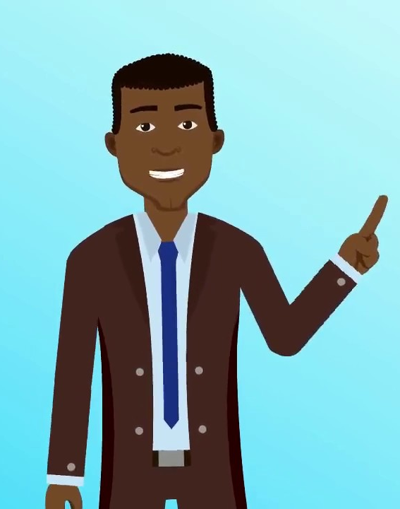
What is the University’s Intake Process?
How are Reports Received?
Via Maxient, Phone Call, Email, In Person
How are Reports Reviewed?
Complete Intake Assessment
  Determine whether the alleged conduct is within OCR9’s scope
  Determine whether conduct if substantiated would constitute conduct prohibited by the University policy
Complete Safety Risk Assessment
  Determine what action is necessary or permissible that may address the allegations
Provide information about available options
  Provide information about victim advocate
  Discuss availability of supportive measures with or without filing a complaint
  Consider Complainant’s request for supportive measures
  Provide information about investigative rights and options

Slide 7

What is the University’s Investigation Process?
Complaint received
  Determine whether the alleged conduct is within the scope
  Determine whether mandatory dismissal apply
  Determine if there are safety/risk concerns
Complaint accepted
Notice of Allegations is sent
  Sufficient details about the allegations provided
  Identities of parties provided
  A statement that the Respondent is presumed not responsible for the alleged conduct
Rights of Complainant and Respondent explained
Supportive Measures Implemented
Investigation
  Seventy-five (75) calendar timeframe (can be extended)
  OCR9 is neutral (we are required to gather exculpatory and inculpatory evidence)
  The university has the responsibility of gathering evidence/burden of proof
Parties have opportunity to review the OCR9 investigation file (TIX Cases)
Title IX Hearing Held or Determination Findings Issued and Transferred

Slide 8
SUPPORTIVE MEASURES
Supportive Measures are supportive services that are non-disciplinary, non-punitive, and individualized services. The University is required to offer supportive measures after receiving notice of possible violations of discrimination and harassment policies (i.e., Title VI, Title VII, Title IX, VAWA).
Supportive measures must be offered to individuals (i.e., employees and students) involved in OCR9 investigations.
Faculty should trust the Title IX Coordinator and Victim Services have reviewed/verified the request for supportive measures.
Faculty must offer supportive measures commonly known as academic support to students involved in Title IX reports.
Examples of supportive measures can include:
No / Limited contact directive
Counseling services
Campus Escort services
Changing office location or classroom seating
Academic supportive measures can include:
Amending attendance policy (excusing absences)
Providing students with make-up dates for missed assignments
Extending deadlines or providing alternative dates to take exams
Allowing students to complete exams outside the class in a controlled setting (i.e., with a proctor)

Slide 9
WHO CAN HELP AT FAU?
Victim Services
  Provide services designed to help Victims/Complainants navigate available campus support options
Respondent Services
  Provide services designed to assist Students who are Respondents in Conduct Cases.
The Office of Civil Rights and Title IX (OCR9)
  Provide services for the University Community regarding Unlawful Discrimination and Harassment.
University Counseling and Psychological Services (CAPS)
  Provide Confidential Counseling Services for University Students.
University Health Services
  Provide Medical Care Services for University Students
University Student Accessibility Services
  Provide disability support services for University Students with disabilities.
Dean of Students Office
  Provide help for University Students managing crises and life traumas.
The Office of the Ombuds
  Assist individuals seeking help to solve problems, allay frustration, and provide advice to those requesting help.
University Human Resources (Employee Relations)
  Provide employment services for University Employees dealing with workplace issues.
Florida Atlantic University Police Department
  Provide public safety services to the University Community.

Slide 10
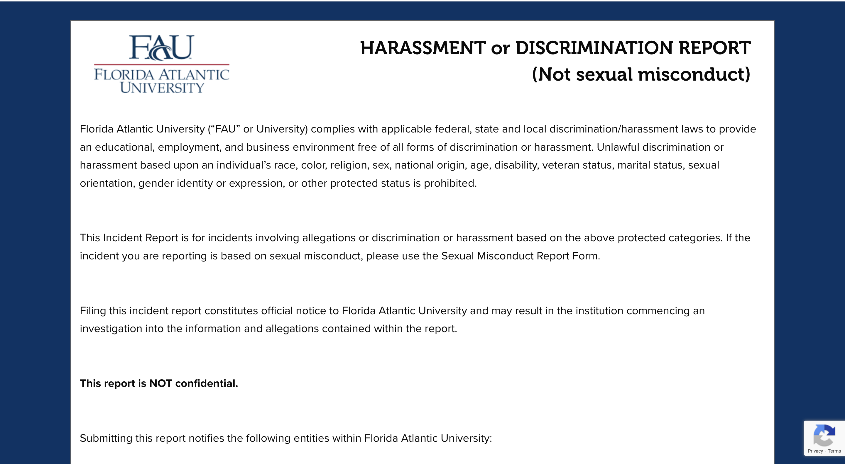
Incident Report

Slide 11
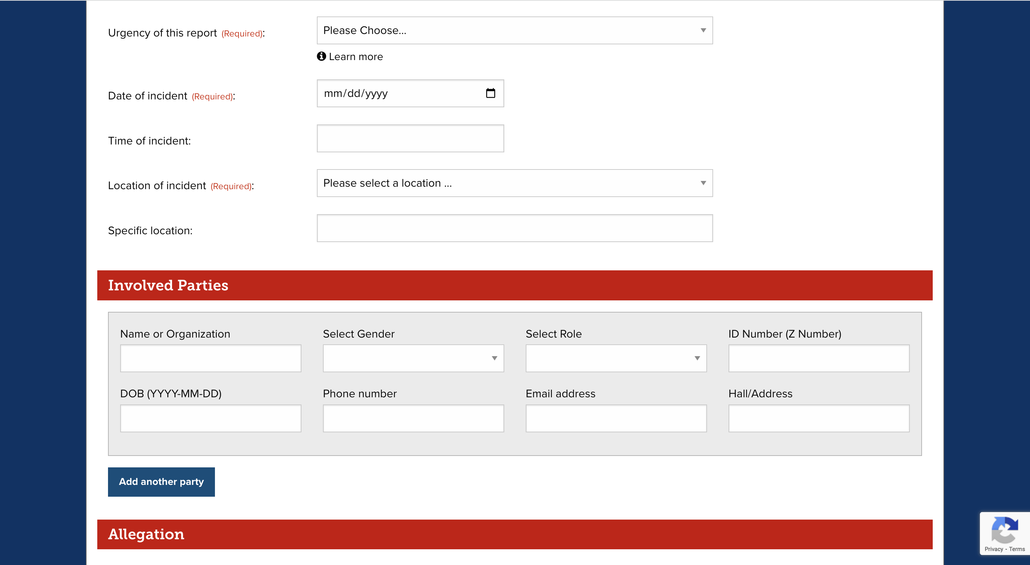
Incident Report Online Form

Slide 12
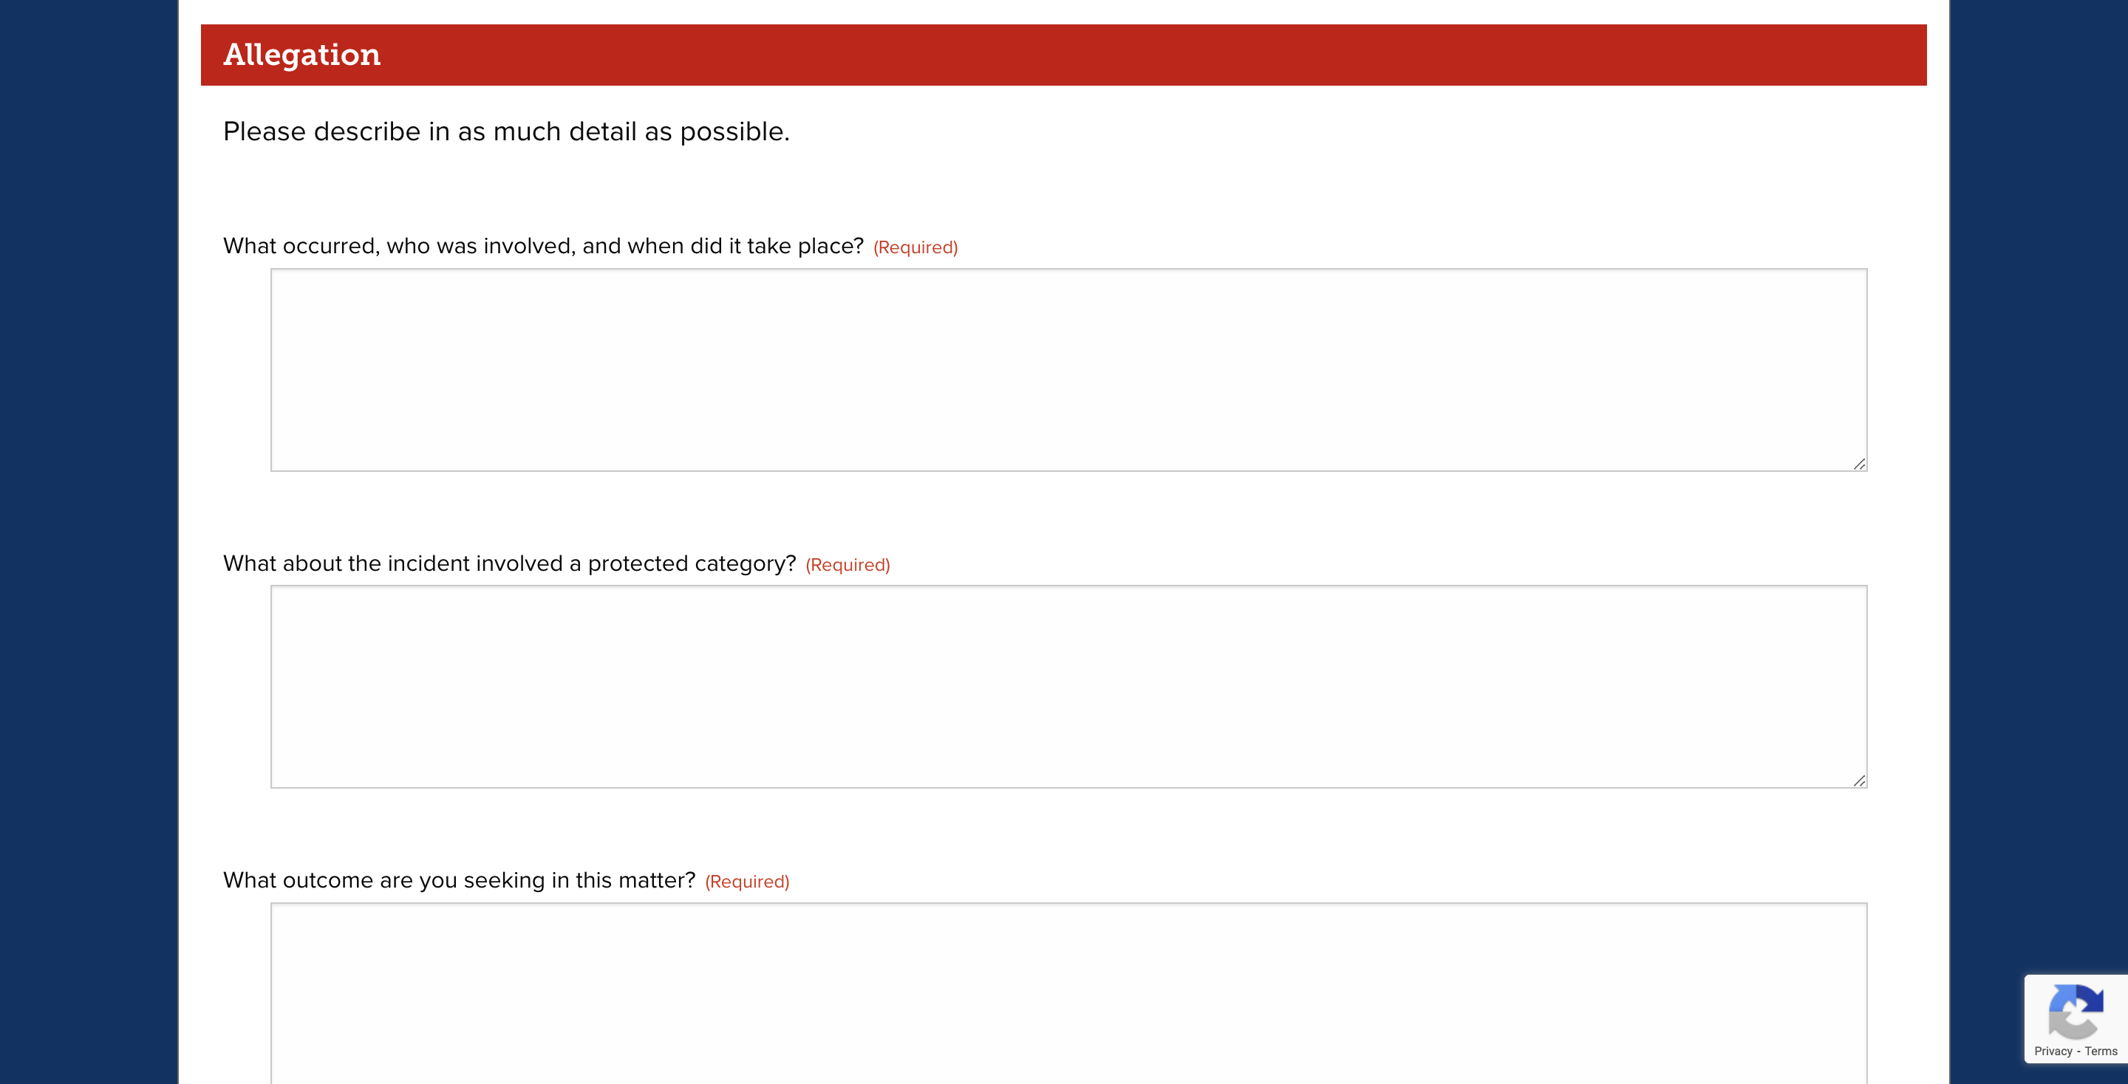
Incident Report Online Form (part 2)

Slide 13
KEY TAKEAWAYS
Know the University Policies that Apply to You
Always Follow the Policy - “Do What’s Right, Not What’s Easy”
Treat University Community Members with Respect
Don’t intimidate, manipulate, or threaten University Community Members
Don’t use verbally abusive language when speaking to University Community Members
Don’t engage in physically abusive conduct toward University Community Members
Remember anyone can experience Discrimination
Remember Discrimination comes in different forms
Remember to Respect People’s Individual Differences
OCR9 is the office responsible for responding to reports about discrimination, harassment, and retaliation based on protected categories.
OWL Be There - Always Be a Proactive Owl Bystander
Report incidents that you witness or receive information about. Don’t Presume someone else has reported the incident!
Remember to support individuals who disclose incidents to you.
Providing supportive measures is a statutory requirement.
Submitting a report to OCR9 DOES NOT initiate an Investigation. A complaint must be filed.
If you don’t know what to do – call OCR9!
Remember Your Choices Have Consequences

Slide 14

Any Questions

Slide 15
Florida Atlantic University
Student Accessibility Services
Presenter: Michelle Shaw, Director, M.Ed., ADAC
mshaw@health.fau.edu 561.297.3880

Slide 16
What is SAS?
Provide equal access for individuals with disabilities.
SAS works to ensure that the University stays compliant in regard to:
  Section 504 & 508 of the Rehabilitation Act
  ADAAA
  Fair Housing Act (FHA)
  All State and Local Laws

Slide 17
2025-2026: Actively using Accommodations.
ESA only: 89
Housing Only: 8
Hearing impairments: 34
Visual impairments: 26
Physical impairments: 127
Learning disabilities: 964
Other disabilities: 1099 (medical, ASD and psychological)
Service Animal Only: 7
TOTAL = 2354

Slide 18

Visible vs. Invisible Disabilities

Slide 19
SAS Portal
Academic Accessibility Agreements (AAA’s) are sent electronically
Faculty can acknowledge AAA’s via the portal
Tutorial is located on: SAS Website www.fau.edu/sas
  https://www.fau.edu/sas/portal/index.php (Tutorial and login to online portal)
  Login is your username and Password
Faculty will receive exam accommodation requests via email – review in portal
  Can submit exams via the portal (SAS is proctoring exams/quizzes M-F 8-5pm

Slide 20
SAS Accommodation@ fau.edu Email
Dear Professor (name),
One of your students has registered with Florida Atlantic University Student Accessibility Services (SAS) Office and has an Academic Accessibility Agreement (AAA) letter ready for your review. Once you have reviewed the letter, please check in the box provided to acknowledge this.
Please click on the link below to access the portal with your FAU login and review the AAA letter:
https://clockwork.fau.edu/ClockWork/user/instructor/default.aspxhttps://clockwork.fau.edu/ClockWork/user/instructor/default.aspx
This portal is part of our new secure paperless system implemented to create an easier process for facilitating the delivery and acknowledgement of student accommodation letters. If you have any questions or concerns, please do not hesitate to contact us. accommodations@fau.edu or call the SAS at 561 297 3880.

Slide 21
Assistive Technology Resource Center Lab - ATRC
A Braille translator & printer
Refreshable Braille keyboard
JAWS screen readers – available in al open labs
Zoomtext screen enlarger – available in all open labs
Closed Circuit TV system (CCTV)
Read Write Software available to all students – available to all faculty, staff and students
Kurzweil 1000
Stand alone scanners that read textbooks
Dragon Naturally Speaking speech recognition systems
Livescribe Smart Pen/ Neno Pen
Ally – accessibility App in Canvas
Genio formally Glean – Notetaking/Study tool will be an app added in Canvas for ALL students
Equatio Readable Math coming soon for all students, faculty and staff
https://www.fau.edu/sas/technology/ check out our website for more details
https://www.fau.edu/sas/technology/accessible-text/ - Accessible Format Materials Portal is a free and available 24/7

Slide 22
Changes in Title II
All Online Content must be accessible
  Course materials (PowerPoints, PDF’s, etc.)
  Website: Forms, videos, etc.
  Social Media
Deadline was April 24, 2026, extended one year, however the Florida Atlantic Policy 7.12 requires we apply the new standards under Title II of the ADA: Disabilities and Accommodations - Disabilities and Accommodations
Faculty Resources:
  Accessibility Requirements | Florida Atlantic University – Resources and Guides
  Instructional Technologies Calendar - LibCal - Florida Atlantic University – OIT Tech Talks
  OIT Resources for Faculty | Florida Atlantic University Appointment scheduling
  Ally | Florida Atlantic University - Canvas Ally Accessibility Tool

Slide 23
SAS Things to Know
Refer a Student to SAS through Navigate
  Email and Teams too
Course Substitutions
  Student with disabilities can apply for substitution for Gordon Rule Math and Foreign Language
  Committee meets once a semester
Priority Registration
  For students who have specific needs
Florida Civic Literacy Exam (FCLE)
  Seeing across the state students struggling with this exam.
  Currently no disability accommodation; working with FLDE
Training and workshops for faculty and staff on request
Study skills and time management
  How to read a syllabus
  Scheduling advising appointments
  Talking to professors
Weekly, biweekly, or monthly check ins
AT training
Group Mentoring Program

Slide 24
Questions
Resources:
https://techevents.fau.edu/ SAS Digital Accessibility Trainings and Office Hours
https://www.fau.edu/sas/technology/assistive-training/ Training videos and guides for Assistive Technology
https://www.fau.edu/sas/technology/useful-apps/ Useful accessibility apps
https://www.fau.edu/sas/technology/read-and-write/ - Read/Write tutorials on how to download and use.
instructor-guide-new.pdf (fau.edu) – Faculty Guide to SAS
Group Mentorship Program | Florida Atlantic University (fau.edu) Group Mentorship Program
Accessible Text Portal | Florida Atlantic University Accessible Format Materials Portal
Genio free account Genio Notes makes effective learning easy | Genio (SSO)
Equatio - Equation Editor to Create Accessible Digital Math | Texthelp – Coming soon Fall 2025
Contact: mshaw@health.fau.edu 561-297-3880 office 561-352-4136 cell text first

