Slide 1
Florida Atlantic Police Department
FACULTY ORIENTATION

Slide 2
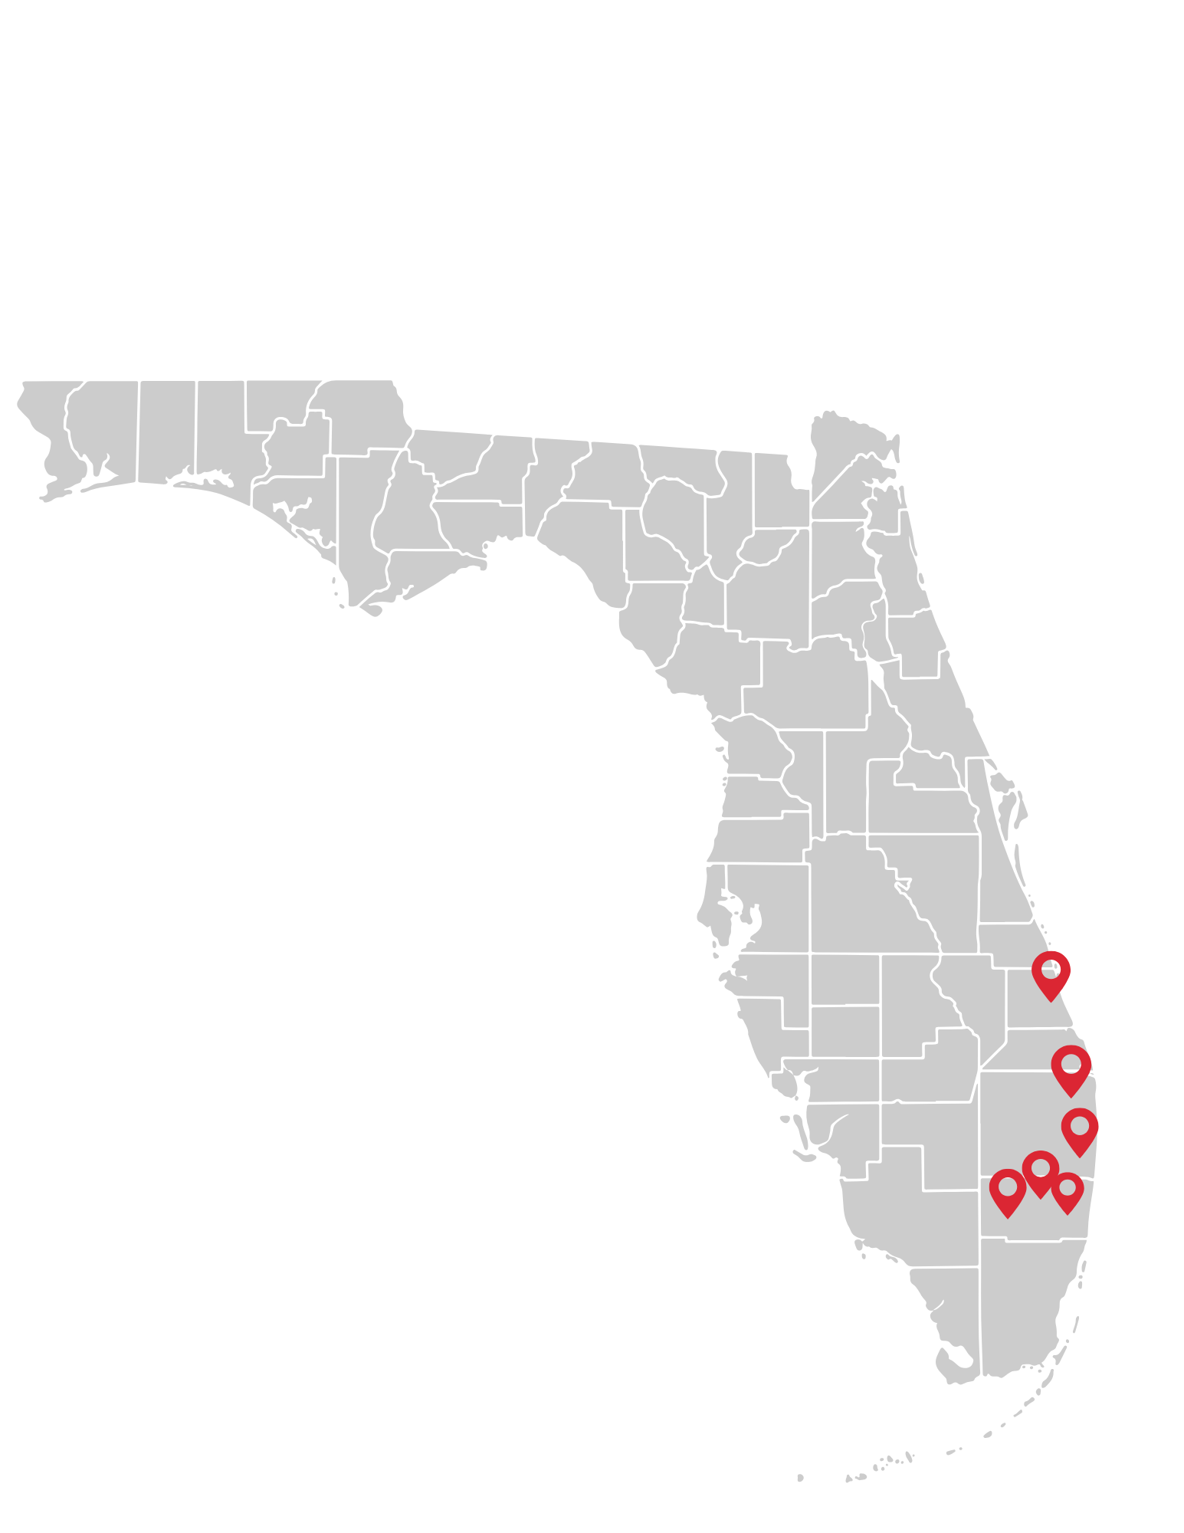




O
Police Services
Accredited Law Enforcment Agency
Serving Six Campuses
Available 24/7/365
See Something, Say Something

Slide 3
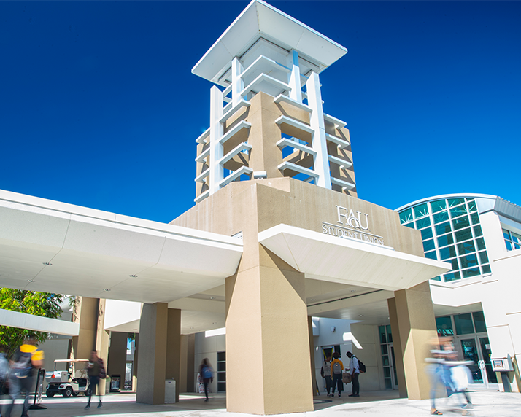

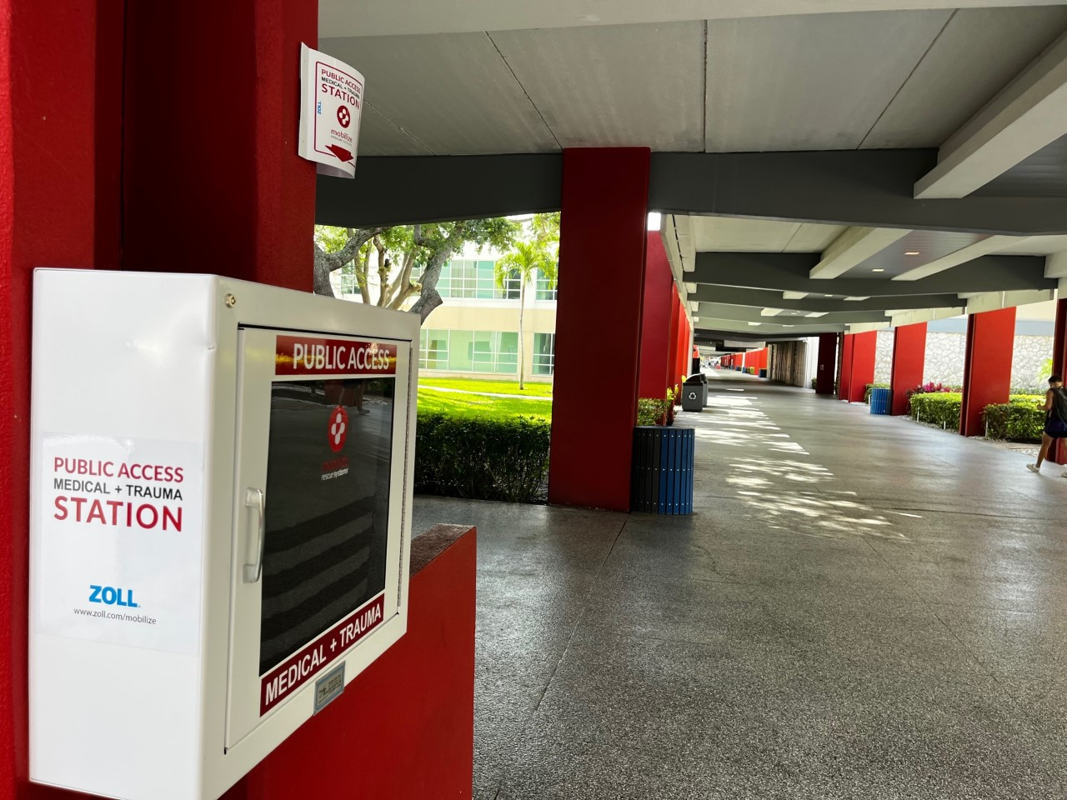
Available Resources
CPTED
Active Threat
Stop the Bleed

Slide 4
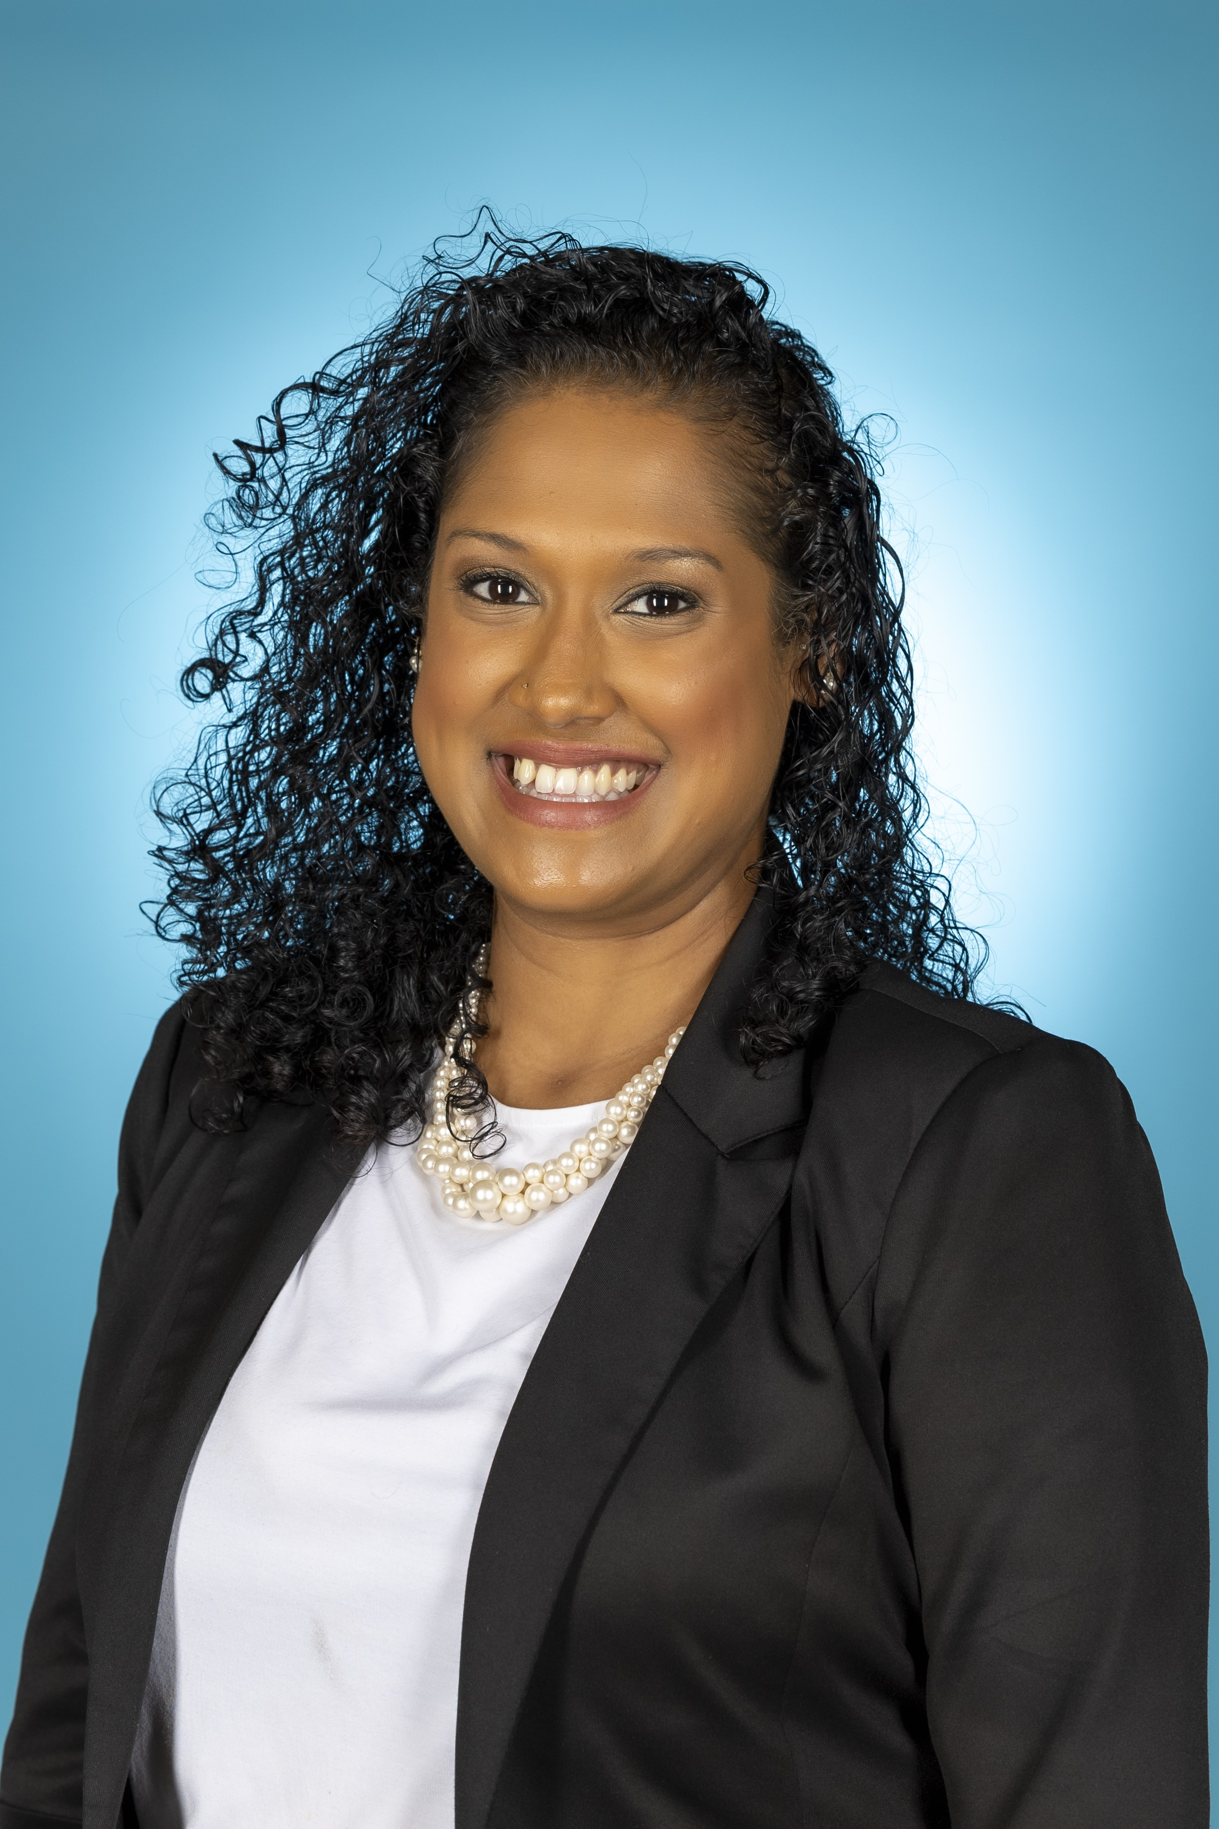

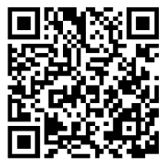
Victim Services
Whether the incident occurred on or off campus, in the past, or recently,
We are here to help.
Support faculty, staff and students
Provide resources and services
Assists with all victim related crimes
Provides information for polices and processes
Associate Director, Victim Services
Candace Harrinarine
Victim Advocate Brittany Mascetti
Office Line: (561) 297- 4841​
24/7 Number: ​
561-297-0500
(ask to speak to an advocate)​
victimservices@fau.edu

Slide 5
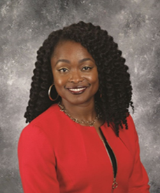
Behavioral Services Unit
"You Are Not Alone"
"You Are Not Alone"
"
Consultation & Collaboration
Co-responder
Risk
Assessments
Support Campus Safety
Mental Health & Community-based Referrals
Prevention
FAPD Mental Health Clinician
Christine T. Campbell, LCSW-QS
Dispatch: (561) 297-3500
Office: (561) 297- 4012
Email: christinecam2024@fau.edu

Slide 6




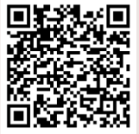


Jeanne Clery Campus Safety Act
What is the Clery Act?
Your Role
Clery Geography
Report and share campus crime & safety information
Must Report Clery Crimes Immediately
On-campus/ Public Areas near Campus/ Non-Campus Areas
Why does it matter?
Campus safety Federal compliance Supports community transparency
Scan to view the Current
Annual Security Report
Questions?
FAPD: 561-297-3500
Email: coralus2013@fau.edu

Slide 7



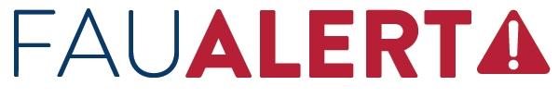
Department of Emergency Management
01
02
03
04
The University’s emergency notification system
Unit Emergency Response Plans / Unit Continuity of Operations Plans
Owl Ready – Mobile Safety Application
Global Travel Safety & Security

