Slide 1

FERPA & Other Legal Issues For New Faculty
Andrea G. Amigo
Associate General Counsel
August 2025

Slide 2

Scope of Presentation
This is an overview for faculty of FERPA (also known as the “Buckley Amendment”), Florida’s similar state laws and Florida’s Sunshine Laws.
The University Registrar should be the primary contact regarding FERPA issues.

Slide 3
FERPA is Unique For Us Given FAU’s Sunshine Law Status
Based on Florida’s Government-in-the-Sunshine laws, nearly every record is a “public record” open to inspection.
For example, all documents, papers, letters, maps, books, tapes, photographs, films, sound recordings, data processing software, or other material, regardless of physical form or means of transmission, made or received in connection with the transaction of official FAU business is a public record unless a specific exemption applies.

Slide 4
FERPA – The Opposite of the Sunshine
Under the public records law, all university records are “public” unless there is an express exemption making the record confidential. FERPA is an exemption.
Under FERPA, all student records are “confidential” unless there is an express exemption making the information public.
Under state law, all applicant records are also “confidential.”

Slide 5
You are bound by FERPA. What are Your Responsibilities?
To maintain confidential student educational records in an appropriate manner.
To limit access to student educational records to those with a “legitimate educational interest.”
Generally, you may only share the contents of student educational records with non-FAU officials where the student has provided written consent for such disclosure.

Slide 6
What “Educational Records” Must Be Kept Confidential?
Any “personally identifiable” information that would make a student’s identity easily traceable including:
Social Security Number or Z number
Grades and GPA
Class schedules
Transcripts
Student Conduct records

Slide 7
What Educational Records May Be Released to the Public?
Directory Information
FERPA defines “Directory information” as information that if disclosed to third parties will not violate a student’s privacy. This is set by the school.
NOTE: Requests for Public Records including Directory Information should be referred to the Media Relations office.

Slide 8
Directory Information is:
DEFINED BY FAU REGULATION 4.008
a. Student name;
b. Student address;
c. Student telephone number (if it is a listed number);
d. Student date and place of birth;
e. Student class and college of enrollment;
f. Student major field of study;
g. Student dates of attendance;
h. Student degrees and awards received;
i. Student participation in officially recognized activities and sports;
j. Student weight and height of members of athletic teams; and
k. Most recent previous educational agency or institution attended by the
student.

Slide 9
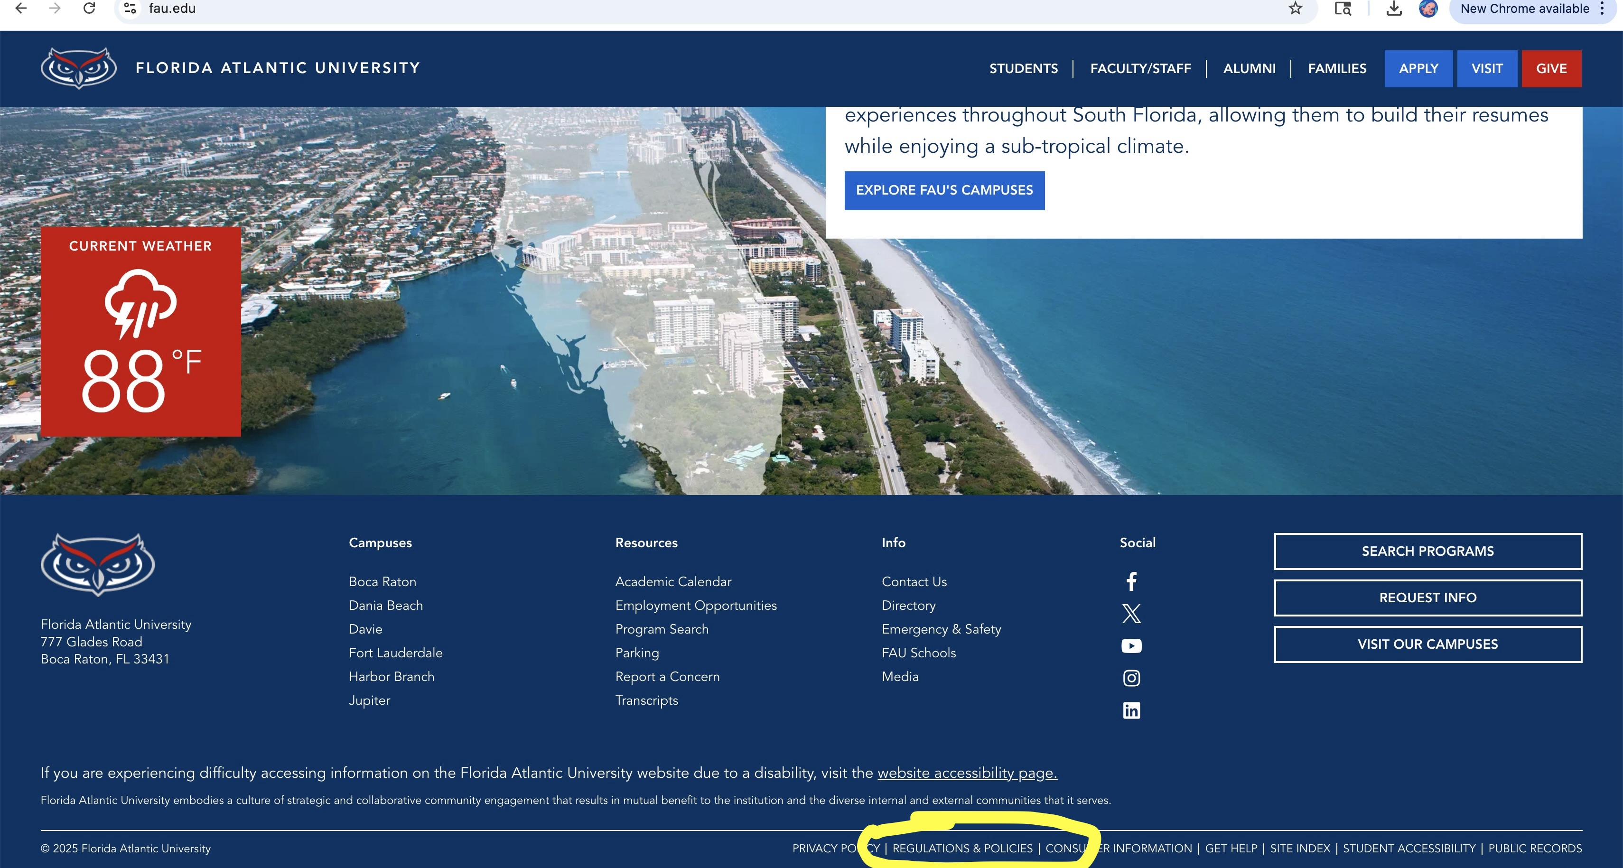

Slide 10
Students May “Opt Out” of Disclosure of Their Directory Information
Students may opt out of having all or part of their Directory Information disclosed without their express permission by completing a Non-Disclosure Request.
The Non-Disclosure Request form is available online and in the Registrar’s Office.
NOTE: Another reason to refer directory requests to Media Relations who will check with the University Registrar.

Slide 11
What Educational Information Is Not Protected By FERPA?
Personal knowledge derived from direct, personal experience with a student is not protected.
For example, a faculty or staff member who personally observes a student engaging in erratic and threatening behavior is not prohibited by FERPA from disclosing that observation.
But you would not be permitted to disclose the record of the observation unless one of the exceptions to FERPA applied.

Slide 12


Slide 13
SCENARIO 1
STUDENT PASSES OUT IN YOUR CLASS
YOU CALL 911
IF 911 ASKS YOU ABOUT THE STUDENT AND WHAT IS WRONG
WHAT DO YOU DO?

Slide 14
SCENARIO 2
YOU SEE A FIGHT IN THE HALLWAY
YOU CALL FAPD
YOU ARE ASKED FOR INFORMATION ABOUT THE STUDENTS INVOLVED
WHAT DO YOU DO?

Slide 15
FERPA Doesn’t Apply to All Student Records
The following types of records are not educational records: medical records, employment records, counseling records, police reports, etc.
However, these records may be covered by other Sunshine Law exemptions.

Slide 16
Students May Review All Their Educational Records EXCEPT:
The portions of their educational records mentioning other students.
The financial records of their parents.
Letters of recommendation (where they waive access).

Slide 17
Parties to Whom Educational Records May Be Disclosed Without Prior Consent
A FAU official with an “educational interest.”
Another institution where the student is seeking to be enrolled.
To a necessary party for health or safety emergency.
The DOE or state/local educational authorities (to meet legal requirements).

Slide 18
“Legitimate Educational Interest” in Student Educational Records
Who has a legitimate interest?
A school official who has a need to review the educational record to fulfill his/her job duties.
Who does not have a legitimate interest?
Parents, spouses, siblings, girlfriends, boyfriends, roommates, etc.

Slide 19


Slide 20
SCENARIO
FRESHMAN LEVEL CHEMISTRY PROFESSOR GETS CALL FROM A JUNIOR LEVEL CHEMISTRY PROFESSOR ABOUT A STUDENT WHO NEEDS A PRE-REQUISITE TO GET INTO THE HIGHER-LEVEL CLASS & STUDENT IS SEEKING A WAIVER
JUNIOR LEVEL PROFESSOR WANTS TO KNOW HOW THE STUDENT DID IN THE FRESHMAN CLASS
DOES THE JUNIOR LEVEL PROFESSOR HAVE A LEGITIMATE EDUCATIONAL INTEREST IN THIS INFO?

Slide 21
TWIST ON SCENARIO
WHAT IF THE FRESMAN LEVEL PROFESSOR WAS AN ENLIGH LITERATURE PROFESSOR?
DOES THE JUNIOR LEVEL CHEMISTRY PROFESSOR STILL HAVE A LEGITIMATE EDUCATIONAL INTEREST?

Slide 22
Additional Examples of When Prior Consent is Not Required
Parents of dependent students (as defined by IRS). FAU, through the Registrar, will generally notify students of any records we have made available to parents.
Accrediting bodies.
Other educational institutions the student seeks or intends to enroll.
An attorney or court to comply with a judicial order or lawfully issued subpoena (may require notice).
NOTE – You will want to refer these types of requests to Media Relations or Office of the General Counsel.

Slide 23
Final FERPA Thoughts
Always be very careful to protect the confidentiality of student information
When in doubt about your responsibilities under FERPA, call the Registrar.

Slide 24
WHAT IS DUE PROCESS?
A fundamental legal principle in the United States that ensures fairness in government actions impacting an individual’s life, liberty or property
Due process is guaranteed by the Fifth and Fourteenth Amendments of the U.S. Constitution

Slide 25
WHAT IS DUE PROCESS
The process that is due depends on the right or property interest being burdened or withdrawn.
The greater the right or interest, the more process that is due:
Criminal cases that could result in jail-time or even death
Termination of welfare or disability benefits
Involuntary admission for mental health or substance abuse treatment

Slide 26
DUE PROCESS AT THE UNIVERSITY
Student Conduct – high level of process
Admissions – less stringent than conduct cases or academic dismissals
Academics - University of Missouri v. Horowitz:
The need for flexibility is well illustrated by the significant difference between the failure of a student to meet academic standards and the violation by a student of valid rules of conduct. This difference calls for far less stringent procedural requirements in the case of an academic dismissal.

Slide 27
DUE PROCESS AT THE UNIVERSITY
“When judges are asked to review the substance of a genuinely academic decision, such as this one, they should show great respect for the faculty’s professional judgment. Plainly, they may not override it unless it is such a substantial departure from accepted academic norms as to demonstrate that the person or committee responsible did not actually exercise professional judgment.”
Regents of the University of Michigan v. Ewing

Slide 28
WHAT IS DUE PROCESS
Elements of due process:
- Notice
- Opportunity to be heard

Slide 29
WHAT PROCESS IS DUE
Student Code of Conduct
FAU Regulation 4.007
www.fau.edu/regulations

Slide 30
STUDENT CODE OF CONDUCT Regulation 4.007
Processed by Student Affairs – Office of Student Conduct
6 step process:
1. Identification of a potential violation and report
2. Investigation Conference
3. Notice of Charges
4. Student Conduct Conference (more than 5 days after notice of charges)
5. Hearing (no less than five days after SCC)
6. Appeal to the Vice President for Student Affairs

Slide 31
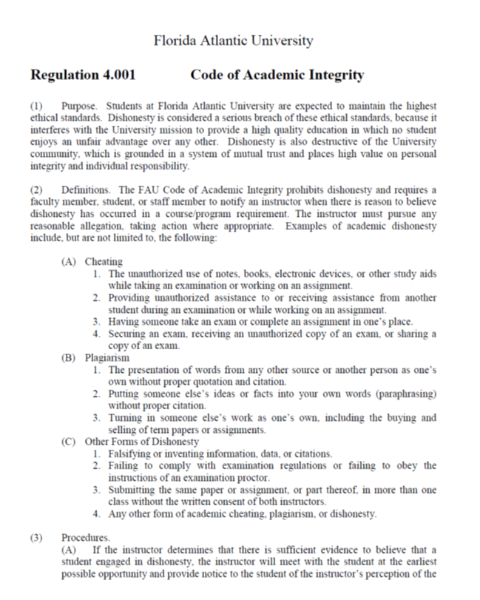
WHAT PROCESS IS DUE
Code of Academic Integrity
FAU Regulation 4.001

Slide 32
Academic Integrity Regulation 4.001
Processed by the College, with the assistance of Student Affairs
6 step process:
1. Perceived act of dishonesty, including cheating, plagiarism or other
form of dishonesty
2. Professor meets w/ Student to discuss and provide notice
3. Written notice of the charges and the penalty
4. Opportunity to be heard by chair and instructor
5. Appeal to the Dean – convening of a Council
6. Appeal to the Provost

Slide 33
Recording class lectures
Under a law enacted by the Florida Legislature in 2021, a state university student may, without prior notice, audio or video record a class lecture for a course in which the student is enrolled if the recording is for one of the following purposes:
- personal educational use of the student;
- in connection with a complaint to the university where the
recording is made; or
- as evidence in, or in preparation for, a criminal or civil
proceeding.

Slide 34
Recording class lectures
A recording of a class lecture may not be published without the consent of the lecturer, except it may be shared with university officials in connection with a complaint to the university or as evidence in a criminal or civil proceeding.
What is a “class lecture”?
What is “publication”?

Slide 35
Recording class lectures
A class lecture is defined as a formal or methodical oral presentation as part of a university course intended to present information or teach students about a particular subject.
Class lecture does not include student presentations (whether individually or as part of a group), class discussion (except when incidental to and incorporated within a class lecture), labs, clinical presentations such as patient history, academic exercises involving student participation, test or examination administrations, field trips, and private conversations between students in the class or between a student and the lecturer.
To publish means to share, transmit, circulate, distribute or otherwise provide access to the recording, regardless of format or medium, to another person (or other persons), including but not limited to another student in the class. Additionally, a recording, or transcript of the recording, is published if it is posted on or uploaded to, in whole or in part, any media platform, including but not limited to social media, book, magazine, newspaper, leaflet, picket signs, or any mode of print.

Slide 36
Duty to Report Child Abuse
Florida law (§39.201) requires all persons to report knowledge or reasonable suspicion that a child is abused, abandoned, or neglected to the Florida Department of Children and Family Services (DCF).
The law further prohibits any person from preventing another person from meeting their reporting obligation to DCF.
A person who knowingly and willfully violates the law is subject to criminal prosecution.

Slide 37
TITLE IX
The Basics:
- Protects people from discrimination based on sex in education programs and activities that receive federal financial assistance (Education Amendments 1972).
DOE Regulations, effective August 14, 2020, in effect.
- The Biden Administration’s April 2024 changes to Title IX regulations were struck down in a court ruling that applies nationwide. State of Tennessee v. Cardona, No. 2: 24-072-DCR (E.D. Ky. Jan. 9, 2025).

Slide 38
TITLE IX
Reporting Requirements
If you become aware of any incident of sexual assault, violence, and/or harassment, you must report to the Title IX Coordinator.
Bobby Brown Office of Civil Rights and Title IX Florida Atlantic University Administration Bldg., Suite 265 brownb@fau.edu
561-297-4644

Slide 39
Students in Distress
Kognito Interactive
https://www.fau.edu/training/kognito/
Students In Distress Guide
http://www.fau.edu/studentsindistress/
Report a Concern
https://www.fau.edu/report/

Slide 40


