Slide 1
FACULTY ORIENTATION
Fall 2026
Payroll Operations Monday, August 10, 2026

Slide 2
Introduction
Annie Yahinian Head Director of Payroll Operations & Taxation/Compliance Phone: 561-297-4273 Email: ayahinia@fau.edu
Anely Cabrera Assistant Director of Time & Absence Phone: 561-297-2862 Email: cabrera@fau.edu | Loredana Negulescu Assistant Director of Payroll Operation Phone: 561-297-1423 Email: lnegulescu@fau.edu
Payroll Department Phone: 561-297-6401 Email: payroll@fau.edu https://www.fau.edu/controllers-office/payroll/

Slide 3
Table of Contents
Payroll Schedules
Payslips
Payment and Withholding Elections
Deferred and Non-Deferred Pay
Model My Pay
Tax Documents
Absence Plans and Balances
Requesting and Correcting Time Off
The payroll and timekeeping job aids are available in Workday – click on MENU → FAU Job Aids → FAU's Library of Workday Job Aids

Slide 4
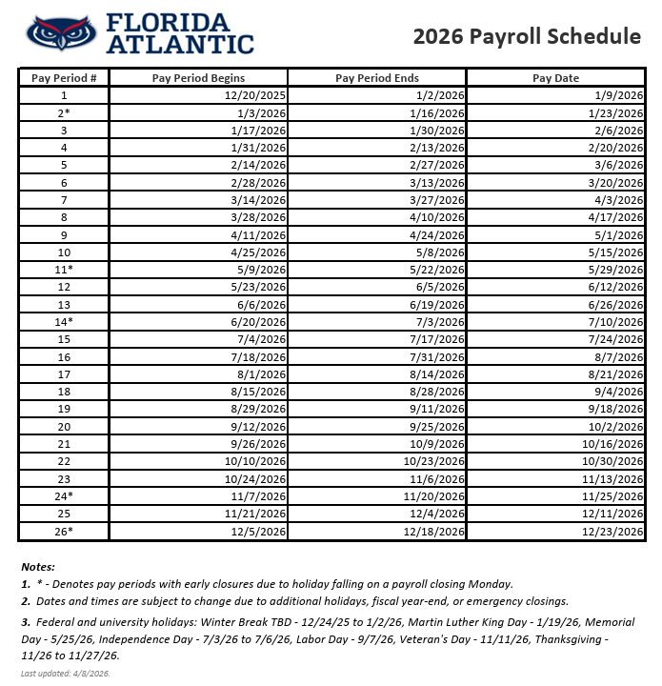
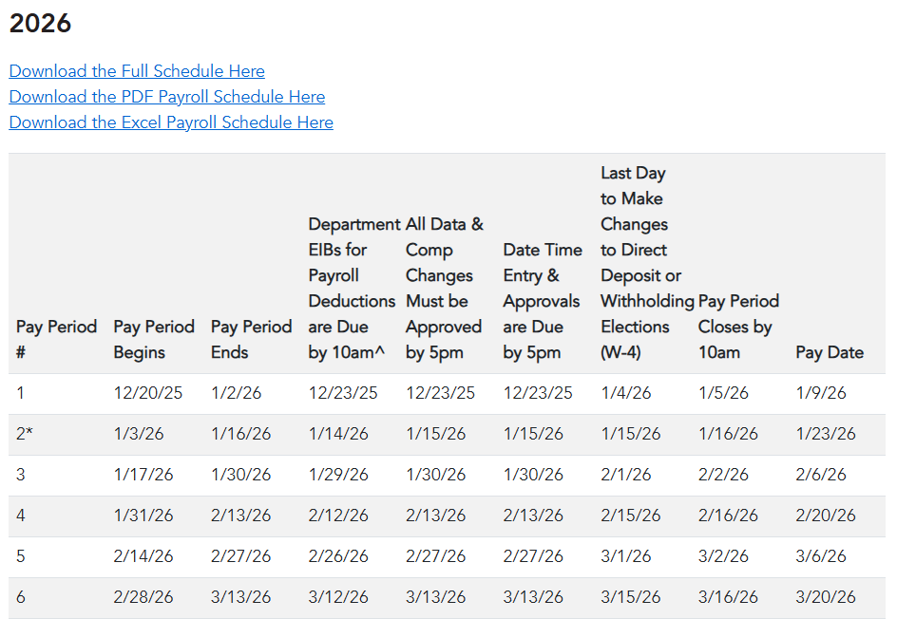
Payroll Schedules
→

Slide 5
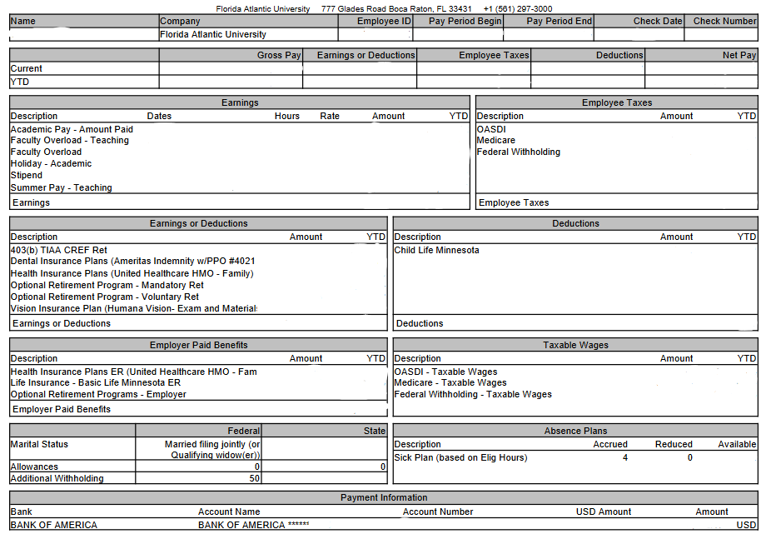
Payslips
Access your payslips by clicking on MENU on the Workday homepage → Pay (under the Personal section)
Click on Payslips
To calculate bi-weekly pay:
  12-month faculty divide annual salary by 26.1
  9-month faculty divide annual salary by 19.5

Slide 6
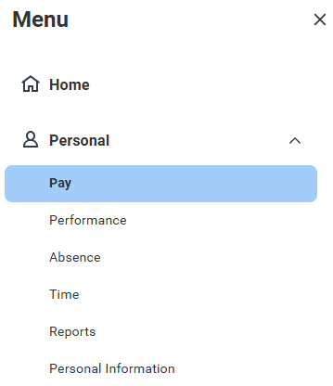
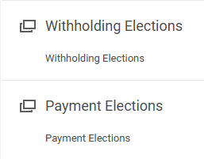

Payment and Withholding Elections
Access your payment and withholding elections by clicking on MENU → Pay
  Click Withholding Elections
  to change or update your
  W-4 IRS tax withholdings
  Click Payment Elections
  to change or update your
  banking and direct deposit
  information

Slide 7
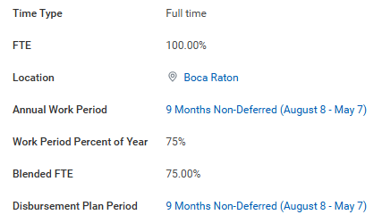
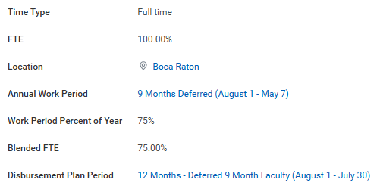
Deferred and Non-Deferred Pay
9-month faculty employees have the option to receive their salary over their academic period (non-deferred) or over 12-months (deferred)
Deferred Pay Option calculator - (https://www.fau.edu/provost/for-faculty/deferred-payment-plan)
9-month Faculty Non-Deferred
9-month Faculty Deferred

Slide 8
Model My Pay
This feature allows employees to make hypothetical changes to their pay and view their results
Make adjustments to:
  Earnings—your regular wages, hourly pay, and additional earnings
  Earnings or Deductions—your health and retirement benefits (pre-tax)
  Deductions—optional retirement (Roth plans) and other voluntary deductions (post-tax)
9-month faculty must only select pay results corresponding to their annual work period, not summer pay results
Limitations:
  Insurance plans (dental, health, vision, disability, etc.), mandatory retirement plans are not editable for modeling
  Not all states are available for modeling
  Deferred faculty employees cannot make adjustments to earnings on primary position; changes can be made to additional earnings (overload, bonus, awards)

Slide 9
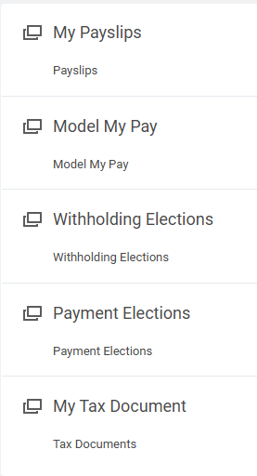
Tax Documents
To access your W-2 tax documents, click on MENU → Pay
Click on Tax Documents
Click View/Print to download a PDF copy of your W-2

Slide 10
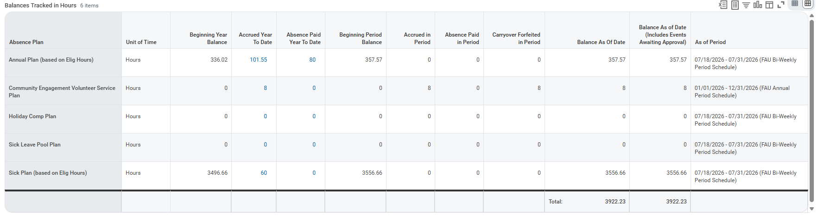
Absence Plans and Balances

Slide 11
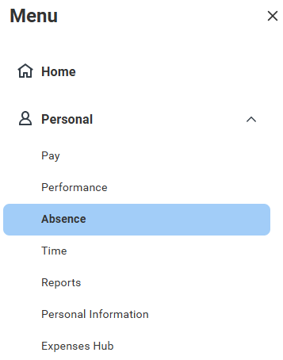
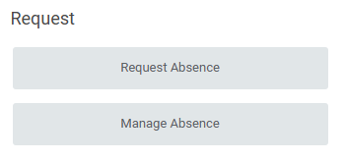
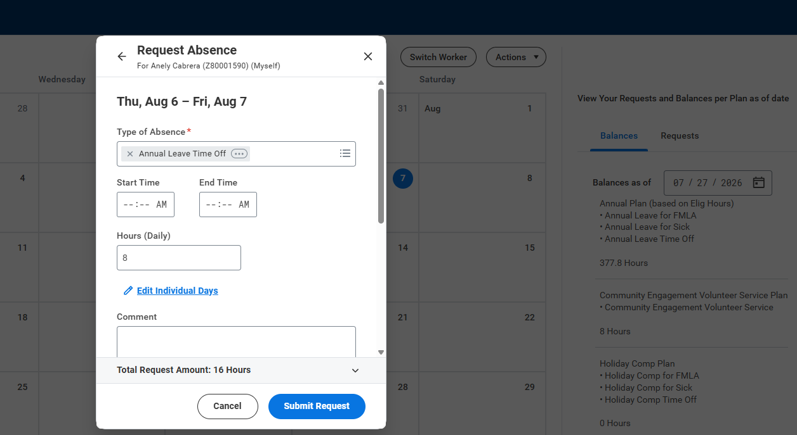
Requesting Time Off
To request time off, click on MENU → Absence, click on Request Absence under the Request Column to open a micro calendar, or click on Manage Absence to go to a full-view calendar
Leave balances will appear on the right; change the “Balance as of” date to see forecasted available balances
Click on the day(s) you would like to request time off, then click on the Request Absence button
Select the Type of Absence, enter the number of hours, and click Submit Request

Slide 12
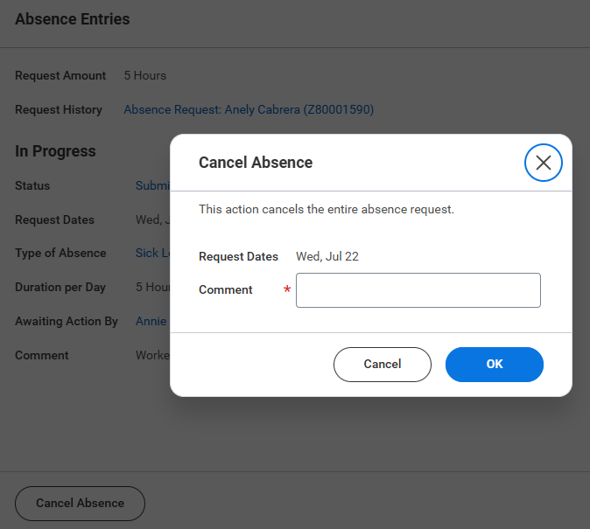
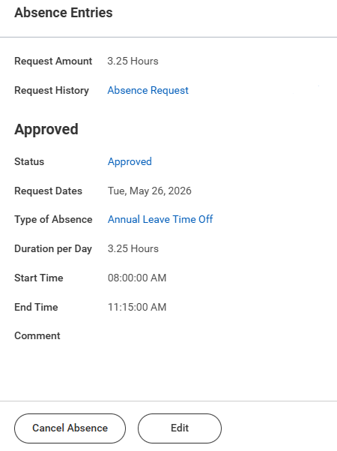
Correcting Time Off
To correct time off in submitted status:
  Click on the request and then on the Cancel Absence button
  Enter a comment and click OK
To cancel or delete approved
time off:
  Click on the request, then on the Cancel Absence button
  Enter a comment and click OK
To correct or make changes to approved time off:
  Click on the request, click on Edit
  Change the Type of Absence and the Hours (Daily), as applicable

Slide 13
Questions?
Thank you!

