Slide 1

2026 Faculty Orientation

Slide 2

State of Florida Benefit Programs
Provided through the Department of Management Services (DMS), Division of State Group Insurance (DSGI), and are administered through the People First system.
The State of Florida offers a comprehensive insurance benefits package that includes:
  Health Insurance
  Dental and Vision
  Basic Life Insurance
  Savings and Spending Accounts (Health Savings Account (HSA), Flexible Spending Accounts (FSA), Health Reimbursement Account (HRA)
  Other Supplemental Insurances (Accident, Cancer, Disability, Hospitalization, and Hospital Intensive Care)
Insurance elections must be made through People First

Slide 3
How to Enroll
Online
  https://peoplefirst.myflorida.com
  People First Login ID and Password Required
Call the People First Service Center
  Hours: Mon – Fri 8:00 a.m. to 6:00 p.m.
  Phone Number: 866-663-4735
  People First Login ID Required

Slide 4

People First Default Password:
PeopleFirstMMDDYYYY! (8-digit birthdate)

Slide 5
Insurance and Effective Dates
Employees have 60 days from their date of hire to enroll in insurance.
The earliest effective date for health insurance coverage is the first day of the month following the date of hire.
Example: If you are hired on August 7, 2026, the earliest date your health insurance coverage can begin is September 1, 2026*
*To ensure coverage is effective on this date, your enrollment must be completed by the last day of the month prior to the effective date. For example, you must complete your enrollment with People First by 4:00 p.m. on August 31, 2026.
Premiums are deducted one month in advance. If you elect an early effective date, this may result in double premium deductions during the first month of coverage.
Supplemental insurance plans generally become effective on the first day of the month following the first payroll deduction.

Slide 6
Changing Insurance after 60-Day Window
Open Enrollment
October/November - Changes effective January 1
Qualifying Status Change
Allow you to make specific benefit changes outside of new hire/open enrollment
Examples include • Marriage/Divorce • Birth/Adoption • Change of Dependents • Loss of Coverage
60-day enrollment window from date of event
Supporting documentation required

Slide 7
Eligible Dependents
Spouse (legally married)
Children: child, stepchild, foster child, guardianship (covered until the end of the year they turn 26)
May be eligible until age 30 with additional premium
Children with disabilities may be eligible after age limit
Dependent eligibility verification documentation is required by People First!

Slide 8
Health Insurance: PPO vs HMO
PPO Plan
Offered through Florida Blue
In-network and out-of-network coverage
Using in-network providers results in lower out of pocket expenses
HMO Plan
In-network coverage only
Care must be received within the network to be covered
Members can see an in-network specialist without a referral
Providers vary by county of residence
  United Healthcare HMO Palm Beach/Martin County
  Aetna HMO Broward/Miami-Dade/Indian River

Slide 9
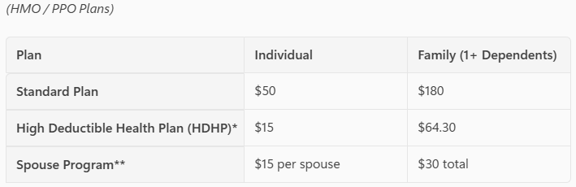

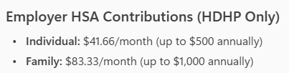
Health Insurance: Monthly Premiums

Slide 10
Health Insurance: Standard Option
The Standard Plan offers choice of PPO or HMO
  Note – same providers as high-deductible plan options
You pay a copayment for most office visits
Higher Premiums, but may pay less out of pocket when receiving care
Participation in Flexible Savings Account (FSA) to offset out-of-pocket expenses

Slide 11
Health Insurance: HDHP Option
The High-Deductible Health Plan offers choice of PPO or HMO
  Note – same providers as standard plan options
Employee assumes greater responsibility with healthcare
Lower Premiums, but may pay more out of pocket when receiving care
High Deductibles - Including deductibles for HMO plans
Participation in Health Savings Account (HSA) to offset out-of-pocket expenses. Employer contribution to HSA

Slide 12
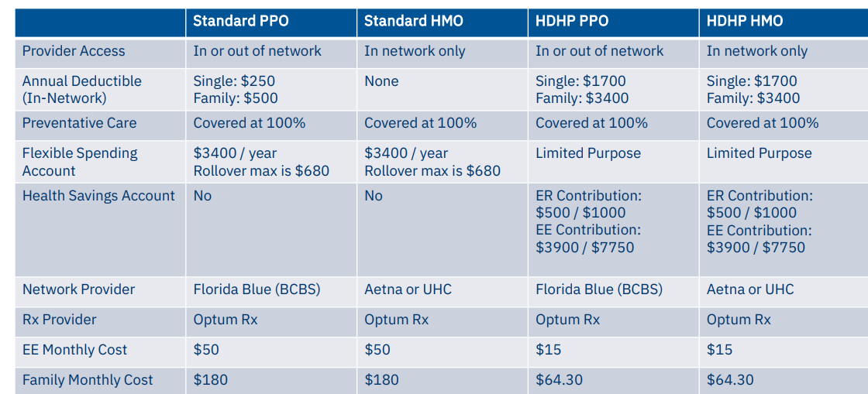
Health Insurance: Highlights

Slide 13

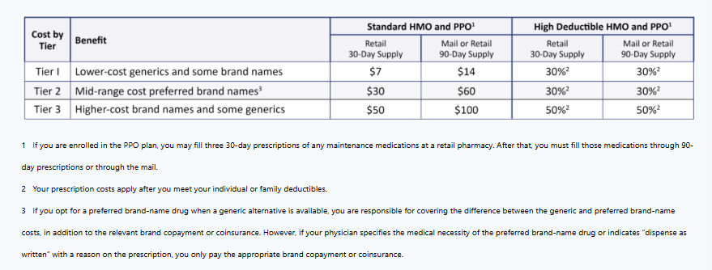
Health Insurance: Prescription Drug Plan

Slide 14
Health Savings Account (HSA)
A Health Savings Account is available only if you enroll in a High-Deductible Health Plan (HDHP). HSAs are designed to help pay current and future healthcare expenses.
Key Features:
Employees can contribute pre‑tax dollars to the account
FAU contributes to the HSA (employee not required to contribute)
  Individual coverage $41.66 per month
  Family coverage $83.33
HSA funds belong to you and roll over year to year—there is no forfeiture.
Funds can be used for eligible medical, dental, vision and medication expenses.
HSA balances can be saved and used in retirement for healthcare
Contributions are subject to annual IRS limits.

Slide 15
Flexible Spending Accounts (FSA)
Flexible Spending Accounts allow employees to set aside pre‑tax dollars to pay for eligible out‑of‑pocket expenses.
Health Care FSA – Used for eligible medical, dental, vision and medication expenses (copays, prescriptions, eyeglasses, orthodontia, etc.).
Limited Purpose FSA – For employees with a HDHP, covers dental and vision expenses only
Dependent Care FSA – Used for eligible childcare or elder care expenses that allow you (and your spouse, if married) to work.
Key Features:
Contributions are deducted pre‑tax, lowering taxable income.
Annual election amount is generally available at the beginning of the plan year (Health Care FSA).
“Use‑it‑or‑lose‑it” rules apply, meaning unused funds may be forfeited if not used by the allowed deadline.

Slide 16
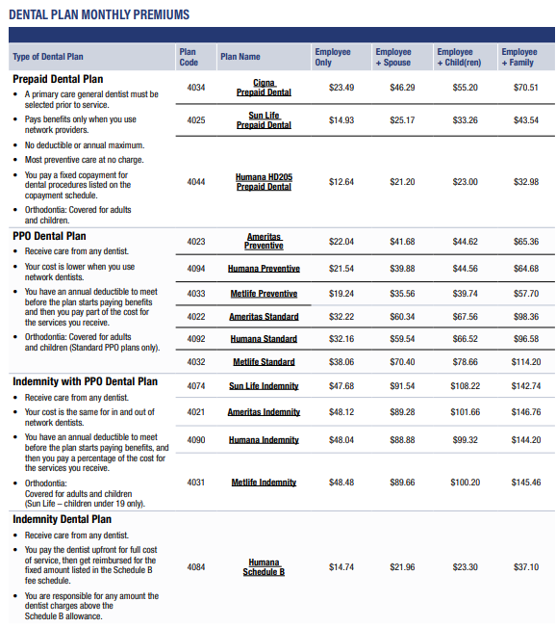
Dental Insurance

Slide 17
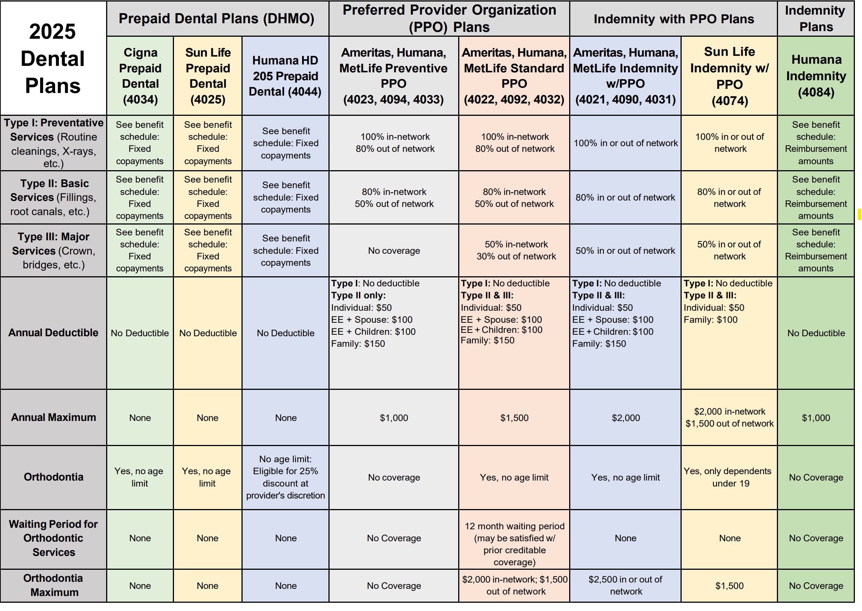


Slide 18
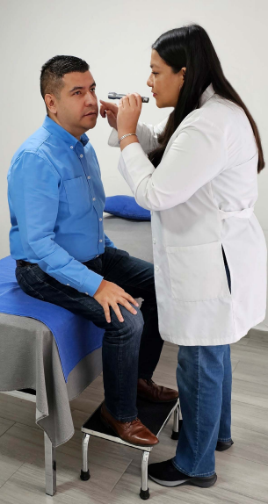
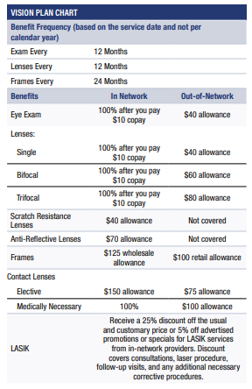


Vision Insurance

Slide 19

State Basic Life Insurance
Offered through MetLife – Life Insurance
$25,000 group term life benefit
No cost to employee, premiums paid by FAU
Designate your beneficiary online or by mail

Slide 20
Optional Life Insurance – MetLife
Optional Life Insurance
Coverage based on salary multiples up to $1,000,000
Guaranteed issue during the first 60 days of employment up to 5x salary or $500,000
Premiums vary by age and coverage level
Dependent Spouse Life Insurance
$15,000 or $20,000 coverage
Guaranteed issue during the first 60 days of employment or first 60 days of marriage
Premiums are $5.18 or $6.90 per month
Optional Child Life Insurance
$10,000 coverage
Guaranteed Issue
Premiums are $.85 per month and cover all eligible children

Slide 21
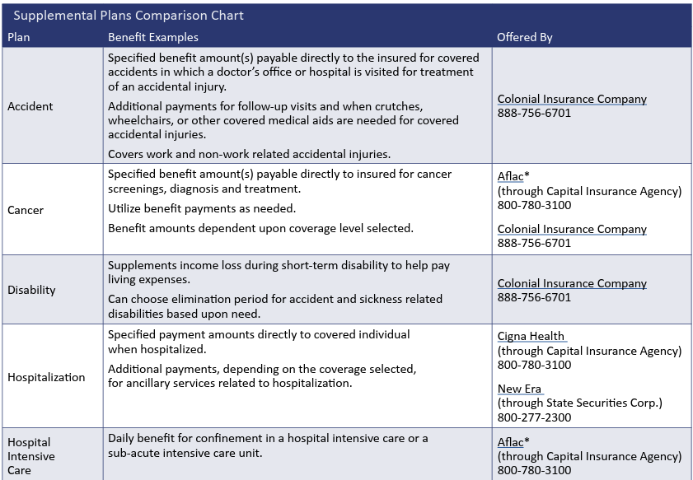
Supplemental Insurance

Slide 22
Other FAU Benefits
Gabor Agency – Term Life and Disability Insurance
Preferred Legal Plan
Pet Assure – Pet Insurance Alternative
Discounts and Perks
  Cell Phone Discounts
  Tickets at Work
  Broward Center for the Performing Arts
Credit Unions
  Bright Star Credit Union
  Gold Coast Federal Credit Union
  iTHINK Southeast Employees Credit Union
  Discounts & Perks | Florida Atlantic University

Slide 23
Employee Education Program (EEP)
The Employee Education Program (EEP) provides eligible Florida Atlantic University employees, along with their qualified spouses and dependents, the opportunity to pursue educational goals through a valuable tuition benefit.
Program Overview
Eligible employees may receive tuition coverage for up to six (6) credit hours per academic term.
Courses may be taken as part of a degree program or on a space-available basis.
Tuition coverage is based on the applicable Florida resident undergraduate or graduate tuition rate.
Courses may be completed online or at any FAU campus, including Boca Raton, Dania Beach, Davie, Fort Lauderdale, Harbor Branch, and Jupiter.
The six (6) credit-hour maximum per term is shared among the employee, eligible spouse, and eligible dependents.

Slide 24
Employee Assistance Program (EAP)
Aetna Resources for Living
This confidential service provides professional guidance to help you address personal issues and find effective solutions. EAP counselors are independent professionals, ensuring privacy and confidentiality.
Counseling Options – 5 counseling sessions per concern
Talkspace Virtual Therapy – 5 free sessions per concern
Mind Companion Self-Care – digital self-paced well-being program
Legal Services – one 30-minute consultation with a network attorney
Financial Service – 30-minute phone consultation with a money coach
Identity Theft – 60-minute phone consultation with a fraud resolution specialist
Call: 800-865-3200 TTY: 711
resourcesforliving.com
Username: Florida Atlantic University Password: EAP

Slide 25
State Sponsored Retirement Plans
All retirement plans have a mandatory 3% employee contribution beginning with your first pay.
Enroll in one of following 3 plans (eligibility depends on employee type)
Florida Retirement System (FRS) Pension Plan
  Available to SP, AMP and Faculty
Florida Retirement System (FRS) Investment Plan
  Available to SP, AMP and Faculty
State University System Optional Retirement Plan (SUSORP or ORP)
  Available to AMP and Faculty
  Post Docs

Slide 26
State Sponsored Retirement Plans (cont.)
FRS PENSION PLAN
Eligible Employees include SP / Faculty / AMP
Vesting occurs after 8 years of creditable service within the FRS system.
Defined Benefit = Guaranteed lifetime monthly income for life, regardless of how long you live, which creates a stable, predictable income in retirement. FAU contributes an amount set by the Florida Pension Trust which includes required fees. Please note that the amount on your pay statement does not reflect the actual amount contributed on your behalf.
Formula-Based Benefit = Benefit in retirement is based on a formula using your years of service, average final compensation (highest 5 or 8 years) and your membership class.
May be eligible for additional benefits including Disability and Deferred Retirement Optional Plan (DROP)
Health Insurance Subsidy (HIS) - Receive $7.50 per month for every year of service with a maximum benefit of $225 per month. Can use to help offset health insurance expenses and premiums

Slide 27
State Sponsored Retirement Plans (cont.)
FRS INVESTMENT PLAN
Eligible Employees include SP / Faculty / AMP
Vesting occurs after 1 year of creditable service within the FRS system
Defined Contribution = FAU currently contributes 8.3% to the employee’s account. Contributions are invested in funds selected by the employee
Benefit in retirement based on contributions made to your account, and Investment performance over time.
No age or service requirements to receive benefits, once vested. Roll over into a new employer plan or IRA when leave FAU/retire. Tax implications for early retirement – consult tax advisor
Health Insurance Subsidy (HIS) - Receive $7.50 per month for every year of service with a maximum benefit of $225 per month. Can use to help offset health insurance expenses and premiums

Slide 28
State Sponsored Retirement Plans (cont.)
State University System Optional Retirement Program (SUSORP)
Eligible Employees include Faculty / AMP / Post-Docs
Vesting occurs immediately
Defined Contribution = FAU currently contributes 5.14% to the employee’s account. Contributions are invested in funds selected by the employee
Benefit in retirement based on contributions made to your account, and Investment performance over time.
State of Florida ORP account MUST BE OPENED and enrollment form submitted to benefits@fau.edu.
Not eligible for HIS benefit.
In addition to the mandatory 3% employee contribution, employees may choose to contribute up to an additional 5.14% of pay. These voluntary contributions are made solely by the employee, with no additional university funding.

Slide 29
Voluntary Retirement Options
University Sponsored 403(b)
  Choice of investment providers, including Corebridge Financial, Voya, and TIAA/CREF
  Pre-Tax and Roth contribution options available
  To Enroll:
    Complete the FAU Salary Reduction Agreement
    Contact one of the FAU Plan Providers to establish an account
State of Florida Sponsored 457(b)
  Investment providers include Corebridge, Voya, and Nationwide
  Pre-Tax and Roth contribution options available
  To enroll visit: Florida Deferred Compensation or call: 877-299-8002
  You can enroll at any time.
  FAU does not match voluntary employee contributions.

Slide 30

Florida New Employee Benefits Guide
Visit:
https://www.mybenefits.myflorida.com/health
Click on Benefits Guide

Slide 31

Human Resources
Benefits & Retirement
777 Glades Rd
Building IS-4, Second Floor
M-F 8:00 a.m. – 5:00 p.m.
Email: benefits@fau.edu
Employee Benefits Line: (561) 297-5555
Web: www.fau.edu/hr/benefits

