Slide 1

FAU QEP Proposal 2021: Communicating Our Excellence: Enriched Communication Curricula Across the University
Jeffrey R. Galin, Director WAC/UCEW/CCEW and Professor of English

Slide 2
Contributing and Submitting Faculty and Staff
Jeff Galin, WAC/UCEW/CCEW/English
Ann Branaman, Sociology
Lindsay Harroff, Communication/Speaking Center Dir.
Carol Mills Dir. School of Communication
Wendy Hinshaw, English
Anthony Stagliano, English
Camila Afanador-Llach, Graphic Design
Claudia Amadori, Acting Assistant Director WAC
Education Melissa Mariani Counselor Education
Engineering Fred Bloetscher Civil Engineering/Assoc. Dean
Mary Kay Boyd Director Business Communication
Papiya Bhattacharjee, Mathematics
Korey Sorge, Physics
Jerry Haky, Chemistry
Tim C. Theisen, Biological Sciences
Rachel Luria, Honors College
Precious Skinner-Osei, Social Work
Karen Gough, Assistant VP, FAU Career Center
Library Amy Kornblau, Interim Dean, Libraries
Dawn Smith, Assistant Dean, Library
Debra Szabo, Director of Assessment
Dr. Julie Golden Botti, Executive Director for Online and Continuing Education

Slide 3
Four Communication Modalities
STUDENTS
WRITTEN
ORAL
VISUAL
DIGITAL/TECHNOLOGICAL

Slide 4
Currently, FAU lacks a uniformly focused, fully aligned, and integrated approach to tackling these communication needs.

Slide 5
Our approach
Build upon existing efforts and programs
Develop new methods and tools designed to foster and create a more consistent approach
Deliver high quality, comprehensive, and actionable experiences for faculty, staff, students, and the community.

Slide 6
SUSTAINABLE, SYSTEMATIC, TRANSFORMATIVE CURRICULAR CHANGE
We have one opportunity over the next ten years to build a curricular initiative for the university that will establish transformative curricular change that, once initiated, will persist over time.
The department level is the most efficient and strategic point of intervention to maintain resilience and sustainability.

Slide 7
6 Goals: multiprong approach
1. Student support services, including the UCEW, Speaking Center, and proposed Center for Visual and Digital Scholarship
2. Integrate communication abilities into departmental curriculum, modeled from Univ. of Minnesota’s WEC program
3. Support undergraduate and graduate presentation and publication of research, including existing OURI initiatives.
4. Provide faculty support for curricular revision, teaching, and researching the effectiveness of curricular changes
5. Prepare students to communicate ethically and effectively in workplace/grad school with enhanced sensitivity to DEI
6. Explore expansion of communication services for the local community as part of our Carnegie status for community engagement

Slide 8
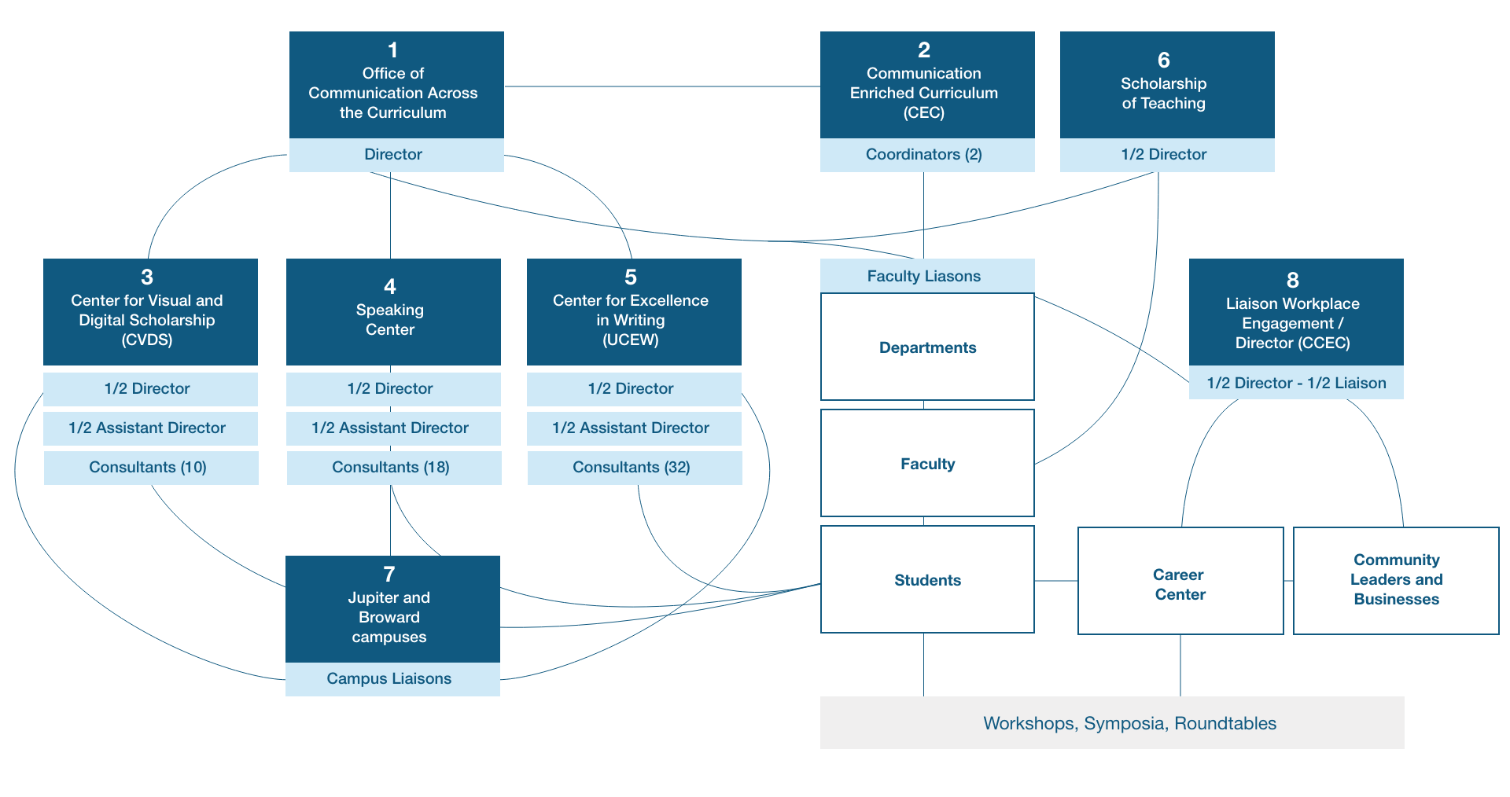
Organizational Chart

Slide 9
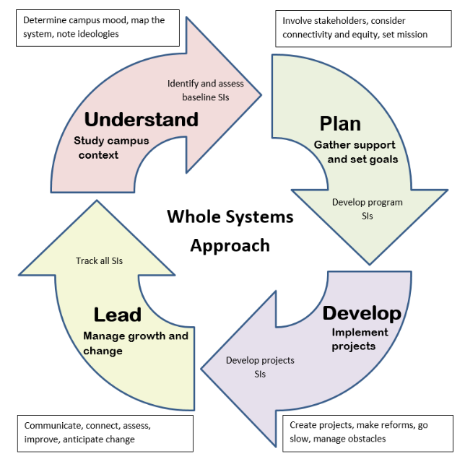
Whole Systems Approach (WSA) for transformative and sustainable curricular Change
Cox, M., Galin, J., and Melzer, D. (2018). Sustainable WAC: A Whole Systems Approach to Launching and Developing Writing Across the Curriculum Programs. NCTE.

Slide 10
Departments Interested in Learning More
Chemistry
Political Science
Honor’s College
School of Architecture
Biology
Music
Anthropology
SURP
School of Communication and Multimedia Studies
Languages, Linguistics, and
Comparative Literature
English
Business Communications Program
Civil Engineering
Counselor Education

Slide 11
Built on Data
Bob Ward, CEO of the Florida Council of 100 met with the Florida Career Centers at the Florida Board of Governor’s Task Force on Workforce Development. He asked his council of about 140 business representatives about hard skills of new employees.
“Verbal and written communication skills remain imperative but are still lacking in post-secondary graduates.”

Slide 12
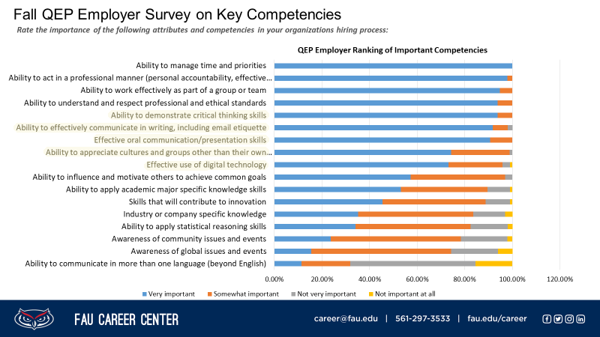

Slide 13
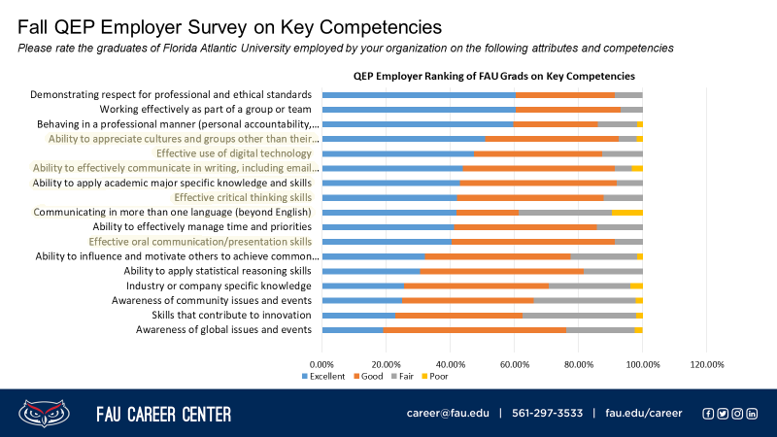

Slide 14
Four Faculty meetings in first year
Faculty Liaison paid to facilitate
Annual assessment, one day
Assignment changes in selected courses
Workshops, competitions, materials
Any major curricular changes in committee
Faculty Time?

Slide 15
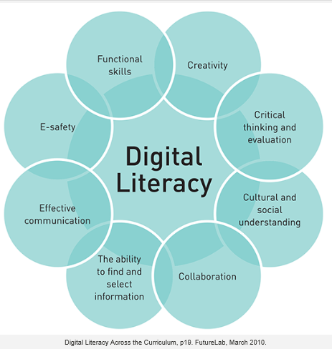
SLOs based on departmental self-study of student abilities and, if desired . . .
AACU Value Rubrics for written and oral communication, intercultural knowledge and competence, and ethical reasoning
Association of Colleges and Research Library’s Visual Competency Standards
Digital literacy Hague et al., 2010
Student progress over time will be measured with updated Academic Learning Compacts that track 6-8 departmentally determined SLOs a year on a 3-4-year cycle.

Slide 16
University metrics impacted
Through Student Support Centers and Curricular Change:
Time to Graduate
Drop, Fail, Withdraw rates
Progress rate and degrees awarded without excess hours
Timely awarded bachelor degrees to minorities
Improve retention rates
Through Additional Workshops, Symposia, and Roundtables on Communication in the Workplace for Students
Increased median wages of bachelor’s graduates employed full-time 1 year after graduation
Percent of bachelor's graduates enrolled/employed ($25,000+) in the U.S. 1 year after graduation

Slide 17
NOTE: End of presentation proper
Remaining slides will be available for Q&A

Slide 18
Participating WEC Department Accomplishments
Sociology
LLCL
Political Science

Slide 19
Sociology
Established desired learning outcomes and writing abilities for majors
Established a writing curriculum-with exposure, skill building, and advanced levels
Implemented a program change to facilitate student writing development – restructured 3000 and 4000 level course to better serve students in the major
Created external resources to recognize and facilitate student writing – undergraduate writing competition, writing consultant trained, professional development workshops
Established a plan for systematically assessing student writing – at beginning and end of program and assess overall program with program benchmarks

Slide 20
LLCL
Developed set of desired abilities used to assess student outcomes
Increased training & support –UCEW trained graduate students for specialized writing support
Increased recognition of excellence in writing -- yearly awards recognizing excellence in undergraduate writing
Increased student resources -- added resources for the French Linguistics programs
Increased curricular focus on writing -- in-depth and careful assessment of course design and curriculum sequencing undertaken in each program, developed new course, reinstated a course, added new courses, and syllabi revision in several courses in each program with some new assignments.

Slide 21
Political Science
Developed set of desired abilities used to assess student outcomes
Increased training & support –UCEW trained graduate students for specialized writing support. Not only assisted students one-on-one, but also holds workshops for students that focus on essential writing skills necessary for political science.
Developed and approved a new required course for our majors

Slide 22
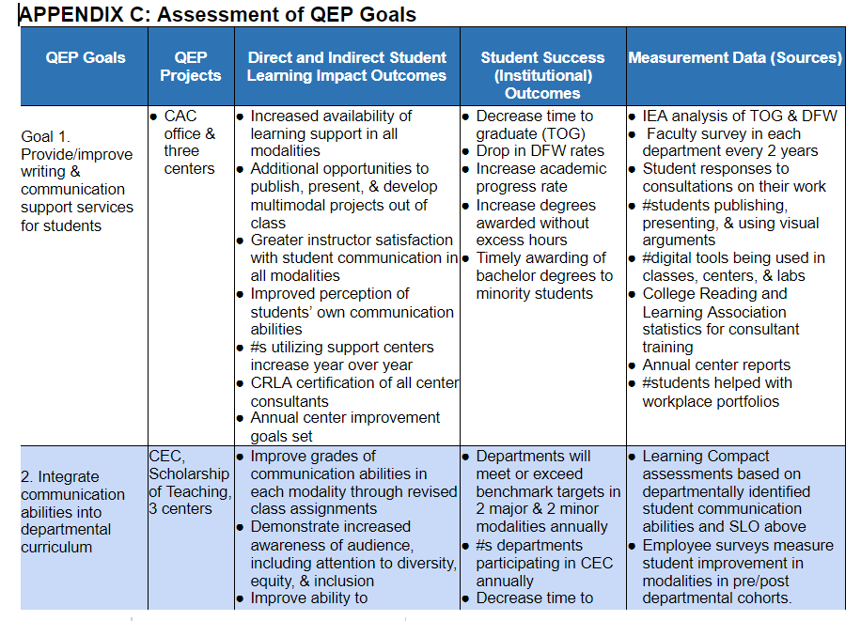
Assessment Table: Click to see full Table

Slide 23
SLOs: Value Rubrics, and other sources
WRITTEN (See “AACU Value Rubric”)
Demonstrate understanding of context, audience, and purpose that is responsive to the assigned task(s)
Use content to illustrate mastery of the subject
Demonstrate execution of conventions particular to a specific discipline and/or writing task(s)
Use sources to develop ideas that are appropriate for the discipline and genre of the writing
Communicate meaning to readers with consideration for clarity, fluency, and sentence-level errors

Slide 24
SLOs: Value Rubrics, and other sources (Cont)
ORAL (See “AACU Value Rubric”)
Provide a consistently observable organization
Use language choices that enhance the effectiveness of the presentation for appropriate audience(s)
Make a compelling presentation(s) with effective delivery techniques
Draw upon a range of supporting materials for support and analysis
Provide a compelling central message

Slide 25
SLOs: Value Rubrics, and other sources (Cont)
Visual (See ACRL’s “Visual Literacy Competency Standards for Higher Education)
Determine the nature and extent of the visual materials needed
Find and access needed images and visual media effectively and efficiently
Interpret and analyze the meanings of images and visual media
Evaluate images and their sources
Use images and visual media effectively
Design and create meaningful images and visual media

Slide 26
SLOs: Value Rubrics, and other sources (Cont)
Digital/Technological (Derived from Hague et al, 2010)
Share meaning in different modes and formats
Navigate and use digital systems, databases, and applications effectively
Collaborate and communicate effectively using digital technologies
Understand how and when digital technologies can best be used to support these processes
Critically engage with technology
Develop a social awareness of how several factors including commercial agendas and cultural understandings can shape how technology is used to convey information and meaning

