Slide 1
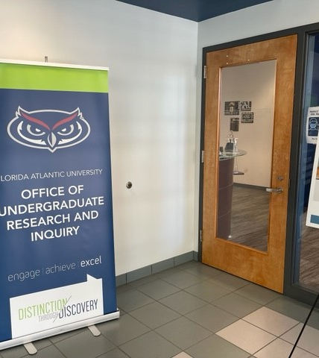
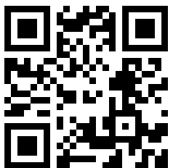
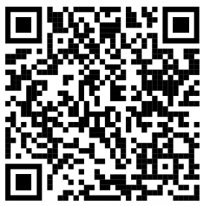
Research Intensive (RI) Course
In this course you will conduct research and inquiry (URI) at an intensive level, through classroom projects and assignments.
For further engagement in URI opportunities – reach out to OURI OR to OURI’s Peer Mentors
OURI Website Peer Mentors

Slide 2

What’s next?
Undergraduate Research Certificate
OURI Opportunities for you:
UR Professional Development:
OURI workshops
UR Engagement
Directed Independent Research
Honors Programs
UR Funding:
Undergraduate Research Grants
Fellowships
Publication:
FAU Undergraduate Research Journal (FAURJ)
Recognition:
Undergraduate Research Symposium,
Undergraduate Researcher of the Year

