Slide 1
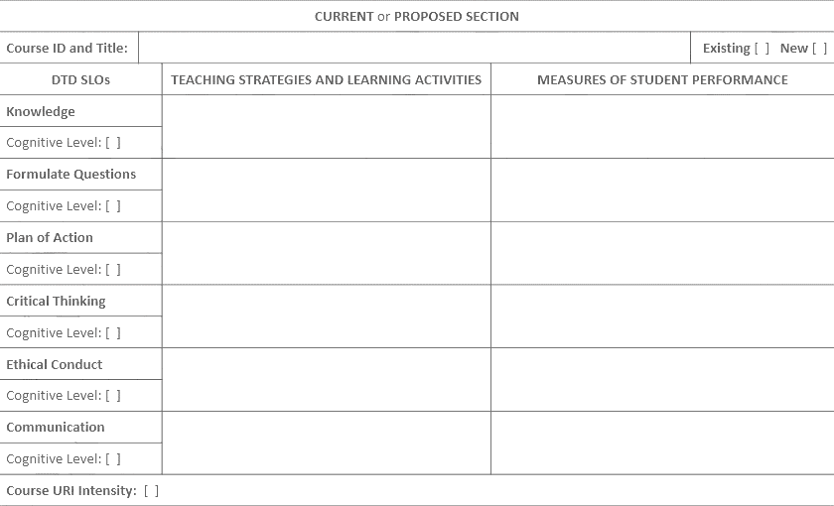
Course Plan Worksheet (without narration)
James K. Fowlkes
Many of the slides are duplicates from the Curriculum Inventory presentation. Since the concepts and information apply here as well, we have including them for quick reference.

Slide 2

Remember, the goal is integrating research and inquiry into your curriculum in your discipline.

Slide 3
Why a Course Plan Worksheet?
Whereas the Curriculum Inventory guides your proposal for change, the Course Plan Worksheets guide the implementation of it
Given the targeted DTD SLOs and their cognitive levels from the Curriculum Inventory, the Course Plan Worksheets are where you develop the measures of student performance to verify the achievement of them
Given the measures of student performance, the Course Plan Worksheets are where you develop the teaching strategies and learning activities to support student success in them
The course URI intensity of the current and proposed courses confirm the enhancement of undergraduate student research in the curriculum

Slide 4
Distinction Through Discovery Student Learning Outcomes
Knowledge – Students will demonstrate content knowledge, core principles and skills.
Formulate Questions – Students will formulate research questions, scholarly of creative problems with integration of fundamental principles and knowledge in a manner appropriate to their discipline.
Plan of Action – Students will develop and implement a plan of inquiry to address research and inquiry questions or scholarly problems.
Critical Thinking – Students will apply critical thinking skills to evaluate information, their own work and the work of others.
Ethical Conduct – Students will identify significant ethical issues in research and inquiry and/or address them in practice.
Communication – Students will convey all aspects of their research and inquiry (processes and products) in appropriate format, venues and delivery modes based on the conventions of their disciplines.

Slide 5
Student Learning Outcomes
Course vs. Distinction Through Discovery (DTD)
Example:
Course - Students will be able to use the vocabulary of the discipline both orally and in writing.
DTD – Students will be able to identify research methodologies based on descriptors.
In the example above, only the latter outcome would be appropriate since it is the only one that relates to student research. Your course will have many learning outcomes, but the SLOs used in the Course Plan Worksheet must be research-related.

Slide 6
Cognitive Levels
Outcomes can be covered in progressive cognitive levels. To indicate this progression, three cognitive levels have been defined:
Exposure – the cognitive skill needed to meet the outcome at the lower two levels of Bloom’s taxonomy—knowledge and comprehension
Skill building – the cognitive skill needed to meet the outcome at the middle two levels of Bloom’s taxonomy—application and analysis
Intensive – the cognitive skill needed to meet the outcome at the highest two levels of Bloom’s taxonomy—synthesis and evaluation

Slide 7
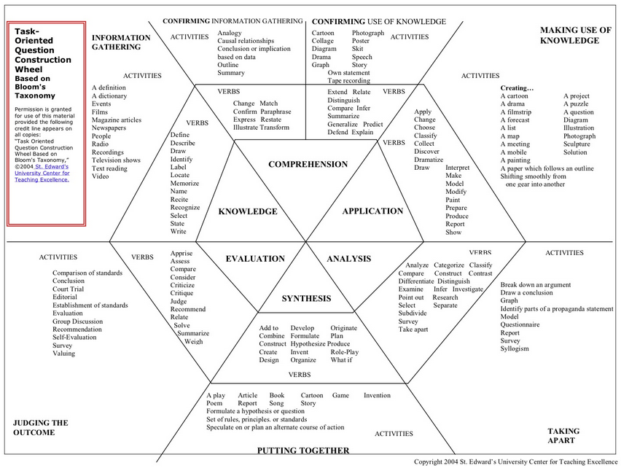
Task-Oriented Question Construction Wheel
Based on Bloom’s Taxonomy
Permission is granted for use of this material provided the following credit line appears on all copies:
Tasks Oriented Question Construction Wheel Based on Bloom’s Taxonomy, ©2004
St. Edward’s University Center for Teaching Excellence.
E
S
As you develop your proposal, you will identify the cognitive level for each outcome for each course.
This chart illustrates the distribution of the cognitive levels. Starting at the center and working out, you have Bloom’s cognitive domain that defines our cognitive levels—Exposure (E) being knowledge and comprehension, Skill Building (S) being application and analysis, and Intensive (I) being synthesis and evaluation. Moving outward, the chart list the correlating action verbs, activities and assessments.
The chart will assist you when identifying the cognitive level in your courses for each outcome.
X
I
Visit Bloom’s Polygon to download
Whenever you see a “?” button, click for further information.
?
NEXT
PUTTING TOGETHER

Slide 8
Distinction Through Discovery
Student Learning Outcomes & Cognitive Levels
DTD Student Learning Outcome | Exposure (Knowledge & Comprehension) | Skill Building (Application & Analysis) | Intensive (Synthesis & Evaluation)
Knowledge | Summarize previous literature / prior work | Demonstrate information (meta-) literacy Appraise appropriateness of theoretical framework(s) | Assess social value Create new knowledge
Formulate Questions | Identify questions Give example(s) of research questions | Discover new questions Breakdown question(s) into manageable units | Compose logical argument Predict outcomes
Plan of Action | Define steps of inquiry | Employ appropriate methodologies | Synthesize and evaluate plan(s) of inquiry
Critical Thinking | Recognize gaps Describe differences, etc. | Interpret information, results Examine limits Analyze feedback | Justify conclusions Prepare critical review Evaluate feedback
Ethical Conduct | Explain academic integrity | Point out ethical issues Outline potential ethical concerns | Design ethical research Maintain ethical integrity
Communication | Communicate clearly Reproduce proper format | Apply appropriate mode(s) / venue(s) for communication | Prepare / direct communication appropriately based on given audience(s)
Employ appropriate methodologies
Within a course, students apply research methodologies to a project. What is the student learning outcome and cognitive level of this activity?
?
ANSWER
Visit Student Learning Outcomes & Cognitive Levels for download
NEXT

Slide 9
View Achievement Rubric for download
STUDENT LEARNING OUTCOME | URI INDICATOR | PERFORMANCE CRITERIA
 |  | Developing | Competent | Exemplary
Knowledge | Vocabulary / basic skills
 | Theoretical frameworks or genres
 | Information literacy / sources
Formulate Questions | Relevant issues / content
 | Rationale
Plan of Action | Methods of exploration
 | Design
 | Implementation
 | Observation / data collection
 | Technical skills
This slide and the next one combines to form a rubric that breaks down the outcomes into more descriptive indicators. It also shows the three performance criteria levels that you will use when you develop your assessment plan. As you consider if an outcome applies to your curriculum, you will find the indicators beneficial in your decision-making. Appendix L from the QEP document is the completed rubric that you can use as a guide. The link above will take you directly to the document.

Slide 10
View Achievement Rubric for download
STUDENT LEARNING OUTCOME | URI INDICATOR | PERFORMANCE CRITERIA
 |  | Developing | Competent | Exemplary
Critical Thinking | Analysis
 | Interpretation
 | Source of error
 | Conclusions
Ethical Conduct | Academic integrity
 | Safety
 | Ethical treatment
 | Ethical issues
Communication | Clarity / organization
 | Quotation / attribution / Citation
 | Format / Level
This slide and the previous one combines to form a rubric that breaks down the outcomes into more descriptive indicators. It also shows the three performance criteria levels that you will use when you develop your assessment plan. As you consider if an outcome applies to your curriculum, you will find the indicators beneficial in your decision-making. Appendix L from the QEP document is the completed rubric that you can use as a guide. The link above will take you directly to the document.

Slide 11
Course Plan Worksheet Information
For each of the courses identified in the Curriculum Inventory that you propose changes, the following items need to be provided for both the proposed and current courses, if applicable.
Course ID and title
Is the course new or existing?
Teaching strategies and learning activities for each identified outcome
Measures of student performance for each identified outcome
Cognitive level of each identified outcome
Course Undergraduate Research and Inquiry (URI) Intensity

Slide 12
CURRENT [ ] PROPOSED [ ]
Course ID and Title: |  |  |  | Existing [ ] New [ ]
DTD SLOs |  | TEACHING STRATEGIES AND LEARNING ACTIVITIES | MEASURES OF STUDENT PERFORMANCE
Knowledge
Cognitive Level: [ ]
Formulate Questions
Cognitive Level: [ ]
Plan of Action
Cognitive Level: [ ]
Critical Thinking
Cognitive Level: [ ]
Ethical Conduct
Cognitive Level: [ ]
Communication
Cognitive Level: [ ]
Course URI Intensity: [ ]
DTD SLOs
Unlike the Curriculum Inventory, the Course Plan Worksheets must be in this completed using this template. It should be completed for both the current and proposed versions of each course identified for changes in the Curriculum Inventory. If the course is new, only a proposed version is summited. Let’s review the components of a worksheet.
Teaching strategies and learning activities to address the DTD SLOs
Measures of student performance to assess the DTD SLOs
Cognitive Level

Slide 13
EXAMPLE 1
A Course Plan Worksheet needed to be completed for each existing course with proposed changes.
The Current Section is needed for each existing course for which you are proposing changes.
CURRENT [ x ] PROPOSED [ ]
Course ID and Title: | GLY 4300 Biogeography |  | Existing [ x ] New [ ]
DTD SLOs | TEACHING STRATEGIES AND LEARNING ACTIVITIES | MEASURES OF STUDENT PERFORMANCE
Knowledge | Course field research project and tri-weekly reading, writing, and class discussion assignments from the academic biogeography literature. | Course field research project requires students to perform literature review to provide context to the research and for comparison of results and interpretation. Part tri-weekly reading, writing, and class discussion assignments require students to assess the scholarly and societal value of the research for addressing pressing issues.
Cognitive Level: [ S ]
Formulate Questions | Course field research project and tri-weekly reading, writing, and discussion assignments form the academic biogeography literature. | The research questions for the field research assignment are pre-designed for the students. Their role is to carry out the research and analyze the results without question development. Through the tri-weekly reading, writing, and discussion assignments students are exposed to real research questions from the academic literature and critically review that research.
Cognitive Level: [ E ]
When entering information in these cells, the information must be about what students are doing or how they are being assessed that relates to this SLO. Remember, it must relate to research & inquiry.
After you have entered the information in the two cells to the right, you must specify the cognitive level of coverage for this SLO (see Proposal Guidelines for further information).
Complete the form for the remainder of the SLOs.
Example 1 contains the Course Plan Worksheets for an existing course. Remember, all existing courses will proposed changes need a Course Plan Worksheet completed for the current and proposed curricula.

Slide 14
CURRENT [ x ] PROPOSED [ ]
Course ID and Title: | GLY 4300 Biogeography |  | Existing [ x ] New [ ]
DTD SLOs | TEACHING STRATEGIES AND LEARNING ACTIVITIES | MEASURES OF STUDENT PERFORMANCE
Ethical Conduct | NA | NA
Cognitive Level: [ ]
Communication | Course field research project and tri-weekly reading, writing, and discussion assignments from the academic biogeography literature. | Students are required to communicate the results of the field research project in writing with a format that is largely based on directly answering the assigned questions. They are also required to communicate orally during class discussion and in writing their analysis of the academic readings for the tri-weekly assignments.
Cognitive Level: [ S ]
Course URI Intensity: [ S ]
“NA” must be entered for any SLO not addressed in the course.
After you complete the Teaching Strategies and Learning Activities, Measures of Student Performance, and Cognitive Level sections for each SLOs, remember to specify your Course URI Intensity level below (see the Proposal Guidelines for further information).

Slide 15
For SLOs that do not have any proposed changes, please state this in the Proposed Section.
The Proposed Section is needed for each existing course for which you are proposing changes.
CURRENT [ ] PROPOSED [ x ]
Course ID and Title: | GLY 4300 Biogeography |  | Existing [ x ] New [ ]
DTD SLOs | TEACHING STRATEGIES AND LEARNING ACTIVITIES | MEASURES OF STUDENT PERFORMANCE
Knowledge | No changes proposed. | No changes proposed.
Cognitive Level: [ E ]
Formulate Questions | Course field research project question will be student-driven (in group settings) subject to instructor approval. | While the study location(s). Will be chosen a priori for logistical reasons, students will be asked to develop the research questions in consultation with their group for the semester field research project based on knowledge they gain from literature review, course lectures, and an initial inspection of the study location.
Cognitive Level: [ I ]
Plan of Action | Course field research project. | Students will be required to design the field sampling protocols and statistical analyses to address the research questions they developed, then implement the project under their own leadership with the instructor working in a mentoring role.
Cognitive Level: [ I ]
After you have entered the information in the two cells to the right, you must specific the cognitive level of coverage for this SLO (see Proposal Guidelines for further information).
Complete the form for the remainder of the SLOs.
When entering information in these cells, the information must be about what students are doing or how they are being assessed that relates to this SLO. Remember, it must relate to research & inquiry.

Slide 16
CURRENT [ ] PROPOSED [ x ]
Course ID and Title: | GLY 4300 Biogeography |  | Existing [ x ] New [ ]
DTD SLOs | TEACHING STRATEGIES AND LEARNING ACTIVITIES | MEASURES OF STUDENT PERFORMANCE
Ethical Conduct | NA | NA
Cognitive Level: [ ]
Communication | Course field research project. | Students are required to write a paper in an academic journal style with introduction, methods, results, discussion, and conclusions, and present the results orally as a formal conference style presentation to the class. These assignment will be evaluated using rubrics developed by this grant.
Cognitive Level: [ S ]
Course URI Intensity: [ S ]
“NA” must be entered for any SLO not addressed in the course.
After you complete the Teaching Strategies and Learning Activities, Measures of Student Performance, and Cognitive Level sections for each SLOs, remember to specify your Course URI Intensity level below (see the Proposal Guidelines for further information).

Slide 17
CURRENT
Knowledge - Skill building
Formulate Questions - Exposure
Plan of Action - Exposure
Critical Theory - Skill building
Ethical Conduct - Not applicable
Communication - Exposure
Course URI Intensity: Exposure
PROPOSED
Knowledge - Skill building
Formulate Questions - Skill building
Plan of Action - Skill building
Critical Theory - Skill building
Ethical Conduct - Not applicable
Communication - Intensive
Course URI Intensity: Skill building
Let’s review how this course changed.
It is now easy to see that the research experiences for the students progressed from exposure to skill building in SLO 2, 3, and 4. Also, SLO 6 has progressed from exposure to intensive. As a result, the overall course has moved from the exposure course URI intensity to skill building.

Slide 18
A Course Plan Worksheet needed to be completed for the proposed curriculum only since this course is new.
Only the Proposed Section is needed since this is a new course.
EXAMPLE 2
CURRENT [ ] PROPOSED [ x ]
Course ID and Title: | EGN 3910 Intro to Research |  | Existing [ ] New [ x ]
DTD SLOs | TEACHING STRATEGIES AND LEARNING ACTIVITIES | MEASURES OF STUDENT PERFORMANCE
Knowledge | NA | NA
Cognitive Level: [ ]
Formulate Questions | Small group activities in class will involve critique of instructor-provided examples and peer review of first drafts of student-created work. | Module will be created for the following activities: Design a hypothesis Introduction writing Justification / persuasive writing Literature review An activity description and standardized rubrics for small group in class critiques and peer-reviews will be developed for these assignments. Criteria for selecting topics or narrowing topics for these assignments will be developed to help faculty and students understand what is expected. Subsequent assessment will be conducted on individual work products This will also be assessed in the final exam with targeted exam questions.
Cognitive Level: [ S ]
“NA” must be entered for any SLO not addressed in the course.
Example 2 contains the Course Plan Worksheet for a new course. Remember, proposed new courses need only one Course Plan Worksheet completed for the proposed curriculum.
After you have entered the information in the two cells to the right, you must specific the cognitive level of coverage for this SLO (see Proposal Guidelines for further information).
When entering information in these cells, the information must be about what students are doing or how they are being assessed that relates to this SLO. Remember, it must relate to research & inquiry.
Complete the form for the remainder of the SLOs.

Slide 19
CURRENT [ ] PROPOSED [ x ]
Course ID and Title: | EGN 3910 Intro to Research |  | Existing [ ] New [ x ]
DTD SLOs | TEACHING STRATEGIES AND LEARNING ACTIVITIES | MEASURES OF STUDENT PERFORMANCE
Communication | The strategy will be to use the authentic learning approach in which students will prepare a conference level abstract and defense presentation. | Modules will be created for the following activities: Preparing a conference level abstract Presenting a project defense An activity description and standardized rubrics for oral and written communications will be developed for these assignments. An effective assignment description will be developed to help faculty and students understand what is expected. Subsequent assessment will be conducted on individual worked products. This will also be assessed in the final exam with targeted exam questions.
Cognitive Level: [ I ]
Course URI Intensity: [ S ]
After you complete the Teaching Strategies and Learning Activities, Measures of Student Performance, and Cognitive Level sections for each SLOs, remember to specify your Course URI Intensity level below (see the Proposal Guidelines for further information).

Slide 20
Questions
For questions, email ouri@fau.edu.
We look forward to seeing your completed Course Plan Worksheets in your Curriculum Grant Proposals.

