Slide 1
Welcome

Slide 2
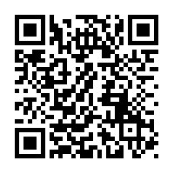
Live Captioning
Notes:
QR code updated on 8/10 by arz

Slide 3
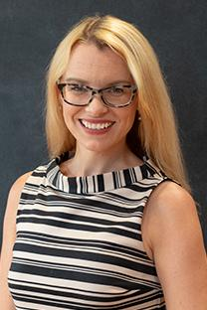
Dr. Katie G. Burke
Executive Director
New Student Transitions & Family Engagement

Slide 4
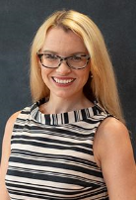
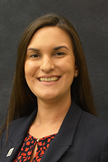
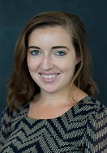
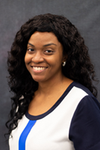
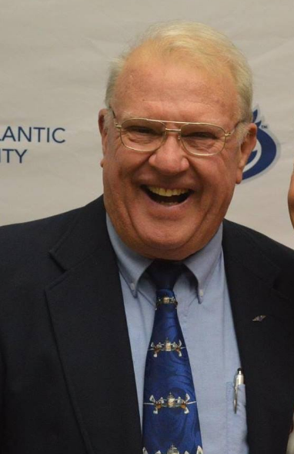
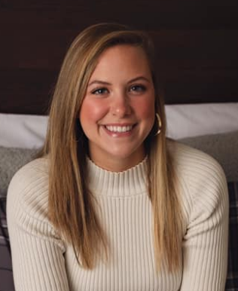
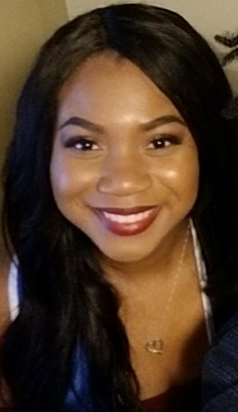
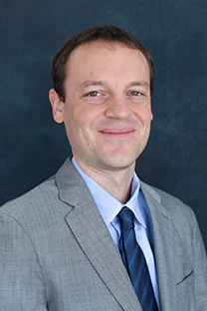

Slide 5
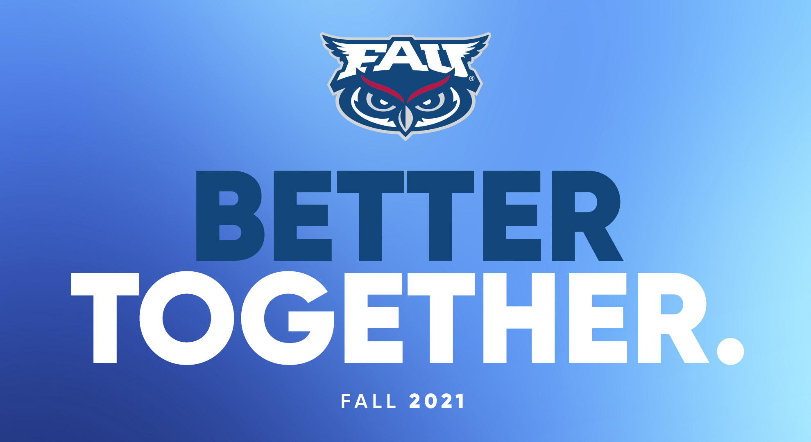

Slide 6
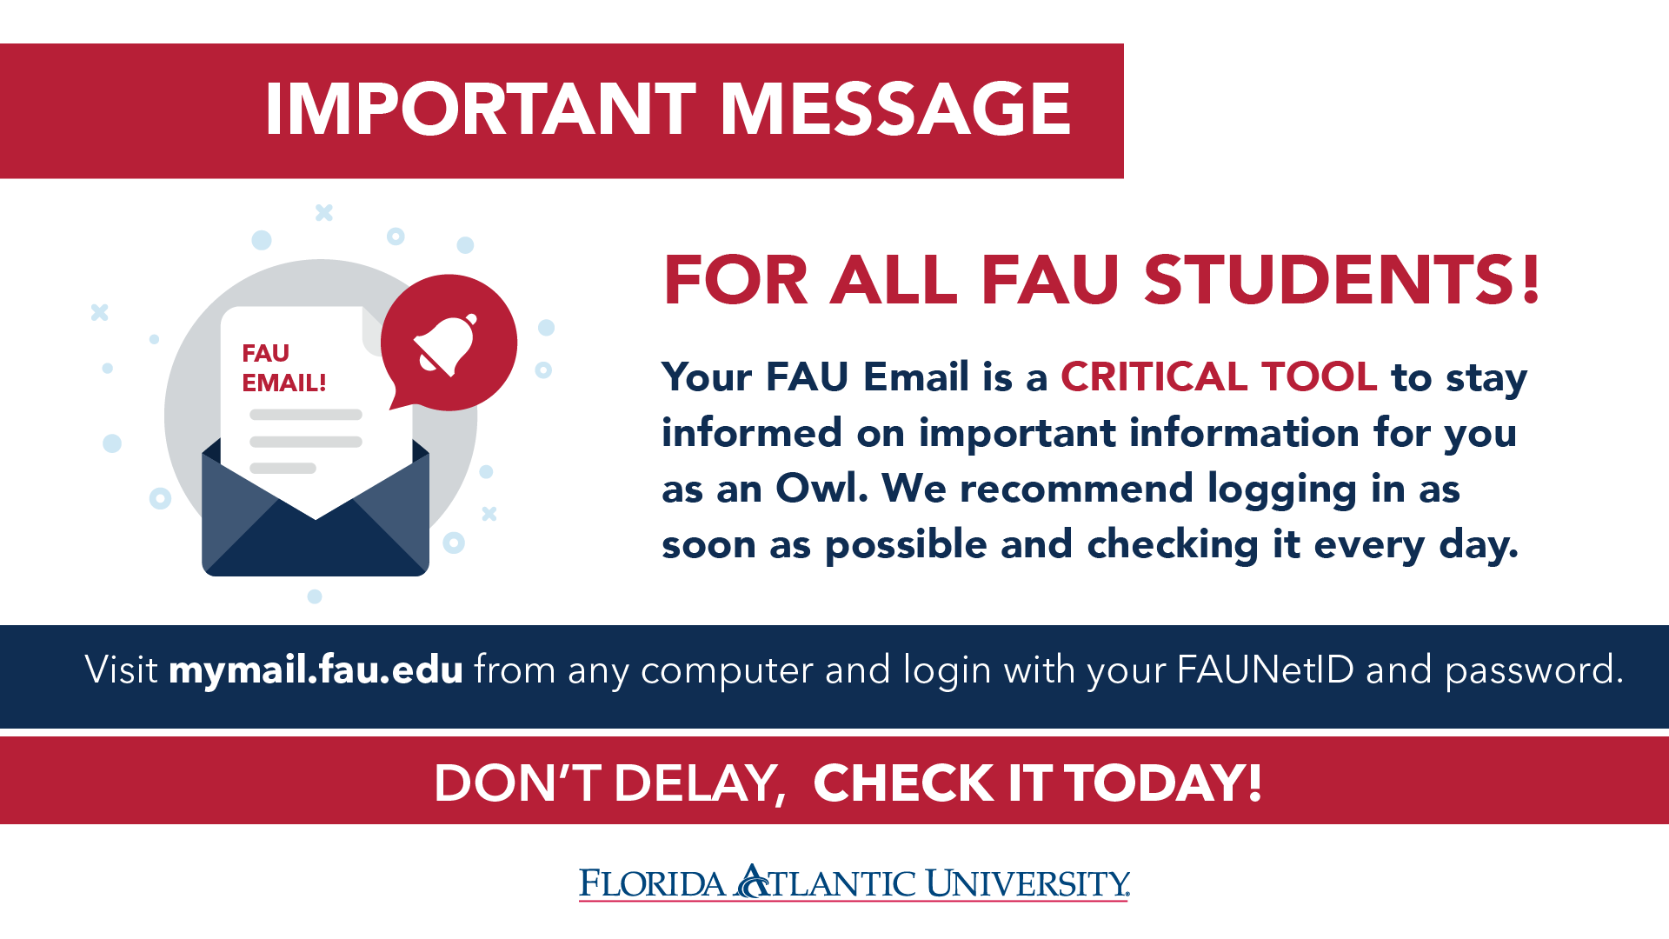

Slide 7
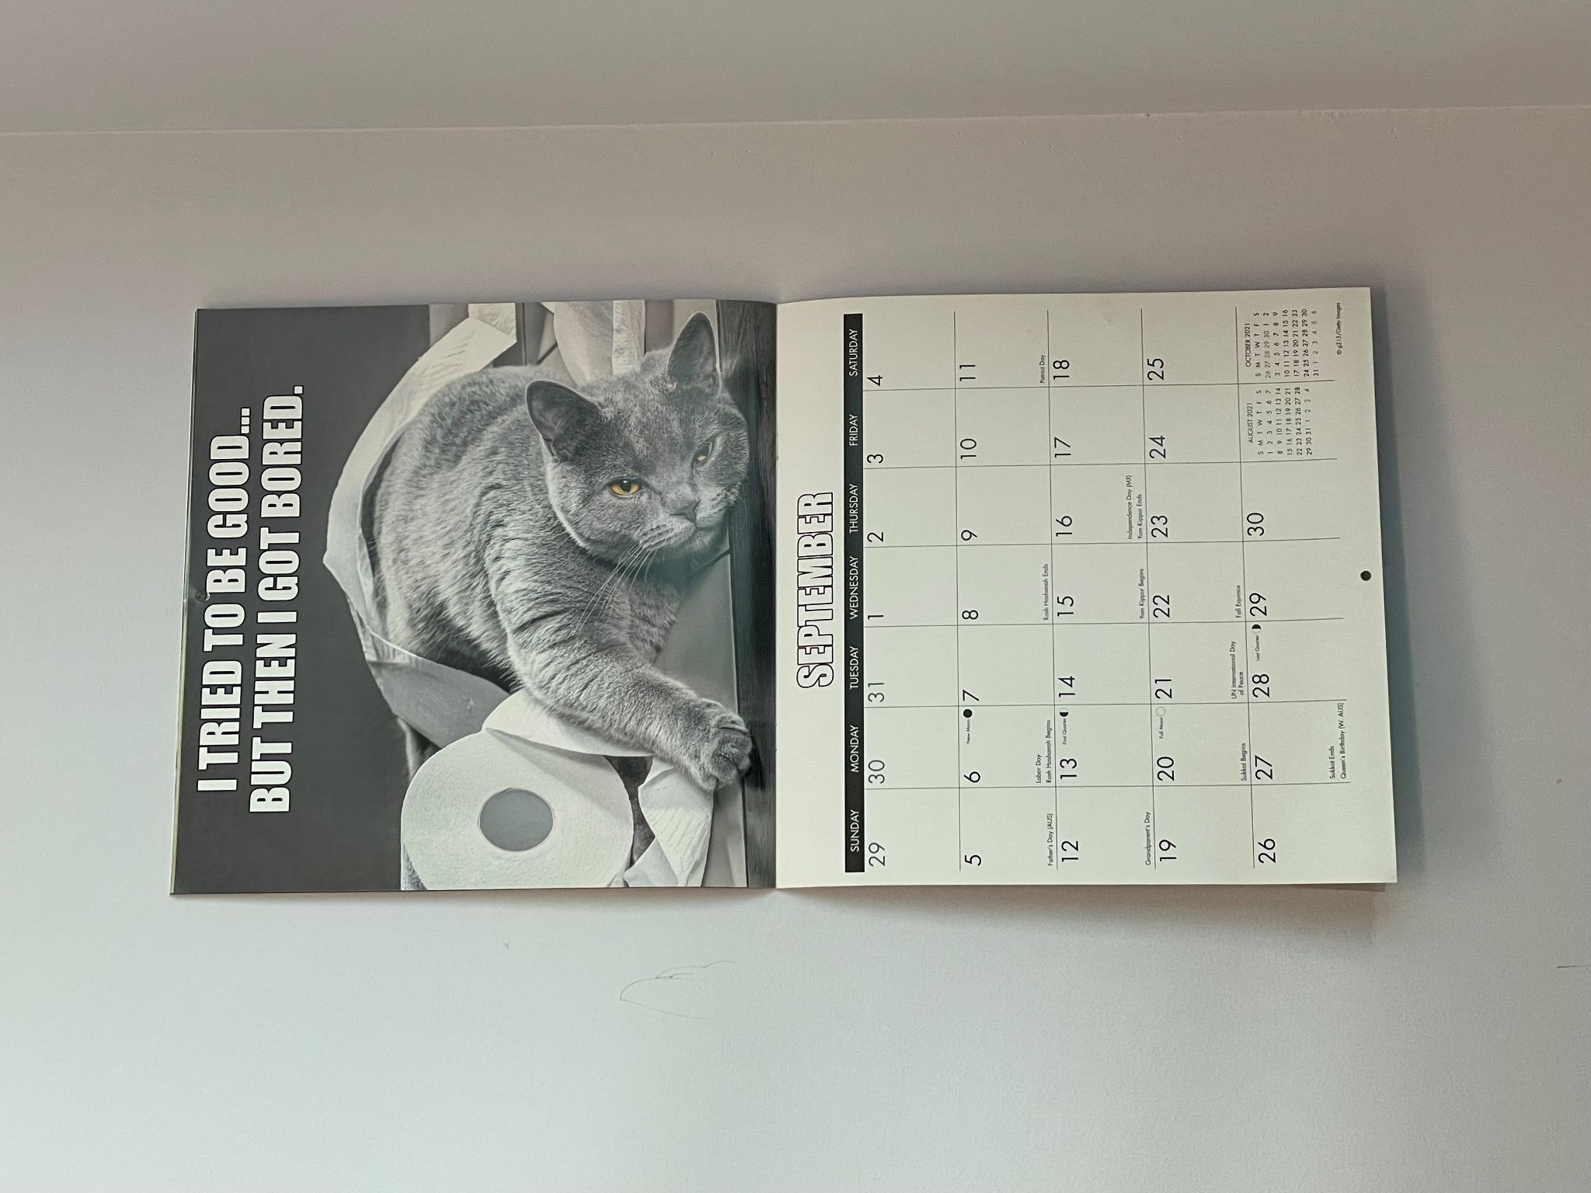
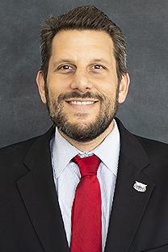
Dr. Larry Faerman
Interim Vice President
Student Affairs and Enrollment Management

Slide 8
Location:Bldg. SU-80, Rm. 214
Phone: 561-297-4941
Email: firstgenprogram@fau.edu
First-Generation
Student Success
The term “first-generation college student” is defined as a college student whose parents have not obtained a degree from a four-year college or university.
Goal: to connect students to resources available at Florida Atlantic University that better support and assist in their development as a student beyond average expectations!
The Office of First-generation Student Success serves as the first of its kind as an inclusive hub that serves as representation for the first-generation student, and programs containing resources that can benefit and most importantly, motivate students towards a successful college experience.

Slide 9

Jordan DiPentima
Assistant Director
New Student Orientation

Slide 10
2021 Orientation Leaders

Slide 11


Slide 12
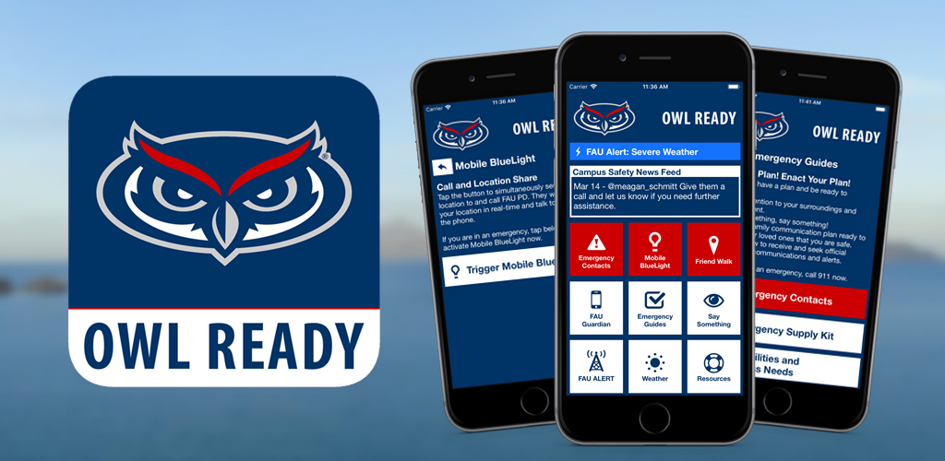

Slide 13
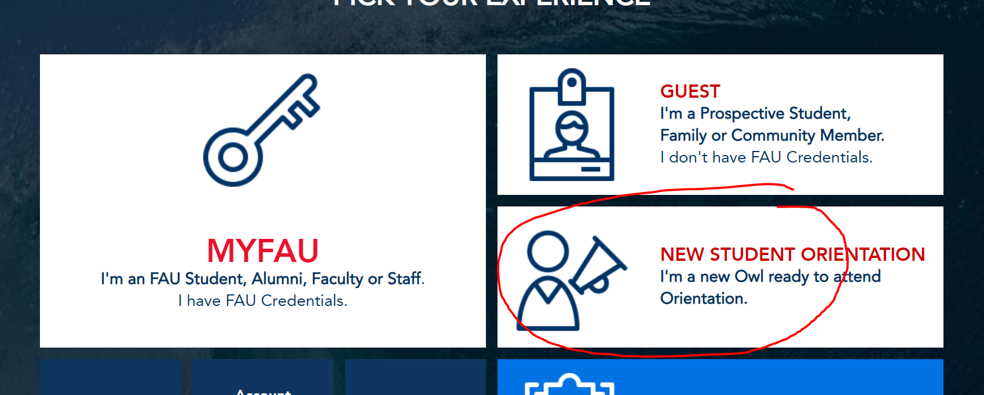
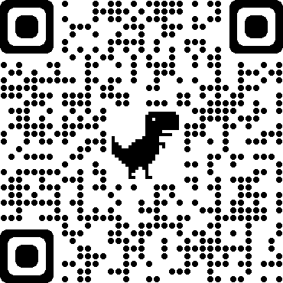
Visit MYFAU

Slide 14
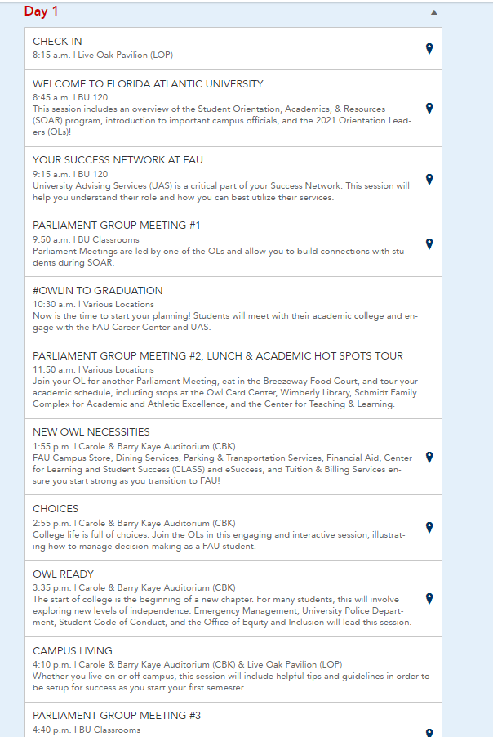
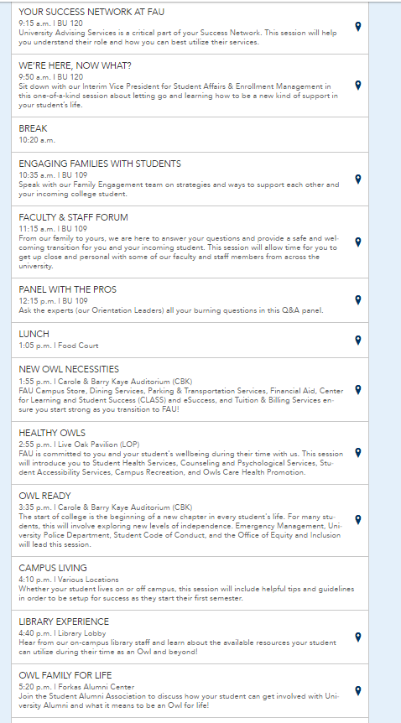
Student
Family

Slide 15
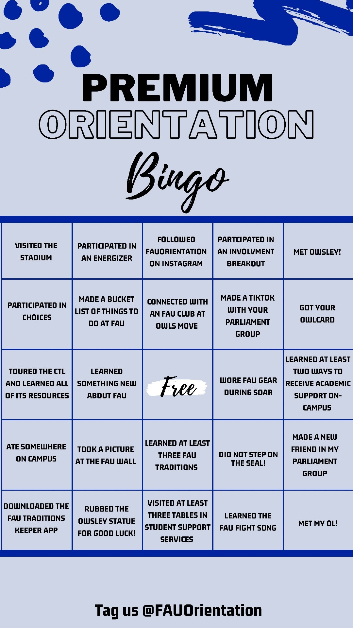
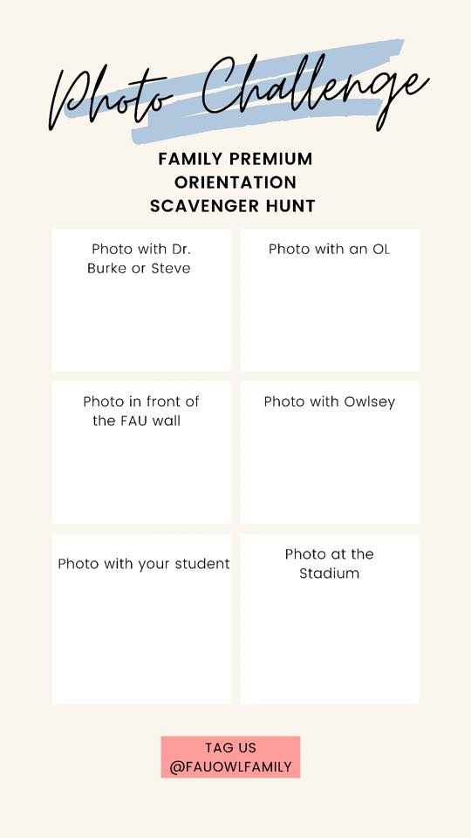

Slide 16
