Slide 1


Slide 2




Slide 3
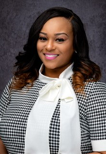
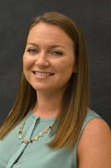
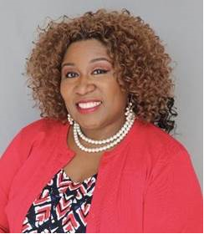
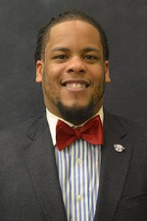

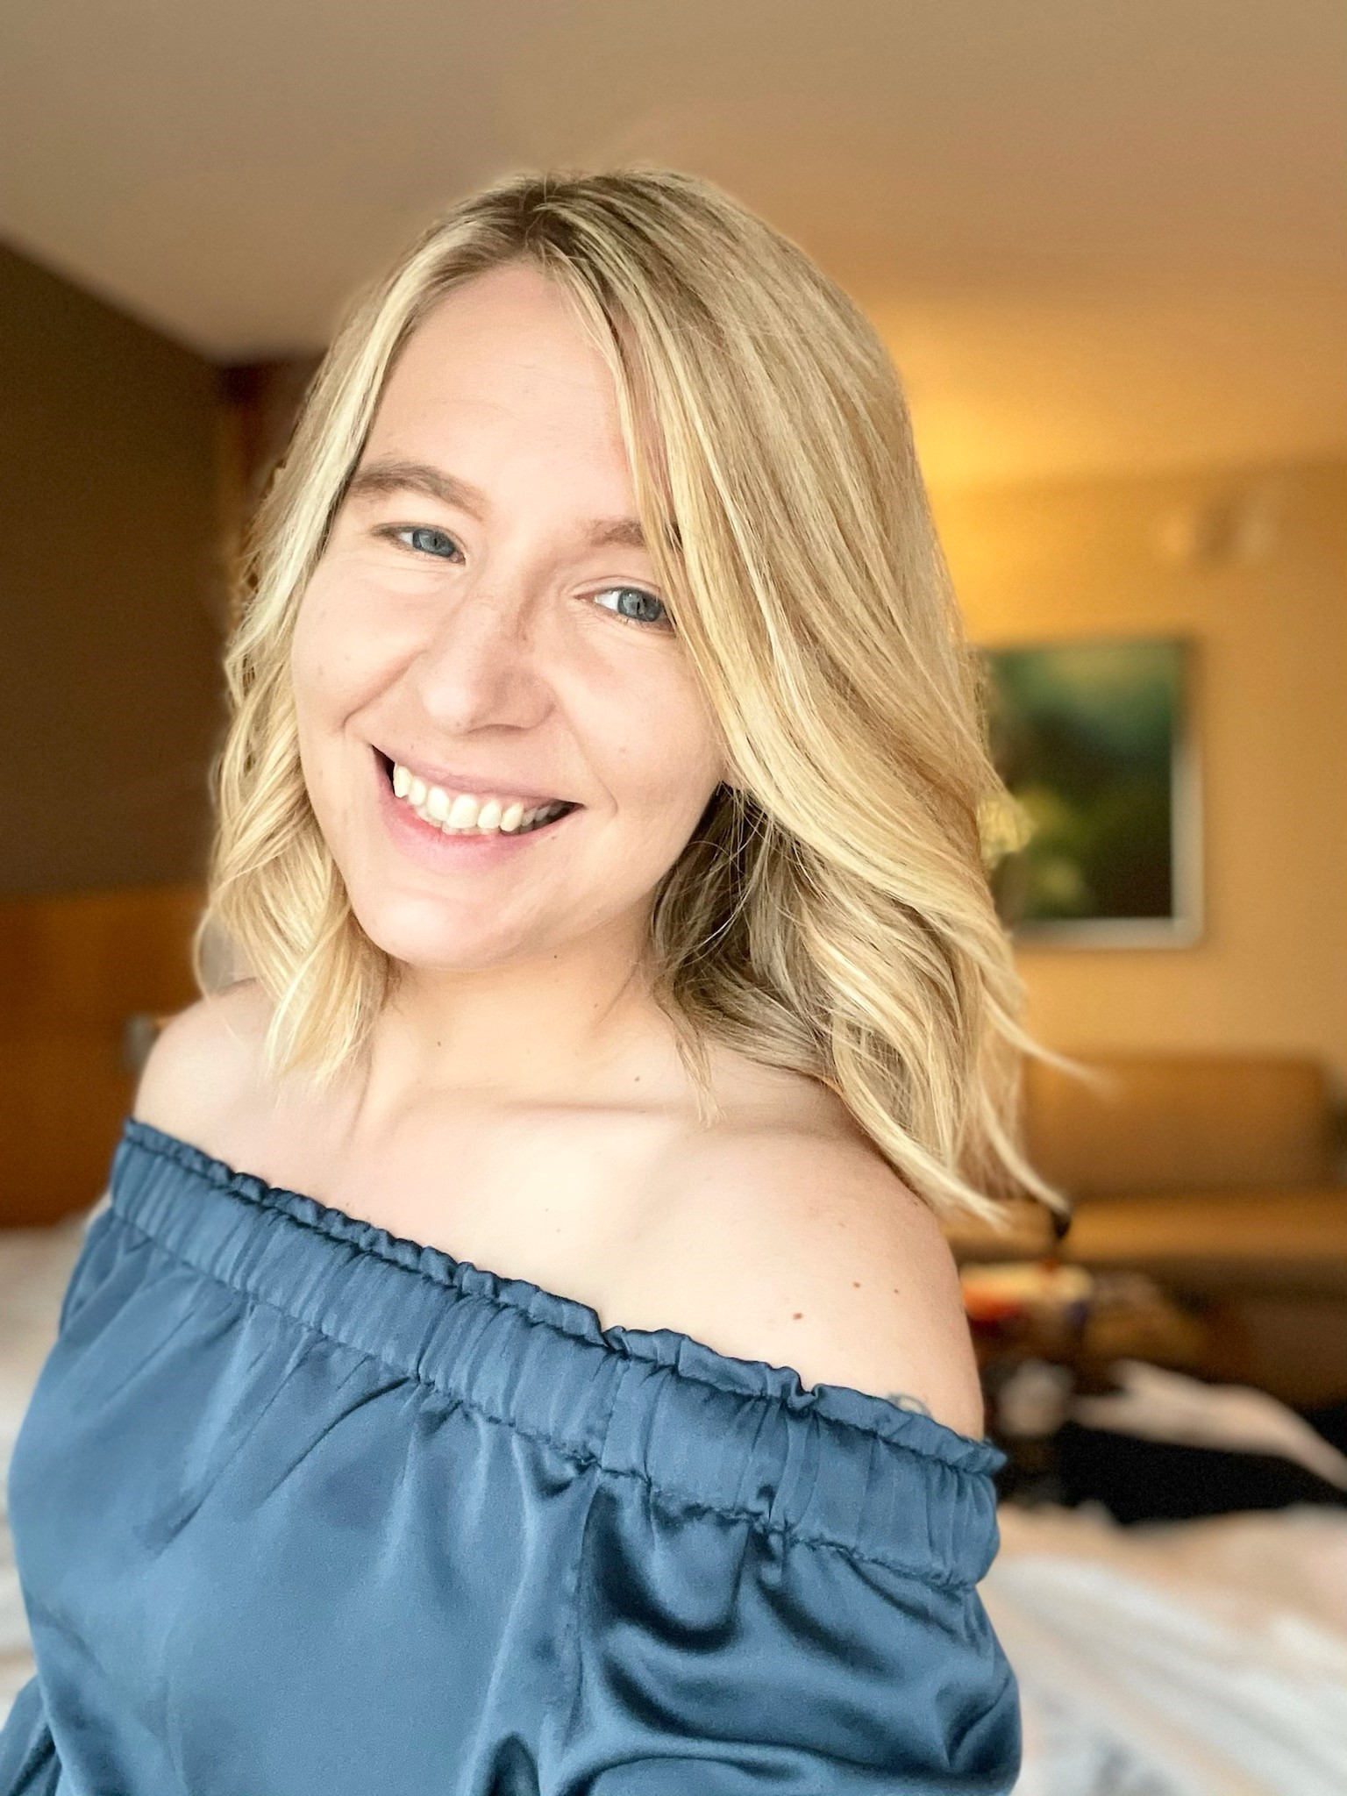
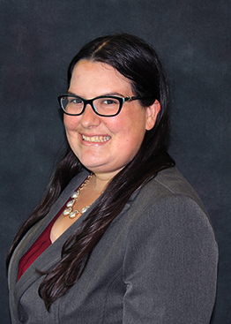
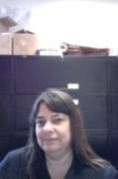

MEET THE TEAM!
Donald Van Pelt
Director, SAI
Area of focus:
SAI Leadership
Student Government
Tikiya Henry
Associate Director, SAI
Area of focus:
Student Government
Elaine Jordat
Associate Director, FSL
Areas of focus:
Panhellenic
IFC
Ebony Lamar
Assistant Director, FSL
Areas of focus:
NPHC
MGC
Lindsey Goldstein
Assistant Director Weppner Center, SAI
Area of focus: Service , Civic Engagement
Marian Williams
Office Manager, SG
Area of focus:
SAI office Operations Human Resources
Richard Mahler
Assistant Director, SAI
Area of focus:
Programming, Traditions, Mascot, Homecoming
Renee Fellinger
Assistant Director, SAI
Area of focus:
Student Organizations Graduate and Professional Student Association
Connect with us on Social Media!
@fauinvolvement
@sgatfau
@pbfau
@FAUFSLIFE
Stop by our office on the second floor
of the Student Union, room 220

Slide 4

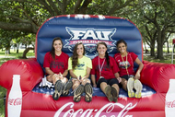
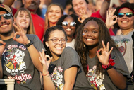
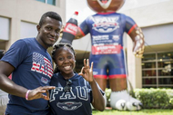
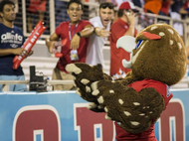
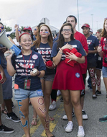

WHAT IS INVOLVEMENT?
INVOLVEMENT

Slide 5

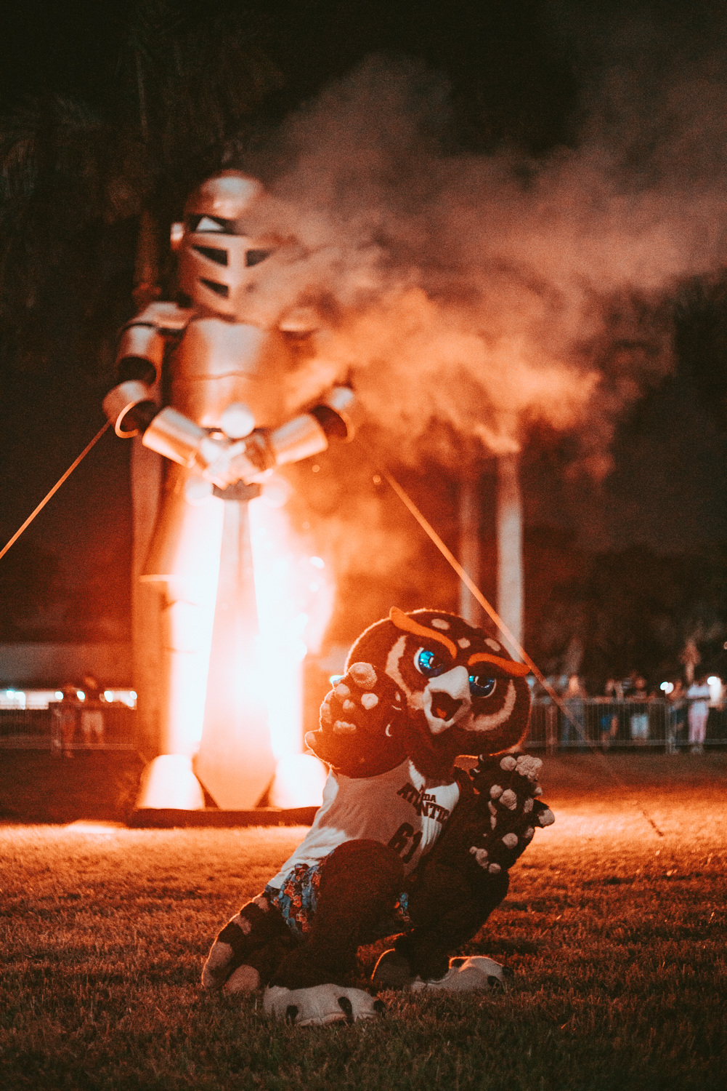
WHY IS INVOLVEMENT
IMPORTANT?
Students involved in at least one activity or organization outside of the classroom:
- Have better grades
- Improve time management and intrapersonal skills
- More marketable to future employers and graduate programs
- Create long lasting friendships and connections
- Gain transferrable skills
45% of the 2019-2020 first year cohort were involved in at least 1 student organization.
With over 400+ organizations, and up to three governance positions in each, there are over 1200 opportunities for you to lead!

Slide 6
WHAT IS AN ACTIVITY &
SERVICE FEE?

Slide 7

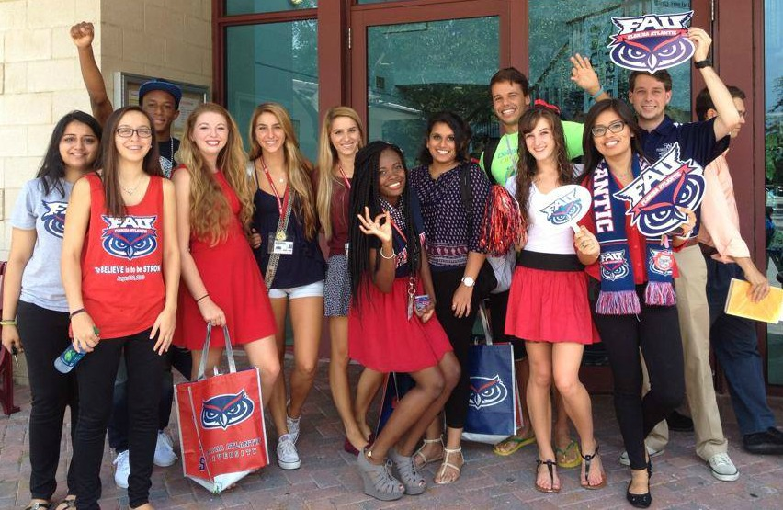
REGISTERED STUDENT ORGANIZATIONS
QUICK FACTS
Florida Atlantic University is home to over 400 unique
registered student organizations (RSO)
These organizations plan over 5000 events annually
Average GPA is 3.2 or higher
Organizations are arranged into the following Councils:
Academic
Multicultural / Spiritual
Special Interest
Sports Clubs
Fraternity & Sorority Life

Slide 8
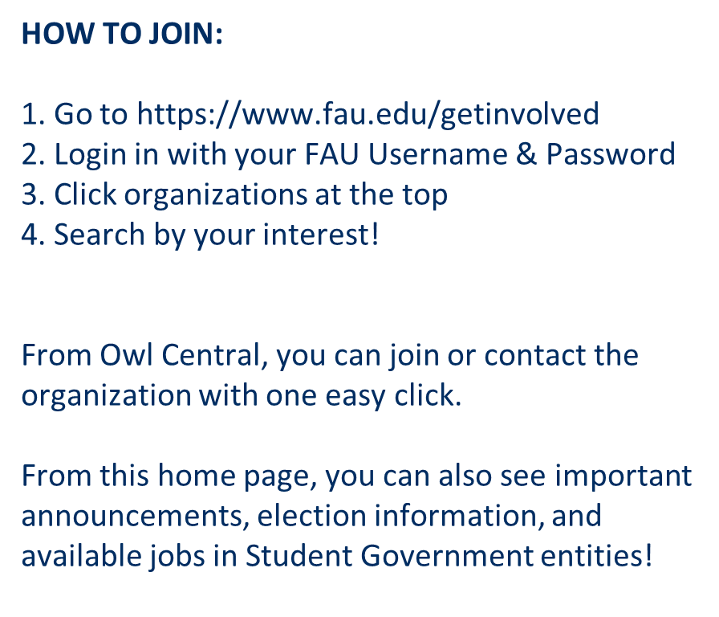
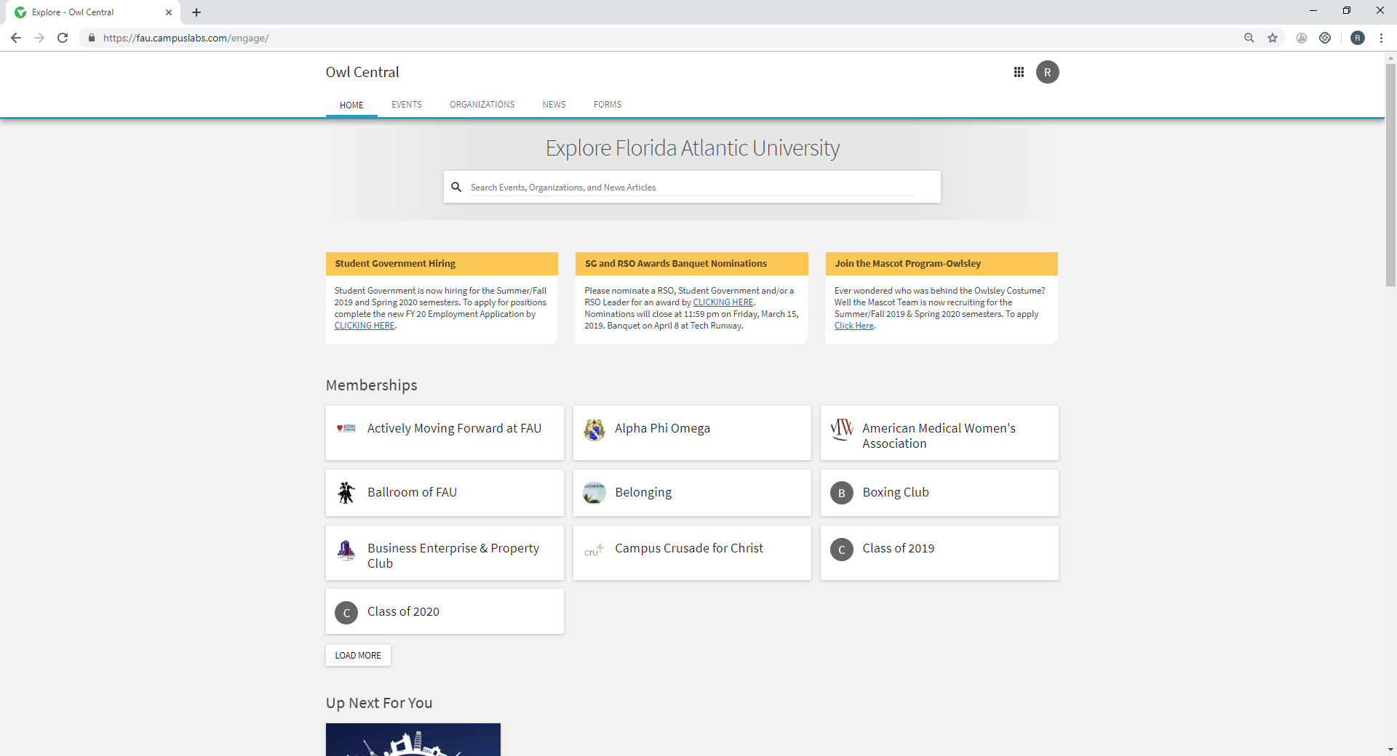
REGISTERED STUDENT ORGANIZATIONS
SEARCH HERE
OR HERE
IMPORTANT ANNOUNCEMENTS
Prefer to use an app? Download the free CORQ app,
your mobile home for Owl Central and FAU Involvement.

Slide 9
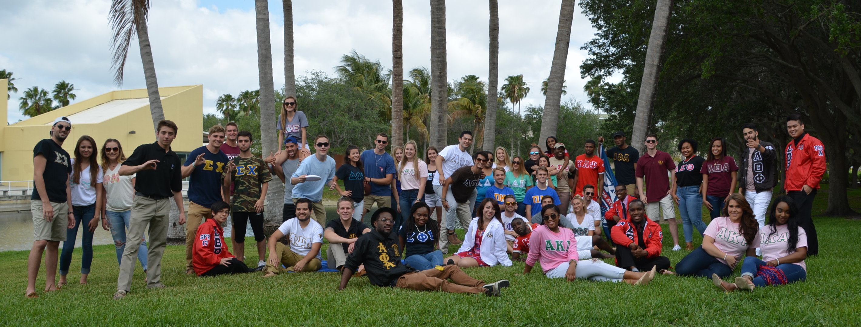
FRATERNITY AND SORORITY LIFE
College Panhellenic Association
National Pan-Hellenic Council
Interfraternity Council
United Greek Council
Fraternities and sororities are about friendship, scholarship, community service, and leadership.

Slide 10
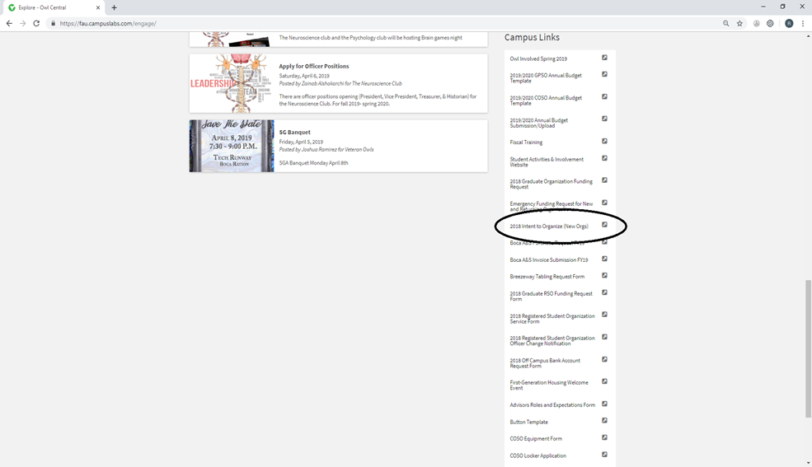
REGISTERED STUDENT ORGANIZATIONS
CREATE YOUR OWN ORGANIZATION
1. Go to https://www.fau.edu/getinvolved
2. Login in with your FAU Username & Password
3. Scroll to the bottom right and click Intent to Organize
What you need?
President, Vice President, Treasurer, and Advisor

Slide 11
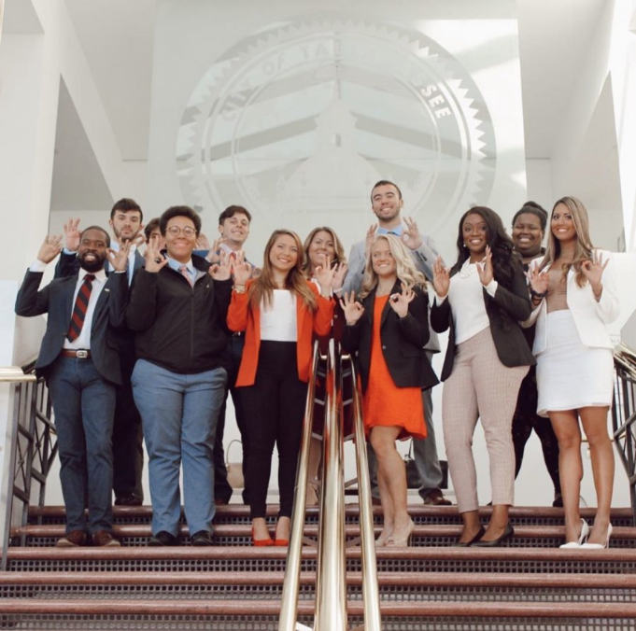
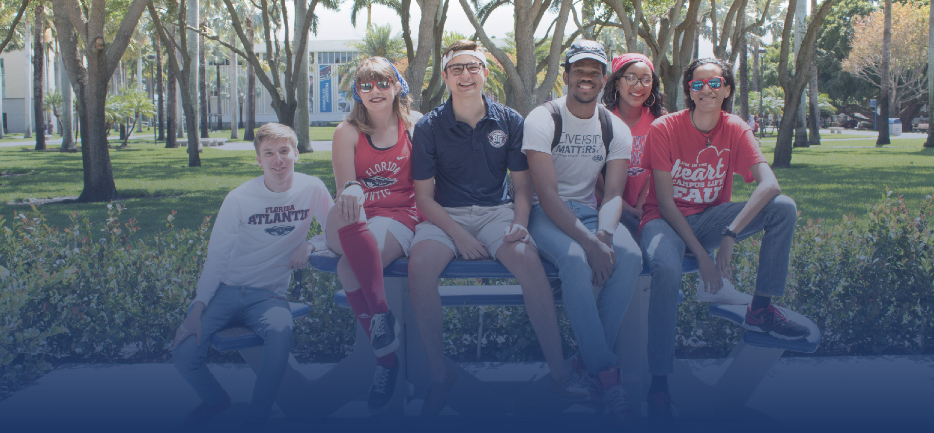
STUDENT GOVERNMENT
Three branches of Governance
Executive Branch
Legislative Branch
Judicial Branch
Signature Services
SG Scholarship
Owl Ride with Lyft
FAU Owl Perks
FAU Lazy Texts
SG Parking Citation Forgiveness
Research Poster Printing

Slide 12
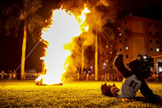
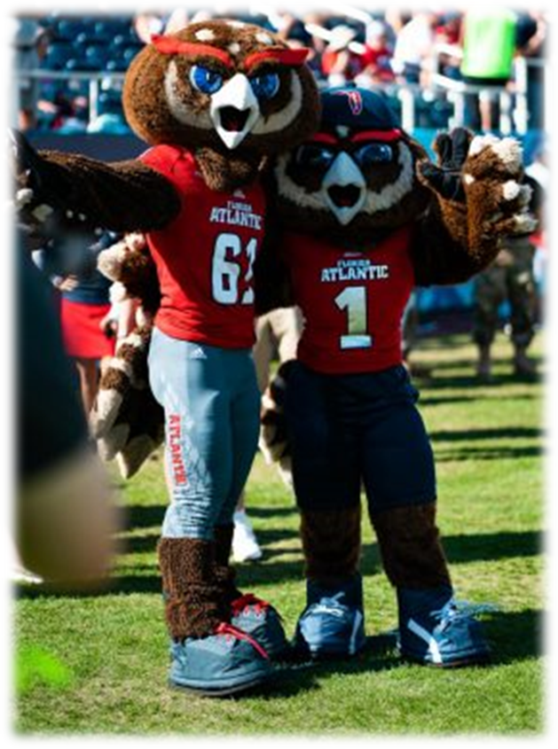
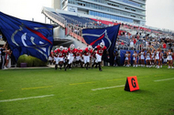
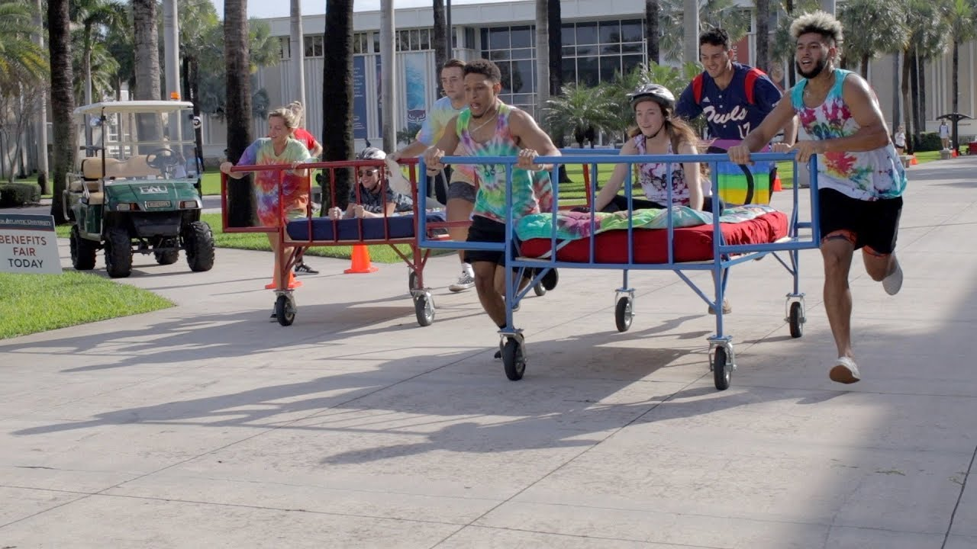

TRADITIONS
YOUR INVOLVEMENT GUIDES YOU TOWARD THE FUTURE
BLUEsday
Homecoming
Bed Races
Drag Show
Sunshine State Classic Step Show
Annual Bonfire
Festival of Nations
Come See Owlsley and Hoot around campus!
@owlsleyandhoot
@fauinvolvement

Slide 13
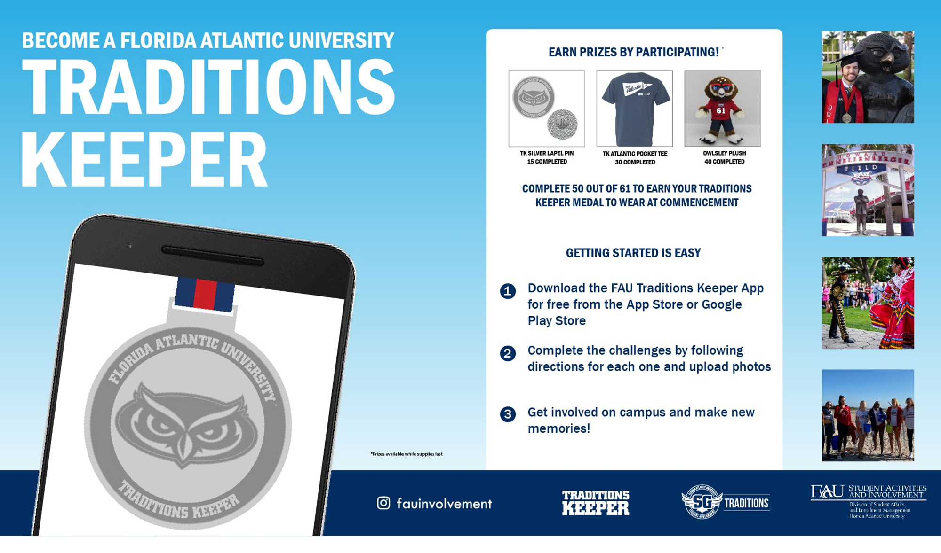

Slide 14
Learning Outcomes
•Understand the different opportunities available within a student organization on campus.
•Learn about the many entities of the Student Government including Activities and Service Fees, leadership roles, Learn about campus traditions, Weeks of Welcome, Homecoming, and Greek Life.
•Through Owl Central, learn the different ways to navigate joining an RSO, applying for jobs within the Student Government, and starting an organization of their own.

Slide 15
QUESTIONS?

