Slide 1

Sean Brammer
Chief of Police
www.fau.edu/publicsafety

Slide 2

Police Department Services
Victim Services
Rape Aggression Defense
Emergency Blue Light Phones
Emergency Alert System
“Owl Ready” – Safety App.
Night Owls Program
Lost & Found/Property Registration
Fingerprinting

Slide 3
Crime Prevention
TIPS
While in buildings and dorms…
Do not let strangers into buildings anytime keep your room secure
Do not prop doors open
Do not lend anyone your Owl Card, drivers license or room keys
Do not leave valuables out in the open
Know where you are at all times
Avoid internet scams

Slide 4
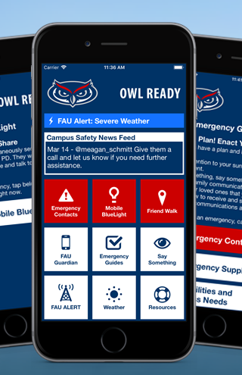
Safety Resources
RAD/Flip the Script
Blue Light Phones
Owl Ready
Night Owls (561-297-NOWL)
Lost and Found Property Registration
Extra security in order to gain access into the residential halls

Slide 5
Reporting an incident
Anyone can file a report!
Silent Witness
See something
(or hear something),
SAY SOMETHING
Three ways:
FAU PD - for emergencies or non-emergency incidents
DOS office – walk-ins, email and phone contacts
Online at: fau.edu/report/

Slide 6
In the event of an emergency, dial
9-1-1

Slide 7
Police Department
Contact Information
Non-Emergency
(561) 297-3500
Victim Advocate
(561) 297-0247
Victim Services
(561) 297-0500
Lost & Found
(561) 297-2174
C.O.P.S. Center
(561) 297-4894
Harbor Branch
(772) 216-1124
Jupiter
(561) 799-8700
Davie
(954) 236-1140
Ft. Lauderdale
(954) 201-7963
Dania Beach
(954) 924-7000

Slide 8

See something
Say something!!!
Enjoy a fantastic college experience
Be Prepared, Not Scared

Slide 9
