Slide 1

Owl Ready
Be prepared. Be safe.

Slide 2

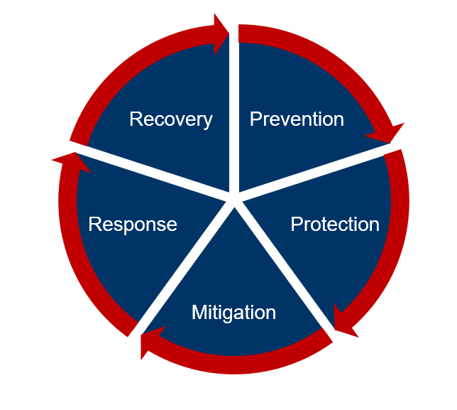
Our mission is to coordinate and facilitate Florida Atlantic University’s emergency preparedness, response, recovery and mitigation activities to protect our students, faculty, staff, resources and infrastructure in order to maintain or restore University operations.

Slide 3
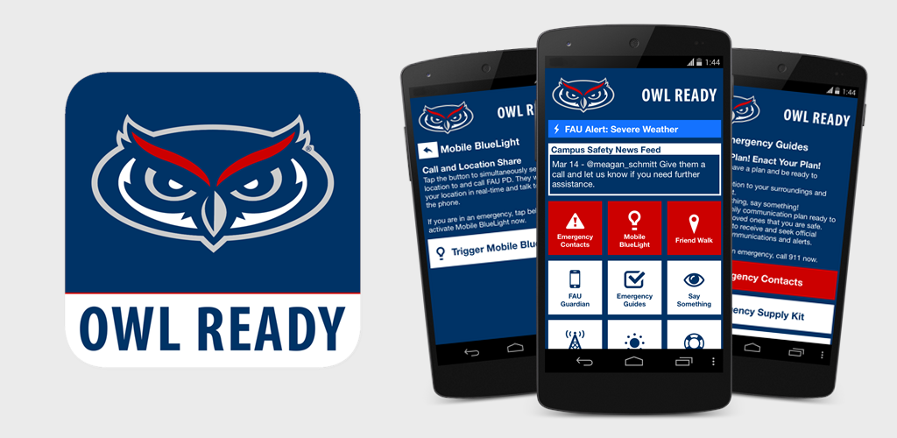

Owl Ready App
Easily Access Emergency Contacts
Turn Your Phone Into A Mobile Blue Light
Emergency Guides for Many Situations
  Emergency Kits, Disabilities and Access Needs, Evacuation, Shelter in Place, Emergencies: Weather Emergencies, Physical and Psychological Threats, Medical, Facilities-related, HazMat, etc.
FAU Guardian
Current Weather Updates
Language Translation
See Something, Say Something

Slide 4
Have a Plan
Know what to do
Know when to do it
Know where to get information
Know how to communicate and with whom & when
Disasters Don’t Wait
Make Your Plan Today.
Download and fill out a family emergency plan or use it as a guide to create your own.
  https://www.ready.gov/plan

Slide 5

Emergency Notification & Information
FAU Alert
Owl Ready App
FAU Hotline
FAU Advisory
FAU Facebook
FAU Twitter
1-888-8FAUOWL
SEEK SHELTER/SAFETY THEN SEEK INFORMATION

Slide 6

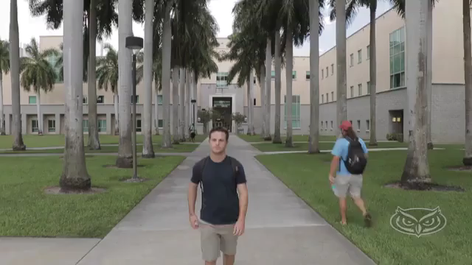

Slide 7



REPORT SUSPICIOUS ACTIVITY

Slide 8
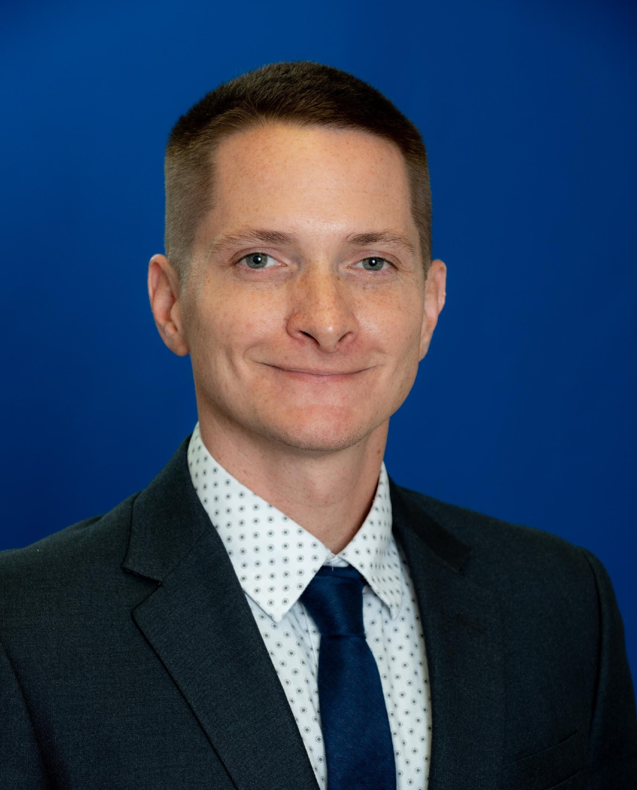
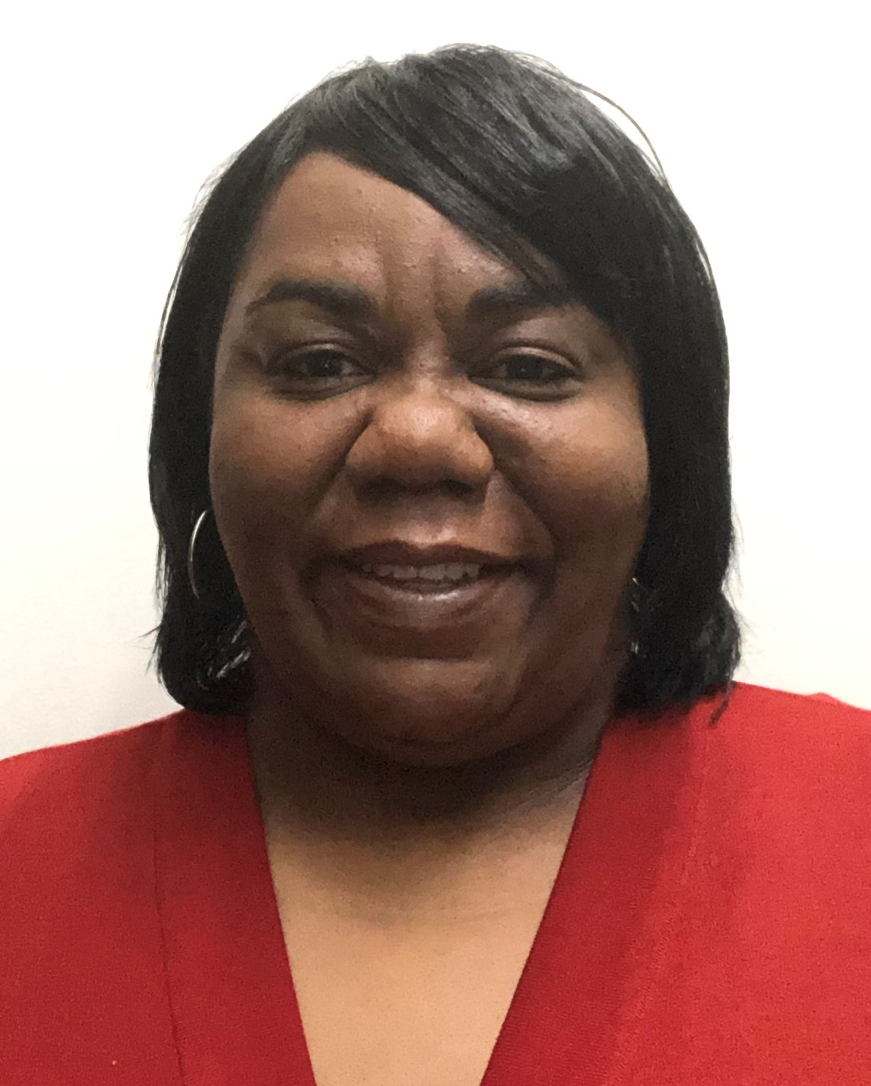
Contact Us!
Jaeson Weber
Melonie Carmichael
Director
Coordinator
Department of Emergency Management www.fau.edu/emergency
em@fau.edu

Slide 9


Have a Plan
  Know what to do
  Know when to do it
  Know where to get information
FAU Alert
  MyFAU
  1-888-FAUOWL
Owl Ready App
Be prepared. Not scared.

Slide 11
Prohibited Discrimination and Harassment at FAU

Slide 12
Who we are…
Office of Equity and Inclusion
Administration Building, Room 265
Our office investigates complaints of discrimination, harassment,
sexual assault and other types of sexual misconduct.

Slide 13
Why are we here?
To provide you with information on the University’s policies and regulations relating to discrimination, harassment, and Title IX Matters.
To discuss reporting and investigative processes.
To provide information on the resources available to all students.

Slide 14
FAU Prohibits Discrimination
+ Harassment
All forms of discrimination or harassment based upon an individual’s race, color, religion, sex, national origin, age, disability, veteran status, marital status, pregnancy and parenting status, sexual orientation, gender identity or expression, or other protected status is a violation of University Regulation.
Title IX Matters refers to discriminatory conduct that includes sexual harassment, sexual assault, dating violence, domestic violence, and stalking. Such conduct is expressly prohibited.

Slide 15
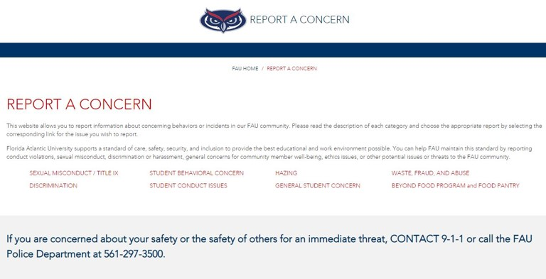
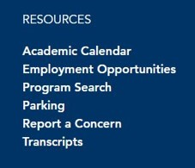
How do I make a report?
Visit www.fau.edu/report or select “Report a Concern” from main FAU homepage.

Slide 16
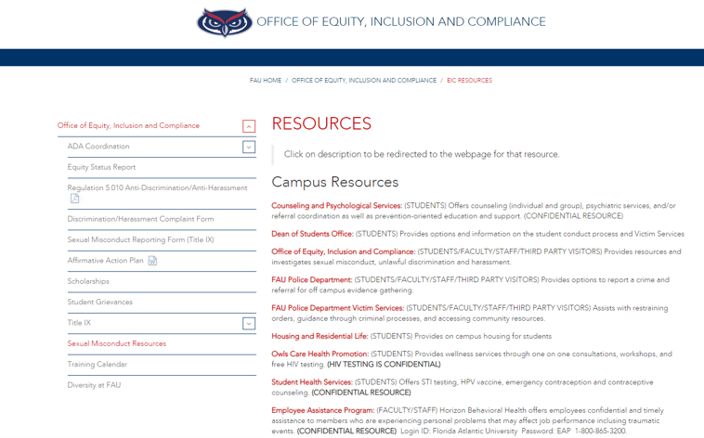
What are the available resources?
Visit www.fau.edu/eic/resources
Or
http://www.fau.edu/dean/victimservices
for more information about resources available
on and off campus.

Slide 17
What happens after I make a report?
Upon receiving report of discrimination or harassment, OEI ensures parties are provided with supportive measures.
OEI determines whether it has enough information to begin an investigation. If yes, OEI will follow procedure outlined in Policy 1.15.
Final investigation report submitted to appropriate administrator.
If a violation is determined in non-Title IX matters, the Administrator will issue corrective action. All Title IX Matters are referred to a hearing to determine the outcome.

Slide 18

  How/What to report
  Where to get help
  Be Aware
Office of Equity and Inclusion
561-297-3004
Protect your Owl Family!

Slide 19
Responsible Freedom
Audrey L. Pusey, Interim Dean of Students
Ryan Iocco, Assistant Director for Student Conduct

Slide 20
Dean of Students Office
We Advocate for Students
Questions, Concerns?
Come see us!
Services
Food Pantry
Exceptional Circumstance Withdrawal
Student Crisis Intervention
Victim Services
Respondent Services
Medical Amnesty
Academic Integrity Seminar
Student Code of Conduct
Conflict Resolution and Mediation

Slide 21
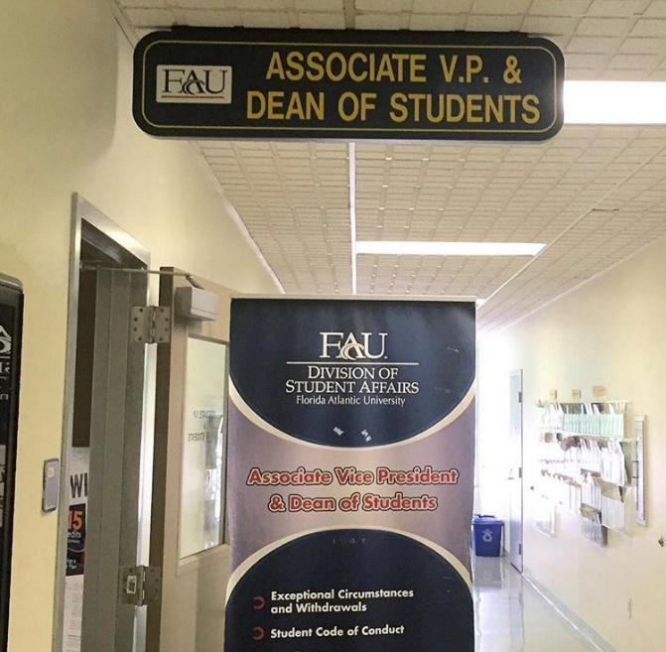
Dean of Students Office
Student Services Building (SS #8), Room 226
561-297-3542
http://www.fau.edu/dean/

Slide 22

Be Responsible in Your Decision Making
Know the Code! (On and Off Campus)
Regulation 4.007
www.fau.edu/studentconduct/

Slide 23
Student Conduct
Philosophy & Mission
“Helping students who make decisions that are not in
their best interest, to develop into their best self.”
Restorative Justice Focus
Conflict Resolution Skill Building
Conflict Coaching
Facilitated Dialogue
Formal Mediation

Slide 24
Assessment of Violations of the Code of Conduct
Partner with university departments to triage and assess immediate risks:
Immediate measures via Dean of Students
Safety planning
Support of impacted individuals
Referrals to various campus departments (CAPS, Student Health, PD)
Possible incidents addressed via the Student Code of Conduct
Residential Community Guide
Student of Conduct (Regulation 4.007)

Slide 25
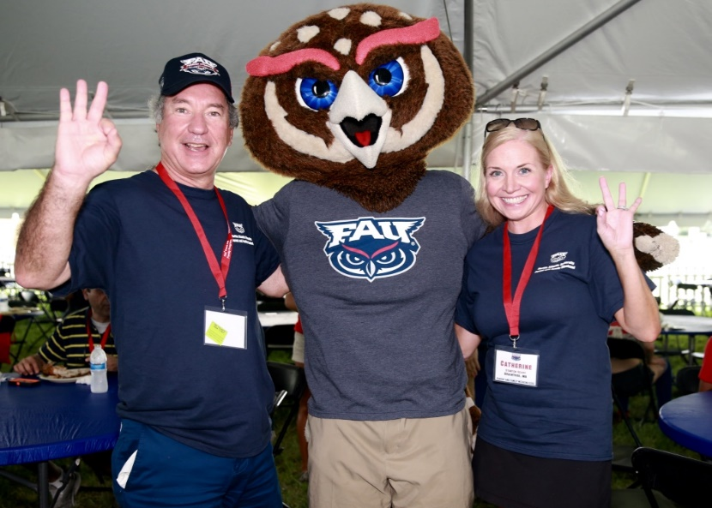
Alcohol Use
If you are under 21, you may not use or possess alcohol.
Hard liquor is not permitted in the residence hall.
Alcohol may not be consumed outside of a residence hall suite.
You may not be intoxicated in the residence hall regardless of age.
Parental Notification
If you are under the age of 21, we will notify your family for violations of our alcohol and drug policies.

Slide 26
Drugs/Controlled Substances Policy
Use, possession, delivery to, sale of drugs or drug paraphernalia.
Penalty – Probation, community service, educational class, and parental notification, removal from the residence halls.
You may be arrested and/or suspended from school on a first violation depending on the incident.

Slide 27
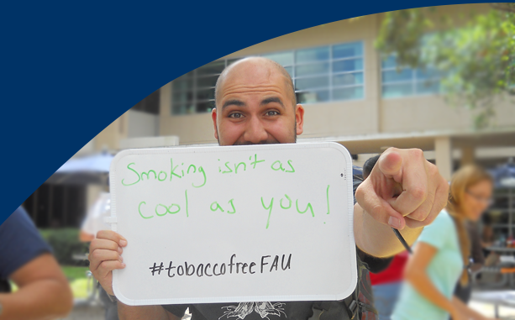
FAU is a Tobacco Free Campus
Use of all tobacco products including: cigarettes, cigars, pipes, smokeless tobacco, snuff, chewing tobacco, smokeless pouches and any other form of loose-leaf, smokeless tobacco is prohibited on all FAU campuses – includes E-Cigarettes and vapes
Includes indoor, outdoor and in vehicles on campus

Slide 28
Victim Services Office
Supports student victims/survivors:
Acting as a liaison between the victim/survivor and FAU
Assisting with navigating campus processes
Referrals to resources
Class and housing accommodations
Safety planning
Guidance with criminal processes
Located in the Wimberly Library, Room 156
http://www.fau.edu/dean/victimservices/
561-297-4841

Slide 29
Respondent Services
Provides guidance, resources, information, and referrals for students who have been accused of sexual misconduct related violations of the Student Code of Conduct or the Anti-Discrimination and Anti-Harassment regulation.
Assist students with understanding their rights.
Aides students in navigating investigation and adjudication processes.
Located in the Dean of Students Office, SS8-226
561-297-3542

Slide 30

“Know the Code”
Academic Dishonesty.
Conduct Record could impact your future jobs and graduate school.

Slide 31
Be an Active Bystander
  Your awareness, and reporting, allows FAU administration to assist with early interventions
Medical Amnesty
Keep your friends safe, call for help
See something! Say something!
  The Dean of Students works closely with our FAU police department to determine immediate safety needs
Be Prepared, Be Safe
Dean of Students Office http://www.fau.edu/dean/

Slide 32

Sean Brammer
Chief of Police
www.fau.edu/publicsafety

Slide 33

Police Department Services
Victim Services
Rape Aggression Defense
Emergency Blue Light Phones
Emergency Alert System
“Owl Ready” – Safety App.
Night Owls Program
Lost & Found/Property Registration
Fingerprinting

Slide 34
Crime Prevention
TIPS
While in buildings and dorms…
Do not let strangers into buildings anytime keep your room secure
Do not prop doors open
Do not lend anyone your Owl Card, drivers license or room keys
Do not leave valuables out in the open
Know where you are at all times
Avoid internet scams

Slide 35
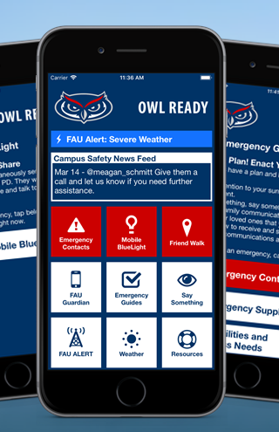
Safety Resources
RAD/Flip the Script
Blue Light Phones
Owl Ready
Night Owls (561-297-NOWL)
Lost and Found Property Registration
Extra security in order to gain access into the residential halls

Slide 36
Reporting an incident
Anyone can file a report!
Silent Witness
See something
(or hear something),
SAY SOMETHING
Three ways:
  FAU PD - for emergencies or non-emergency incidents
  DOS office – walk-ins, email and phone contacts
  Online at: fau.edu/report/

Slide 37
In the event of an emergency, dial
9-1-1

Slide 38
Police Department
Contact Information
Non-Emergency
(561) 297-3500
Victim Advocate
(561) 297-0247
Victim Services
(561) 297-0500
Lost & Found
(561) 297-2174
C.O.P.S. Center
(561) 297-4894
Harbor Branch
(772) 216-1124
Jupiter
(561) 799-8700
Davie
(954) 236-1140
Ft. Lauderdale
(954) 201-7963
Dania Beach
(954) 924-7000

Slide 39
See something
Say something!!!
Enjoy a fantastic college experience
Be Prepared, Not Scared

Slide 40
