Slide 1
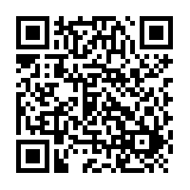
Live Captioning

Slide 2



WELCOME
FAU Campus Store
______________________
777 Glades Rd
Building 76
Boca Raton, FL 33431
561.297.3720
faustore.com
YOU’RE OFFICIAL.
GET GEARED UP!
READY TO SHOW YOUR SCHOOL SPIRIT?
SIGN-UP TO GET YOUR COUPON.
ONLINE OR IN-STORE
The FAU Campus Store has everything you need to prepare for class from orientation to graduation!
DayOneWelcome.com
Access Code: 2076
ONE APPAREL, GIFT OR SUPPLY ITEM*

Slide 3
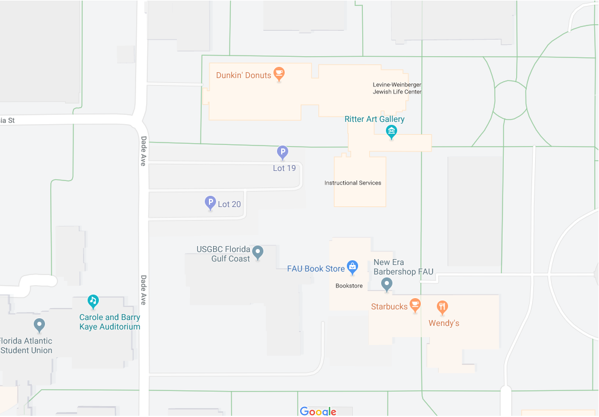

FAU Campus Store
Breezeway (building 76)
Website
FAUStore.com
GET YOUR BOOKSTORE 30% OFF COUPON SIGN UP NOW AT DayOneWelcome.com / ACCESS CODE: 2076

Slide 4

THE BEST PLACE FOR TEXTBOOKS
Why buy textbooks from us?
We work directly with faculty
We carry every book and supporting material you’ll need
Options: Rental, digital, used or new
Use financial aid funds in-store and online
Online and in-store
We price match against Amazon and most local competitors.* Find a cheaper advertised price within seven days, and we’ll give you the difference on a gift card.
TEXTBOOK OPTIONS!
Rental
Digital
Used
New
*Restrictions apply, see store for details.
GET YOUR BOOKSTORE 30% OFF COUPON SIGN UP NOW AT DayOneWelcome.com / ACCESS CODE: 2076

Slide 5

HOW TO FIND YOUR TEXTBOOKS
DIRECT
Follett Discover tool through Canvas
Inclusive access Program
IN-STORE
Textbooks are available in-store by Shop-by-Author
ONLINE
On our website, faustore.com
REQUIRED
Necessary materials requested by your Instructor (or Department)
RECOMMENDED
Optional materials requested by your Instructor (or Department)
SUGGESTED
Bookstore-suggestions based on previous students’ purchases
GET YOUR BOOKSTORE 30% OFF COUPON SIGN UP NOW AT DayOneWelcome.com / ACCESS CODE: 2076

Slide 6

FINANCIAL AID & THE BOOKSTORE
Bookstore funds can be used online and in store for textbook purchases at the FAU Campus Store.
Students must authorize Title Financial Funds for non institutional expenses under the Money Matters tab on MyFAU.FAU.edu.
Aid-Eligible Items
Textbooks (new, used, rental, digital)
GET YOUR BOOKSTORE 30% OFF COUPON SIGN UP NOW AT DayOneWelcome.com / ACCESS CODE: 2076

Slide 7




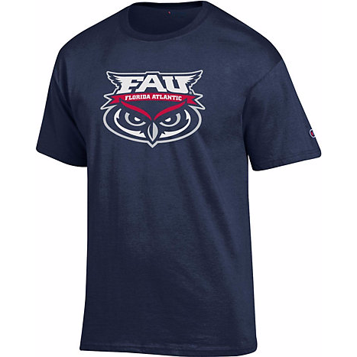

THE BEST PLACE FOR GEAR
OWL PRIDE!
Simply Put: We have the best selection of Florida Atlantic University stuff anywhere.
T-shirts, Sweatshirts, Hats
Decals, Lanyards, Mugs
Notebooks, Pens, Pencils, Binders
Snacks, Energy Drinks, Soda
computers, software, headphones, chargers
Charging station, Wi-Fi
And more…
GET YOUR BOOKSTORE 30% OFF COUPON SIGN UP NOW AT DayOneWelcome.com / ACCESS CODE: 2076

Slide 8
THANK YOU!
SIGN UP NOW TO GET YOUR COUPON FOR
30% OFF
ONE APPAREL, GIFT OR SUPPLY ITEM*
VALID ONLINE OR IN-STORE
FAU Campus Store
______________________
777 Glades Rd
Building 76
Boca Raton, FL 33431
561.297.3720
faustore.com
DayOneWelcome.com
Access Code: 2076
*This is not a coupon. Please sign up using the web address to receive one.

Slide 9


Slide 10

FAU Business Services
Owl Card
Parking and Transportation
Copy Center
FAU Barbershop
FAU Campus Store
Dining and Meal Plans

Slide 11

FAU Owl Card – Why and How to Get Yours
Why do you need an Owl Card?
Access to your meal plan and Owl Bucks
Library access
Your official FAU ID
Swipe into labs, classrooms, and buildings

Slide 12
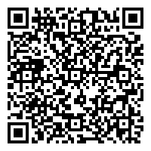
Obtaining Your Owl Card
Online
You may request your Owl Card online using this QR code
In Person
Visit one of our locations (Boca Raton, Jupiter, Davie)
Check our website for current operating hours
Before Receiving an Owl Card
Must be registered for at least one class
Bring a valid, original, government issued picture ID (i.e., driver’s license or passport)
Lost or damaged Owl Card
Replacements are $15 each charged to your student account
Visit or contact the Owl Card Center office for your replacement

Slide 13

Parking and Transportation
ALL vehicles parked on campus MUST be registered with FAU Parking
The Transportation Access Fee includes your virtual parking permit
Know where you can park
Resident students park in Green lots
Commuter students park in Blue lots
Find permit registration form, parking rules and regulations, parking maps and more:
fau.edu/parking
Transportation Services
Buses will require a face covering and seating will be limited to enforce physical distancing.
Current routes and schedules can also be found on our Parking website

Slide 14
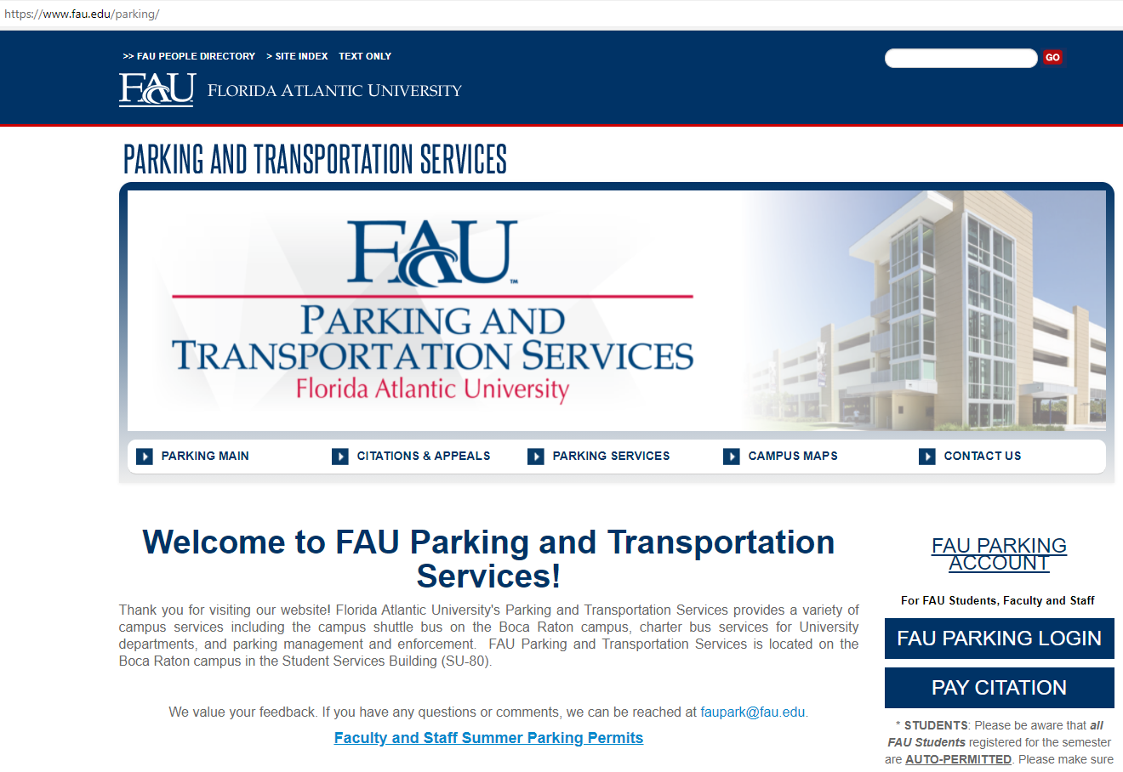
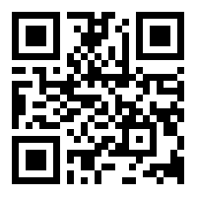
Register Your Vehicle with FAU
Visit fau.edu/parking (or QR code)
Click “FAU Parking Login”
Login using your FAU credentials

Slide 15
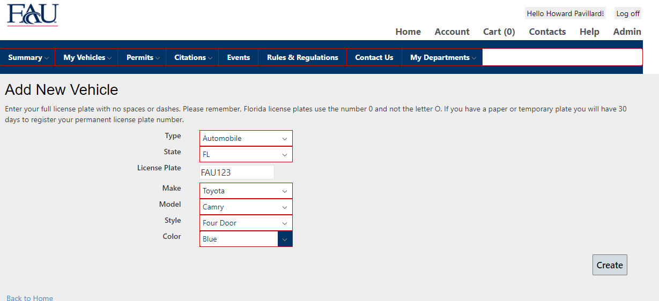
Register Your Vehicle with FAU
Click “My Vehicles” the “Add Vehicle”
Fill out the information requested
Verify your State and Plate
Click “Create”
Vehicle is now attached to your account

Slide 16
Parking Questions
Email us at faupark@fau.edu
Call us at 561-297-2771
Visit our website at fau.edu/parking
Location: Student Support Services (SU-80) – First Floor
Transportation Services
Buses will require a face covering and seating will be limited to enforce physical distancing.
Current routes and schedules can also be found on our Parking website

Slide 17
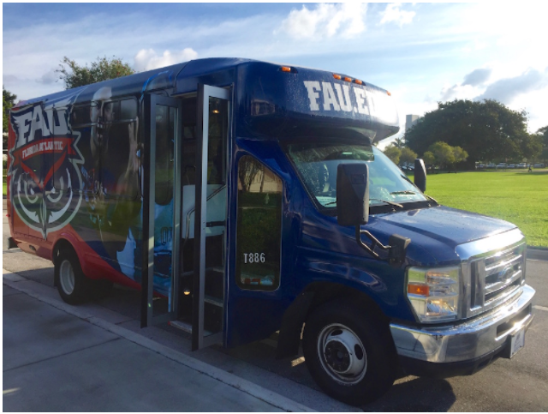
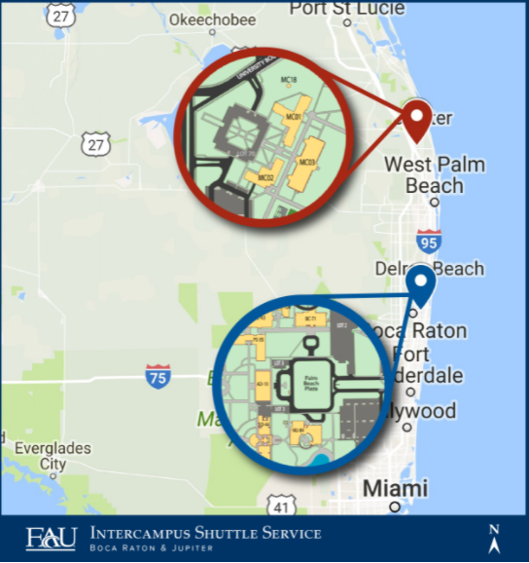
Transportation Services
Shuttle Routes
Boca to Jupiter
Owl Express (Boca Raton Campus)
Shuttle Tracking (fau.etaspot.net)
Palm Tran Route 94 (FAU to Tri-Rail)

Slide 18
FAU Campus Store -- Copy Center -- Barbershop
FAU Campus Stores are located on the Boca and Davie campuses
Books and supplemental materials for your courses
Items can be ordered online and through the store
FAU Campus Store is also your school spirit store
Copy Center
Not only copying – other services include binding and graphic design.
Barbershop
Full service barbershop on the Boca Raton campus
Appointments are strongly encouraged

Slide 19
FAU Business Services
Please visit us at our site below or email us anytime
http://www.fau.edu/business-services/
Email: bizsevices@fau.edu

Slide 20


Slide 21

Atlantic Dining Hall / Jupiter Dining Hall
All you can eat with a great variety of favorites and flavors.
Let us serve you! – Our dining halls are still all you care to eat.
Let us cook for you, stay on campus.
Breakfast, lunch, and dinner are served weekdays with brunch and dinner on weekends.
We are closed in between meal periods for deep cleaning and disinfection.
Grab and go options available to keep you moving through your day.
Most of all – a great value anytime you want to eat.

Slide 22

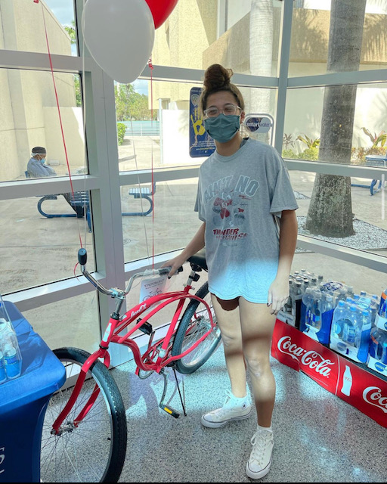
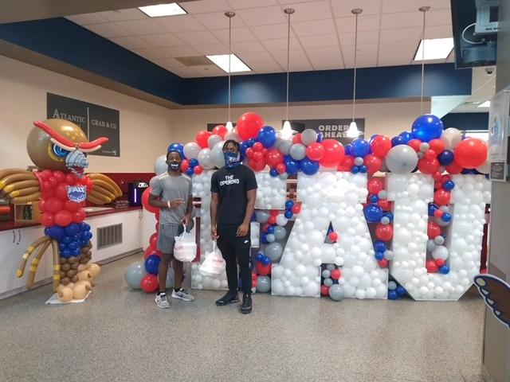
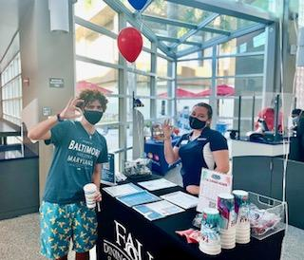
EVENTS
2 x a month
Music
Decor
Theme Meals
Great Food
Entertainment
Games
Raffles

Slide 23
Dining Plans - Residential Students
Residential Meal Plans - Boca Raton Campus (Per Semester)
19 Meals a Week $1,951.00
15 Meals a Week and $100 in Flex Bucks $1,846.50
12 Meals a Week and $100 in Flex Bucks $1,646.00
7 Meals a Week and $550 in Flex Bucks $1,990.50
Residential Meal Plans – Jupiter Campus (Per Semester)
19 Meals a Week $2,070.00
14 Meals a Week $1,948.00
◊ Meals are for the Atlantic Dining Hall and Jupiter Dining Hall.
◊ Flex Bucks can only be used at dining locations, they are issued one time per semester, and expire at the end of the semester.
◊ Meal plans reset every Sunday.

Slide 24

Commuter Students – Profiler Meal Plans and Owl Bucks
Profiler Meal Plans can be used at the Atlantic Dining Hall and the Jupiter Dining Hall – These meals do not expire throughout the year and only expire after one year of inactivity.
30 Meals $247.17
50 Meals $348.82
85 Meals $569.33
110 Meals $700.85
Owl Bucks
Pre-paid declining balance account for use at any FAU Dining location and the FAU Bookstore
May be added to any meal plan
Do not expire

Slide 25



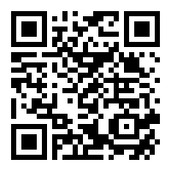
Where to Eat (Summer 2021)
Starbucks
Chick-fil-A
Subway
Outtakes

Slide 26




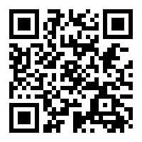
Where to Eat (Fall 2021)
Atlantic Dining Hall
Starbucks
Chick-fil-A
Pizza Hut
Wendy’s
Pollo Tropical
Dunkin’
Einstein Bros.
Subway
Outtakes

Slide 27

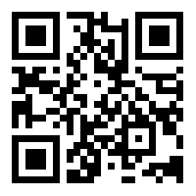
The GET App
What is the GET app? We are excited to present this new and innovative dining feature.
The GET app allows you to track your meal plan, Flex Bucks, and Owl Bucks.
The ability to order food in advance for pick up.
The GET app is available for download in both the Apple App Store and Google Play Store.

Slide 28


Slide 30
STUDENT ACCOUNT BILLING
Students can access their bills and make payment online 24/7 through the MyFAU self-service portal.
Be Sure to check your FAU email frequently. Paper statements will not be mailed.
Students are responsible to meet all deadlines listed on the Tuition and Billing Important Dates Calendar which can be found at the following link: fau.edu/controller/student-services/.
FERPA: Florida Atlantic University cannot discuss student records unless the student has signed a FERPA authorization naming that person on file.
Authorized User Account: Students can authorize others—such as parents, guardians, or sponsors—to view their accounts and pay their bills. The authorized user account does not negate the submission of FERPA form.

Slide 31
METHODS OF PAYMENT
Online payment is the quickest and preferred method of payment:
Credit Card: All major credit cards accepted. A non-refundable fee of 2.85% or a minimum fee of $3 will be charged to all credit card transactions.
Electronic Check (WebCheck): Using a personal checking or savings account with no additional fee.
Mail in payment by check or money order to:
Florida Atlantic University
PO Box 745368
Atlanta, GA 30374-5368
Please place your student Z number on checks or money orders.

Slide 32

Billing of Florida Prepaid is an automated process completed after the add/drop period of each term. Please ensure your social security number is on file with the Registrar’s Office so we can bill your account.
Florida prepaid amounts received range per credit hour determined by the type of plan purchased for the student, in addition to the year it was purchased. Please contact Florida Prepaid to confirm the type of plan purchased.
Florida Prepaid does not cover all tuition and fees billed to a student each semester.
Students will receive an email when Florida Prepaid has been billed and once Florida Prepaid has been received and posted to the student account.
Students who do not wish to use their Florida Prepaid credits must submit a “Change in Billing form” by the drop/add deadline of each semester.

Slide 33
ADDITIONAL PAYMENT INFORMATION
THIRD PARTY PAYMENTS:
If an outside entity is paying FAU directly for a portion or all your tuition & fees, please submit supporting documentation to: sponsoredstudents@fau.edu.
INTERNATIONAL PAYMENTS:
FAU accepts international payments only through FAU’s international payment portal powered by Flywire.
PAYMENT PLANS:
A $15 non-refundable fee is assessed to all plans.
Students will be assessed a $100 late payment fee if the last installment is not made on time.
Deferred students receiving Financial Aid, Florida Prepaid, Waivers or VA benefits already have an extended deadline and are not required to enroll in a payment plan.

Slide 34
CONSEQUENCES OF NON-PAYMENT
LATE PAYMENT FEE: The university will assess a late payment fee to student accounts who fail to pay tuition and fees by the deadlines set by the university.
FISCAL CANCELLATION: Failure to set up a payment plan, pay tuition and fees in full or be deferred by the end of the designated fee payment deadlines for each semester will result in cancellation of the student’s course registration.
REGISTRATION & TRANSCRIPT HOLDS: Students who have an outstanding balance will receive holds which prevent future registration and access to academic transcripts.
DELINQUENT ACCOUNTS/COLLECTIONS: Any student account with a balance more than 90 days past due is deemed eligible to be sent to collections.

Slide 35

Tuition & Billing Services
Located on the Boca Raton campus in Student Support Services:
SU 80, Room 130
Hours of operations:
Monday – Thursday: 8:00 AM – 6:00 PM
Friday’s: 8:00 AM – 5:00 PM
Phone: (561) 297 – 6101
Email: webcontroller@fau.edu
Fax: (561) 297 - 0683
All students can use the Success Network to schedule a phone appointment with our staff. Appointment availability will be on a first come first serve basis. https://www.fau.edu/successnetwork/

Slide 37




Hello!
Office of Student Financial Aid Student Support Services Bldg SU80, Room 233 (561) 297-3530

Slide 38

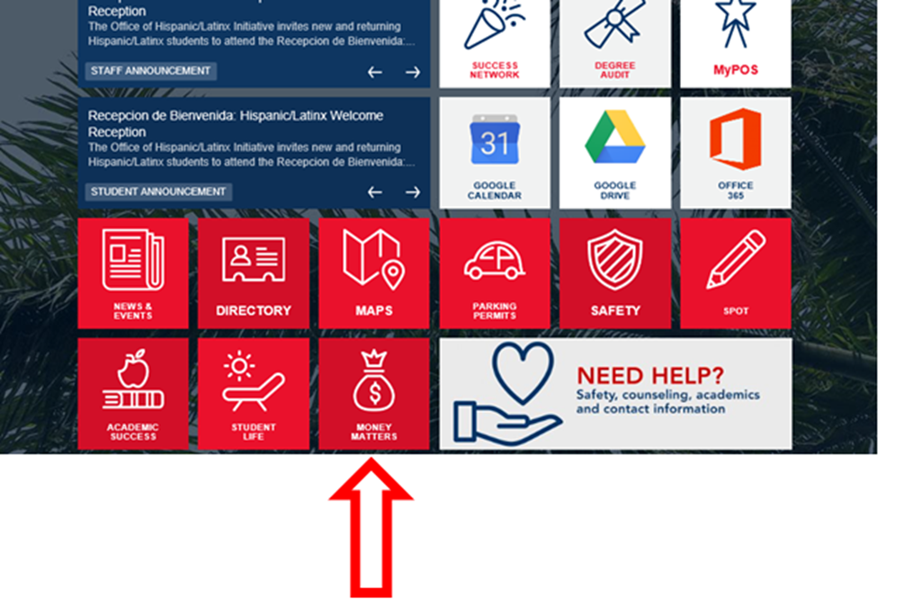

Slide 39
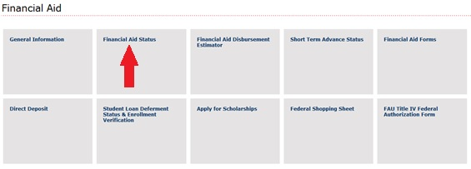
Student requirements
Financial Aid offer
Academic Progress

Slide 40
Complete a FAFSA
When:
Now! FAFSA opened October 1st each year
Summer semesters: 2020-2021 application
Fall 2021 and on: 2021-2022 application
Why:
Apply for grants, loans, Work-Study, and to be considered for institutional grants and scholarships… You never know!
How:
Online at studentaid.gov
StudentAid.gov app

Slide 41
Understanding your Aid Package
Don’t see it yet?
All student requirements must be satisfied for a student to be packaged and for aid to disburse
Must meet SAP, enrollment requirement,
degree applicability

Slide 42
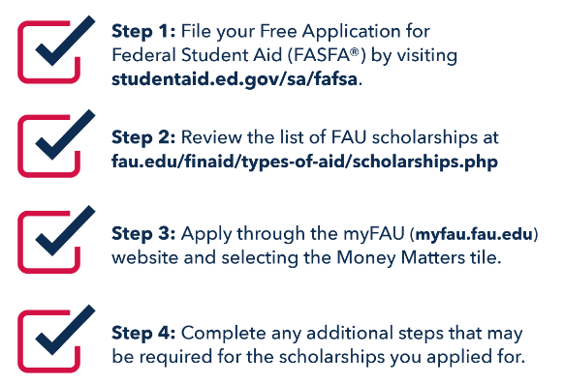
Apply for Scholarships

Slide 43
Bright Futures Scholarships
Inform Bright Futures that you will attend FAU
Required GPA to renew
Florida Academic Scholarship: 3.0 GPA
Covers 100% of tuition and applicable fees
Florida Medallion Scholarship: 2.75 GPA
Covers 75% of tuition and applicable fees
Must be enrolled in minimum 6 credits and degree seeking
Available during the Summer!

Slide 44
Student Loans 101
If you need to borrow money for college costs:
Start with federal loans: subsidized vs unsubsidized
Fixed interest rate, income-driven repayment plans, periods of deferment
Keep in Mind:
Be a responsible borrower
Research starting salaries in your field
Understand terms of your loan
Make payments on time

Slide 45


My financial aid package is all set…now what?
Check out the Financial Aid Disbursement Estimator
Set up Direct Deposit
Download the Financial Aid Calendar

Slide 46

Using Financial Aid to pay for Books
Short Term Advance – up to $750 in your direct deposit
Book Store Line of Credit – up to $400 at the bookstore

Slide 47

Learn more…
.. ..about student loans, budgeting, and making educated financial decisions!
Available to ALL currently enrolled students
NO additional cost
Zero credit hours = NO PASS/FAIL!
Materials remain fully accessible

Slide 48
Questions?!
Office of Student Financial Aid
Student Support Services Bldg,
SU80, Room 233
(561) 297-3530
Contact your Financial Aid Counselor

Slide 50
Center for Learning And
Student Success (CLASS) Objectives
• Intellectual Foundation Courses (IFP)
• High School vs. College
• Skills for College Success
• Faculty Interaction Skills
• Campus Resources
• Center for Teaching & Learning (CTL) Information

Slide 51


Slide 52
HIGH SCHOOL
COLLEGE
Your time is structured by your family, teachers & others.
You are in class 30 hours per week.
Your family & teachers will remind you of your responsibilities & help you manage them.
You manage your own time.
You are in class 12-16 hours a week. That is 135 fewer hours in class!
You must balance your own responsibilities and set your own priorities.

Slide 53
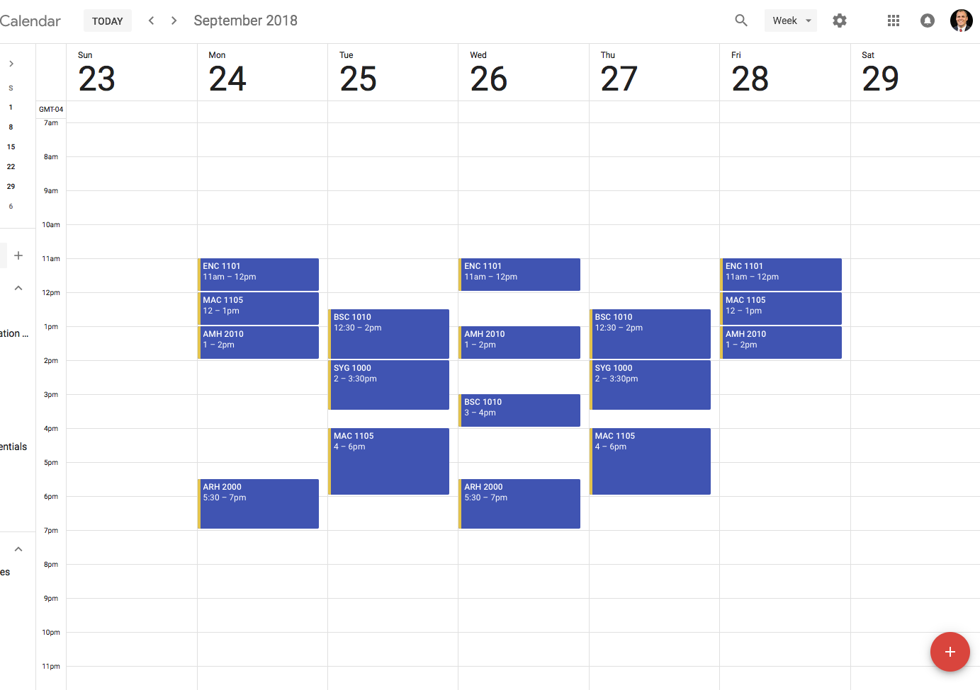
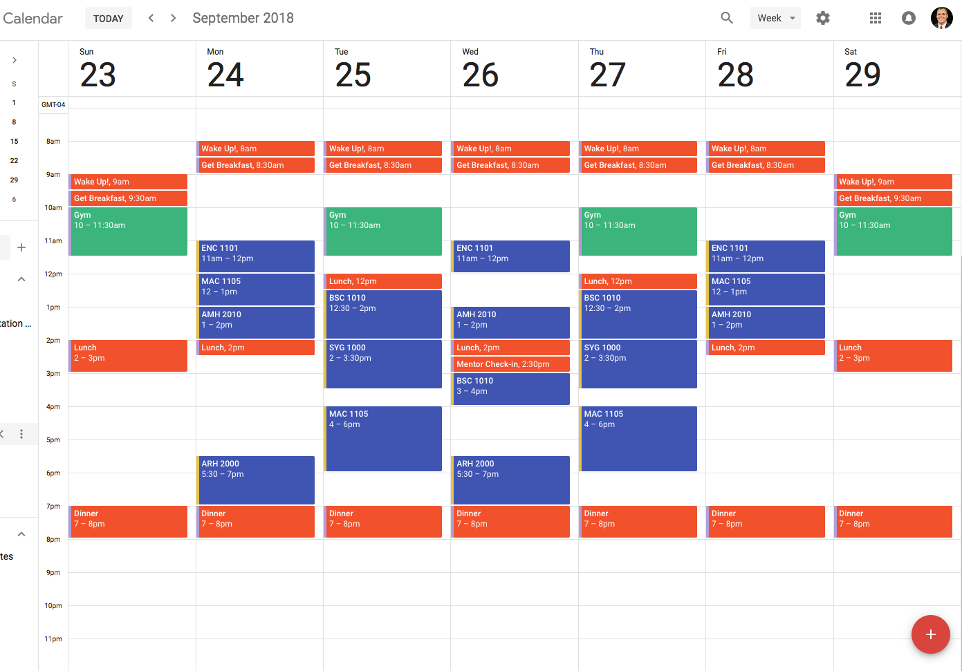
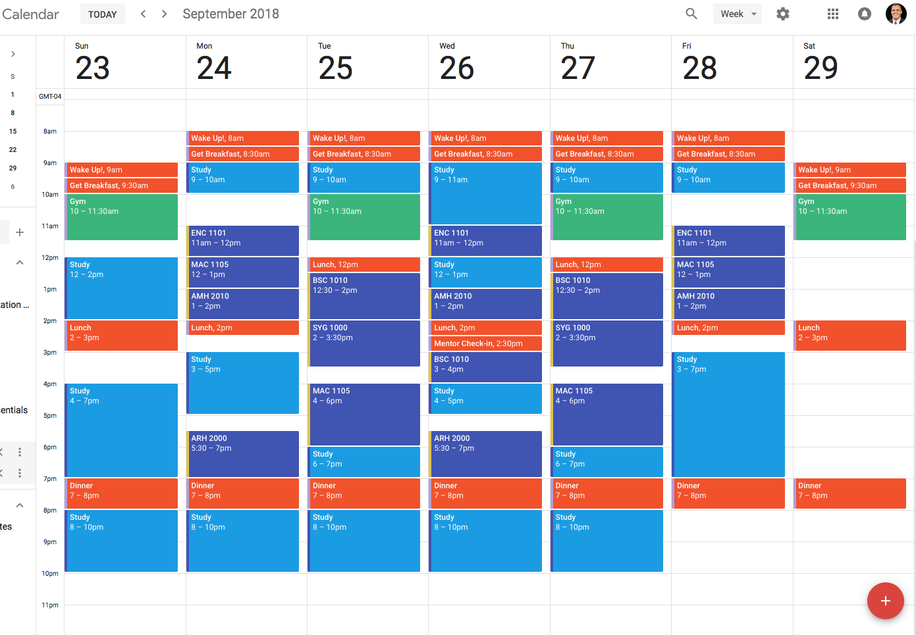
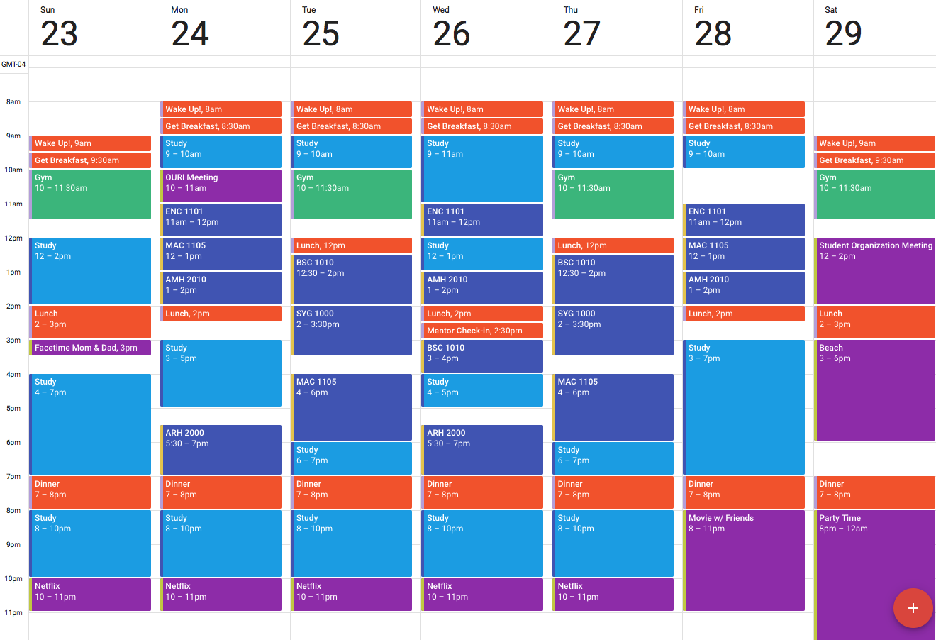

Slide 54




Skills for College Success
Engage in your classes
Time management
Sharpen your study skills
Practice self-care

Slide 55

Center for Learning And
Student Success (CLASS) Objectives

Slide 56
Interacting with Faculty: Top 5 Tips
Go to class prepared
Read your syllabus
Use office hours
Ask for help before you need it
Be honest with your professor & to yourself

Slide 57
Campus Resources
Office | Location | Phone Number | Email/ Website
University Advising Services | SU 80 Room 201 | 561-297-3064 | advisingservices@fau.edu
Student Accessibility Services | SU 80 Room 133 | 561-297-3880 | https://www.fau.edu/sas/about/contact_us.php
Career Center | SU 80 Room 220 | 561-297-3533 | career@fau.edu
OIT Help Desk | CM 138 | 561-297-3999 | http://helpdesk.fau.edu
Student Health Services | SS-8W Room 240 | 561-297-3512 | https://www.fau.edu/shs/about/contact_us.php
Counseling and Psychological Services (CAPS) | SSB 8 Room 229 | 561-297-3540 | https://www.fau.edu/counseling

Slide 58
Let’s Recap
Feel and build curiosity about your classes. Make connections to what you already know, what interests you, and who you want to become.
Embrace an active role - learn with your faculty and peers.
Explore the differences between high school and college. College is real life – develop the habits of the mind that will help you succeed now and in your future.

Slide 59
Come visit us!
General Classroom South (GS) Building, 2nd floor
Academic Success Initiatives
Center for Learning And Student Success
- eSuccess
- Science Learning Center (located in the Schmidt Family Complex)
- Supplemental Instruction
- Tutoring
Math Learning Center
Open Study and UHP Study Space
The Speaking Center
Undergraduate Research and Inquiry
University Center for Excellence in Writing

