Slide 1

Notes:
2:55 - 3:25 pm
Live Oak pavilion

Slide 2

Health and Wellness
Campus Recreation
Counseling & Psychological Services
Owls Care Health Promotion
Student Accessibility Services
Student Health Services
Notes:
Additional information about the Health and Wellness departments can be found at the Canvas course
Great expectations for smooth sailing but challenges are to be expected

Slide 3

Top Academic Impediments (NCHA)
Procrastination (45.1%)
Stress (40.9%)
Anxiety (32.1%)
Chronic medical conditions (25.8%)
Depression (25.1%)
Notes:
Karen - But- the survey changed from 2018 to 2020-
Work was recoded to career from 2018 to 2020 which has different connotations and can’t be directly compared.
we know what gets in their way and work to make programs to address it. have data & expertise

Slide 4
Academic Impairment due to Emotional/Mental Difficulties (HMS)
21% None
26% 1-2 days
25% 3-5 days
28% 6 or more days
Notes:
Karen - (Past 4 weeks)
In the past 4 weeks, how many days have
you felt that emotional or mental difficulties
have hurt your academic performance?
If you find this worrisome- consider calling Karen and her team at Owls Care Health Promotion- they will work with you to create a short module that they or you can present in your class

Slide 5
Mental health services needed…
76% Need help for mental health problem
41% Currently in counseling
Barriers:
49% Not sure where to go for services
19% Cost or no insurance
Notes:
Kate
parents are part of team, they can look out for warning signs and refer them.

Slide 6
Decreasing Stigma
80% kept their mental health problems a secret
54% wish to disclose their mental problems to others
53% thought others stigmatized use of mental health services (perceived public stigma)
93% don’t stigmatize mental health service use (personal stigma)
Notes:
Kate
emphasize most people won’t stigmatize you

Slide 7


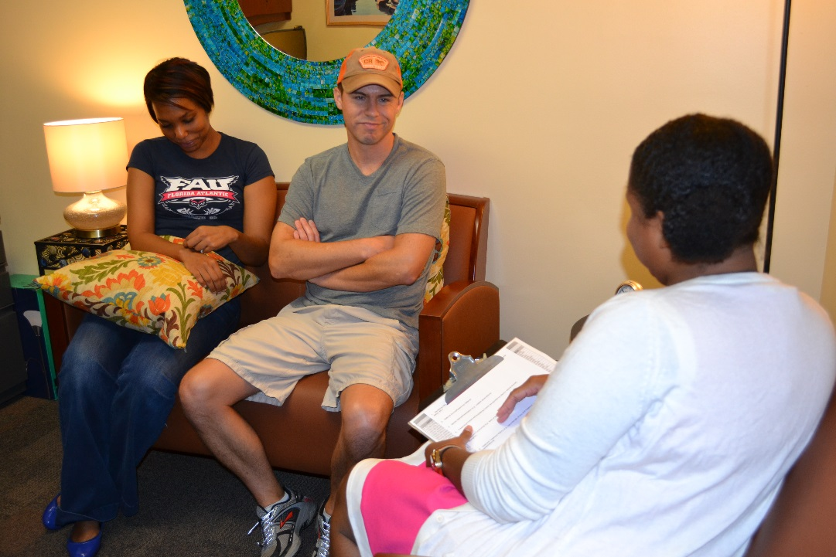
Counseling & Psychological Services (CAPS)
Confidential Services
www.fau.edu/counseling
Individual counseling
Group counseling
Relationship counseling
Crisis management
Consultations
Workshops
Online and live suicide awareness trainings
After-hours assistance
Mental Health Screenings
Notes:
Kate - Counseling and Psychological Services is your on-campus place for therapy and support.
Counseling and Psychological Services, also known as CAPS, provides different types of services to enrolled students.
These services might include:
-Individual, group, and relationship counseling
-Consultations about others who might be at risk or in distress
-Classroom, housing, or Greek Life Workshops
-Online and live Suicide Prevention Awareness Trainings
-and on on-call emergency service available by phone after hours for students who are in distress.
college students do really well in group counseling. CAPS can consult with parents on intervening.
if forget who to talk to, call office of family engagement to get more resources.

Slide 8


Owls Care Health Promotion
Sexual Assault Prevention
AlcoholEdu
Kognito Mental Health Training
Diversity Equity and Inclusion
Hazing Prevention
Notes:
Interactive Workshops
Campus Outreach Activities
Individual Consultations
HIV Testing
Free Health Promotion/Self-Care Items
Women and Gender Equity Resource Center

Slide 9

Student Accessibility Services
Academic Accommodations
Accessible Material
Advocacy
Assistive Technology
Faculty Notification
Online Services
Scholarships
Study Strategy Instruction
Notes:
Karen - The SAS comprehensive academic support services include advocacy, academic accommodations, assistive technology, equipment, and software training, assistive technology resource center, and learning strategies training. SAS has offices across three of FAU's campuses-- Boca Raton, Davie, and Jupiter. However, accessibility services are available for students attending any of our six FAU campuses and online. We offer a wide range of assistive technology to assist our students become independent learners, which are transitional skills that can take along with them into the workplace. We offer a wide range of screen reading devices, audio recording devices, Life Scribe smart pen, Read Write, ZoomText, JAWS, Dragon Naturally Speaking, and specialized keyboards and mice, and much, much more. Student Accessibility Services strives to be nationally-distinguished leader for accessibility resources offering comprehensive services and student centered environment. We are committed to providing quality and comprehensive individualized service and a state-of-the-art assistive technology while adapting to the dynamic needs of a diverse student population of Florida Atlantic University. Please call our office and talk with one of our staff members to find out how we can help you or find out about our volunteer opportunities with SAS
Read&Write (RW) for Windows and Mac is a reading and writing solution for students with dyslexia and other Learning Disabilities (LD). The text-to-speech application allows users to read Word documents, Web pages, or PDF files aloud. Some of Read&Write features allow for the conversion of scanned documents into text documents,highlighting words when reading, word prediction support, highlighting and highlight extraction, screenshot reader for images, and the conversion of text documents into audio formats.
Read&Write is not only a great software solution for students with disabilities, it is an effective study and writing tool for all students. This was made possible through a Student Technology Fee grant awarded to Student Accessibility Services, and is available for use by all students at Florida Atlantic University.

Slide 10






Student Health Services
INEXTRICABLE LINK BETWEEN HEALTH AND ACADEMIC PERFORMANCE
Families serve as primary resource for health information
Primary Care, Acute Care, Women’s Health
No Cost COVID Visits and Testing
Chronic Care Management
Nutrition, Psychiatry, Dental
No Cost Flu Vaccines
24/7 Nurse Line
Clinics at Boca Raton, Davie, and Jupiter Campuses
Confidential Care: HIPAA Compliant FERPA Releases Not Applicable
Cost: Charges apply (listed on the website)
Should never be a barrier to care
No money collected up front
Self-pay discount available
Charges are sent to student account
Accepts most insurance

Slide 11

Food For Thought
Changes are challenging for everyone.
Meaningful connections take time.
Don’t delay getting help for physical, emotional or academic challenges.
Avoidance undermines success.
Notes:
Kate - Lots of people are new to FAU although it may seem like everyone knows everyone else, they don’t
roommates/suitemates are necessarily best friends
Be understanding of yourself and others, give yourself permission to take the advice you would give to a close friend
Don’t compare your insides to other people’s outsides, people may seem confident, but seems may be deceptive
Practice self=compassion and self-care – healthy habits go out the window when we need them
Educate students about the low stigma rates
Common cultural construct of perfectionism feeds procrastination
Academic support not used
61% Academic support (writing center, tutor)
44% Faculty office hours
54% Teaching assistants

Slide 12




If You Are Thinking,
What is wrong with me?
I’ll never succeed
No one likes me
I can’t tell anyone how I feel
I’m disappointing everyone
I don’t know who I am anymore
I’m lonely
I give up
I wish I could escape
I can’t make it
I have no friends
I’m drowning
I feel overwhelmed
Nobody understands me
Notes:
Kate - So, if you are thinking that you have no friends, that you are lonely, that you are disappointed, or that you struggle to function, please schedule a first appointment to talk to one of our counselors. You can call the main CAPS number to make an appointment – M-F 8-5pm. During that session can talk about your concerns and learn about the available and relevant follow up options for you – at CAPS, OwlsCare, Student Health, Student Accessibility and other university departments as well.
Psychiatrist and Nutrition Consultation with Reg. Diet.

Slide 13
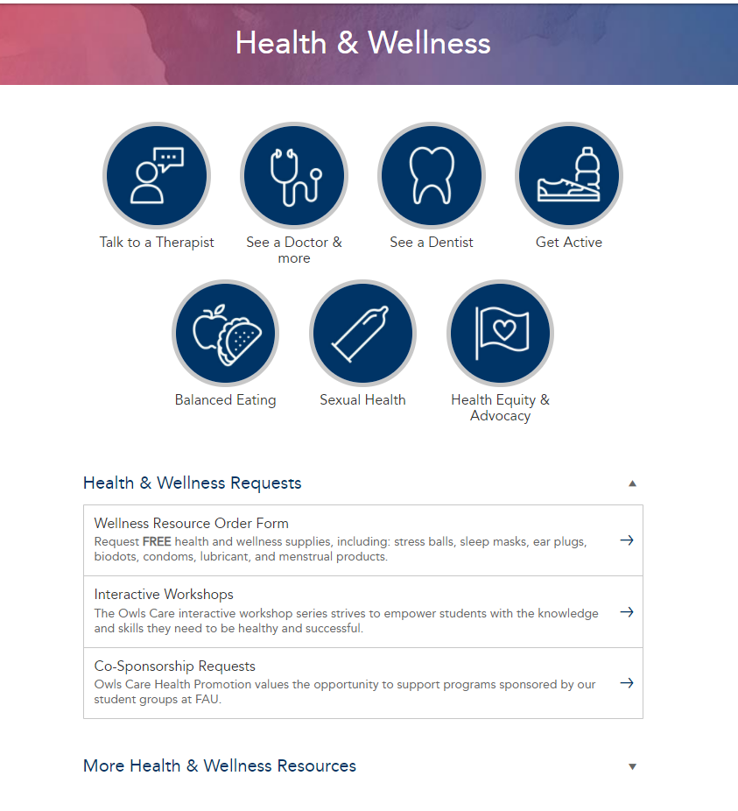
https://myfau.fau.edu/signed_in/health

Slide 14


Connect with us
https://www.instagram.com/fau_caps/
FAU Owls Care Health Promotion (@fauowlscare) • Instagram photos and videos
https://www.instagram.com/FAUStudenthealth/
https://www.facebook.com/FAUCAPS/
(14) FAU Student Health Services | Facebook
(14) FAU Owls Care Health Promotion | Facebook
FAU Student Accessibility Services (facebook.com)
Website
FAU – CAPS
FAU - Owls Care
FAU - Accessibility Services
FAU - Student Health Services
Notes:
connect with us via Instagram, Facebook, or our website fau.edu/counseling. Our website has additional resources that might assist you with self-help.

Slide 15
Health and Wellness
Contact Us
Campus Recreation
  561-297-2421
Counseling & Psychological Services (CAPS)
  561-297- CAPS (2277)
Owls Care Health Promotion(OCHP)
  561-297-1048
Student Accessibility Services (SAS)
  561-297-3880
Student Health Services (SHS)
  561-297-3512

