Slide 1

Fraternity & Sorority Life
Virtual Orientation for
Freshman and Transfer Students

Slide 2

Welcome to FAU! We’re glad you are interested in Greek Life. In this presentation, we will:
Introduce the FSLife staff and FS Ambassadors
Review our four governing councils, the chapters in each and general eligibility criteria
Important information about hazing
What’s great about Greek Life, and how YOU can join a Greek organization
How to sign up for more information or contact our office
Look forward to bonus content at the end, including a throwback Greek Life video!

Slide 3

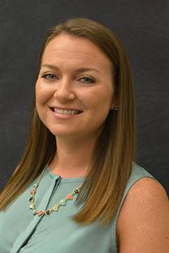
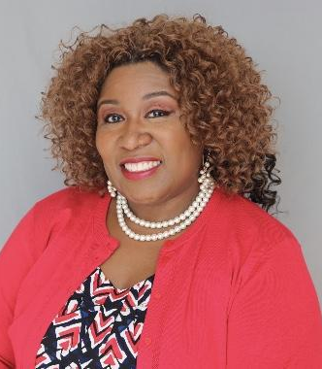

Introductions
Fraternity and Sorority Life Staff
Fraternity & Sorority Ambassador Introductions
Elaine Jahnsen Jordat
Associate Director
Ebony Lamar
Assistant Director

Slide 4

Our Fraternity and Sorority Life Community
27 social Greek-lettered organizations, divided into 4 councils
Nearly 6% of FAU undergraduate students are members of fraternities and sororities → about 1,400 members
Chapter members completed more than 6,000 hours of community service in 2020
Chapters raised over $130,000 for charitable organizations in the last year (2020) alone

Slide 5

It’s All Greek To Me
Words to know
Sorority and Fraternity
Greek familial organizations of sisters and/or brothers founded on social, philanthropic, scholarship, religious, cultural, and/or community service principles
Interest
A person seeking membership into a UGC or NPHC organization
Intake
The process of becoming a member in a UGC or NPHC organization
PNM
Potential New Member, one who is seeking membership into CPA or IFC
Primary Recruitment
Series of events held by each CPA and IFC to recruit and select new members

Slide 6

Interfraternity Council (IFC)
all-men’s fraternities
Alpha Epsilon Pi (ΑΕΠ) “AEPi”
Delta Tau Delta (ΔΤΔ) “Delts”
Phi Delta Theta (ΦΔΘ) “Phi Delts”
Pi Kappa Alpha (ΠΚΑ) “Pike”
Pi Kappa Phi (ΠΚΦ) “Pi Kapp”
Sigma Chi (ΣΧ) “Sigs”
Sigma Nu (ΣN)* “SigNu”
Beta Theta Pi (BΘΠ)* “Beta” coming Fall 2021
*indicates new (not yet chartered) chapter

Slide 7

College Panhellenic Association (CPA)
all-women’s sororities
Alpha Delta Pi (ΑΔΠ) “ADPi”
Alpha Xi Delta (ΑΞΔ) “AZD”
Delta Phi Epsilon (ΔΦΕ) “DPhiE”
Sigma Kappa (ΣΚ) “SigKap”
Theta Phi Alpha (ΘΦΑ) “Theta Phi”
Phi Mu (ΦΜ)

Slide 8


Cost and Requirements
of IFC & CPA
No FAU credits needed to join
(can join as a first-semester freshman)
Average GPA requirement: 2.75 (depends on the organization)
Dues are paid semesterly
first semester will be a bit higher while a new member
($600-$800 first semester and $500-$700 each semester after that)

Slide 9

United Greek Council (UGC)
culturally-based fraternities and sororities + one co-ed organization
Lambda Theta Alpha Latin
Sorority, Inc. (ΛΘΑ) “LTA”
Alpha Psi Lambda Co-Ed Latin Fraternity, Inc. (ΑΨΛ) “A-Psi”
Lambda Alpha Upsilon Fraternity, Inc. (ΛΑϒ) “LAU”
Sigma Beta Rho Fraternity (ΣΒΡ)“SigRho”
Delta Kappa Delta Sorority, Inc. (𝚫𝚱𝚫) “DKD” *coming Fall 2021

Slide 10

National Pan-Hellenic Council (NPHC)
Also known as The Divine Nine, historically black fraternities and sororities
Alpha Phi Alpha Fraternity, Inc. (ΑΦΑ) “Alphas”
Alpha Kappa Alpha Sorority, Inc. (ΑΚΑ) “AKA”
Kappa Alpha Psi Fraternity, Inc. (ΚΑΨ) “Kappas”
Omega Psi Phi Fraternity, Inc. (ΩΨΦ), “Omegas”
Delta Sigma Theta Sorority, Inc. (ΔΣΘ) “Deltas”
Phi Beta Sigma Fraternity, Inc. (ΦΒΣ) “Sigmas”
Zeta Phi Beta Sorority, Inc. (ΖΦΒ) “Zetas”
Sigma Gamma Rho Sorority, Inc. (ΣΓΡ) “SGRhos”

Slide 11


Cost and Requirements
of UGC & NPHC
Some FAU credits needed to join
(between 12-36 depending on the organization)
Average GPA requirement: 2.50+ (depends on the organization)
Dues are paid up front when you join, then annually after that
($200 - $2,000 depending on the organization)

Slide 12
Important information about Hazing
FAU has a zero-tolerance hazing policy: please watch our message about hazing: http://fau.edu/fslife/hazing/index.php
All fraternity and sorority members are required to complete the online Hazing Prevention: It’s Everyone’s Responsibility training module prior to joining or being initiated into the organization: http://www.fau.edu/fslife/hazing/hazingprevention.php
Every September, our community participates in National Hazing Prevention Week which includes educational programming to increase awareness and knowledge on how to prevent, identify and report hazing activity: http://www.fau.edu/fslife/hazing/nhpw.php

Slide 13

So what is Greek Life REALLY all about?
Notes:
Good questions everyone. Well here is what we know Greek life to be really about.
These are some core things that all the groups have in common. We have some photos to show you as examples of these things in the following slides.
Maybe you see a lot of things you like on this list, and maybe there’s something you don’t see which we can talk about in the Q&A at the end…
Either way wherever you want to put the most of your time and energy as a member of a Greek organization, it really is that you get out what you put in. Maybe you want a sense of brotherhood/sisterhood and that’s your focus; maybe you want to improve as a student, leader, or as a person in general. There are opportunities to do these things that you can dabble in or capitalize on… it’s totally up to you.
Now I also know that as an incoming college student you’re more focused on your High School Graduation than thinking down the line about COLLEGE graduation, but another thing to note is that Greek membership is for life; your opportunities for involvement in many of these areas continues after you leave FAU.

Slide 14
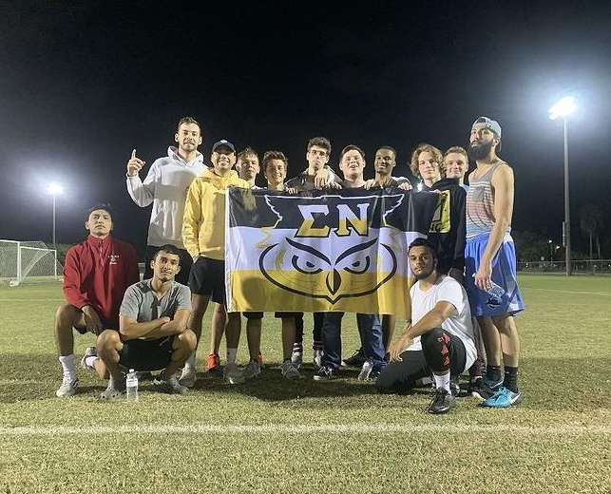
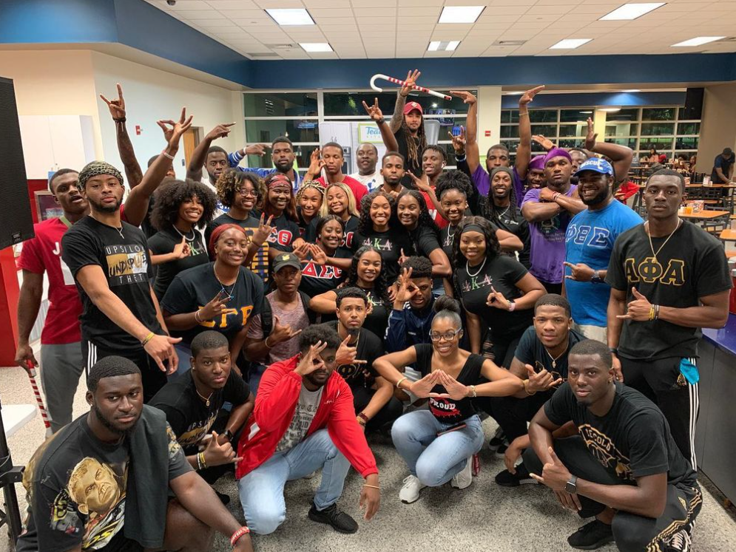
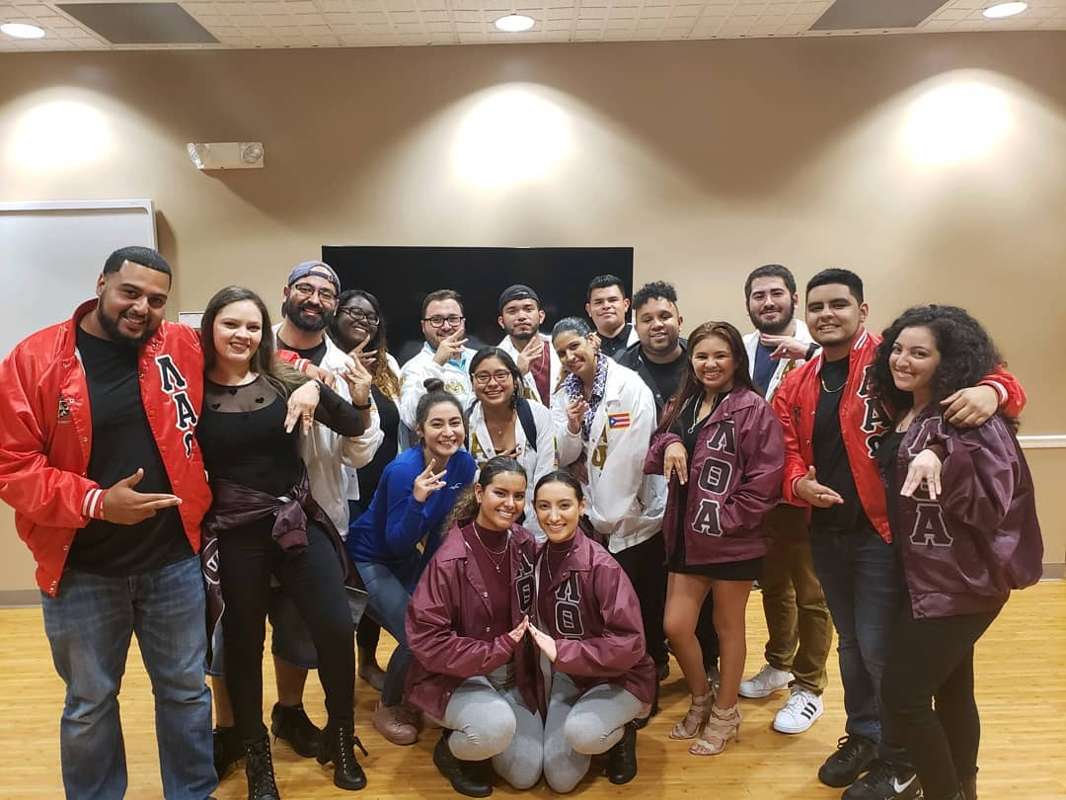
Brotherhood
& Sisterhood
Friendships that become family
Mentorships
A support network
People to have fun with!
Members of Sigma Nu
participating as a intramural
sports team
NPHC- Greeks Take Over the Caf’
United Greek Council (UGC)

Slide 15
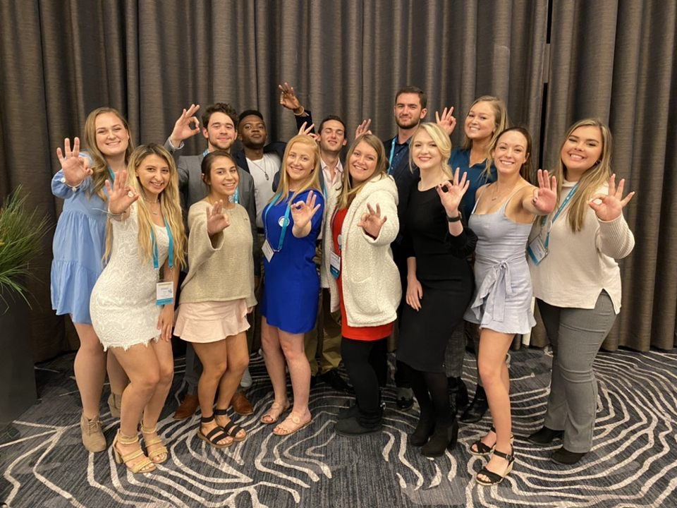
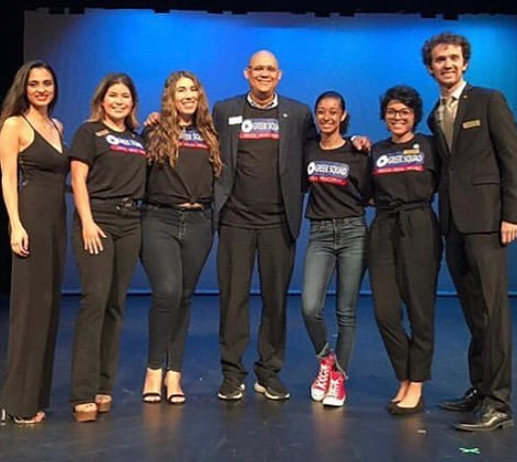
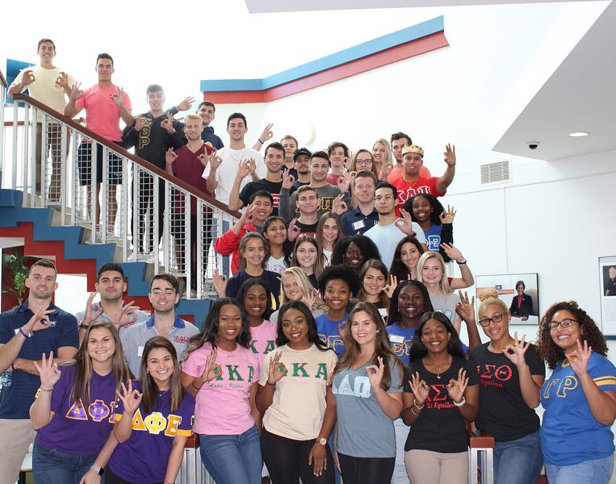
Leadership
In your chapter or in your governing council
In the Greek community
Attend local, regional, national conferences
Get connected to opportunities across campus
Association of Fraternal Leadership and Values Conference
Greek Week Executive Board
Greek Officer Leadership Development Retreat in Jupiter

Slide 16
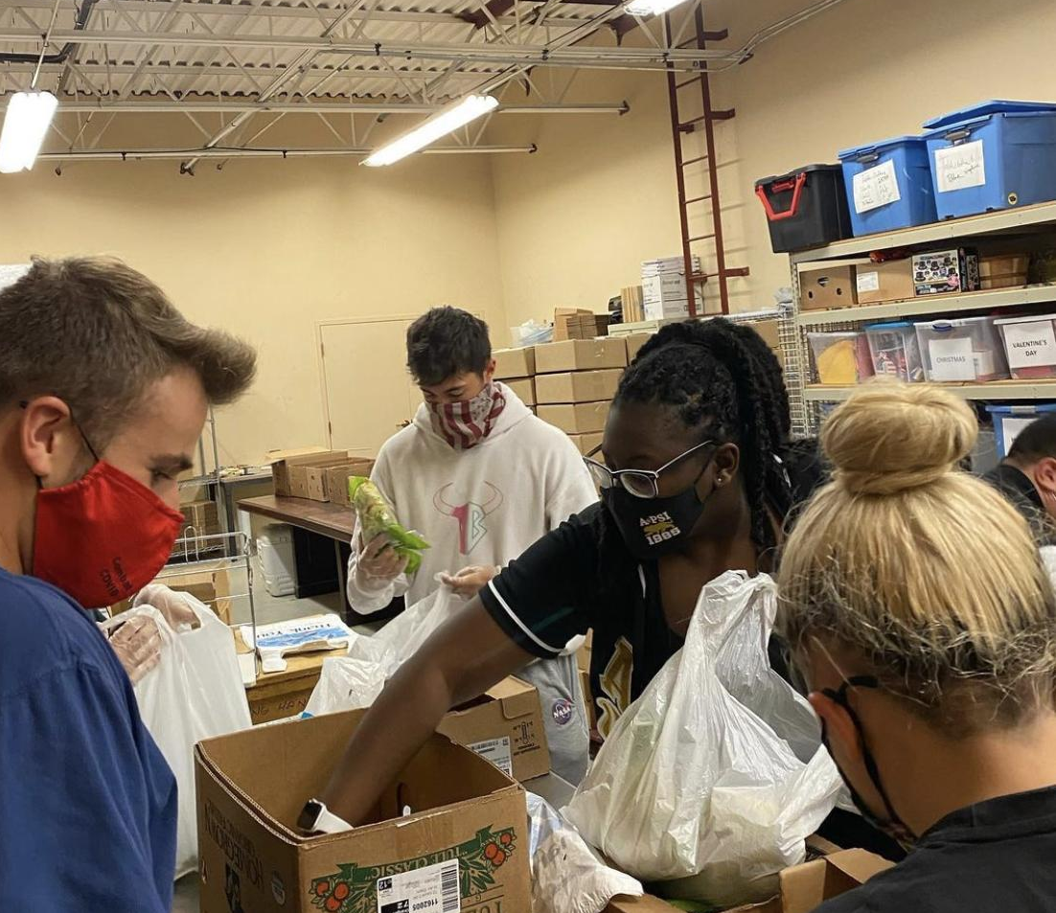
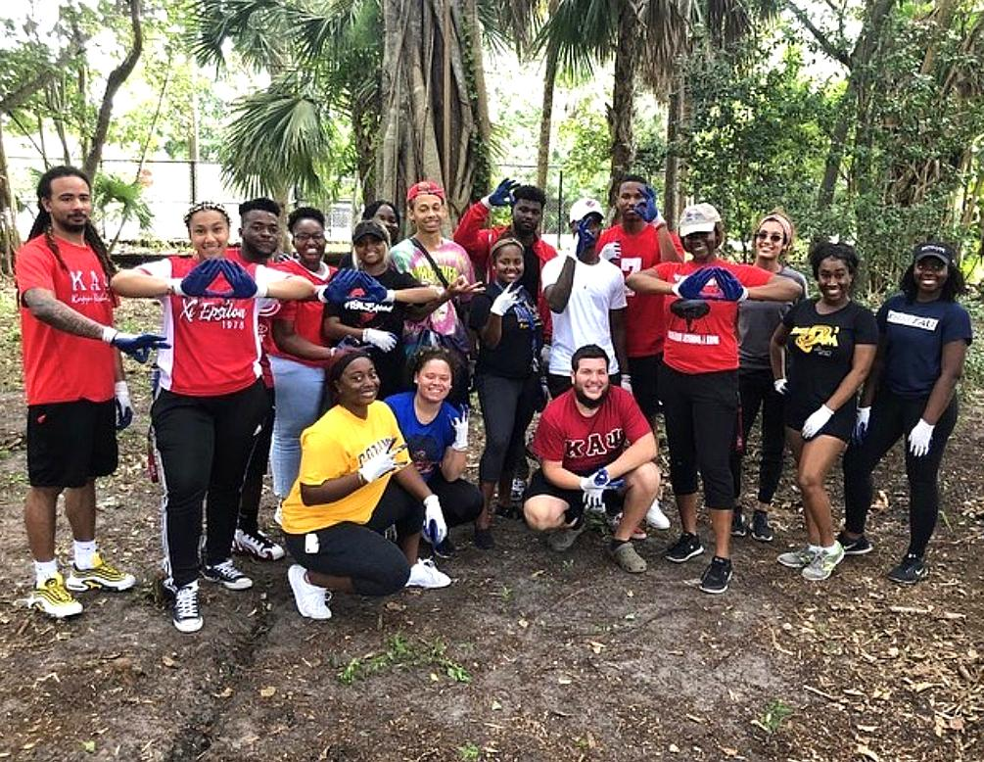

Community Service
& Philanthropy
Raise awareness and funds
Participate in service events
Support the local community
Give back
Alpha Psi Lambda and Pi Kappa Alpha packing food kits
NPHC hosting a beach cleanup
FAU OwlThon raising funds for Children’s Miracle Network Hospitals

Slide 17
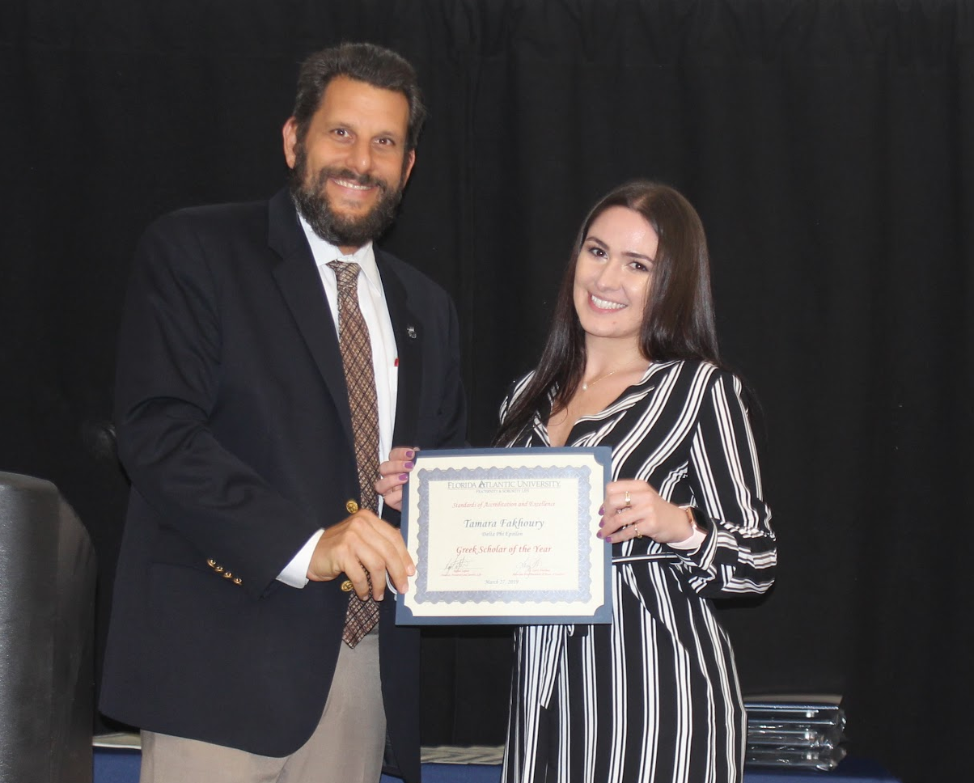
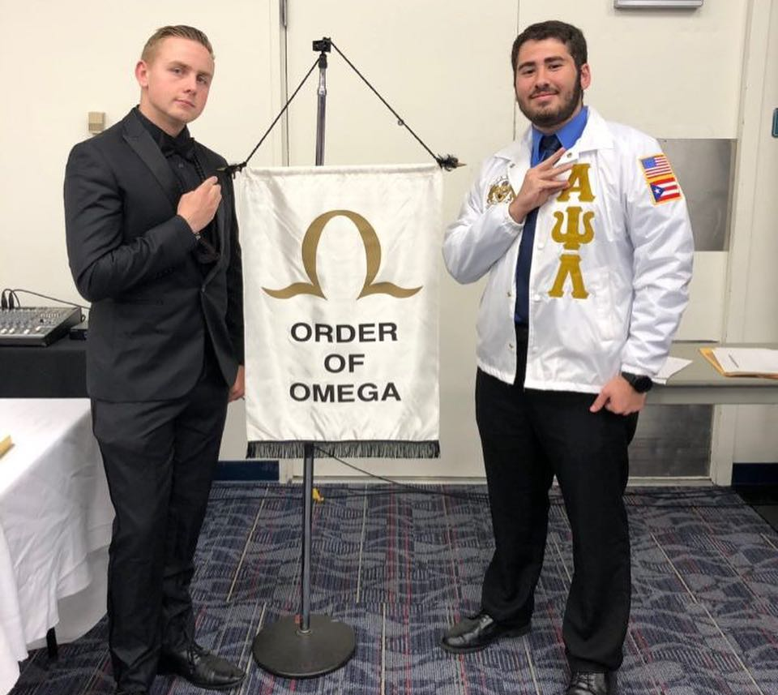

Scholarship
Friends to study with
People in the same major/classes
Recognition for academic achievement
Induction into a Greek Honor Society
Greek Scholars of the Year
Order of Omega
Greeks studying together in the computer lab

Slide 18
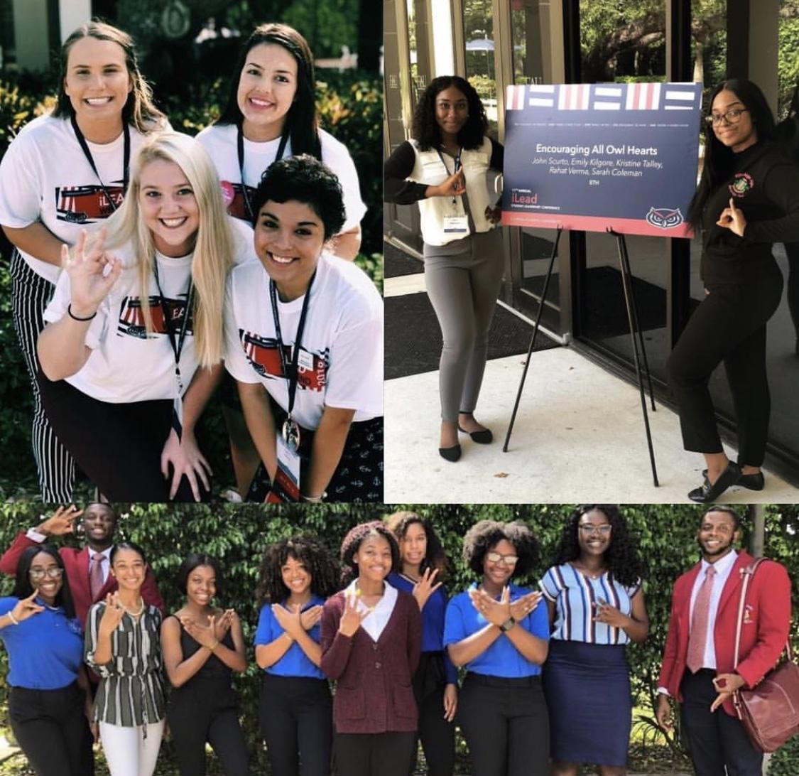
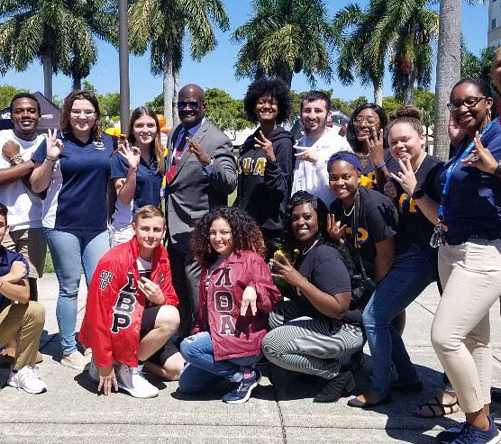
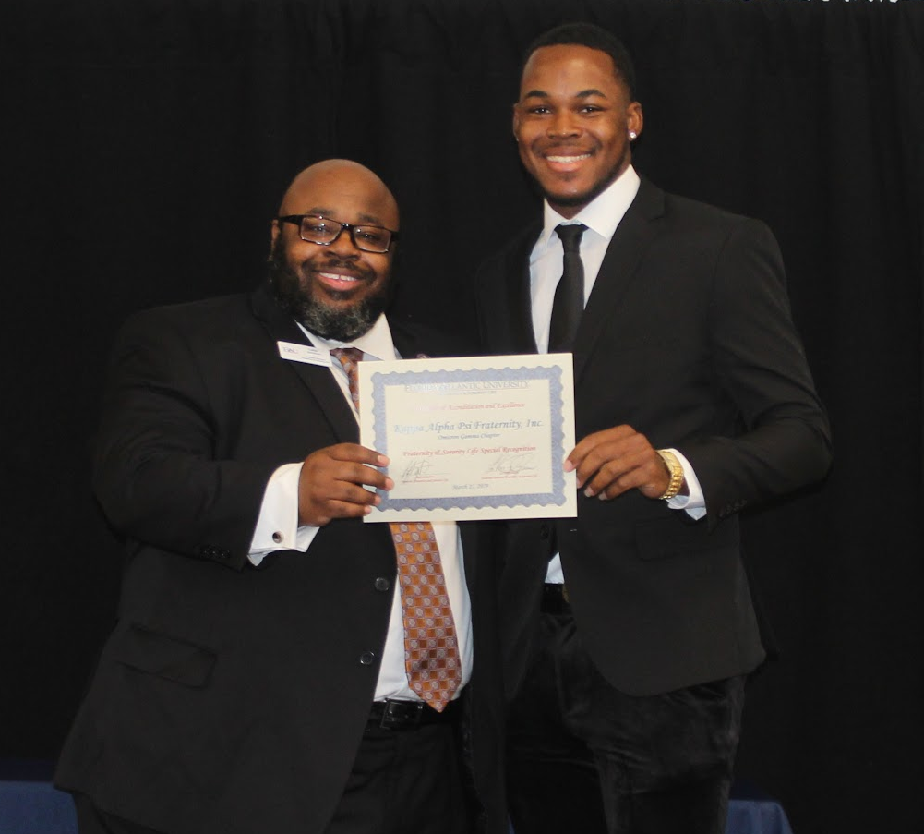
Self Improvement
& Living Your Values
Hone your skills
Meet your goals and challenge yourself
Step out of your comfort zone
Discover what’s important to you
Greeks presenting at the FAU iLead Conference
Talking to incoming students about Fraternity and Sorority Life
Recognition for major
improvement

Slide 19

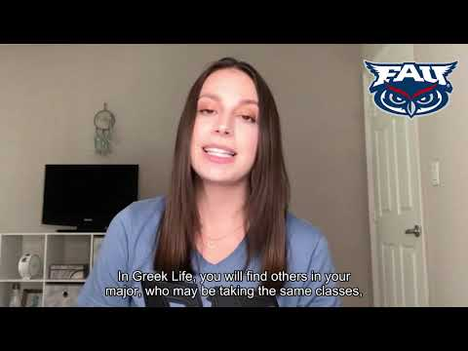
Learn a little more about our community!

Slide 20
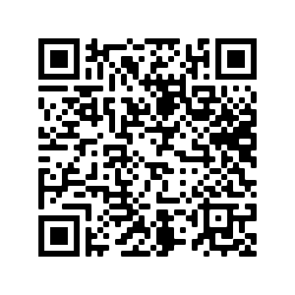
How YOU can join a Greek organization
Fill out our Interest Form to stay updated on upcoming opportunities to meet members of the FAU Greek Community
Make sure to input your email correctly!
Attend our events:
See following slides
Follow us on social media:
@FAUFSLife

Slide 21
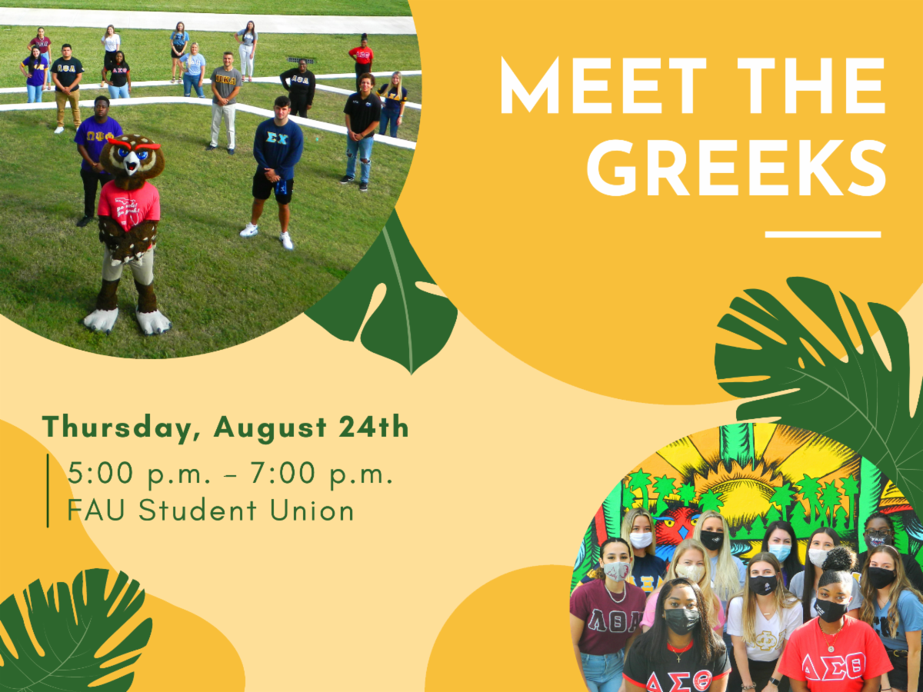
Dates to Know: FSLife Events
Fraternity & Sorority Life Fall 2021 Weeks of Welcome event: Meet the Greeks
Tuesday, August 24th

Slide 22

Dates to Know: NPHC & UGC Events
NPHC Sorority Recruitment Night
Tuesday, August 31st, 6pm (virtual)
NPHC Fraternity Recruitment Night
Wednesday, September 8th, 7pm (virtual)
NPHC Greeks Take Over the Caf (in-person)
Date/Time TBD
UGC Recruitment Night
Wednesday, September 15th, 7pm (virtual)

Slide 23
Dates to Know: CPA & IFC Events
CPA Panhellenic (Sorority) Primary Recruitment
August 27th - September 5th, 2021
Register by August 25th https://enroll.icsrecruiter.com/pan/FLATUN
IFC Fraternity Recruitment
September 20th - 24th, 2021
Must register in order to receive a bid: https://enroll.icsrecruiter.com/IFC/FLATUN

Slide 24
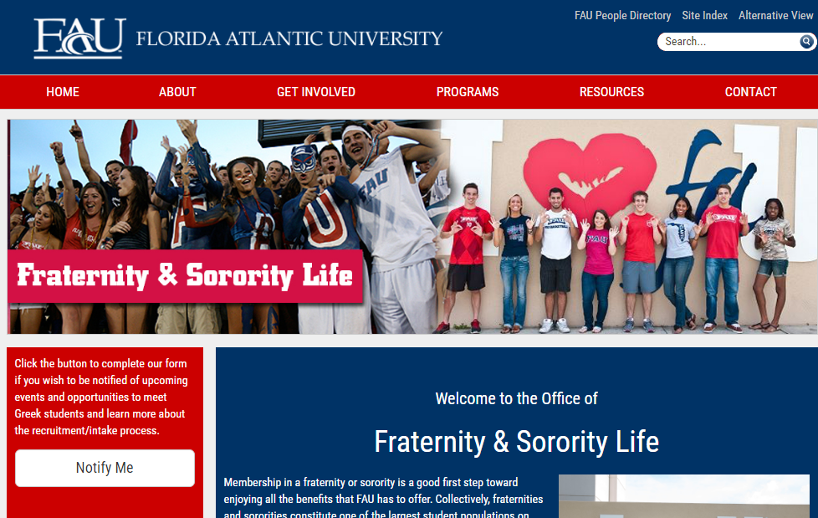
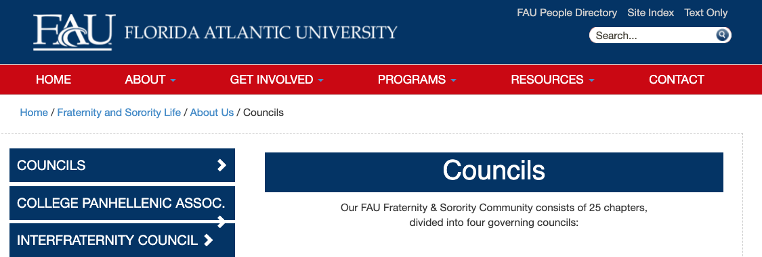
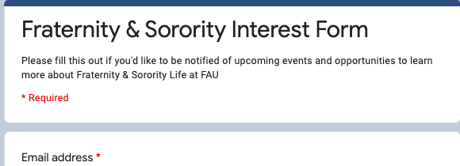
Check out our website to:
(1) Sign up for more info and (2) Learn more about the governing councils
http://www.fau.edu/fslife/

Slide 25



Questions?
We’re here for you!
Shoot us an email to fslife@fau.edu with any questions you have, or leave your phone number and a good time of day to reach you. One of our FS Ambassadors or staff members will call you back!
Follow us on social media!
@FAUFSLife

Slide 26
Thank you for your time!
Enjoy the rest of orientation and GO OWLS!

Slide 27
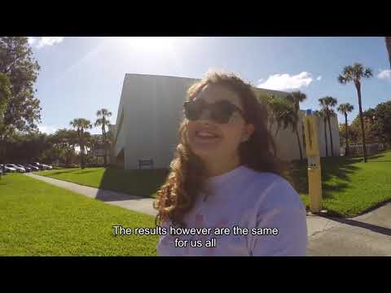
Bonus Content:
Throwback Greek Life Video

Slide 28

Your Involvement Breakout Session is complete!
Students, please head back to your small group Parliament breakout rooms. To get there, use the same link that you used to access your Parliament group earlier.
Family members, you will be heading to the “Family Wrap-Up” Zoom session.
Enjoy the rest of your day SOARing with us!

