Slide 1


Slide 2

Center for Learning And
Student Success (CLASS) Objectives
• Intellectual Foundation Courses (IFP)
• High School vs. College
• Skills for College Success
• Faculty Interaction Skills
• Campus Resources
• Center for Teaching & Learning (CTL) Information

Slide 3



Slide 4

HIGH SCHOOL
COLLEGE
Your time is structured by your family, teachers & others.
You are in class 30 hours per week.
Your family & teachers will remind you of your responsibilities & help you manage them.
You manage your own time.
You are in class 12-16 hours a week. That is 135 fewer hours in class!
You must balance your own responsibilities and set your own priorities.

Slide 5

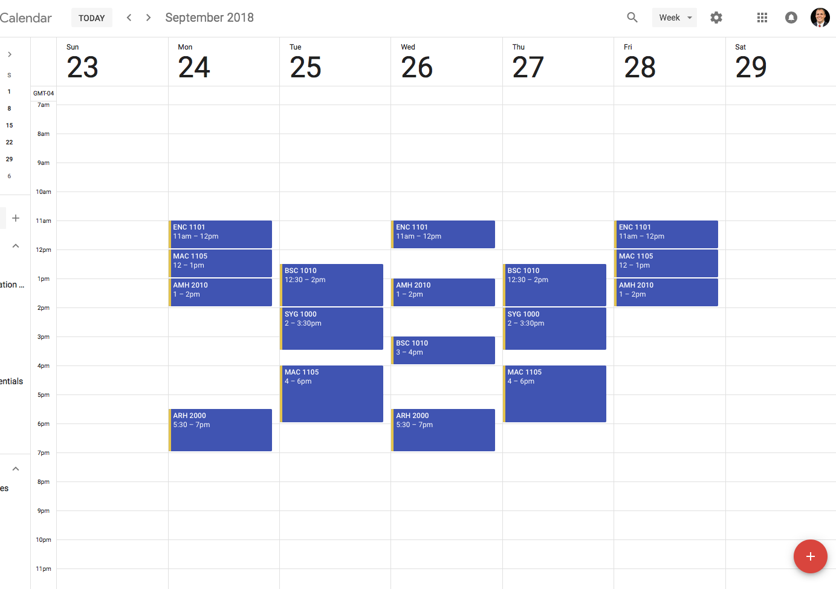
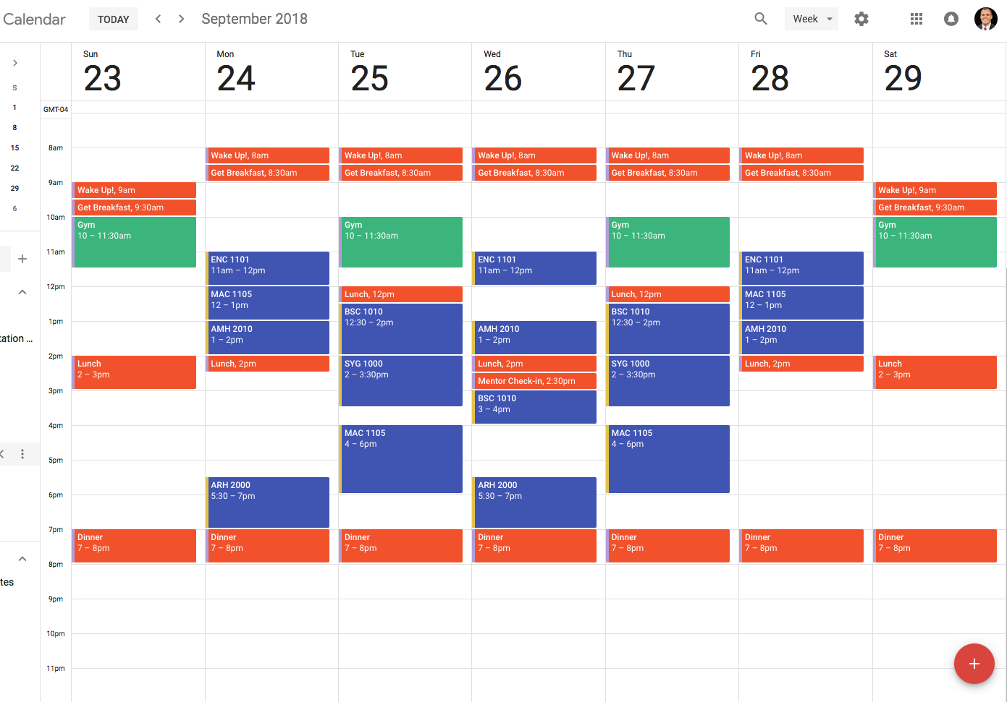
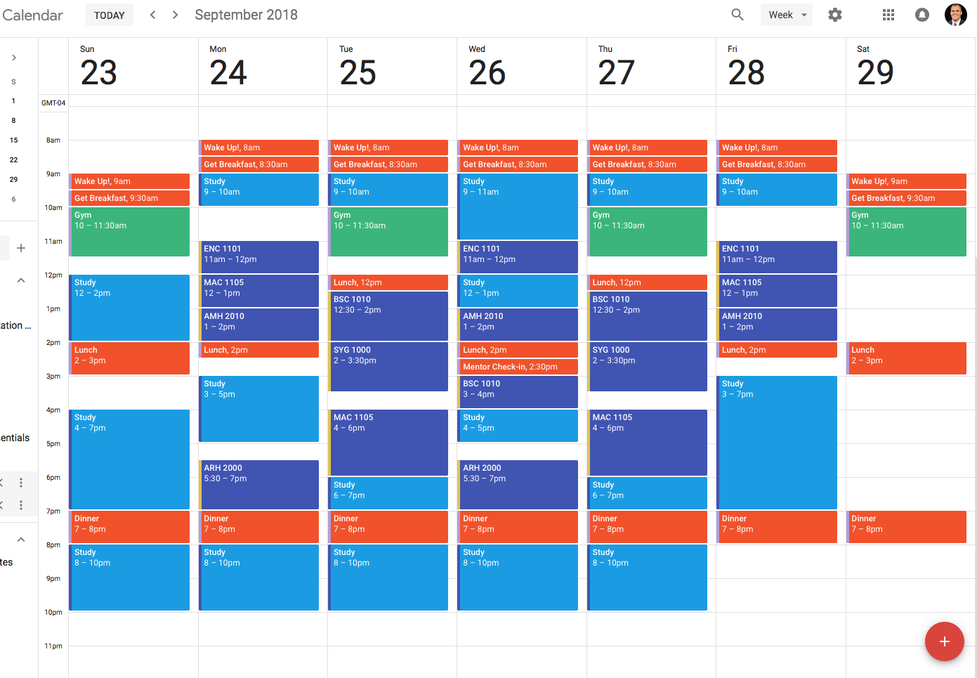
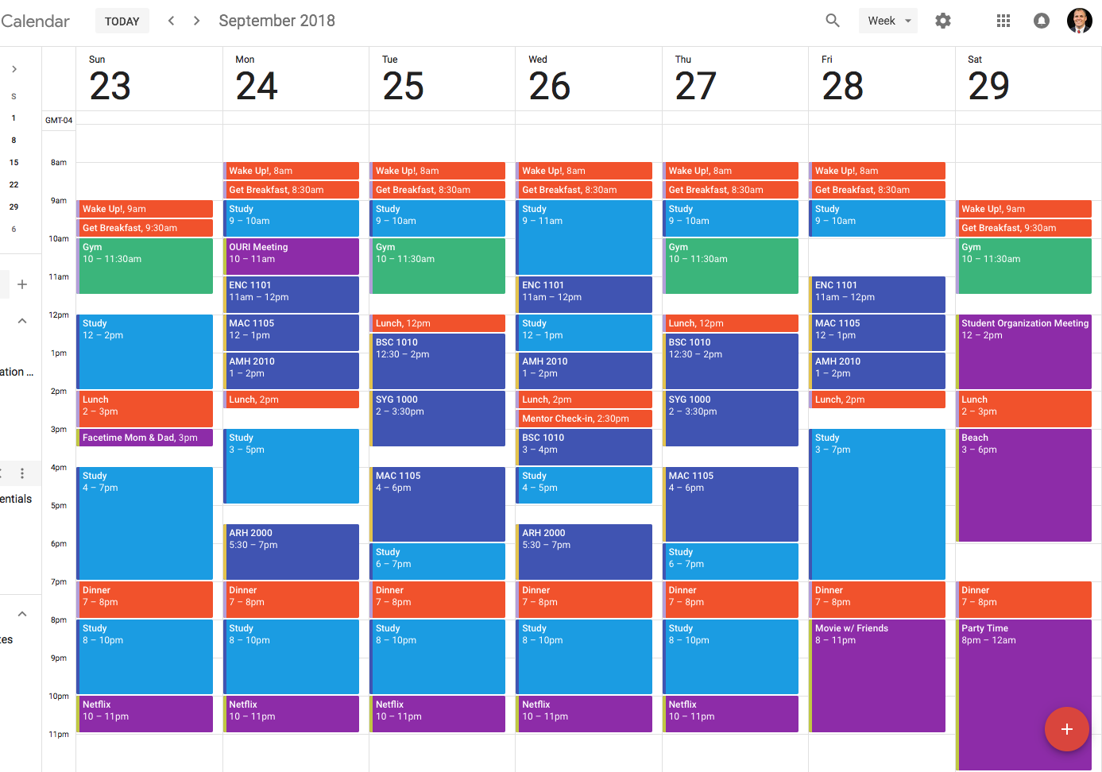

Slide 6




Skills for College Success
Engage in your classes
Time management
Sharpen your study skills
Practice self-care

Slide 7

Center for Learning And
Student Success (CLASS) Objectives

Slide 8
Interacting with Faculty: Top 5 Tips
Go to class prepared
Read your syllabus
Use office hours
Ask for help before you need it
Be honest with your professor & to yourself

Slide 9
Campus Resources
Office | Location | Phone Number | Email/ Website
University Advising Services | SU 80 Room 201 | 561-297-3064 | advisingservices@fau.edu
Student Accessibility Services | SU 80 Room 133 | 561-297-3880 | https://www.fau.edu/sas/about/contact_us.php
Career Center | SU 80 Room 220 | 561-297-3533 | career@fau.edu
OIT Help Desk | CM 138 | 561-297-3999 | http://helpdesk.fau.edu
Student Health Services | SS-8W Room 240 | 561-297-3512 | https://www.fau.edu/shs/about/contact_us.php
Counseling and Psychological Services (CAPS) | SSB 8 Room 229 | 561-297-3540 | https://www.fau.edu/counseling

Slide 10
Let’s Recap
Feel and build curiosity about your classes. Make connections to what you already know, what interests you, and who you want to become.
Embrace an active role - learn with your faculty and peers.
Explore the differences between high school and college. College is real life – develop the habits of the mind that will help you succeed now and in your future.

Slide 11
Come visit us!
General Classroom South (GS) Building, 2nd floor
Academic Success Initiatives
Center for Learning And Student Success
- eSuccess
- Science Learning Center (located in the Schmidt Family Complex)
- Supplemental Instruction
- Tutoring
Math Learning Center
Open Study and UHP Study Space
The Speaking Center
Undergraduate Research and Inquiry
University Center for Excellence in Writing

