Slide 1


Welcome
FIRST-YEAR MENTORING
Notes:
ARZ & Shamere
-Welcome
-In the chat, place your name, major, and what you’re looking forward to in a mentoring relationship?

Slide 2

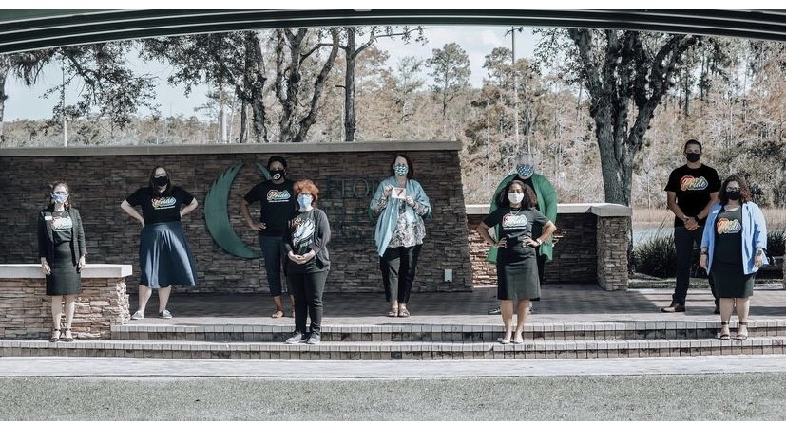
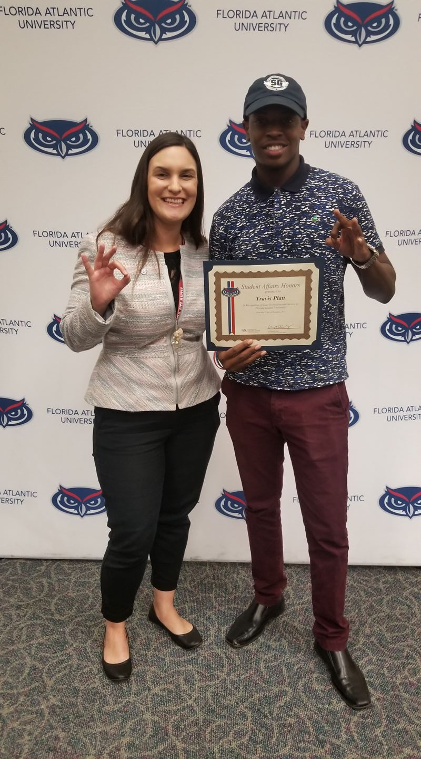
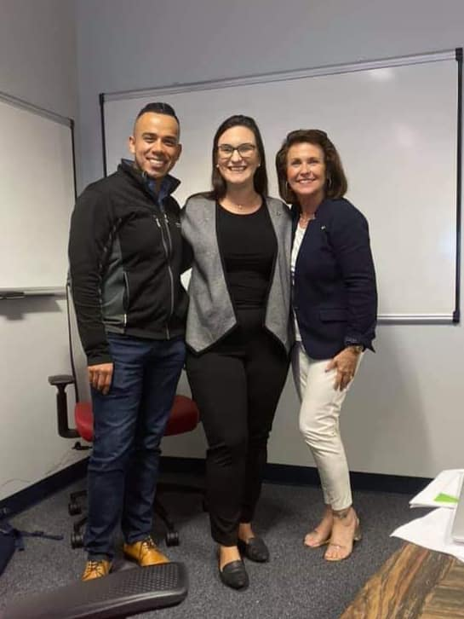
Why are we here today?
We are excited to introduce you to First-Year Mentoring and how to connect you to a social and/or academic mentor in your first-semester at FAU!
Notes:
Allison

Slide 3

What does Mentorship mean to you?
Define mentoring
or
Share a name of a mentor/mentee in your life
Notes:
Shamere

Slide 4
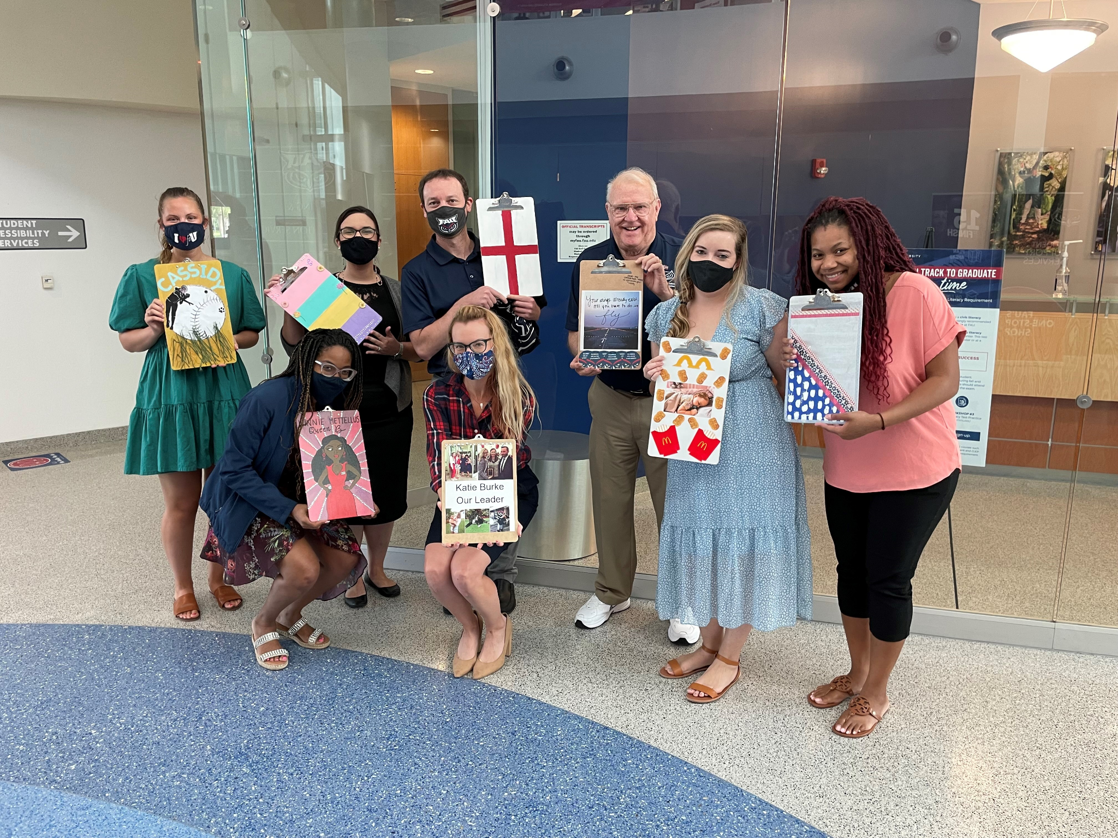
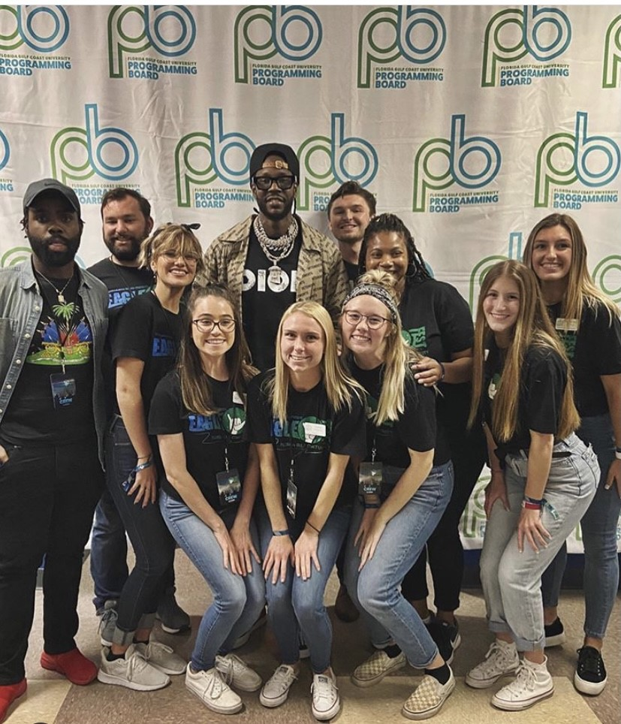
The Importance of Mentoring
Build On Campus Connections
It’s about what you know AND who you know
Gain practical advice, encouragement and support
Increase your social and academic confidence
Develop your communication, study and personal skills
Develop strategies for dealing with both personal and academic issues
Notes:
Shamere/Allison alternate
Build On Campus Connection
Transferable Knowledge
It’s about what you know AND who you know
Gain practical advice, encouragement and support
Learn from the experiences of others
Increase your social and academic confidence
Become more empowered to make decisions
Develop your communication, study and personal skills
Develop strategies for dealing with both personal and academic issues

Slide 5

Defining Mentorship
(Nora and Crisp, 2007)
A trusting and vulnerable relationship between a more experienced individual and a first-semester student seeking advice and guidance in transitioning successfully to university life.
Psychological or emotional support
Goal setting or career planning support
Academic or discipline-based knowledge
Academic or professional culture behavioral role model
Notes:
Allison

Slide 6

How are we matched?
Students will be matched by Campus
Students will be matched preferring:
Race/Ethnicity
Gender Identity
College Major
Military Veteran
First-Generation
No Preference
Unique elements: (1) One-on-one format, (2) preferred matching, (3) semester connection
Notes:
Allison
Unique Elements:
Speak to the one-on-one format , we can go up to 3 mentees.
Preferential matching: Every match will include preferred campus, then every mentor mentee can elect to be matched on ;
match based on mentor mentees primary campus . Mentors mentees have the ability to be matched by race , enicnity , ect
Recruitment Targets:
Spring 2020:
100 mentors for:
250 First Year mentees (24 will be Orientation leaders )
50 Transfer mentees
Onboarding :
We will be utilizing mentorcliq to onboard our mentors & mentees:
Registering through Mentorcliq
Matching will begin in Week#2 Sp 2020.
Mentors & mentees will meet during the first of three hosted events
Spark: Mid January 2019
Sparkle: Dining Hall- March
Splash: Mid April
Match Criteria: The updated matching criteria will be assigned through MentoricliQ. Variables labeled as solid are static whereas the flexible variables allow the mentor and mentee to identify their matching preferences. The flexible preference statement would be as followed:
1. “Yes, I want to be matched with this preference.”
2. “No, I do not want to be matched with this preference.”
3. “I have no preference.”
The matching will be based on the following when possible:
• Preferred Campus (Solid)
• No preference
Race/ethnicity (flexible based on preference)
• Gender identity (flexible based on preference)
• College/major (flexible based on preference)
• Military veteran (flexible based on preference)
• First-generation College student (flexible based on preference)
Assessment :
We will be utilizing mentorcliq to onboard our mentors & mentees
Onboarding
Matching
Assessment

Slide 7
How do we connect?
Apply to become a mentee
Match will begin Week two of fall 2021
Connect with your Mentor in late August and meet throughout fall semester
  Event 1: Late August
  Event 2: Mid October
  Event 3: Late November
Notes:
Allison

Slide 8
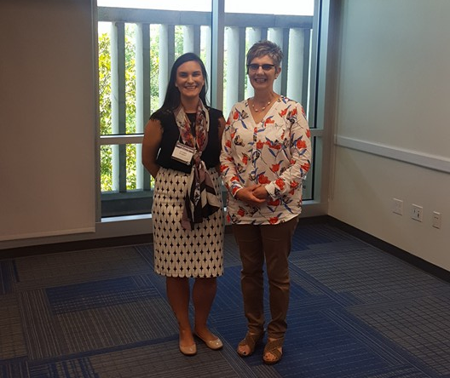
What is the role of a Mentor?
A mentor is a person with more experience or knowledge in a specific area, who agrees to mentor another person and guide them in becoming successful.
First-Year Connections Mentors include: Undergraduate Students, Graduate Students, Faculty, Staff, and University Leaders
Notes:
Shamere

Slide 9
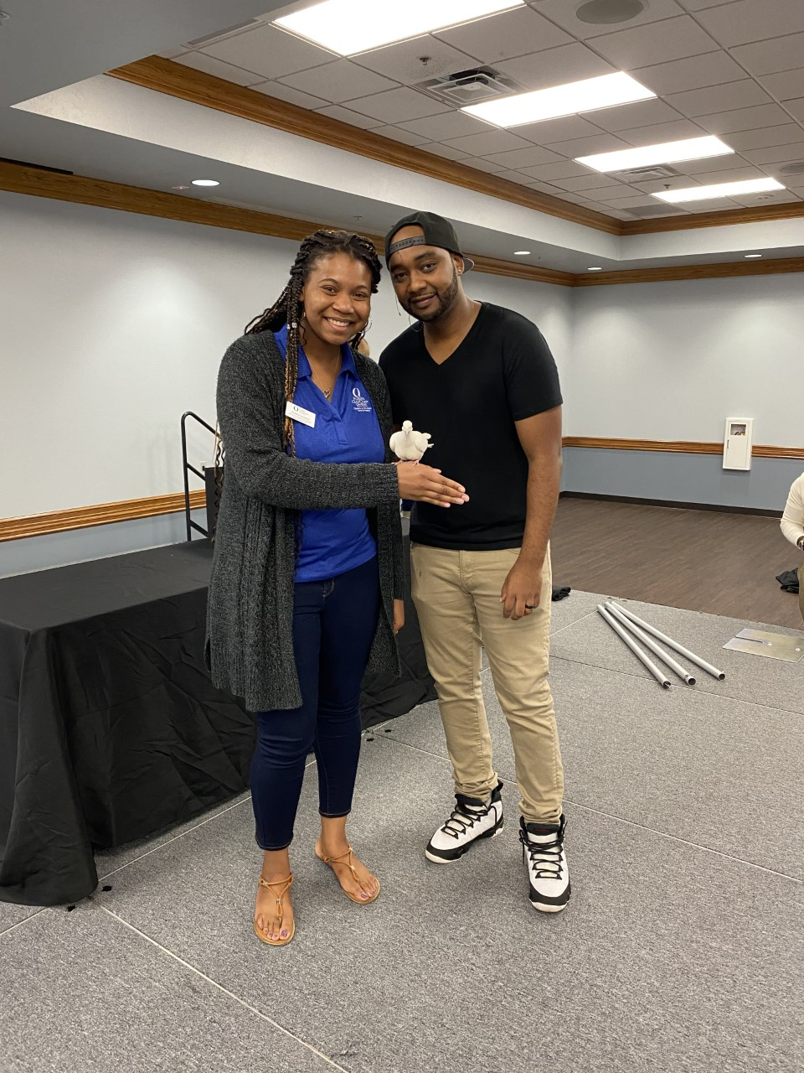
What is the role of a Mentee?
A mentee is a person whose role is to learn from the expertise and experiences of another person, willing to offer knowledge, guidance, and support.
First-Year Connections Mentees include: First-Year Students and Transfer Students in your first semester at FAU
Notes:
Shamere

Slide 10
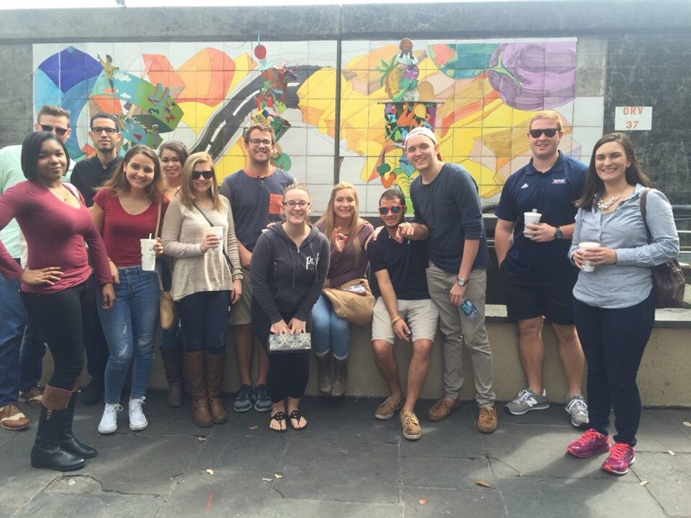
What will Mentees learn?
Recognize normalized feelings of fear of the unknown, excitement and anxiety in exploration
Solve specific problems and challenges
Practice an expanded understanding of the university
Express increased commitment and connection to the FAU community; and
Explore mentoring opportunities that expand beyond the life of the program
Notes:
Shamere: main takeaways: (1) first-semester students are not alone. (2) Mentors want to be there for you in the highs and the lows; it’s okay to be vulnerable. (3) Trust the mentoring process.

Slide 11
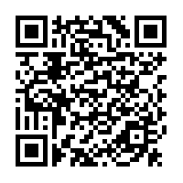

What’s Next?
First-Year Connections
Mentee Application
(FAU email required) --->
Apply today!
Questions?
Email us at mentoring@fau.edu
Allison Rodgers Zapata RodgersA@fau.edu
call 561.297.2733
Follow us on Instagram: @faumentoring
Notes:
Shamere

Slide 12

Your Involvement Breakout Session
is complete!
Students
Parliament Group Meeting #5
Ready, Set, Resources!
Families
Family Wrap-Up
Ready, Set, Resources!

