Slide 1


Slide 2





Hello!
Office of Student Financial Aid Student Support Services Bldg SU80, Room 233 (561) 297-3530

Slide 3

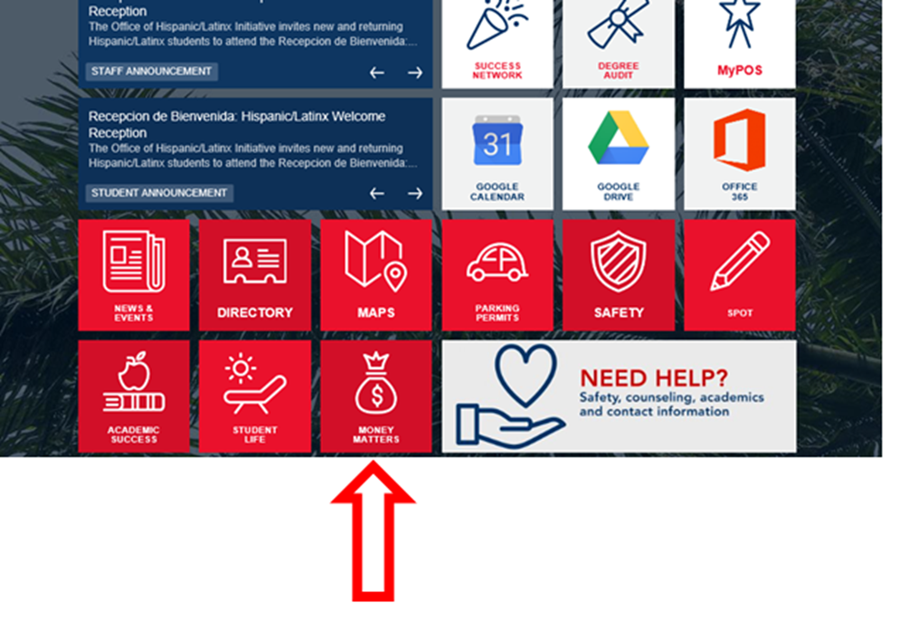

Slide 4

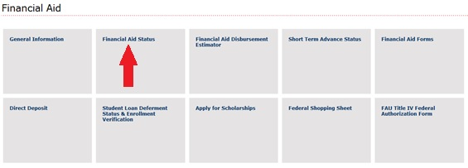
Student requirements
Financial Aid offer
Academic Progress

Slide 5

Complete a FAFSA
When:
Now! FAFSA opened October 1st each year
Summer semesters: 2020-2021 application
Fall 2021 and on: 2021-2022 application
Why:
Apply for grants, loans, Work-Study, and to be considered for institutional grants and scholarships… You never know!
How:
Online at studentaid.gov
StudentAid.gov app

Slide 6
Understanding your Aid Package
Don’t see it yet?
All student requirements must be satisfied for a student to be packaged and for aid to disburse
Must meet SAP, enrollment requirement,
degree applicability

Slide 7
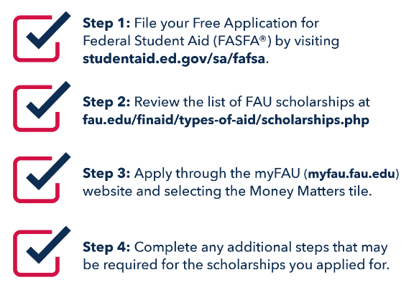
Apply for Scholarships

Slide 8
Bright Futures Scholarships
Inform Bright Futures that you will attend FAU
Required GPA to renew
Florida Academic Scholarship: 3.0 GPA
Covers 100% of tuition and applicable fees
Florida Medallion Scholarship: 2.75 GPA
Covers 75% of tuition and applicable fees
Must be enrolled in minimum 6 credits and degree seeking
Available during the Summer!

Slide 9
Student Loans 101
If you need to borrow money for college costs:
Start with federal loans: subsidized vs unsubsidized
Fixed interest rate, income-driven repayment plans, periods of deferment
Keep in Mind:
Be a responsible borrower
Research starting salaries in your field
Understand terms of your loan
Make payments on time

Slide 10


My financial aid package is all set…now what?
Check out the Financial Aid Disbursement Estimator
Set up Direct Deposit
Download the Financial Aid Calendar

Slide 11

Using Financial Aid to pay for Books
Short Term Advance – up to $750 in your direct deposit
Book Store Line of Credit – up to $400 at the bookstore

Slide 12

Learn more…
.. ..about student loans, budgeting, and making educated financial decisions!
Available to ALL currently enrolled students
NO additional cost
Zero credit hours = NO PASS/FAIL!
Materials remain fully accessible

Slide 13
Questions?!
Office of Student Financial Aid
Student Support Services Bldg,
SU80, Room 233
(561) 297-3530
Contact your Financial Aid Counselor

