Slide 1


Slide 2

Prohibited Discrimination and Harassment at FAU

Slide 3
Who we are…
Office of Equity and Inclusion
Administration Building, Room 265
Our office investigates complaints of discrimination, harassment, sexual assault and other types of sexual misconduct.

Slide 4

Why are we here?
To provide you with information on the University’s policies and regulations relating to discrimination, harassment, and Title IX Matters.
To discuss reporting and investigative processes.
To provide information on the resources available to all students.

Slide 5

FAU Prohibits Discrimination
+ Harassment
All forms of discrimination or harassment based upon an individual’s race, color, religion, sex, national origin, age, disability, veteran status, marital status, pregnancy and parenting status, sexual orientation, gender identity or expression, or other protected status is a violation of University Regulation.
Title IX Matters refers to discriminatory conduct that includes sexual harassment, sexual assault, dating violence, domestic violence, and stalking. Such conduct is expressly prohibited.

Slide 6
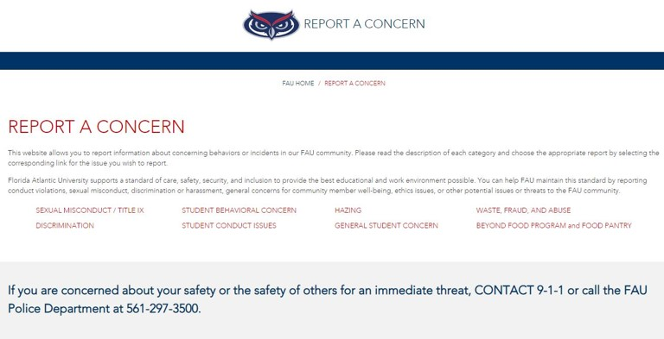
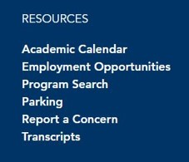
How do I make a report?
Visit www.fau.edu/report or select “Report a Concern” from main FAU homepage.

Slide 7
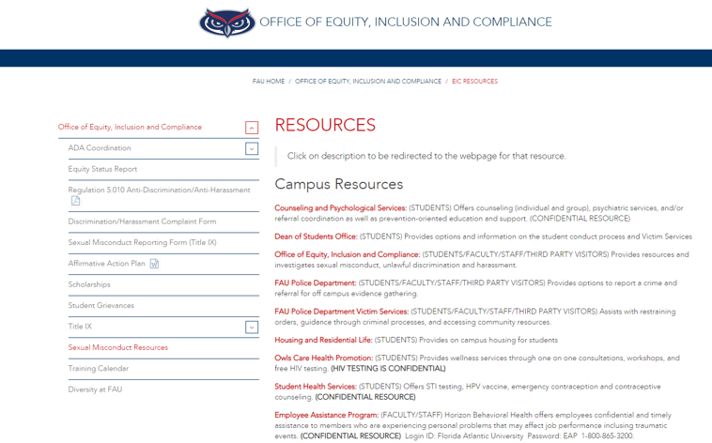
What are the available resources?
Visit www.fau.edu/eic/resources
Or
http://www.fau.edu/dean/victimservices
for more information about resources available
on and off campus.

Slide 8
What happens after I make a report?
Upon receiving report of discrimination or harassment, OEI ensures parties are provided with supportive measures.
OEI determines whether it has enough information to begin an investigation. If yes, OEI will follow procedure outlined in Policy 1.15.
Final investigation report submitted to appropriate administrator.
If a violation is determined in non-Title IX matters, the Administrator will issue corrective action. All Title IX Matters are referred to a hearing to determine the outcome.

Slide 9

How/What to report
Where to get help
Be Aware
Office of Equity and Inclusion
561-297-3004
Protect your Owl Family!

