Slide 1

Education Abroad

Slide 2

EDUCATION ABROAD
Staff
Madison McShane - Director
Brendan Richardson – Assistant Director
Lindsay Hughes – Study Abroad Coordinator
Our Mission
Education Abroad supports FAU’s global initiatives by creating accessible international programming and opportunities for students, faculty, and staff. Through advocacy, advising, research, education, and training, we promote a globally-minded and culturally aware community.

Slide 3


EDUCATION ABROAD
Notes:
Introduction – little bit about presenter

Slide 4



ELIGIBILITY
Good standing with an overall 2.5 GPA or higher
Freshman, Sophomore, Junior, Senior, & Graduate students
Open to students of any major, minor, certificate or undecided

Slide 5



PROGRAM OPTIONS
Faculty-Led Programs
Exchange Programs
Direct Enroll Partner Programs
Notes:
Briefly discuss the different options
FLP – an international component added to an already existing FAU course taught by FAU faculty
Exchange – agreement between two universities that allow exchanging students; tuition through FAU; typically a semester; pre-approved coursework
Direct Enroll – students enroll directly with host institution; pay their tuition; great for out-of-state students; pre-approved coursework

Slide 6

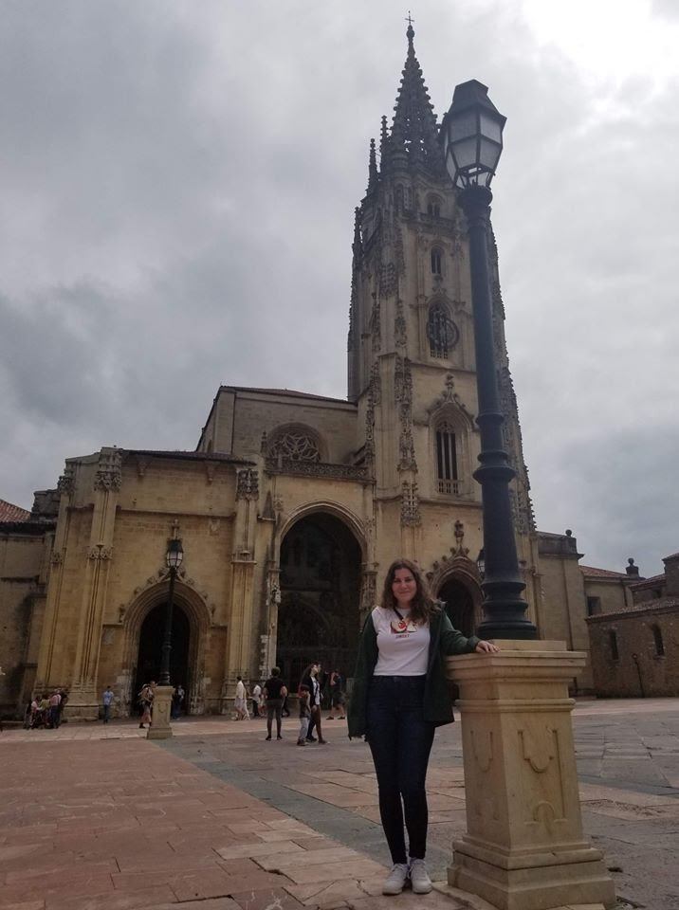
Services Provided
Group Advising Sessions
1:1 Advising appointments
Working with Advisors for course approvals
International Health Insurance
Various events and workshops
Pre-Departure Orientation
Notes:
Our office provides weekly or bi-weekly group advising sessions that cover what study abroad, financial aid, etc. it’s designed for those students that are just starting to think about it
We also organize individual advising sessions once a student has started to identify a program, semester, or given more thought on study abroad
I mentioned that students are getting courses pre-approved, well we work with advisors and department heads to get any course pre-approved that hasn’t been already
FAU Education Abroad mandates that all students studying abroad have international health insurance. Those participating on our programs will enroll in CISI Insurance, which can be found on our website
We partner with other departments on campus to host various workshops and events on campus. We’ve partnered with Financial Aid, the Career Center, International Student Services, and plan to work with more
It is a requirement that all study abroad students, regardless of program, attend the Pre-Departure Orientation. Our office manages the expectations of students by covering information before traveling, while abroad, and coming home

Slide 7

FUNDING
Federal Financial Aid
Scholarships
Education Abroad
National
Departmental
Outside sources
GI Bill
Bright Futures
Florida Prepaid

Slide 8
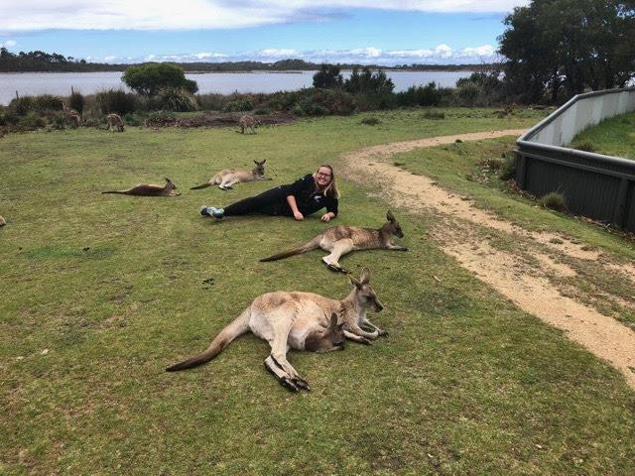
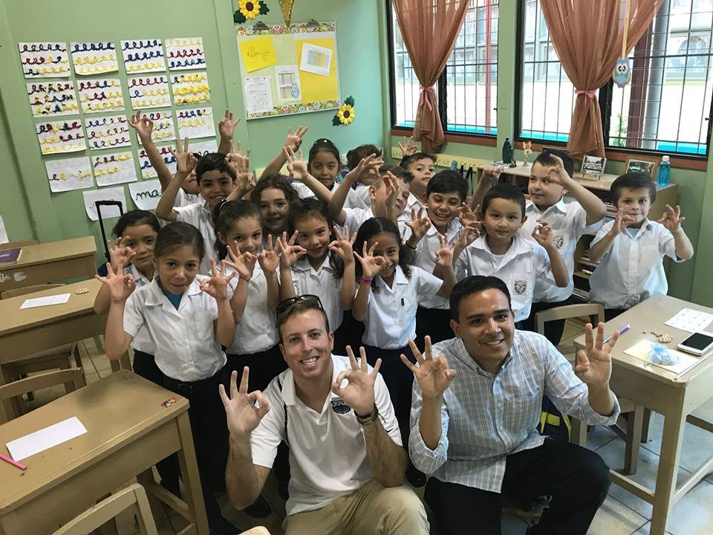
FREQUENTLY ASKED QUESTIONS
Do I need to know the language?
Will credits go toward required summer credits?
Where will I stay?
When is the best time to go?
What’s my next step?

Slide 9


EDUCATION ABROAD
Location: General Classroom South 212Q
Hours: 8:00am – 5:00pm Monday – Friday
Email: goabroad@fau.edu
Phone: 561-297-1208
Website: fau.edu/goabroad
FAU Education Abroad
@FAU Education Abroad

Slide 10
Your Involvement Breakout Session is complete!
Students, please head back to your small group Parliament breakout rooms. To get there, use the same link that you used to access your Parliament group earlier.
Family members, you will be heading to the “Family Wrap-Up” Zoom session.
Enjoy the rest of your day SOARing with us!

