Slide 1

Responsible Freedom
Audrey L. Pusey, Interim Dean of Students
Ryan Iocco, Assistant Director for Student Conduct

Slide 2

Dean of Students Office
We Advocate for Students
Questions, Concerns?
Come see us!
Services
Food Pantry
Exceptional Circumstance Withdrawal
Student Crisis Intervention
Victim Services
Respondent Services
Medical Amnesty
Academic Integrity Seminar
Student Code of Conduct
Conflict Resolution and Mediation

Slide 3

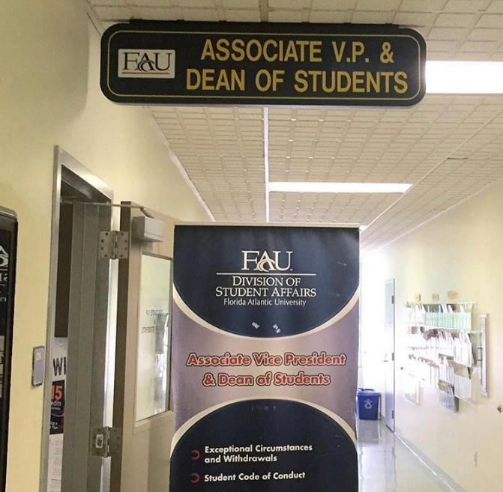
Dean of Students Office
Student Services Building (SS #8), Room 226 561-297-3542
http://www.fau.edu/dean/

Slide 4


Be Responsible in Your Decision Making
Know the Code! (On and Off Campus)
Regulation 4.007
www.fau.edu/studentconduct/

Slide 5

Student Conduct
Philosophy & Mission
“Helping students who make decisions that are not in
their best interest, to develop into their best self.”
Restorative Justice Focus
Conflict Resolution Skill Building
Conflict Coaching
Facilitated Dialogue
Formal Mediation

Slide 6
Assessment of Violations of the Code of Conduct
Partner with university departments to triage and assess immediate risks:
Immediate measures via Dean of Students
Safety planning
Support of impacted individuals
Referrals to various campus departments (CAPS, Student Health, PD)
Possible incidents addressed via the Student Code of Conduct
Residential Community Guide
Student of Conduct (Regulation 4.007)

Slide 7

Alcohol Use
If you are under 21, you may not use or possess alcohol.
Hard liquor is not permitted in the residence hall.
Alcohol may not be consumed outside of a residence hall suite.
You may not be intoxicated in the residence hall regardless of age.
Parental Notification
If you are under the age of 21, we will notify your family for violations of our alcohol and drug policies.

Slide 8
Drugs/Controlled Substances Policy
Use, possession, delivery to, sale of drugs or drug paraphernalia.
Penalty – Probation, community service, educational class, and parental notification, removal from the residence halls.
You may be arrested and/or suspended from school on a first violation depending on the incident.

Slide 9
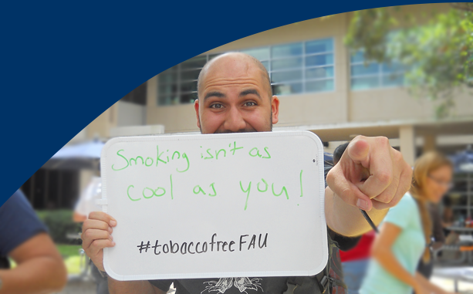
FAU is a Tobacco Free Campus
Use of all tobacco products including: cigarettes, cigars, pipes, smokeless tobacco, snuff, chewing tobacco, smokeless pouches and any other form of loose-leaf, smokeless tobacco is prohibited on all FAU campuses – includes E-Cigarettes and vapes
Includes indoor, outdoor and in vehicles on campus

Slide 10
Victim Services Office
Supports student victims/survivors:
Acting as a liaison between the victim/survivor and FAU
Assisting with navigating campus processes
Referrals to resources
Class and housing accommodations
Safety planning
Guidance with criminal processes
Located in the Wimberly Library, Room 156
http://www.fau.edu/dean/victimservices/
561-297-4841

Slide 11
Respondent Services
Provides guidance, resources, information, and referrals for students who have been accused of sexual misconduct related violations of the Student Code of Conduct or the Anti-Discrimination and Anti-Harassment regulation.
Assist students with understanding their rights.
Aides students in navigating investigation and adjudication processes.
Located in the Dean of Students Office, SS8-226
561-297-3542

Slide 12

“Know the Code”
Academic Dishonesty.
Conduct Record could impact your future jobs and graduate school.

Slide 13

Be an Active Bystander
Your awareness, and reporting, allows FAU administration to assist with early interventions
Medical Amnesty
Keep your friends safe, call for help
See something! Say something!
The Dean of Students works closely with our FAU police department to determine immediate safety needs
Be Prepared, Be Safe
Dean of Students Office http://www.fau.edu/dean/

