Slide 1


Slide 2

Atlantic Dining Hall / Jupiter Dining Hall
All you can eat with a great variety of favorites and flavors.
Let us serve you! – Our dining halls are still all you care to eat.
Let us cook for you, stay on campus.
Breakfast, lunch, and dinner are served weekdays with brunch and dinner on weekends.
We are closed in between meal periods for deep cleaning and disinfection.
Grab and go options available to keep you moving through your day.
Most of all – a great value anytime you want to eat.

Slide 3

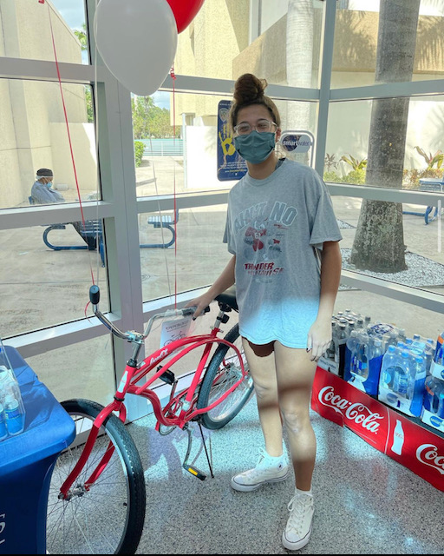
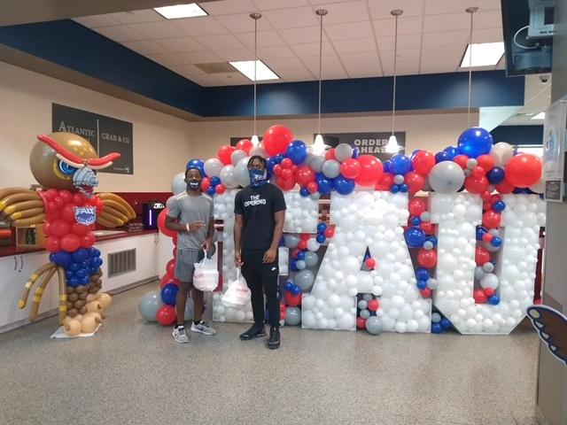
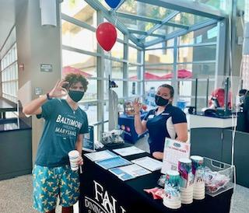
EVENTS
2 x a month
Music
Decor
Theme Meals
Great Food
Entertainment
Games
Raffles

Slide 4
Dining Plans - Residential Students
Residential Meal Plans - Boca Raton Campus (Per Semester)
19 Meals a Week $1,951.00
15 Meals a Week and $100 in Flex Bucks $1,846.50
12 Meals a Week and $100 in Flex Bucks $1,646.00
7 Meals a Week and $550 in Flex Bucks $1,990.50
Residential Meal Plans – Jupiter Campus (Per Semester)
19 Meals a Week $2,070.00
14 Meals a Week $1,948.00
◊ Meals are for the Atlantic Dining Hall and Jupiter Dining Hall.
◊ Flex Bucks can only be used at dining locations, they are issued one time per semester, and expire at the end of the semester.
◊ Meal plans reset every Sunday.

Slide 5

Commuter Students – Profiler Meal Plans and Owl Bucks
Profiler Meal Plans can be used at the Atlantic Dining Hall and the Jupiter Dining Hall – These meals do not expire throughout the year and only expire after one year of inactivity.
30 Meals $247.17
50 Meals $348.82
85 Meals $569.33
110 Meals $700.85
Owl Bucks
Pre-paid declining balance account for use at any FAU Dining location and the FAU Bookstore
May be added to any meal plan
Do not expire

Slide 6



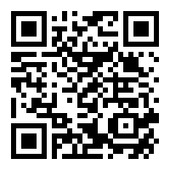
Where to Eat (Summer 2021)
Starbucks
Chick-fil-A
Subway
Outtakes

Slide 7




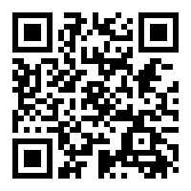
Where to Eat (Fall 2021)
Atlantic Dining Hall
Starbucks
Chick-fil-A
Pizza Hut
Wendy’s
Pollo Tropical
Dunkin’
Einstein Bros.
Subway
Outtakes

Slide 8

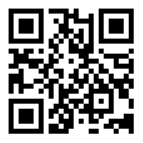
The GET App
What is the GET app? We are excited to present this new and innovative dining feature.
The GET app allows you to track your meal plan, Flex Bucks, and Owl Bucks.
The ability to order food in advance for pick up.
The GET app is available for download in both the Apple App Store and Google Play Store.

Slide 9


