Slide 1

College of Social Work and Criminal Justice
#OwlInToGraduation

Slide 2

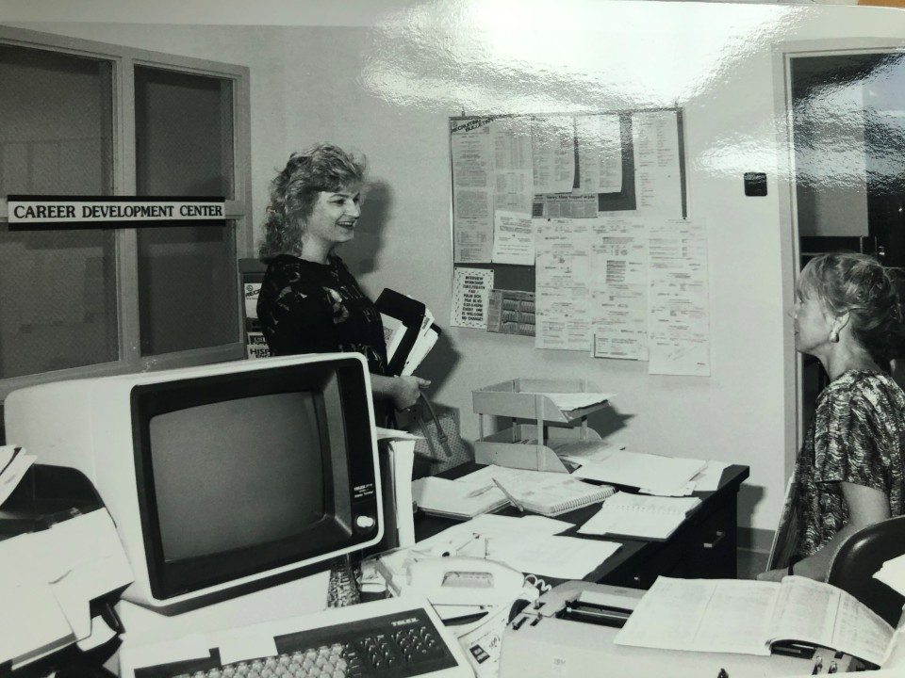
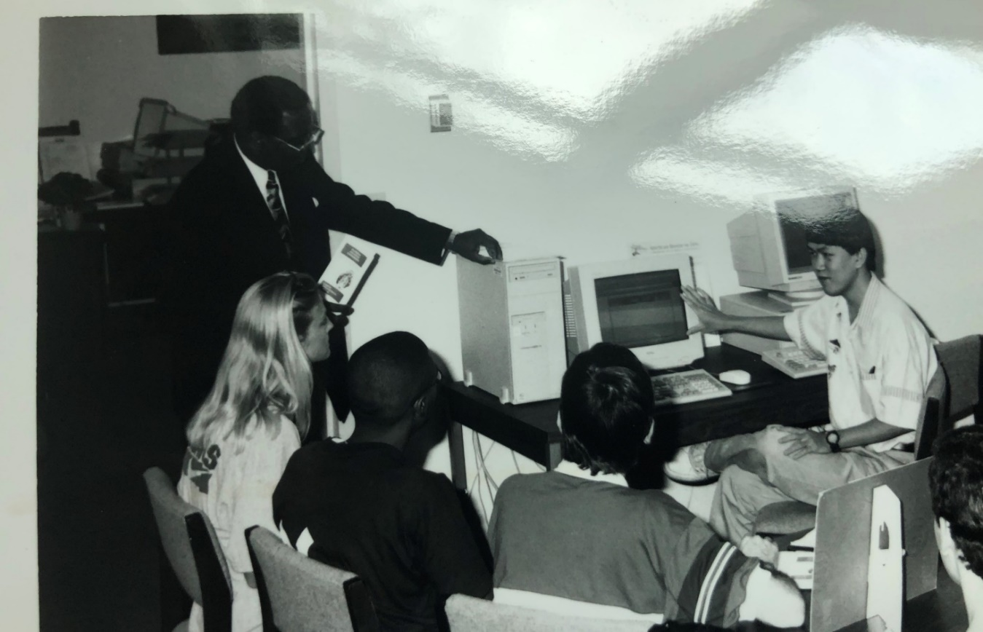
How It Started Career Center, 1965
Notes:
Show Career Center was one of the first offices at FAU.. Career has always been a value to FAU. What we looked like “before”

Slide 3
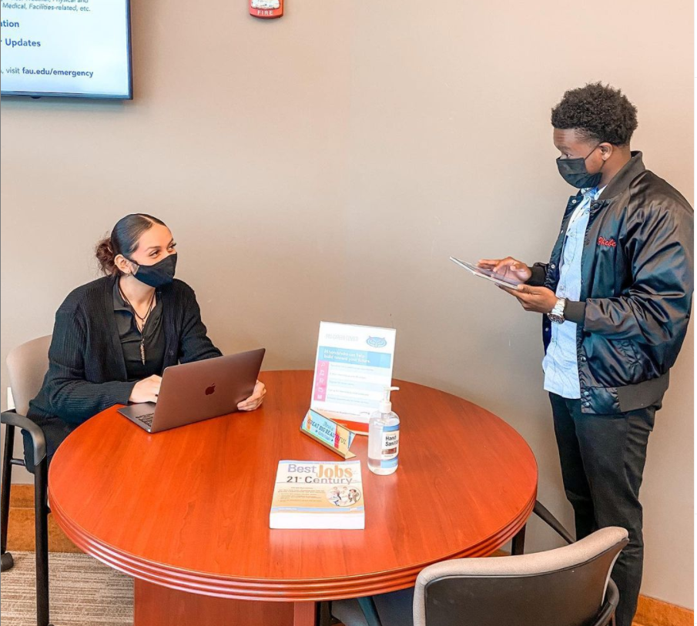
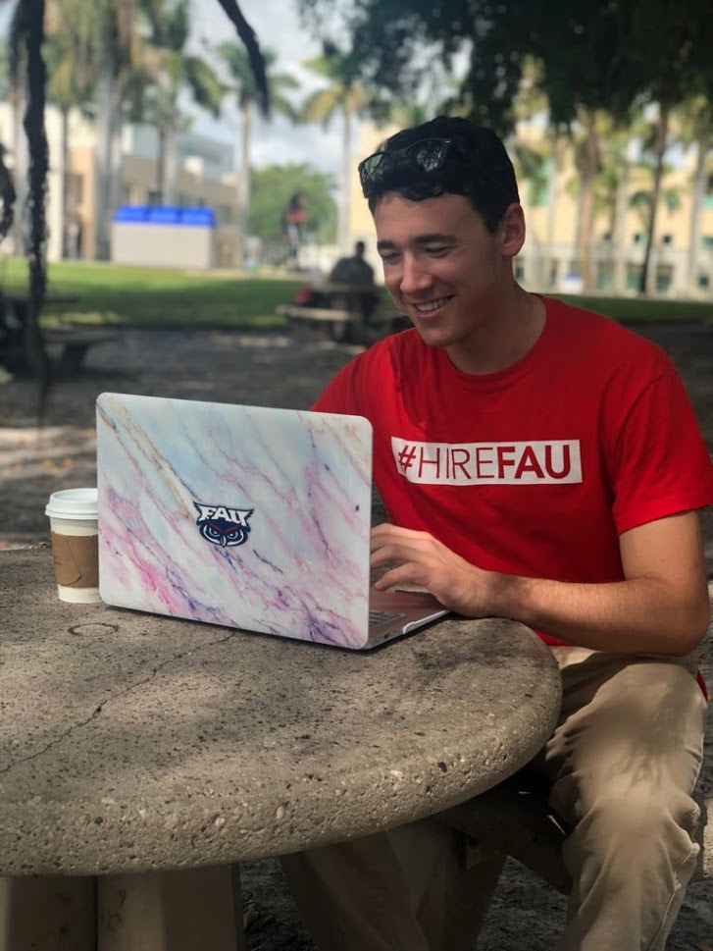
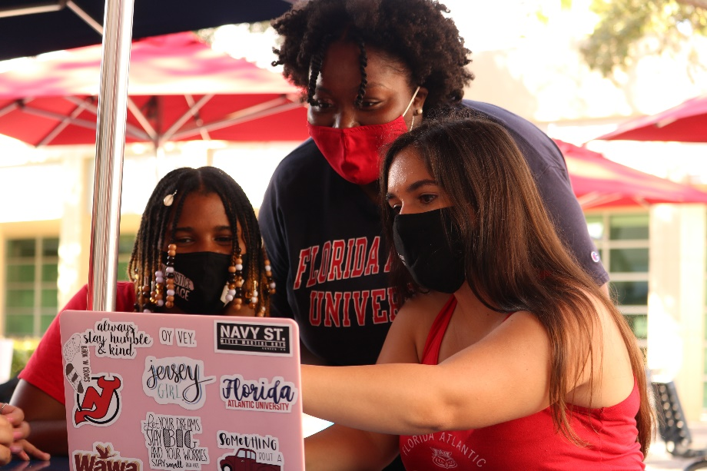
How It’s Going Career Center, 2021
Notes:
Career Center now– more modern, all over campus, help students where they are at.. Online and in-person.. Career ecosystem idea.

Slide 4

How It’s Going Career Center, 2021
Notes:
Career Center now– more modern, all over campus, help students where they are at.. Online and in-person.. Career ecosystem idea.

Slide 5

3
Things To Do Before Classes Start …
To Be Career Ready
Notes:
Learning a lot at SOAR.. Here is what you can do now to be career ready before classes start

Slide 6
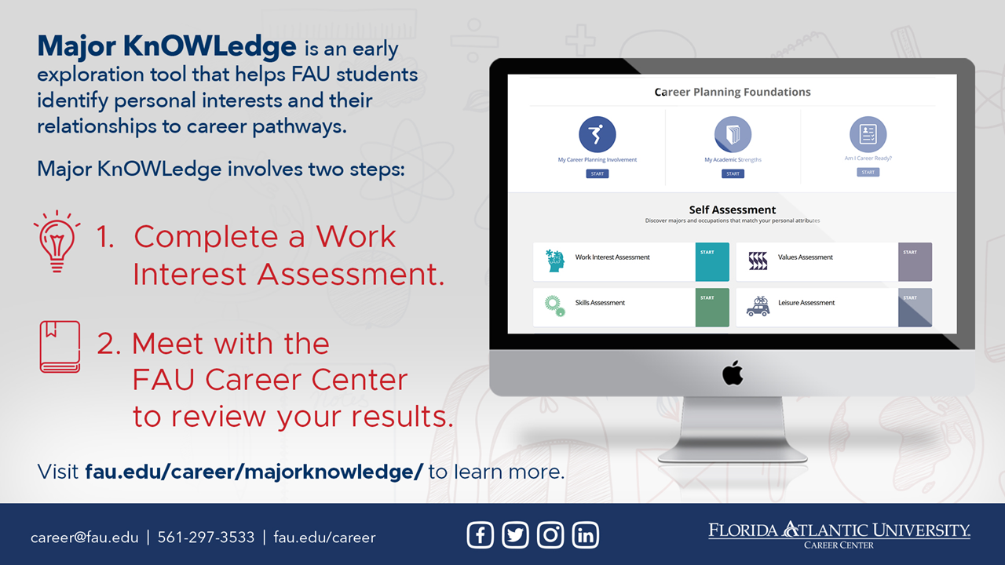
Notes:
Take MK
Explain both parts

Slide 7
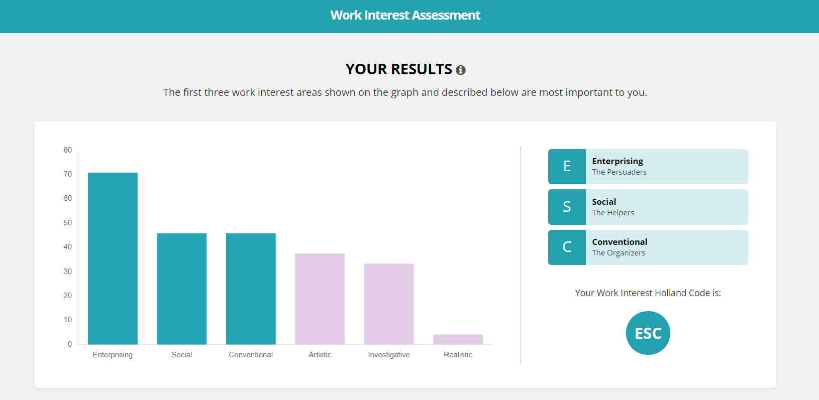
Notes:
Take interest inventory and get top 3 types… career coach will review in more detail during session.

Slide 8
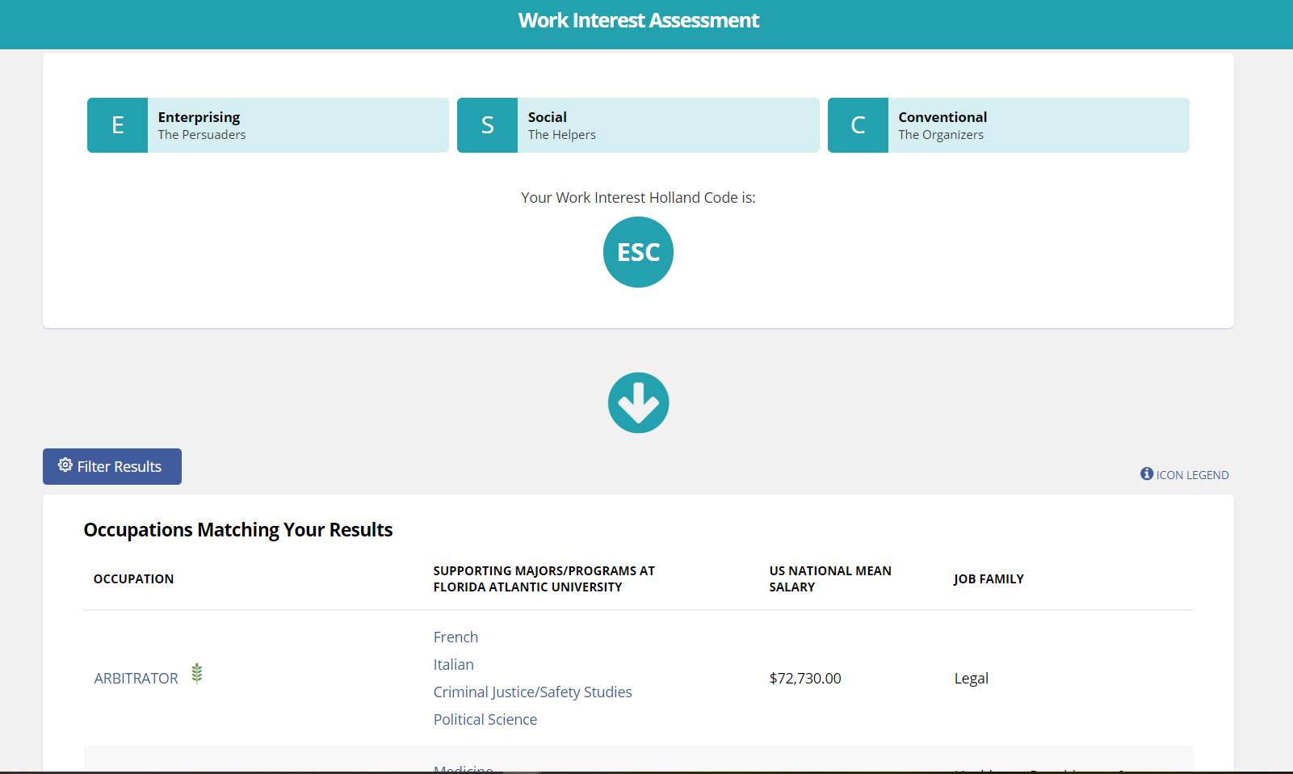
Notes:
The types converts into list of occupations and you can learn salaries, skills, and majors and more when clicked.

Slide 9
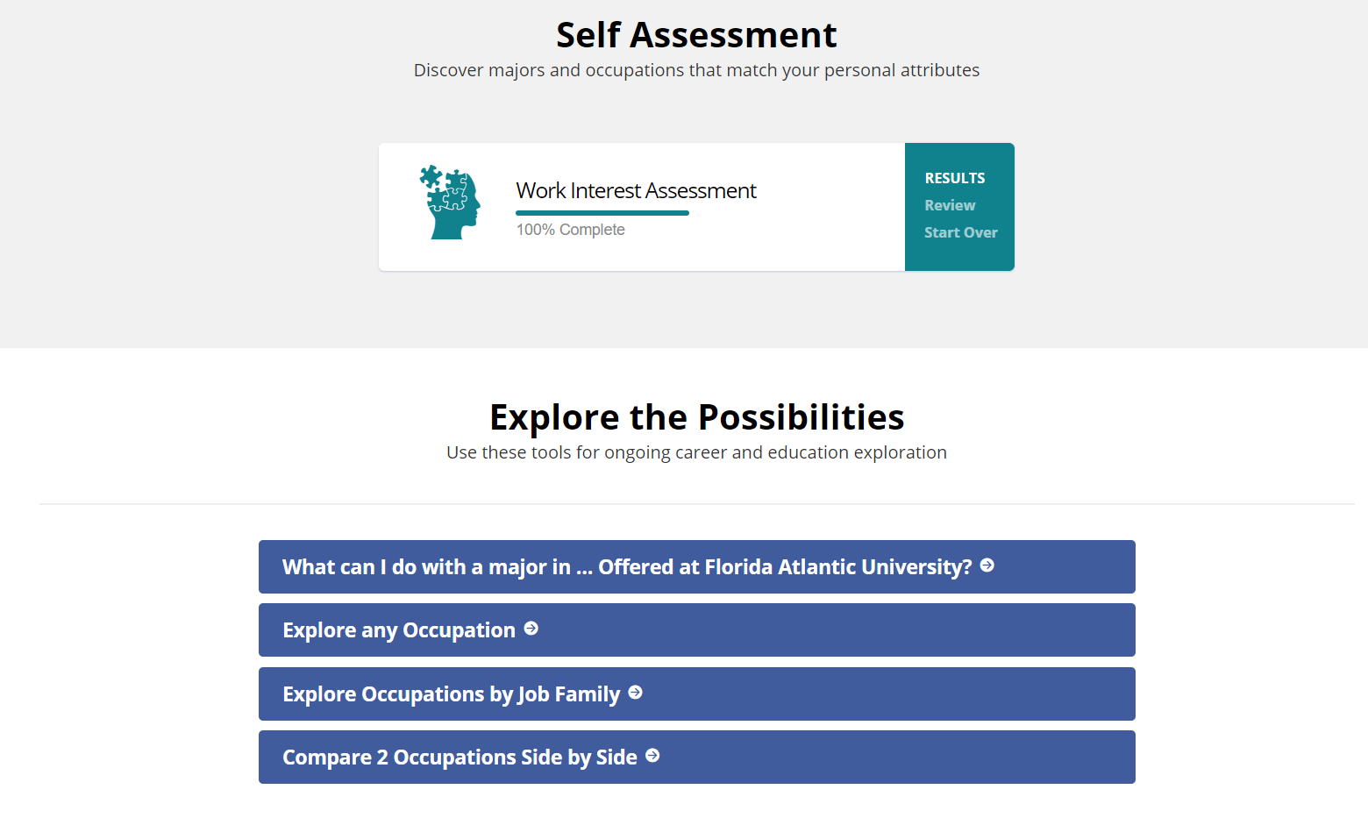
Notes:
Already know what you want to do? Explore what you can do with a major in.. Explore occupations, compare occupations, etc.

Slide 10

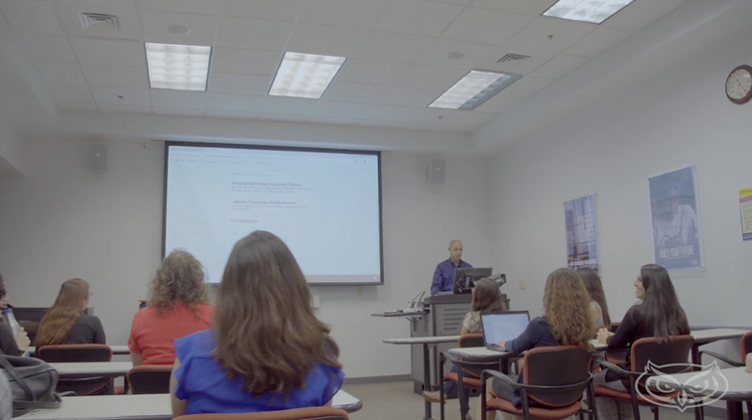
Still Deciding? Sign up for SLS 1301
1-credit elective course
This class provides an overview of career development theories and decision-making skills for career/life planning.
Focuses on:
self-assessment
deciding a major
exploring career options
developing an action plan
All to help you achieve your career goals!
Notes:
Please promote SLS 1301, even if students feel confident in the college but not the major this could be helpful or to help them decide on occupations other options!

Slide 11

Notes:
Second thing to do.. Claim Handshake account. Quick review of what is Handshake.

Slide 12

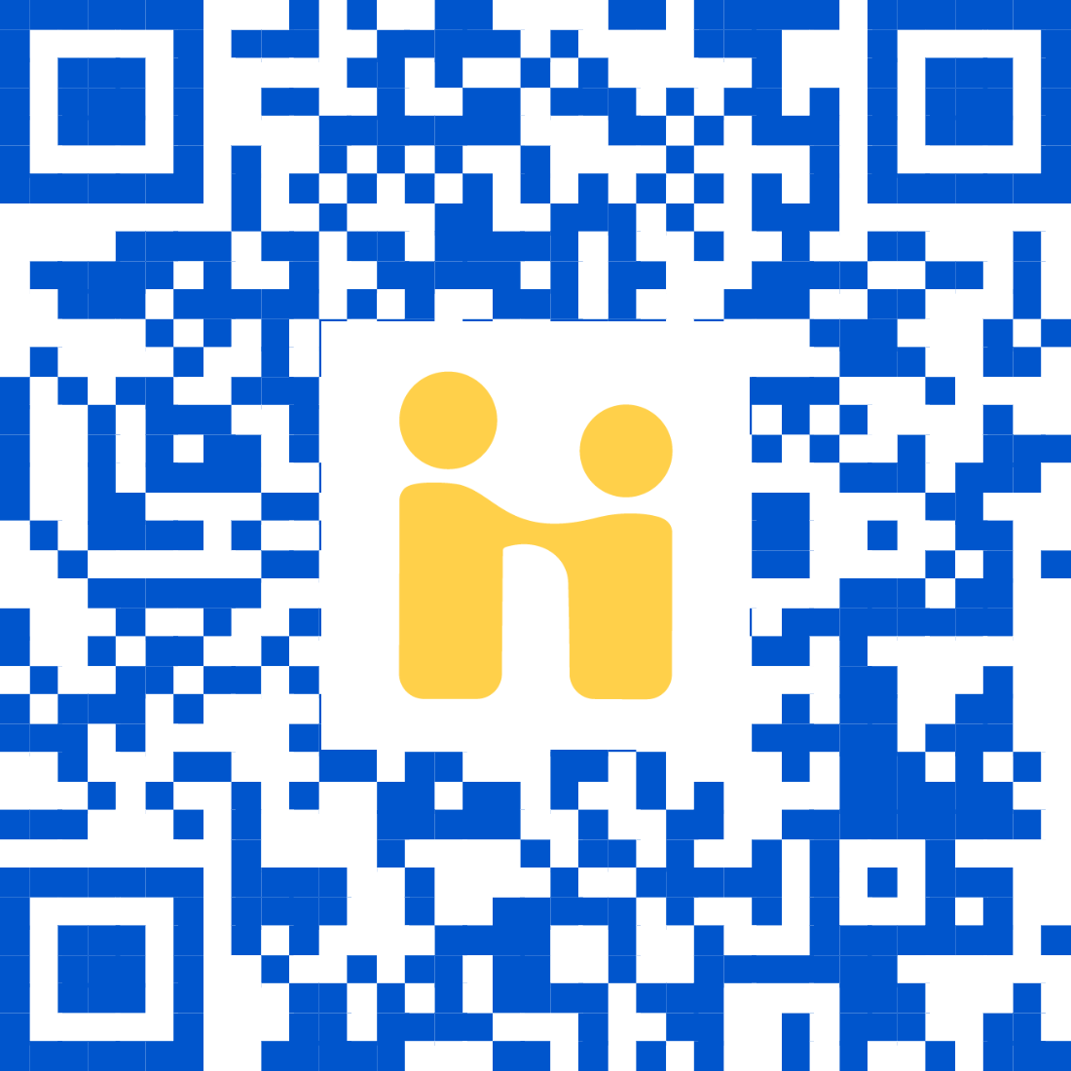

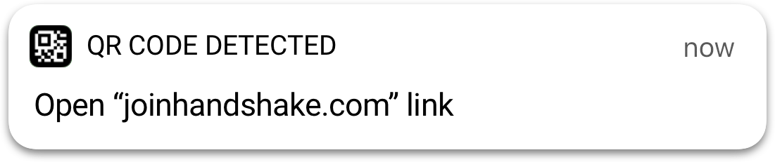
Open your camera app
Tap the notification that pops up!
OR
Go to
fau.joinhandshake.com
Note: If you have not registered (or just registered) for classes yet, you will not be able to login yet and will receive an email from our team when your account is ready!
Notes:
If time permits.. ask students to claim account. Only students that registered for classes can claim account. Or will be able to claim one week after registering for classes.

Slide 13



Slide 14
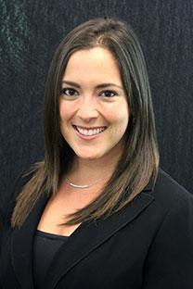
Contact Information
Dawn Kesselman
Career Counselor for Social Work and Criminal Justice Majors
dfriedman2012@fau.edu

Slide 15
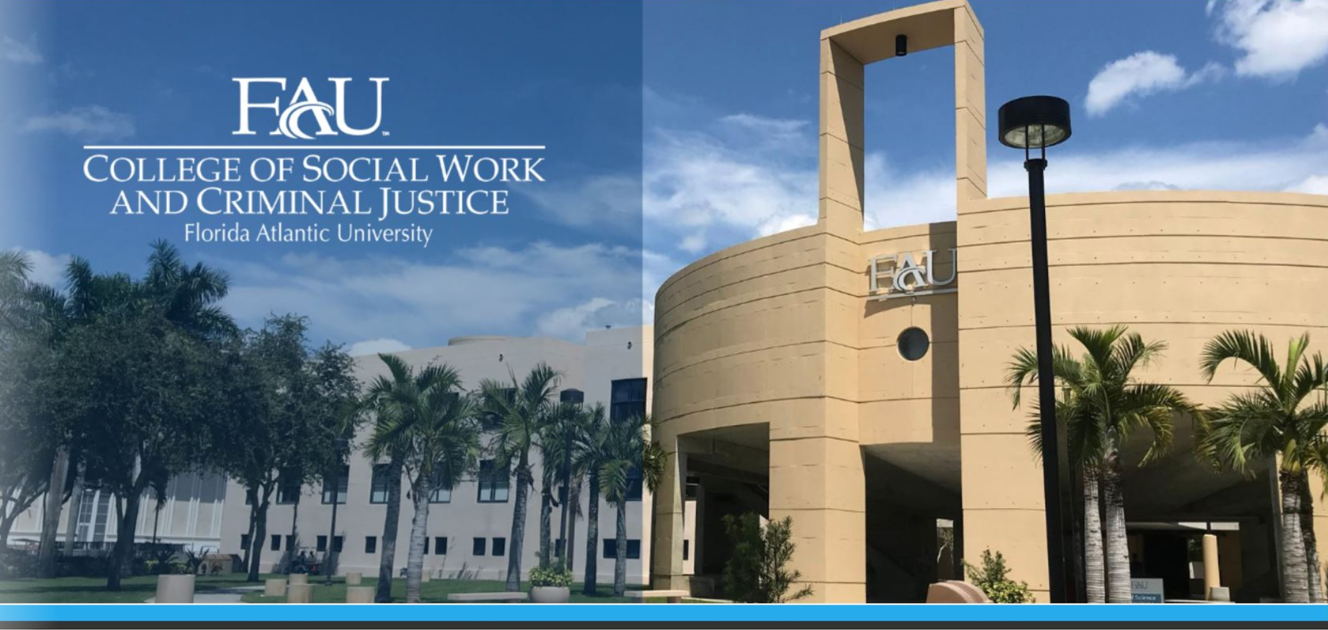

Slide 16

Social Work
Phyllis and Harvey Sandler School of Social Work
Provides for an undergraduate education that contributes to the well-being of the communities of Florida and educates competent and compassionate social workers for entry-level practice.
120 credits total, minimum 2.5 gpa core courses
Graduate pathway program
MSW, Advance Standing & DSW
Earn a grade of C or higher in all SOW classes
15 credit Minor ***NEW***
Book Lending Program
Students of Social Work (SOS) & Phi Alpha Honor Society

Slide 17


Field Education Internship
Required for graduation
12 Credit hours total
Last class before graduation
400 hours
Real life experience in agencies
Notes:
Download the Owl Ready app.
See something, say something.
Have fun today, and be safe.

Slide 18



Social Work Certificates

Slide 19

Criminal Justice
School of Criminology and Criminal Justice
Provides students with knowledge about the nature and causes of crime and delinquency, law and the legal system for juveniles and adults in American society, and the decision processes of criminal justice agencies.
120 Credit hours total including IFP
Fully in-person or Fully online program available
Freshmen are required to take CCJ2002
Earn a grade of C or higher in all CJ classes
15 credit minor
FAU Criminal Justice Club & Alpha Phi Sigma – national honor society for CJ
Notes:
Download the Owl Ready app.
See something, say something.
Have fun today, and be safe.

Slide 20

Combined Masters & etc.
Jumpstart your master's degree during your senior year:
Complete up to 12 graduate level credits
Must have at least a 3.5 GPA
Scholarships available
Research opportunities
Study Abroad in Scotland
Use of Force Simulator

Slide 21

Criminal Justice Internship
Not required but encouraged
3 credits (CCJ4940)
2.5 GPA minimum
Must be a 2nd semester Junior/ Senior
Potential Agencies Includes:
Broward County Public Defender’s Office
Palm Beach County Sheriff’s Office
Florida Highway Patrol
Florida Fish & Wildlife Conservation Commission
Secret Service/Homeland Security
Notes:
Download the Owl Ready app.
See something, say something.
Have fun today, and be safe.

Slide 22
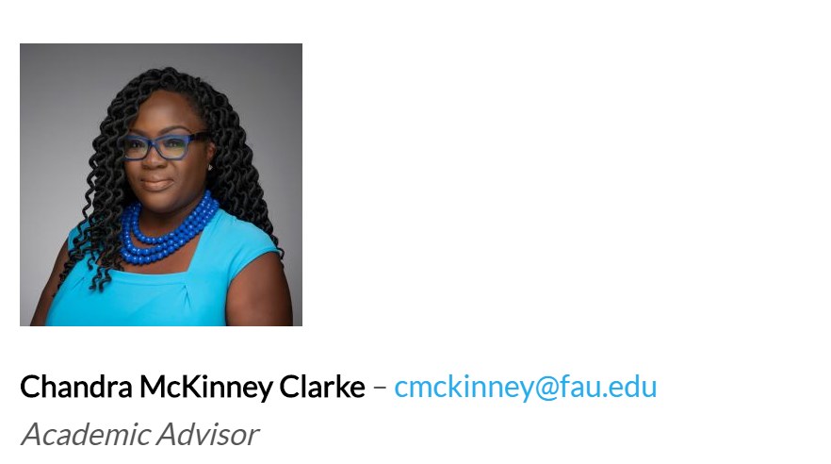
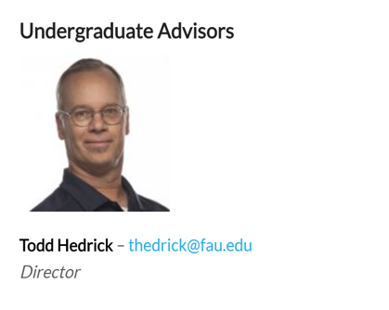
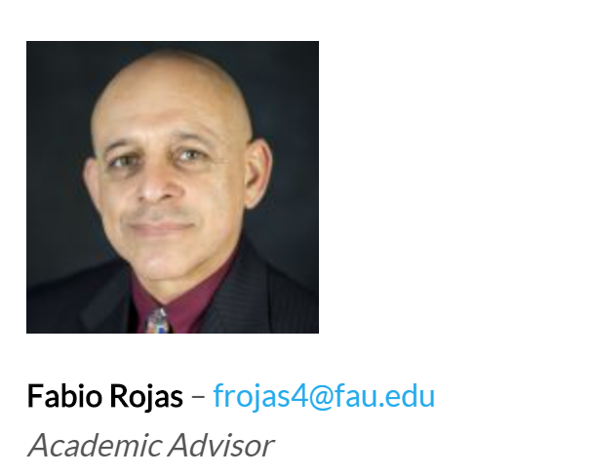
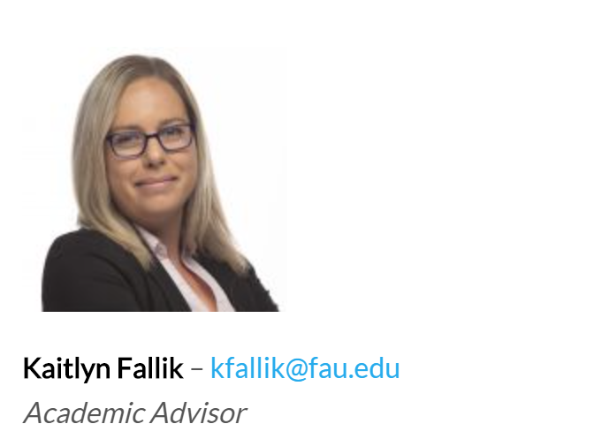
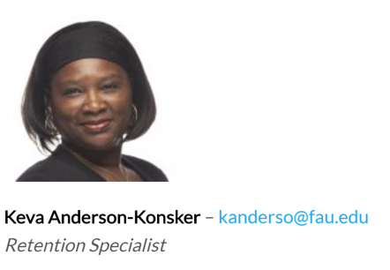
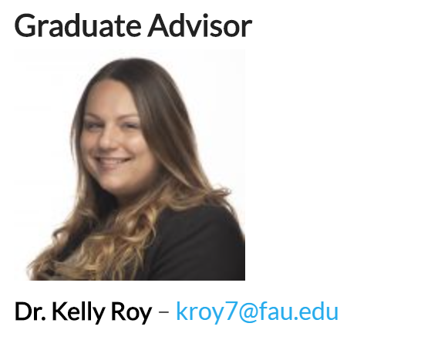
Meet your SWCJ Advisors

Slide 23
University Advising Services
University Advising Services will be your primary resource for the following:
Course advising
Academic policies and information
Changing or declaring majors
Making appropriate referrals to important resources on campus
Academic questions

Slide 24
READ
Email is FAU’s main form of communication. All emails will be sent to your FAU email. Please check your email daily!
Expect emails from your academic advisor for:
Summer and Fall advising
Midterm grades
Important updates or information

Slide 25
READ
Your syllabi will provide an outline for assignments, grading, exams, instructions, and instructor contact information.
It is expected that you read your syllabi at the beginning and throughout the semester
Your syllabi can be found on Canvas

Slide 26
READ
Please read your advisor’s comments on EZ Advising and all emails in your FAU email in box
Do you still need to send important documents to FAU?
AP / IB / AICE / Dual Enrollment / Transfer credits?

Slide 27
KNOW What Is Happening & When

Slide 28
IMPORTANT DATES
Spring Semester
Classes begin: Saturday, January 8th
Last Day to add/drop: Friday, January 14th
Last Day to withdraw from Full Term classes: Friday, March 25th
SCHEDULE ADVISING APPOINTMENT:
After MLK Day: Monday, January 17th

Slide 29
Summer 2021 Admission Pathways
Several different pathways for Summer admission to FAU
Jump Start
Academic Success Pathway
Engineering Bridge Program
FAU Summer Pathways Website: https://www.fau.edu/uas/summerpathways.php
Students in each of these three pathways must complete 6 credit hours in the Summer Term 3.
Summer Term 3 begins June 26. If you have not completed EZ Advising or have not fully registered for 6 credits in Summer Term 3, you must complete this ASAP.
Notes:
These are the three pathways that have specific criteria that students admitted in the Summer must meet in order to continue enrollment into Fall. It is your responsibility to read your Admissions letter and the informational pamphlet included in your Admissions materials to know the specific pathway you have been admitted under and also the specific criteria you must meet to continue enrollment into the Fall at FAU. You may also view this information on our website here. If you are not admitted into a specific pathway for Summer or admitted for Fall, this information does not apply to you.
Just one common requirement for each of these pathways is that students must complete 6 credit hours-2 academic IFP courses-in Summer term 3. If you are admitted to FAU for Summer 2021 under one of these three pathways and you do not complete 6 credit hours in Summer term 3, then you will not be able to continue at FAU in Fall 2021. Summer classes are filling quickly, and you should be fully registered for 6 credit hours in Summer term 3 by now. Being on the waitlist for a course is NOT fully registered. If you are not fully registered for 6 hours in Summer Term 3, you should complete your registration ASAP. Time is running out to complete registration and seats are filling quickly-Summer begins on June 26. If you have questions, need an additional course option, or are having trouble with registration, please reach out to the specific advisor that approved your EZ Advising form (email is in your FAU Email account) or our general office email at advisingservices@fau.edu.

Slide 30
Use Your Tools & Resources

Slide 31
Success Network
Your Success Network connects you to your support system
Your academic advisor
Professors
Tutors
Financial aid counselor
Click Here for a Success Network Tutorial
You will log into Success Network to schedule appointments with your academic advisor at University Advising Services

Slide 32
Intellectual Foundations Program (IFP)

Slide 33
DARS (Degree Audit)
The Degree Audit Reporting System (DARS) displays what courses you need and how they apply toward your degree program.
How to run your DARS

Slide 34
Academic Success Resources
Supplemental Instruction (SI) provides students with academic support for courses. Click Here for SI Information
The Center for Teaching & Learning (CTL) provides many more academic support resources and tutoring for math, writing, science, and other subjects. Click Here for Tutoring Information

Slide 35
Policies You Should Know Now

Slide 36
Foreign Language
ARA 1120/1121 – Beginning Arabic I/II
FOL 1120/1121 – Beginning Chinese I/II
FRE 1120/1121 – Beginning French I/II (must take Placement Exam)
GER 1120/1121 – Beginning German I/II
HBR 1120/1121 – Beginning Hebrew I/II
ITA 1120/1121 – Beginning Italian I/II
JPN 1120/1121 – Beginning Japanese I/II
LAT 1120/1121 – Beginning Latin I/II
SPN 1120/1121 – Beginning Spanish I/II (must take Placement Exam)
IMPORTANT TO NOTE:
For SWCJ, Foreign Language is a graduation requirement for Criminal Justice Only.
If you have taken 2 years of a language in high school, the Languages & Linguistics Department requires you to start with the 1121 level.
All courses are 4 credits

Slide 37
Withdrawal Policy (W Policy)
Undergraduate students may not withdraw (with a grade of “W” or “ZR”) from more than 2 courses at the lower-division level (1000- and 2000-level courses) and from more than 3 courses at the upper-division or higher level (3000- and 4000-level courses.)
Always speak with your academic advisor before making any decision to withdraw from a course.

Slide 38
FAU Civic Literacy Requirement
To graduate from FAU with any degree, students entering this Spring must meet the Florida Civic Literacy statue by completing both a course and exam.
Courses | Civic Literacy Exam Requirement
AP, AICE, or IB U.S. Government or History credit | Requirements change based on credit type; consult with your Academic Advisor
50 or higher on American Gov. CLEP exam | Civic Literacy Requirement is met
Passing grade in POS 2041 (Government of the U.S.) or AMH 2020 (U.S. History since 1877) | Must take Exam and score 60 or higher: U.S. Citizenship and Immigration Services Naturalization Test or Florida Civic Literacy Examination (FCLE)
For more information Requirements and Exams, visit https://www.fau.edu/ugstudies/civic-literacy-requirement/

Slide 39
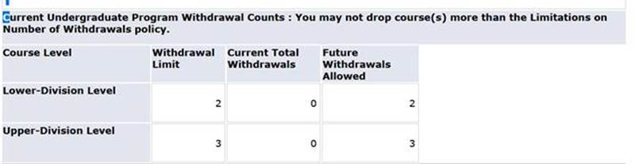
Withdrawal Policy (W Policy)

Slide 40
Questions?

Slide 41
Your College Breakout Session is complete!
Please head back to your small group Parliament breakout rooms. To get there, use the same link that you used to access your Parliament group earlier.
Enjoy the rest of your day SOARing with us!

