Slide 1

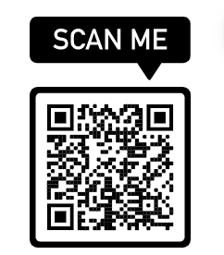
Live Captioning
Notes:
Wellbeing and academic success are tightly linked, so we have so many different departments and services to support students’ wellbeing at FAU. In addition to helping students feel better when they’re feeling overwhelmed, sick, or struggling with a health condition, we also support students with resources to prevent illness as well as equip them with skills to help them manage stress when it comes. We’re here to help students thrive during their time at FAU.

Slide 2
Health and Wellness
Campus Recreation & Fitness Center
Counseling & Psychological Services (CAPS)
Owls Care Health Promotion (OCHP) &
Women & Gender Equity Resource Center (WGERC)
Student Accessibility Services (SAS)
Student Health Services (SHS)
Notes:
Wellbeing and academic success are tightly linked, so we have so many different departments and services to support students’ wellbeing at FAU. In addition to helping students feel better when they’re feeling overwhelmed, sick, or struggling with a health condition, we also support students with resources to prevent illness as well as equip them with skills to help them manage stress when it comes. We’re here to help students thrive during their time at FAU.

Slide 3

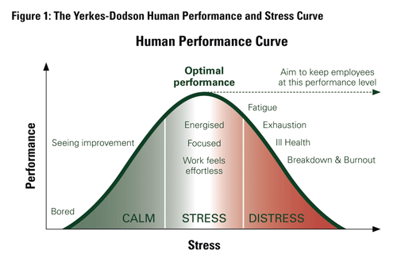
The Yerkes Dobson Human Performance and Stress Curve
Notes:
Kate - The sweet spot – or the goldilocks principle - not too much

Slide 4
Top Academic Impediments (NCHA)
Procrastination (45.1%)
Stress (40.9%)
Anxiety (32.1%)
Chronic medical conditions (25.8%)
Depression (25.1%)
Notes:
Karen - But- the survey changed from 2018 to 2020-
Work was recoded to career from 2018 to 2020 which has different connotations and can’t be directly compared.

Slide 5
Academic Impairment due to Emotional/Mental Difficulties (HMS)
21% None
26% 1-2 days
25% 3-5 days
28% 6 or more days
Notes:
Karen - (Past 4 weeks)
In the past 4 weeks, how many days have
you felt that emotional or mental difficulties
have hurt your academic performance?
If you find this worrisome- consider calling Karen and her team at Owls Care Health Promotion- they will work with you to create a short module that they or you can present in your class

Slide 6
Mental health services needed…
76% Need help for mental health problem
41% Currently in counseling
Barriers:
49% Not sure where to go for services
19% Cost or no insurance
Notes:
Kate

Slide 7
Decreasing Stigma
80% kept their mental health problems a secret
54% wish to disclose their mental problems to others
53% thought others stigmatized use of mental health services (perceived public stigma)
93% don’t stigmatize mental health service use (personal stigma)
Notes:
Kate

Slide 8

Food For Thought
Changes are challenging for everyone
Meaningful connections take time
Don’t delay getting help for physical, emotional or academic challenges.
Avoidance undermines success.
Notes:
Kate - Lots of people are new to FAU although it may seem like everyone knows everyone else, they don’t
roommates/suitemates are necessarily best friends
Be understanding of yourself and others, give yourself permission to take the advice you would give to a close friend
Don’t compare your insides to other people’s outsides, people may seem confident, but seems may be deceptive
Practice self=compassion and self-care – healthy habits go out the window when we need them
Educate students about the low stigma rates
Common cultural construct of perfectionism feeds procrastination
Academic support not used
61% Academic support (writing center, tutor)
44% Faculty office hours
54% Teaching assistants

Slide 9

Owls Care Health Promotion
Women & Gender Equity Resource Center
Empowering students to be healthy, responsible, & successful.
Advancing gender equity.
Promoting a safe and inclusive environment.
Educating the campus community.
Notes:
We’re going to start with one of FAU’s hubs for wellbeing resources, our department, Owls Care Health Promotion, where our mission is to empower students to be healthy, responsible, and successful. We are also proud to host the Women & Gender Equity Resource Center so that we can offer gender-specific resources to all FAU students, such as menstrual products and pronoun pins. You might have noticed that Imtisal, Maya, and I each listed our pronouns after our names when we introduced ourselves. This is a strategy that we use to create a more safe, inclusive, and welcoming environment for students by showing we know we can’t assume someone’s pronouns by simply looking at them or hearing their name.

Slide 10
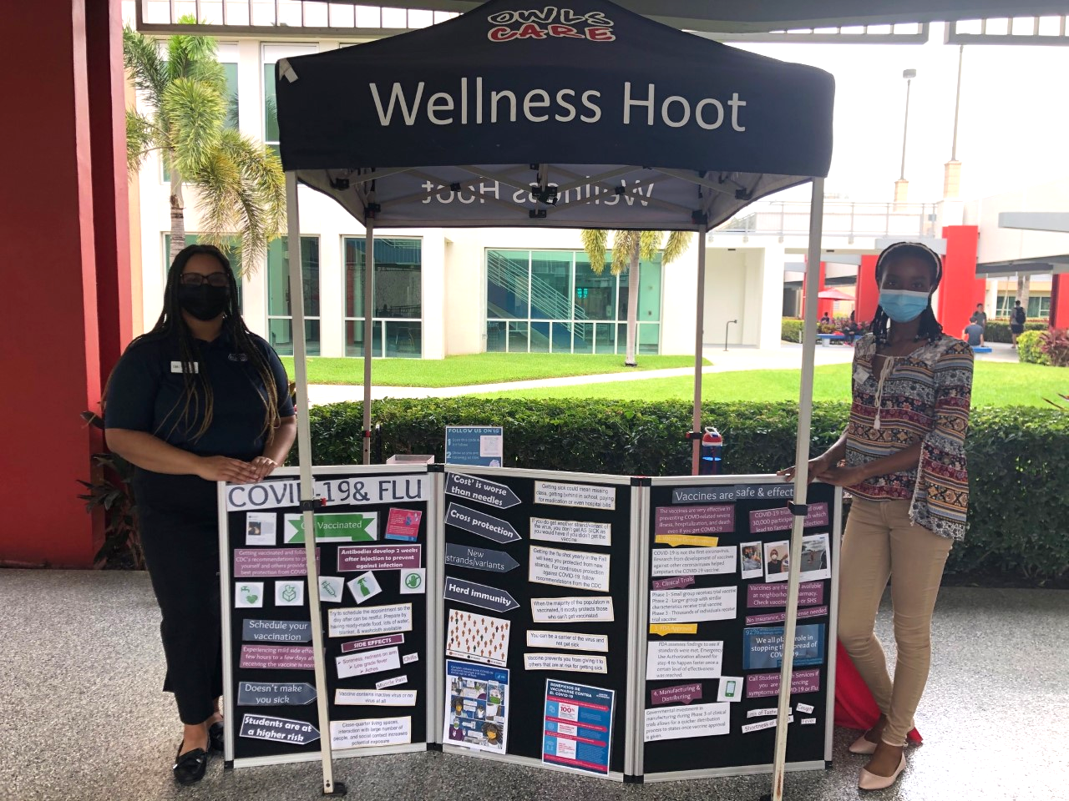
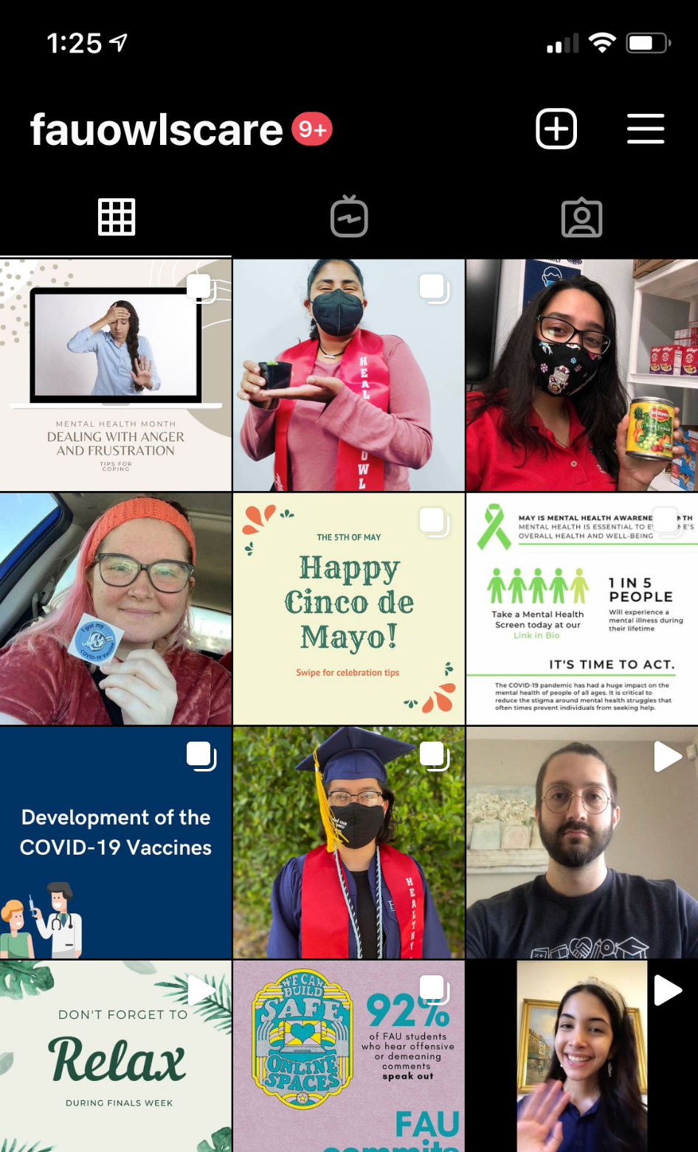

Top Academic Impediments (NCHA)
Mental and emotional problems (20%)
Financial challenges (20%)
Lack of motivation (17%)
Academic challenges (16%)
Stress Management “Wellness Hoots!”
Wellness Resources!
Tips via Instagram
@fauowlscare
Notes:
Kristina: To determine what barriers our students are experiencing to being healthy, responsible, and successful, we partner with the health-focused departments on campus to ask FAU students what they’re experiencing and what they need. So according to the National College Health Assessment, we are able to see that some of the top impediments to academic success are mental and emotional problems, financial challenges, lack of motivation, and academic challenges. So, Maya and Imtisal, what are some of the things we do in Owls Care to support students in these areas?
Student: OCLs, like myself or Sheivon and Sarah in the picture on this slide, present stress management hoots on the Breezeway. Also, stop by our office to pick up free wellness resources like stress balls, aromatherapy, scratch-off coloring kits, and biodot cards. And, follow us on Instagram @fauowlscare to learn more tips on how to to stay organized and destress.

Slide 11

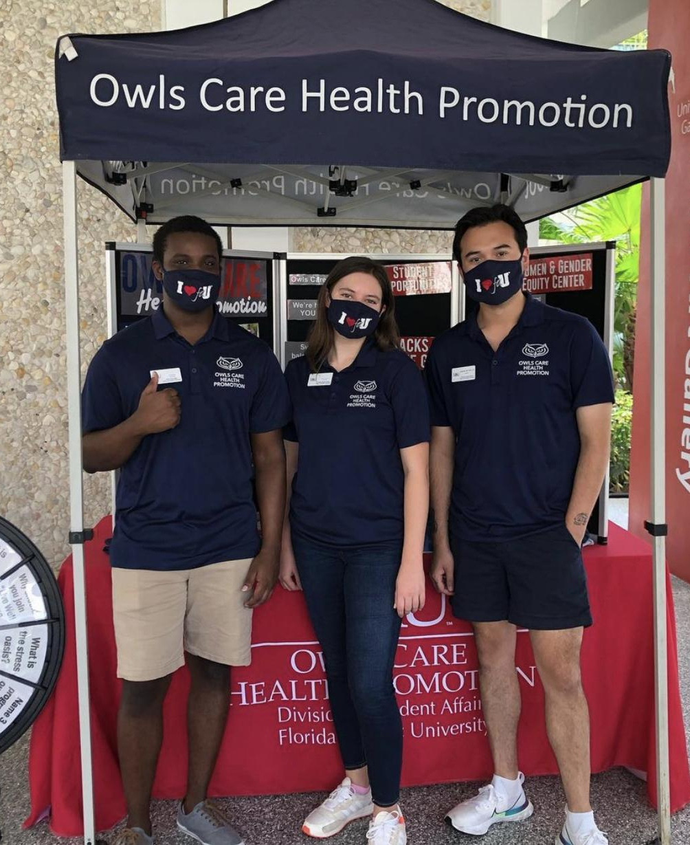
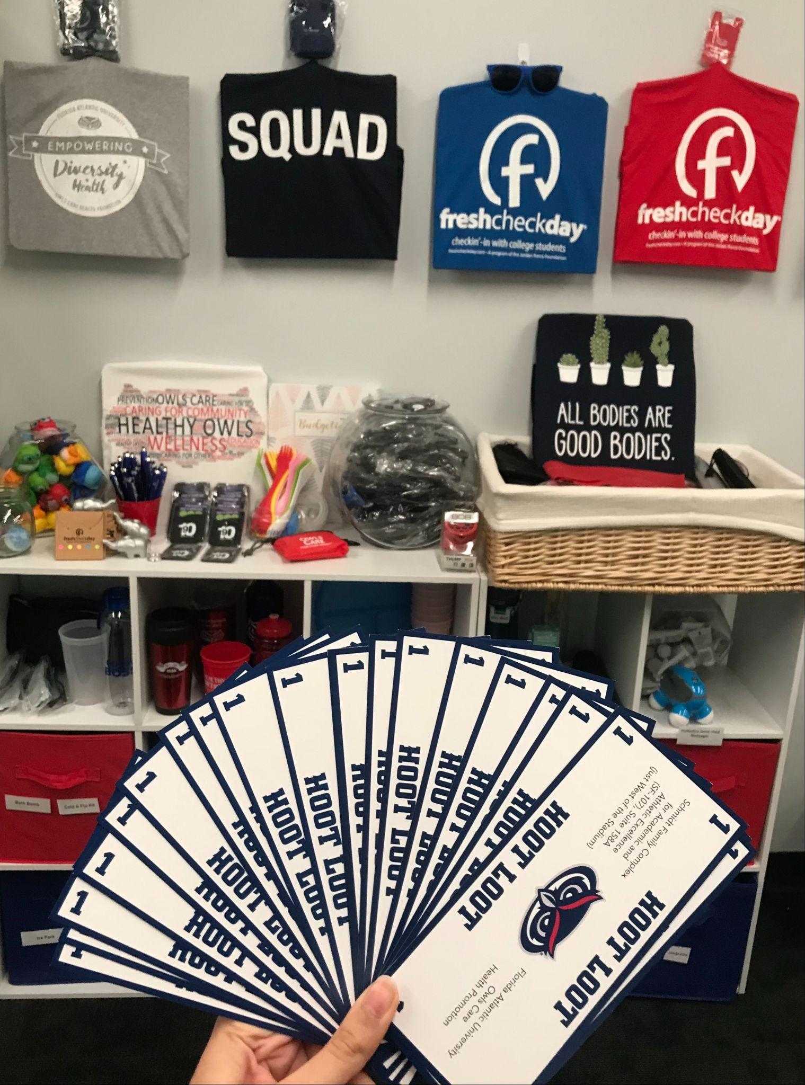
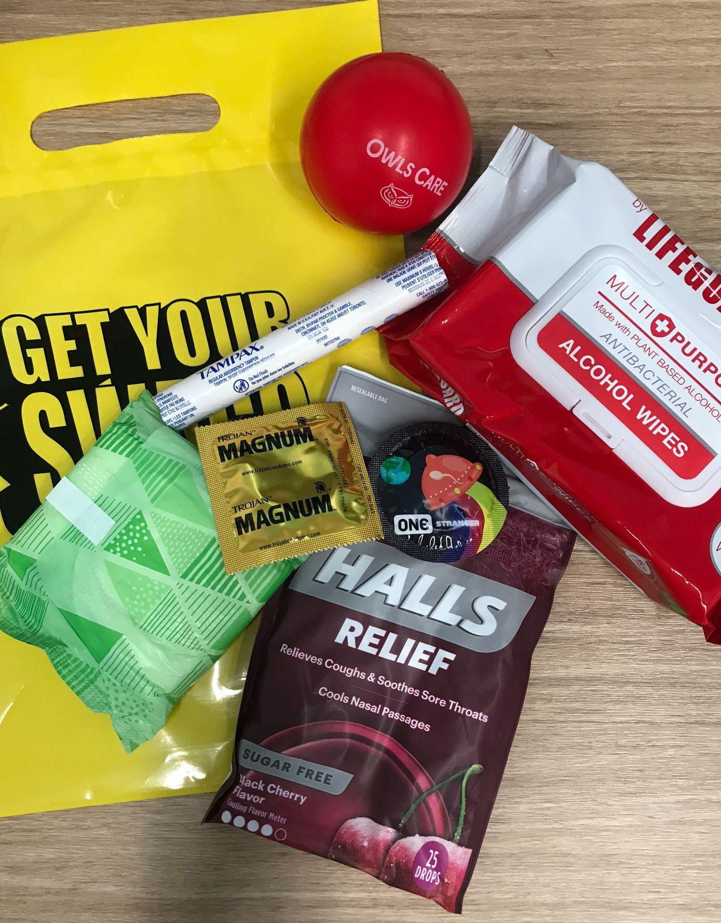
Wellness Hoots, Gender Hoots,
& Free Resources!...
Notes:
Student: When you’re not in class, catch us on the Breezeway to listen to our short presentations or as we like to call them “Hoots” on topics including stress and time management, Flu, colds, and COVID-19, healthy relationships and self-compassion. While you’re there, you can collect Hoot Loot, which is our office’s fake money that you can redeem for prizes like t-shirts and a Brita water-filter pitcher. Finally, we offer resources including sanitizers, sleep masks, condoms, menstrual products, aromatherapy, and so much more FREE to you as FAU students!
Interactive Workshops
Campus Outreach Activities
Individual Consultations
HIV Testing
Free Health Promotion/Self-Care Items
Women and Gender Equity Resource Center

Slide 12


FIT First-Year
Sexual Assault Prevention
AlcoholEdu
Kognito Mental Health Training
Diversity Equity and Inclusion
Hazing Prevention
Notes:
Student:
We also invite all first-year students to complete the following online courses [above] to make sure that all students are prepared to take care of themselves and others at FAU.

Slide 13
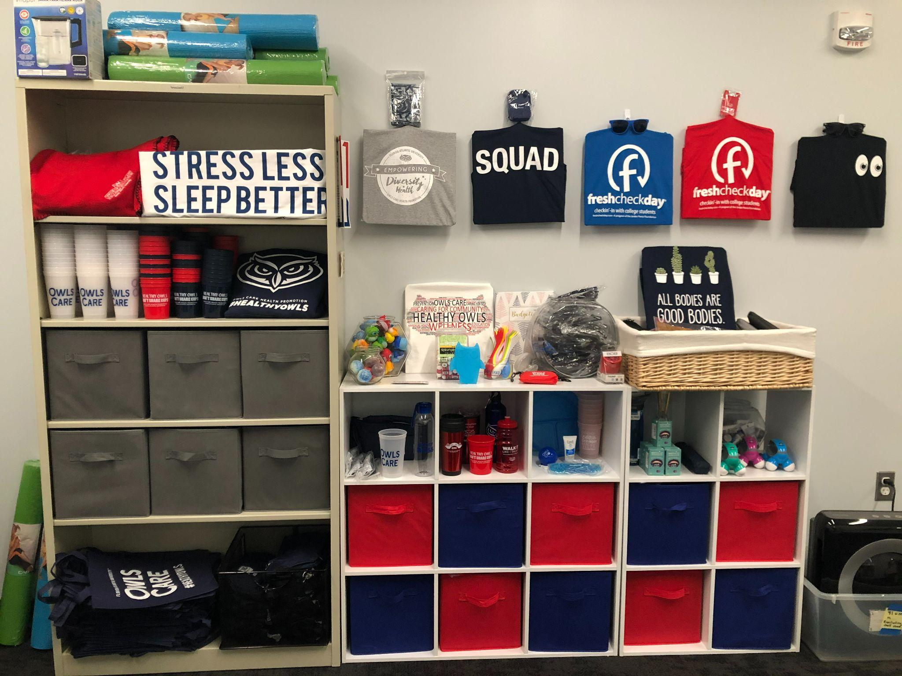
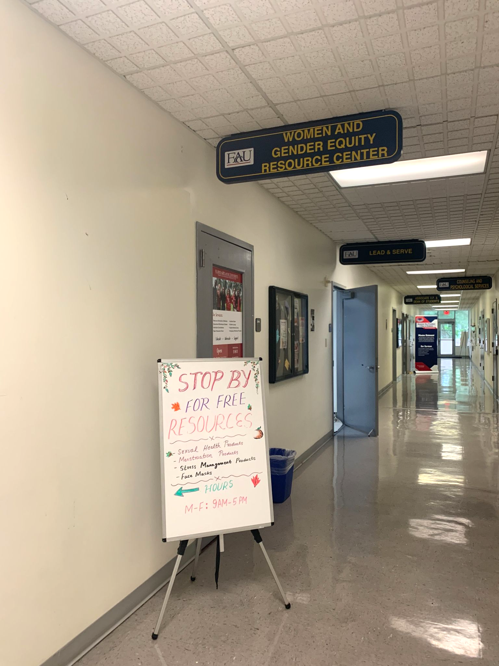
Schmidt Family Complex for Academic & Athletic Excellence- Suite 158A
Building SS-8, Room 224A
2nd floor of the Breezeway above the food court
OCHP
WGERC
Notes:
Student:
If you want to learn more about the different wellness and gender-specific resources we offer, please feel free to visit us at either of our Boca Raton Campus locations.
Now, Owls Care Leaders are Certified Peer Educators trained to give students tips on a wide variety of wellness and gender equity topics, but we always recommend students visit the experts in other health and wellness departments on campus that Kristina will go over now.

Slide 14
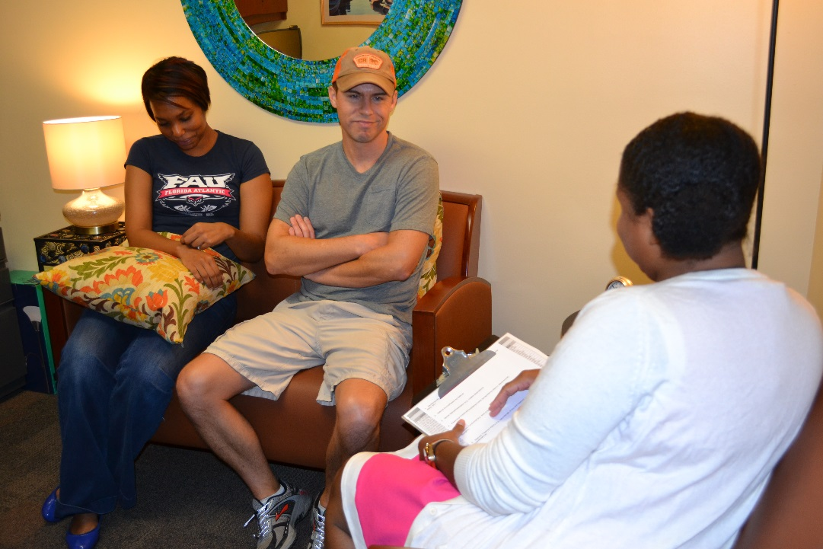
Counseling & Psychological Services (CAPS)
Confidential Services
Individual counseling
Group counseling
Relationship counseling
Crisis management
Consultations and workshops
Online and live suicide awareness trainings
After-hours assistance
Mental health screenings
www.fau.edu/counseling
Notes:
Kristina: Schedule your first appointment online!

Slide 15

TAO
Virtual therapy assistance.
Online tools to help you conquer:
  Day-to-day struggles
  General stressors like anxiety and depression
  Specific troubles like relationships and addiction.
Therapist-assisted and self-help options available!
Notes:
Kristina: CAPS also offers online self-help resources through a platform called TAO

Slide 16

Student Accessibility Services (SAS)
Academic Accommodations
Accessible Material
Advocacy
Assistive Technology
Faculty Notification
Online Services
Scholarships
Study Strategy Instruction
Notes:
Kristina: If you have a disability, if you have a medical condition, we have assistance and accommodations for you through Student Accessibility Services. They have a wide range of assistive technologies to support your academic success and they help other departments make sure that their materials and resources are accessible.

Slide 17

SAS Volunteering Opportunities
Notetaker: Take lecture notes for hearing impaired, physical impaired, or learning disabled students.
Reach out for other volunteer opportunities.
Hours are recorded on your college transcript!
Website: www.fau.edu/sas/
Notes:
Kristina:
You may be wondering how Student Accessibility Services is able to provide accommodations like note-taking support. They do this by offering volunteer opportunities to students to be notetakers, and hours are recorded on your transcript. We love opportunities to give back to our community so definitely contact Student Accessibility Services to get involved or register for accommodations.

Slide 18
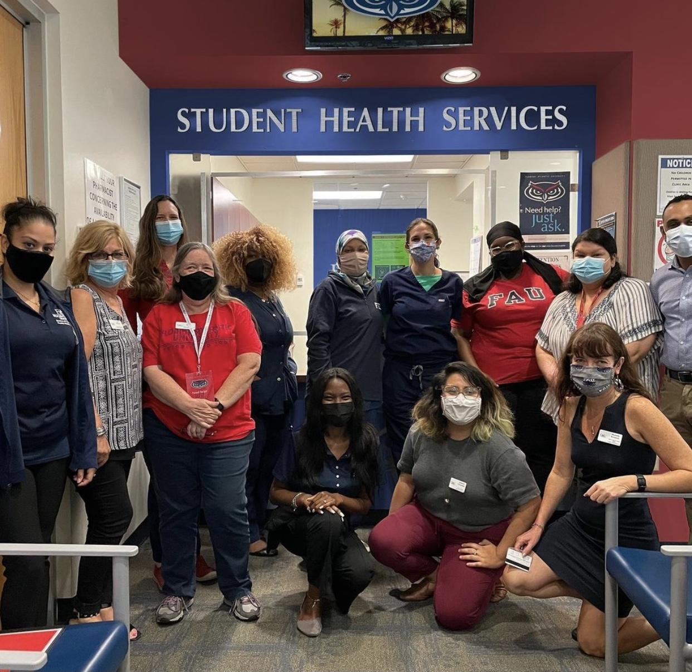
Student Health Services (SHS)
Services:
  Primary and acute care
  Women’s Health
  Nutrition
  Dental
  Psychiatry
Free COVID-19 visits, tests, and flu shots
Confidential Care: HIPAA Compliant FERPA Releases Not Applicable
Cost: Charges apply (listed on the website)
Website: https://www.fau.edu/shs/
Notes:
Kristina: Student Health Services has a range of preventative and treatment services for students. These are certified doctors and other healthcare providers.

Slide 19
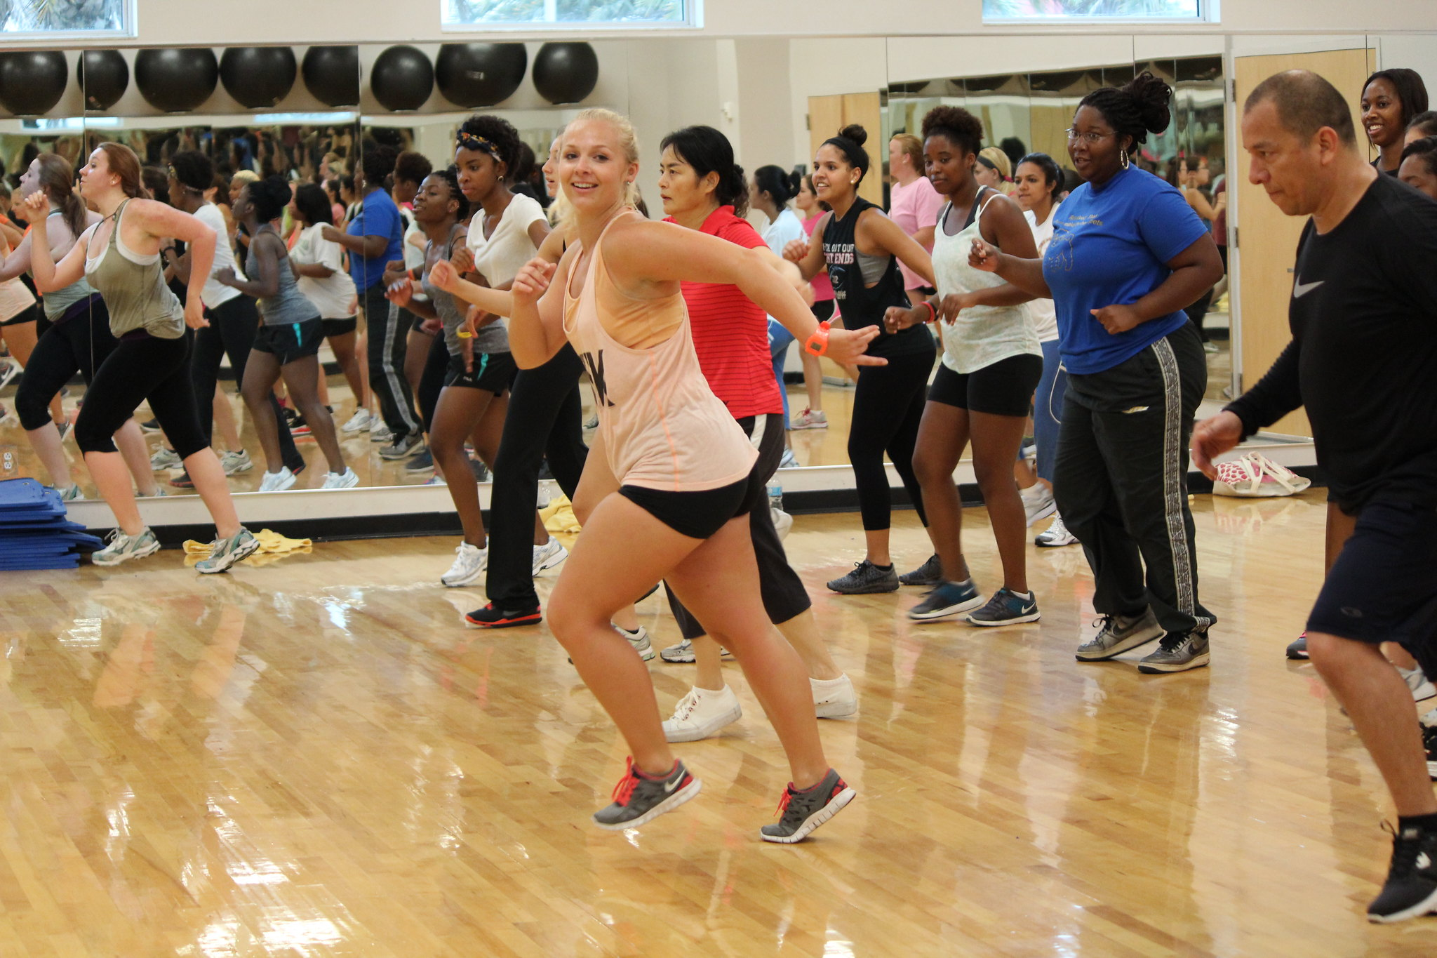
Campus Recreation & Fitness Center
Group fitness classes
Fitness on Demand
Personal training
Club sports
Intramural sports
Adventure trips and Challenge Course
Notes:
Kristina: The last department we’re going to be reviewing today is last, but certainly not least--the Campus Recreation and Fitness Center! They have in-person and online group fitness classes, club and intramural sports, as well as adventure trips, a challenge course, and personal training. So many opportunities to move in whatever ways make you feel good.

Slide 20


Connect with us
Websites
Campus Recreation - fau.edu/campusrec/
CAPS – fau.edu/counseling/
Owls Care – fau.edu/owlscare/
Student Accessibility Services – fau.edu/sas/
Student Health Services – fau.edu/shs/
@faucampusrec
@fau_caps
@fauowlscare
@faustudenthealth
FAU Campus Recreation
FAU Counseling and Psychological Services
FAU Owls Care Health Promotion
FAU Student Accessibility Services
FAU Student Health Services
Notes:
Student: There are so many wonderful resources and centers on campus that work to ensure you’re successful and healthy here at FAU! If you want to be in the loop, please feel free to stay connected via these websites, Instagram, and Facebook accounts…..

Slide 21
Health and Wellness
Contact Us
Campus Recreation & Fitness Center
  561-297-2421
Counseling & Psychological Services (CAPS)
  561-297- CAPS (2277)
Owls Care Health Promotion(OCHP)
  561-297-1048
Student Accessibility Services (SAS)
  561-297-3880
Student Health Services (SHS)
  561-297-3512
Notes:
or to reach these offices by phone. I know, it’s a lot to remember, but you’re in luck because we actually have an app that organizes it all for you!

Slide 22
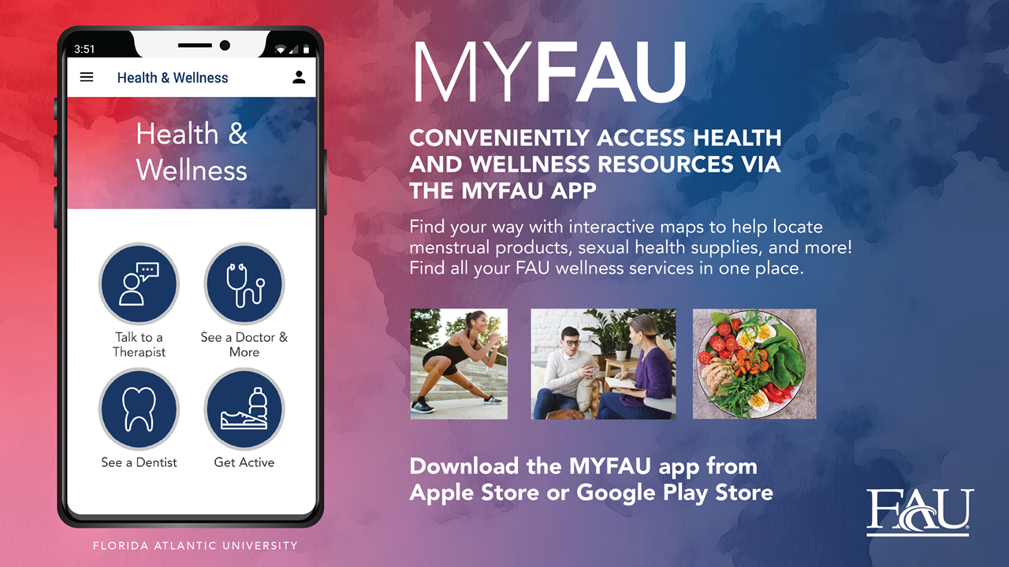
Health and Wellness
Notes:
Student: Don’t worry about memorizing that contact information, because it’s all at your fingertips in the Health & Wellness section of the MYFAU app!
Kristina: We hope you’ve enjoyed this review of health and wellness services and hope you feel supported in your time at FAU. Thank you!

Slide 23






Student Health Services
INEXTRICABLE LINK BETWEEN HEALTH AND ACADEMIC PERFORMANCE
Families serve as primary resource for health information
Primary Care, Acute Care, Women’s Health
No-Cost COVID Visits and Testing
Chronic Care Management
Nutrition, Psychiatry, Dental
No-Cost Flu Vaccines
24/7 Nurse Line
Clinics at Boca Raton, Davie, and Jupiter Campuses
Confidential Care: HIPAA Compliant FERPA Releases Not Applicable
Cost: Charges apply (listed on the website)
Should never be a barrier to care
No money collected up front
Self-pay discount available
Charges are sent to student account
Accepts most insurance
Notes:
connect with us via Instagram, Facebook, or our website fau.edu/counseling. Our website has additional resources that might assist you with self-help.

Slide 24



If You Are Thinking…
What is wrong with me?
I’ll never succeed.
No one likes me.
I can’t tell anyone how I feel.
I’m disappointing everyone.
I don’t know who I am anymore.
I’m lonely.
I give up.
I wish I could escape.
I can’t make it.
I have no friends.
I’m drowning.
I feel overwhelmed.
Nobody understands me.
Notes:
Kate - So, if you are thinking that you have no friends, that you are lonely, that you are disappointed, or that you struggle to function, please schedule a first appointment to talk to one of our counselors. You can call the main CAPS number to make an appointment – M-F 8-5pm. During that session can talk about your concerns and learn about the available and relevant follow up options for you – at CAPS, OwlsCare, Student Health, Student Accessibility and other university departments as well.
Psychiatrist and Nutrition Consultation with Reg. Diet.

