Slide 1
WELCOME
FAMILIES

Slide 2

FAMILIES NEEDING SUPPORT...
We are here for you!
Solution Station for assistance throughout the day or call 561-297-2733 at any point!

Slide 3
Interim Vice President,
Dr. Larry Faerman, PhD
Student Affairs & Enrollment Management
lfaerman@fau.edu |deanofstudents@fau.edu
WE’RE HERE,
NOW WHAT?

Slide 4
WHAT WILL THE DAY LOOK LIKE?
Notes:
FAU High Families 12:45- 1:30 p.m.
I can verbally elaborate if you’d like:
FRAME THIS, their first time together/in orientation, FOR THE FAMILIES FOR THE WELCOME—you made it! Orientation. Wahoo!
What are your students doing right now? Explain the parliament model.
Intro of OLs who will be with us for the session. Spell it out Orientation Leaders
Who is introducing first – suggest Daniel, then X, X, X OL
Intro of your role---you are the first face – share with them why you are an important resource/your positionality in the University
Presentation? Please send me your slides—are there more than the three? Lots of text and worried about timeliness
If the guests are supposed to intro themselves with the chat, put on slide what you want them to include
Words that were used frequently: “kind of”… for example, “kind of” go over the welcome, kind of speak to that
Language – when referring to the family virtual experience, pick one way of referring to it and be consistent. For example… Canvas virtual orientation? Go over the virtual orientation? – you mentioned a video, What video? (mentioned you already saw this in the video, fears, vulnerabilities, family excitement) – be sure to refer back to the Family Virtual Orientation they did on Canvas frequently so they know what you are talking about.
Not actually giving them time to get questions answered? I feel like this was a missing piece.
NOOOOOO we aren’t sharing the date for OFW.
Use of word “expert” - need to give expert explanation a little more in depth. Some will cringe at that.

Slide 5
BREAK

Slide 6
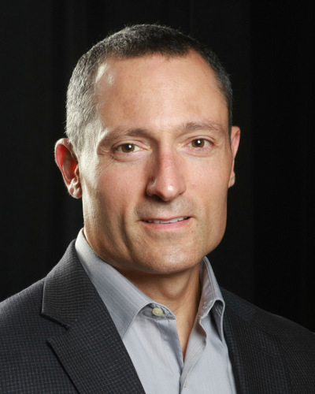
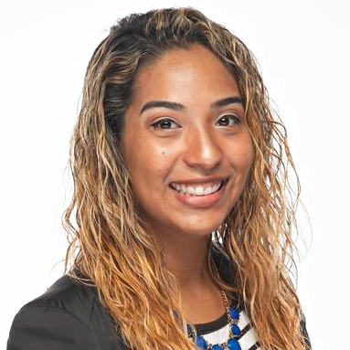
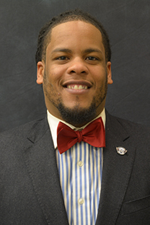
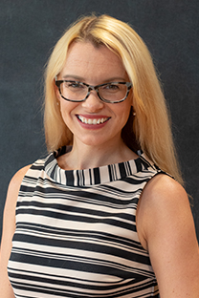
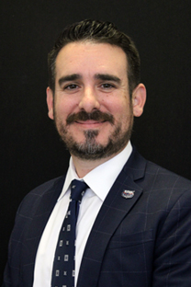
PANEL WITH THE PROS
Assistant Professor,
Michael Dedonno
Department of Educational Leadership and Research Methodology
Associate Director,
Marlynn Lopez
Center for IDEAS (Inclusion, Diversity Education
& Advocacy)
Director,
Donald Van Pelt
Student Activities
& Involvement
Executive Director,
Katie Burke
New Student Transitions
& Family Engagement
Senior Director,
Brian Montalvo
Career Center
Notes:
Below this slide are extra slides
Qs for Panel: you’ve already share dyour 30 second intro, introduce now with why you are an expert/pro on this panel today
Why FAU
What did you look for in your family support role?
What is it like to be away from your family for the first time?
Describe how your relationships changed when you came to college? How did this transition from your relationship with family while in high school

Slide 7
LIBRARY EXPERIENCE

Slide 8
ENGAGING FAMILIES WITH STUDENTS
New Student Transitions & Family Engagement
Division of Student Affairs & Enrollment Management 561.297.2733 | owlfamily@fau.edu

Slide 9
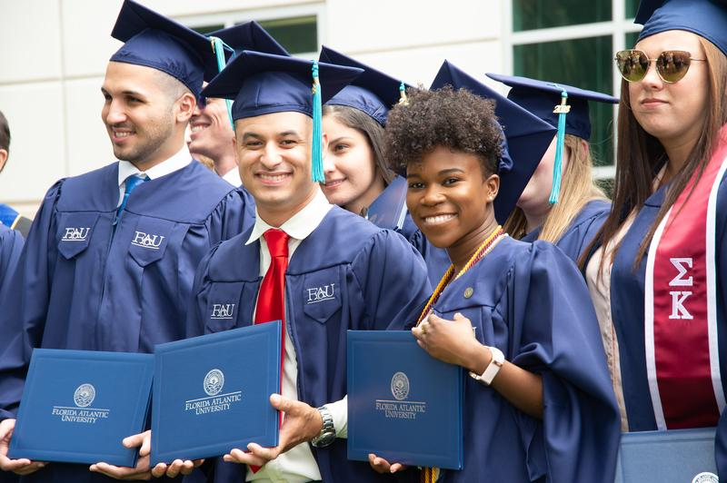
Engaging Families & Students
Florida Atlantic University Office of Family Engagement
Notes:
My goal for you today is for you to gain a stronger sense on how you can help your students be successful at FAU.

Slide 10
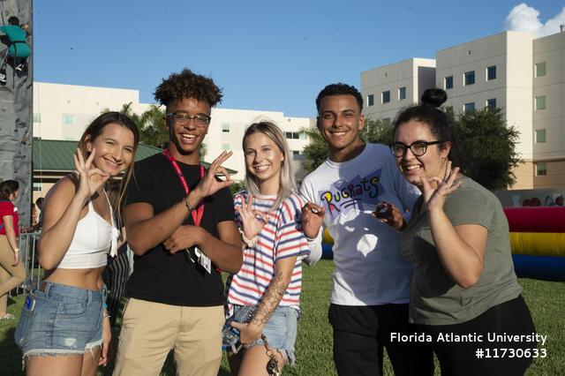
Defining “Family” at FAU
The word “family” is not defined by bloodlines - it is anyone our students develop a relationship with that includes a level of trust, love, and support.
Notes:
( 5- 6 minutes ) - Running time at 5 min ( at end of slide).
I’d like to start our session with a group activity. The purpose of this activity is for you to engage with other families at your table. Here are your instructions.
Please talk with at least one other family member at your table and learn more about their student. For example, get their student’s name , where they are from, major, and or something unique about their student. When we are done, I will ask for volunteers to share what they have learned.
Ill give you a few minutes to chat.

Slide 11
History of Family Programs
1922
1999
1923
Notes:
(3-4 Minutes ) - Running time at 8 mins ( at end of slide).
In 1922, University Illinois at Urbana-Champaign created the Dads Association. Followed by the Mom’s Association in 1923. In 1981, they had over 8,000 due paying members. (Shifting the Paradigm of Parent and Family Involvement, 2015).
Based on the success of these two programs, many universities and colleges followed suite. Many higher ed institutions began to focus on programs that allowed for more family support and services. This ensured a smooth transition into college and allowed families to be part of the college experience as well.
A huge shift occurred in the late 90’s and early 2000’s as the millennial generation began college. Campuses realized that in addition to students they must be prepared to welcome families as a Parents as Partners concept began to emerge. It was no longer a parent or family supporting their students in college, but more of a joint collaboration. Parents began accompanying their students and had strong voices in terms of choice of major preferred residence hall, fraternity or sorority, and parking lot. (Shifting the Paradigm of Parent and Family Involvement, 2015).
Today, most family engagement programs operate with the goal of families being as involved with the their students school as much as the students. This allows for campus offices to create mediums that keep families engaged in in all aspects of the university.

Slide 12
Consider as your student begins their journey at FAU…
What is your biggest fear?
What are you most excited about?
How can we assist?

Slide 13
Family & College Student
Relationship Strengthening Pillars
1. Engagement
2. Understanding students
3. Identify family opportunities
Notes:
(1 minute) - Running time at 9 mins ( at end of slide).
The three pillars for family programs include overall engagement, understanding students, and identifying the family opportunities for that engagement.
Student success is not achieved solely on the student. Anne Henderson and Nancy Berla book on family student achievement (1994) conducted research and stated that the most particular predictor of student’s achievement is not economic or social status but the extent to which that student’s family is able to get involved. The importance of any successful parent family program requires a foundation focused on its purpose of student’s success. The three listed above are Engagement, Understanding students, and Family opportunities. Pillars of sustainability
Parent & family engagement
Engagement
Understanding students
Family opportunities

Slide 14
Relationship Strengthening Pillars:
Engagement
1. Engagement
Connection
Trust
Partnership
Notes:
(3 minutes) - Running time at 12 mins ( at end of slide).
So taking the community engagement model and applying it to a university setting, the four elements include comfort, connection, trust, and partnership. In terms of applying comfort, comfort is creating an environment where there is a sense of safety for parents and families to ask questions where they don’t feel as if it’s a adverse environment that they don’t know information , so increasing their comfort and really being ok with them not having all the information to help their students become successful. Each campus is different, resource navigation is different, so even for students who may have attended the university as an undergraduate or graduate student , they may notice that things may now look different. And its completely ok. So increasing their comfort level with being in that stage of wanting to gain information.
Then theirs that connection. How are we connecting families and parents to the shared values for student success, our goals for getting students through their academic pursuits. And how were ensuring information is available and inclusive to them.
And Trust. Establishing rapport and trust with parents and families . It is important for parents and families to recognize that when they leave there students in the care of a university that we have their best interest at heart and in mind. Please afford the university the benefit the doubt in times when an experience or incident seems out of character.
And then again recognizing the underlining philosophy with an emphasis on the partnership that is over an over stating to them the value that they bring for student success and the participation and engagement for the student experience.

Slide 15
Relationship Strengthening Pillars: Understanding Students
Chickering’s Theory of Identity Development
Vector 1
Developing competence
Vector 5
Establishing identity
Vector 2
Managing emotions
Vector 6
Developing purpose
2. Understanding Students
Vector 3
Moving through autonomy toward interdependence
Vector 7
Developing integrity
Vector 4
Developing mature interpersonal relationships
Notes:
(3-4 minutes) - Running time at 15 mins ( at end of slide).
Progression areas…
Student to provide an example of vectors 1-5.
https://studentdevelopmenttheory.weebly.com/chickering.html
Developing competence
In Education and Identity, Chickering and Reisser use the analogy of the three-tined pitchfork to describe competence. The tines are intellectual competence, physical competence, and interpersonal competence. The handle of the pitchfork represents the sense of competence that comes from the knowledge that the individual is able to achieve goals and cope with adverse circumstances.[1][3]
Managing emotions
This vector consists of learning to understand, accept, and express emotions. Individuals learn how to appropriately act on feelings that they are experiencing. In his more recent work, Chickering's theory was broad and covered emotions including anxiety, depression, guilt, anger, shame along with positive emotions such as inspiration and optimism. In his original work, he focused primarily on aggression and sexual desires.[1][3]
Moving through autonomy toward interdependence
The successful achievement of this vector involves learning how to be emotionally independent. This includes becoming free from the consistent need for comfort, affirmation, and approval from others. Individuals also see growth in problem solving abilities, initiative, and self-direction. They begin to understand that they are part of a whole. They are autonomous, but interdependent on others in society.
In Chickering's updated theory, much more emphasis is placed on interdependence.[1][3]
Developing mature interpersonal relationships
In this vector, individuals learn to appreciate and understand others. Some of the related tasks include cross-cultural tolerance and appreciation for the differences of others. An individual also becomes competent in developing and maintaining long-term intimate relationships. Chickering moved this up to list of vectors in his revised edition in order show the importance of developing relationships.[1][3]
Establishing identity
This vector builds on each of the ones which comes before it. It involves becoming comfortable with oneself. This includes physical appearance, gender and sexual identity, ethnicity, and social roles. It also includes becoming stable and gaining self-esteem. A person who has a well-developed identity can handle feedback and criticism from others.[1][3]
Developing purpose
In this vector, an individual develops commitment to the future and becomes more competent at making and following through on decisions, even when they may be contested. It involves developing a sense of life vocation. It may involve the creation of goals, and is influenced by the family and lifestyle of the individual.[1][3]
Developing integrity
This vector consists of three stages which flow in chronological order, but are able to overlap. These stages are humanizing values, personalizing value, and developing congruence. The process of humanizing values encompasses the shift from a cold, stiff value system to one which is more balanced with the interests of others matched with the interests of the self. After this is established, the individual begins to assemble a core group of personal values which are firmly held, but the beliefs of others are considered and respected. Developing congruence involves bringing actions in line with belief

Slide 16
Relationship Strengthening Pillars: Understanding Students
Student Experience
#1. Procrastination
2. Understanding Students
#2. Stress
Top Impediments to Academic Achievement
#3. Anxiety
Notes:
(3-4 mins) - Running time at 18 mins ( at end of slide).
Next is to understand the student experience. For example for students coming in to the university, there is a live on campus requirement for freshmen and the exception is students who live under 30 miles. And some students still live locally want to be immersed in the university environment and choose to live on campus. The student experience is about all the transitions that students experience when they are coming to a university. That is the change in their relationships with friends, families, and parents. They are leaving their belongings behind, they are packing up as much as they can fit into two creates, they are being assigned into a new living condition and some of that can be really exciting for students, but can also increase their levels of vulnerability about their sense of belonging and wondering how they are going to fit in and how all those factors are going to impact their academic performance.
Lastly to understand our students is to understand or to recognize what are the top academic impediments. According to the American College Health Association the top three are on the screen followed by depression, sleep difficulties…. Understanding that those are the chief complaints that students will report about what gets in the way of their studies and for them to be at their best.
Top 10 Impediments to Academic Achievement 2017 data
According to the American College Health Association (ACHA), national college health assessment students reported the following factors affected their individual academic performance. Please note: 9 of the 10 factors are mental health and/or coping skills related, and areas where Student Counseling Services can help.
Factors
Percentage of Students Affected
Stress 30.6% Anxiety 24.2% Sleep Trouble 19.7% Depression 15.9% Cold / Flu /Sore Throat 14.6% Work 13.0% Concern for Troubled Friend of Family Member 10.3% Extracurricular Activities 9.7% Internet/Computer Games 9.6% Relationship Difficulties 9.1% (from ACHA-NCHAII, Spring 2017 Survey)

Slide 17
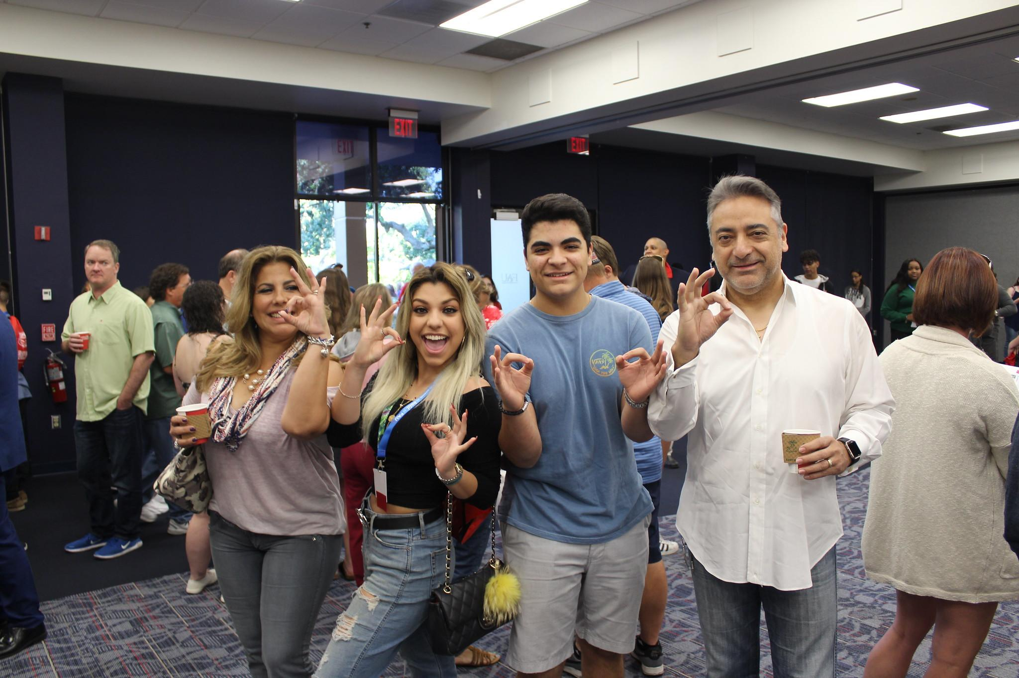
Relationship Strengthening Pillars:
Identify Family Opportunities
Emotional Well-being Check-In’s.
Communication Norms.
Ask questions before giving advice.
Allow student to process any feedback or advice.
Offer directives and don’t over insert.
3. Identify Family Opportunities
Notes:
(3 mins) - Running time at 29 mins ( at end of slide).
The last critical element to a family engagement program is identifying the family opportunities.
Research has demonstrated that there is a role parents play in the emotional well-being of their students (Sax & Weintraub, 2014). Also, the level of closeness between student and parent relationships is important (Wartman & Savage, 2008). And last and one of the biggest impacting factors is communication. Research was found that 80% of the 18–25- year-olds sampled reported talking to their parents daily, and half reported regularly seeing their parents on a daily basis. A later study of first-year college students found that nearly all participants (95%) communicated with their parents at least one day a week, and that female students communicated with parents more often than male students. (Small,Morgan, Abar, &Maggs, 2011).
If you think about the context of the frequencies and all the opportunities to recognizing what the student is experiencing, where there at in their developmental stages, what are the most likely to encounter, those should really inform parents with what information sources are important to support their students through those challenges and experiences.
Running time at 33 mins.

Slide 18
Change: Fears & Excitement
Families, what would you do in these situations?
You find out your student is spending less time on classroom & more time in extracurricular activities. How do you address the issue?
Your student calls you in the middle of the night to tell you they are home sick and they want to go home. What do you do?
Your student has been spending an astronomical amount of money on food and entertainment. How would you handle this?
Notes:
(8 minutes) - Running time at 40 mins ( at end of slide).
The purpose of this group exercise is to practice connecting to the student experience and trust.
Scenario: Pair share
You find out that your student is speeding more time outside of the classroom and more time in social situations. How do you address the issue?
Your student calls you in the middle of the night and tells you that they want to go home. How do you facilitate that conversation?
Your student has been spending astronomical amounts of money on food and entertainment?
Connect the fear: volunteering , not know for what,
Vulnerabilities: Letting someone else control everything, having no control, not knowing what is going to happen next.
Excitement: trying something new , being selected, waiting for the results
Blindfold Activity- Experiential Learning
“Form a rectangle with string”
This activity will require 4 volunteers. Each participants will be blindfold and their goal is to form a rectangle. When participants feel they form the rectangle they can take out their blindfold with one of their hand to see if they form a rectangle.
*Question to ask participants:
What were you thinking during this process? / what was going on?
How did you feel?
Did you think all of you were thinking the same thing?
Did at any point during the process did you feel like you wanted to give up/shut down?
Question to ask audience:
What did you observe?
What could they have done differently?
What was going through your mind?
Talk about Experiential Learning and how students learn different. Families must be aware and learn how to approach their students.
Video Reference: https://www.youtube.com/watch?v=gcy-pkwLjXE
Running time at 44 mins.

Slide 19
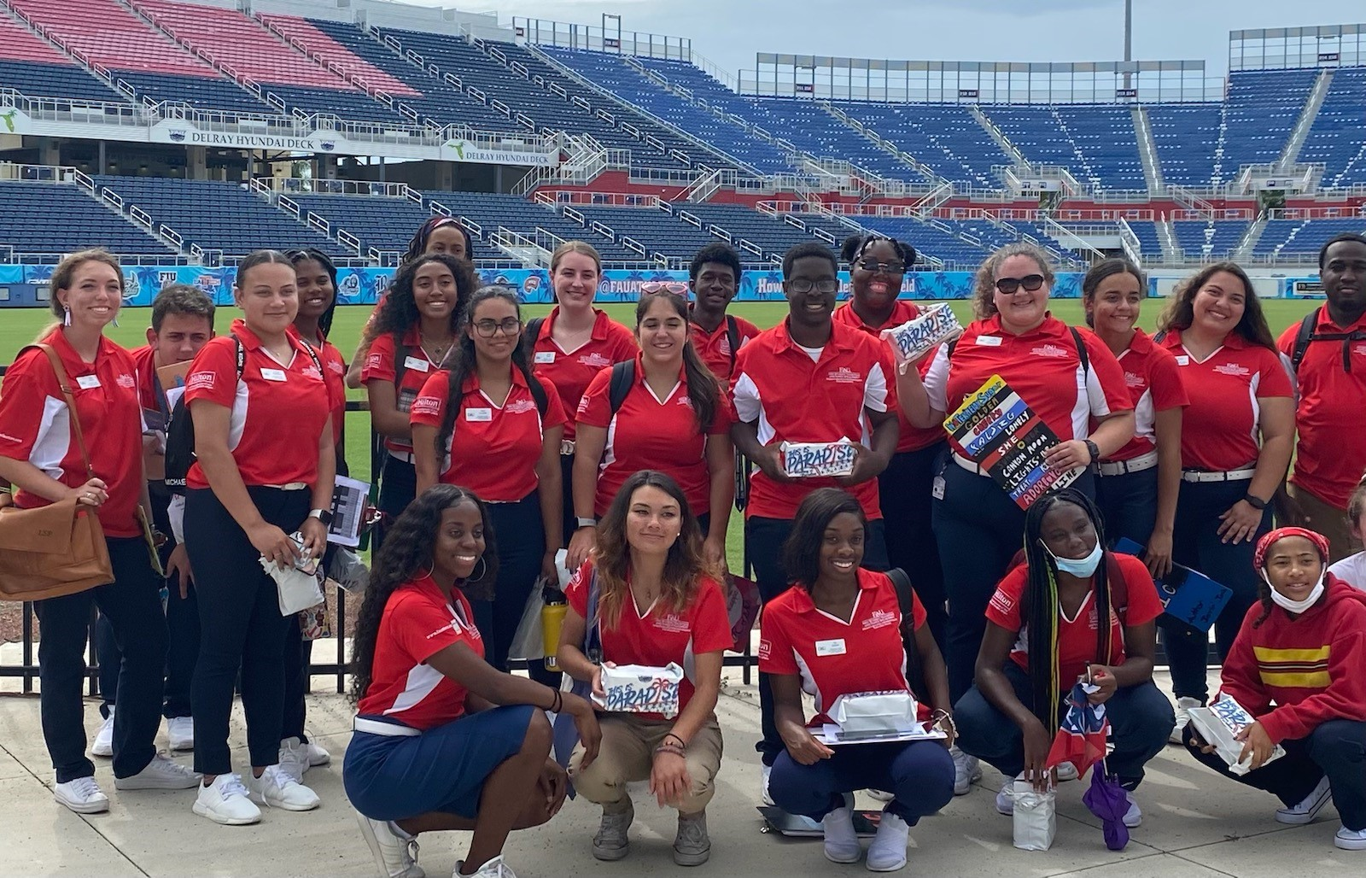
Orientation Leaders

Slide 20
PANEL WITH THE PROS

Slide 21
ENGAGING BEYOND
S.O.A.R.
Notes:
Below this slide are extra slides
Qs for Panel: you’ve already share dyour 30 second intro, introduce now with why you are an expert/pro on this panel today
Why FAU
What did you look for in your family support role?
What is it like to be away from your family for the first time?
Describe how your relationships changed when you came to college? How did this transition from your relationship with family while in high school

Slide 22
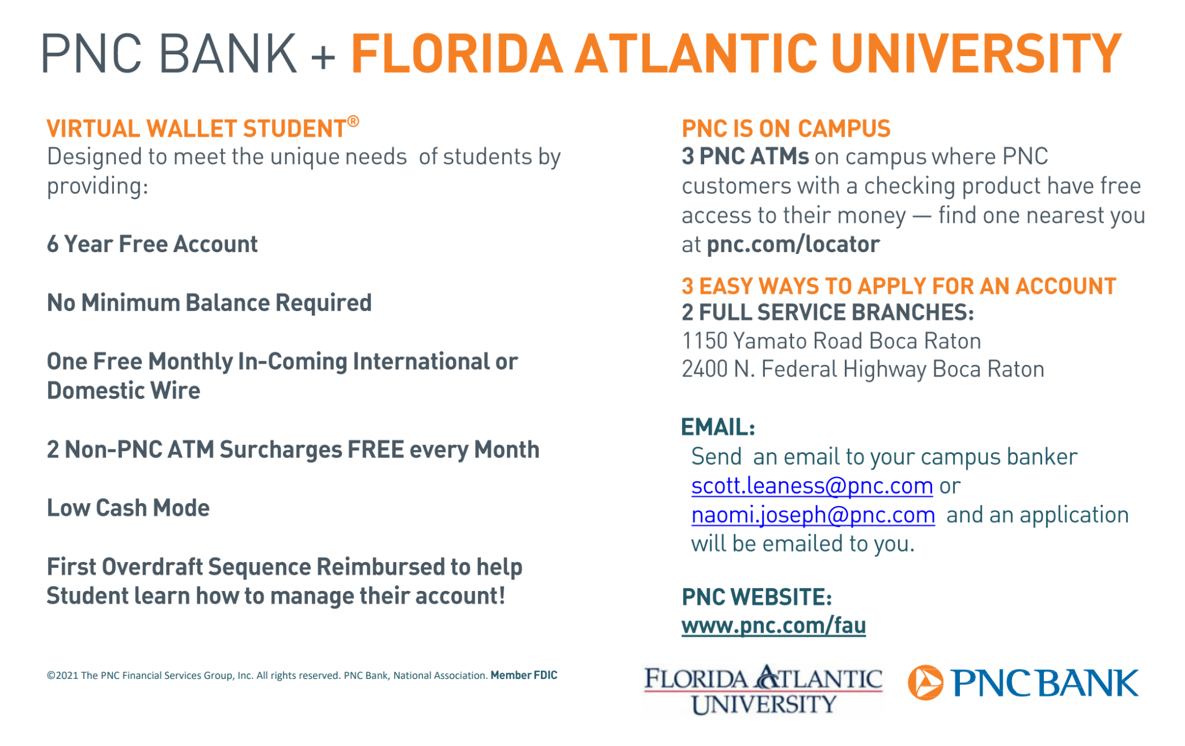

Slide 23
Families: Don’t forget about your Canvas course for more resources following the Orientation Day program

Slide 24
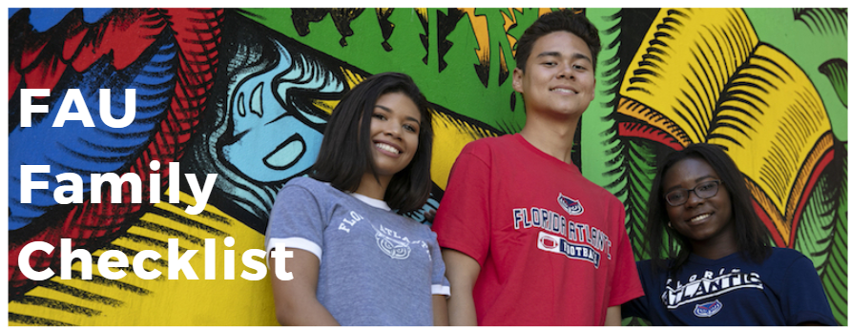
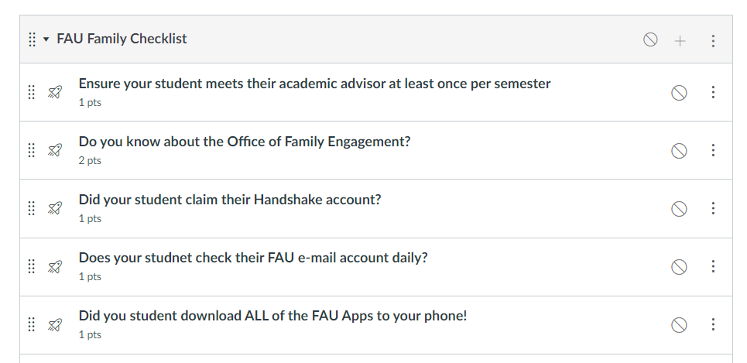

FAU FAMILY CHECKLIST
All families will receive an invite to join Family Checklist via CANVAS.
The checklist will provide dates, contact numbers, and follow up questions to help you support your student.
Similar to your student’s 1st Year-Student Success Checklist, but for families!

Slide 25
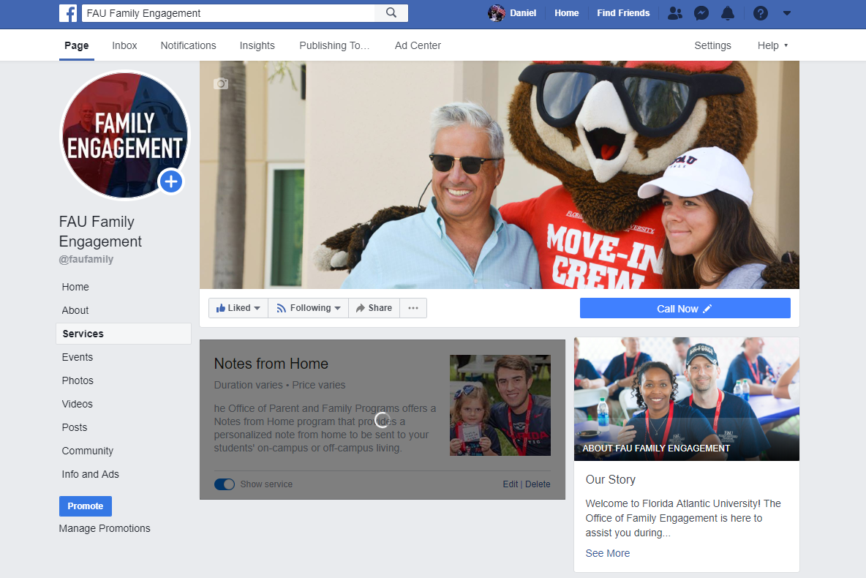
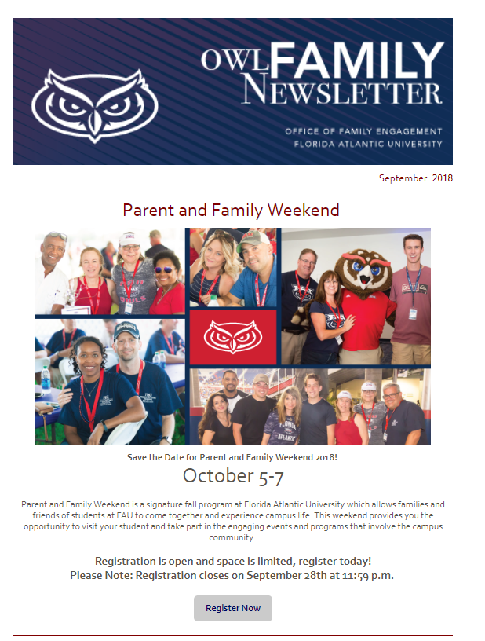
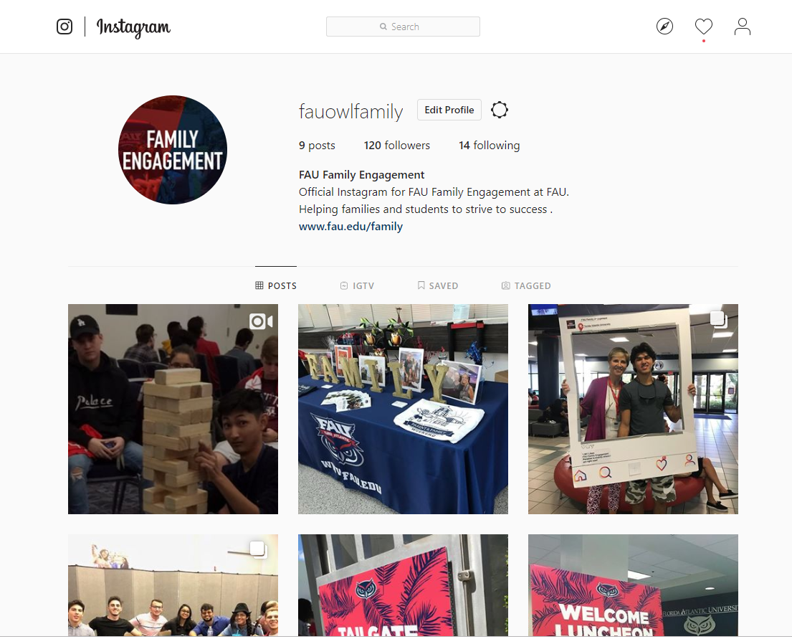
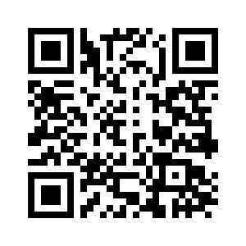
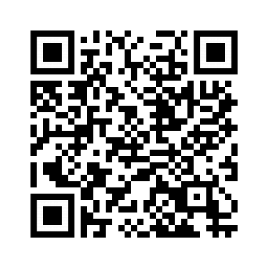
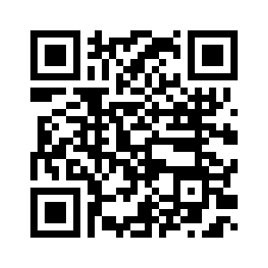
Let’s Connect! #AskFAU
Family Engagement Facebook:
https://www.facebook.com/faufamily/
Family Engagement Newsletter:
https://www.fau.edu/family/services/Newsletters-Archive.php
fauowlfamily: https://www.instagram.com/fauowlfamily/?hl=en
Notes:
1 minute) - Running time at 46 mins ( at end of slide).
Give opportunity for families to sign up for Owl Family Newsletter (Have laptop and iPad)
Promote Owl Family Weekend ( Fall Semester)
Promote social media pages
Implement #AskFAU
Show how to sign up for Newsletter
Running time at 50 mins.

Slide 26
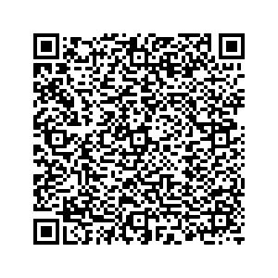
FAMILY ASSESSMENT
Check your email or use the QR code!

Slide 27
Let’s Connect! #AskFAU
Family Engagement Facebook
https://www.facebook.com/faufamily/
Family Engagement Newsletter
https://www.fau.edu/family/services/Newsletters-Archive.php
@fauowlfamily
https://www.instagram.com/fauowlfamily/?hl=en

Slide 28
LUNCH
Notes:
Below this slide are extra slides
Qs for Panel: you’ve already share dyour 30 second intro, introduce now with why you are an expert/pro on this panel today
Why FAU
What did you look for in your family support role?
What is it like to be away from your family for the first time?
Describe how your relationships changed when you came to college? How did this transition from your relationship with family while in high school

Slide 29
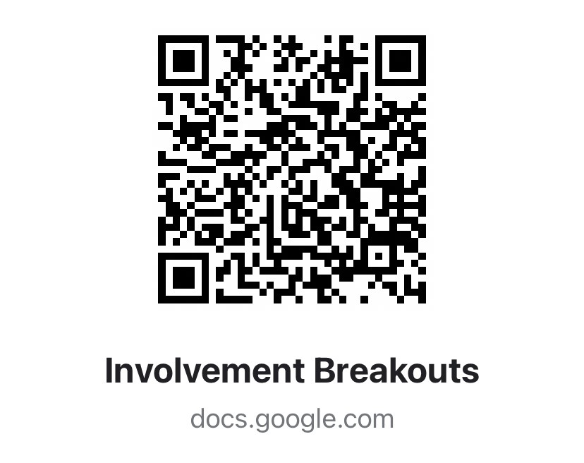
WELCOME TO DAY 2!
Notes:
Below this slide are extra slides
Qs for Panel: you’ve already share dyour 30 second intro, introduce now with why you are an expert/pro on this panel today
Why FAU
What did you look for in your family support role?
What is it like to be away from your family for the first time?
Describe how your relationships changed when you came to college? How did this transition from your relationship with family while in high school

Slide 30

FAMILY WRAP UP

Slide 31
Student Outcomes (Parliament Sessions)
Major Outcomes
Building connections
Values Identification
Personal fears & hopes
Resource awareness

Slide 32
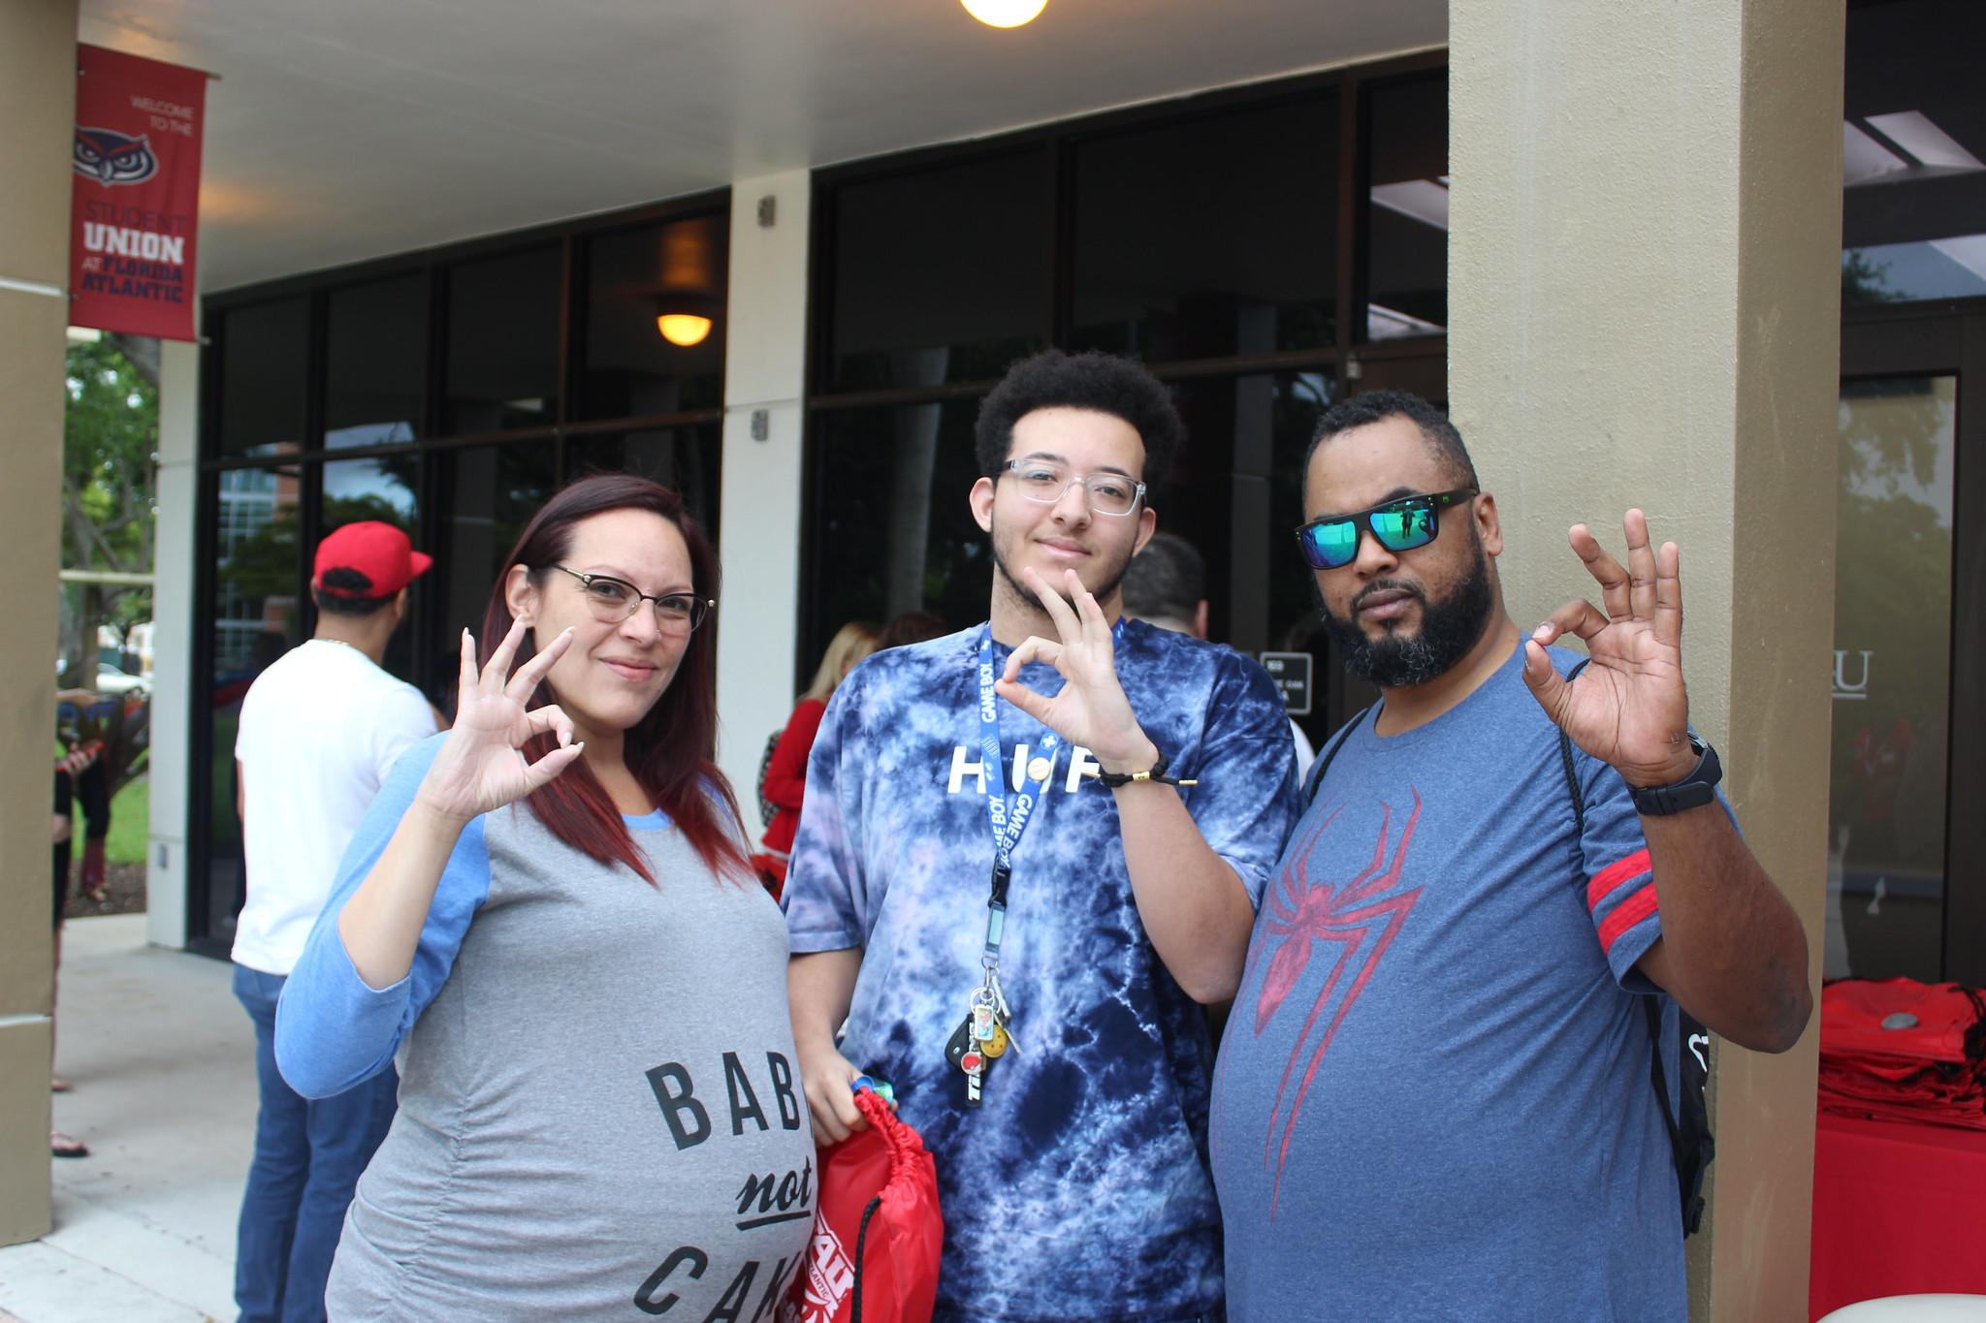
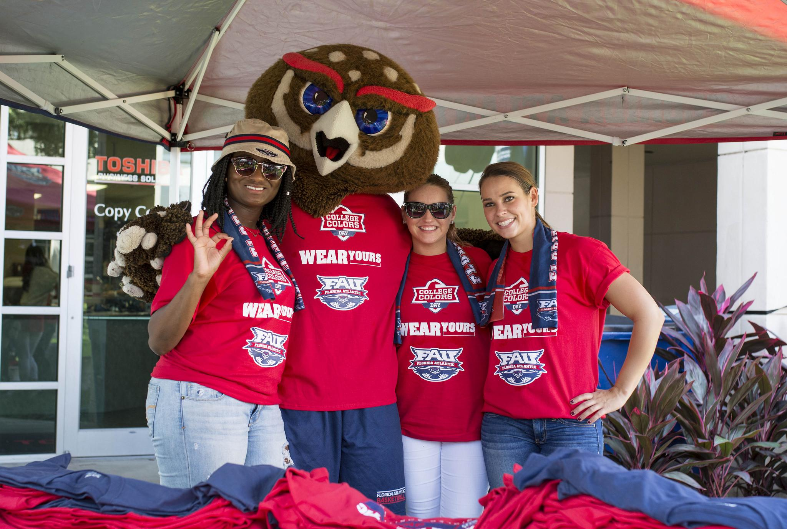
Family Outcomes (Family Sessions)
Major Outcomes
Guidelines and Expectations
Preparation
How/when/why to be a Guide
Connections
Encouragement to enjoy the moment
Families: Don’t forget about your Canvas course for more resources following the Orientation Day program

Slide 33
Important Dates
Please note, some of these dates/deadlines have specific timeframes associated with them – review area websites for more details
August 17 - 22: 9 a.m. to 6 p.m.: Move-In. (schedule in July)
August 20: Deadline - Orientation Canvas course for fall students
August 21: Fall Classes Begin
August 21: Fall How to FAU (+ Family Success Conference)
August 22: Freshman Convocation and Owl Involved
August 27: Last day to drop/add fall courses without consequences
August 30: Last day to pay fees for fall
October 2: Owl Family Weekend
December 17: Fall semester ends

Slide 34
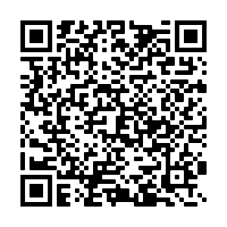

SAVE THE DATES
Family Success Conference is for incoming families interested in learning how to be of support to their college student.
This program aims to provide additional support to families who are interested in learning how to best assist their college student.
How to FAU Conference runs at the same time as Family Success Conference
January 8, 2022 from 1-2:30 p.m.

Slide 35

Save the Dates!

