Slide 1

Prohibited Discrimination
and Harassment at FAU
Notes:
Hello, and welcome to FAU! My name is Winnie Jean-Pierre, and I’m with the Office of Equity and Inclusion. I’m so honored to have your attention for the next few minutes to discuss the very important topic of prohibited discrimination, harassment, and sexual misconduct at FAU.

Slide 2

Who we are…
Office of Equity and Inclusion
Administration Building, Room 265
Our office investigates complaints of discrimination, harassment, sexual assault and other types of sexual misconduct.
Notes:
A little bit about who we are at the Office of Equity and Inclusion.
Our office investigates complaints of discrimination, harassment, sexual assault, and other types of sexual misconduct.

Slide 3
Why are we here?
To provide you with information on the University’s policies and regulations relating to discrimination, harassment, and Title IX Matters
To discuss reporting and investigative processes
To provide information on the resources available to all students
Notes:
FAU is deeply committed to providing a safe environment that embraces differing backgrounds and experiences while recognizing the unique perspectives each individual brings to our community. Today, I want:
To provide you with information on the University’s policies and regulations relating to discrimination, harassment, and Title IX Matters
To discuss reporting and investigative processes
To provide information on the resources available to all students

Slide 4

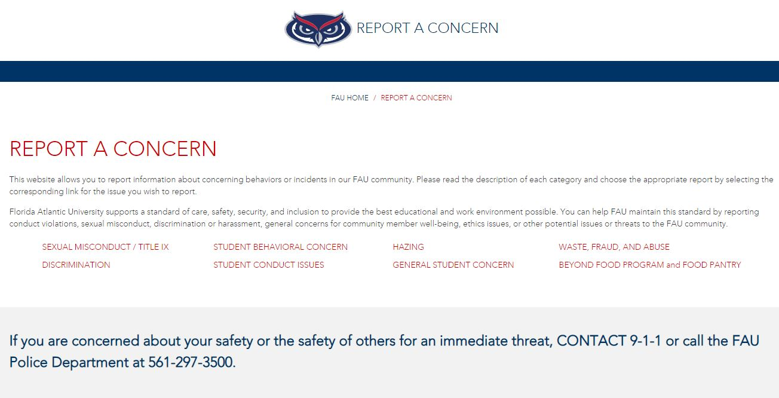
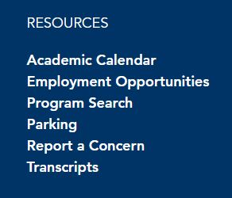
How do I make a report?
Visit www.fau.edu/report or select “Report a Concern” from main FAU homepage.
Notes:
How do I make a report? To make a report go to the FAU reporting web page at www.fau.edu/report or if you go to the main FAU homepage, and scroll all the
way to the bottom, you will see a column titled “Resources”, you can also click on “Report a Concern” and that will get you to the reporting page.
From there choose the appropriate category for the type of behavior that you would like to report. When filling out the report, it’s important to be as thorough
as possible. The more information that we have, the easier it is to understand what occurred and how to address the issue.

Slide 5

FAU Prohibits Discrimination + Harassment
All forms of discrimination or harassment based upon an individual’s race, color, religion, sex, national origin, age, disability, veteran status, marital status, pregnancy and parenting status, sexual orientation, gender identity or expression, or other protected status is a violation of University Regulation.
Title IX Matters refers to discriminatory conduct that includes sexual harassment, sexual assault, dating violence, domestic violence, and stalking. Such conduct is expressly prohibited.
Notes:
University Regulation is very clear that all forms of discrimination and harassment based on a person’s protected class is prohibited.
The protected classes are outlined on this slide and include: race, religion, national origin, etc.
Title IX Matters refers to discriminatory conduct that includes sexual harassment, sexual assault, dating violence, domestic violence, and stalking. Such conduct is expressly prohibited.

Slide 6
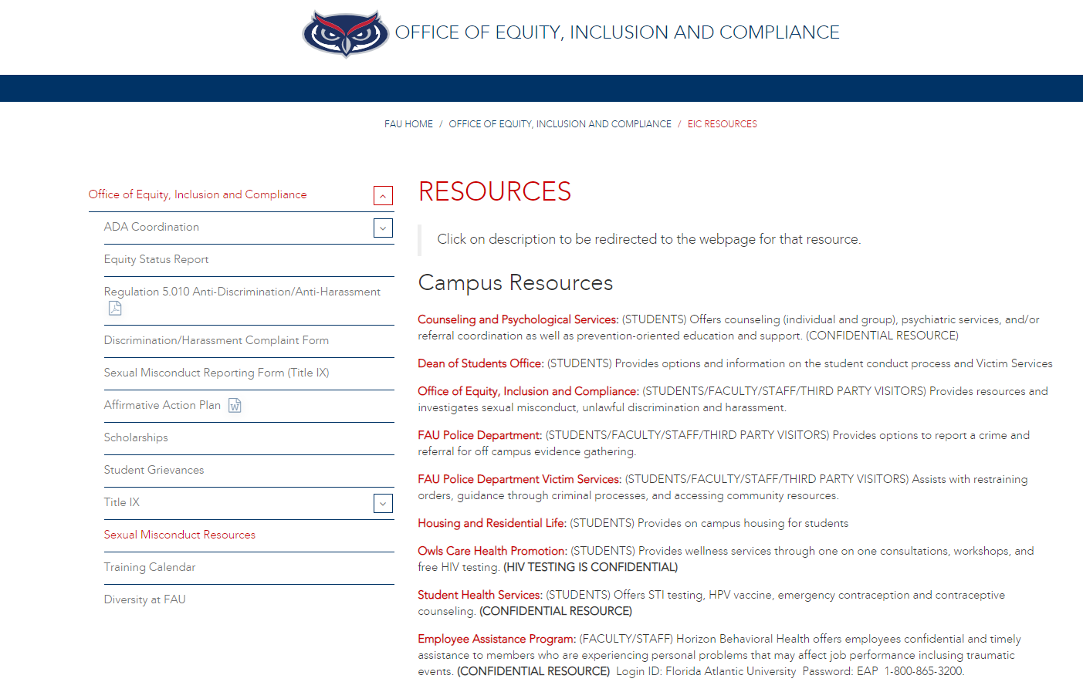
What are the available resources?
Visit www.fau.edu/eic/resources
OR
http://www.fau.edu/dean/victimservices/
for more information about resources available on and off campus.
Notes:
The image on this slide is a screenshot of the first thing you’ll see when you click on the link for resources. This page also provides off-campus resources and highlights the confidential resources available on and off campus. We update this webpage regularly with up to day resources available to all our students. We encourage you to let us know if you feel your needs are not met. Please note that supportive measures also include academic accommodations for those impacted by discrimination or harassment.

Slide 7
What happens after I make a report?
Upon receiving report of discrimination or harassment, OEI ensures parties are provided with supportive measures.
OEI determines whether it has enough information to begin an investigation. If yes, OEI will follow procedure outlined in Policy 1.15.
Final investigation report submitted to appropriate administrator.
If a violation is determined in non-Title IX matters, the Administrator will issue corrective action. All Title IX Matters are referred to a hearing to determine the outcome.
Notes:
So, what happens after I make a report? OEI is neutral. OEI does not take sides or advocate for either the complainant or respondent involved in an investigation. We are committed to providing a fair and unbiased review, and our investigations are focused on the information available. We also help both complainants and respondents by providing information about supportive measures, advocacy, and resources.
Once an investigation begins, we meet with both the Complainant and Respondent, any relevant witnesses, and review relevant evidence.
At the conclusion of an OEI investigation, a final investigation report is prepared to summarize the findings of the investigation, and the report is shared with the appropriate administrator for adjudication.

Slide 8

How/What to report
Where to get help
Be Aware
Office of Equity and Inclusion
561-297-3004
Protect Your
Owl Family
Notes:
Today’s presentation is a basic overview of discrimination and harassment in our limited time. If you have any additional questions, please come visit us, or contact us at 561-297-3004.
Welcome to FAU and Go OWLS!

