Slide 1

Charles E. Schmidt College of Science
#OwlIn to Graduation

Slide 2

Learning Outcomes
You will…
Learn about the majors, minors, certificate available in the college.
Learn more about what the college of science offers.
Learn about the career center and its services.
Understand the purpose of academic advising.
Identify the FAU personnel in your Success Network
List and explain the IFP registration options for the College of Science

Slide 3


Slide 4


Why Study Science?

Slide 5

Scientists……..
Make new discoveries.
Create the future.
Develop excellent critical thinking skills fostered through the scientific method.
Quench their natural love for learning.
Work within many disciplines.
Are prepared to excel is some of the fastest growing career areas.

Slide 6

Degree Programs
Majors
BA/BS Biological Science
BA/BS Chemistry (ACS)
BS Chemistry: Biochemistry Concentration
BS Data Science and
Analytics (Natural Science Concentration
BS Exercise Science & Health Promotions
BA/BS Geoscience
BA Health Science
BS Neuroscience and Behavior
BA/BS Physics
BA Psychology
BA/BS Math
BS Medical Biology
Bachelor of Urban Design
Bachelor of Urban Regional Planning

Slide 7
Minors
Biology
Geography
Psychology
Mathematics
Geology
Statistics
Physics
Certificates
Environmental Studies
Biotechnology
Data Science
Geographic Information Systems
Actuarial Science
Statistics
Mental Health

Slide 8
Pre-Health
Professions Program
For students interested in medical, dental, veterinary, and other professional training in the health sciences (other than Nursing).
We assist in preparing students to matriculate into graduate professional schools.
Requirements for Pre-health Professions Advising
No Admission Requirements
Advising for this program takes place in the Pre-Health Professions Office (SE 308).
Students must maintain a 3.0 GPA to continue pre-health advising.
Students are expected to participate in shadowing and volunteering (100 minimum) as part of pre-health advising program.

Slide 9
Components of the Pre-Health Professions Program
First Year Interest Groups
Pre-Health Courses:
  Introduction to Pre-Professional Studies with lab
  Medical Internship for shadowing experience
Pre-Health Professions Week
Pre-Health Workshops-tailored to student needs. (basics, beyond basics, financing, application, interviewing)
Mock medical school interview with Pre-Health Professions Committee
“Wall of Fame” recognition for accepted students
Future Doctors reception for all students accepted into medical, veterinary, or dental school.
MCAT prep course taught by FAU Science faculty.

Slide 10

Science@FAU Highlights
Eminent Scholars in Science, Brain Sciences and Marine Biology
Education and research partnerships with Scripps Florida, the Max Planck Florida Institute and the Torrey Pines Institute for Molecular Studies
Professional Science Master’s Degrees in Medical Physics, Masters in Marine Science and Oceanography and Business Biotechnology, Masters Data Science
Six Research Centers of Excellence: Complex Systems and Brain Sciences, Biological and Materials Physics, Environmental Studies, Molecular Biology and Biotechnology, and Geo-Information Science, Cryptology and Information Security.
Home of the FAU Astronomical Observatory
Harbor Branch Oceanographic Institute and Gumbo Limbo

Slide 11

Research
Importance of Research
Ways to Engage in Research
Having a research experience can teach you skills of academic inquiry beyond what you can learn in the classroom.
It is an opportunity to be curious, inventive, and creative.
It will allow you to engage in a particular subject in great detail.
Research helps to develop competencies such as critical thinking, teamwork, communication, reliability, dependability, resilience, adaptability, and capacity for improvement.
Laboratory and clinical trials
  Volunteer
  Receive course credit
Student can participate in DIR(Directed Independent Research) which is an option for all majors in the college.

Slide 12



NSF-LEARN Program
Research Scholarship Program for Science, Technology, Engineering, and Math (STEM) Students

Slide 13

What’s in it for you?
Eligibility
Structured help adjusting to FAU
$500 scholarship
Priority registration
2 free research focused courses
Mentorship by faculty and peers
Academic, social, and community events
Leadership and networking opportunities
Hands-on research experience in your field of interest
Incoming from high school
Have a declared major in the College of Science or College of Engineering and Computer Science
Pursue a Bachelor of Science (B.S.) degree
High school GPA of 3.6 or higher
SAT score of 1100 or higher or ACT score of 22 or higher

Slide 14
Honors Options
Biology-Introduction to Honors and Honors Thesis in Biology
Honors in Mathematics
Upper-Division Honors in Psychology
MAX Planck Honor Program(high school GPA, National Merit)
Clubs
The Math Club
Chemistry Club
Psychology Club
Geo Club
Society of Physics students

Slide 15
Workshop/Seminars
Internships
The college of science offers a variety of workshops designed to help you navigate your academics and career goals.
The university offers series of lectures called “ The Frontiers in Science”. These public lectures are geared towards providing a deeper understand of science.
The college offers a paid and unpaid internship course opportunity with your major in mind.
The college also offers a medical shadowing internship (unpaid shadowing opportunity)

Slide 16
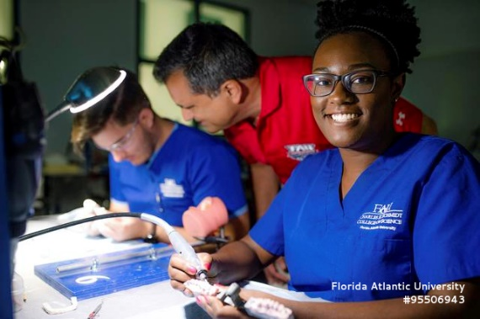
First-Year Interest Groups (FIGS)
In a FIG, you:
take a 1-credit course with 24 other students who share similar majors.
have a seminar class that led by faculty and advisors from your specific college.
have an opportunity to build relationships within your college as soon as classes begin.
get the inside scoop on what it takes to excel in your major.
have an opportunity to build a community that makes this large research university feel like home
College of Science
and Pre-Health FIGS:
Exploring Behavioral Science
Healthcare and Society FIG
Success in Science
Pre-Health Professions
Learn more and enroll at: fau.edu/academicsuccess
Notes:
Affinity Groups at FAU provide first-year students with the opportunity to engage with peers who share their major and/or interests
Affinity Groups are open to both first-year residential and commuter students!
Affinity Groups will share experiences through their Affinity Group SLS Course and programming outside of the classroom
Students a part of Affinity Groups attain higher GPAs and higher first-to-second year retention
Inform students that they can also join an AG that is not major based. For example, LEAD and Serve, First Generation, Pre-Law, La Casa FAU and Media and Communications

Slide 17
To learn more about getting engaged with science…
Visit www.science.fau.edu (or contact a College of Science Advisor)
To learn more about research opportunities in general visit The Office of Undergraduate Research and Inquiry. http://www.fau.edu/ouri/

Slide 18


Slide 19

#OwlInToGraduation
FAU Career Center

Slide 20


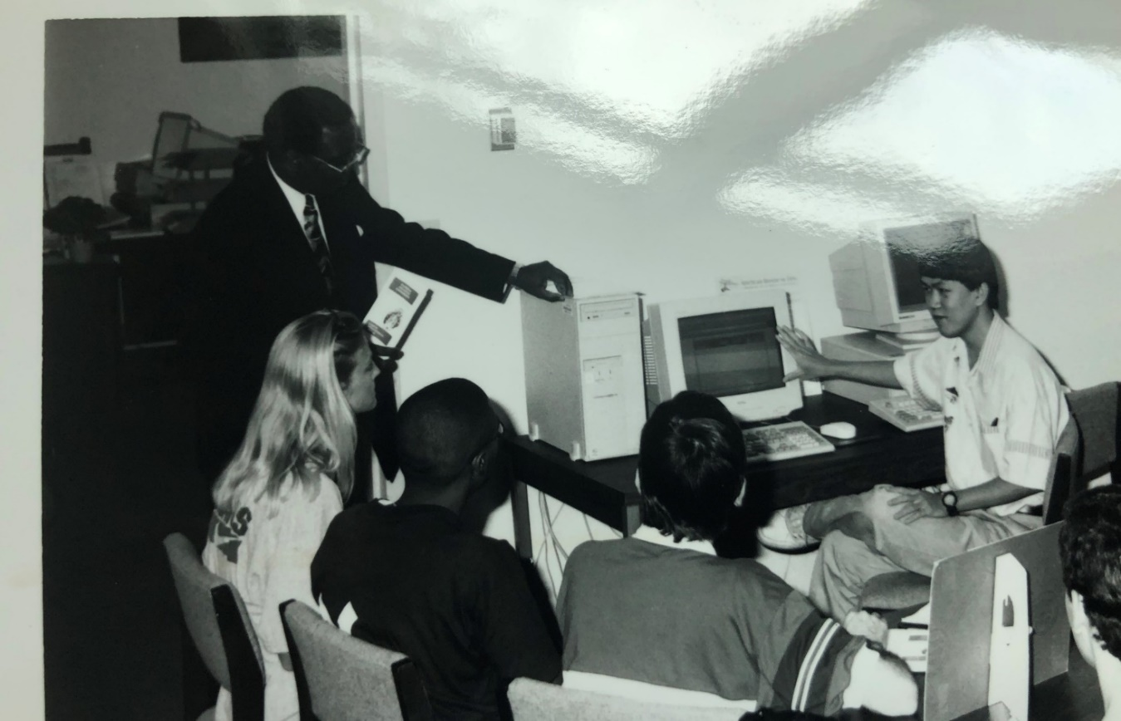
How It Started
Career Center, 1965
Notes:
Show Career Center was one of the first offices at FAU.. Career has always been a value to FAU. What we looked like “before”

Slide 21
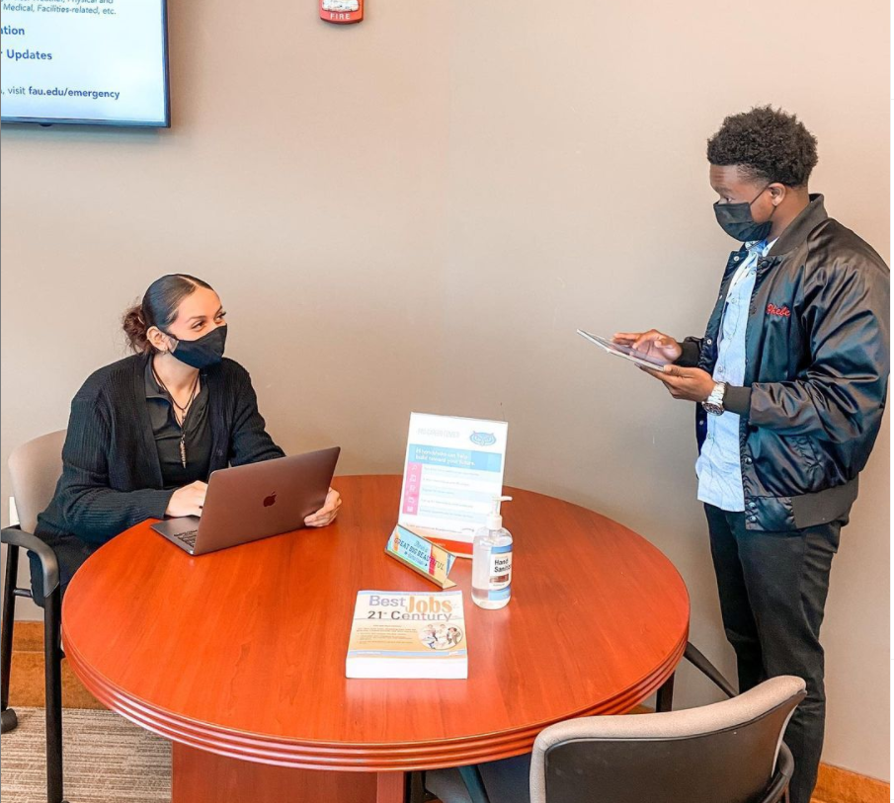
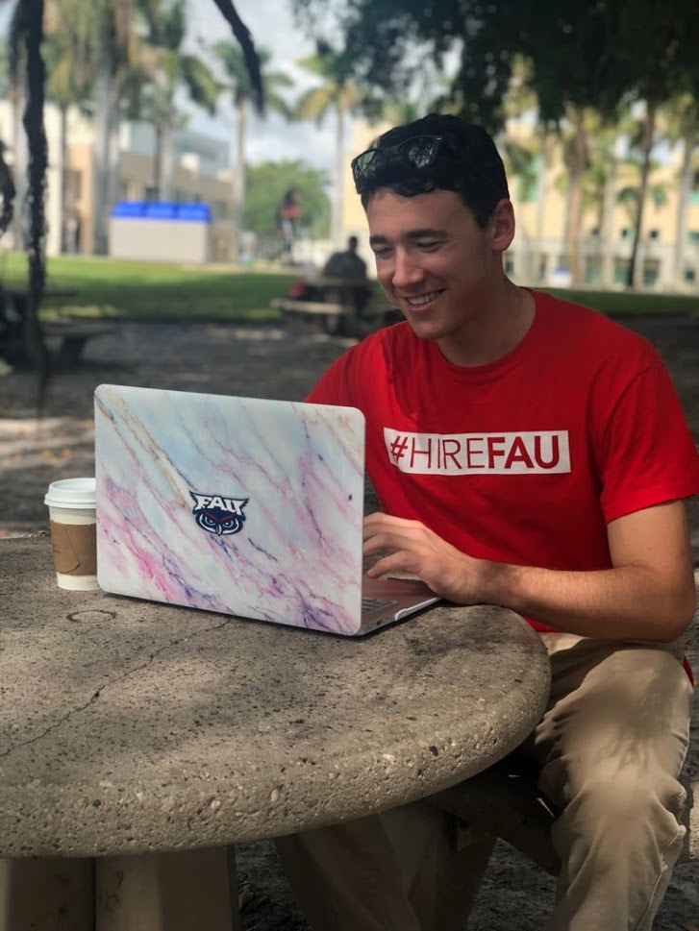
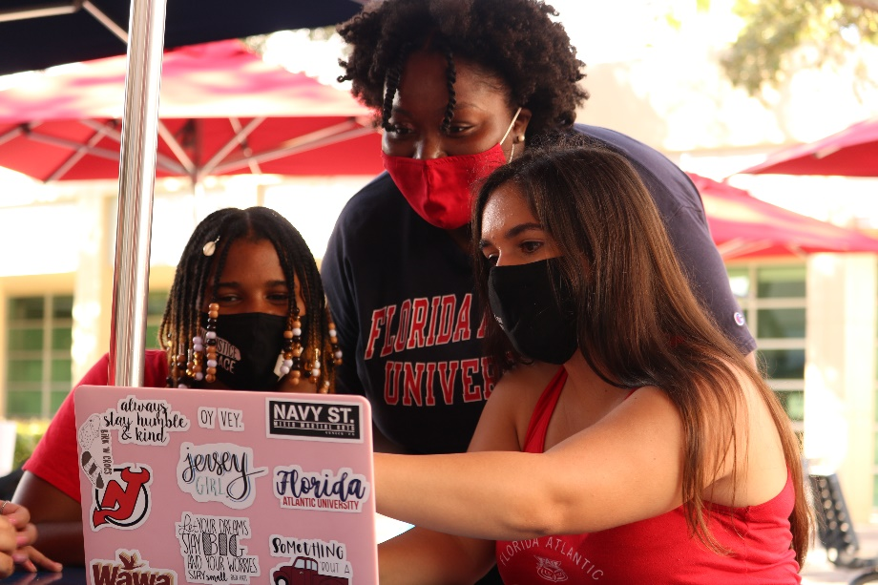
How It’s Going
Career Center, 2021
Notes:
Career Center now– more modern, all over campus, help students where they are at.. Online and in-person.. Career ecosystem idea.

Slide 22
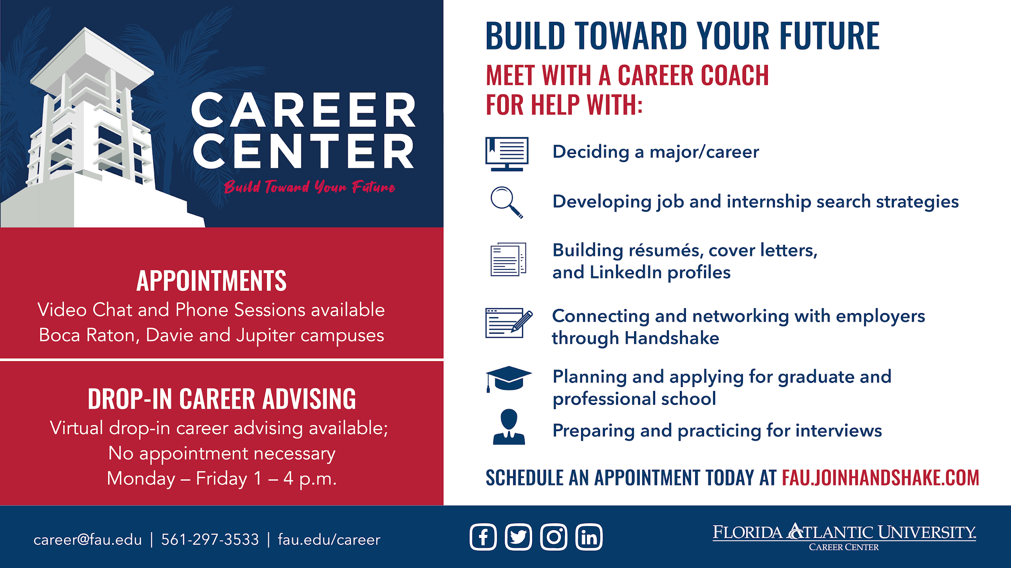

Slide 23

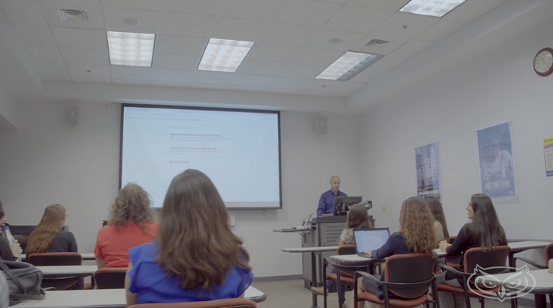
Still Deciding?
Sign up for SLS 1301
  1-credit elective course
  This class provides an overview of career development theories and decision-making skills for career/life planning.
  Focuses on:
  self-assessment
  deciding a major
  exploring career options
  developing an action plan
  All to help you achieve your career goals!
Notes:
Please promote SLS 1301, even if students feel confident in the college but not the major this could be helpful or to help them decide on occupations other options!

Slide 24

Things To Do Before Classes Start …
To Be Career Ready
Notes:
Learning a lot at SOAR.. Here is what you can do now to be career ready before classes start

Slide 25
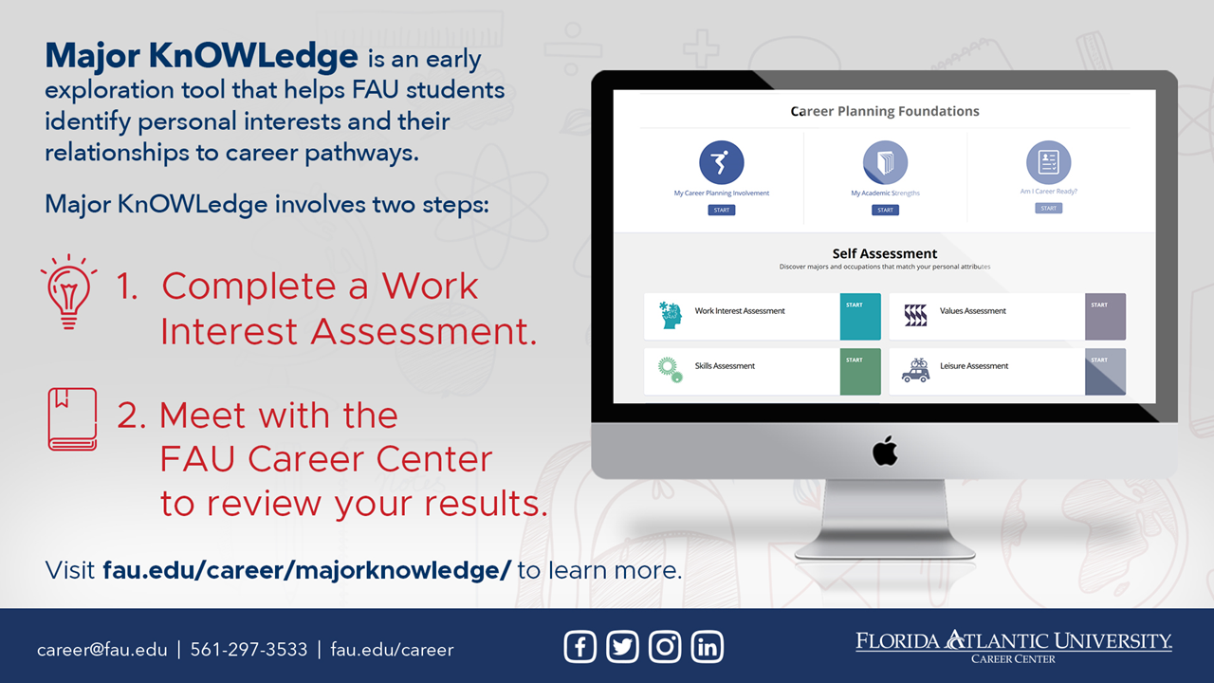
Notes:
Take MK
Explain both parts

Slide 26

Notes:
Second thing to do.. Claim Handshake account. Quick review of what is Handshake.

Slide 27

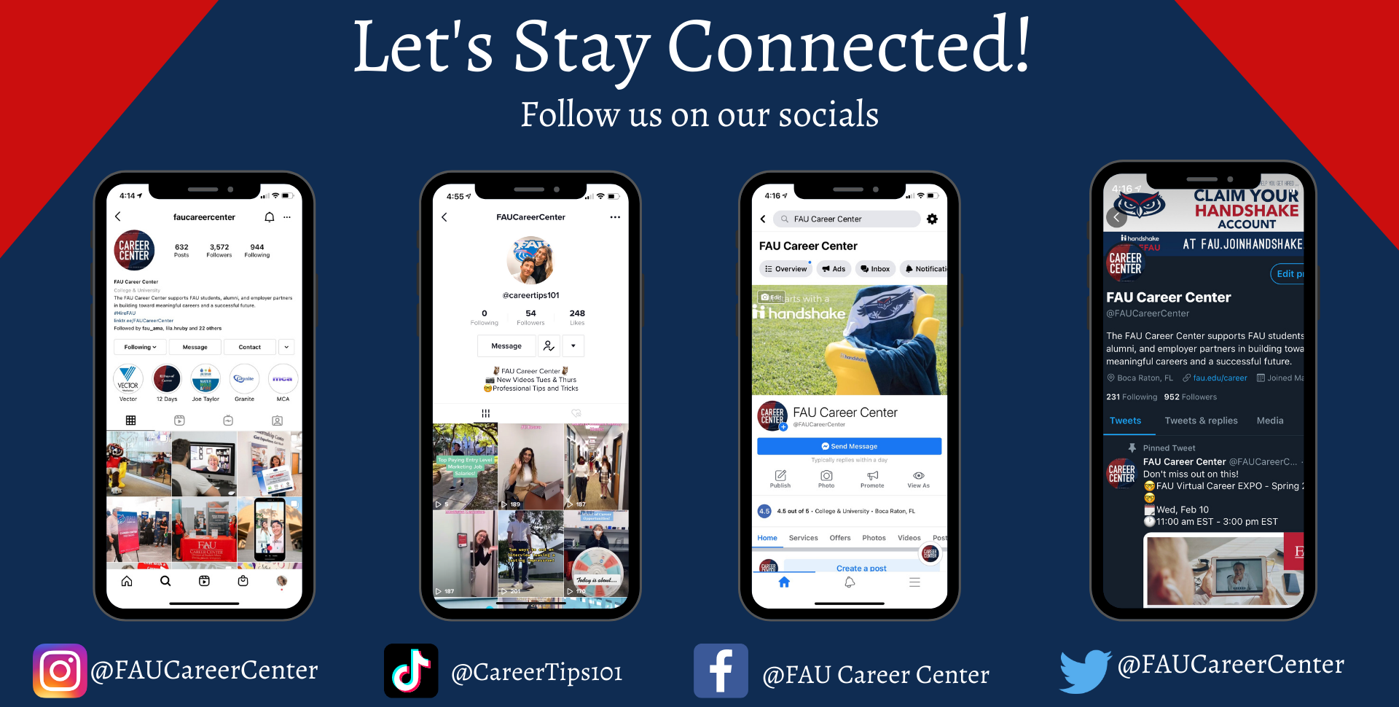

Slide 28
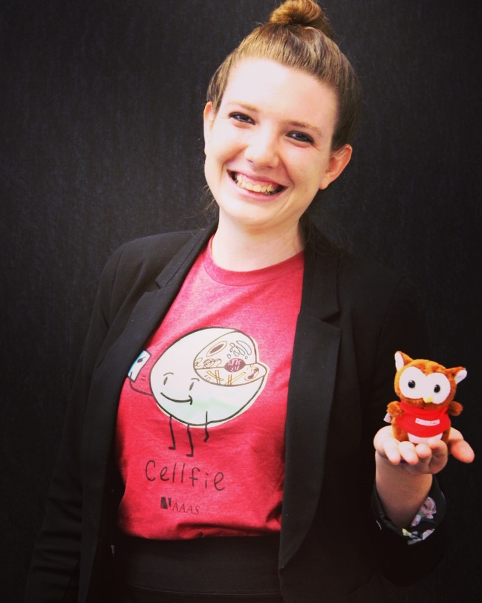
Contact Information
Ella Feliciano
Career Coach for Science Majors
etepper1@fau.edu

Slide 29
#OwlInToGraduation
University Advising Services (UAS)

Slide 30
READ
Email is FAU’s main form of communication. All emails will be sent to your FAU email. Please check your email daily!
Expect emails from your academic advisor for:
  Spring advising
  Midterm grades
  Important updates or information

Slide 31
READ
Your syllabi will provide an outline for assignments, grading, exams, instructions, and instructor contact information.
It is expected that you review your syllabi at the beginning and during the semester.
Your syllabi can be found on Canvas.

Slide 32
READ
Please review your advisor’s comments on EZ Advising form and all emails in your FAU email in box
Do you still need to send important documents to FAU?
      AP / IB / AICE / Dual Enrollment / Transfer credits?

Slide 33
KNOW What Is Happening
& When

Slide 34
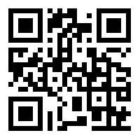
Find your schedule
Self-Service
Student Services
Registration
My Schedule
Spring 2022

Slide 35
IMPORTANT DATES
Class Begin | January 8th
Last day to Drop/Add | January 14th
Last day to Pay Tuition | January 18th
Start to meet with your advisor | AFTER MLK DAY (January 17th)
FAU Internship and Part-Time Job Fair | February 2022
Last day to Withdraw | March 25th
Registration | It’s Happening! Get Registered NOW!
Final Exams | April 28th – May 4th
Semester Ends | May 6th

Slide 36
Use Your Tools
& Resources

Slide 37
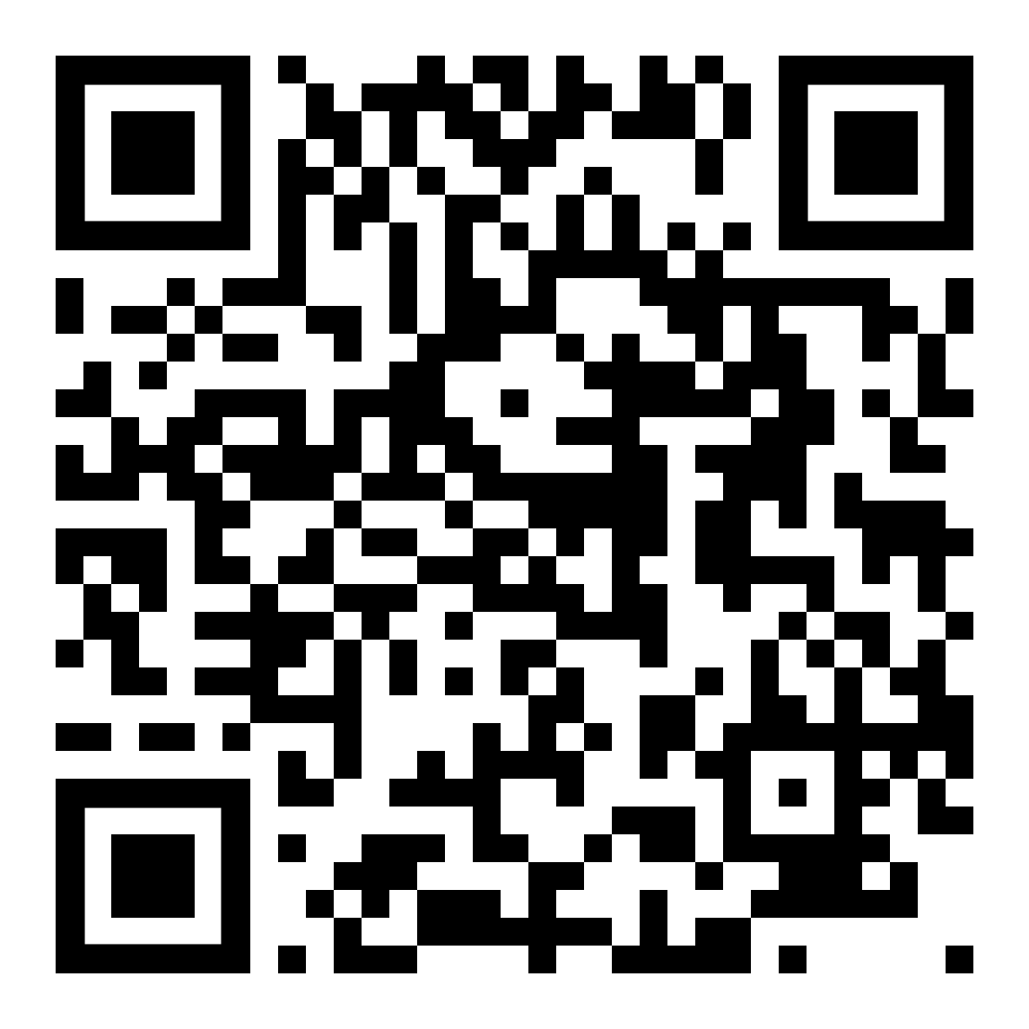
Resources!
Virtual Registration Lab:
Help with class days/times.
Email from your FAU account.
Solutions for your schedule
The advisor who processed your EZ Advising Form
https://tinyurl.com/282ejabf
advisingservices@fau.edu

Slide 38

Success Network
Your Success Network connects you to your support system- your academic advisor, professors, tutors, financial aid advisor, and many other support professionals
Click for a Success Network Tutorial (http://www.fau.edu/uas/videos/video_library/Success_Network_Video.ocap.mp4)
The contact information for each assigned staff member can be found once you log into your Success Network
You will log into Success Network to schedule appointments with your academic advisor at University Advising Services
UAS Walk-In Advising through your Success Network during the 1st week of class!

Slide 39



Contact Information
Email
  UAS - advisingservices@fau.edu
  Career Center – career@fau.edu
Web
  UAS - www.fau.edu/uas
  Science - www.science.fau.edu
  Career Center – www.fau.edu/career
  OURI – www.ouri.fau.edu
Phone
  UAS - 561.297.3064
  Science - 561.297.3700
  Career Center - 561.297.3533
Curriculum Sheets: www.fau.edu/uas/curriculum.php
@UASFAU
@UASFAU
University Advising Services - FAU

Slide 40
University Advising Services
University Advising Services will be your primary resource for academic advising, course scheduling, and guidance during your first and second year at FAU. UAS can assist with:
  Course advising
  Academic policies and information
  Changing and/or declaring majors
  Making appropriate referrals to important resources on campus

Slide 41
Intellectual Foundations Program (IFP)

Slide 42
What is the
Intellectual Foundation Program (IFP)?
Your core curriculum/basics
All majors must complete the IFP
There are six (6)segments of the IFP
The requirements for each section varies depending on your major
You will complete a minimum of six (6) credits in each segment (requirements vary by major)
Segments with “A” and “B” sections have a requirement that one course must be taken in section “A”
Review the curriculum sheet for your major and speak with your academic advisor for specific major information: http://www.fau.edu/uas/curriculum.php

Slide 43
Mathematics
6 credit hours Required – C or better**
At least one (1) course must be from Group A
Group A
____ MAC 1105 College Algebra
____ STA 2023 Introduction to Statistics (only for Health Sciences and Geosciences majors)
____ MAC 2311 Calculus with Analytic Geometry 1 (4 credits)
or any mathematics course for which one of the above courses is the direct prerequisite
Group B
____ MAC 1147 Precalculus Algebra & Trigonometry (4 credits)
____ MAC 2233 Methods of Calculus
____ MAC 2241 Life Science Calculus 1 (4 credits)
____ MAC 2312 Calculus with Analytic Geometry 2 (4 credits)
**FRESHMEN -- Math courses will be determined by your SAT, ACT and high school math grades.
* The most universal Math class for science majors.

Slide 44
Society and Human Behavior
6 credit hours required – At least one (1) course must be from Group A
Group A
History Department
____ AMH 2020 & D United States History Since 1877 (P/F) – helps with state of Florida Civic Literacy Requirement
Anthropology Department
____ ANT 2000 & D Introduction to Anthropology (WAC)
Economics Department
____ ECO 2013 Macroeconomic Principles
Political Science Department
____ POS 2041 Government of the United States – helps with state of Florida Civic Literacy Requirement
Psychology Department
____ PSY 1012 General Psychology – recommended for all majors (Req’d. Neuro, Psych, Health Sciences)
Sociology Department
____ SYG 1000 Sociological Perspectives – recommended for all majors (Rec’d. Neuro, Psych, Health Sciences)
IMPORTANT
  Writing Across the Curriculum (WAC) Must earn “C” or higher
  ENC 1101/1102 prerequisites with a minimum grade of “C” or higher

Slide 45
FAU Civic Literacy Requirement
To graduate from FAU with any degree, students entering this Spring must meet the Florida Civic Literacy statue by completing both a course and exam.
Courses | Civic Literacy Exam Requirement
AP, AICE, or IB U.S. Government or History credit | Requirements change based on credit type; consult with your Academic Advisor
50 or higher on American Gov. CLEP exam | Civic Literacy Requirement is met
Passing grade in POS 2041 (Government of the U.S.) or AMH 2020 (U.S. History since 1877) | Must take Exam and score 60 or higher: U.S. Citizenship and Immigration Services Naturalization Test or Florida Civic Literacy Examination (FCLE)
For more information Requirements and Exams, visit https://www.fau.edu/ugstudies/civic-literacy-requirement/

Slide 46
Policies to Know
Gordon Rule: Applies to both Writing Across the Curriculum (WAC) courses and Math classes.
  Must be completed for a “C” or higher to receive credit.
Pass / Fail Option: this option is not available for courses in the student’s major, students on probation, or for pre-health students.
Repeat Surcharge – 3x ***
*** Limitation on Repeated Courses for Science Majors.
No course may be taken more than twice, whether at FAU or at any other institution, without the permission of the student’s advising office. Consult with an advisor to discuss options in the case that you cannot complete a course within 2 attempts.

Slide 47
Withdrawal Policy (W Policy)
Undergraduate students may not withdraw (with a grade of “W” or “ZR”) from more than 2 courses at the lower-division level (1000- and 2000-level courses) and from more than 3 courses at the upper-division or higher level (3000- and 4000-level courses.)
Always speak with your academic advisor before making any decision to withdraw from a course.

Slide 48
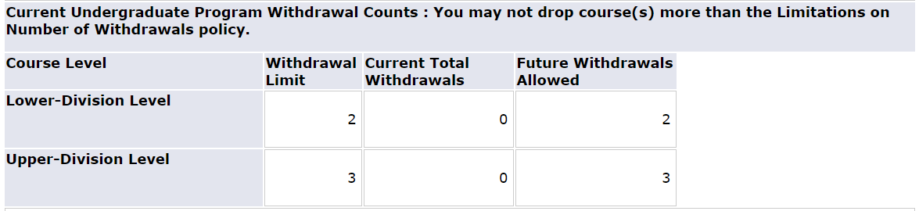
Withdrawal Policy (W Policy)

Slide 49

Writing Across the Curriculum (WAC)
ALL students must complete four (4) WAC courses. Must earn a "C" or better.
WRITTEN COMMUNICATIONS
English Department
  ENC 1101
  ENC 1102 or allowable substitute: ENC 1939 or HIS 2050
SOCIETY AND HUMAN BEHAVIOR
Anthropology Department
      ANT 2000 & D Introduction to Anthropology
GLOBAL CITIZENSHIP
  History Department
  WOH 2012 & D History of Civilization I
HUMANITIES
  Philosophy Department (Group A)
PHI 2010 & D Introduction to Philosophy
English Department (Group B)
    LIT 2010 Interpretation of Fiction
    LIT 2030 Interpretation of Poetry
    LIT 2040 Interpretation of Drama
    LIT 2070 Interpretation of Creative Non-Fiction
    *Additional WAC courses may be available. Please speak with your advisor

Slide 50
Foreign Language
ARA 1120/1121 Beginning Arabic I/II
CHI 1120/1121 Beginning Chinese I/II
FRE 1120/1121 Beginning French I/II
GER 1120/1121 Beginning German I/II
HBR 1120/1121 Beginning Hebrew I/II
ITA 1120/1121 Beginning Italian I/II
JPN 1120/1121 Beginning Japanese I/II
LAT 1120/1121 Beginning Latin I/II
SPN 1120/1121 Beginning Spanish I/II
IMPORTANT TO NOTE:
Foreign Language is a graduation requirement for ALL science majors. This is different from your high school foreign language for college admission requirement.
If you have taken 2 years of a language in high school, the Languages & Linguistics Department requires you to start with the 1121 level.
All courses are 4 credits
CLEP Option Available – speak with your advisor

Slide 51
Learning Outcomes
You have …
Learned about the majors, minors, certificate available in the college.
Learned more about what the college of science offers.
Learned about the career center and its services.
Understood the purpose of academic advising.
Identified the FAU personnel in your Success Network
Understood the IFP registration options for the College of Science

Slide 52

Questions

Slide 53
Your College Breakout Session is complete!
Please head back to your small group Parliament breakout rooms. To get there, use the same link that you used to access your Parliament group earlier.
Enjoy the rest of your day SOARing with us!

