Slide 1

Owls in the Classroom Dr. Jennifer Bebergal

Slide 2

Owls in the Classroom Objectives
• WHY Intellectual Foundation Courses (IFP)
• High School vs. College
• Skills for College Success
• Campus Resources

Slide 3


CHOOSE your attitude
Get CURIOUS
CONNECT what you know

Slide 4

HIGH SCHOOL
COLLEGE
Your time is structured by your family, teachers & others.
You are in class 30 hours per week, 1 hour per day/180 days/subject
Your family & teachers will remind you of your responsibilities & help you manage them.
You manage your own time.
You are in class 12-16 hours a week, 3 hours x 15 weeks/course. That is 135 fewer hours in class!
You must balance your own responsibilities and set your own priorities.

Slide 5

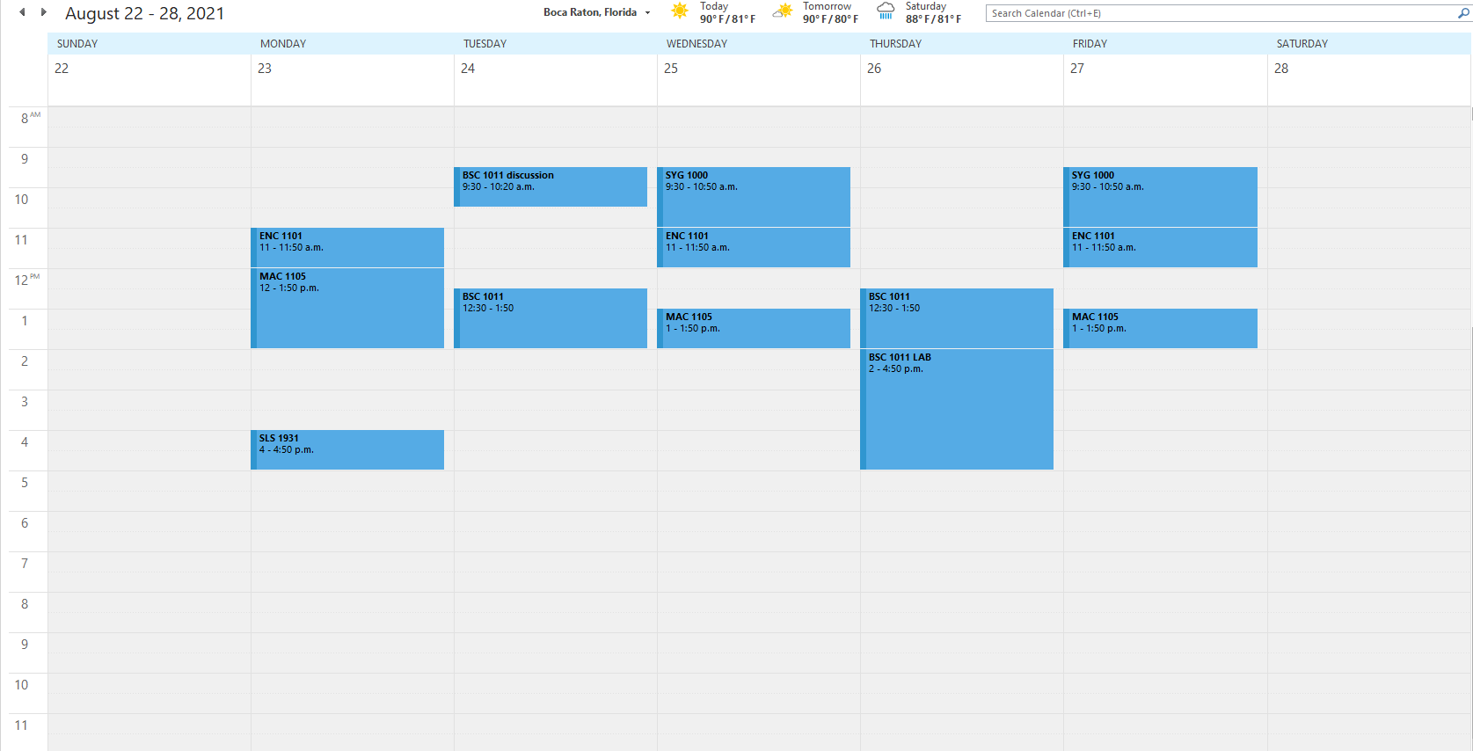
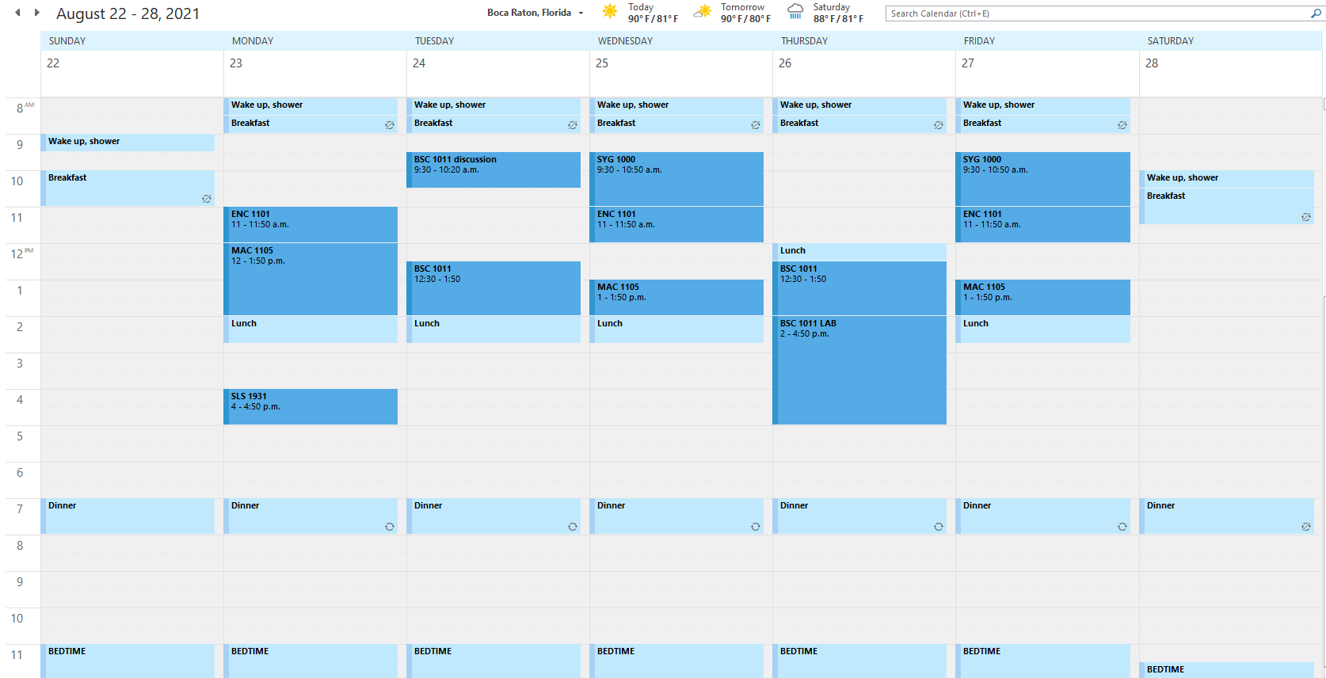
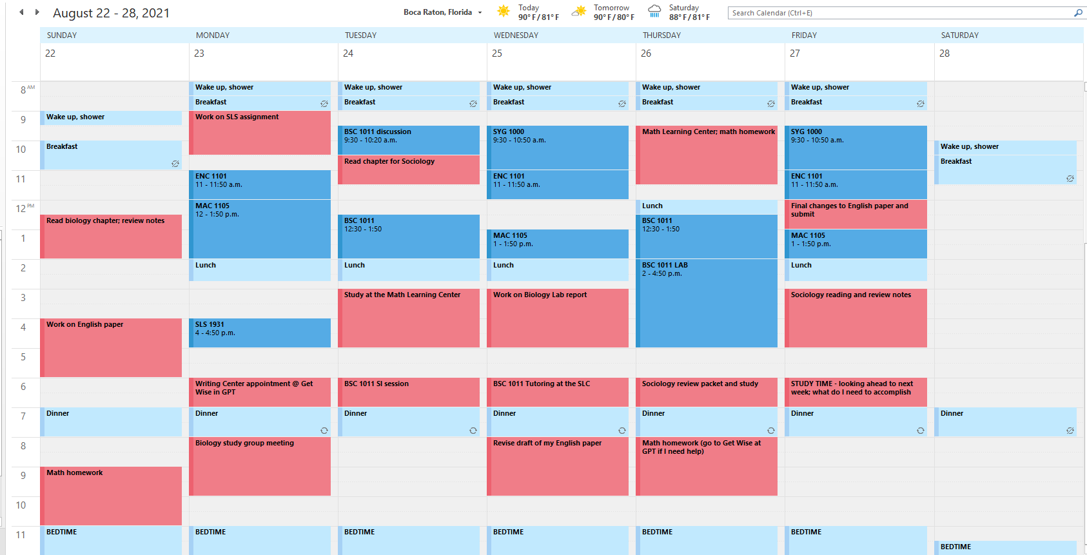
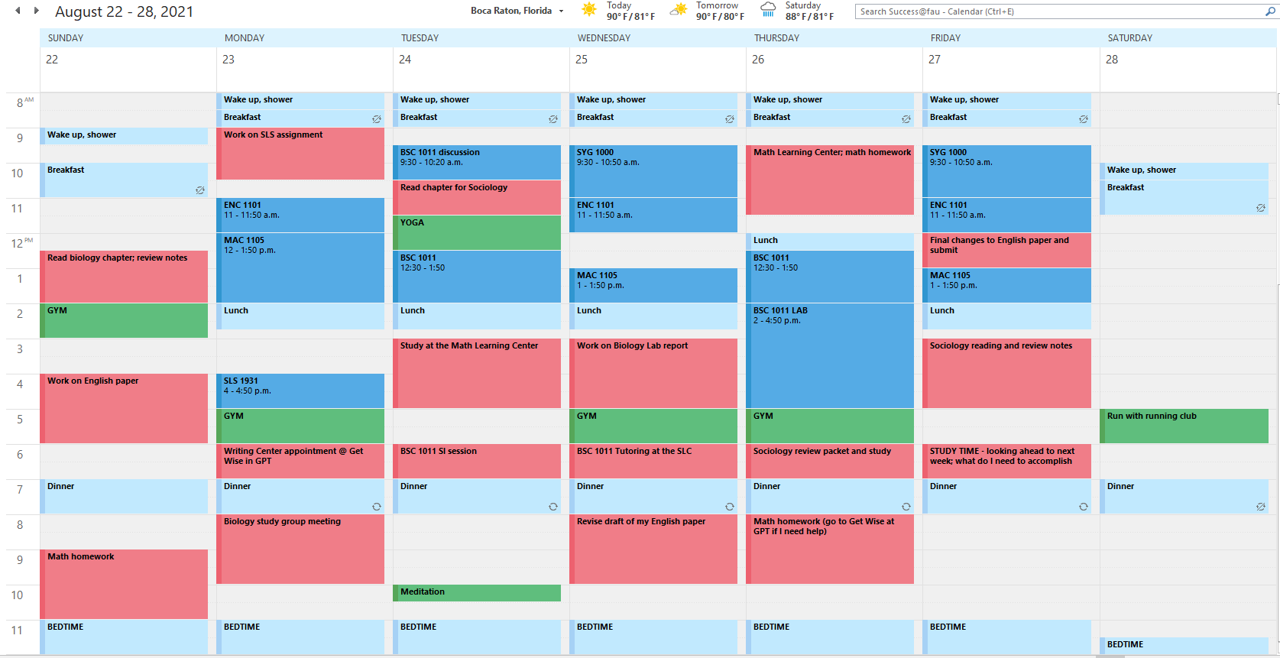
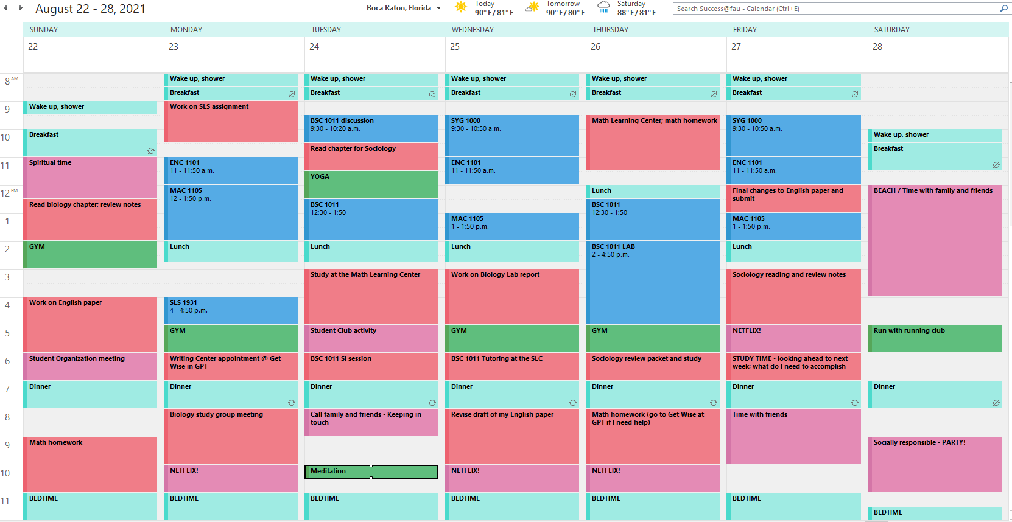

Slide 6




Skills for College Success
Sharpen your study skills
Engage in your classes
Time management
Practice self-care

Slide 7
Interacting with Faculty: Top 5 Tips
Go to class prepared
Read your syllabus
Use office hours
Ask for help before you need it
Be honest with your professor & to yourself

Slide 8
Campus Resources
Office | Location | Phone Number | Email/ Website
University Advising Services | SU 80 Room 201 | 561-297-3064 | advisingservices@fau.edu
Student Accessibility Services | SU 80 Room 133 | 561-297-3880 | https://www.fau.edu/sas/about/contact_us.php
Career Center | SU 80 Room 220 | 561-297-3533 | career@fau.edu
OIT Help Desk | CM 138 | 561-297-3999 | http://helpdesk.fau.edu
Student Health Services | SS-8W Room 240 | 561-297-3512 | https://www.fau.edu/shs/about/contact_us.php
Counseling and Psychological Services (CAPS) | SSB 8 Room 229 | 561-297-3540 | https://www.fau.edu/counseling

Slide 9
Come visit the CTL – Center for Teaching and Learning
Center for Learning And Student Success (CLASS)
- eSuccess
- Science Learning Center (located in the Schmidt Family Complex)
- Supplemental Instruction (SI)
- Tutoring
Math Learning Center (MLC)
Open Study and UHP Study Space
The Speaking Center
Undergraduate Research and Inquiry
University Center for Excellence in Writing (UCEW)
www.fau.edu/ctl

Slide 10
Let’s Recap
Build curiosity about your classes.
Make connections to what you already know, what interests you, and who you want to become.
Choose a good attitude each day!
Embrace an active role - learn with your faculty and peers.
Develop the habits that will help you succeed now and in your future.

Slide 11
THANK YOU!!!
Go OWLS!

