Slide 1


Slide 2

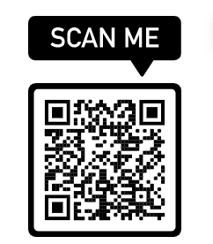
Live Captioning

Slide 3
Business Services
What: Business Services provides you with a wide variety of services and retail options.
When: M – F 8 a.m. – 5 p.m.
Where: Building 8, Suite 124
Why: To ensure that your needs are met without ever having to leave campus
How:Email bizservices@fau.edu or call 561-297-2041
Visit our website https://www.fau.edu/business-services

Slide 4
Parking and Transportation
What: Parking and Transportation facilitates and
promotes alternative transportation options and provides a safe,
well-maintained parking facilities while ensuring equitable parking for the community.
When: M – F 8 a.m. – 5 p.m.
Where: Building 80, Suite 116
Why: To ensure that your needs are met regarding parking permits and transportation
How:
Email: FAUPARK@FAU.EDU
Phone: 561-297-2771
website: https://www.fau.edu/parking/

Slide 5

•Order course materials early from our website www.FAUstore.com
•Check website often for updates on store hours, timeline to receive your order
•Read your emails from Follett.com and eFollett.com. This is information regarding your order.
•Why buy from your Campus Store
•We work directly with faculty
•Some courses do not use an actual book but online resources, lab items, etc.
•If you need an actual book you can purchase a New or Used book, Rent your book or buy Digital book
•Use financial aid funds in-store and online
•We have the best selection of Florida Atlantic University Gear!
•When you come to the store
•Have your Z number
•Have your order confirmation number
•Be patient
FAU Campus Store is located on the Breezeway (Building 76)
561.297.3720 – telephone
Cheri Pearcey, Store Manager

Slide 6

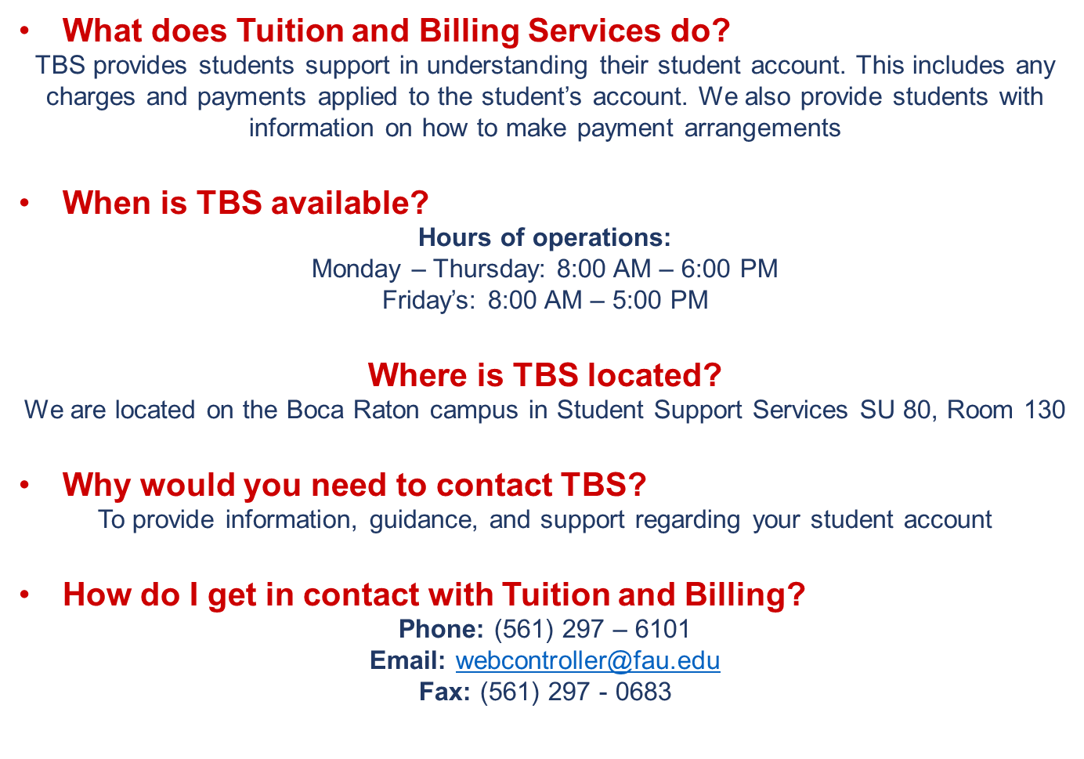

Slide 7


