Slide 1
High Impact Engagement Opportunities
Experiential Learning & Internships

Slide 2
Mission, Vision and Values
MISSION STATEMENT
To support FAU students, alumni, and employer partners in building toward successful futures.
VISION STATEMENT
The FAU Career Center will establish an interconnected career ecosystem that engages and prepares students for life after college.
To achieve this vision, the FAU Career Center will develop strong industry and employer relationships and implement best in class, forward leaning career readiness programs and platforms, with experiential learning opportunities.
CORE VALUES
Agility, Professionalism, Veracity, Positive Collaboration, Innovation, Accountability

Slide 3
Why Intern?
Build
your
network!
Learn
the
job
search process
Increase
your confidence
Further your
skill
set
Enhance
your
résumé
Explore career options

Slide 5
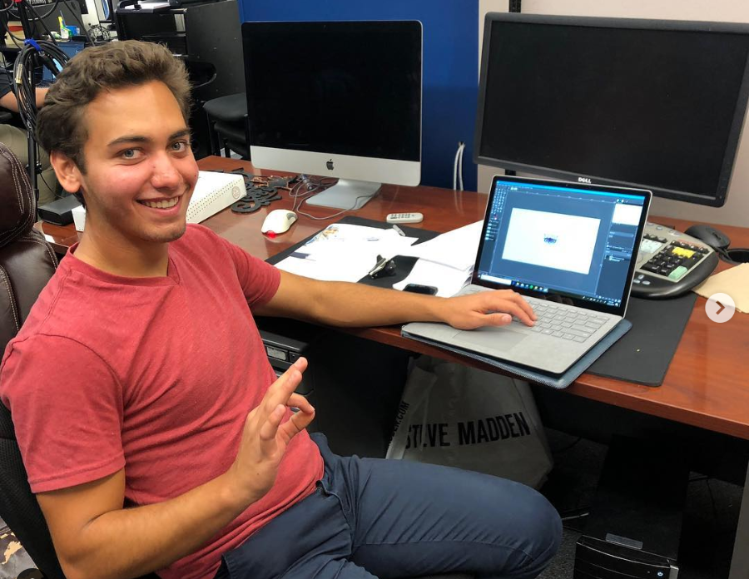
Internship Facts
Are internships paid? Yes! The majority of internships are paid.
Are internships only off-campus? Internships can be both on and off campus.
FAU Departments include:
Housing and Residential Education, New Student Orientation, Student Government, College of Engineering & Computer Science, Campus Recreation Center, Athletics, Owls Care Health Promotion, Student Union, Weppner Center for Lead & Service-Learning, Louis and Anne Green Memory & Wellness Center, Student Government, FAU Hillel and Comprehensive Center for Brain Health
Source: National Association of Colleges and Employers, 2021

Slide 6
Internship Facts
Do internships last only one semester?
Internships are typically one semester to one year long, but it is possible to receive an extension to continue interning.
Do you have to wait to apply for internships until your junior or senior year?
There are internship opportunities for all class standings, though some organizations may look for students with particular class standings or other qualifications.

Slide 7
Internship Facts
Are internships the only way to gain experience? No! There are
Job Shadowing, Externships, On-Campus Jobs and Campus Involvement
What is the difference between an on-campus job and an internship? The internship will have set learning objectives/goals that the student will be working on throughout the semester. The internship will include project work and clerical work cannot exceed 20%.

Slide 8
Internship Facts
Can I balance an internship along with my studies?
Absolutely! Internships can be part-time working between 10-20 hours per week. Hours are typically flexible which will allow you to be a full-time student. For the summer semester some students take a semester off and work full-time.
Notes:
Learning a lot at SOAR.. Here is what you can do now to be career ready before classes start

Slide 9
Internship Facts
I am an international student. Can I do an internship?
Of course! International students can engage in an internship / CPT after being a FAU student for two consecutive semesters. They would need to sign up in a Professional Internship Course offered by the Career Center and be approved by FAU International Services Office.
Notes:
Learning a lot at SOAR.. Here is what you can do now to be career ready before classes start

Slide 10
Employers are Hiring their Interns!
$20.76 Average hourly wage for interns in 2021
66.4% Internship to full-time hire conversion rate in 2021
What does this mean?
Source: 2021 Internship & Co-op Survey, National Association of Colleges and Employers
Notes:
Learning a lot at SOAR.. Here is what you can do now to be career ready before classes start

Slide 11
Interns Stay Employed
Why do you think internship hires stay longer with an organization?
Try before you buy! Learn about company culture, company values and work-life balance
Interns are more likely to be with the company both one year and five years later!
Notes:
Learning a lot at SOAR.. Here is what you can do now to be career ready before classes start

Slide 12
Finding
Internships
Notes:
Claim your Account on Handshake
Visit the Career Center: Meet with our Internship Specialists. Set up an appointment on Handshake

Slide 13
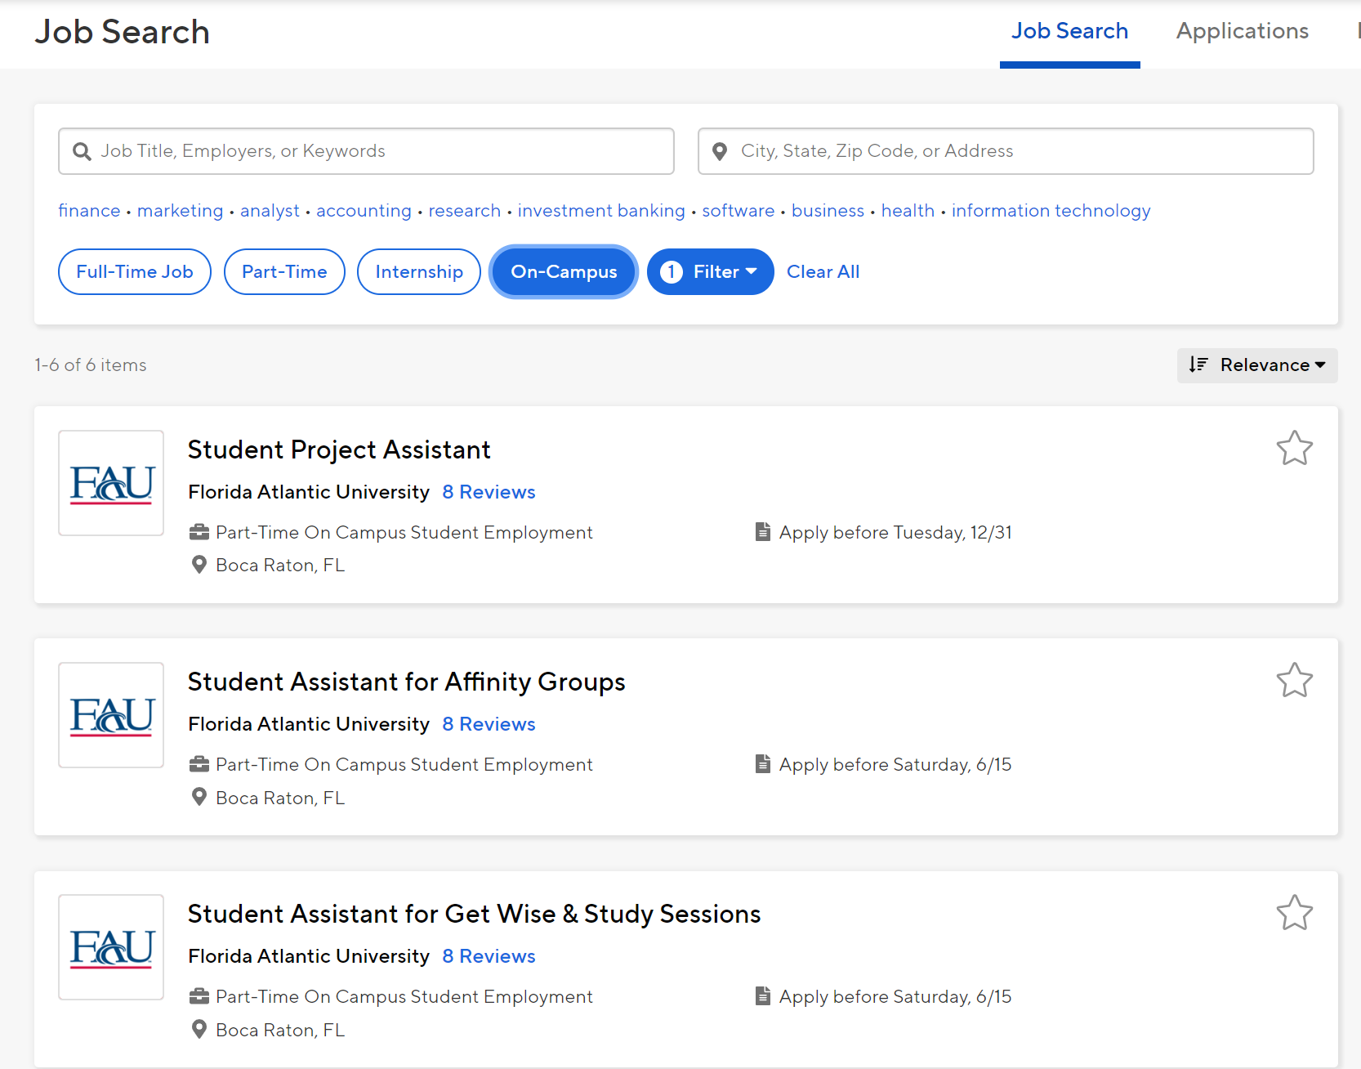
Begin Researching On-Campus Internships
Both on-campus internships and
on-campus employment will be listed under “on-campus”

Slide 14
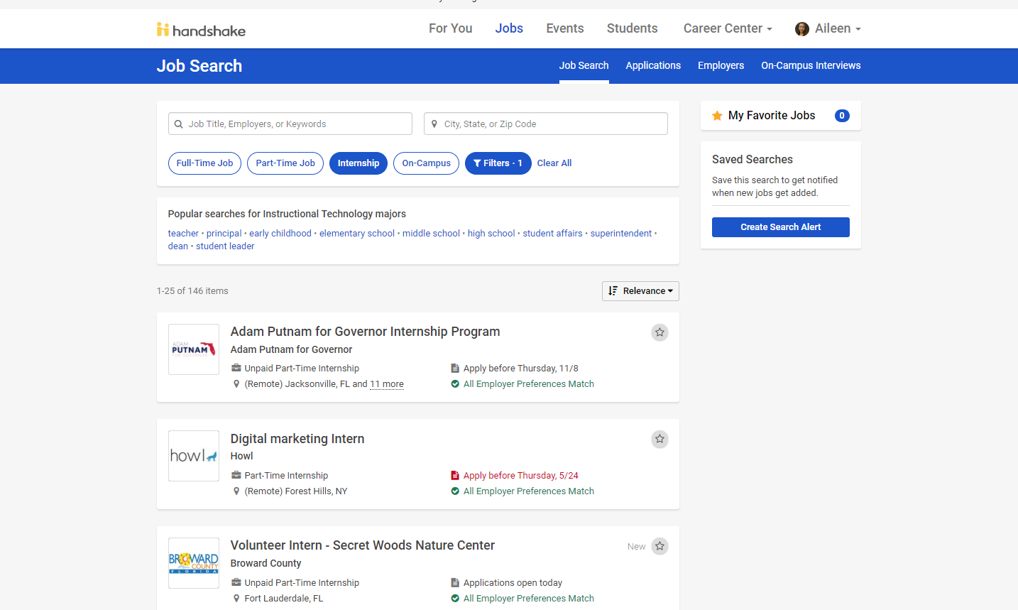
Begin Researching Off-Campus Internships
Employers begin recruiting 8.5 months prior to the internship start date

Slide 17
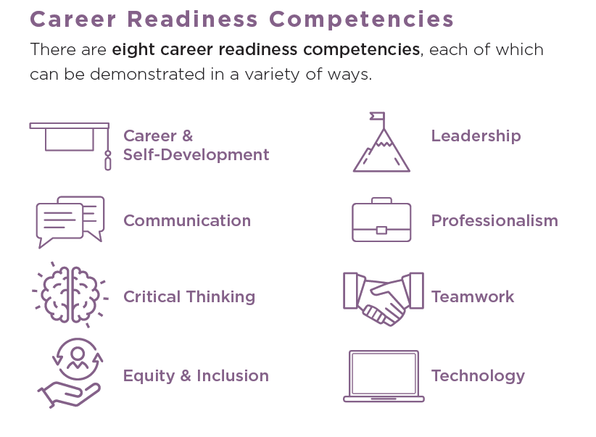
Interns Stay Employed
The Career Center is dedicated to helping you develop these key career skills:
How can you grow these skills? …By interning!
Notes:
Learning a lot at SOAR.. Here is what you can do now to be career ready before classes start

Slide 18
Other Ways to Get Experience
Notes:
Learning a lot at SOAR.. Here is what you can do now to be career ready before classes start

Slide 19
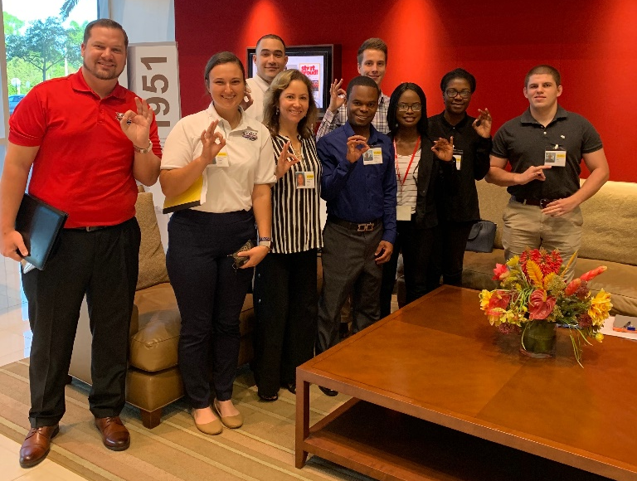
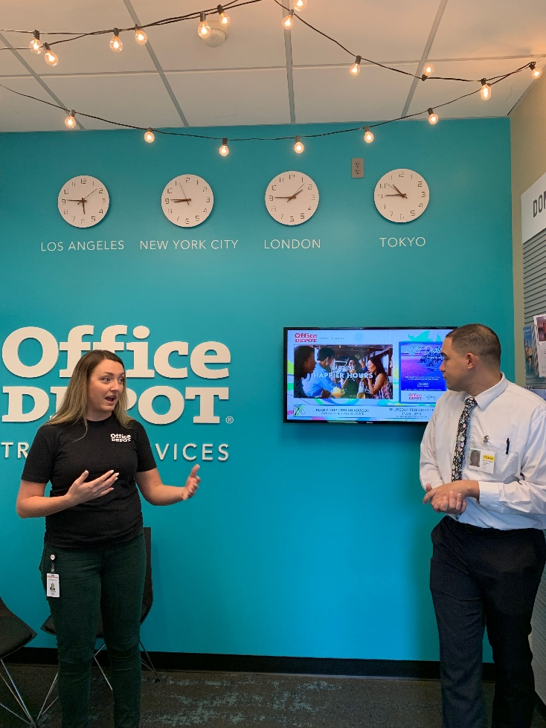
ExSEL Program
Externship and
Shadow
Experiential
Learning
Program

Slide 20
Micro-Internships
https://info.parkerdewey.com/fau

Slide 21
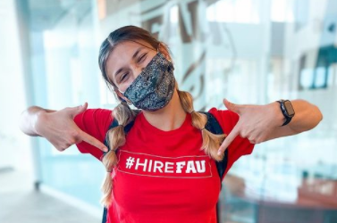
What is a Micro-Internship?
Short-term: Projects range from 5-40 hours in duration.
Paid: Each project has a fixed rate of pay and expected amount of time to complete.
Professional: Similar to those given to interns or new hires.
Comprehensive: All industries, all departments (sales, marketing, HR, finance, etc.), and can take place year-round.

Slide 25
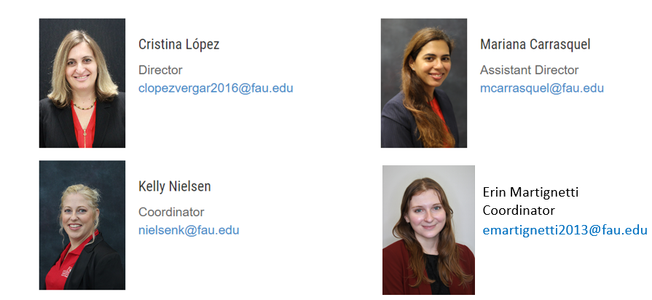
Contact Information
Telephone: 561.297.3533 Email: intern@fau.edu Website: www.fau.edu/career

