Slide 1

College of Education First Year Orientation
#OwlInToGraduation

Slide 2

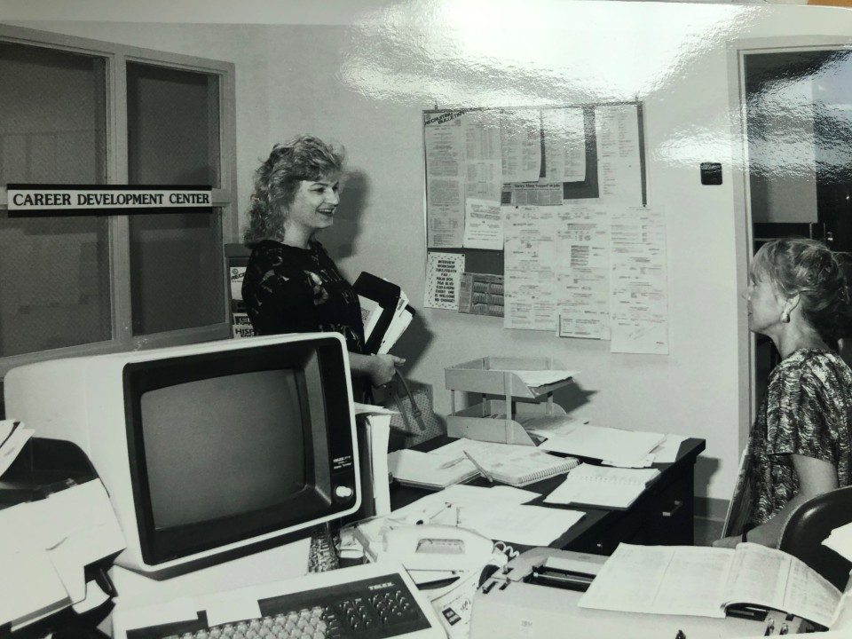
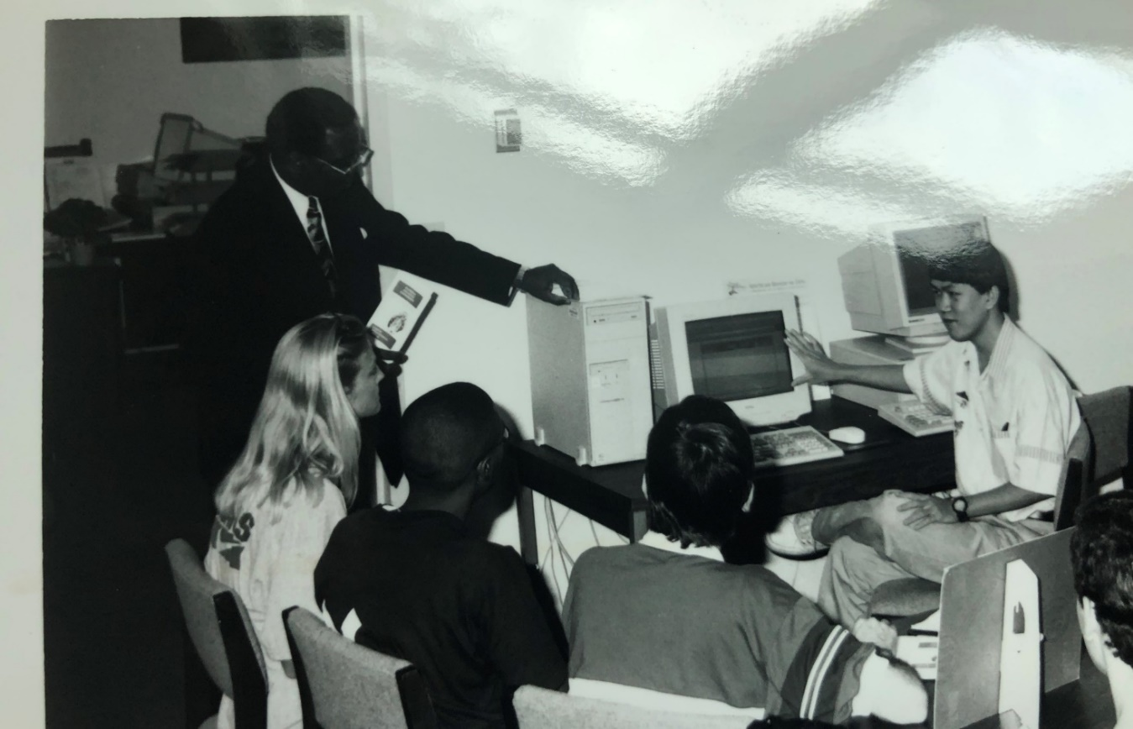
How It Started Career Center, 1965

Slide 3
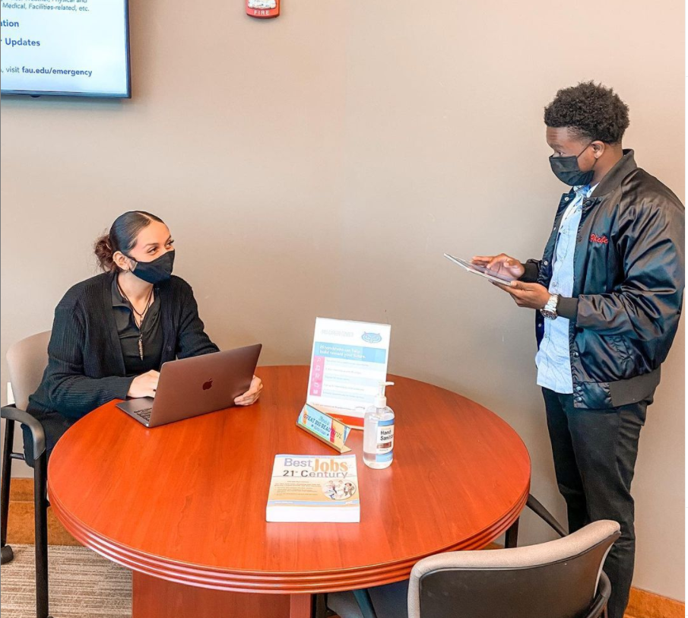
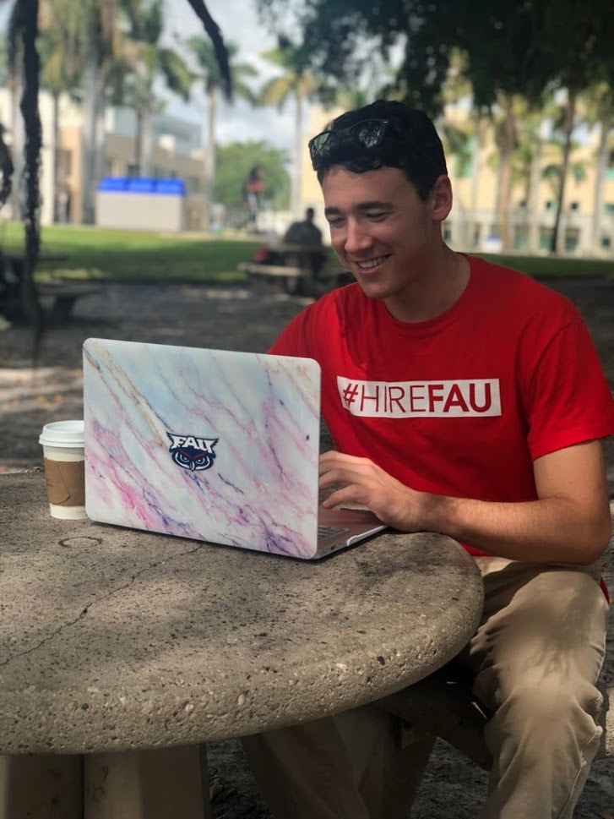
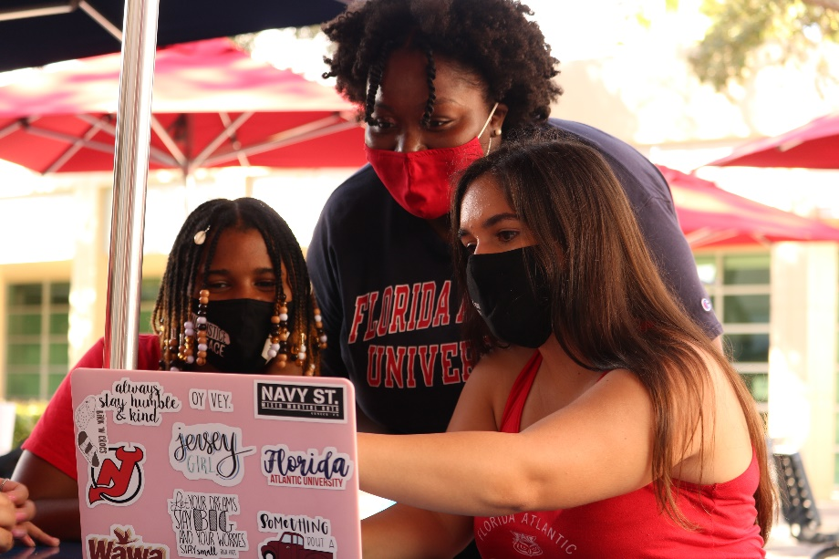
How It’s Going Career Center, 2021

Slide 4

University Advising Services Intellectual Foundations Program (IFP)
In-Person: Student Support Services (SU 80) RM: 201
Across the bridge from the Career Center
Virtual: advisingservices@fau.edu

Slide 5
FAU ADVISING STRUCTURE
First and Second Year Students - UAS
After 45 credits - College of Education
**Advisors help you develop and implement your 4 year plan**
GOAL: Graduate in 2026!
*Your DARS – WHAT IF Function
*IFP Checklists/Flight Plans: www.fau.edu/uas

Slide 6


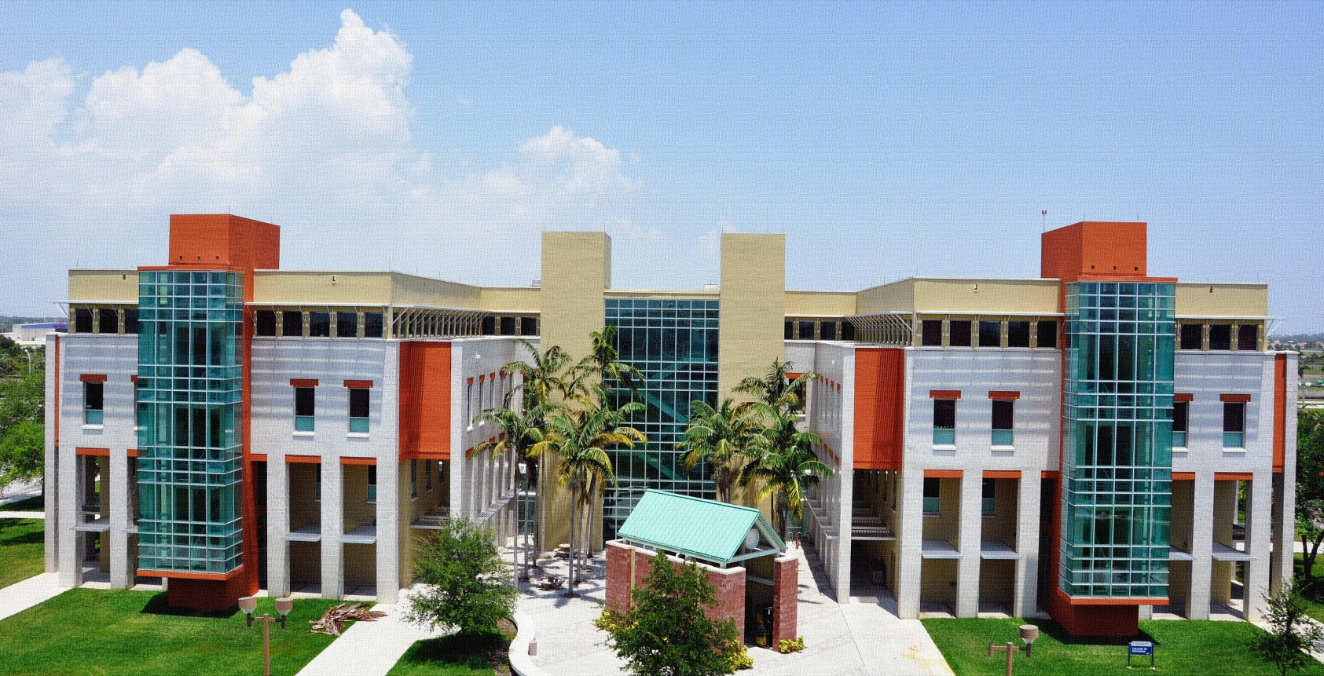
We are here to help you!
Visit our website:
www.coe.fau.edu/students/oass
Contact Information and Location:
College of Education Building
2nd Floor – Room 230
E: coeadvising@fau.edu

Slide 7


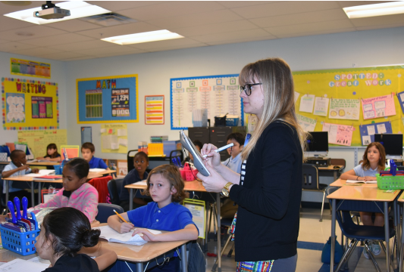

Who Inspired You?

Slide 8
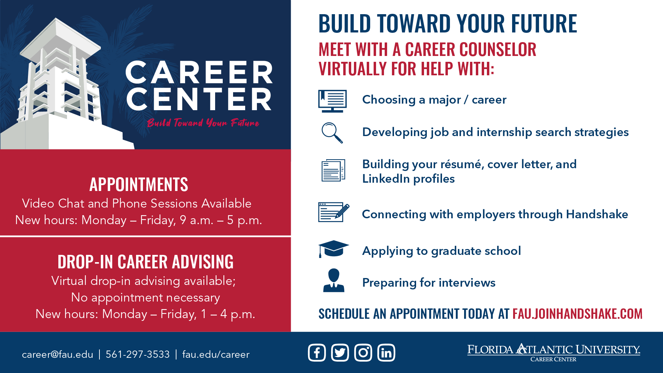

Slide 9
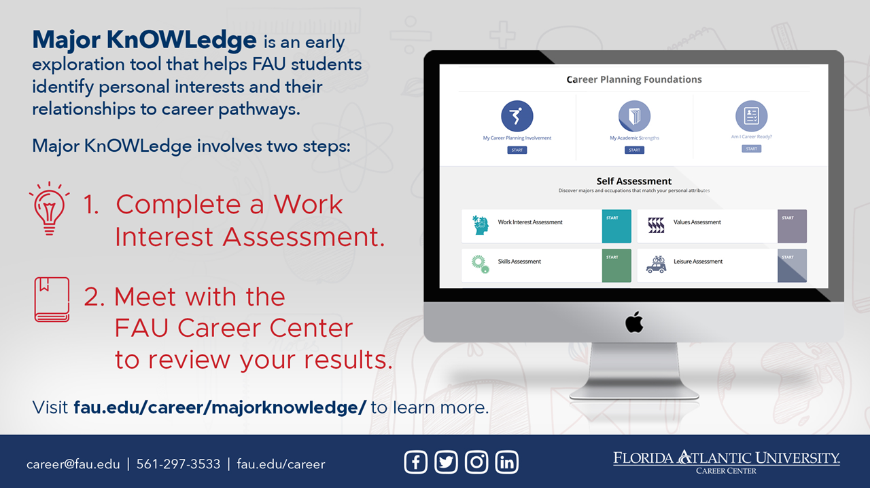

Slide 10
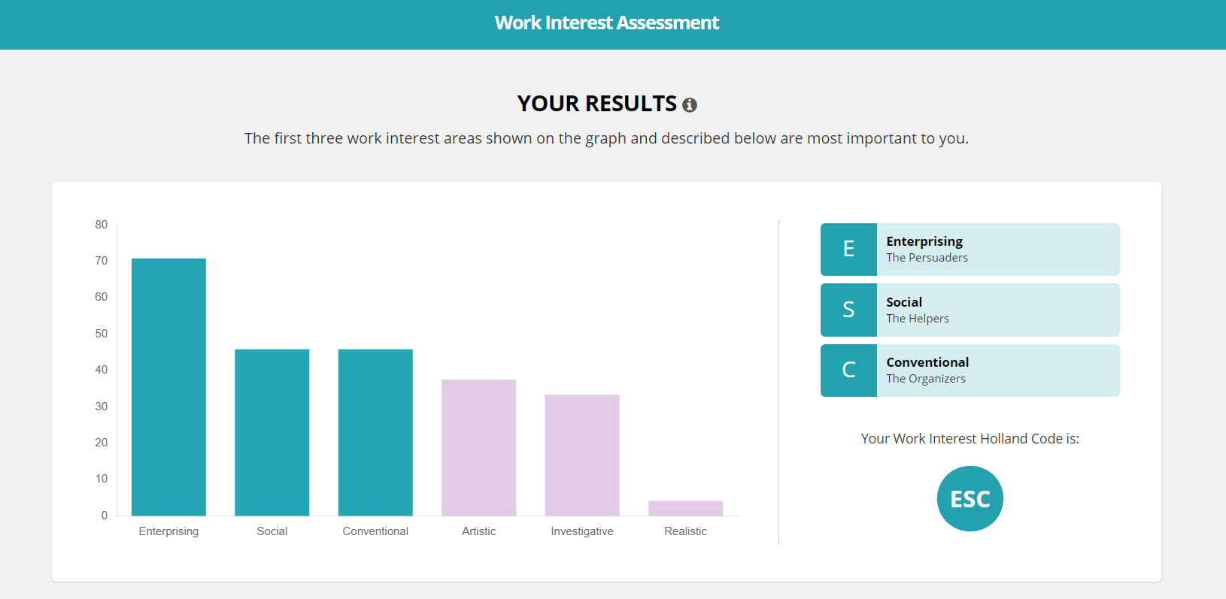

Slide 11
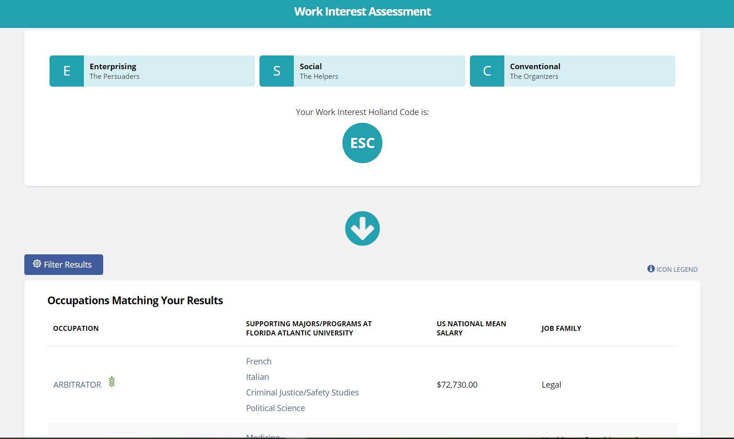

Slide 12
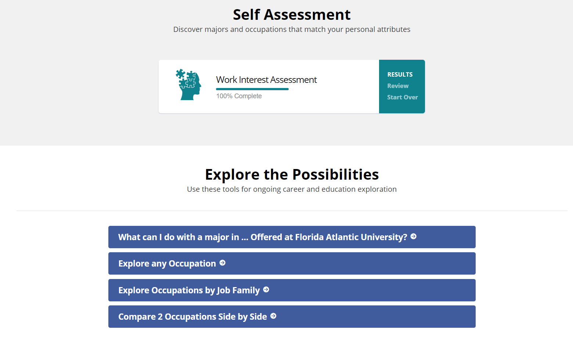

Slide 13
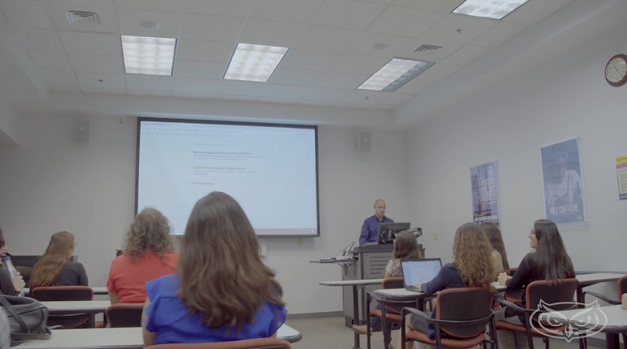
Still Deciding? Sign up for SLS 1301
1-credit elective course
This class provides an overview of career development theories and decision-making skills for career/life planning.
Focuses on:
self-assessment
deciding a major
exploring career options
developing an action plan
All to help you achieve your career goals!

Slide 14
3
Things To Do Before Classes Start …
To Be Career Ready

Slide 15

Notes:
Second thing to do.. Claim Handshake account. Quick review of what is Handshake.

Slide 16
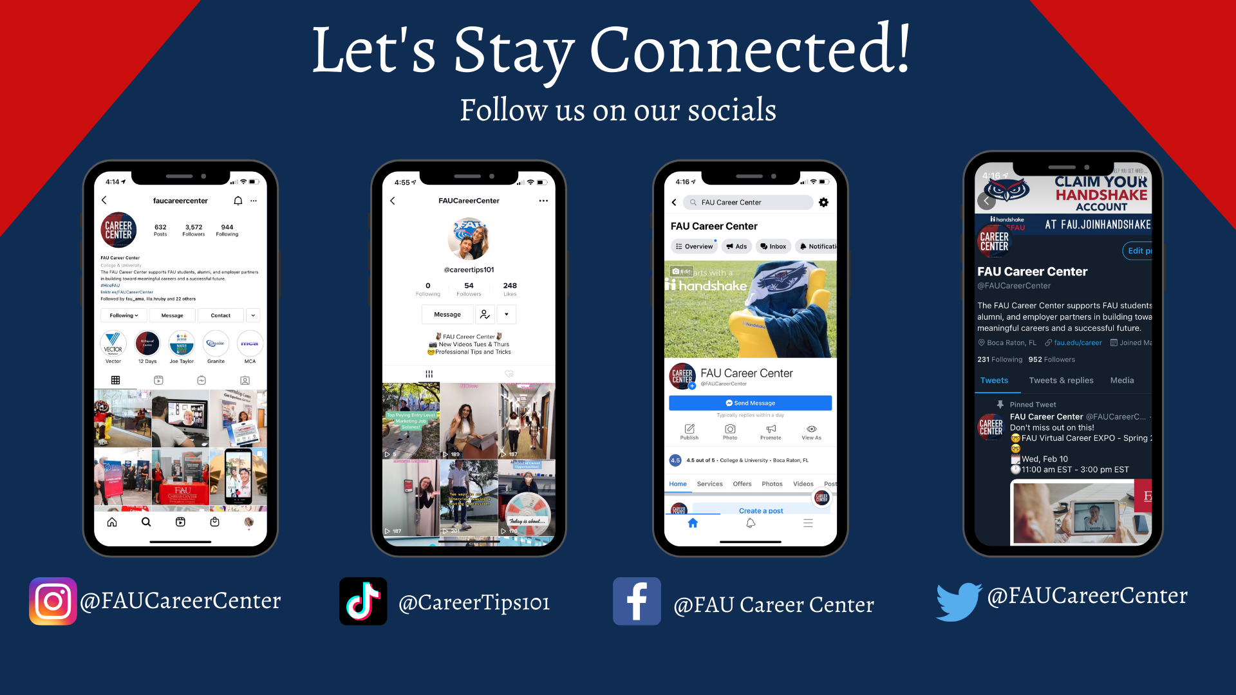

Slide 17
Teacher Education
Elementary – Grades K-6 with ESOL/Reading Endorsement
Exceptional Student – Grades K-12 with ESOL Endorsement
Secondary – Grades 6-12: Biology, Chemistry, English with
ESOL Endorsement, Mathematics, Physics, & Social Science
Certification-Only Programs
Art, French & Spanish – Grades K-12
(For students majoring in Art, Spanish or French in the College of Arts & Letters)
All of our teaching certification programs include Field Experiences
designed to explore new approaches to teaching-learning experiences.
All of our teaching certification programs are CAEP** approved.
** Council for the Accreditation of Educator Preparation
FAU’s Elementary Ed program has been
Ranked #1
in the state of Florida by the Florida Department of Education

Slide 18
Montessori
Schools
Schools for those with Special Needs
Private
Schools
Where Can You Teach?
Charter Schools
Teach
Abroad
Religious
Schools

Slide 19
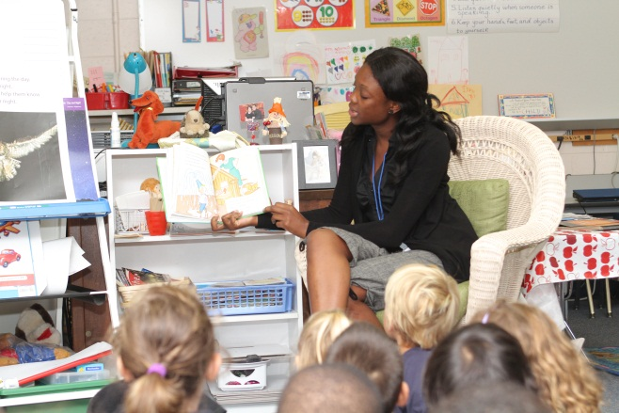

Field Placements
All students requiring a field experience placement must have evidence of current security clearance ON FILE with OASS. All placement arrangements must be coordinated through OASS.
Application for field experience placements and security clearance information is available on the OASS website at the web address listed below:
http://www.fau.edu/education/students/oass/fieldexperience/

Slide 20

Florida Teacher Certification Exams
All FAU students who choose to major in Elementary, Secondary, or Exceptional Student Education are required to take and pass the following FTCE’s to be eligible for student teaching:
· General Knowledge
(needed for formal admission)
· Professional Education
· Subject Area
To register, visit
www.fl.nesinc.com

Slide 21
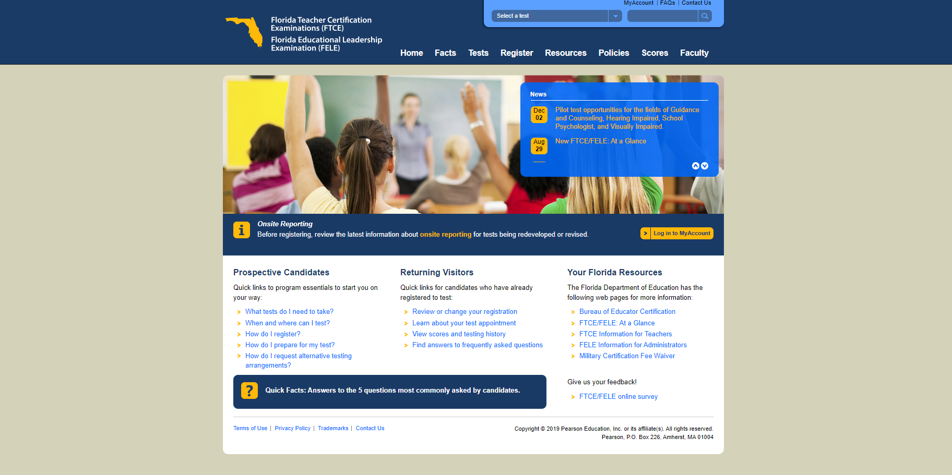

Slide 22
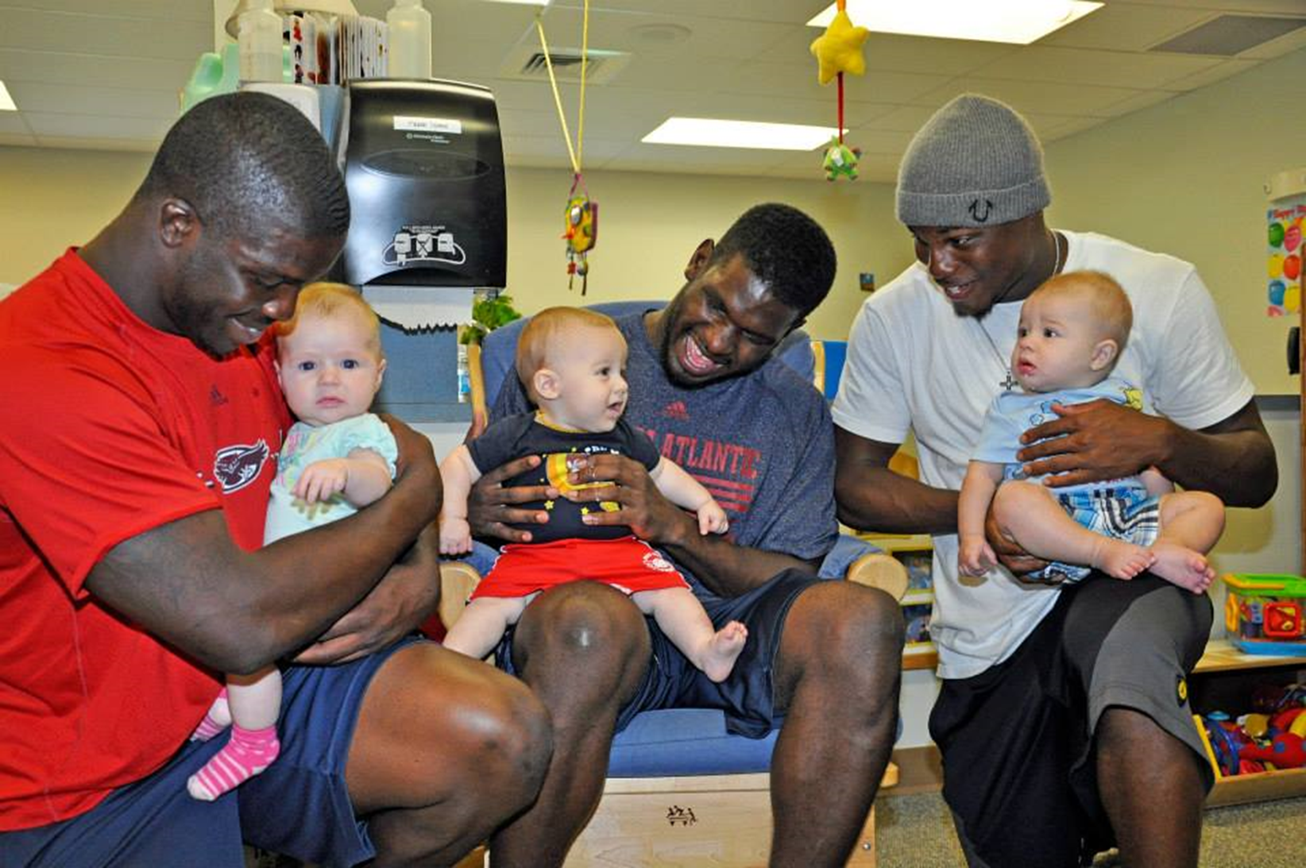
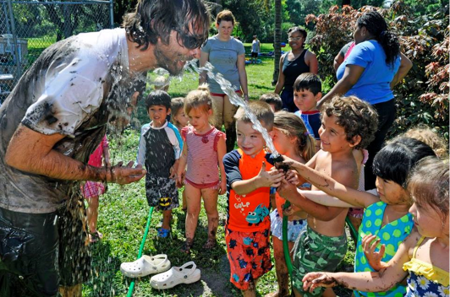
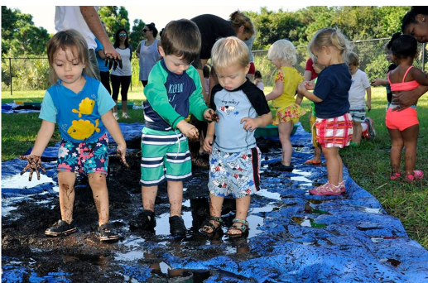
Early Care & Education (BECE)
Prepares students to work with young children from birth to age 5
Employment in the fields of child care and children services
Represents the highest professional standards
Not a teacher certification program.

Slide 23
Daycare/
Preschools
Childcare Centers
Family Support Programs
Where Can You Work?
Home-Based Service Providers
Educational Products Companies
Headstart
Programs

Slide 24
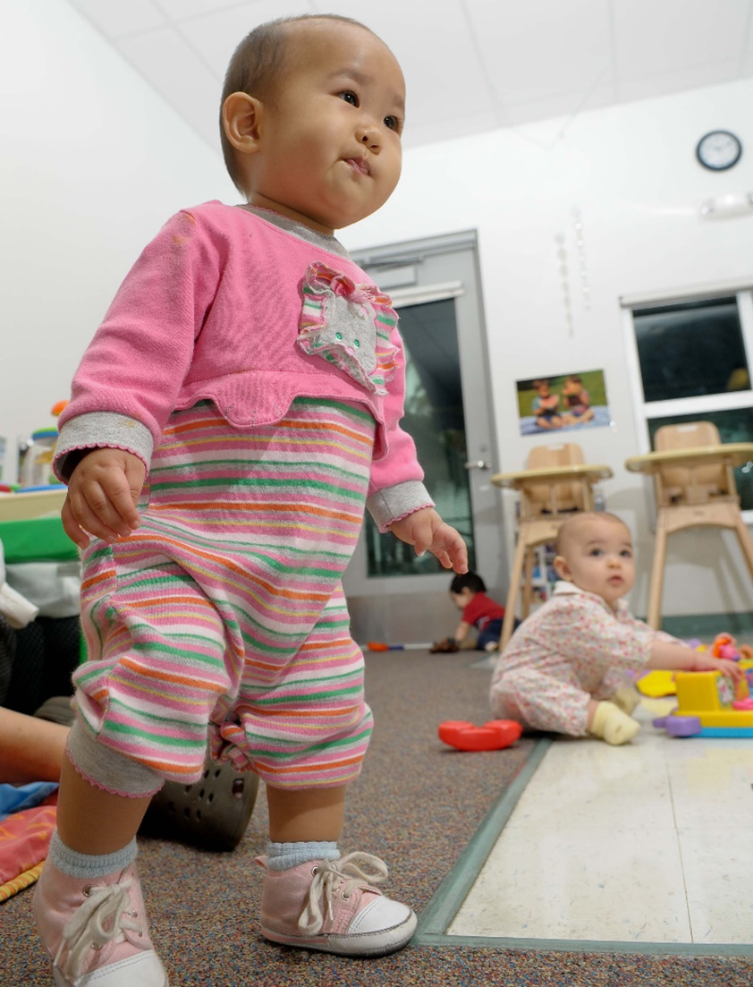

Formal Admission: Assignment of Faculty Advisor and
Signing of Program Contract
Teacher Education :
2.5 GPA, 60 credits, all IFP requirements and Foreign Language
General Knowledge Exam
Early Care & Education:
2.5 GPA, 60 credits all IFP requirements and Foreign Language

Slide 25
Soar-in-4 Scholars Program
The Soar-in-Four program offers highly disciplined and motivated first-time-in-college (FTIC)students an incentive to graduate with a Baccalaureate Degree in four years or less. (students must meet requirements)
Student Success Advising and Faculty Mentoring
Priority Registration
Connection to various campus resources (clubs, Scholarship links etc.)

Slide 26
#OwlInToGraduation

Slide 27
READ
Email is FAU’s main form of communication. All emails will be sent to your FAU email. Please check your email daily!
Expect emails from your academic advisor for:
Spring advising
Midterm grades
Important updates or information

Slide 28
READ
Your syllabi will provide an outline for assignments, grading, exams, instructions, and instructor contact information.
It is expected that you read your syllabi at the beginning and throughout the semester
Your syllabi can be found on Canvas

Slide 29
READ
Please read your advisor’s comments in your EZ Advising email and all emails in your FAU
Do you still need to send important documents to FAU?
AP/AICE/IB/Dual Enrollment/Transfer Credits?

Slide 30
KNOW what is happening and When it is happening

Slide 31
Important Dates
When is your first day of classes?
Classes for Summer Term III Begins: June 26
Classes for Fall Begins: Aug 21
Schedule an Advising Appt after Labor Day!

Slide 32
Use Your Tools and Resources

Slide 33
Success Network
Your Success Network connects you to your FAU support system:
Your academic advisor
Professors
Tutors
Financial Aid counselor
You will log into your Success Network to schedule advising appts with your academic advisor at University Advising Services

Slide 34
University Advising Services (UAS)
UAS will be your primary source for the following:
Course advising
Academic policies and information
Changing or declaring majors
Making appropriate referrals to important resources on campus
Academic questions

Slide 35
Intellectual Foundations Program (IFP)

Slide 36
Bachelor of Arts (BA) / Bachelor of Science (BS)
Requires completion of a language at the collegiate level
The language credits used to satisfy this will use free elective credit in order to satisfy this requirement IF:
Does not have previously earned language credit (i.e. AP, IB, AICE, etc)
Bachelor of Arts in Education (BAE) /
Bachelor of Science in Education (BSE)
Language has already been completed through high school credit
Collegiate level language is NOT required
Foreign Language
Arabic (ARA 1120/1121)
Chinese (FOL 1120/1121)
French (FRE 1120/1121)
German (GER 1120/1121)
Hebrew (HER 1120/1121)
Italian (ITA 1120/1121)
Japanese (JPN 1120/1121)
Latin (LAT 1120/1121)
Spanish (SPN 1120/1121)
IMPORTANT TO NOTE:
Foreign language is a graduation requirement for only certain majors
2 years of a language in high school = starting with 1121 level (per the Languages and Linguistics Department)
All courses are 4 credits – be mindful of elective credits
CLEP

Slide 37
DARS (Degree Audit)
The Degree Audit Reporting System (DARS) displays what courses you have completed, what courses you have in-progress, and which courses you need for your major.
DARS is helpful for the following:
Determining where you are in your program
What courses you have left to take
How courses have transferred to FAU (if applicable)

Slide 38
Academic Success Resources
Supplemental Instruction (SI) provides students with academic support for courses.
The Center for Teaching and Learning (CTL) provides many more academic support resources and tutoring for math, writing, science, and other subjects.

Slide 39
Policies You Should Know Now

Slide 40
Withdrawal Policy (W Policy)
Undergraduate students may not withdraw (with a grade of “W” or “ZR” from more than 2 courses at the lower-division level (1000 – 2000 level courses) and from more than 3 courses at the upper division or higher level (3000 and 4000 level courses.)
Always speak with your academic advisor before making any decisions to withdraw from a course.

Slide 41
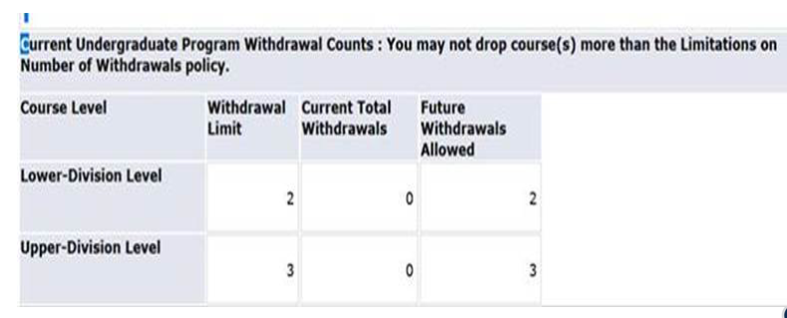
Withdrawal Policy (W Policy)

Slide 42
Civic Literacy
Students may complete this requirement in one of the following ways:
Take a course:
Successfully pass POS 2041: Government of the United States.
Successfully pass AMH 2020: U.S. History since 1877.
Achieving the minimum required score on the following assessments:
Civic Literacy Test
Advanced Placement Government and Politics: United States
Advanced Placement U.S. History
CLEP American Government
Click Here for Required Scores

Slide 43

First-Year Interest Groups (FIGS)
Meet and learn with peers who share the same major and/or interests!
In a FIG, you:
take a 1-credit course with 24 other students who share similar majors.
have a seminar class that led by faculty and advisors from your specific college.
have an opportunity to build relationships within your college as soon as classes begin.
get the inside scoop on what it takes to excel in your major.
have an opportunity to build a community that makes this large research university feel like home.
Learn more and enroll at: fau.edu/academicsuccess

Slide 44
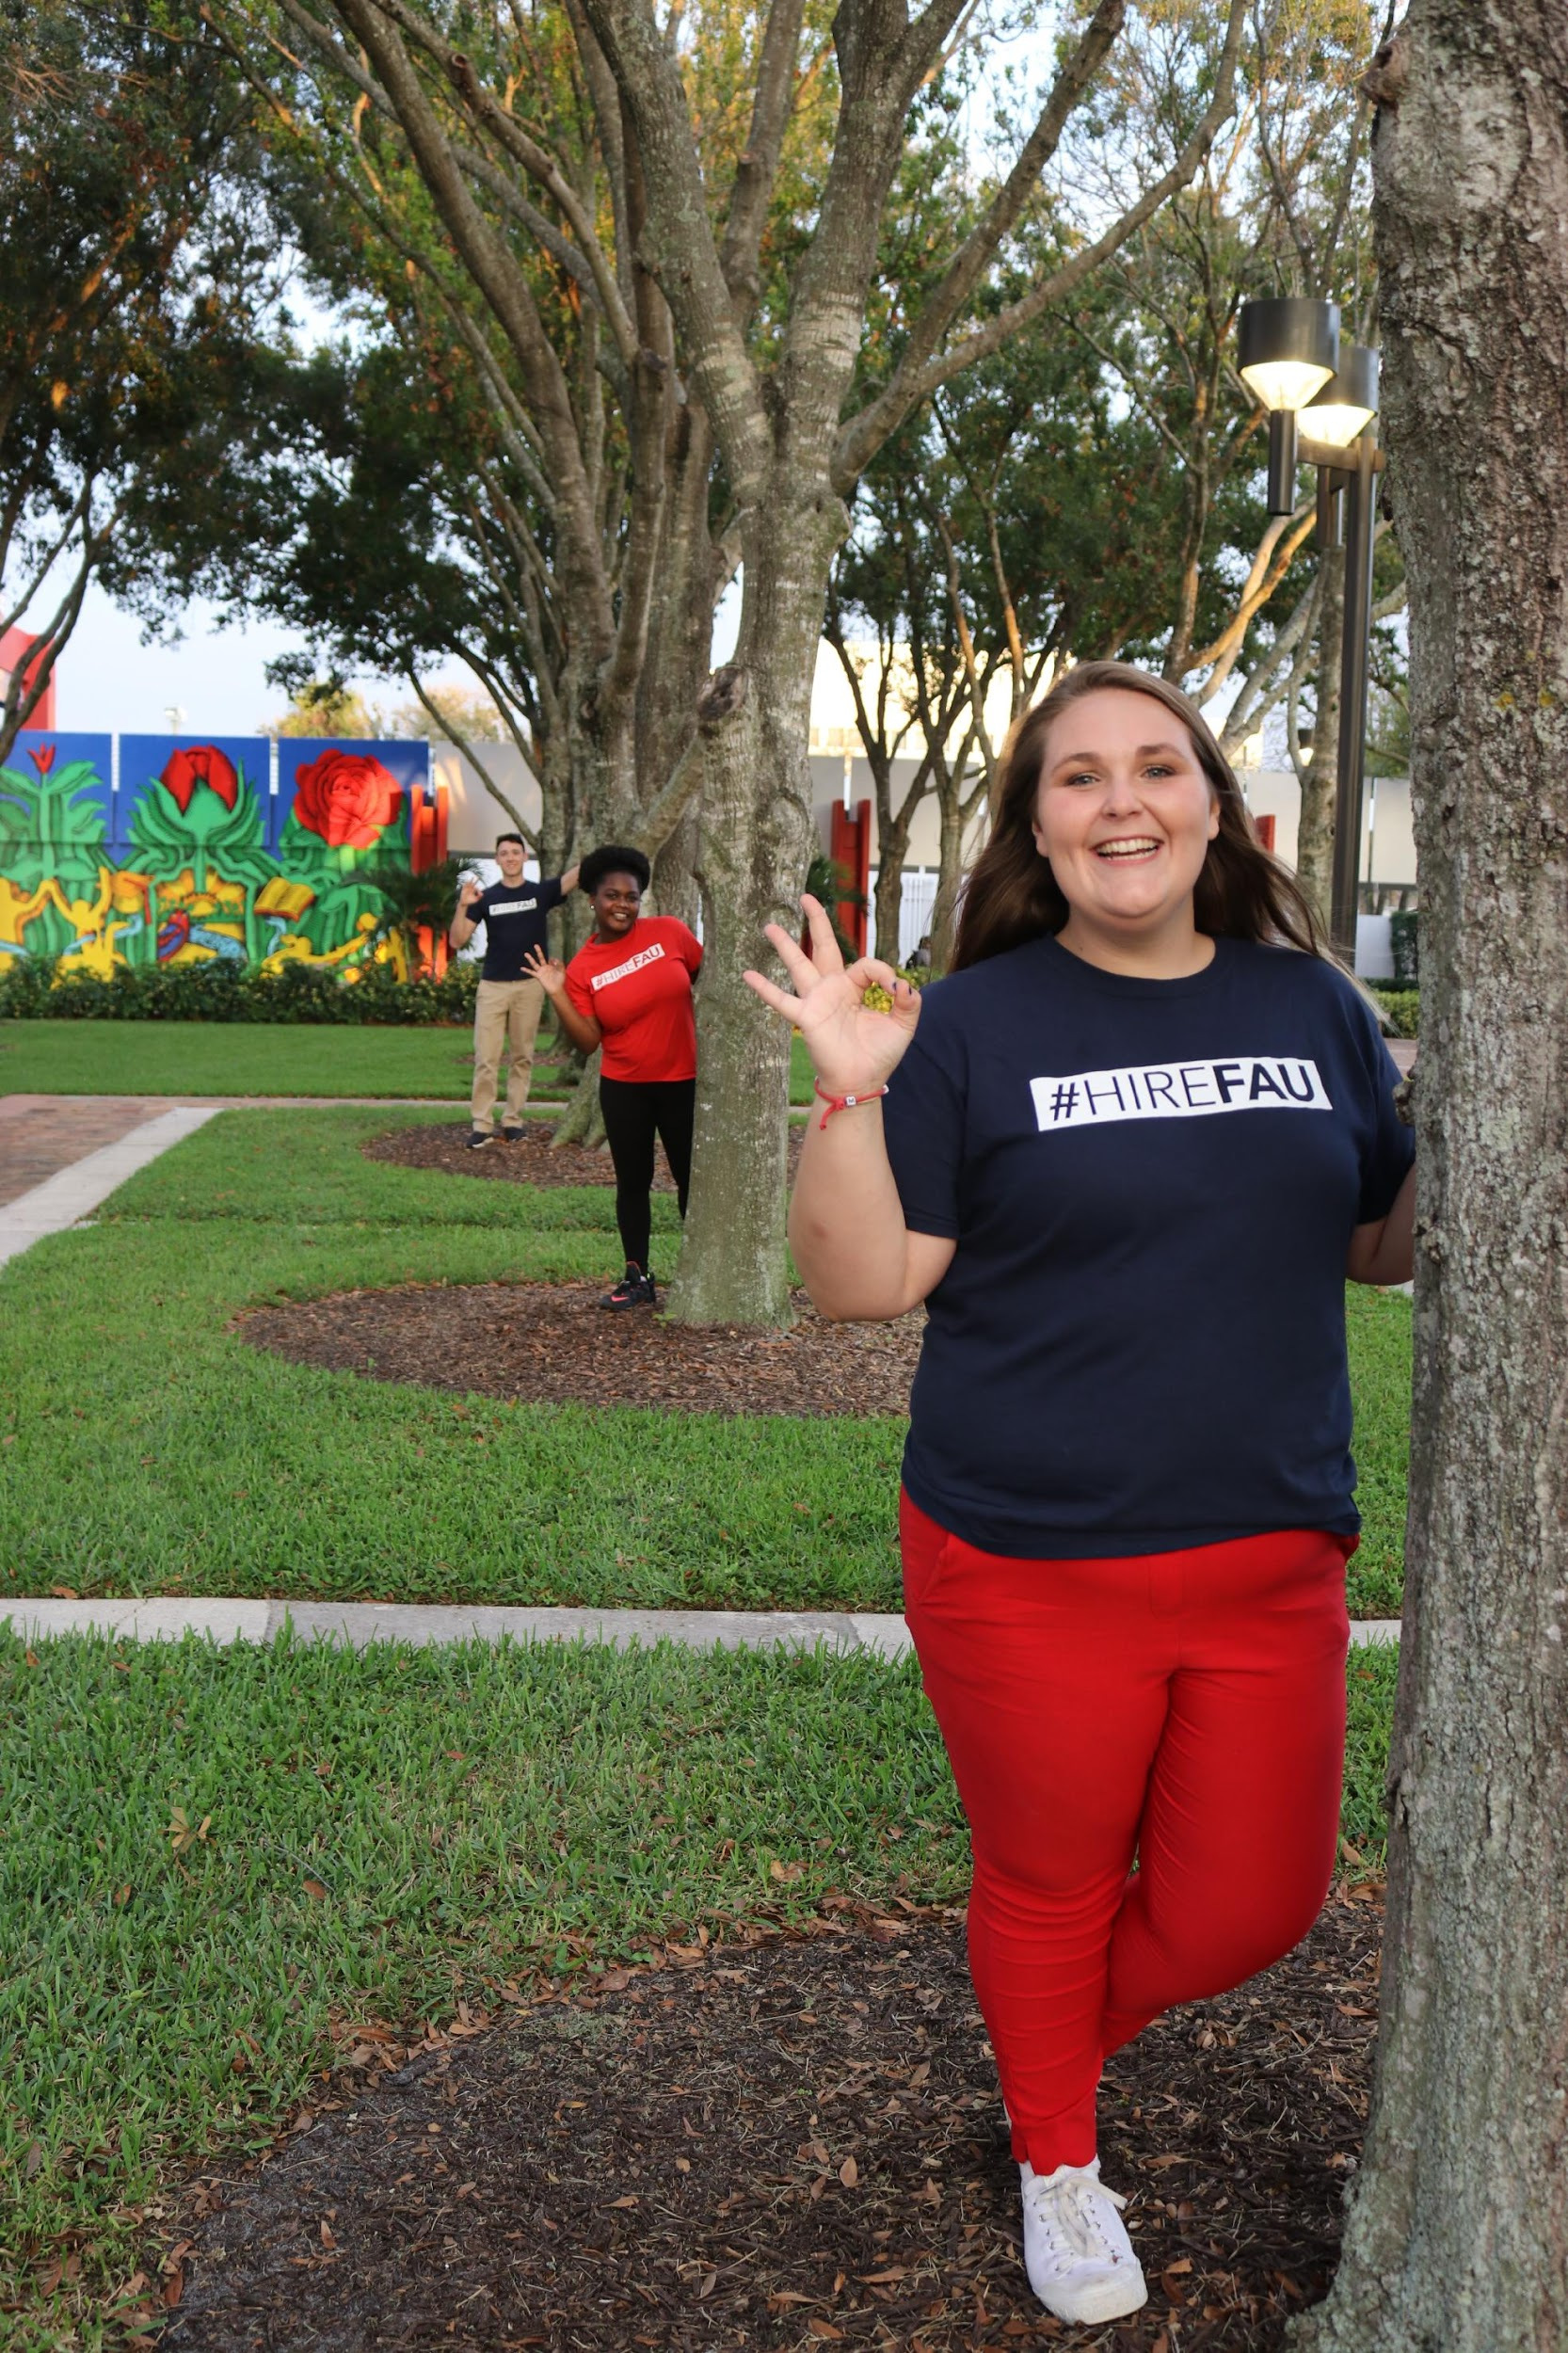



Follow us on social media
Like us on Facebook
FAU Career Center
University Advising Services – FAU
FAU College of Education
Follow us on Twitter
@FAUCareerCenter
@uasfau
@faueducation
Follow us on Instagram
@FAUCareerCenter
@uasfau
#faucollegeofeducation

Slide 45
Email: UAS - advisingservices@fau.edu
Career Center – career@fau.edu
Web
COE - www.coe.fau.edu
UAS – www.fau.edu/uas
Career Center – www.fau.edu/career
Phone
COE – 561-297-3570
UAS – 561-297-3064
Career Center – 561-297-3533
Curriculum Sheets/Flight Plans: www.fau.edu/uas

Slide 46
Questions?

