Slide 1

#OwlInToGraduation

Slide 2


Welcome to the College of Arts and Letters!

Slide 3

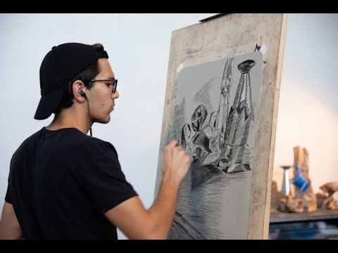
The Dorothy F. Schmidt College of Arts and Letters

Slide 4

The Dorothy F. Schmidt College of Arts and Letters
Offers over 22 undergraduate programs
27 Minors
8 Certificate Programs
On 4 of FAU campuses
Boca (Main Campus)
Jupiter
Ft. Lauderdale
Davie
Notes:
Introduce Arts & Letters as a College – the college where creative and critical thinking thrives
Say…We have a variety of programs ranging across the arts and humanities- over 22 undergraduate programs from several colleges. The college has a distinguished faculty, smaller classes that allow for more personalized attention.

Slide 5

The Dorothy F. Schmidt College of Arts and Letters
Why a degree in Arts and Letters?
85% of workers with a Bachelor’s degree in humanities are satisfied with their job
96% of students with a humanities degree are employed
60% have managerial or supervisory responsibilities as part of their job
>50% of law school applicants have majors in Arts, Humanities & Social Sciences
Humanities majors score higher on the MCAT than Biology majors
And - they are accepted at a higher rate than majors in Physical or Biological Sciences
Notes:
Introduce reasons why students should apply for programs in CAL-Also list some of the careers available depending on major. Can facilitate discussion (if time allows) to see if students are surprised by these numbers and/or what they think.
COMT- ESPN, Advertising, Lawyer, Screen Writers,
MMSF- New York Giants/ Miami Dolphins/ FAU Football
MMSJ- News Anchors, broadcasters, sports reporters
Music- Sony Records
English- Paralegal, Grant Writing, Teacher, etc.
History- Travel Industry, Teachers, Museum Coordinators, Peace Corps, Political Science- Law Firms, Governmental Campaigns, etc.
IDS-grad programs- health sciences, Business, etc.
Sociology- Social Work, Human Resources
Political Science- state lobbyists, lawyers, political journalists, campaign managers, etc.
Theatre- Actors, Choreographers, Dancers, etc.
Studio Art- Video Game Design, Graphic Design, teaching, Art Therapy, pottery, clay-making, etc.
Minors- Science majors/art minors- work towards designing medical helix models

Slide 6

Guess this CEO’s major!
Susan Wojcicki- CEO, Youtube
Major: Bachelor of Arts: History and Literature
Christopher Connor- Executive Chairman,
Sherwin- Williams
Major: Bachelor of Arts: Sociology
Steve Ells, Co-CEO, Chipotle
Major: Bachelor of Arts: Art History
Carly Fiorina, Former CEO, Hewlett-Packard
Major Medieval History & Philosophy
Notes:
Facilitate a discussion on how AL majors provide a variety of skills and experiences applicable to the workforce today

Slide 7

The Purpose of Advising
Help you to achieve your academic, personal, and professional goals
Encourage you to maximize your college experience
Collaborative partnership

Slide 8
Student Academic Services for the College of Arts & Letters
Academic Support
Academic Planning
•Majors/ Double majors
•Minors
•Internship opportunities
•Study Abroad
Accessibility
•In Person appointments
•Virtual appointments
•Virtual Chat
Notes:
Advisors are here to help students figure out their academic plans and directions. We provide current and accurate information about degree plans and the student’s overall progress toward degree completion, based on available information. Discuss the role of advising.

Slide 9
The Arts & Letters Experience: Involvement Opportunities
Ballroom Dance Club
Owl Radio
Owl TV
Hoot/Wisdom Records, LLC
Potters’ Guild
American Institute of Architecture students at FAU
Coastline Literary Magazine
Philosophy Club
Spanish Club
Computer Graphics Club
Designers’ Edge
Film Club

Slide 10
First-Year Interest Group Course
SLS 1931 CRN 21101
Wednesdays 4pm to 5pm
A 1-credit, 8 week, face to face course with 24 other students who are arts and letters students.
Seminar class that will be led by an advisor from the College of Arts and Letters.
Have an opportunity to build relationships within your college as soon as classes begin.
Get the inside scoop on what it takes to excel in your major.
Have an opportunity to build a community that makes this large research university feel like home.
Notes:
Introduce Arts & Letters as a College – the college where creative and critical thinking thrives
Say…We have a variety of programs ranging across the arts and humanities- over 22 undergraduate programs from several colleges. The college has a distinguished faculty, smaller classes that allow for more personalized attention.

Slide 11
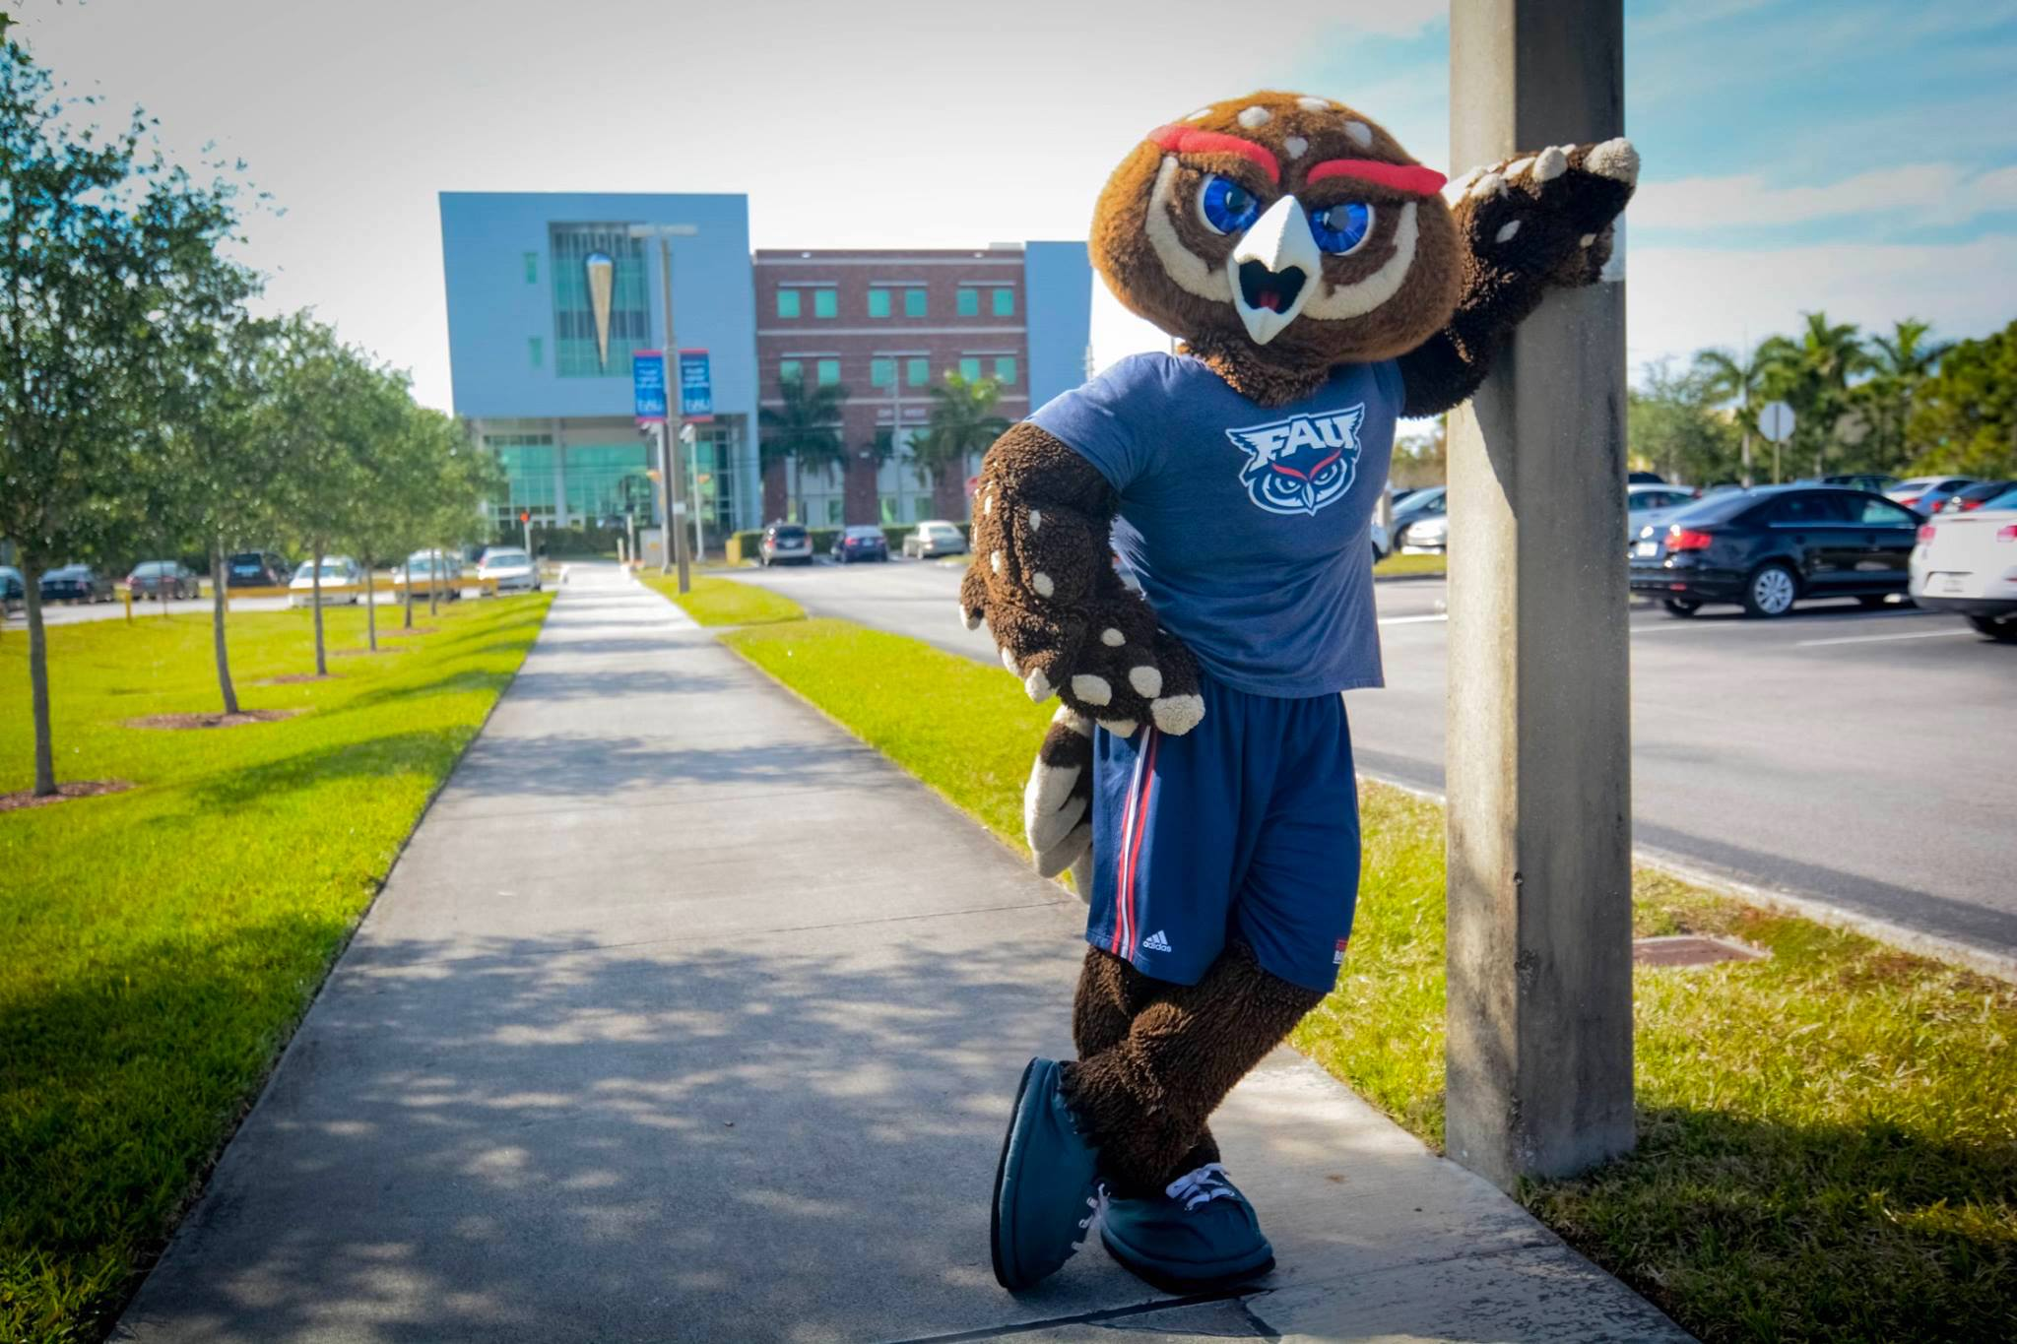
GO OWLS!

Slide 12


Arts & Letters Advising Contact Information
Virtual chat & email
aladvising@fau.edu
Notes:
Ask here if anyone is coming in with large numbers of credits (dual enrollment, AP, AICE, etc. and/or an AA Degree) – take their information

Slide 13
Mitchell Roshel Career Center Liaison to the Dorothy F. Schmidt College of Arts & Letters mroshel@fau.edu appointments via Handshake fau.joinhandshake.com
Notes:
Learning a lot at SOAR.. Here is what you can do now to be career ready before classes start

Slide 14
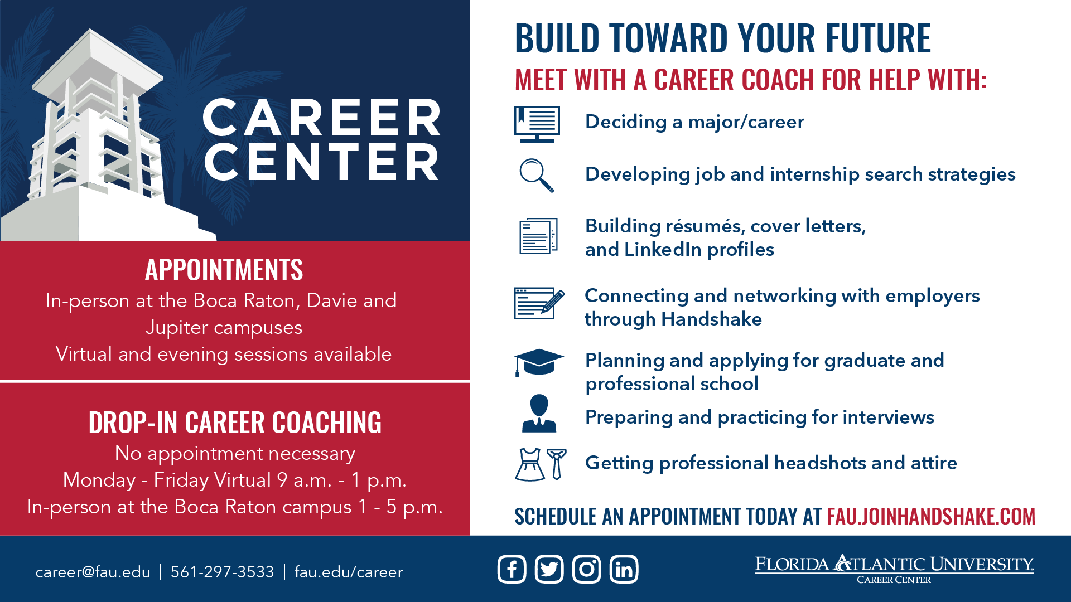

Slide 15
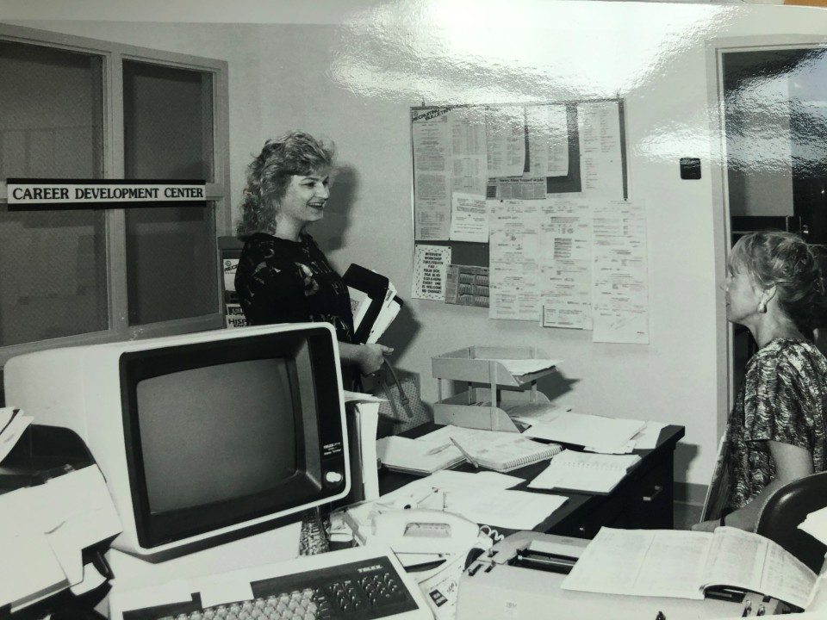
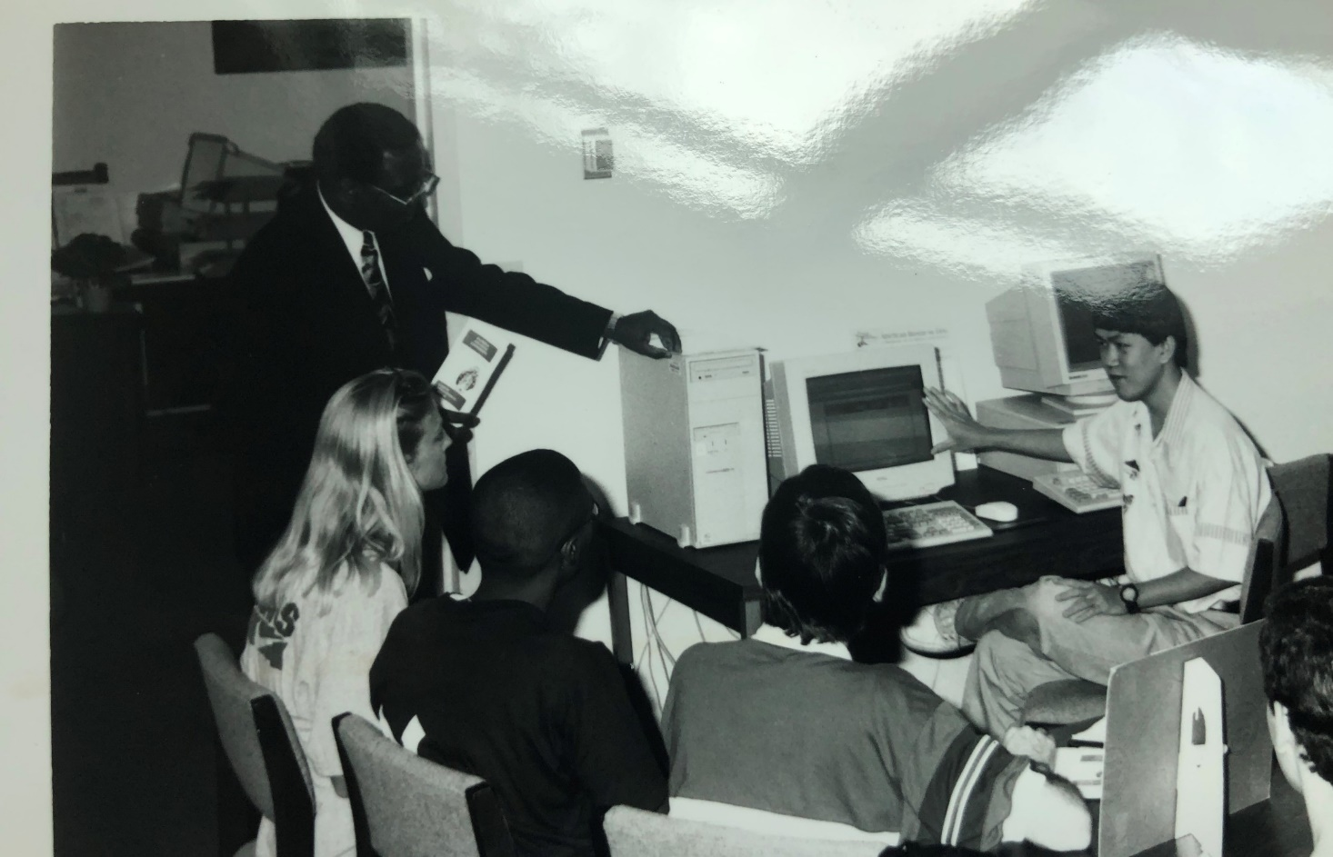
How It Started Career Center, 1965
Notes:
Show Career Center was one of the first offices at FAU.. Career has always been a value to FAU. What we looked like “before”

Slide 16
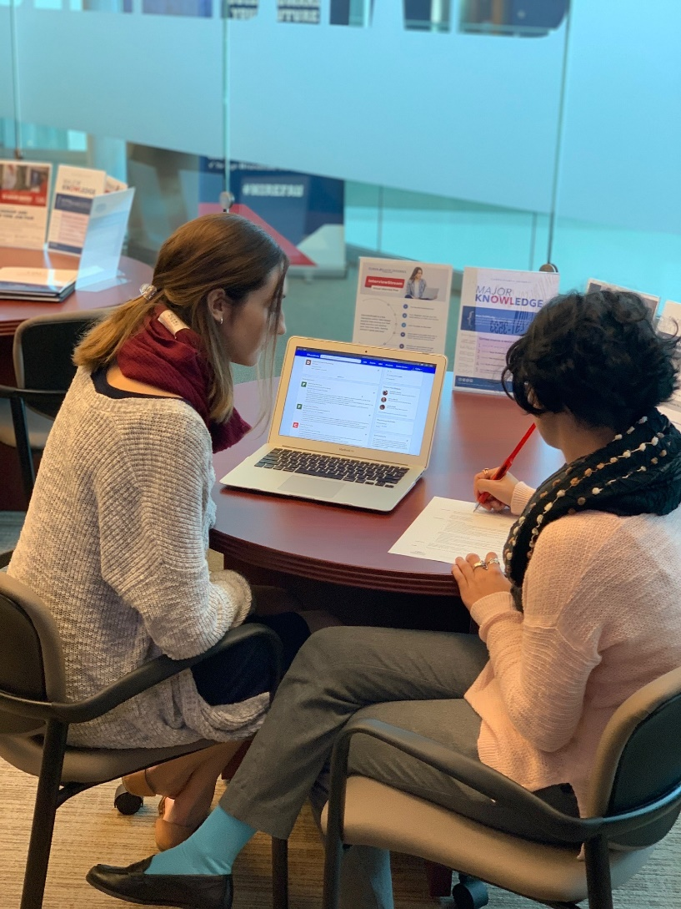
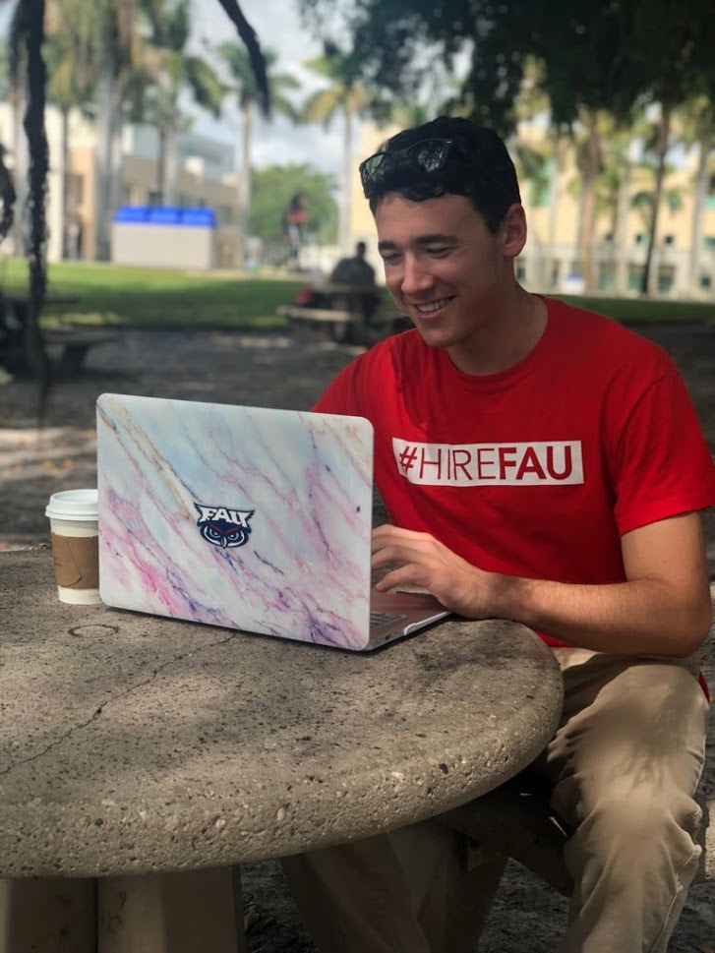
How It’s Going Career Center, 2021
Notes:
Career Center now– more modern, all over campus, help students where they are at.. Online and in-person.. Career ecosystem idea.

Slide 17
3 Things to-do before classes start... To be career ready
Notes:
Learning a lot at SOAR.. Here is what you can do now to be career ready before classes start

Slide 18
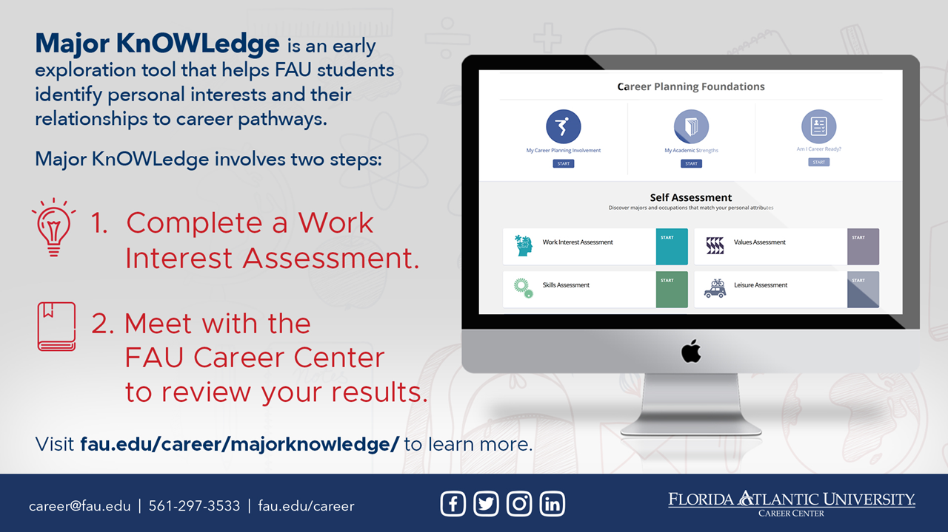
Notes:
Take MK
Explain both parts

Slide 19
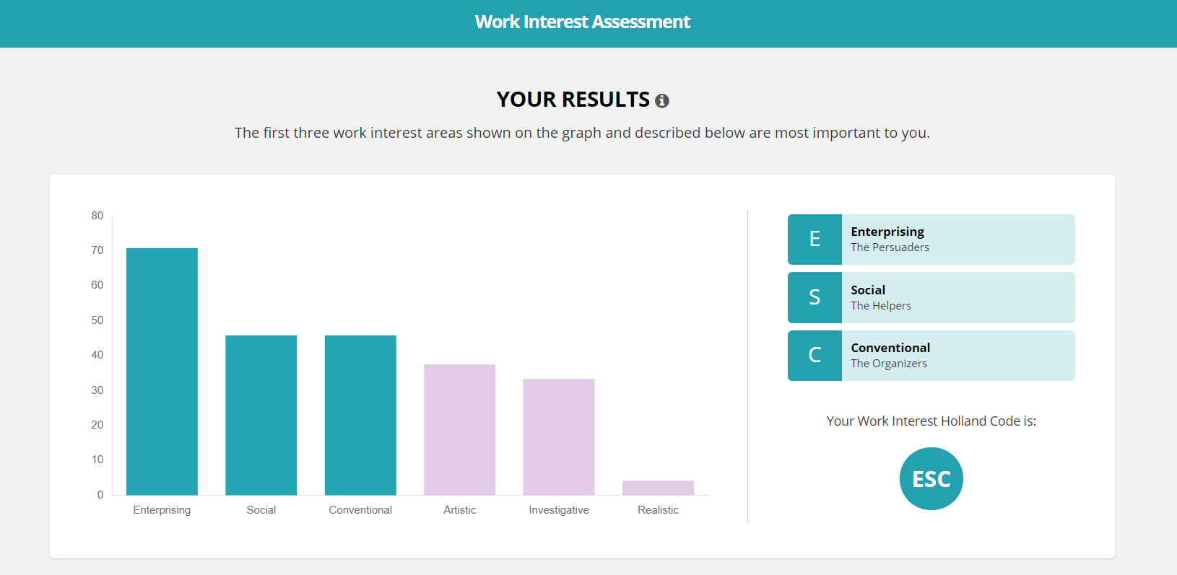
Notes:
Take interest inventory and get top 3 types… career coach will review in more detail during session.

Slide 20
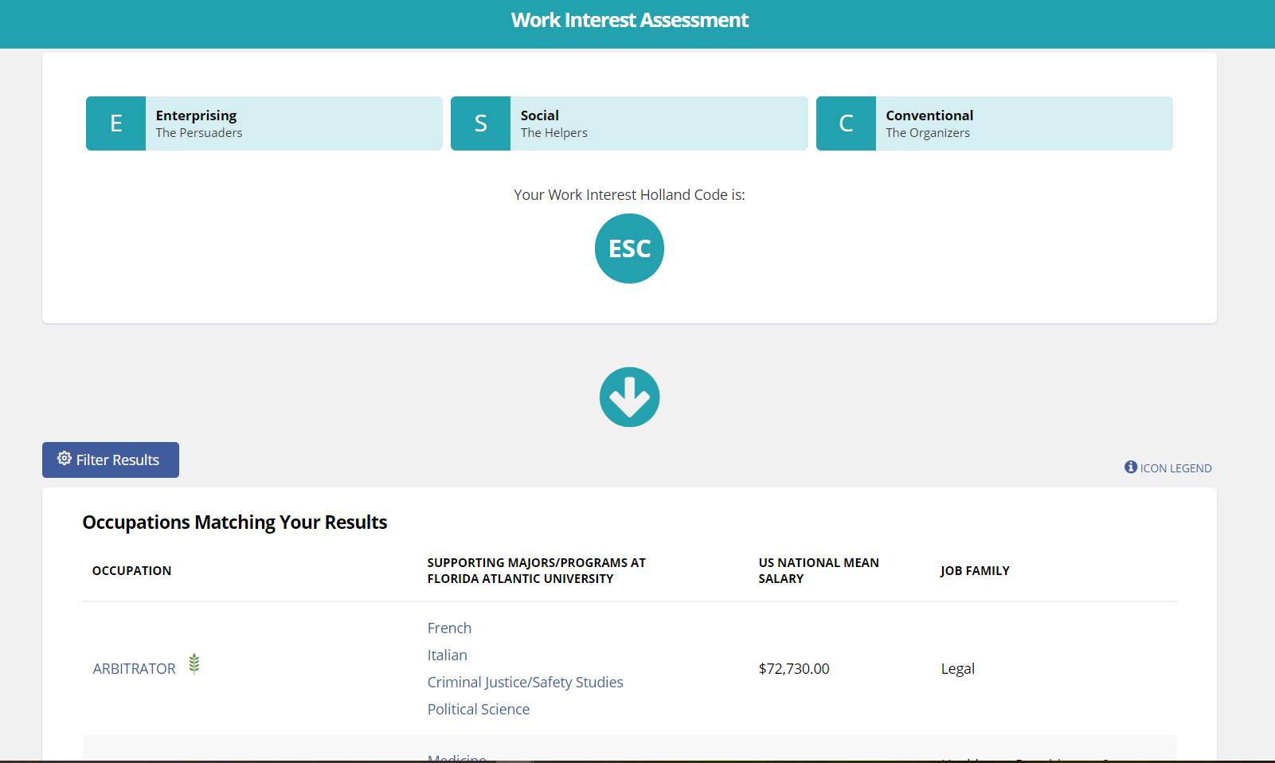
Notes:
The types converts into list of occupations and you can learn salaries, skills, and majors and more when clicked.

Slide 21
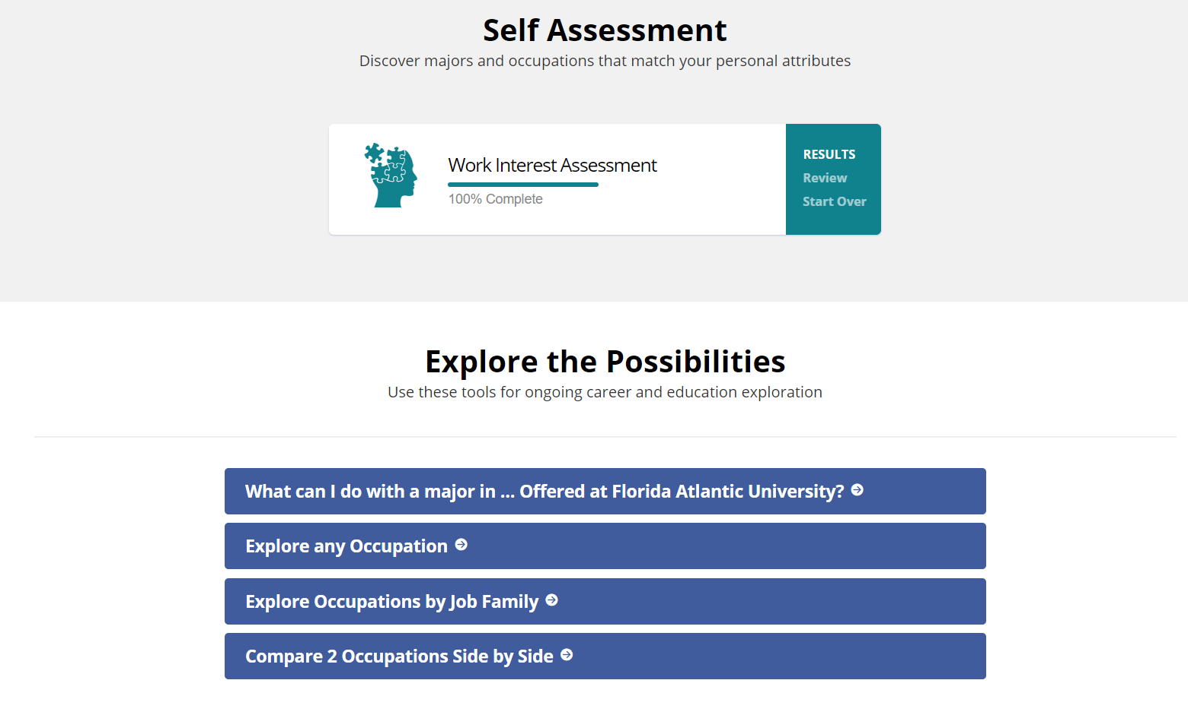
Notes:
Already know what you want to do? Explore what you can do with a major in.. Explore occupations, compare occupations, etc.

Slide 22

Notes:
Second thing to do.. Claim Handshake account. Quick review of what is Handshake.

Slide 23


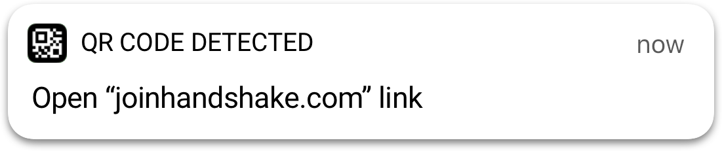
Open your camera app
Tap the notification that pops up!
OR
Go to
fau.joinhandshake.com
Notes:
If time permits.. ask students to claim account. Only students that registered for classes can claim account. Or will be able to claim one week after registering for classes.

Slide 24


Slide 25
Internship Facts
Do internships last only one semester?
Internships are typically one semester to one year long, but it is possible to receive an extension to continue interning.
Are Internships the only way to gain experience?
No! Job Shadowing, Externships, On-Campus Jobs, Campus Involvement.

Slide 26
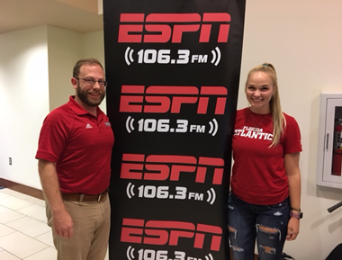

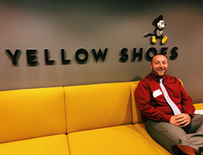

Off Campus and Virtual Internships

Slide 27
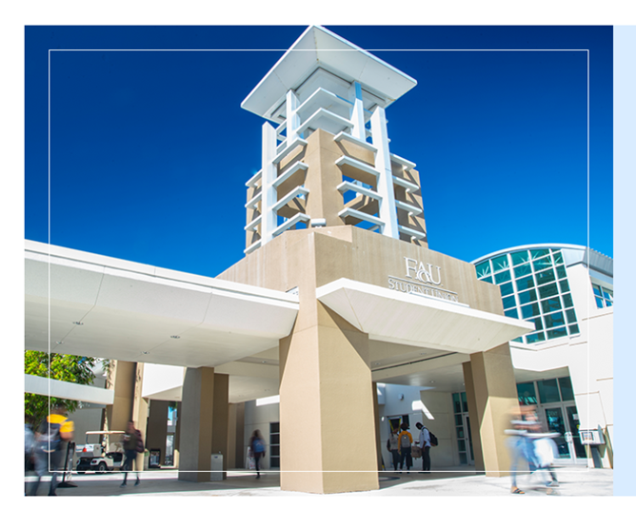
On Campus Internships
Athletics
Student Union
Dept of Emergency Mgmt
Undergraduate Admissions

Slide 28

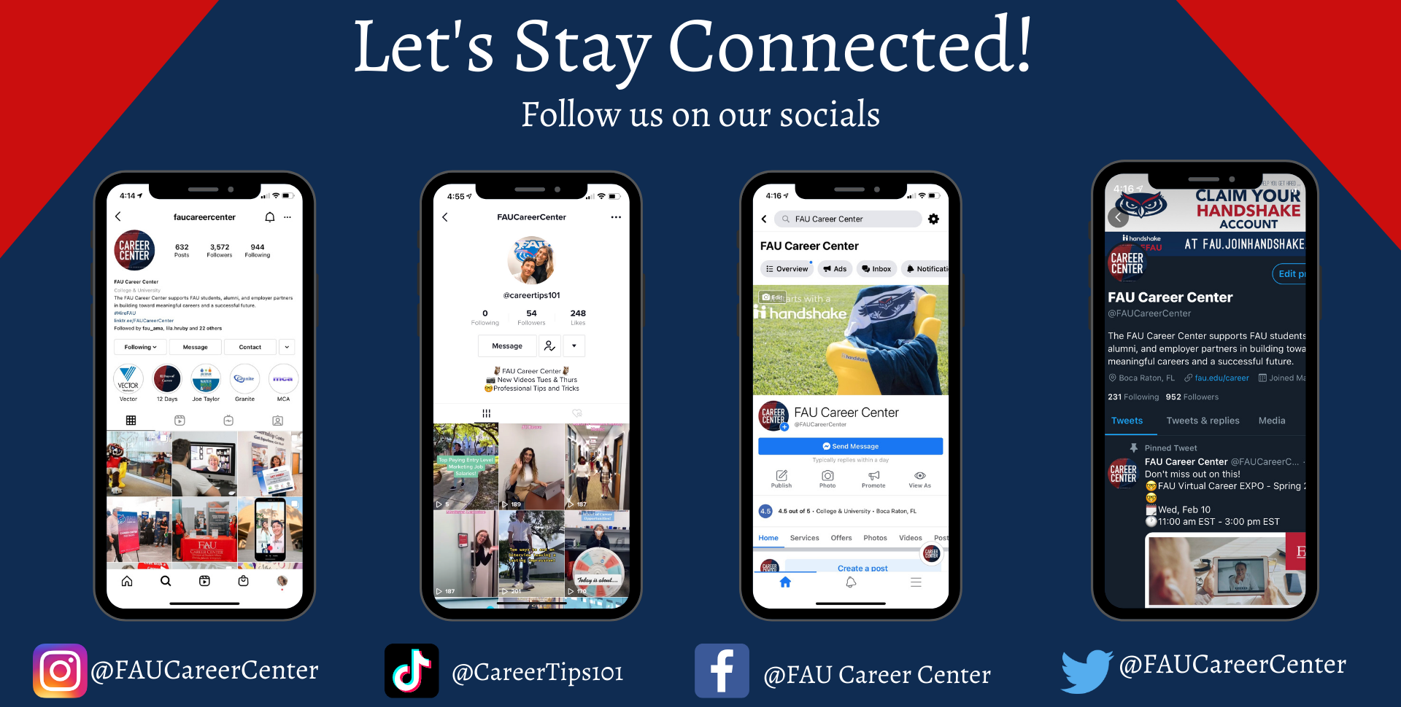

Slide 29
Welcome! Introduction
University Advising Services​ (UAS)
AdvisingServices@fau.edu​
Appointment through Success Network!​
561-297-3064​
SU-80, Suite 201​

Slide 30
Introduction to UAS and Success Network​ Insight about the IFP and advising​ Tips for success
**FAU Email is our main communication. All emails will be sent to your FAU email. Check your FAU email regularly​**
​Emails from academic advisor about:​
Advising appointments: Avoid the Hold and waiting room! ​
Midterm grades​
W deadline ​
Other deadlines and updates

Slide 31
Who are we? What do we do?
Who are we?
First- and Second-Year; Undecided; General Ed​
What do we do?​
Declaring/changing your major​
Academic advising for General Ed/IFP​
Academic support
Referrals to resources

Slide 32
Introduction to the IFP
2021_22_IFP_Curriculum.pdf (fau.edu)
Key policies to remember:
WAC: Four courses
Civic Literacy Requirement
Withdrawal policy

Slide 33
IFP notes for A&L Majors:
Language requirement​
BA v. BFA​
Portfolio​
Audition​
Co-advising for the Arts
Sequential courses for Art, Music, etc.
Minors/Certificates​

Slide 34
Important Resources
Key academic support
Center for Teaching and Learning www.fau.edu/ctl ​
Math Learning Center www.math.fau.edu/mlc ​
Writing Center www.fau.edu/ucew​
E-Success www.fau.edu/class/esuccess

Slide 35
Pre Law University Services (PLUS) ​
Undergraduate Law Journal​ (Get published!)
Phi Alpha Delta Pre Law Org​anization
Academic & Pre-Law Advising​
Sign up at www.fau.edu/prelaw​
Draide2012@fau.edu​

Slide 36
Your Success Network!
What is the Success Network?
The Success Network powered by Starfish Solutions is an online communication system that connects you, the student, to a network of support and to the resources needed to be successful at FAU. Advisors, faculty, tutors, and many different support staff make up your "Success Network".

Slide 37


Slide 38
Important Dates To Remember!
For Full Term:
Classes begin: August 21
Last day to Add/Drop: August 27
Tuition deadline: August 30
Internship and Part-Time Job Fair: September 9
Withdrawal deadline: October 29
Classes end: December 4
Finals begin: December 9

Slide 39
Thank you. See you soon!
University Advising Services​ (UAS)
AdvisingServices@fau.edu​
561-297-3064​
SU-80, Suite 201​

Slide 40
Your College Breakout Session is complete!
Enjoy the rest of your day SOARing with us!

