Slide 1

Instrumentation: Validity Measuring Caring in Nursing

Slide 2
Validity: Defined
Extent to which instrument reflects abstract construct being examined; measures what it is supposed to measure
Domain or Universe of Construct
Concept analysis
Extensive literature search; theory
Qualitative study results
Conceptually define the construct and subconcepts
Blueprint or matrix
Test items
Instrument items

Slide 3
Validity: Face
Face Validity: Instrument looks like it is measuring the construct
Face and content validity of the CARE-Q were established by carefully identifying and developing the behavioral items from the perspective of both nurse and patient in two earlier studies conducted by Larson

Slide 4
Validity: Content Types
Content validity: extent to which method of measurement includes appropriate sample of items for construct being measured and adequately covers construct; based on subjective judgment; how representative are the items of the universe of items on the topic?
evidence comes from
literature
theory
representatives of relevant populations
content experts

Slide 5
Validity: Content, Theoretical
Content Validity: Theoretical validity
domain of construct identified through concept analysis or extensive literature search; qualitative methods can also be used
matrix or blueprint is created to develop items for a test
item format, item content, and procedures for generating items carefully described

Slide 6
Validity: Content, Theoretical
Technological Competency as Caring in Nursing Instrument (TCCNI): Locsin explicated theoretical underpinnings of nursing grounded in caring and technology. TCCNI advances the interrelationship between technology and caring in nursing, emphasizing professional nurse caring competence through technological knowing
Caring Nurse Observational Tool (CNOT) is framed in Watson’s(1997) humanistic stance (10 carative factors under 3 dimensions) and Watzlawick et al.’s (1967) interactive communication (2 axes of communications) with content and relational elements. The Humanistic Aspect of care, Therapeutic relationship, and Clinical Activities are main parts of the frame of reference
Individual CARE-Q behavioral items are derived from a preliminary study with patients and provide theoretical categorizations of the behavioral items

Slide 7
Validity: Content, Theoretical
Caring Behaviors Assessment (CBA): based on Watson’s description of caring, reflecting existential-phenomenological and spiritual influence in Watson’s value system and helped form Watson’s Carative Factors; carative factors were used as a framework for development of the CBA
Using results from a literature review, 48 indicators of caring were selected and classified as being either content or relational and verbal or non-verbal behaviors in the Caring Nurse Observational Tool (CNOT)

Slide 8
Validity: Content, Expert
Content Validity: Expert validity
experts (5 or more) judge items in relation to fit with construct and subscales of construct
experts rank items on scale and record comments
experts use scale
1 = not relevant; 2 = unable to assess relevance without item revision or item in need of such revision that it would no longer be relevant; 3 = relevant but needs minor alteration; 4 = very relevant and succinct
means calculated and decisions made about items
(Lynn, 1986; Thomas, 1992)
comments include offering critique of items, etc., including readability and language used

Slide 9
Validity: Content, Expert
Content Validity Index (CVI)
Numerical value reflecting level of content-related validity
Experts rate content relevance of each item using 4-point rating scale
Items rated according to 4-point Lynn scale
Complete agreement among expert reviewers to retain an item with 7 or fewer reviewers
Relevance = 4 on 4 pt. scale
4 of 6 reviewers rate item relevant; 4/6 or 0.67%

Slide 10
Validity: Content, Expert Type
Content validity was established by a panel of four nurse experts (CBI-42)
Lynn’s Content Validity Index (CVI) approach was used to establish the Technological Competency as Caring In Nursing Instrument (TCCNI); theory and practice experts (N = 13) assessed content validity of 30 items. The final instrument with 25 items had a Scale-Content Validity Index/Universal Agreement of .72
Item and scale level content validity was established at .92 to 1.00 based on five expert reviewers on the Adapted Caring Behavior Checklist

Slide 11
Content Validity, Expert: Example
CBI-E items originated in related literature and research on nurse caring from patients’ and nurses’ perspectives as well as expert review. Six experts in gerontologic nursing reviewed the CBI-E and rated the items, directions, length, and other critical points regarding this draft so that content validity of the expert type (Burns & Grove, 2005) was established. Three of the experts were doctoral-prepared. Two were geriatric nurse practitioners, three were clinical nurse specialists, one was a long-term care administrator, and one was a psychiatric-mental health clinician. The content validity (content relevance) of each item was rated by experts using the following 4-point rating scale (Lynn, 1986): “1 = not relevant; 2 = unable to assess relevance without item revision or item is in need of such revision that it would no longer be relevant; 3 = relevant but needs minor alteration; 4 = very relevant and succinct” (p. 384). Items were revised based on expert reviews and one item was eliminated from the 29-item draft. This item had the lowest mean. Experts commented on nebulous wording on specific items and on the excellence of many. Specific item revisions were offered and the investigators modified several items accordingly.

Slide 12
Content-Related Validity: Example
The content validity of the Nurse-Nursing Assistant-Caregiver Reciprocity Scale (NNA-CRS) was examined through extensive literature review, focus group member checking of item wording and themes, and calculation of the content validity index (CVI) from content experts (3 experts, CVI = .90)

Slide 13
Construct Validity
Construct Validity: test assumptions about instrument; extent to which test measures theoretical construct

Slide 14
Construct Validity: Hypothesis-testing
Theory or concept underlying instrument’s design used to develop hypotheses regarding behavior of individuals with varying scores on the measure; determine if rationale underlying instrument’s construction is adequate to explain findings

Slide 15
Construct Validity: Known Groups
Hypotheses identified about expected response of known groups
Contrasted or known groups: groups who may have significantly varied scores on instrument
t-test or ANOVA determines difference
Male and female participants’ perceptions of nurse caring compared on the CBI-42; no statistically significant difference found (t = -.682, df = 67, p = 0.49)
Patient and nurse perceptions of nurse caring differed on the CBI-42 (t = 3.01, df = 539, p = .003)
African American, White, and Hispanic Perceptions of Caring on the Caring Behaviors Inventory for Elders (CBI-E) were compared; no statistically significant difference found (F = .252, df = 2, 169, p = .778)

Slide 16
Construct Validity: Multitrait-multimethod (Discriminant and Convergent)
Multiple measures of perceptions of nurse caring
Caring Dimension Inventory scores correlated with a 1-item Caring Behavior measure, scaled with ordinal data (Convergent)
Interviewing patients about nurses’ caring behaviors and observing nurses’ caring behaviors using a checklist (CNOT)
Visual Analog Scale to measure nurse caring behavior according to patients correlated in same study with Caring Dimension Inventory scores (Convergent)

Slide 17
Construct Validity: Discriminant (Divergent)
Construct Validity: Discriminant validity
Instrument that measures opposite of construct is administered to subjects at same time the instrument measuring variable in research question is; results are compared with correlation coefficient (r = - 0.??)
Caring Behavior (CB) (CBI-24) was correlated with Burnout (BO). The correlation coefficient was 0.333 (p = .01). Emotional intelligence and psychological ownership help reduce the burnout of nurses by decreasing their feelings of depersonalization; this effect in turn improves the caring behavior of nurses. The hypothesized negative relationship between BO and CB was not supported.

Slide 18
Construct Validity: Convergent
Construct Validity: Convergent validity
two or more tools that measure the same construct are administered at same time to same subjects; demonstrated by high correlations between scores (r = + 0.??)
Construct validity of the convergent type was tested using the CBI-E and Cronin and Harrison’s Caring Behaviors Assessment (CBA), a 62-item instrument (Baldursdottir & Johsdottir, 2002; Cronin & Harrison, 1988) with authors' (Cronin & Harrison) permission. Fourteen senior citizens residing in an independent-residing residence participated.
A moderately strong, non statistically significant correlation (r = .50, p = .06) was calculated between the total scores of the CBI-E and CBA..
There was a significant, positive, moderate correlation between the caring scores (Modified Caring Dimensions Inventory [CDI-29]) and empathy (Toronto Empathy Questionnaire) scores (r = 0.5, p = 0.001)

Slide 19
Construct Validity: Expanded Example
Construct validity of the convergent type (Waltz, Strickland, & Lenz, 1984) was tested using the CBI-E and Cronin and Harrison’s Caring Behaviors Assessment, an 62-item instrument (Baldursdottir & Jonsdottir, 2002; Cronin & Harrison, 1988) with the authors’ (Cronin & Harrison) permission. Fourteen senior citizens residing in an independent residence participated. There was a moderately strong, non statistically significant correlation (r = .50, p = .06) calculated between the total scores of the CBI-E and the CBA. The null hypothesis could be false. However, the sample size is too small; additional testing is necessary to confirm convergent validity.

Slide 20
Validity: Factor Analysis
relationships among various items of instrument established; items fall into a factor, correlate with other items
items that are closely related are clustered into a factor
factor = subscale = dimension = domain
instrument may reflect several constructs rather than one construct
factor loadings (-1 to +1) may be thought of as correlations of the item with the factor

Slide 21
Construct Validity: Convergent
Every year approximately 4 million women in the United States experience childbirth. This event has been cited as pivotal in a woman's life. Labor support is an important part of this experience since it influences the woman's classification of the birth experience as positive or negative. Therefore, understanding how intrapartum nurses perceive the role of supportive care during labor is paramount. The purpose of this study was to develop a reliable and valid instrument that measures intrapartum nurses' perceptions concerning the importance of professional labor support in their practice. The sample included 146 intrapartum nurses from Texas. Cronbach's alpha, Pearson's r, and descriptive statistics were used for data analysis. Cronbach's alpha for the Labor Support Questionnaire (LSQ) was 0.90. Convergent validity with the Caring Behavior Inventory was .57 (p < .001). Findings indicated beginning support for the reliability and validity of the LSQ. Further development and psychometric testing is recommended to ascertain the dimensionality of the LSQ.

Slide 22
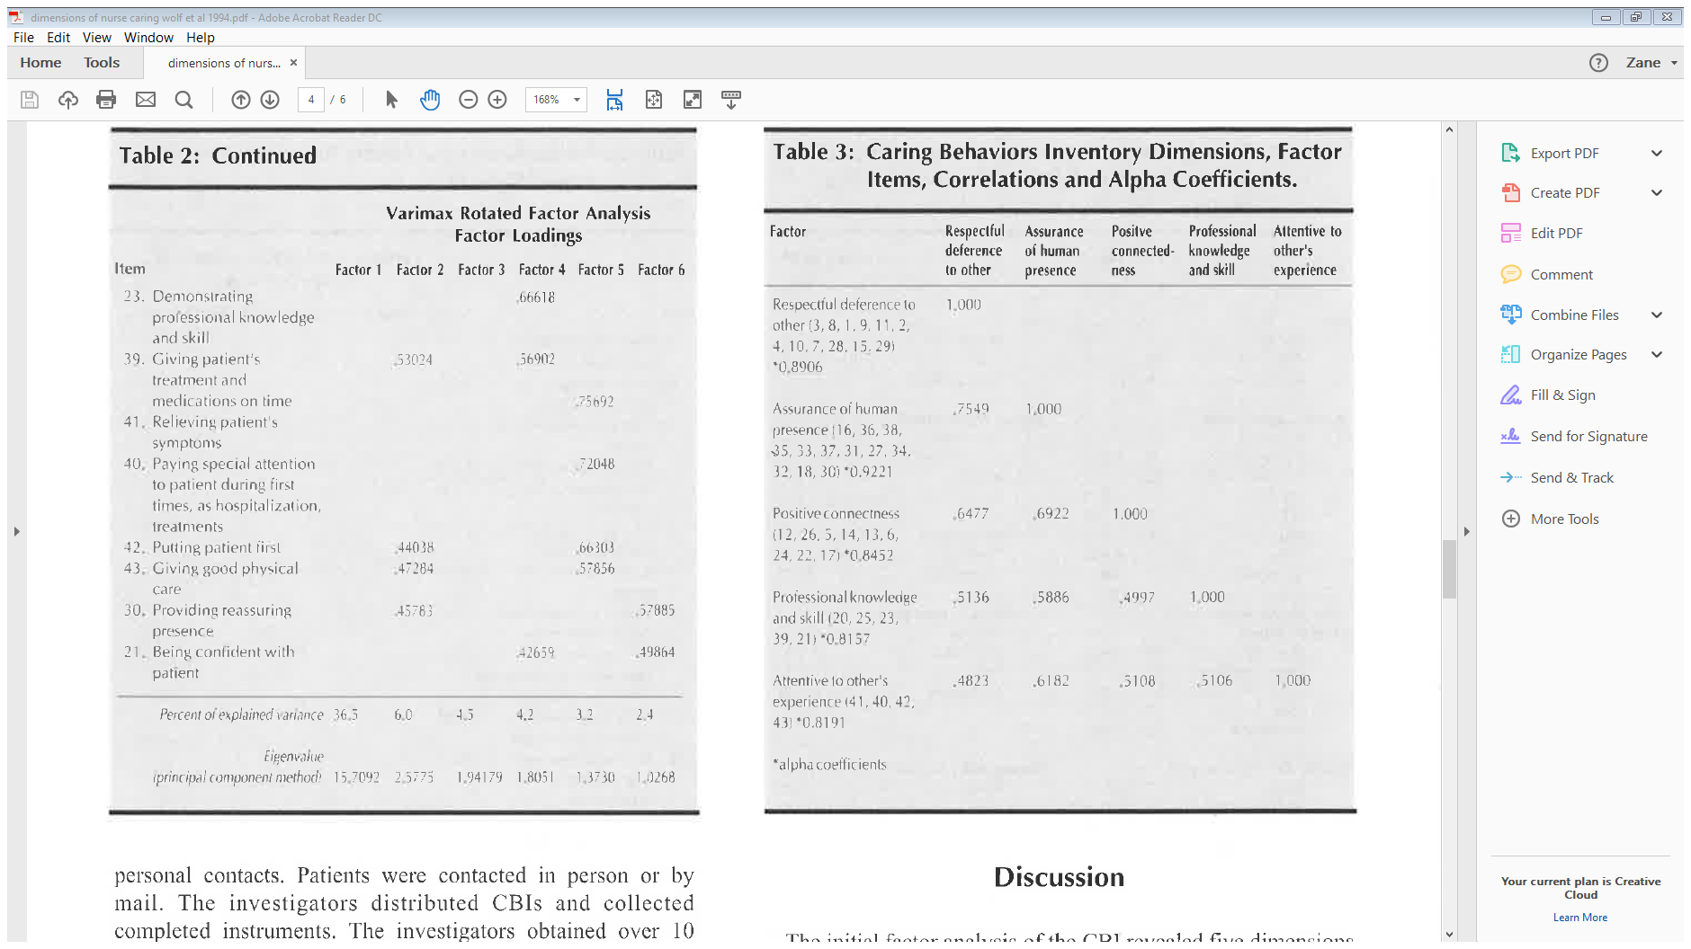

Slide 23
Validity: Factor Analysis or Factorial
number of constructs in instrument can be validated through use of confirmatory factor analysis; one-dimension instrument (Principal Component Analysis)
factor loadings are proportion of variance the item and factor have together
communality is portion of item variance accounted for by various factors
eigenvalue for factor is total amount of variance explained by factor (add squared loadings contained in single column [factor])
factor eigenvalues and variance accounted for are most important results in unrotated factor matrix

Slide 24
Criterion-Related Validity: Predictive, Future and Concurrent
Predictive Validity: Future events
Scores on one instrument predicts future scores on a second instrument
Predictive Validity: Concurrent events
Scores on one instrument predicts score on a second instrument

Slide 25
Criterion-Related Validity: Predictive Validity
Test scores are related to a criterion
Criterion is behavior that test scores are used to predict
Correlation coefficient X is test score and Y is criterion score
predictive or concurrent validity estimate is established by a validity coefficient (correlation coefficient)

Slide 26
Criterion-Related Validity: Predictive
Predictive-validity = future
test score (X) now, correlate with future criterion score (Y)
Concurrent-validity = at same time
test score (X) now, correlate with same time criterion score (Y) now
The Nurse-Nursing Assistant-Caregiver Reciprocity Scale (NNA-CRS) correlated with Kouvonen et al. (2006) Social Capital Scale (r = .546, p = <.05)

Slide 27
References
Cossette & Forbes (2012)
Dunnington & Farmer (2015)
Kaur, Sambasivan, & Kumar (2013)
Kouvonen et al. (2006)
Parcells & Locsin (2011)
Wolf et al. (1994)
Yen-Patton, Dowling, & Clayton-Matthew (2013)

