Slide 1
Instrument Development: Measures of Caring and Related Constructs

Slide 2
Devices for Measuring Constructs
Device = test of knowledge, machine, psychometric (psychologic measurement) instrument
Administration elicits a sample of behavior for many purposes
Sample of behavior represented by numbers: ultimate reduction, also operationalization of constructs
Measurement: assign numbers to individuals’ responses, chart data, biophysiologic data, etc.

Slide 3
Measurement: Defined
Rules for assigning numbers to objects to represent quantities of attributes
Assign numbers to objects according to rules
Remember attributes of objects vary day to day, from situation to situation, or from one object to another
Variability: numeric expression that signifies how much of an attribute is present in the object
Quantification communicates that amount

Slide 4
Rules and Measurement
Numbers must be assigned to attributes of objects according to rules
Scores assigned systematically
The conditions and criteria with which the numeric values are assigned are specified
The measurement instrument must correspond with the real world of the object being measured
instruments help researchers to measure concepts/constructs/attributes

Slide 5
Direct and Indirect Measures of Concept/Construct
Direct Measures: straightforward measurement of concrete object
Indirect Measures: indicators of concept used to represent abstract concept

Slide 6
Direct and Indirect Measures of Concept/Construct
Direct: blood alcohol level; arterial blood gas; mean arterial pressure; digitalis level; GSR (galvanic skin response) as pain indicator
Indirect: Abuse-a-stick alcohol level; pulse oximetry; auscultatory blood pressure; symptoms of digitalis toxicity; pain level on VAS; intelligence; caring; pain; coping; anxiety; social support; teasing frequency and teasing bother; spiritual/coping; perception of individualized nursing care
More indirect: phenomenological description; ethnographic analytic description

Slide 7
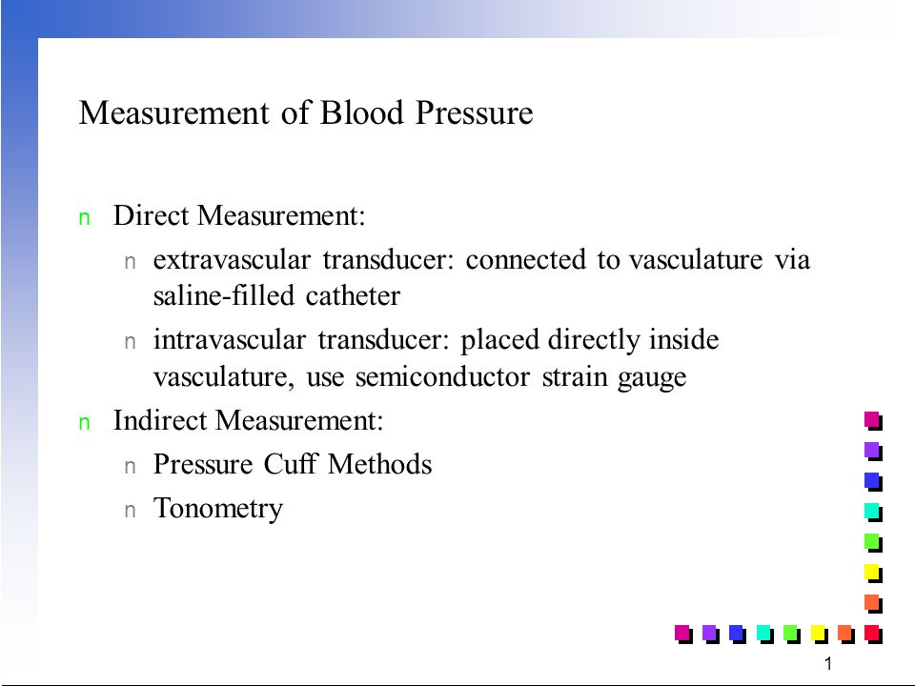

Slide 8
Measurement and Data Collection: Intersect
Measurement
Data Collection

Slide 9
Measurement Error
Difference between what exists in reality and what is measured (obtained or observed score) by a research instrument
Measurement exists in direct and indirect measures
Measurement errors include:
Random error
Systematic error

Slide 10
Variance: Errors of Measurement
Systematic variance: leans in one direction; scores tend to be all positive, all negative, all high, or all low
Error is constant or biased
Glucometer and electronic thermometer that are not calibrated
Postpartum depression instrument measures depression scores too high

Slide 11
Variance: Errors of Measurement
Random error or error variance: variability of measures due to random fluctuations whose basic characteristic is that they (fluctuations) are self-compensatory
Unpredictable
Dialysis patients tested for cognitive functioning on first day of their dialysis schedule
Participant affected by family stress

Slide 12
Factors Contributing to Errors of Measurement
Situational contaminants (presence of researcher)
Transitory personal factors (anxiety)
Response-set biases (social desirability, extreme responses, acquiescence)
Administration variations (change test/instrument instructions)

Slide 13
Factors Contributing to Errors of Measurement
Instrument clarity (directions)
Item sampling (which questions included on test)
Instrument format (ordering of questions)
Readability level, e.g., Flesch-Kincaid Grade Level

Slide 14
True score + Error score = Observed score
Direct measures are more accurate than indirect measure
True score = what would be obtained if there were no errors in measurement
Systematic error = considered part of true score and reflects true measure
Error score = amount of random error in measurement process

Slide 15
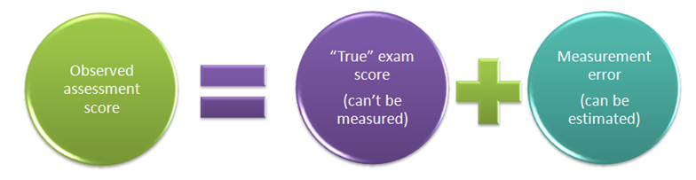

Slide 16
Test/Instrument Scaling
Item scaling
Nominal, Ordinal, Interval, Ratio
Item weighting
Directions specify item and factor (domain) weighting
Total Score calculation
Summing items; converting ordinal to interval level data

Slide 17
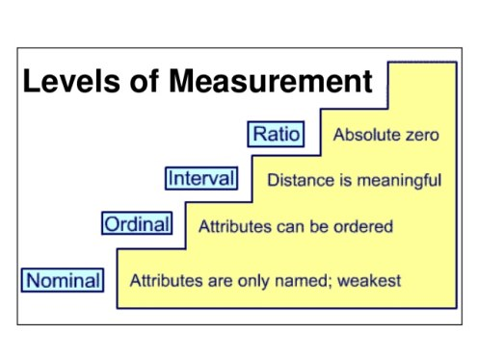
Levels of Measurement

Slide 18
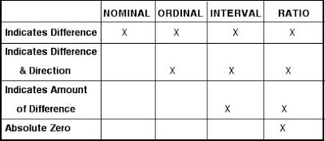

Slide 19
Item Formatting Types
Multiple choice
Dichotomous multiple choice
Yes, No
Bipolar scale
Agree/disagree scale
Preference ordering question
Ranking ordering question
Semantic differential scale
Unipolar scale (one item)
Absence or presence of single item, e.g., Not at all satisfied, slightly satisfied, moderately satisfied, very satisfied, and completely satisfied

Slide 20
Examples of Item Scaling
Nominal
Nurses spend time with the patient. (1 = Yes, 0 = No)
Ordinal
Accepts me as I am. (1 = Never, 2 = Rarely, 3 = Occasionally 4 = Frequently, 5 = Always) (Staff Nurse Survey, Duffy)
Interval/Ratio
Nurses point out positive things about me. (mark 10 cm line, VAS) NEVER TRUE FOR ME 0 ____________________ 100 ALWAYS TRUE FOR ME (Caring Behavior of Nurses Scale, Hinds)

Slide 21
Reliability and Validity
Both needed for valid instrument
Ongoing processes needed
e.g. reliability needs to be established with each new sample

Slide 22
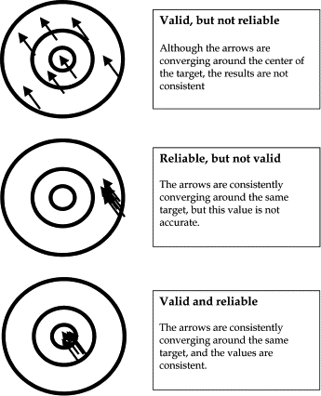

Slide 23
Reliability: Quality Measure of Instrument
Dependability, stability, consistency, predictability, comparability, accuracy
Indicates extent of random error in measurement method
Test is reliable if observed scores are highly correlated with its true scores
How consistently measurement technique measures concept/construct (same trait) (internal consistency)
If two data collectors observe same event and record observations on instrument, recording comparable (interrater)
Same questionnaire administered to same individuals at two different times, individuals’ responses remain same (test-retest)

Slide 24
Reliability
Instruments that are reliable provide values with only small amount of random error
Reliable instruments enhance the power of the study
1.00 is perfect reliability; 0.00 is no reliability

Slide 25
Types of Reliability
test-retest (two administrations of same test)
comparison of means
t-test: t value or t statistic
OR
correlate results
Pearson Product Moment Correlation or r
Time ₁: administer the CBI to a group of nurses
Time ₂: administer the CBI to the same group of nurses

Slide 26
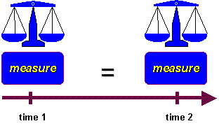

Slide 27
Types of Reliability
Equivalence
Interrater or interobserver
percentage of agreement: number of agreements/number of possible agreements = interrater reliability
Cohen’s kappa
Phi (nominal, dichotomous)
correlation (Pearson r; Kendall’s tau)
intraclass correlation coefficient (ANOVA)
Alternate or parallel forms (two parallel tests)
correlation

Slide 28
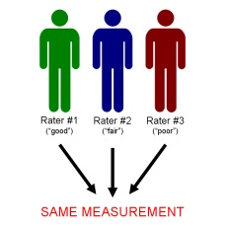

Slide 29
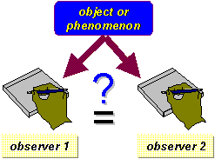

Slide 30
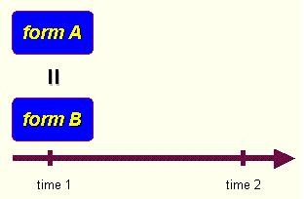

Slide 31

Types of Reliability
Homogeneity
Internal consistency
Cronbach’s alpha (ordinal items)
Modest sample size: at least 25
Kuder-Richardson 20 (dichotomous items)

Slide 32
Reliability
Ischemic Heart Disease Index: coding reliability reported by the authors was .71.
Adult-Adolescent Parenting Inventory (AAPI): Regarding Inappropriate Expectations subscale: in previous studies, Cronbach’s alphas ranged from .40 to .86. Reliabilities in current study ranged from .40 to .84. This subscale was dropped from further analyses.
Cronbach’s alphas are never obtained at a score of 1.00 because all instruments have some measurement error
Test-retest reliability coefficients were r = 0.92 for the whole instrument (SIP) and averaged r = 0.82 for the 12 categories of dysfunctional behavior when two tests were administered at 24-hour intervals
Arterial oxygen saturation was measured by a Nellcor pulse oximeter (Nellcor Inc., Hayward, CA), placed on the subject’s index finger (obtain manufacturer’s product information; conduct test/retest calculations yourself)

Slide 33
Reliability
Anxiety subscale
i1
i7
i14
i23
i37
reliability coefficient
N = cases = 125
N of items = 5
alpha = 0.3682

Slide 34
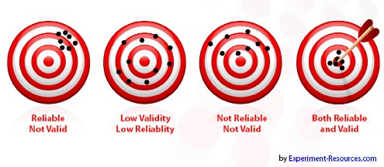

Slide 35
Validity: Defined
Extent to which instrument actually reflects abstract construct being examined; measures what it is supposed to measure
Domain or Universe of Construct
Concept analysis
Extensive literature search
Qualitative study results
Theoretically define the construct and subconcepts
Blueprint or matrix
Test items
Instrument items

Slide 36
Validity Types
Face Validity
Instrument looks like it is measuring the construct

Slide 37
Validity Types
Content validity: extent to which method of measurement includes appropriate sample of items for construct being measured and adequately covers construct; based on subjective judgment
evidence comes from
literature
representatives of relevant populations
content experts

Slide 38
Validity Types
Content Validity: Expert validity
experts (5 or more) judge the items in relation to fit with construct and subscales of construct
experts rank items on scale
experts’ characteristics are described
experts use scale
1 = not relevant; 2 = unable to assess relevance without item revision or item in need of such revision that it would no longer be relevant; 3 = relevant but needs minor alteration; 4 = very relevant and succinct
means calculated and decisions made about items
(Lynn, 1986; Thomas, 1992)
comments included offering critique of items, etc. including readability and language used

Slide 39
Content-Related Validity: Expert
Content Validity Index (CVI)
Numerical value reflecting level of content-related validity
Experts rate content relevance of each item using 4-point rating scale
Items rated according to 4-point Lynn scale
Complete agreement among expert reviewers to retain an item with 7 or fewer reviewers
Relevance = 4 on 4 pt. scale
4 of 6 reviewers rate each item relevant; 4/6 or 0.67%
The Observable Displays of Affect Scale (ODAS): Ten gerontological nursing experts established content validity (Vogelpohl & Beck, 1997).

Slide 40
Instrument Readability
there are over 30 readability formulas
index of probable degree of difficulty of comprehending text
Fog formula example of readability formula
Flesch-Kinkaid Grade Level Word: calculates readability level

Slide 41
Content-Related Validity: Example
CBI-E items originated in related literature and research on nurse caring from patients’ and nurses’ perspectives as well as expert review. Six experts in gerontologic nursing reviewed the CBI-E and rated the items, directions, length, and other critical points regarding this draft so that content validity of the expert type (Burns & Grove, 2005) was established. Three of the experts were doctoral-prepared. Two were geriatric nurse practitioners, three were clinical nurse specialists, one was a long-term care administrator, and one was a psychiatric-mental health clinician. The content validity (content relevance) of each item was rated by experts using the following 4-point rating scale (Lynn, 1986): “1 = not relevant; 2 = unable to assess relevance without item revision or item is in need of such revision that it would no longer be relevant; 3 = relevant but needs minor alteration; 4 = very relevant and succinct” (p. 384). Items were revised based on expert reviews and one item was eliminated from the 29-item draft. This item had the lowest mean. Experts commented on nebulous wording on specific items and on the excellence of many. Specific item revisions were offered and the investigators modified several items accordingly.

Slide 42
Types of Content Validity
Content Validity: Theoretical validity
the domain of the construct is identified through concept analysis or extensive literature search; qualitative methods can also be used
a matrix or blueprint is created to develop items for a test
item format, item content, and procedures for generating items carefully described

Slide 43
Construct Validity: Factor Analysis Validity
Relationships among various items of instrument established; items fall into a factor, correlate with other items
Items that are closely related are clustered into a factor
factor = subscale = dimension
Instrument may reflect several constructs rather than one construct
factor loadings (-1 to +1) may be thought of as correlations of the item with the factor

Slide 44
Construct Validity: Factor Analysis Validity
Number of constructs in instrument can be validated through use of confirmatory factor analysis
Factor loadings are proportion of variance the item and factor have together
Communality is portion of item variance accounted for by various factors
Eigenvalue for factor is total amount of variance explained by factor (add squared loadings contained in single column [factor])
Factor eigenvalues and variance accounted for are most important results in unrotated factor matrix

Slide 45
Construct Validity: Examples
Construct validity of the State and Trait Anger Scales (20 items) (was assessed by Spielberger et al. (1983) using principal factor analysis with orthogonal rotation, which determined the state-trait anger scales. Fuqua et al. (1991) reported a similar factor structure in 455 college students.

Slide 46
Types of Construct Validity
Construct Validity: test assumptions about instrument; extent to which test measures theoretical construct
Hypotheses identified about expected response of known groups
Contrasted or known groups: groups who have significantly varied scores on instrument
Alcoholics versus teetotalers on Alcoholism Health Risk Appraisal Instrument
t-test or ANOVA determines difference

Slide 47
Types of Construct Validity
Construct Validity: Hypothesis-testing approach
Theory or concept underlying instrument’s design used to develop hypotheses regarding behavior of individuals with varying scores on the measure; determine if rationale underlying instrument’s construction is adequate to explain findings

Slide 48
Types of Validity
Construct Validity: Divergent validity
Instrument that measures the opposite of construct is administered to subjects at same time the instrument measuring variable in research question is; results are compared with correlation coefficient (r = - 0.??)
Hearth Hope Scale and Hopelessness Scale
Fear Survey Scale and Happiness Scale

Slide 49
Types of Validity
Construct Validity: Convergent validity
Two or more tools that measure the same construct are administered at same time to same subjects; demonstrated by high correlations between scores (r = + 0.??)
Personal Resource Questionnaire and Norbeck Social Support Questionnaire
Anxiety Scale and Nausea Distress Scale

Slide 50
Construct Validity: Example
Validity of the anxiety VAS has been established using such techniques as concurrent validity and discriminate validity. The VAS has been described as an accurate and sensitive method for self-reporting preoperative anxiety.
Anxiety scores on the visual analogue scale (VAS) have been highly correlated (r = .84) with State-Trait Anxiety Inventory scores.

Slide 51
Types of Validity
Construct Validity: Multitrait-multimethod
multiple measures of anxiety
State-Trait Anxiety Inventory
systolic and diastolic blood pressure readings
interviewing patient about anxious feelings
observing patient’s behaviors
Visual Analog Scale to measure anxiety

Slide 52
Types of Construct Validity
Construct Validity: Discriminant analysis
Instruments measure closely related constructs
Compare extent to which two instruments finely discriminate between these related concepts by administering them simultaneously to a sample
Caring Behaviors Inventory for Elders and Caring Behaviors Assessment

Slide 53
Construct Validity: Example
Construct validity of the convergent type (Waltz, Strickland, & Lenz, 1984) was tested using the CBI-E and Cronin and Harrison’s Caring Behaviors Assessment, an 62-item instrument (Baldursdottir & Jonsdottir, 2002; Cronin & Harrison, 1988) with the authors’ (Cronin & Harrison) permission. Fourteen senior citizens residing in an independent residence participated. There was a moderately strong, non statistically significant correlation (r = .50, p = .06) calculated between the total scores of the CBI-E and the CBA. The null hypothesis could be false. However, the sample size is too small; additional testing is necessary to confirm convergent validity.

Slide 54
Types of Validity
Predictive Validity: Future events
Holmes and Rahe Life Events Scale (stress measure) predicts Health scores
Predictive Validity: Concurrent events
predict self-esteem score from coping score

Slide 55
Predictive Validity = Criterion-Related Validity
Test scores are related to a criterion
Criterion is behavior that the test scores are used to predict
Correlation coefficient X is the test score and Y is the criterion score
Predictive or concurrent validity estimate is established by a validity coefficient (correlation coefficient)

Slide 56
Predictive Validity = Criterion-Related Validity
Predictive-validity = future
Test score (X) now, correlate with future criterion score (Y)
Concurrent-validity = at same time
Test score (X) now, correlate with same time criterion score (Y)
Davies and Ware (1981) established concurrent validity of the General Health Rating Index (GHRI) by correlating it with various measures of physical and mental health.

Slide 57
Validity and Reliability in Screening in Detecting Disease
Screening: presumptive identification of unrecognized disease or defect by application of tests, examinations, or other procedures which can be applied rapidly to sort out apparently well persons who probably have a disease from those who probably do not

Slide 58
Screening Test
Validity: determined by measures of sensitivity and specificity
Usually screening tests have high sensitivity and low specificity
Mini Mental Status Exam (Folstein et al., 1975) provides a global evaluation of participant’s cognitive statuses for screening subjects for the study.
Reliability: repeatability
Yield: amount of disease detected in the population

Slide 59
Instruments Measuring Nurse Caring
Instrument | Citation
Care-Q | Larson (1984)
Caring Behaviors Inventory (CBI-42); CBI-24; CBI-6 | Wolf, Giardino, Osborne, & Ambrose (1994).
Caring Behaviors Assessment Tool (CBA) | Cronin & Harrison (1988) Harrison (1988)
Caring Behaviors of Nurses Scale (CBNS) | Hinds (1985) Hinds (1988)
Professional Caring Behaviors | Horner (2005)
Nyberg Caring Assessment (Attributes) Scale (CAS) | Nyberg (1990)
Caring Ability Inventory (CAI) | Nkongho (1988) Nkongho (1990) Nkongho (2003)
Caring Behavior Checklist and Client Perception of Caring | McDaniel (1990) McDaniel (2002) McDaniel (2003)

Slide 60
Instruments Measuring Nurse Caring
Instrument | Citation
Caring Assessment Tool (CAT) Caring Assessment Tool-Educational Version (CAT-edu) CAT-admin | Duffy (1992) Duffy (2007b) Duffy (2009)
Peer Group Caring Interaction Scale and Organizational Climate for Caring Questionnaire | Hughes (1993)
Caring Efficacy Scale | Coates (1997) Coates (2009) Reid, Courtney, Anderson, & Hurst (2015)
Holistic Caring Inventory | Latham (1996) Pollack-Latham (1991)
Caring Dimensions Inventory | Watson & Lea (1997)
Caring Attributes Professional Self-Concept Technological Influence (CAPSTI) | Arthur et al. (1999)
Caring Professional Scale (CPS) | Swanson (2000) Swanson (2002)
Methodist Health Care System Nurse Caring Instrument | Sherwood & Shepherd (2002)

Slide 61
Instruments Measuring Nurse Caring
Instrument | Citation
Care/Satisfaction CARE/SAT | Larson & Ferketich (1993)
Caring Behaviors Inventory for Elders (CBI-E) | Wolf et al. (2004) Wolf, Zuzelo, Goldberg, Crothers, & Jacobson (2005)
Relational Caring Questionnaire | Turkel & Ray (2001) Ray & Turkel (2009)
Family Caring Inventory | Goff (2009)
Nurse-Patient Relationship Questionnaire | Quinn, Smith, Rittenbaugh, Swanson, & Watson (2009)
Caring Nurse-Patient Interactions Scale | Cossette & Pepin (2009).
Caring Factor Survey | Nelson, Watson, & InnovaHealth. (2009)

Slide 62


Slide 63


Slide 64


