Slide 1
Novelution User Overview
Research Management System
*This overview PowerPoint provides general information regarding Novelution. The College of Medicine does not manage nor is responsible for Novelution. For more information or question about Novelution, please contact the Division of Research’s Office of Sponsored Programs.
Version 1.0 05/31/2022

Slide 2
What is Novelution?
What is Novelution
Novelution provides an intuitive, web-based platform for electronic research administration, including modules for sponsored research (pre- and post-award) and compliance modules for FCOI. Novelution’s integrated modules are specifically designed and tailored to FAU to ensure faculty, staff, and research administrator’s needs are met and to limit inefficiencies and burden. As a centralized research management system, many of the past administrative and compliance functions are now housed and managed in one location.
Key Benefits and Features of Novelution
Integrated with FAU’s single sign-on (SSO) which leverages your FAU credentials to access Novelution
Personnel data is pulled directly from Workday, including names, titles, department, etc.
Able to pull in actual funding opportunity announcements (FOA)
Proposal routing management with intuitive workflow presentation
Robust validations tools, tasks management, and system notifications

Slide 3
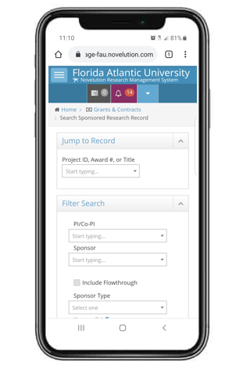
Novelution’s Additional Benefits
Additional Benefits
Since Novelution is web-based, it can be accessed anywhere there is an internet connection
Intuitive UX which allows the user to utilize and view Novelution on various mediums (computer, tablet, and cell phones)
Sophisticated detailed budget development tool
Proposal and compliance items will be centralized
Enables users to save the entire proposal as one document (PDF)
Proposal are transparent for all parties involved
User friendly search pages and projects records using smart forms
Allows for ad hoc reporting utilizing various combinations of search filters

Slide 4
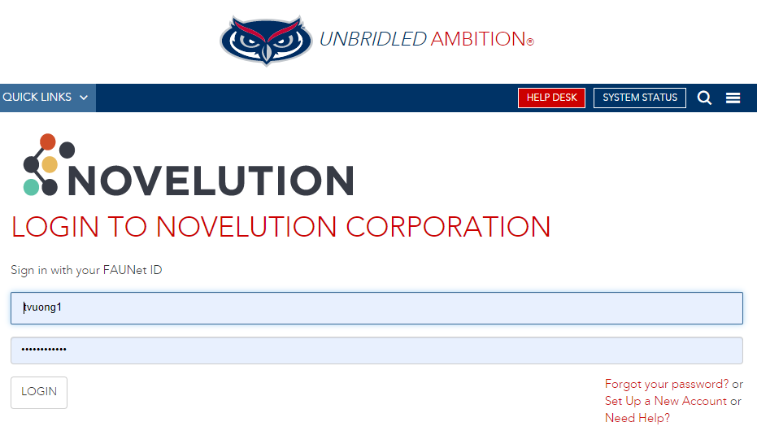
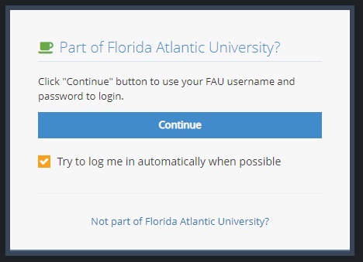
How to Log into Novelution
Access Novelution at: http://fau.novelution.com
Click on “Continue” to confirm you are apart of Florida Atlantic University
Utilize your FAU’s single sign-on (SSO) credentials to access Novelution

Slide 5
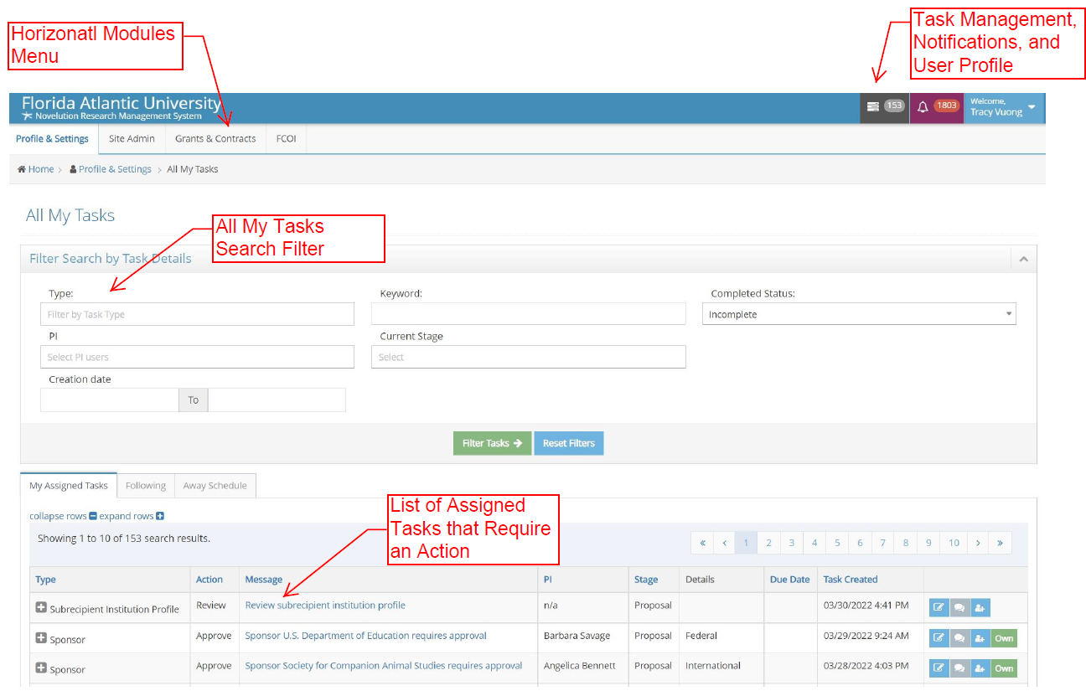
How to Navigate Novelution
Login Home Screen
The login home screen provide users with access to their modules, tasks, notification, and task search filters
The “horizontal” modules menu enables users to access their Profile & Settings, Grants & Contracts, and FCOI tabs
Task management and notifications allow users to quickly view if there are any notifications or pending tasks requiring an action

Slide 6
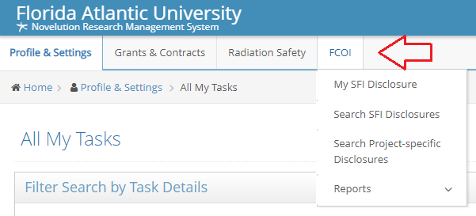
How to Navigate Novelution (Cont.)
Profile & Settings, Grants & Contracts, and FCOI
Profile & Settings - Enables users access to their profile information that is pre-populated from Workday. Additionally, users can assign “Proxy Access” which gives other users full access to their proposal and award records. Users can also view their Training & Certifications in this section
Grants & Contracts – Enables users to “Search Sponsored Research Record”, “Search Subawards”, and run “Ad hoc” reports for their records
FCOI – The financial conflict of interest section enables users to view/edit/search their “Significant Financial Interest” and “Project Specific Disclosures”. Additionally, users can also run reports on their disclosures

Slide 7
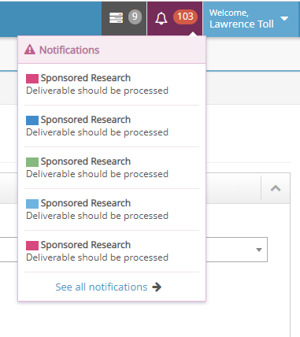
Task Management & Notifications
Tasks and Notifications
Tasks – Are items requiring an action. Tasks appear in two sections on the Novelution home page. On the top right of the home page, tasks appear in the gray box as a numerical value based on the number of pending tasks. This is a quick short-cut view of the user pending tasks. The actual tasks appear at the bottom of the home page in the “My Assigned Tasks” tab. Tasks will be in list form with a “Message” section in which the user can click to access that specific tasks. Certain tasks will also be email generated and the user can access that task through the email notification
Notification – Unlike tasks, notifications do not require an action but provides various information regarding proposals, awards, etc.. Notifications can provide proposal status, routing information, deliverables requirements, etc.

Slide 8
How to Initiate a New Proposal
Initiating a New Proposal
To initiate a proposal, users will need to first contact the COM Office of Research and let them know of your intent to submit.
After discussing with the COM Office of Research, the user will need to complete the College of Medicine “Proposal Routing Form” found here https://fau.az1.qualtrics.com/jfe/form/SV_57osbowZZ6WgaH3
The COM Office of Research will utilize the information submitted through the Proposal Routing Form to initiate and create the Novelution proposal file on the user’s behalf
Please note that only the COM Office of Research should initiate and create Novelution proposal files
Nicholas Kelly, MBA
Associate Director, Research Administration
Phone: (561) 297-4892
Email: nkelly9@health.fau.edu
Laura Van Voorhis, PhD
Sponsored Research Administrator
Phone: (561) 297-4723
Email: Lvanvoor@health.fau.edu

Slide 9
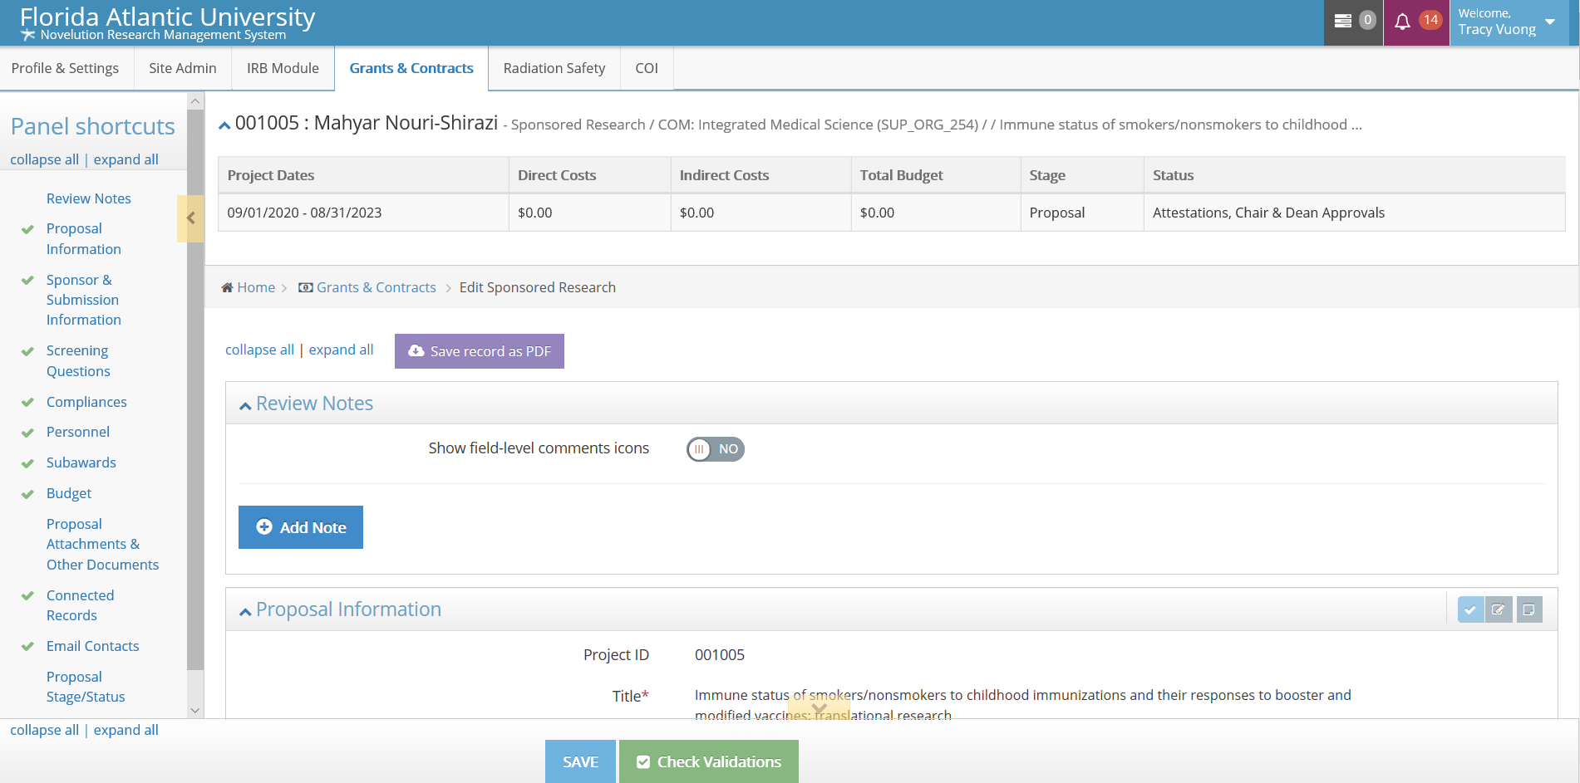
Panel Shortcuts within the Proposal Record
Panel Shortcuts Menu
Allows users to view all sections of the proposals
Since Novelution is a running interface, it allows users to click on the shortcut which directs them to that specific section
The panel shortcuts also serves as visual validation tool, “green checks” means section is complete and validated, while “red warning sign” indicates an error or missing information
Panel shortcut is collapsible to provide more interface real estate

Slide 10
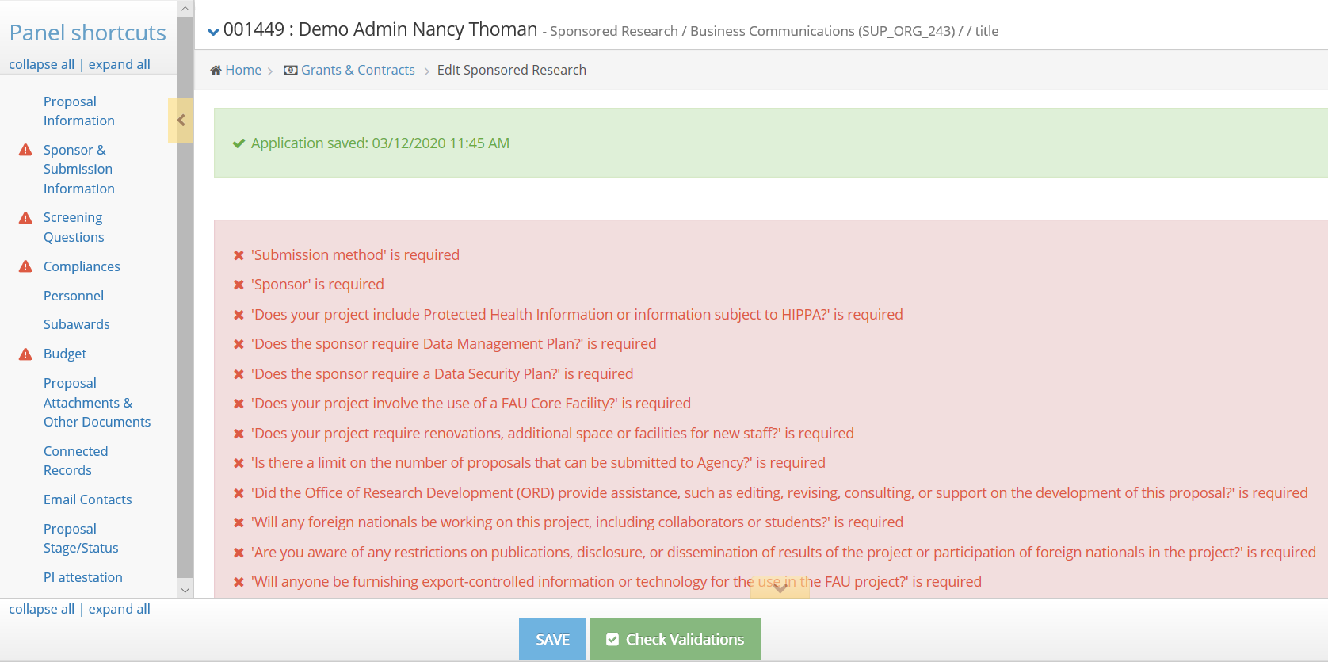
Validation Prior to Proposal Routing
Validation and Routing
The robust validation tool ensure the entire proposal is complete without errors
Missing items or errors are individually identified
The error list can be click to send the user to that specific section/error (error will be then highlighted red in the proposal)
Will not allow user to route the proposal for approval if missing items/errors exist
Validation can be done at any time

Slide 11
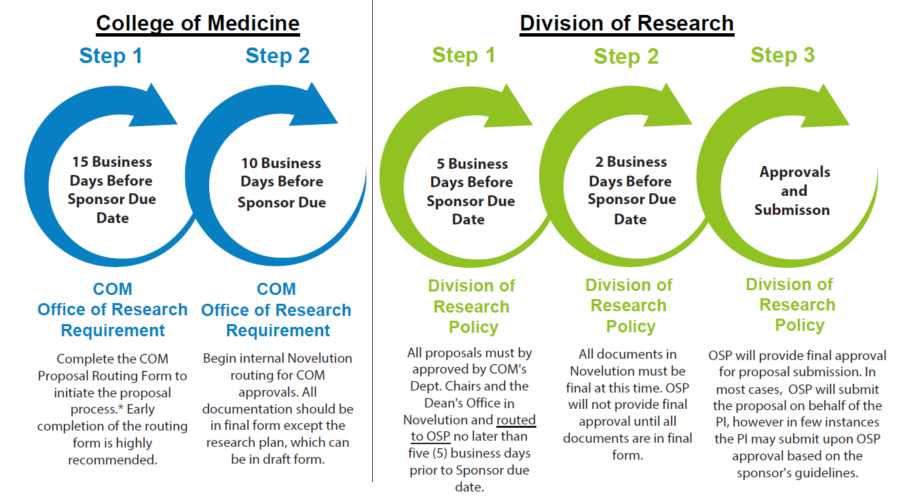
Proposal Routing & Approvals Requirements
Proposal Routing & Approvals
When a proposal file is complete and all attachments are final and uploaded (research plan may be in draft form), the proposal is ready to be routed
The COM Office of Research will submit the proposal to routing for both College of Medicine and Office of Sponsored Programs approval
For proposals that include senior/key personnel from other Colleges, additional approvers will be automatically pulled into Novelution
Please refer to graphic for deadlines date requirements for routing and approvals

Slide 12
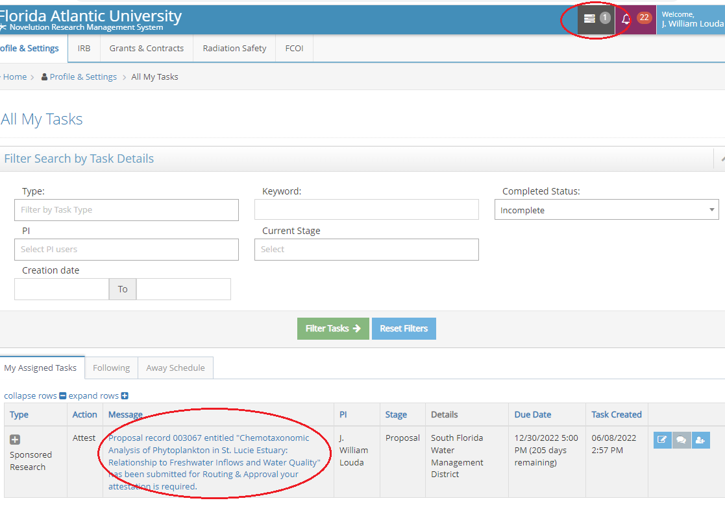
PI and Senior/Key Personnel Attestation
Attestation Requirements
When the COM Office of Research submits the proposal file to routing, all senior/key personnel, including the PI will receive an email and in system task notification to attest to the proposals
All senior/key personnel must complete their attestation in order for the routing process to continue
Prior to attestation, the user(s) may review the contents of the proposal for accuracy
Attestation can be done via the email which shall contain a direct link to attest, or log in Novelution and access the attestation requirements in the “Message” section

Slide 13
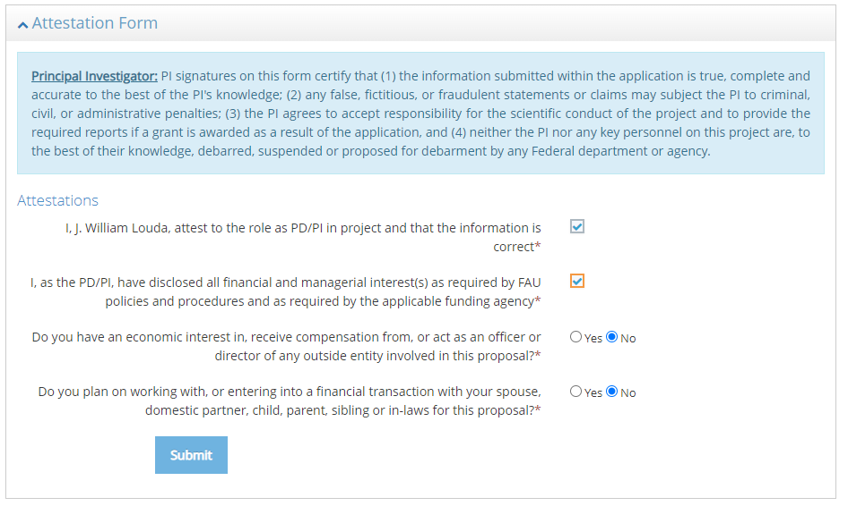
Proposal Attestation (Cont.)
Attestation Form
The Attestation Form appears in the proposal file once the user’s attestation is required
The individual required to attest must confirm to the four questions in the Attestation Form. By checking the boxes and radio buttons, the attestation is now ready for submission by clicking the blue “Submit” button
This completes the attestation requirement for the user and the proposal status is moved on to the next requirement

Slide 14
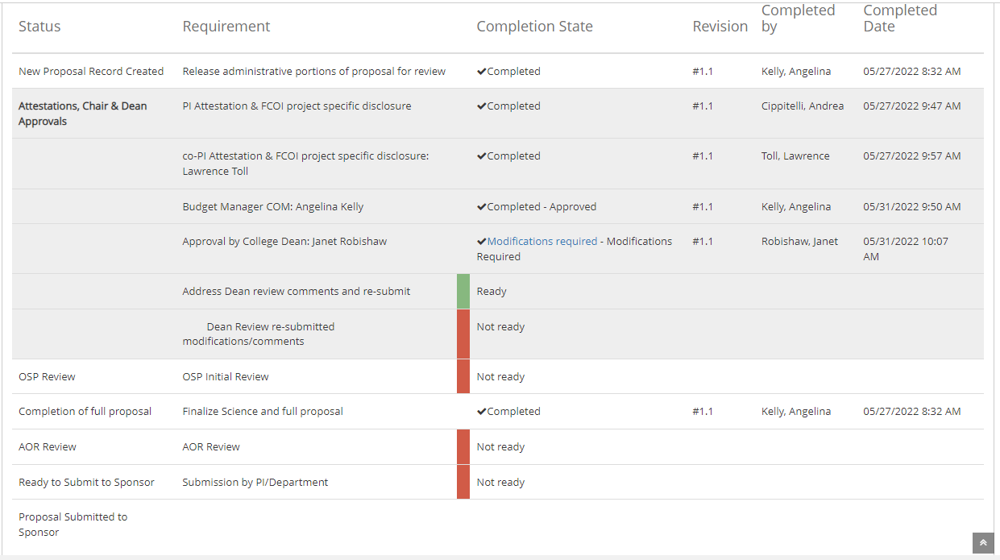
Proposal Stages/Status
Proposal Stages/Status
At any time, the user can view the proposal’s stage or status
Each stage/status/attestation is time-stamped and color coded when completed
This feature provides real time up-to-date information on the progress of the proposal or pending task

Slide 15
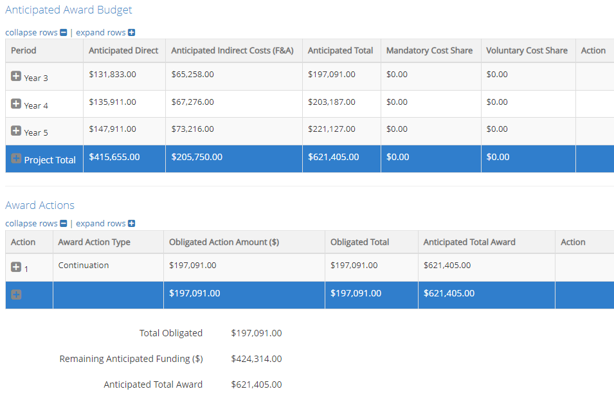
Proposal Submission & Awards
Proposal Submission & Awards
Proposals cannot be submitted until all routing approvers have approved
Depending on sponsor’s requirement, proposal submission may be done by Sponsored Programs or by the investigator
If the proposal is awarded, Sponsored Programs will update the proposal status to “Award” and proceed with the post-award process
In the Award status, investigators will have limited access to the award record in Novelution but will be able to view the post-award process
All senior/key personnel listed on the proposal must confirm their significant financial interest or project specific disclosure in order the for the award to be processed

Slide 16
For Questions or Assistance
College of Medicine
Office of Research
For questions, training requests, or technical difficulties with Novelution, please contact the Division of Research’s Office of Sponsored Programs or the College of Medicine Office of Research
Nicholas Kelly, MBA
Associate Director, Research Administration
Phone: (561) 297-4892
Email: nkelly9@health.fau.edu
Laura Van Voorhis, PhD
Sponsored Research Administrator
Phone: (561) 297-4723
Email: lvanvoor@health.fau.edu

