Slide 1

Novelution FCOI User Overview
Financial Conflict of Interest Module
*This overview PowerPoint provides general information regarding Novelution’s FCOI module. The College of Medicine does not manage nor is responsible for Novelution. For more information or question about Novelution, please contact the Division of Research’s Office of Sponsored Programs.
Version 1.0 05/31/2022

Slide 2
Novelution’s FCOI Module
What is the FCOI Module
Novelution’s robust Financial Conflict of Interest (FCOI) module provides seamless electronic disclosure and management for both annual “Significant Financial Interest” (SFI) and “Project-Specific Disclosures”. All disclosures will now be submitted, reviewed, managed, and approved electronically and will be centrally housed within Novelution.
Key Benefits of the FCOI Module
Seamless disclosures, management, and transparency that reduces investigator burden
Replaces the traditional SFI “paper” or “PDF” disclosure form
Eliminates having to email/pass around the SFI disclosure form for signatures
Eliminates the requirement of having to submit a SFI disclosure form for each proposal
SFI disclosures are valid for 12 months with updates/renewal accessible any time

Slide 3
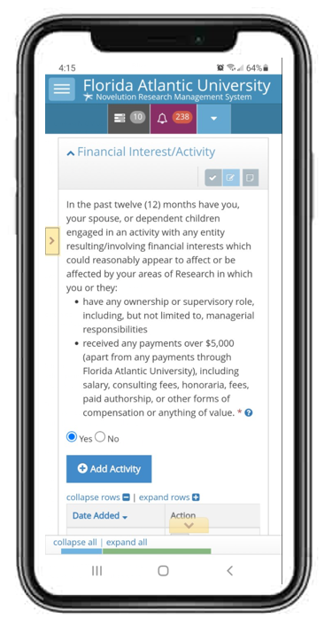
Additional Benefits of the FCOI Module
Additional Benefits
Since Novelution is web-based, it can be accessed anywhere there is an internet connection and users can update their FCOI disclosures utilizing their FAU Single-Sign-On username and password
In-system task reminders when a SFI or Project-Specific Disclosure is required
The FCOI Module works directly with the Sponsored Research Module which makes FCOI routing requirement seamless
Project-Specific Disclosures are only required if the project has been awarded and if there was a SFI disclosed
Each SFI update/renewal automatically extends the disclosure for an additional 12 months

Slide 4
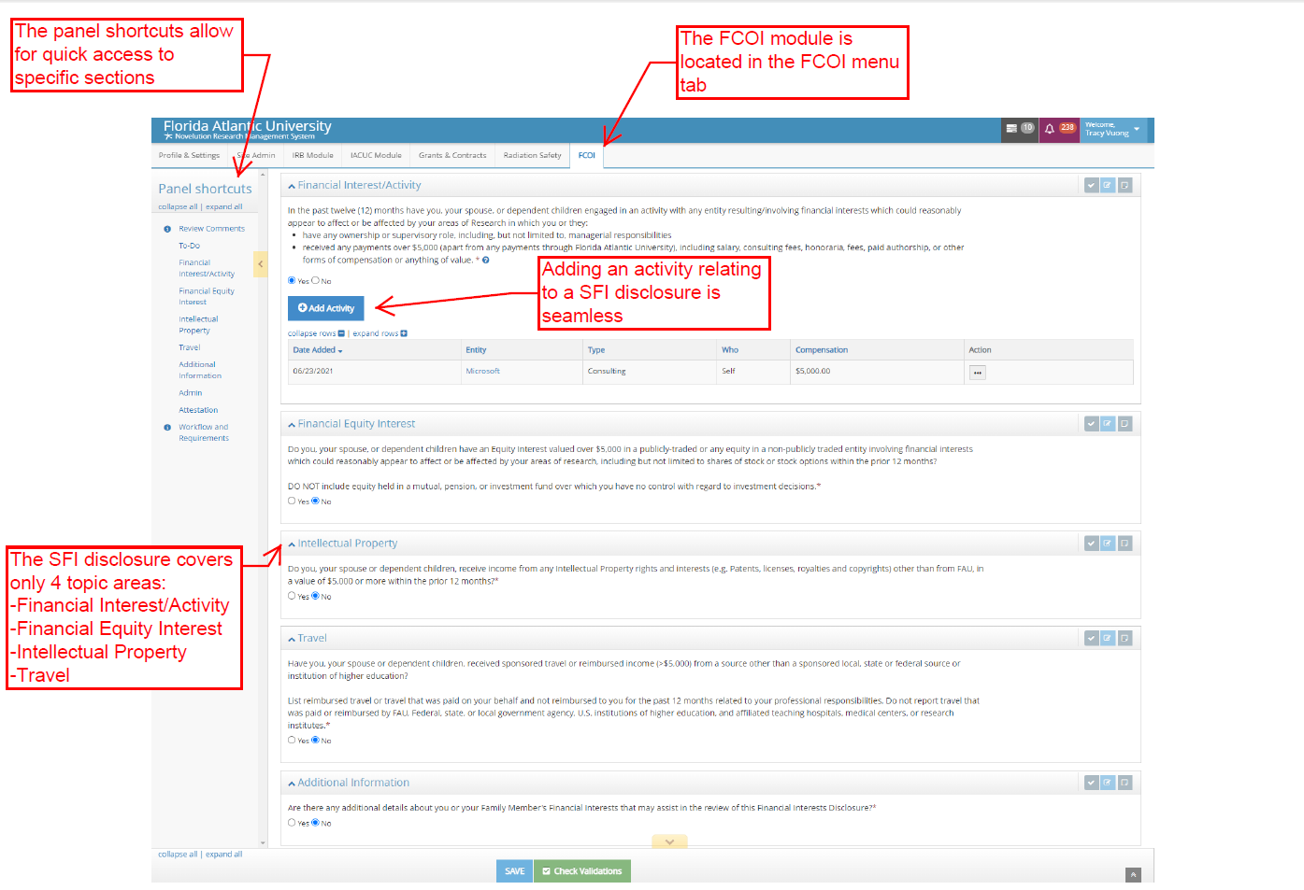
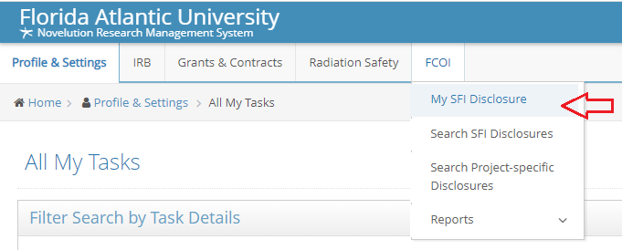
FCOI Module Interface & How to Navigate
Locate the FCOI tab on the horizontal menu bar
Click on “My SFI Disclosure” to complete the disclosure
The module also allows for searches on submitted SFI and Project-Specific Disclosure
Users can also run disclosure ad-hoc reports using the “Reports” function

Slide 5
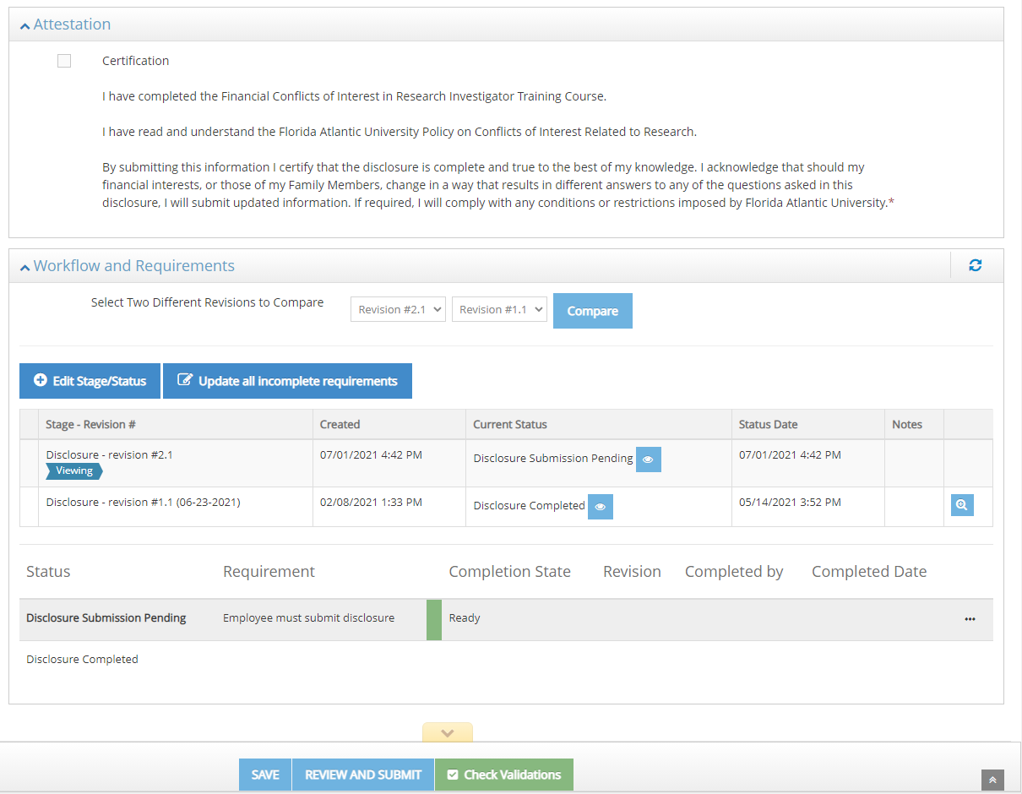
SFI Disclosure Topic Areas & Submission
SFI Four Topic Areas and Submission
The SFI disclosure covers four topic areas, including Financial Interest Activity, Financial Equity Interest, Intellectual Property, and Travel
To complete each topic area, the user will review the topic area question and answer either “Yes” or “No” utilizing the radial buttons
If the answer is “No”, the user can move on to the next question
Only if a selection is answered “Yes” will the user need to further detail the disclosure. The system will populate additional questions when a selection is yes
User can also provide additional information in a separate box to provide further details that may assist reviewers
After attesting, submission is a simple click of a button. No additional approval is required. There will be no additional action needed until either; 12 months have passed, the project is awarded, and/or there has a been a change in the disclosure

Slide 6
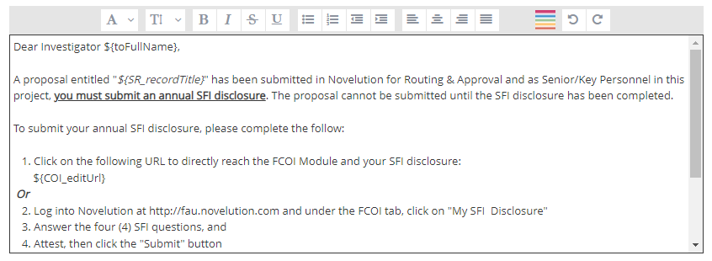
SFI Disclosure Must be Completed for Proposal Submission
A Proposal Cannot be Submitted without the SFI Disclosure
When a proposal is routed for submission approval, an email notification and in system task notification will be sent to all senior/key personnel listed in the proposal
Individuals that have not completed their SFI disclosure will be required to complete their disclosure prior to submission
If the proposal is awarded, an additional email and in system task notification will be sent to all senior/key personnel listed in the proposal to “confirm” that no changes to their initial SFI disclosure has occurred since the initial disclosure and time of award
If changes have occurred, they will be prompted to complete additional questions regarding the new SFI disclosure

Slide 7
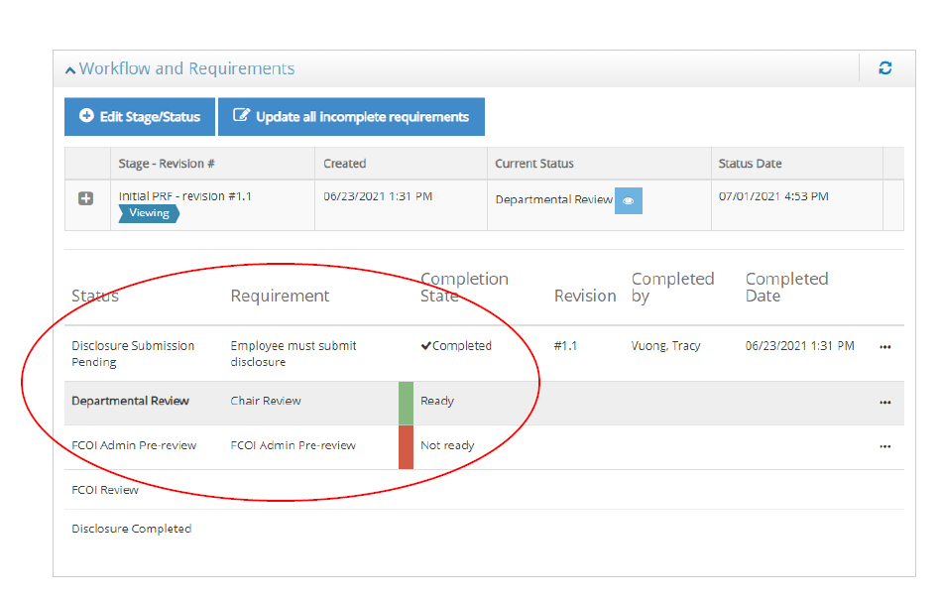
Project-Specific Disclosure
Project-Specific Disclosures
Are only required if, there was a SFI disclosure and the project has been awarded
Novelution will auto-generate notification(s) and task(s) for the investigator to complete the project-specific disclosure
Review, management, and approval from the department Chair, FCOI Committee, or others will be seamless and transparent through the workflow history

Slide 8
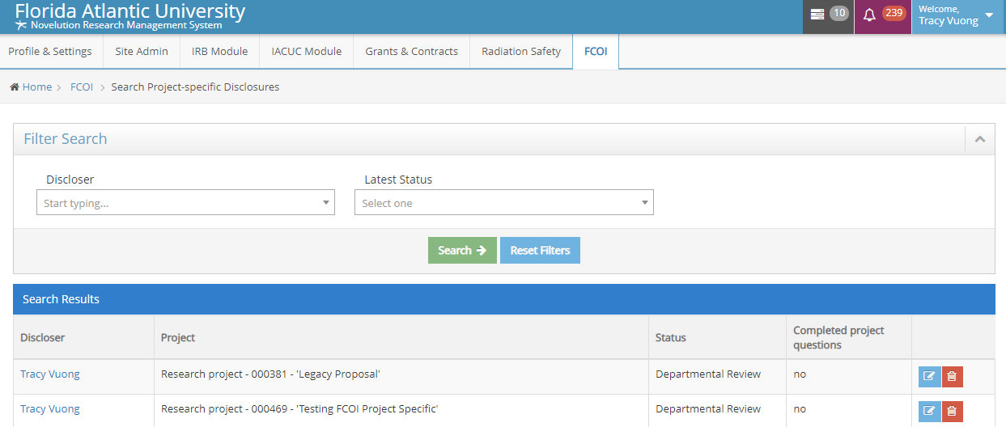
Users are in Control of their own Disclosures
Managing and Tracking Disclosures
Users can manage or review past disclosures
All submitted disclosure remain in the user’s FCOI module profile
Users can search past disclosure including project-specific disclosure
Approval documents or management plans will also be uploaded in the users’ FCOI module profile

Slide 9

FCOI Module Final Thoughts & Recap
Final Thoughts and Recap
The Novelution FCOI module is a robust financial conflict of interest management and tracking tool
The FCOI module leverages the Sponsored Research module which makes the submission and tracking of disclosures seamless within one system
Users can view and update disclosures at anytime which gives them more control over their disclosures
In system notifications makes sure the user is always in compliance and reduces additional burden

Slide 10
For Questions or Assistance
College of Medicine
Office of Research
For questions, training requests, or technical difficulties with Novelution’s FCOI Module, please contact the Division of Research’s Office of Sponsored Programs or the College of Medicine Office of Research

