Slide 1

Benefits Orientation for OPS Employees

Slide 2
Agenda
Who is People First?
How to Enroll in Benefits
Available Plans at FAU
Other Benefit Resources
Q & A

Slide 3

New Employee Benefits Guide
Visit http://mybenefits.myflorida.com/
Go to Health > Forms and Resources > Forms and Publications > Other Forms and Publications

Slide 4

Who is People First?
Plan administrator for State of Florida insurance, including state universities like FAU
Responsible for the following:
Plan Enrollments
Dependent Eligibility
Qualifying Status Changes
Open Enrollment
COBRA

Slide 5

How to Enroll
Online
https://peoplefirst.myflorida.com
User ID and Password Required
Service Center
1-866-663-4735
Available Monday-Friday 8:00 a.m. to 6:00 p.m. EST
To Receive User ID:
Employee’s information is keyed to FAU system
Daily electronic file is submitted to People First
People First mails informational packet (including User ID) to employee’s home

Slide 6

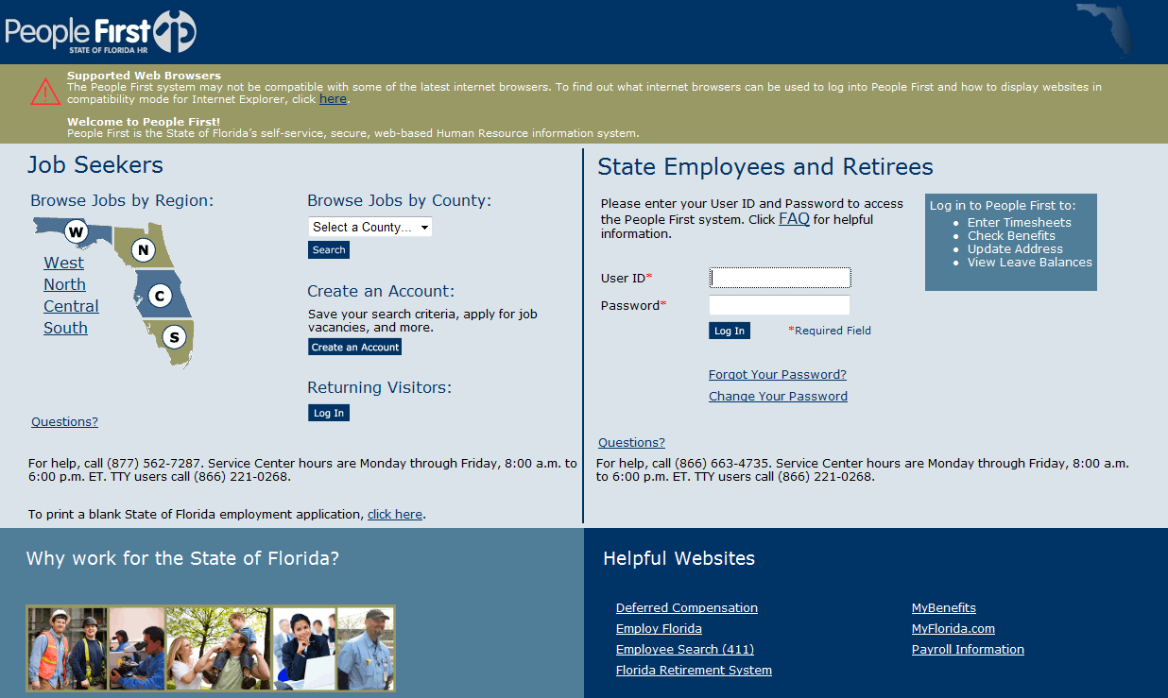
Default password:
Pf + Birth date (PfMMDDYY)
Enter ID and Password

Slide 7

International Employees
People First will not send an enrollment packet until they have all the necessary information, including a valid Social Security Number and a valid address.
Missing information can cause a delay in the start of health coverage for you and your family.

Slide 8

Rehire/Transfer Employees
If you are rehired or transferring from another State University within 26 weeks or
Are rehired/transferring from another non-university State agency within 13 weeks:
You are not considered a new employee in terms of benefits enrollment by the State.
The benefits that you were previously enrolled in will be reinstated upon your rehire without a Qualified Status Change event to cancel or change benefits.
If you are transferring from another State Agency, a new FAU People First ID will be assigned to you by People First.

Slide 9
Insurance Effective Dates
Employees have 60 days from hire date to enroll in insurance.
Note: The State currently does not offer an early effective date to OPS employees.
The earliest effective date for health is the first day of the third month following and including the month of hire.
Ex. If you are hired March 23, 2015, the earliest your health insurance coverage will be active is May 01, 2015.
If you are eligible:
People First eligibility packet mailed to your home address

Slide 10
Changing Insurance
Employees have two ways to change insurance elections after 60-day enrollment window:
Qualifying Status Change
Marriage, divorce, birth of child, spouse insurance termination, etc.
Employees have 60 days from event to contact People First.
Open Enrollment
Held each Fall
Coverage effective January 1 of following year

Slide 11

Eligible Dependents
Spouse
Children (up to age 26)
May be eligible until 30 if they meet certain criteria: Unmarried, no dependents of their own, are dependent on you for financial support, live in Florida or attend school in another state and have no other health insurance.
Children with Disabilities may be covered after age limit if they meet certain criteria.

Slide 12
Graduate Assistantships
FAU Student Health Insurance Plan
Voluntary Injury and Sickness Insurance Plan provides health insurance coverage for all students:
Administered by Insurance for Students, Inc.
Underwritten by Aetna Life Insurance Company
Domestic and International Student Plans
Eligibility based on taking 5 credit hours or more in Fall & Spring; and 3 credit hours in Summer.
Coverage period is based on the academic term(s) that the student has a qualifying assistantship.
Must actively attend class for the first 31 days after the date for which coverage is purchased.
Visit Student Health Services website for more information.
State Group Insurance
OPS employees with a graduate assistantships that meet the eligibility criteria for state benefits will be offered coverage by People First
Coordinated through FAU Human Resources
Administered by People First
Underwritten by various insurance carriers
Eligibility determination by People First
Coverage period is the calendar year
(e.g., annual 1/1/2016-12/31/2016)
Eligibility for the State Group Insurance will not have an impact on eligibility or enrollment in the FAU Student Health Plan. Employees offered the State Group Insurance can elect coverage or choose to decline coverage without any changes to their current Student Health Plan.
Continued…

Slide 13
Please Note: International Students with F-1 or J-1 Visas and their accompanying dependents are required to have health (medical) insurance coverage for their entire duration of studies at FAU that meets all the State of Florida Board of Governors regulations.
The State’s health plans offered by the Division of State Group Insurance do not meet all of the State of Florida Board of Governors regulations.
Additionally, to continue State Group Insurance coverage OPS employees must continue to meet the state’s eligibility criteria on an annual basis.

Slide 14
State Benefit Programs
The State of Florida offers the following insurance:
Pre-tax Options
Health, Basic Life, Dental, Vision, Health Savings Account, Dependent Care Reimbursement Account, Other Supplemental Insurances
Insurance elections must be made through People First.

Slide 15


Health Insurance
Insurance cards mailed after effective date
If early effective date is elected:
Pay first month’s premium via personal check/money order
Payment can be mailed directly to People First
Following premiums will be automatically deducted from FAU paycheck (biweekly)
Continued…

Slide 16
Types of Health Insurance:
PPO
Florida Blue (Blue Cross Blue Shield)
HMO (In-Network Only) Providers in Dade/Broward/Palm Beach/St. Lucie
AvMed
Aetna
Martin & Indian River Counties: AvMed is the only HMO
Plan Options:
Standard
Health Investor Health Plan (HIHP)
Continued…

Slide 17
Health: Standard Option
Plan Type | Coverage Level | Monthly Premium
PPO or HMO – Standard | Individual | $50.00
PPO or HMO – Standard | Family | $180.00
Spouse Program | Family | $15 (per spouse)
Premiums listed are for full-time employees
Continued…

Slide 18
Health: HIHP Option
Health Investor Option offers a choice of PPO or HMO
Note: Same providers as Standard option
Employee assumes greater responsibility with healthcare
Lower Premiums
High Deductibles
Includes the HMO plans
Participation in Health Savings Account (HSA) to offset out-of-pocket expenses
Continued…

Slide 19
Health: Health Investor
Plan Type | Coverage Level | Monthly Premium
PPO or HMO – HIHP | Individual | $15.00
PPO or HMO – HIHP | Family | $64.30
Spouse Program | Family | $15 (per spouse)
Premiums listed are for full-time employees
Continued…

Slide 20
Deductibles: Standard vs. HIHP
Health Plan | Coverage Level | Annual Deductible
PPO - Standard | Individual/Family | $250/$500
HMO - Standard | Individual/Family | None
PPO/HMO – “HIHP” | Individual | $1,300
PPO/HMO – “HIHP” | Family | $2,600

Slide 21
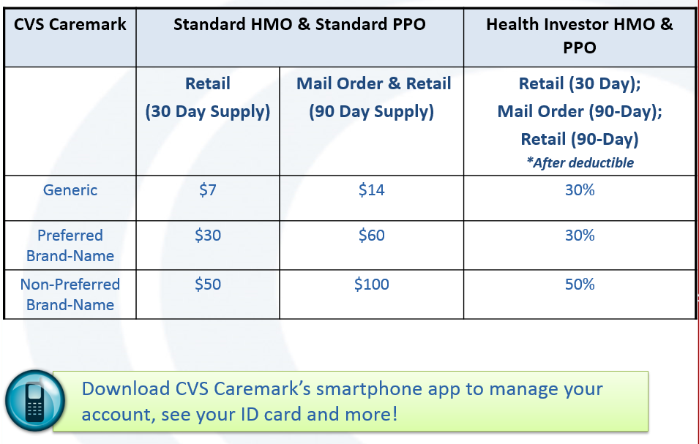
Prescription Drugs

Slide 22

Under “HIHP” plans, you are responsible for 100% of medical bills and prescription costs until annual deductible has been met.

Slide 23
Employees enrolled in HIHP are able to participate in HSA to pay for out-of-pocket medical expenses on a tax-free basis
Account earns interest, functions as tax-free savings account
Participation is voluntary
FAU will contribute $500/year for individual and $1,000/year for family
Employees may contribute up to $2,850/year for individual and $5,550/year for family
Continued…

Slide 24
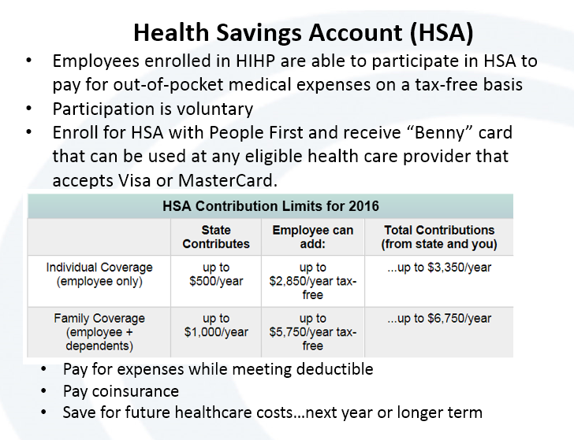

Slide 25
Dependent Care FSA
Minimum amount $60 per year
Maximum amount $2500-$5000 in 2016 (depends on tax filing status )
If you elect $2400 for the calendar year; $100 would be deducted bi-weekly over 24 pay periods for 12 month employees and $150 over 16 pay periods for 9 month employees.
Reimbursements are processed within 7 days
Deadline for filing is April 15 of the following Year
You must incur expense to use money by next March 15th (grace period) or it will be forfeited.
Continued…

Slide 26
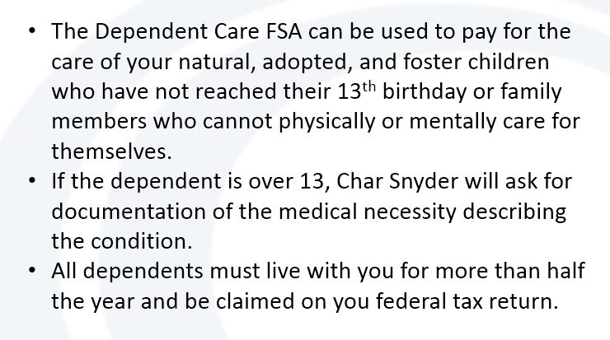
Dependent Care FSA (continued)

Slide 27
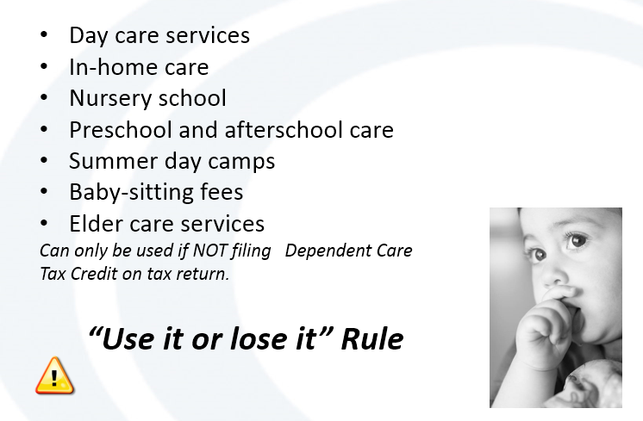
Eligible Dependent Care FSA Expenses

Slide 28
Dental
 | DHMO | DPPO | Indemnity | Indemnity + PPO
Available Providers | Humana United Healthcare CIGNA Assurant | Humana | Humana | Ameritas Assurant
Plan Comparison | Network only Less out-of-pocket expense | Choose network/ non-network Pay percent of contracted fees | No Network Pay for services up front and file claims for reimbursement | Choose network/ non-network Less out-of-pocket if PPO dentist used
Continued…

Slide 29
Considerations for choosing a dental plan:
Compare the four types of options
Check to see which dentists/specialists are available in each plan
Think about your dental care needs
Premiums differ by dental plan
Coverage level determines premium:
Employee
Employee + Spouse
Employee + Child
Employee + Family

Slide 30
Vision
 | In Network | Out of Network
Exams | Every 12 months 100% after co-pay | Every 12 months $40 allowance
Glass Lenses | Every 12 months 100% after co-pay | Every 12 months $40, $60, $80 allowance depending on type
Contacts | Medically needed: 100% after co-pay Elective: $150 allowance | Medically needed: $100 allowance Elective: $75 allowance
Frames | Every 24 months 100% after co-pay $75 wholesale allowance | Every 24 months $60 retail allowance
Co-pays | Exam: $10 Lenses/Frames: $10 | Procedure allowance
Continued…

Slide 31
Vision
Coverage Level | Monthly Premium
Employee Only | $6.32
Employee + Spouse | $12.48
Employee + Children | $12.34
Family | $19.38

Slide 32
State Life Insurance Underwritten By Minnesota Life
Basic Life
Group Term Includes Accidental Death and Dismemberment (AD&D)
Value: $25,000
$3.58 monthly premium for OPS Employees
Beneficiary designation – online or by mailing a form
Dependent Spouse Insurance
Choose $15,000 coverage at $4.50 per month
Choose $20,000 coverage at $6.00 per month
Guaranteed issue during 1st 60 days of employment
Dependent Child Insurance
$10,000 guaranteed issue for eligible children at $0.85 per month
“Eligible children” means your child, adopted child, stepchild, foster child, legal ward or child legally placed in your home for adoption. Children can remain covered to end of calendar year they turn age 26.

Slide 33
Other Supplemental Plans
Hospitalization
Cigna & New Era
Cancer/Intensive Care
AFLAC & Colonial
Accident/Disability
Colonial
Required to meet with company representative to complete medical underwriting.
Plans can either work in conjunction with or independently from health insurance.
Coverage effective date determined by People First.

Slide 34
Other Employee Benefits
Employee Assistance Program (EAP)
Free/Confidential Counseling Service
Wellness Benefits
Both the PPO and HMO plans
have Wellness benefits
Preferred Legal Plan
Unlimited legal advice via phone
Credit Unions
Bright Star
IBM Southeast Employees
Gold Coast Federal Credit

Slide 35

Voluntary Retirement Options
Employees who wish to make voluntary Pre-Tax contributions may do so through the following options:
403(b) Tax Sheltered Annuity
457 State Deferred Compensation
FAU does not match voluntary employee contributions
Enrollment/Changes can be made at any time during the year

Slide 36

How to Enroll
403(b)
Open voluntary retirement account with one of the six voluntary 403(b) companies:
MetLife
TIAA-CREF
VALIC
VOYA
T Rowe Price
Fidelity
457 Deferred Compensation
Contact the State Office of Deferred Compensation
2016 IRS Max:
$18,000: Employees under age 50
$24,000: Employees age 50 and older

Slide 37
Human Resources Benefits & Retirement
Florida Atlantic University
777 Glades Road
IS-4 234
Boca Raton, FL 33431
Benefits Staff:
Insurance Benefits: (561) 297-0242
Retirement: (561) 297-3071
Manager, Benefits & Retirement: (561) 297- 2061
Fax: (561) 297-4220
Email: benefits@fau.edu
www.fau.edu/hr/benefits

