Slide 1

BENEFITS & RETIREMENT ORIENTATION
OFFICE OF HUMAN RESOURCES
DIVISION OF ADMINISTRATIVE AFFAIRS
Building IS-4
777 Glades Road
Boca Raton, FL 33431
Recruitment Services
Benefits and Retirement
Classification and Compensation
Employee Relations and Development
Workforce Administration and Records Control (WARC)
Notes:
No changes.

Slide 2

State Benefit Programs
AGENDA
Retirement Plans
Health Insurance
Dental Insurance
Vision Insurance
Life Insurance
Savings and Spending Accounts (a/k/a Flexible Spending Accounts and Health Savings Account (HSA))
Other Supplemental Insurances
Other Health Benefits
Fringe Benefits and University Benefits (associated with being an employee of Florida Atlantic University)
Leave
“Open Enrollment” – Your initial “open enrollment” (60-days) should not be confused with “annual open enrollment”
Benefits and Benefit Plan support – Navigate
Notes:
No changes.

Slide 3

State Benefit Programs
Retirement…..
When you get there, starts with what you are doing today…… saving for your retirement.
Florida Atlantic University has:
1) Mandatory = FRS Plans
* EE must select one plan and time
sensitive (8 months)
* EE and ER mandatory contributions
2) Voluntary = Supplemental Retirement Plans
(457(b) Plan & 403(b) Plan)
* Voluntary participation
* No ER contribution
* EE can enroll at any time

Slide 4
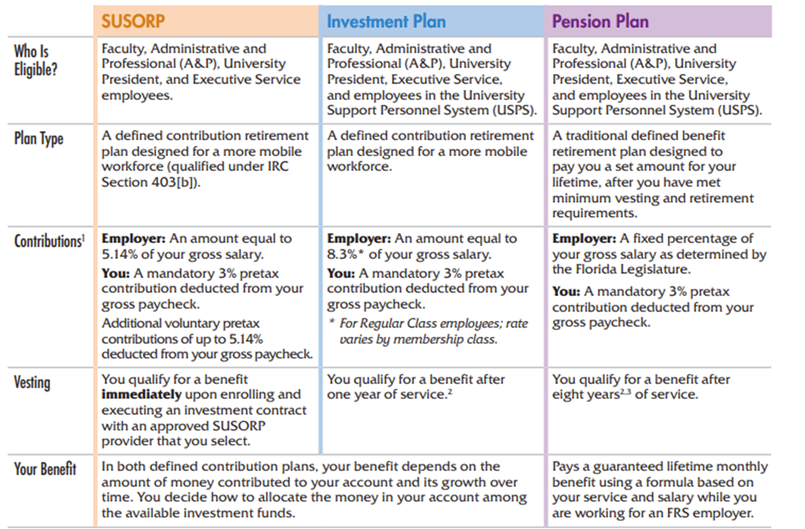
State Benefit Programs
Florida Retirement Services (FRS)
Administers 3 RETIREMENT PLANS (Must pick 1)

Slide 5

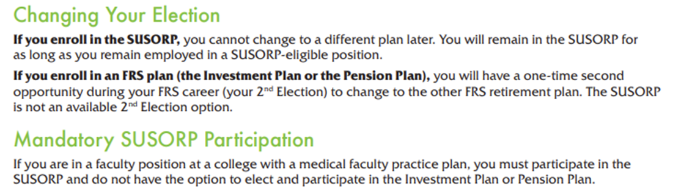
State Benefit Programs
FRS Brochure
For Help Enrolling or to Enroll by Phone Call the MyFRS Financial Guidance Line 1-866-446-9377 Option 1 (or TRS 711)
8:00 a.m. to 6:00 p.m. ET
Learn more at MyFRS.com.

Slide 6
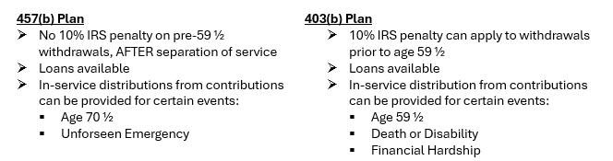

State Benefit Programs
Voluntary 457(b) Plan & 403(b) Plan
Voluntary, participation is not mandatory
No employer contribution
Employee contributions are subject to annual IRS limits
Employee may enroll in either plan (including both) at any time
Many vendors to choose from (Corebridge, TIAA, Voya, etc.)
Link to vendors: https://www.fau.edu/hr/benefits/retirement-providers/

Slide 7
State Benefit Programs
Health Insurance (TYPE and PLAN):
TYPES are PPO and HMO:
PPO – Florida Blue (Blue Cross Blue Shield):
  Offers both in-network and out-of-network benefits, subject to deductibles.
HMO – Providers vary by county of residence: Provides in-network coverage only, with no deductibles or out-of-network benefits.
COUNTY | PLAN PROVIDER
Palm Beach / Martin | United Healthcare HMO
Broward / Miami-Dade / St. Lucie | Aetna HMO
Indian River | Aetna HMO
PLANS:
Standard
High-Deductible (HDHP)

Slide 8
State Benefit Programs
HEALTH INSURANCE PREMIUMS
STANDARD | HMO | PPO | Spousal Program
Individual | $50.00 | $50.00 | N/A
Family | $180.00 | $180.00 | $30.00
HIGH-DEDUCTIBLE* | HMO | PPO | Spousal Program
Individual | $15.00 | $15.00 | N/A
Family | $64.30 | $64.30 | $30.00
*HDHP plans are eligible for HSA, and Employer HSA contributions.
$41.66/month for Individual (up to $500/annually)
$83.33/month for family (up to $1,000/annually)
Notes:
No changes.

Slide 9
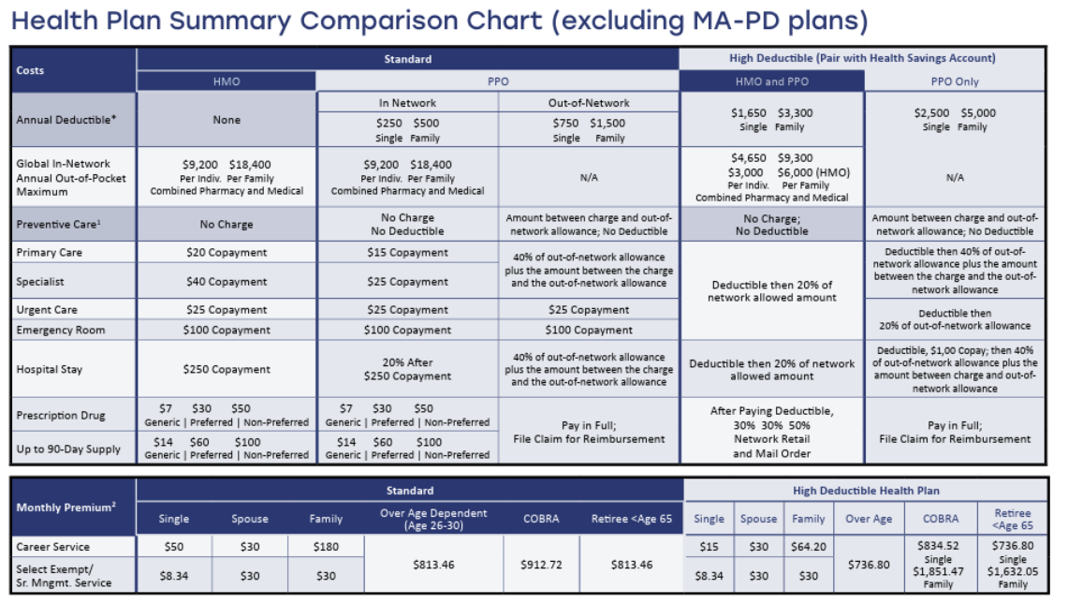
State Benefit Programs
Notes:
No changes.

Slide 10
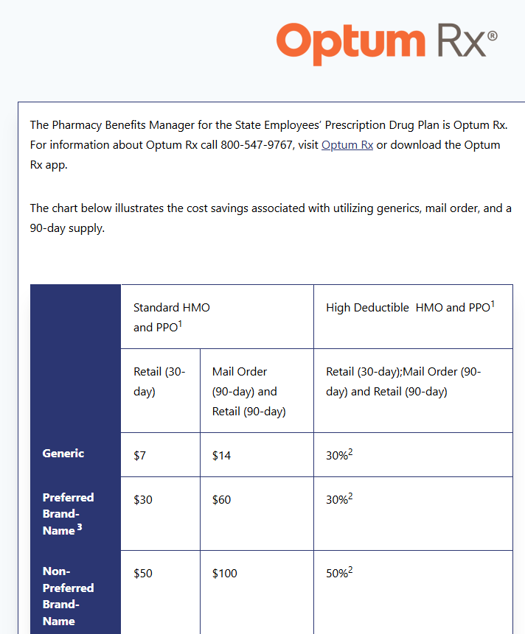
State Benefit Programs
Prescription Drug Plan
Visit: https://www.mybenefits.myflorida.com/myhealth/prescription_drug_plan
Notes:
No changes.

Slide 11

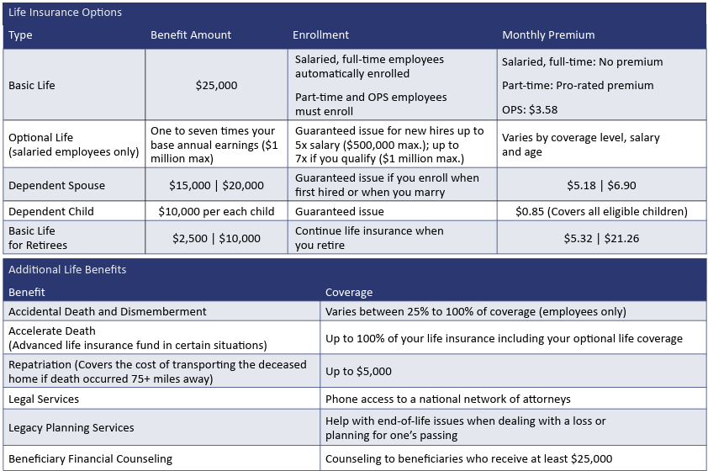
State Benefit Programs
LIFE INSURANCE
Notes:
No changes.

Slide 12
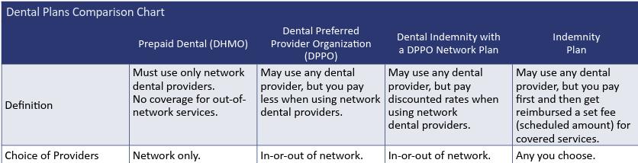
State Benefit Programs
DENTAL INSURANCE TYPES
Notes:
No changes.

Slide 13
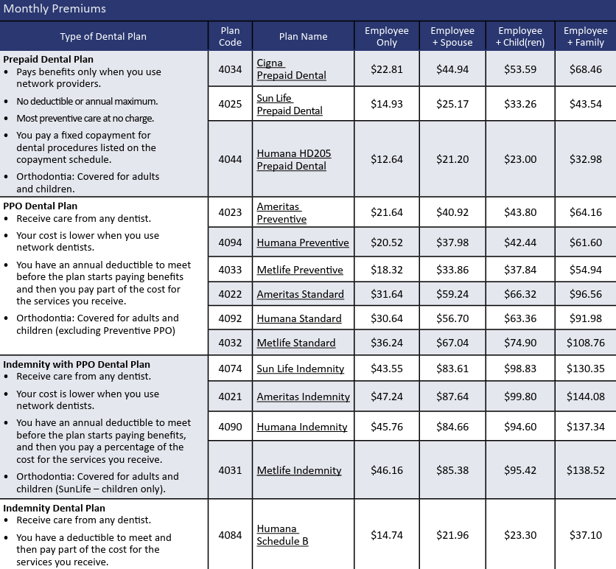
State Benefit Programs
DENTAL PLANS
Notes:
No changes.

Slide 14

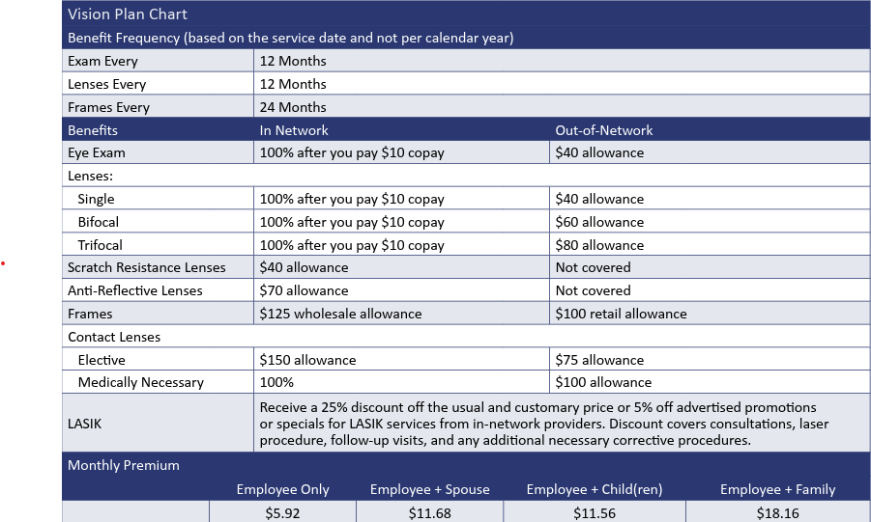
State Benefit Programs
VISION PLAN
Notes:
No changes.

Slide 15
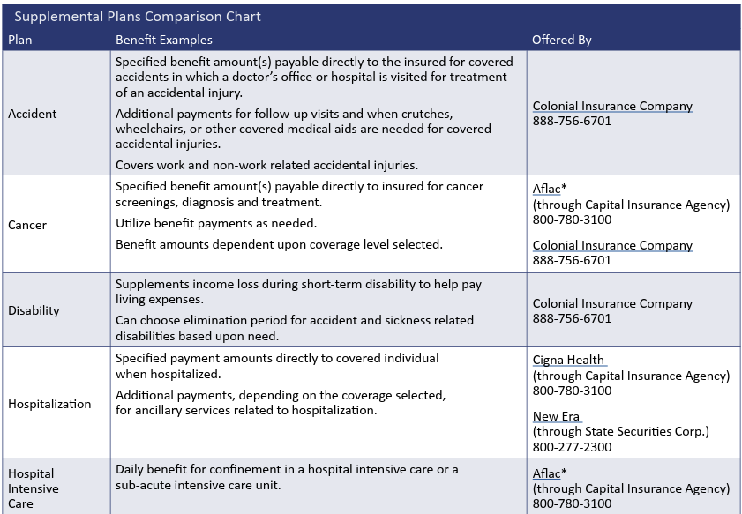
State Benefit Programs
OTHER SUPPLEMENTAL PLANS (w/ DMS)
Notes:
No changes.

Slide 16



State Benefit Programs
Reach out to Benefits and Retirement in Human Resources for additional information,
including obtaining enrollment forms.
    Life (Term) w/ AD&D – Gabor Financial Solutions
    Disability – Gabor Financial Solutions
    Preferred Legal - Preferred Legal Enrollment Form
    Pet Insurance Alternative - Pet Assure
OTHER SUPPLEMENTAL PLANS (NOT w/ DMS)
Notes:
No changes.

Slide 17

State Benefit Programs
SAVINGS & SPENDING ACCOUNTS
Flexible Spending Account (FSA) Chard Snyder is the administrator of three types of Flexible Spending Accounts (FSA) that give you a tax break on eligible out-of-pocket expenses. The minimum contribution amount is $60 per year.
(1) Healthcare FSA You contribute up to $3,300 each plan year on a pretax basis to pay for eligible medical, dental and vision expenses, prescriptions, over-the-counter medications.
(2) Limited Purpose FSA Are limited to HDHPs and you contribute up to $3,200 each plan year on a pretax basis to pay for eligible dental, vision and preventive care expenses. Use HSA for all other medical expenses.
(3) Dependent Care FSA You contribute up to $5,000 per household each plan year on a pretax basis.
For the healthcare FSA and limited purpose FSA, Dec. 31 is the last day to incur expenses for the plan year, and you must submit all claims by April 30. Otherwise, if you have funds remaining at the end of 2025, a maximum of $640 will carry over to the next plan year and any funds in excess of $640 will be forfeited.
For the dependent care FSA, March 15 is the last day to incur expenses for the prior plan year, and you must submit all claims by April 30. Otherwise, you forfeit any remaining funds.
A Health Savings Account (HSA) is a tax-advantaged account available to you if you enroll in a high deductible health plan (HDHP). You do not pay taxes on any money you deposit into it. You may withdraw funds to pay for qualified medical expenses for yourself, your spouse or a qualified dependent without tax penalty.
Notes:
No changes.

Slide 18
State Benefit Programs
Florida Atlantic Employee: Discounts & Perks | Florida Atlantic University
Automotive
Dining
Electronics
Entertainment and Sports
Finance
Health & Wellness
Miscellaneous (Childcare and Owl Perks)
Shopping
Travel
Wireless
Notes:
No changes.

Slide 19
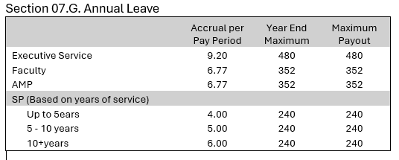
State Benefit Programs
LEAVE
Florida Atlantic University Policies & Procedures 7.5
A. ANNUAL LEAVE*
*Accrual is proportionate to the time in pay status. A 9 or 10 month Faculty employee shall not accrue annual leave unless in a position where an exception applies.
B. SICK LEAVE
Full time Faculty, AMP and SP employees will earn 4 hours of sick leave each pay period. Executive Service employees earn 5 hours of sick leave each pay period. Part time accrual will be proportionate to the full time equivalent. Accrual is proportionate to the time in pay status.
Upon separation from the University, an employee with 10 or more years of service at Florida Atlantic University shall be paid for one-eighth of all unused sick leave accrued prior to October 1, 1973, and for one-fourth of unused sick leave up to a total of 480 hours accrued after October 1, 1973, if eligible in accordance with State law.
Notes:
No changes.

Slide 20




State Benefit Programs
This information will assist you in navigating for assistance for your benefits and benefit plans!
Florida Atlantic University employment (makes you) a Florida Atlantic University employee and State of FL employee!
Department of Management Services (DMS) procures state benefits (ie. health, life dental, etc.) and utilizes Peoplefirst, the State of Florida’s HR system for benefits enrollment/records; therefore, your benefits supports are all the following: (1) Peoplefirst, (2) Benefits and Retirement in Human Resources, and (3) the insurance carriers/providers.
(1) Peoplefirst Online Portal: https://peoplefirst.myflorida.com
Please have your User ID and Password ready.
Peoplefirst Service Center
1-866-663-4735
Please have your User ID ready.
Hours: Monday – Friday, 8 a.m. – 6 p.m.
(2) Benefits and Retirement Office
Department of Human Resources
Building IS-4 / Second Floor
777 Glades Road
Boca Raton, FL 33431
Hours: Monday – Friday, 8 a.m – 5 p.m.
Secure Fax: 561.297.4220
Email: benefits@fau.edu
Web: www.fau.edu/hr/benefits
(3) Insurance Carriers/Providers
See page 5 of the 2025 Benefits Guide
Notes:
No changes.

Slide 21



State Benefit Programs
This information will assist you in navigating for assistance for your retirement plans!
Retirement Plans
Your (mandatory) FRS retirement plan is administered and supported by Florida Retirement Services (FRS) under the purview of the Division of Retirement (DOR).
FRS Website: https://www.myfrs.com/sign-in.htm
Your (voluntary) 403(b) plan is administered and supported by the provider (of your choosing).
403(b) Plan List of Providers: https://www.fau.edu/hr/benefits/retirement-providers/
Your (voluntary) 457(b) plan is administered and supported by the provider (of your choosing) under the purview of the Florida Department of Financial Services.
The 457(b) Plan (a/k/a Deferred Compensation) website is https://myfloridacfo.com/deferredcomp/
Notes:
No changes.

Slide 22

New Employee Benefits Guide
What you need to know about “Open Enrollment”
Do not confuse your only one-time initial “Open Enrollment” (that is 60-days) with the annual open enrollment that takes places every calendar year.
Your one-time “Open Enrollment” is your only one-time opportunity to review and enroll in any and all available and eligible plans, including obtaining insurance coverage up to limits available for each applicable plan, without going through evidence of insurability (if available and/or applicable).
Annual Open Enrollment takes places once a calendar year, and is normally in October. During annual open enrollment, you are afforded the opportunity to review all currently enrolled benefits and benefit plans and make changes (add, remove, change coverage, etc.). All changes made during the annual open enrollment period will not be effective until January 1st of the following calendar year.
Visit the following site/link and click on “Benefits Guide.”
https://www.mybenefits.myflorida.com/health
OR
Direct PDF Link below:
https://dmsmedia.ccplatform.net/content/download/169601/file/2025%20Benefits%20Guide.pdf
Notes:
Updated: Added new image for 2025, changed verbiage to the right and link.

Slide 23
BENEFITS & RETIREMENT ORIENTATION
OFFICE OF HUMAN RESOURCES
DIVISION OF ADMINISTRATIVE AFFAIRS
Building IS-4
777 Glades Road
Boca Raton, FL 33431
THANK YOU AND WELCOME! WE ARE GLAD YOU ARE HERE!!
Notes:
No changes.

