Slide 1
BENEFITS AND RETIREMENT

Slide 2
Agenda
Insurance
Retirement
Who is People First?
How to Enroll in Benefits
Available Plans at FAU
Other Benefit Resources
Q & A
Retirement Plans at FAU
How to Enroll in a Retirement Plan
Re-Employment Restrictions
Q & A

Slide 3

Who is People First?
Plan administrator for State of Florida insurance, including state universities like FAU
Responsible for the following:
  Plan Enrollments
  Dependent Eligibility
  Qualifying Status Changes
  Open Enrollment
  COBRA

Slide 4

Instant access to your benefits through an online secure website at https://peoplefirst.myflorida.com
  User ID and password mailed to you
People First Service Call Center
(1-866-663-4735)
Plan information, Benefits Guide, cost estimators, links to insurance companies, and all brochures found at:
http://www.myflorida.com/mybenefits

Slide 5

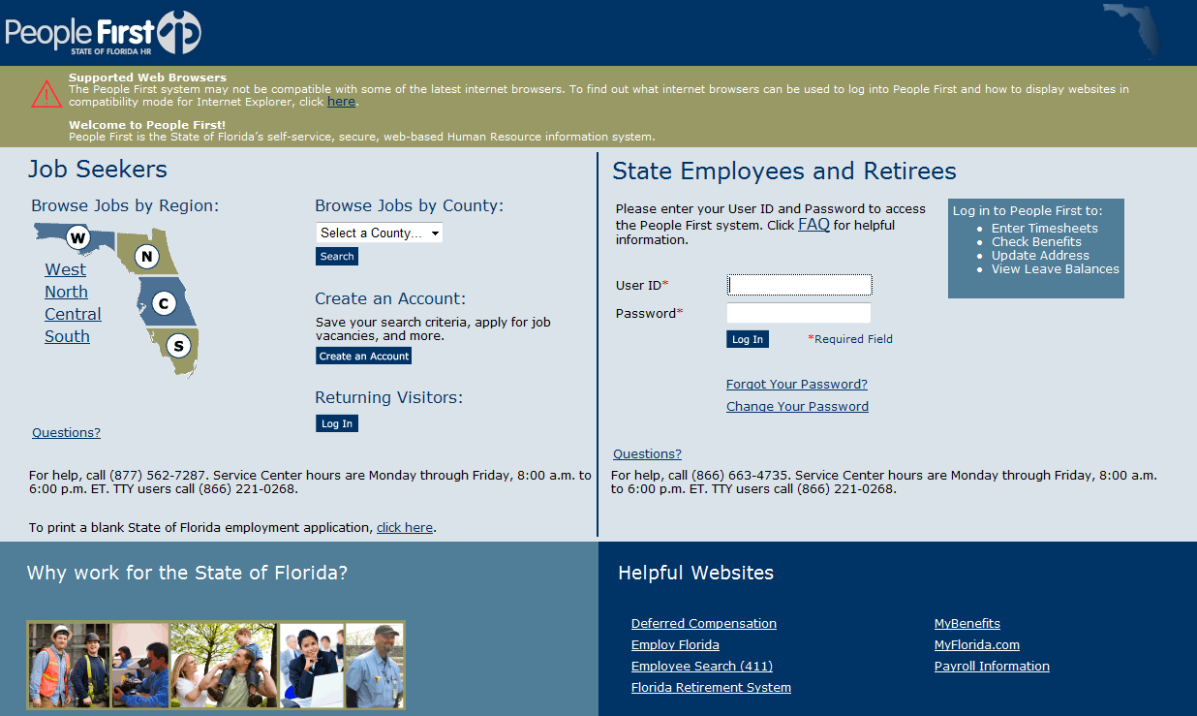
Default password:
Pf + Birth date (PfMMDDYY)
Enter ID and Password

Slide 6

International Employees
People First will not send an enrollment packet until they have all the necessary information, including a valid Social Security Number and a valid address.
Missing information can cause a delay in the start of health coverage for you and your family.

Slide 7

Insurance Effective Dates
Employees have 60 days from hire date to enroll in insurance.
Employees in career service positions may elect health insurance to begin the month after they are hired – this is called an early effective date.
  For example, if you are hired in June, you can start your health insurance July 1.
Health coverage effective First of the Month following enrollment. Prepayment allowed for Medical only. Make checks payable to:
Florida Atlantic University
Supplemental coverage effective First of Month after deductions have been taken.
  If you are transferring from another State Agency, a new FAU People First ID will be assigned to you by People First.

Slide 8
State Benefit Programs
The State of Florida offers the following insurance:
Pre-tax Options
  Health, Basic Life, Dental, Vision, Medical Reimbursement Accounts, Health Savings Account, Other Supplemental Insurances
Post-tax Options
  Optional Life
Insurance elections must be made through People First.

Slide 9

Types of Health Insurance:
  PPO
    Florida Blue (Blue Cross Blue Shield)
  HMO (In-Network Only) Providers in Dade/Broward/Palm Beach/St. Lucie
    AvMed
    Aetna
  Martin & Indian River Counties: AvMed is the only HMO

Slide 10

Insurance Cost per paycheck
Bi-weekly Premium
Individual coverage
$25.00
Family Coverage
$90.00
Cost will be different for part-time employees
(see Benefits Calculator)
Office Visit
$15 PPO Physician
$20.00 HMO
$25 PPO Specialist
$40 HMO Specialist
$25 Urgent-Care Center
$250 Hospital stay
Premiums listed are for full-time employees
9-Month faculty will be double-deducted during Spring months to pay for Summer coverage
Continued…

Slide 11
HMO’s
Exclusive network in the area that you live or work
AvMed & Aetna Healthcare have providers in Dade, Broward , Palm Beach County, and St Lucie Counties
Martin County/Indian River:
AvMed only HMO
No referrals required
No deductible
No claims to file
Mail Order Rx from Retail Pharmacy – CVS/Caremark

Slide 12
PPO- Florida Blue
(Blue Cross/Blue Shield of FL)
Nationwide/World wide coverage
No referrals required
Co-insurance (based on percentage of charges)
Calendar year deductible
CVS/Caremark Prescription Card
90 Maintenance Medication from
Retail Pharmacy

Slide 13
PPO Network
Non-network
Deductible
$250/person
$500/family
Network allowed amount 80%
Hospital Stay $250
Ambulance 100% with no deductible
Deductible
$750/person
$1500/family
Network allowed amount 60%
Hospital Stay $500
Ambulance 100% with no deductible

Slide 14
PPO Calendar Year Out-of-Pocket Maximum $2,500 per person; $5,000 per family
After your out-of-pocket costs reach the maximums,
PPO pays 100% for covered care, up to allowable costs.
HMO’s Out-of- Pocket Maximum
$1,500 per person; $3,000 for family
All Plans: No lifetime maximums

Slide 15
Health Investor High Deductible Health Plans (HIHP)
The Health Investor High Deductible Health Plans offers a reduced premium.
All covered benefits must apply to the Plan Deductible, including prescriptions.
Offered only if you have no other health coverage.
In addition to the higher deductibles, employees will pay co-insurance vs. set dollar co-payments.
Higher out of pocket maximums.

Slide 16
HIHP
Plan Type | Coverage Level | Monthly Premium
PPO or HMO – HIHP | Individual | $15.00
PPO or HMO – HIHP | Family | $64.30
Spouse Program | Family | $15 (per spouse)
Premiums listed are for full-time employees
9-Month faculty will be double-deducted during Spring months to pay for Summer coverage
Continued…

Slide 17
Deductibles: Standard vs. HIHP
Health Plan | Coverage Level | Annual Deductible
PPO - Standard | Individual/Family | $250/$500
HMO - Standard | Individual/Family | None
PPO/HMO – “HIHP” | Individual | $1,300
PPO/HMO – “HIHP” | Family | $2,600

Slide 18
CVS Caremark Rx Manager
CVS Caremark | Standard HMO & Standard PPO |  | Health Investor HMO & PPO
 | Retail (30 Day Supply) | Mail Order & Retail (90 Day Supply) | Retail (30 Day); Mail Order (90-Day); Retail (90-Day) *After deductible
Generic | $7 | $14 | 30%
Preferred Brand-Name | $30 | $60 | 30%
Non-Preferred Brand-Name | $50 | $100 | 50%

Slide 19
 | High Deductible Health Plan- PPO (Florida Blue) |  |  | High Deductible Health Plan - HMO (AvMed, Aetna)
Biweekly Cost | Individual coverage $7.50 Biweekly |  |  | Family coverage $32.15 Biweekly
Covers care received | In Network or non-network |  |  | In network only
Annual deductible Individual coverage Family coverage | In Network $1,250 $2,500 | Non-network $2,500 $5,000 |  | $1,250 $2,500
What you pay for care received after deductible Medical care Prescription drugs - generic / name brand - non-preferred | 30% 30% 50% | Pay in full and fill a claim |  | 30% 30% 50%
Annual out-of-pocket maximum Individual coverage Family coverage | $3,000 $6,000 | $7,500 $15,000 |  | $3,000 $6,000
 | Plan pays 100% after out-of-pocket maximums.
Preventive care | Same as current PPO |  | Same as HMOs

Slide 20

Under “HIHP” plans, you are responsible for 100% of medical bills and prescription costs until annual deductible has been met.

Slide 21
Changing Insurance
Spouse Program – When both spouses are full time active State Employees, each spouse pays only $15 per month for health insurance for full family coverage ($30/month total)
Employees may not change their benefits elections
during the course of a plan year unless they experience
a Qualifying Status Change (QSC) event
Examples: marriage or divorce / death of a spouse or dependent / birth, adoption, or legal guardianship / change in employment status from part time to full-time or vice-versa, change in spouse’s employment status

Slide 22

Eligible Dependents
  Spouse
  Children (up to age 26)
    May be eligible until 30 if they meet certain criteria: Unmarried, no dependents of their own, are dependent on you for financial support, live in Florida or attend school in another state and have no other health insurance.
    Children with Disabilities may be covered after age limit if they meet certain criteria.
Important Note:
Dependent Certification required when enrolling family.
Copies of birth and/or marriage certificates are required for all dependents and should be faxed directly to People First within 60 days of enrollment or coverage suspension.

Slide 23

New Employee Benefits Guide
Visit http://mybenefits.myflorida.com/
Go to Health > Forms and Resources > Forms and Publications > Other Forms and Publications

Slide 24
Reimbursement Accounts
FSA allows you to set aside a portion of your income to pay pretax for health and dependent care expenses not covered by your insurance.
Deduction amounts are taken from gross pay before Social Security, Medicare, and Federal withholding taxes are calculated which creates at least a 20% savings.
Medical Reimbursement Account
Minimum amount $60
Maximum amount $2550 in 2016
myMRA Debit Card

Slide 25
Eligible Health Care Expenses
Co-insurance
Experimental treatment
Contact lenses
In-vitro fertilization
Deductibles
Dental copayments
Vision expenses
Hearing aids
Insulin supplies
Immunizations
Guide dogs
Stop Smoking RX
Vaccines
Medical supplies
Weight loss programs
Wheel Chairs
See IRS Pub 502 for complete list.

Slide 26
Dependent Care Reimbursement Account
Minimum amount $60 per year
Maximum amount $2500-$5000 in 2016 (depends on tax filing status )
If you elect $2400 for the calendar year; $100 would be deducted bi-weekly over 24 pay periods for 12 month employees and $150 over 16 pay periods for 9 month employees.
Reimbursements are processed within 7 days
Some myMRA expenses require documentation
Deadline for filing is April 15 of the following Year
You must incur expense to use money by next March 15th (grace period) or it will be forfeited.

Slide 27


Eligible Dependent Care Expenses
Day care services
In-home care
Nursery school
Preschool and afterschool care
Summer day camps
Baby-sitting fees
Elder care services
Can only be used if NOT filing Dependent Care Tax Credit on tax return.
“Use it or lose it” Rule

Slide 28
Employees enrolled in HIHP are able to participate in HSA to pay for out-of-pocket medical expenses on a tax-free basis
Account earns interest, functions as tax-free savings account
Participation is voluntary
FAU will contribute $500/year for individual and $1,000/year for family
Employees may contribute up to $2,850/year for individual and $5,550/year for family
Continued…

Slide 29
How Does It Work? Enrollment not automatic!
After enrolling through People First, employees must complete a bank application with Tallahassee State Bank.
Receive a debit card and checks:
  Pay eligible healthcare expenses directly or reimburse yourself for eligible healthcare expenses
  Accumulated Balance
Funds remaining in account at year-end roll over to future years.
Funds in account are portable.
Disclaimer: $3/month maintenance fee (for balance under $5,000)

Slide 30
Limited Purpose Medical Reimbursement Account
(to be used ONLY with HSA)
You can use the LPMRA to cover dental, vision and over-the-counter medication costs, IF considered tax deductible by the IRS, but not paid by any health plan.
Dental and vision expenses only
Orthodontia not covered by dental plan
Over-the-counter medications
You can set aside $60 to $2,550 in an account
Not for Medical expenses (use HSA)

Slide 31
Reimbursement Account Comparison
 | Medical Reimbursement Account | LIMITED PURPOSE Medical Reimbursement Account | Dependent Care Reimbursement Account
Enroll if you have: | Standard PPO or HMO No health coverage | Any Health Investor HMO or Health Investor PPO | Eligible expenses for “day care” for an eligible child or qualifying relative so you can work
How much you can contribute: | From $60 to $2,550 in pretax dollars | From $60 to $2,550 in pretax dollars | From $60 to $5,000* in pretax dollars
Use the account to pay yourself back for: | Out-of-pocket medical, prescription, dental , vision and over-the-counter medication expenses: Not paid by insurance or reimbursed from any other source | Out-of-pocket dental, vision and over-the-counter medication expenses: Not paid by insurance or reimbursed from any other source Not available for medical expenses | Care for a child, disabled spouse or qualifying relative who: is dependent on you needs care so that you (and your spouse if you're married) can work

Slide 32
State Life Insurance
Underwritten By Minnesota Life
Basic Life
Group Term
  Includes Accidental Death and Dismemberment (AD&D)
Value: $25,000
No Cost to Full Time Regular Employees
Optional Life
Group Term
  Includes Accidental Death and Dismemberment (AD&D)
Value: 1 - 7x annual salary in addition to Basic Life, up to a maximum benefit of $1,000,000
Employee pays 100% of premium
Policy for employee only
Beneficiary designation – online or by mailing a form

Slide 33
State Life Insurance
Underwritten By Minnesota Life
New for 2016
Dependent Spouse Insurance
Choose $15,000 coverage at $4.50 per month
Choose $20,000 coverage at $6.00 per month
  Guaranteed issue during 1st 60 days of employment
Dependent Child Insurance
$10,000 guaranteed issue for eligible children at $0.85 per month
“Eligible children” means your child, adopted child, stepchild, foster child, legal ward or child legally placed in your home for adoption. Children can remain covered to end of calendar year they turn age 26.

Slide 34
Dental
 | DHMO | DPPO | Indemnity | Indemnity + PPO
Available Providers | Humana United Healthcare CIGNA Assurant | Humana | Humana | Ameritas Assurant
Plan Comparison | Network only Less out-of-pocket expense | Choose network/ non-network Pay percent of contracted fees | No Network Pay for services up front and file claims for reimbursement | Choose network/ non-network Less out-of-pocket if PPO dentist used
Continued…

Slide 35
Considerations for choosing a dental plan:
  Compare the four types of options
  Check to see which dentists/specialists are available in each plan
  Think about your dental care needs
Premiums differ by dental plan
Coverage level determines premium:
  Employee
  Employee + Spouse
  Employee + Child
  Employee + Family

Slide 36
HumanaVision VCP
 | In Network | Out of Network
Exams | Every 12 months 100% after co-pay | Every 12 months $40 allowance
Glass Lenses | Every 12 months 100% after co-pay | Every 12 months $40, $60, $80 allowance depending on type
Contacts | Medically needed: 100% after co-pay Elective: $150 allowance | Medically needed: $100 allowance Elective: $75 allowance
Frames | Every 24 months 100% after co-pay $75 wholesale allowance | Every 24 months $60 retail allowance
Co-pays | Exam: $10 Lenses/Frames: $10 | Procedure allowance
Continued…

Slide 37
HumanaVision VCP
Coverage Level | Monthly Premium
Employee Only | $6.32
Employee + Spouse | $12.48
Employee + Children | $12.34
Family | $19.38

Slide 38
Other Supplemental Plans
Hospitalization
  Cigna & New Era
Cancer/Intensive Care
  AFLAC & Colonial
Accident/Disability
  Colonial
Required to meet with company representative to complete medical underwriting.
Plans can either work in conjunction with or independently from health insurance.
Coverage effective date determined by People First.

Slide 39

The Gabor Agency
Additional options available through The Gabor Agency:
    Short Term & Long Term Disability
    Life Insurance
    Long Term Care
Options are on a post-tax basis
Employees may cancel plans at any time
No annual open enrollment period
How To Enroll:
  Contact local Gabor Representative to enroll.

Slide 40
Attendance & Leave: Sick Leave Pool
Sick Leave - SP, Faculty, and AMP
  Accrue 4 hours bi-weekly (13 days a year)
  Can be used for immediate family
  Annual leave can be used if sick leave has been depleted
Sick Leave Pool
  Full Time and Part Time employees are eligible upon invitation
  Minimum one year of service
  Minimum balance of 64 hours
Sick leave hours from the Pool shall be granted only for the employee’s serious or catastrophic personal illness or injury.
Employees donate 16 hours and can apply up to a maximum of 480 sick leave pool hours once all personal leave has been exhausted.

Slide 41
FAU Education Benefits
Employee Educational Scholarship Program
(EESP)
To Qualify:
Full time employee
May enroll after 6 months of employment
Undergraduate - C grade or better
Graduate - B grade
Degree or non Degree seeking
Employees are allowed to take up to 6 credit hours per semester Tuition FREE.
Some fees still apply.
Must be employed last day of class.
Book Stipend Available, conditions apply.
FAU Bookstores sell text and reference books, school supplies, convenience foods, drinks, clothing, FAU merchandise on all campuses. Online ordering options are available.

Slide 42
Preferred Legal Plan
Biweekly Cost $4.98
Unlimited free legal advice via phone
Free review of legal documents
Initial consultation with attorney no charge
Free letters and phone calls made on your behalf
Free Identity Theft help & restoration
Free credit report analysis and repair
Free Simple Wills for member & spouse
Free notary services
40% - 70% reduced off other legal fees and services
Access 24 hr./day, 7 day/week

Slide 43
EAP – Employee Assistance Program
Investing in your career with completely confidential counseling, through
Aetna Resources for Living
3 free sessions per issue with a private licensed therapist for guidance on:
Financial Issues Legal issues
Relationships Stress or Anxiety
Grief Issues Depression
Child & Elder Care Alcohol/Drug Abuse
Family challenges Special Discounts
Life Improvement
Call: 800-865-3200
www.mylifevalues.com
Login ID: Florida Atlantic University,
Password: EAP

Slide 44

RETIREMENT

Slide 45
Retirement Plans
FRS - Pension Plan
  Defined Benefit
FRS - Investment Plan
  Defined Contribution
State University System Optional Retirement Program (SUSORP)
  Defined Contribution
  College of Medicine = Mandatory

Slide 46
Florida Retirement System
State sponsored retirement plan
  Mandatory 3% pretax contribution
Must choose a plan:
  Pension Plan
  Investment Plan
Eligible Employees:
  All Faculty
  All AMP employees
  All SP employees
  SP employees are automatically enrolled in the FRS when employed by the University.

Slide 47
FRS Pension Plan
Hired after July 1, 2011: Must have 8 years of creditable services in order to be vested and receive retirement benefit. Mandatory 3% Employee Contribution.
Normal retirement is considered to be age 65 with 8 years of service or 33 years of service, regardless of age. For Special Risk members, normal retirement is age 60 with 8 years of service or 30 years of service, regardless of age.
Retirement benefit is based on your earnings, length of service, and membership class.

Slide 48
FRS Investment Plan
Vesting is after 1 year of FRS creditable service, in order to receive the retirement benefit. Mandatory 3% Contribution.
FAU contributes 3.30% (effective July 1, 2012)
No age or service requirements for you to receive a benefit, once vested.
You should consult a tax specialist to get an explanation of the tax implications of early retirement.
If you're vested when you leave FRS-covered employment and go to work for a non-FRS employer, you can:
  Leave your account in the Investment Plan, where it will remain invested until you withdraw it;
  Roll your account over to an Individual Retirement Account (IRA) or to the plan of your new employer, if that plan accepts rollovers; or
  Have your account paid to you. You'll have to pay taxes on this amount in the year during which it's paid to you.
  If withdrawal after termination, you forfeit service credit and will not be able to join any of the State of Florida retirement plans if reemployed.
For more information log on to: www.myfrs.com. or
call 866-446-9377

Slide 49
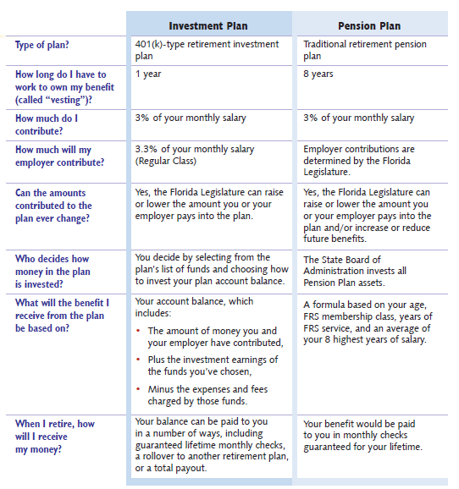
FRS Plan Comparison

Slide 50

State University System Optional Retirement Program (SUSORP)
AMP and Faculty are eligible for ORP
The ORP is a defined contribution plan that provides full and immediate vesting of all contributions.
Mandatory 3% employee contribution.
FAU contributes 5.14% and employees can contribute a voluntary match up to that amount
Maximum voluntary amounts employees can contribute for the year in 2015:
- $18,000 under age 50
- $24,000 if over age 50
90 days to choose plan or employees are automatically defaulted into FRS Pension Plan.
Faculty in the College of Medicine must enroll in the ORP as specified in Faculty Practice Plan.

Slide 51

Tax Sheltered Accounts 403(b) Plan
TSA / 403(b) is a retirement savings plan which
allows you to invest a chosen dollar amount as a pre-tax
deduction.
  Reduces your tax liability
  Choice of approved Providers
  Manage your investments.
  Contribution amounts can be
  changed or stopped at any time.
2016 IRS Max:
$18,000: Employees
under age 50
$24,000: Employees
age 50 and older

Slide 52
Reemployment Restrictions
You are considered a retiree if any portion of your FRS Pension, FRS Investment or SUSORP benefit after 7/1/2010 is:
  Received
  Withdrawn
  Rolled over/transferred
This is regardless of age.
  You can be an FRS “retiree” in your 20’s or 30’s
  If you are considering re-employment, remember:
    Minimum of (6) full calendar months before you can be rehired
    You will be financially liable for repayment if in violation
    Rehired retirees are not eligible for renewed membership in any State of Florida retirement plan

Slide 53
State of FL Deferred Compensation Plan
457 Plan for supplemental pretax retirement savings
Payroll deductions can be up to 80% compensation
Shelter up to IRS limits $18,000 or $24,000 (50+) in 2016
5 state approved vendors
- one online brokerage firm
Hardship provisions
No 10 % penalty after termination
Enroll online at: www.Myfloridadeferredcomp.com

Slide 54
Human Resources
Benefits & Retirement
Florida Atlantic University
777 Glades Road
IS-4 237
Boca Raton, FL 33431
Benefits Staff:
Insurance Benefits: (561) 297-0242
EESP: (561) 297-3073
Retirement: (561) 297-3071
Manager, Benefits & Retirement: (561) 297- 2061
Fax: (561) 297-3915
Email: benefits@fau.edu
www.fau.edu/hr/benefits

