Slide 1
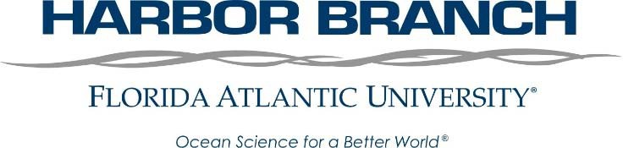
PARTNERSHIPS IN RESEARCH AT HARBOR BRANCH OCEANOGRAPHIC INSTITUTE
Paul S. Wills, Megan Davis, and Susan Laramore

Slide 2

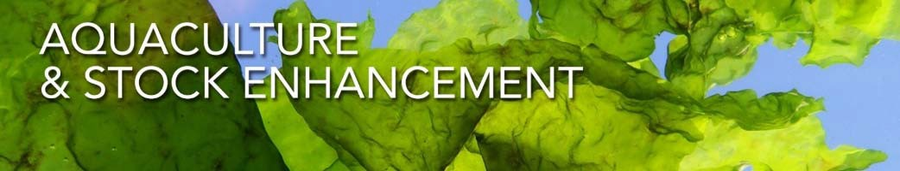
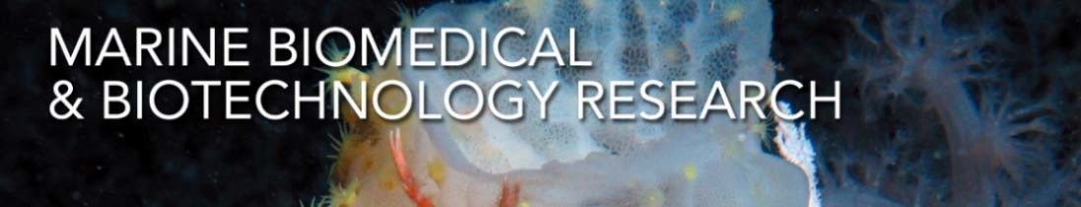
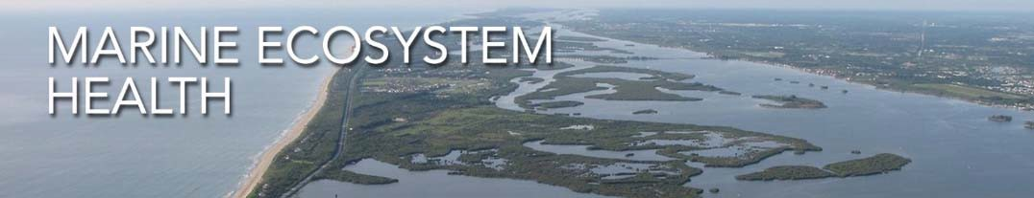
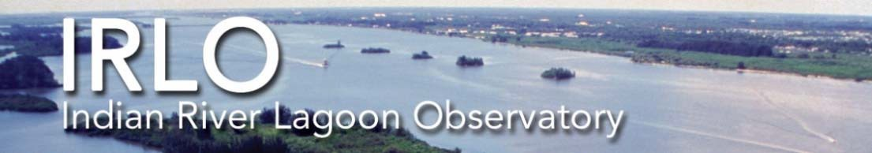
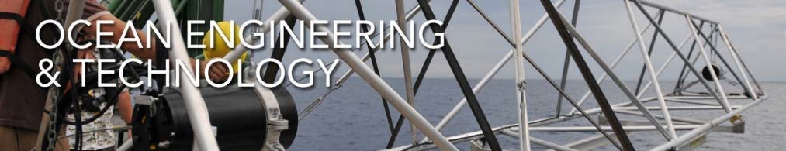
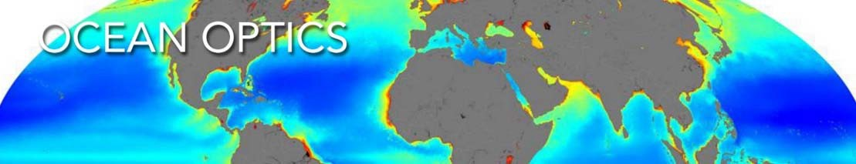
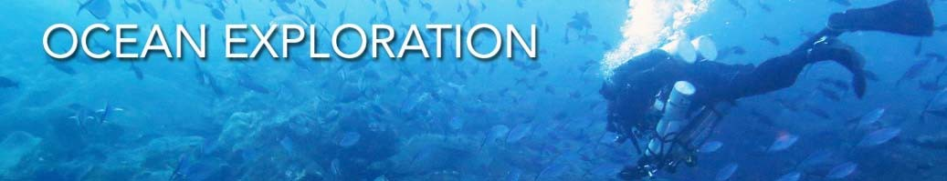

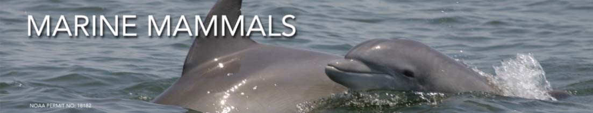
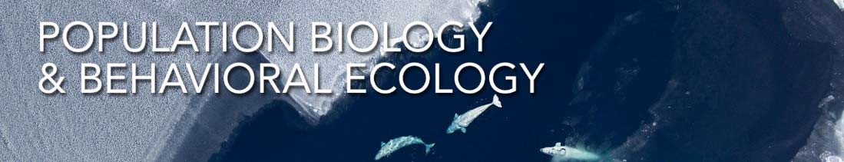
What does HBOI do?

Slide 3

What does HBOI do?

Slide 4

Sea Diver Corporation
Founded: 1971
Joined FAU: 2007
Acreage: 144
Today ➔ 2020
Employees: >200
Budget: 60% external funding

Slide 5

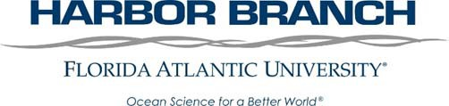
Harbor Branch
Founded: 1971
Joined FAU: 2007
Acreage: 144
Today ➔ 2020
Employees: >200
Budget: 60% external funding

Slide 6

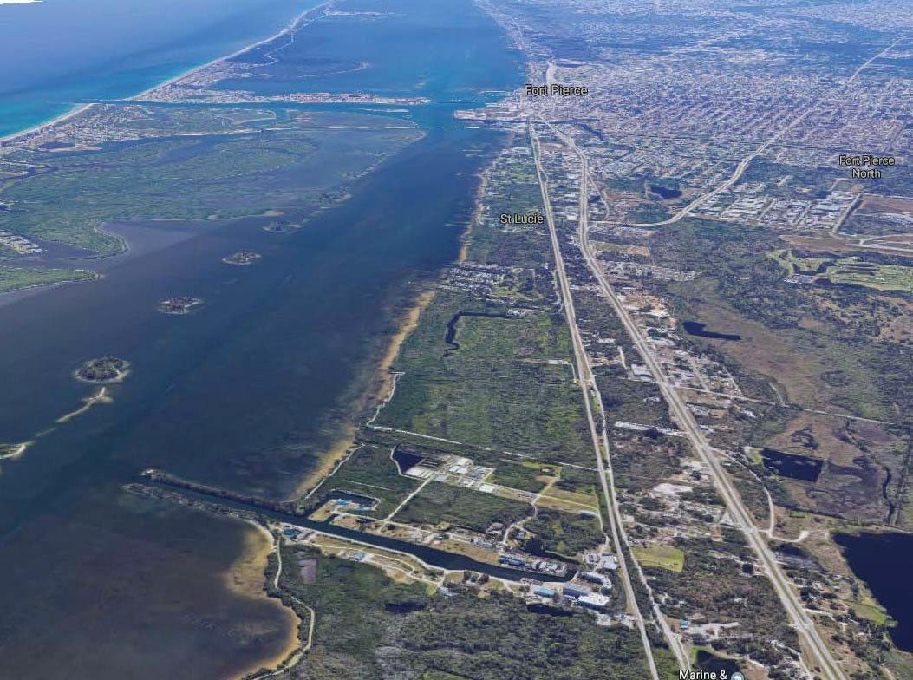

Founded 1971
Founded: 1971
Joined FAU: 2007
Acreage: 144
Today ➔ 2020
Employees: >200
Budget: 60% external funding

Slide 7
1996
COMPREHENSIVE
AQUACULTURE DEVELOPMENT PARK
ACRES: 30
BUILDINGS Research and Commercial: 24 RESEARCH SPACE: 39,000 sq. ft.
SPECIES: fish, clams, oysters, shrimp, urchins, algae & seaweeds, ornamentals
ZERO DISCHARGE AQUACULTURE STATE CERTIFIED

Slide 8
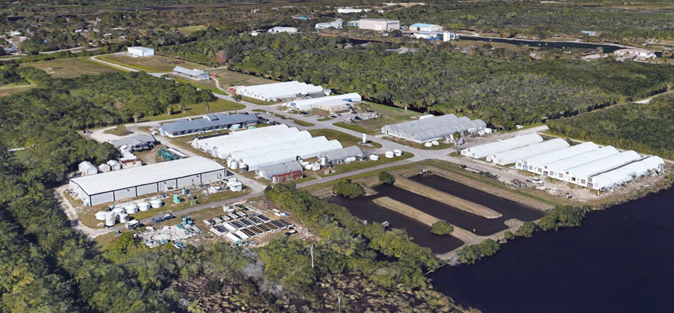

1996 COMPREHENSIVE
AQUACULTURE DEVELOPMENT PARK
ACRES: 30
BUILDINGS Research and Commercial: 24 RESEARCH SPACE: 39,000 sq. ft.
SPECIES: fish, clams, oysters, shrimp, urchins, algae & seaweeds, ornamentals
ZERO DISCHARGE AQUACULTURE STATE CERTIFIED

Slide 9
COMPREHENSIVE 1996
AQUACULTURE DEVELOPMENT PARK
ACRES: 30
BUILDINGS Research and Commercial: 24 RESEARCH SPACE: 39,000 sq. ft.
SPECIES: fish, clams, oysters, shrimp, urchins, algae & seaweeds, ornamentals
ZERO DISCHARGE AQUACULTURE STATE CERTIFIED

Slide 10
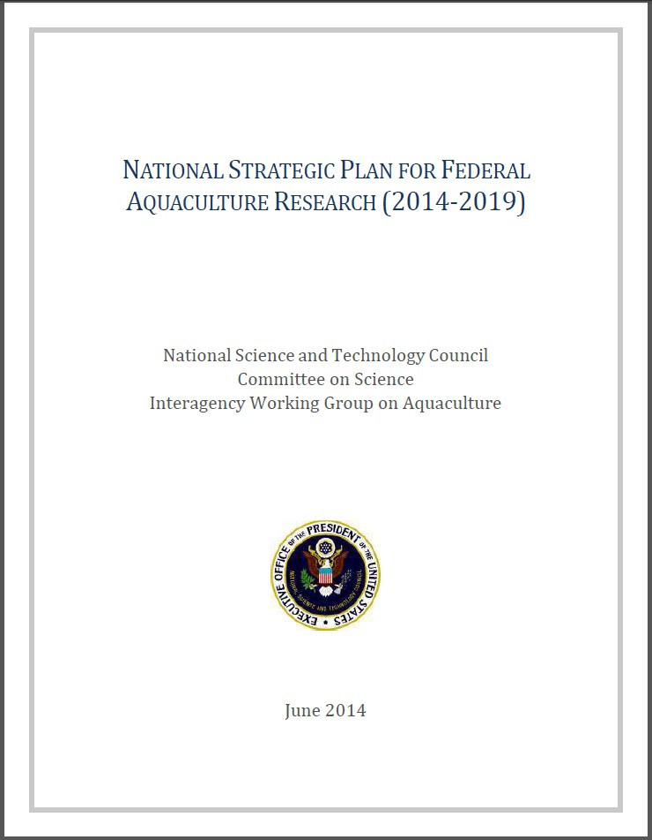
Aquaculture – A Federal Priority
Aquaculture…A Federal Priority
…An HBOI Priority
Strategic Research Goals:
Increase the Supply of Nutritious, Safe, High‐Quality Domestic Seafood
Improve Production Efficiency and Performance of Production Systems
Improve Nutrition and Develop Novel Feeds
Create a Skilled Workforce and Enhance Technology Transfer

Slide 11
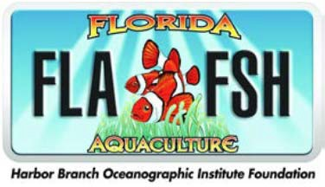

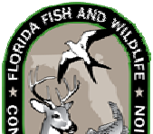

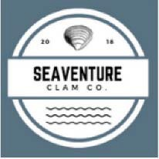




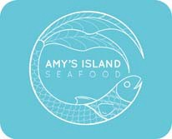
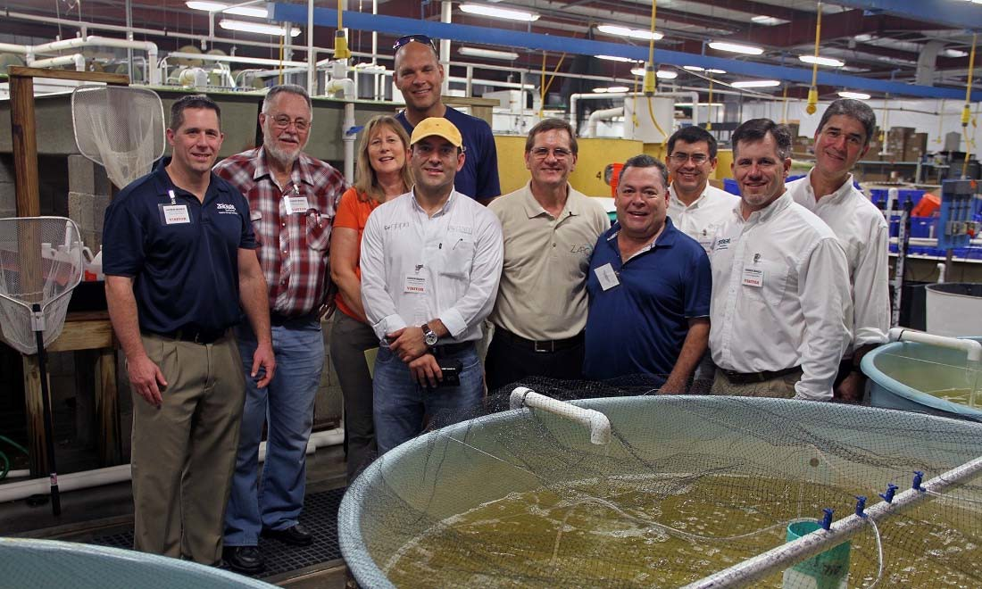
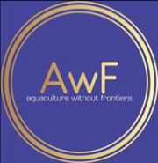
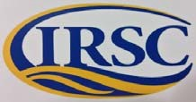
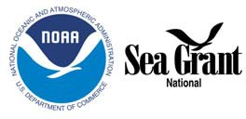


Current and Recent Partnerships

Slide 12




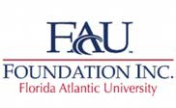
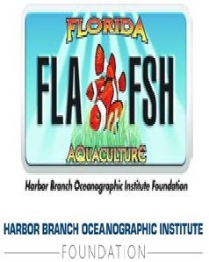





Forms of Partnerships
Remember: HBOI‐FAU is a Research Institute at a State University
‐ Traditional University Research Funding Mechanisms
‐ Sponsored Research/Teaching
‐ Philanthropic Gifts
‐ University Foundation Funding
‐ HBOIF (a DSO for HBOI‐FAU)
‐ FAUF (Routing for Philanthropic Gifts)
‐ External Research Foundation Partnerships
‐ e.g., Bonefish and Tarpon Trust ➔ Bonefish Restoration Research
‐ Public Private Partnerships (PPPs)
‐ Guiding Principle: All PPPs must fulfill HBOI‐FAU’s research and/or education/training mission ➔ this includes publication of research results

Slide 13
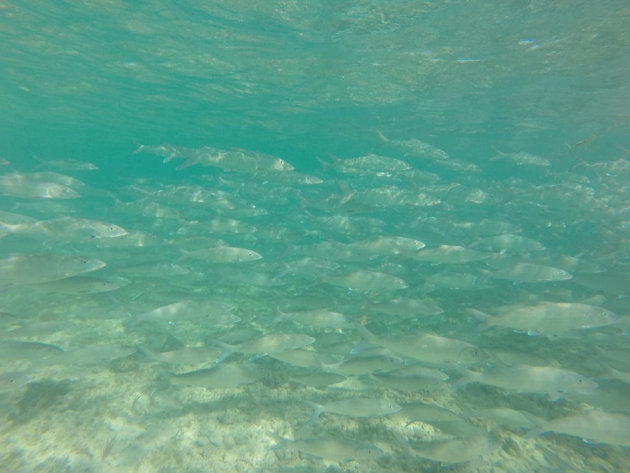

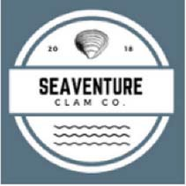
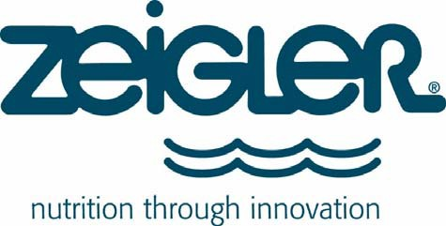
“Case Studies” of
Two On‐Going HBOI‐FAU Public Private Partnerships
Ocean Science for a Better World ®

Slide 14

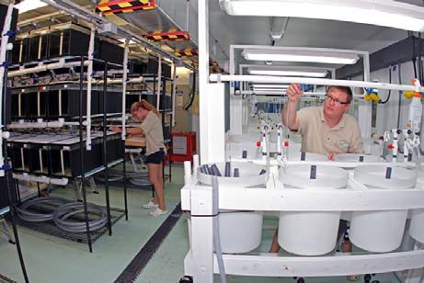
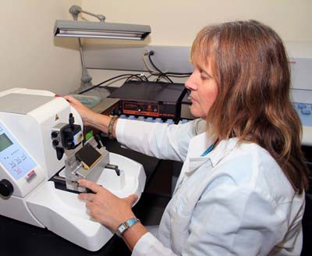

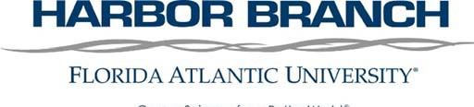

PPP: Zeigler Bros., Inc. (ZBI)
Research Partnership with a Private for Profit entity
  Established MOU
  Research only, no output of physical product
    Sponsor driven research questions
  Research Structure
    ZBI funded research
      ZBI/HBOI‐FAU research team approach
        Direct Funding ➔ ZBI Personnel
        Sponsored Research Funding➔ HBOI‐FAU Personnel
      Operates much like a traditional Sponsored Research Project with HBOI‐FAU and ZBI employees working side by side to achieve objectives
  Also, Subcontractor and Co‐PI on other aquafeed related Sponsored Research

Slide 15
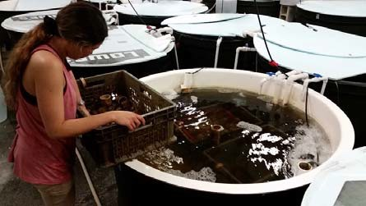
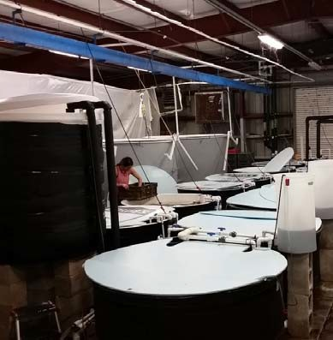
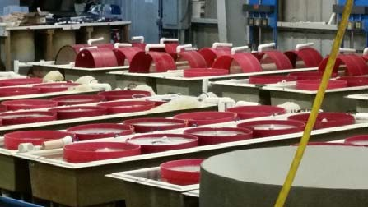
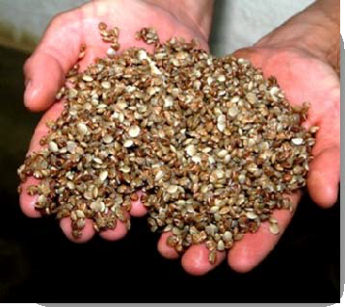
Seaventures Clam Co. (SVCC)
Research Partnership with a Private for Profit entity
  Established MOU
  Research along with production of product for sale (hard clam seed)
    Sponsor driven research questions
  Production Structure ➔ all SVCC staff
    Training and Consultation by HBOI‐FAU Staff only (Funded)
    Rental of Space (Sqft and Utilities) from FAU for Production Space
    Potential for Profit Sharing
  Research Structure
    SVCC funded research
      Sponsored Research Funding➔ HBOI‐FAU Personnel
    Operates much like a traditional Sponsored Research Project funding HBOI‐FAU to achieve objectives

Slide 16
PPPs help HBOI-FAU
PPPs help HBOI‐FAU to achieve our mission in advancement of Applied Aquaculture Research to benefit the industry as a whole
Ocean Science for a Better World ®

