Slide 1
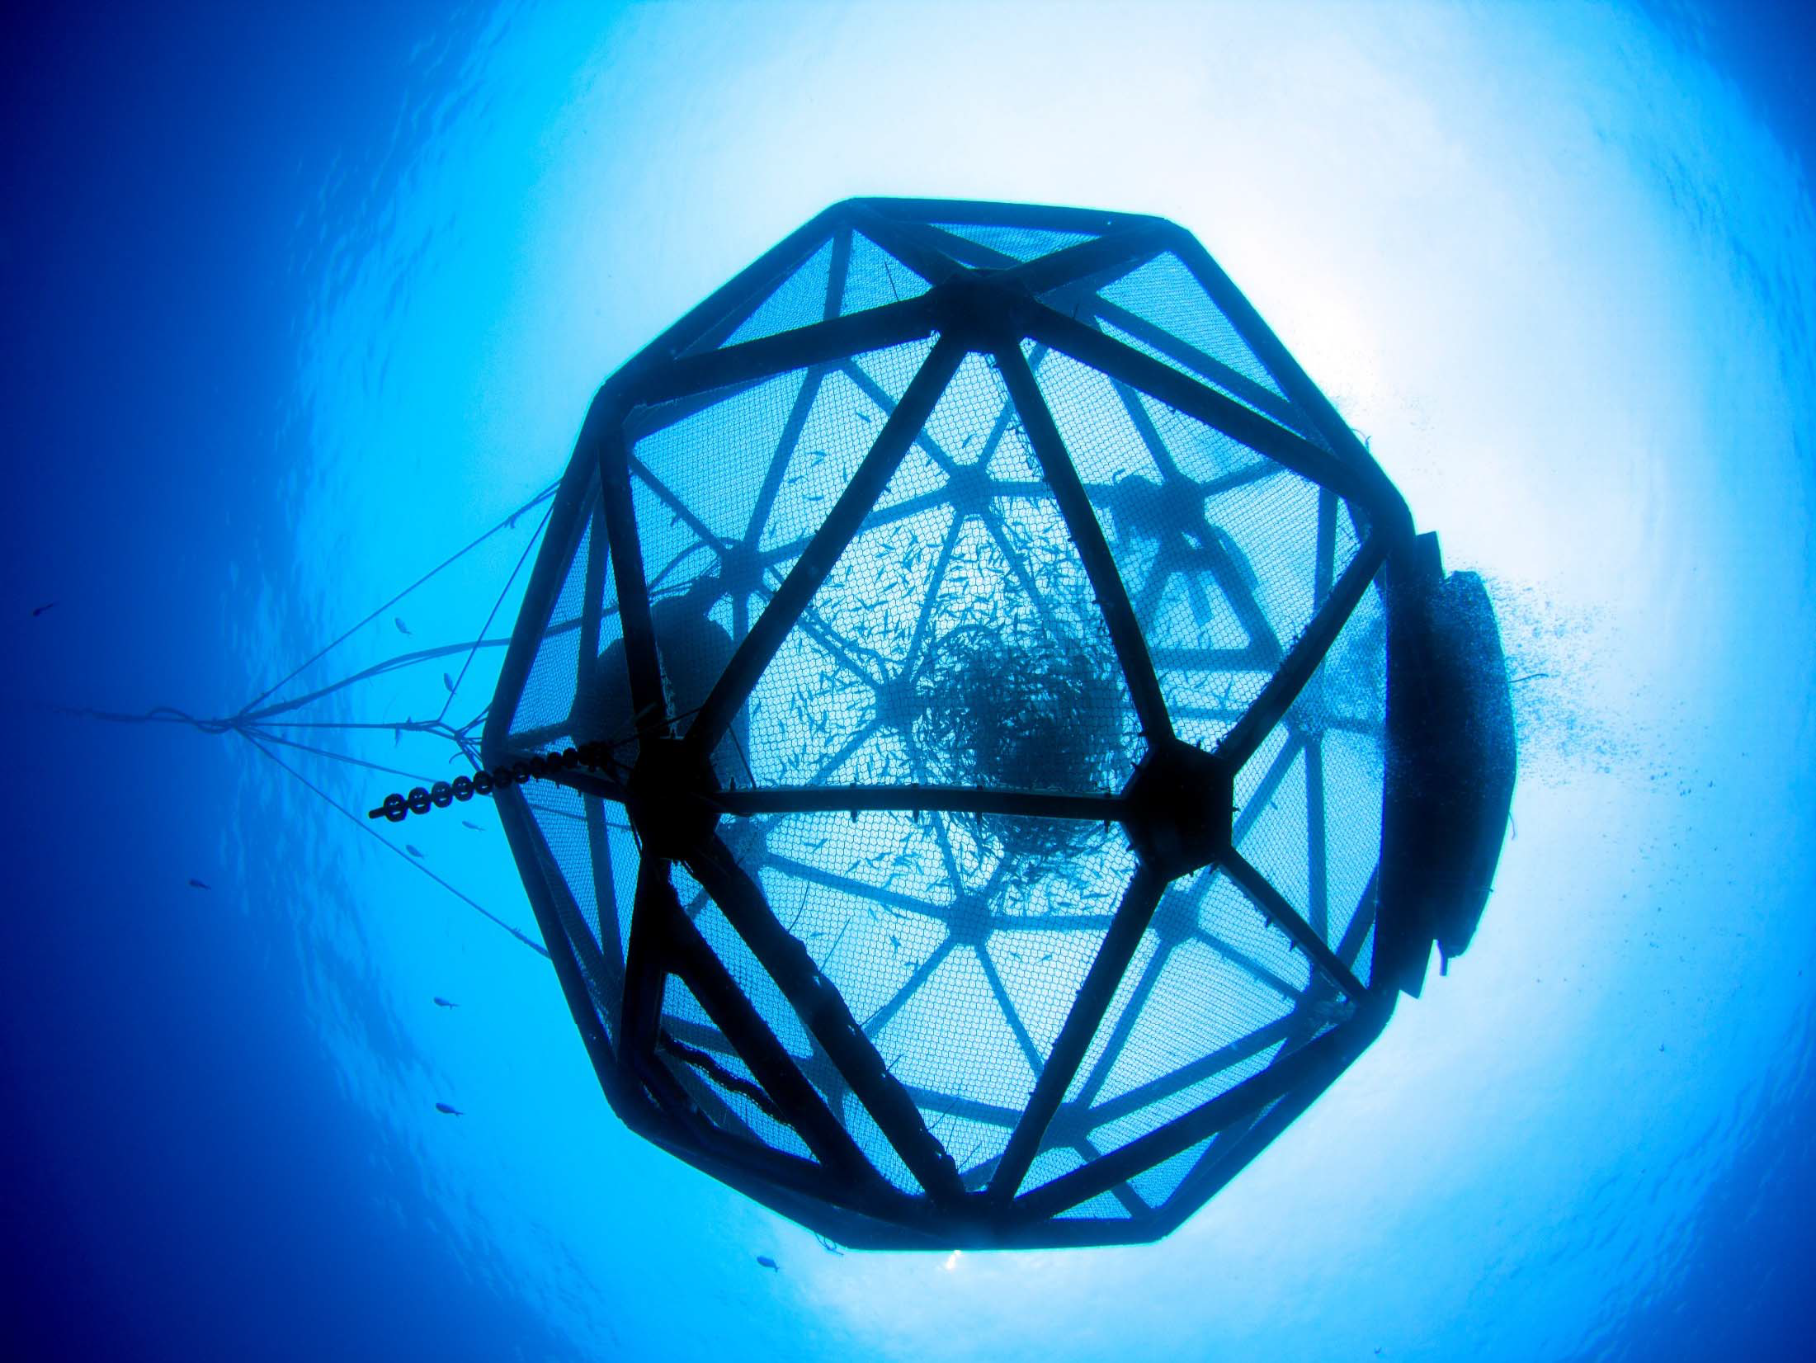

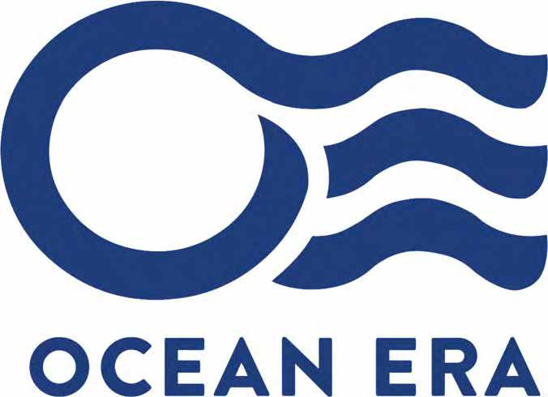

Ocean Era
For: Aquaculture America, Honolulu, HI US Marine Fish R&D Capabilities Tuesday, February 11th, 2020
* = The company formerly known as ‘Kampachi Farms, LLC’
Seriola R&D
Macroalgae culture
Kyphosus culture
Offshore permitting
Neil Anthony Sims, Co‐Founder, CEO.
email: neil@ocean‐era.com

Slide 2
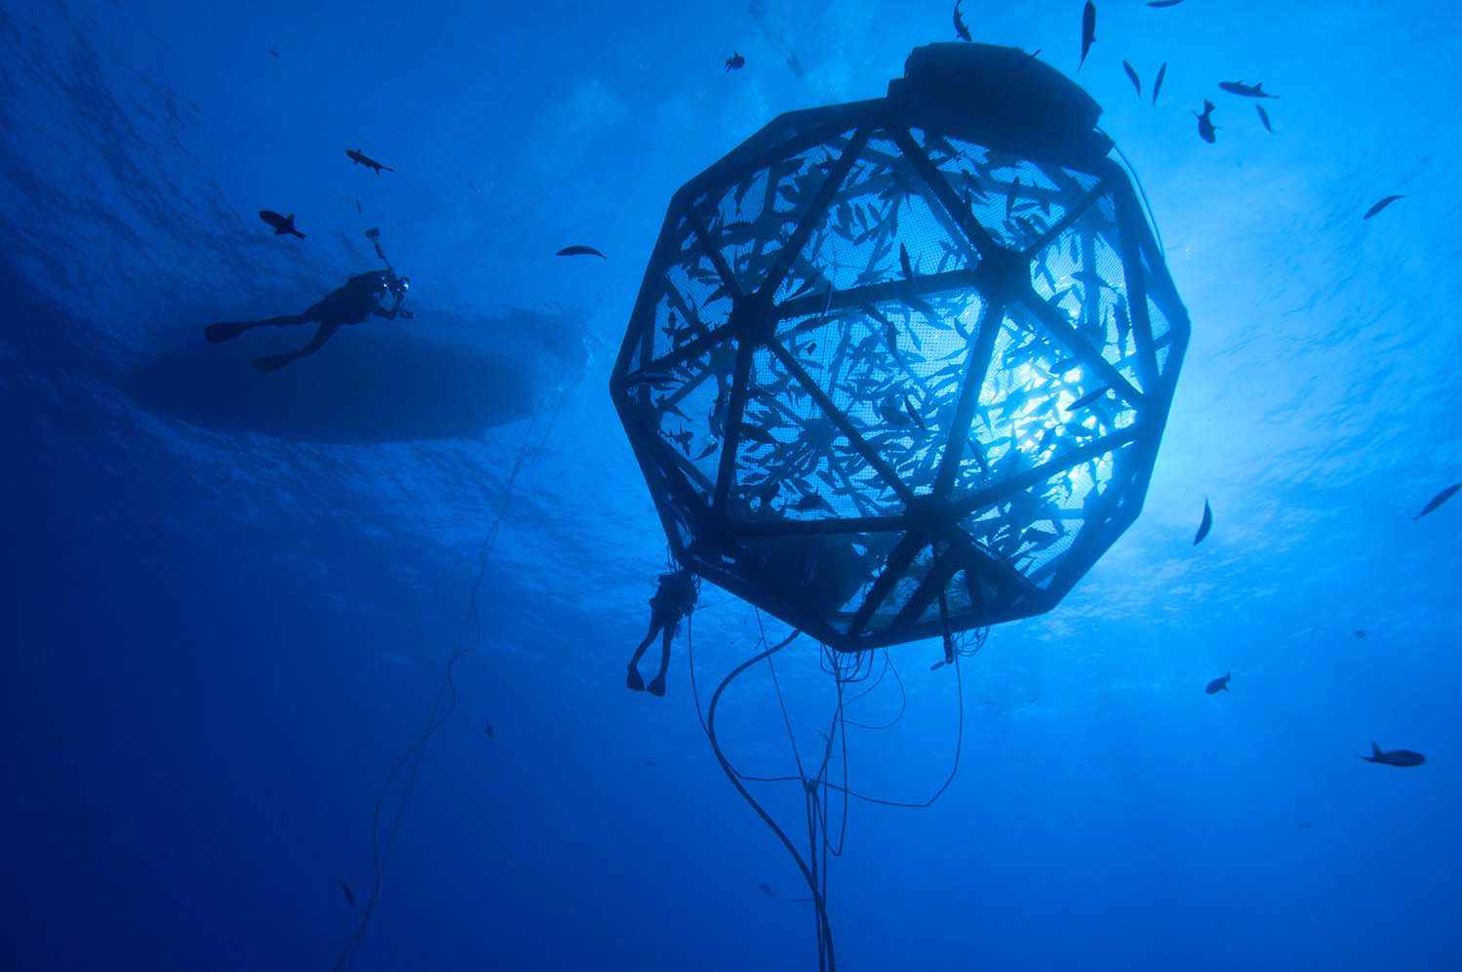








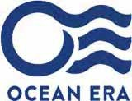
OCEAN ERA –
COLLABORATIVE
OFFSHORE
AQUACULTURE R&D
ECONOMIC OPPORTUNITY
ECOLOGICAL IMPERATIVE
Neil Anthony Sims, Lisa Vollbrecht, Helen Meigs, Keelee Martin and Joseph (Crispin) Nakoa
File name: Sims_480_6
Session Name: Status of US Marine Fish Session Date: Tuesday, February 11 Time Assignment: 10:30 am
(Session #: 68)

Slide 3
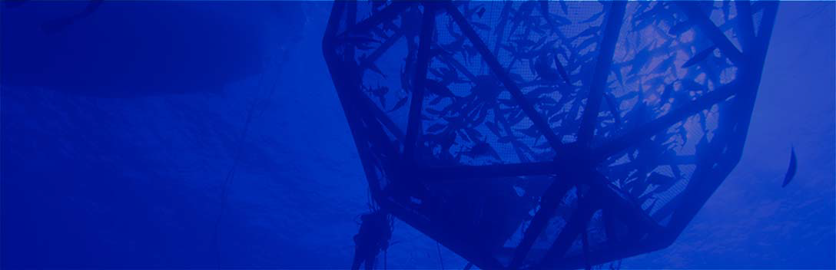
Ocean ERA 2
COLLABORATIVE OFFSHORE AQUACULTURE R&D AT THE NEXUS OF ECONOMIC OPPORTUNITY AND ECOLOGICAL IMPERATIVE
Neil Anthony Sims, Lisa Vollbrecht, Helen Meigs, Keelee Martin and Joseph (Crispin) Nakoa
File name: Sims_480_6
Session Name: Status of US Marine Fish Session Date: Tuesday, February 11 Time Assignment: 10:30 am
(Session #: 68)

Slide 4
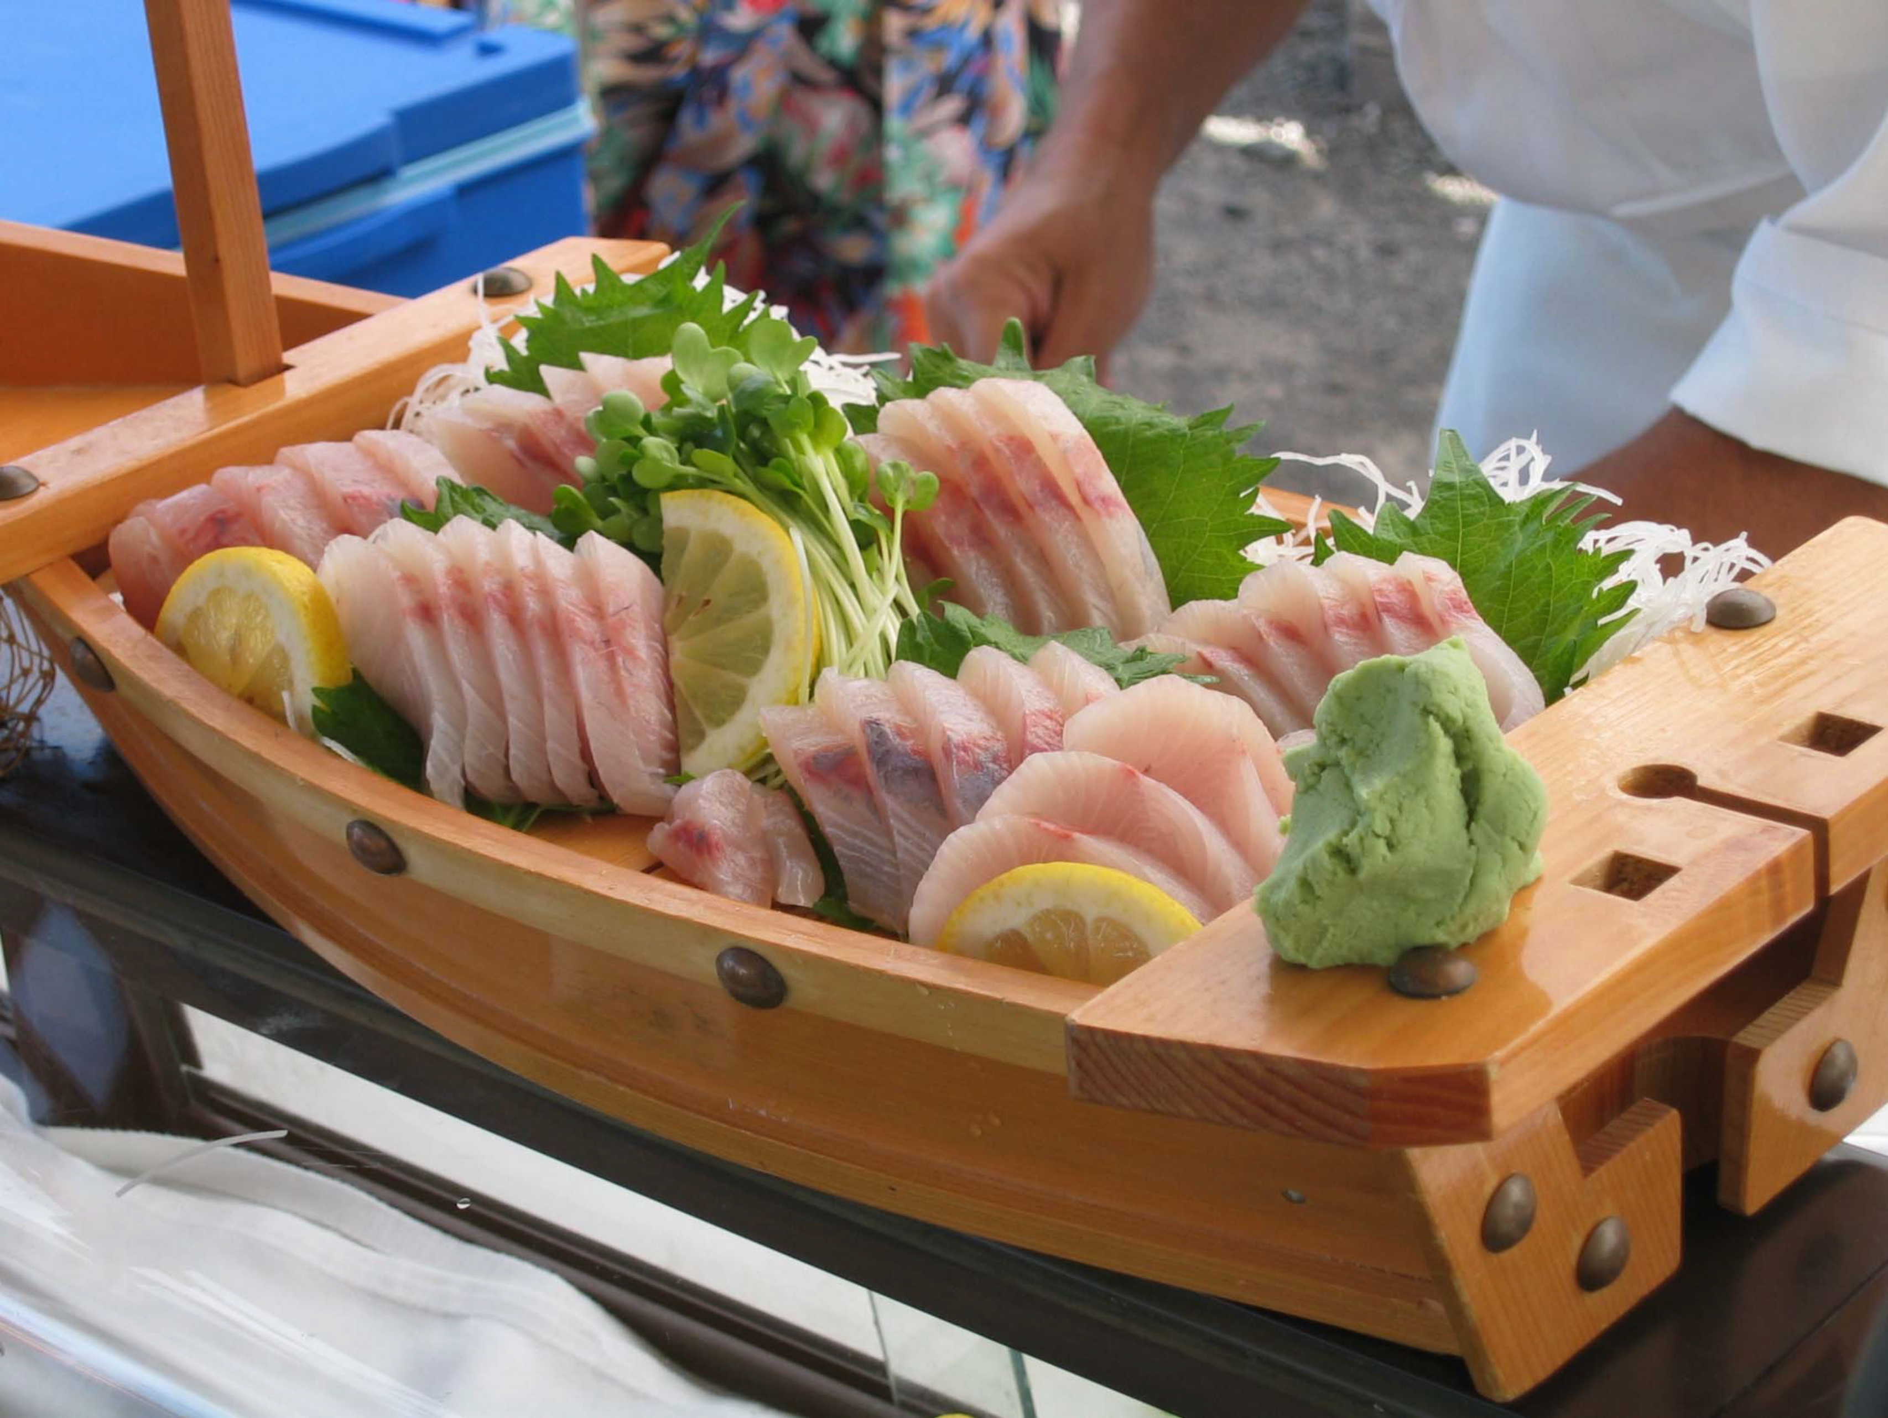
Take‐aways
1. Collaborative
2. Critical commercial path
3. Mission driven
4. Omnivorous
5. Nimble

Slide 5
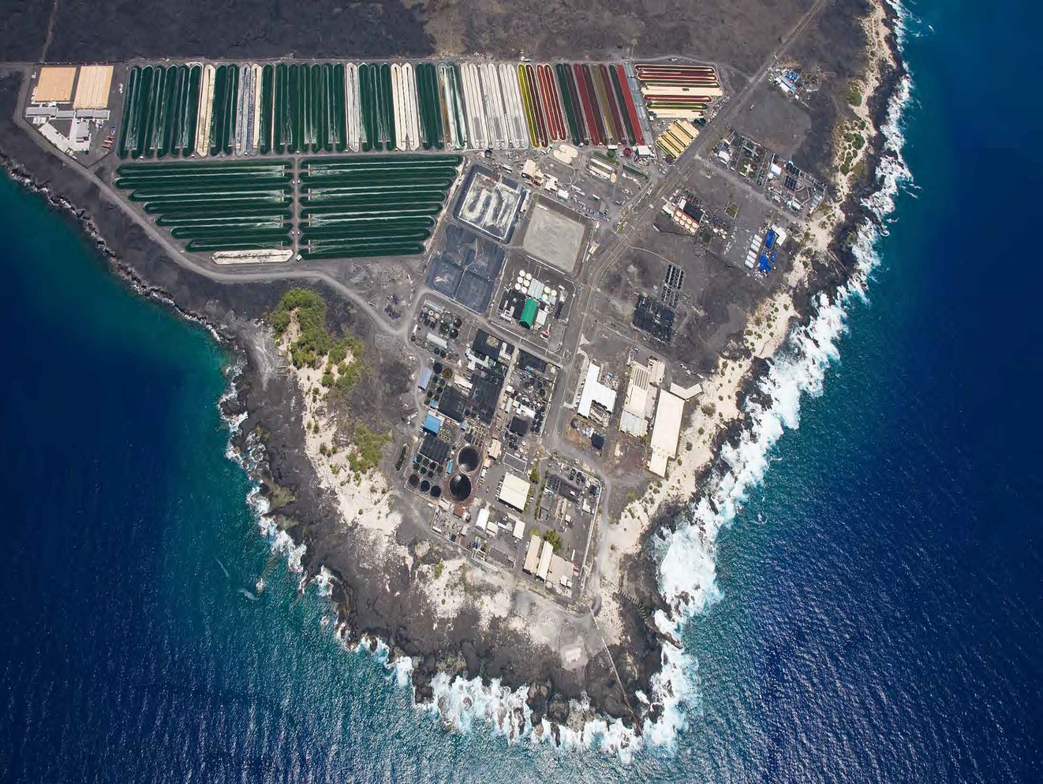











Ocean Era, LLC ancestry
Black Pearls, Inc.
Kona Blue Water Farms, Inc.
Blue Ocean Mariculture
Kampachi Farms, LLC
Forever Oceans
Ocean Era, LLC
5

Slide 6
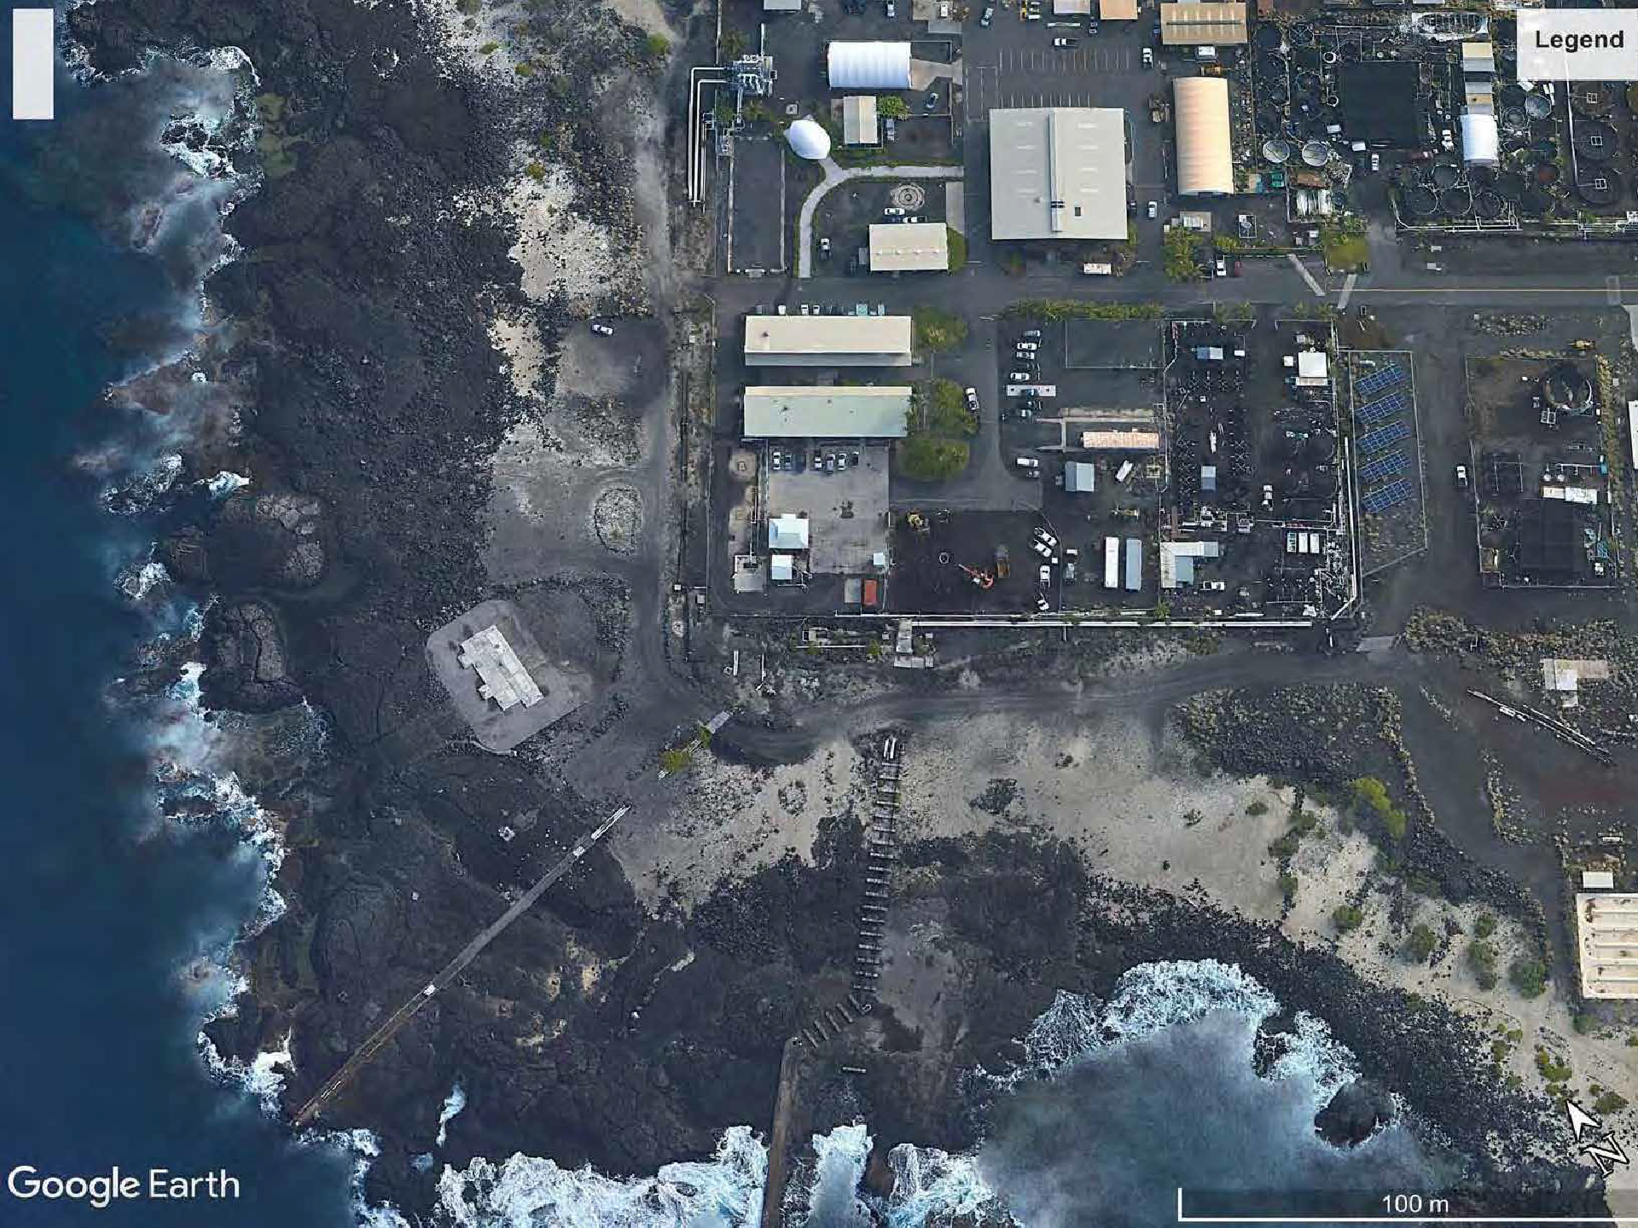


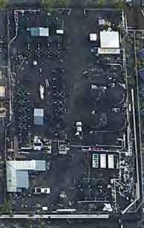



Fish research yard
Ocean Era office
Macroalgae yard
OCEAN ERA facilities at NELHA
6

Slide 7
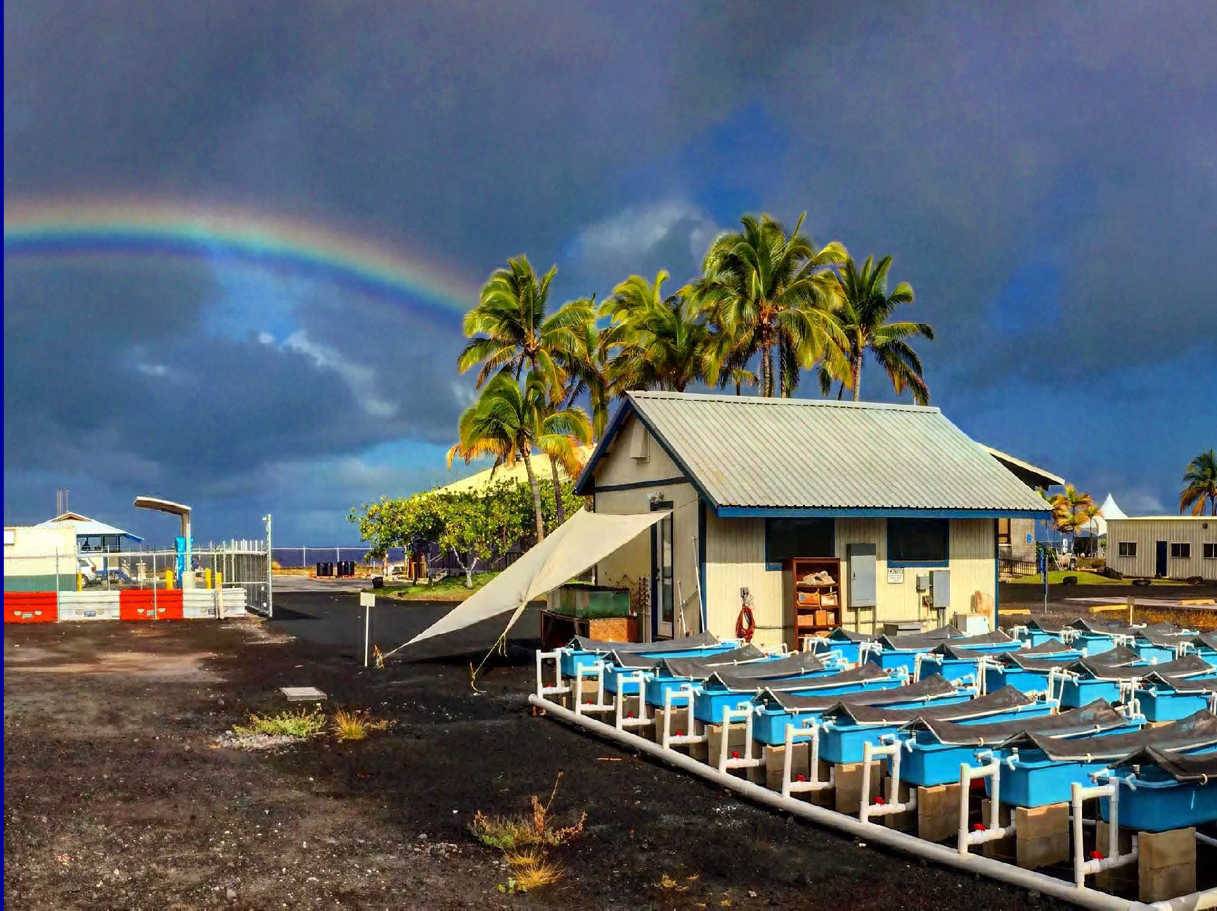

Ocean Era facilities
Macroalgae yard
OCEAN ERA facilities at NELHA
7

Slide 8
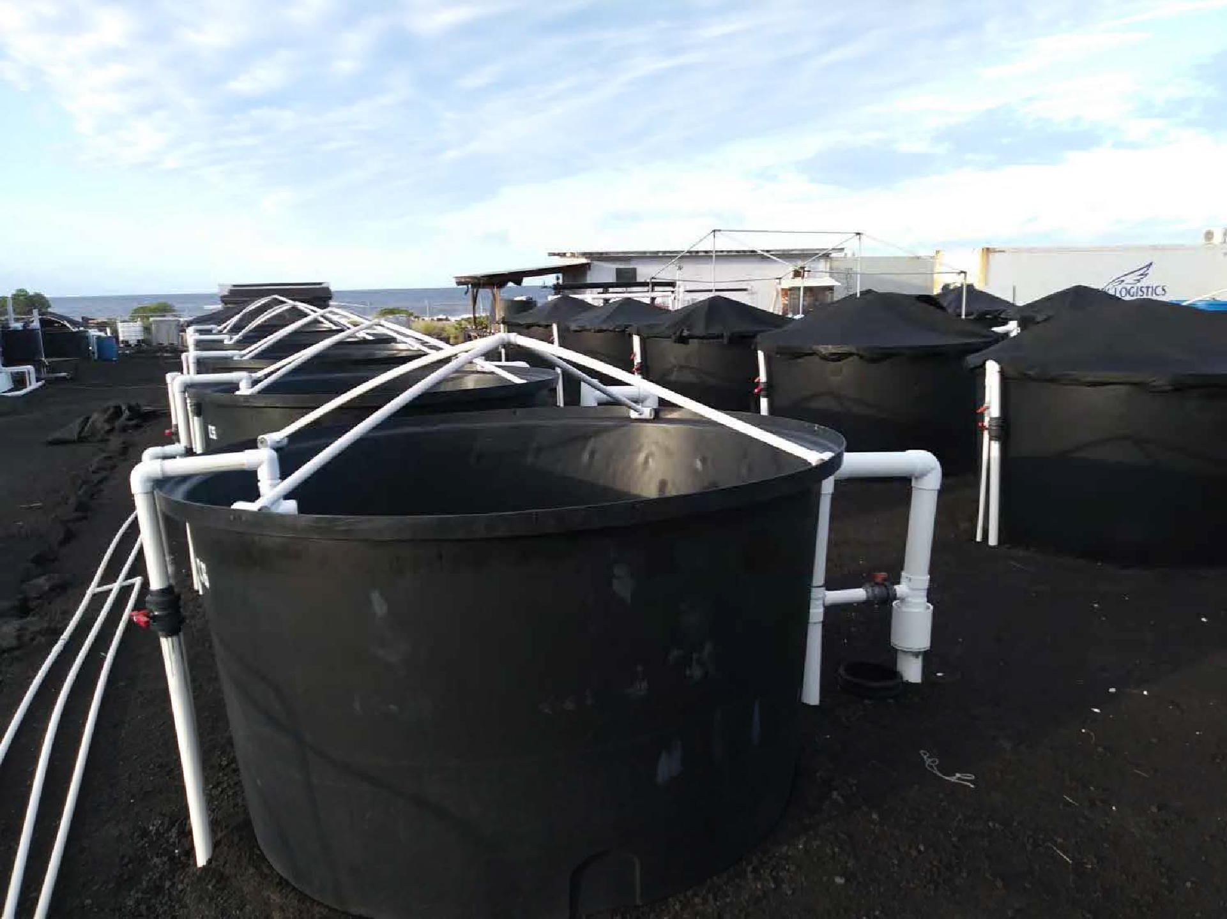

OCEAN ERA facilities at NELHA
Fish research yard
36 x 4,000 L HDPE tanks for replicated trials
8

Slide 9
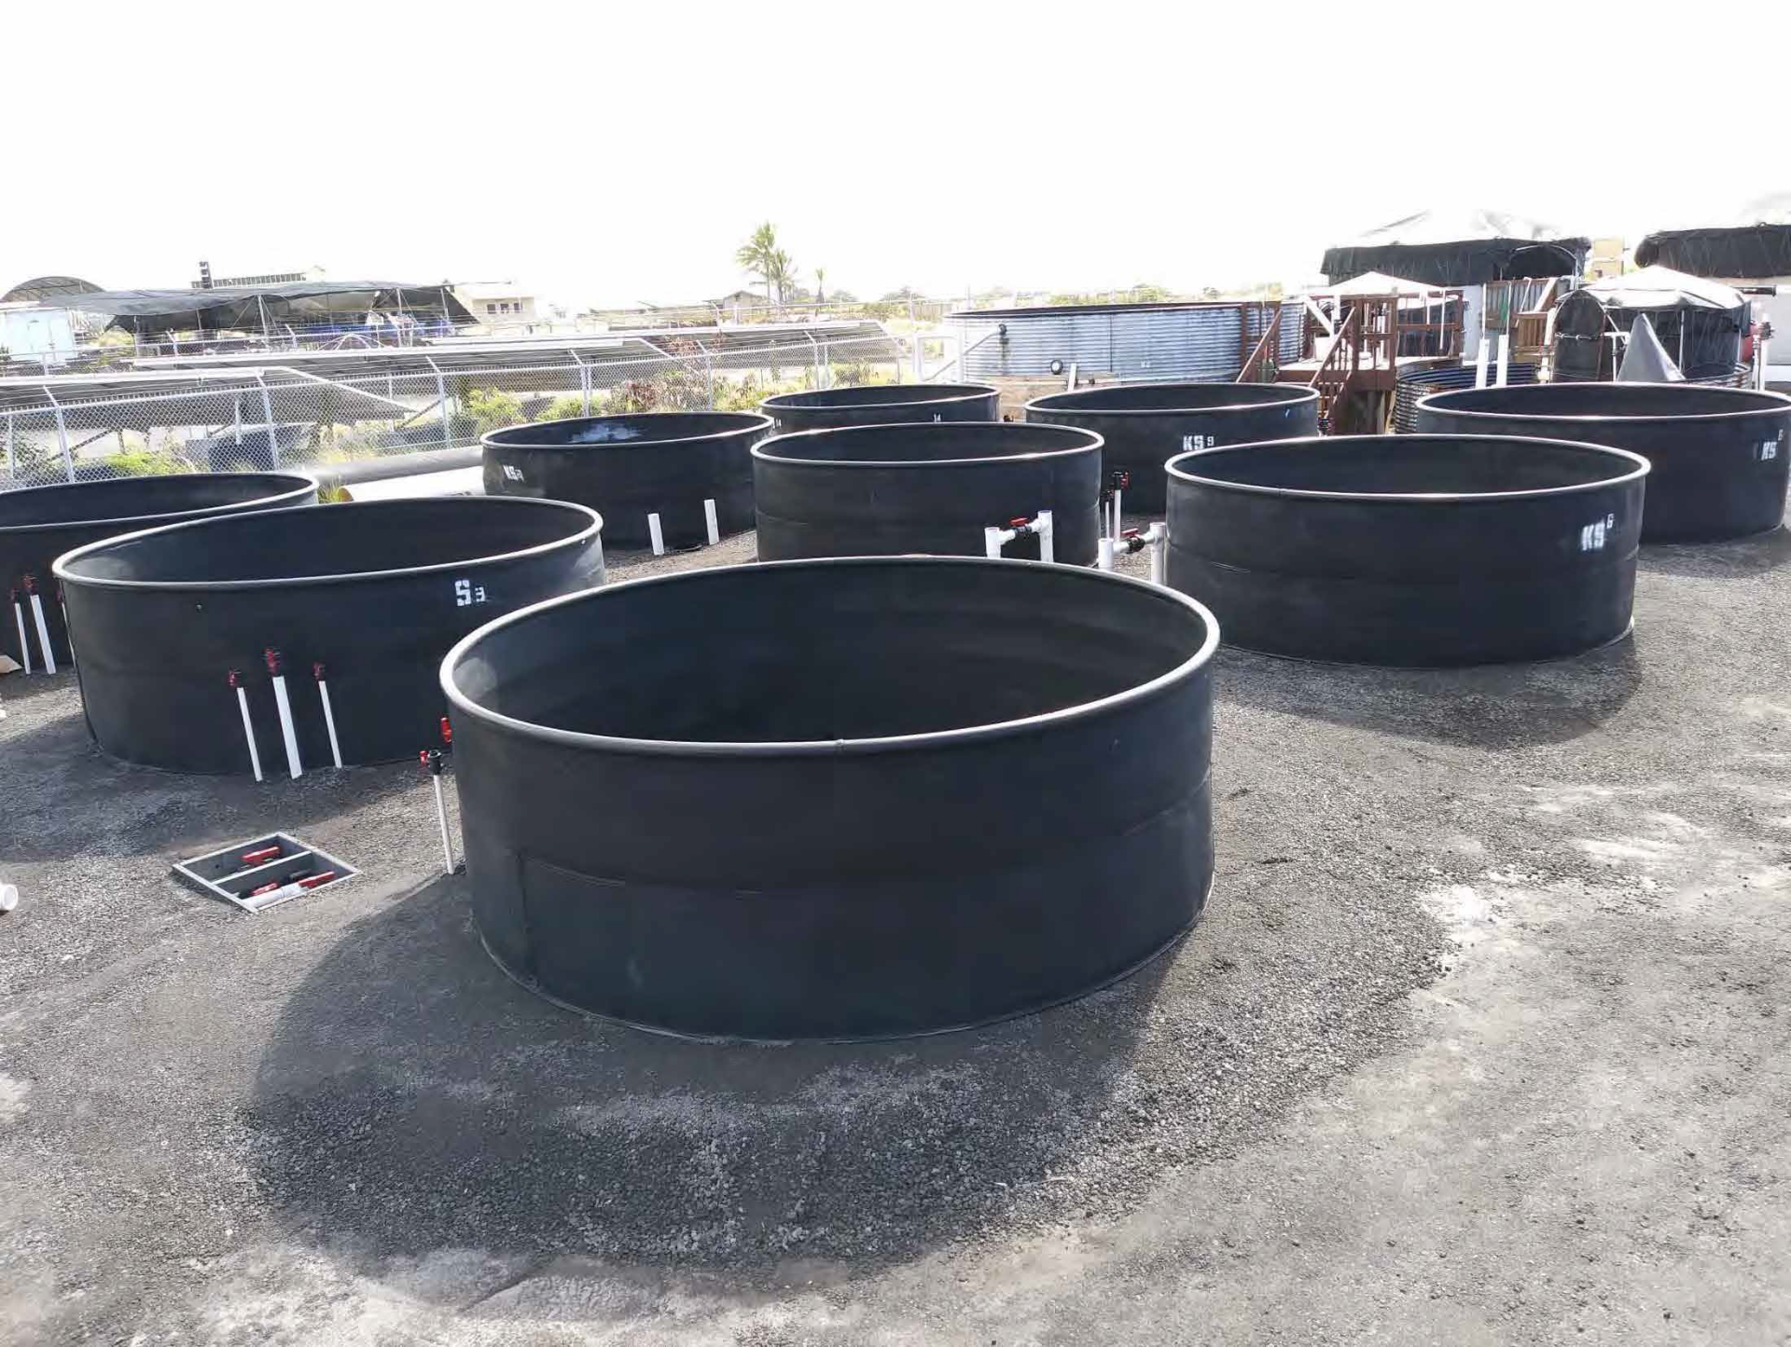
Broodstock tank array (under construction):
Fish research yard
“Pair‐spawning” tank array
12 tanks, @ 10 tonnes

Slide 10
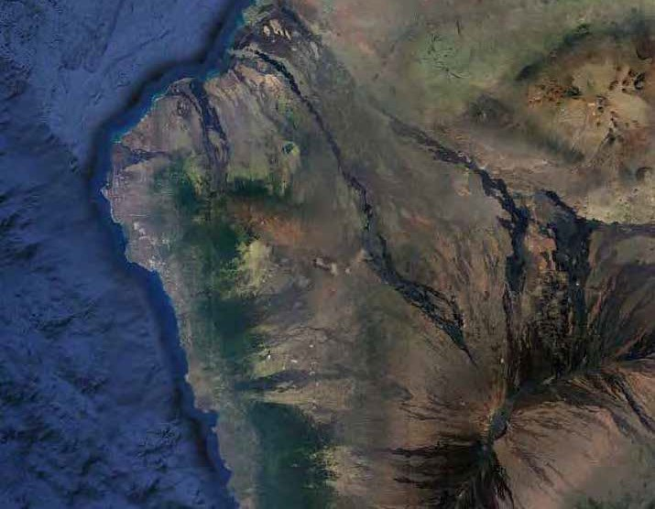




Offshore aquaculture in Kona
Blue Ocean Mariculture ‐ kampachi
NELHA, HATCH, offices, facilities
Ocean Era – macroalgae (permitted, funded)
Forever Oceans – kampachi, automation
1
0

Slide 11
Take‐aways:
1. Collaborative
2. Critical commercial path
3. Mission driven
4. Omnivorous
5. Nimble

Slide 12
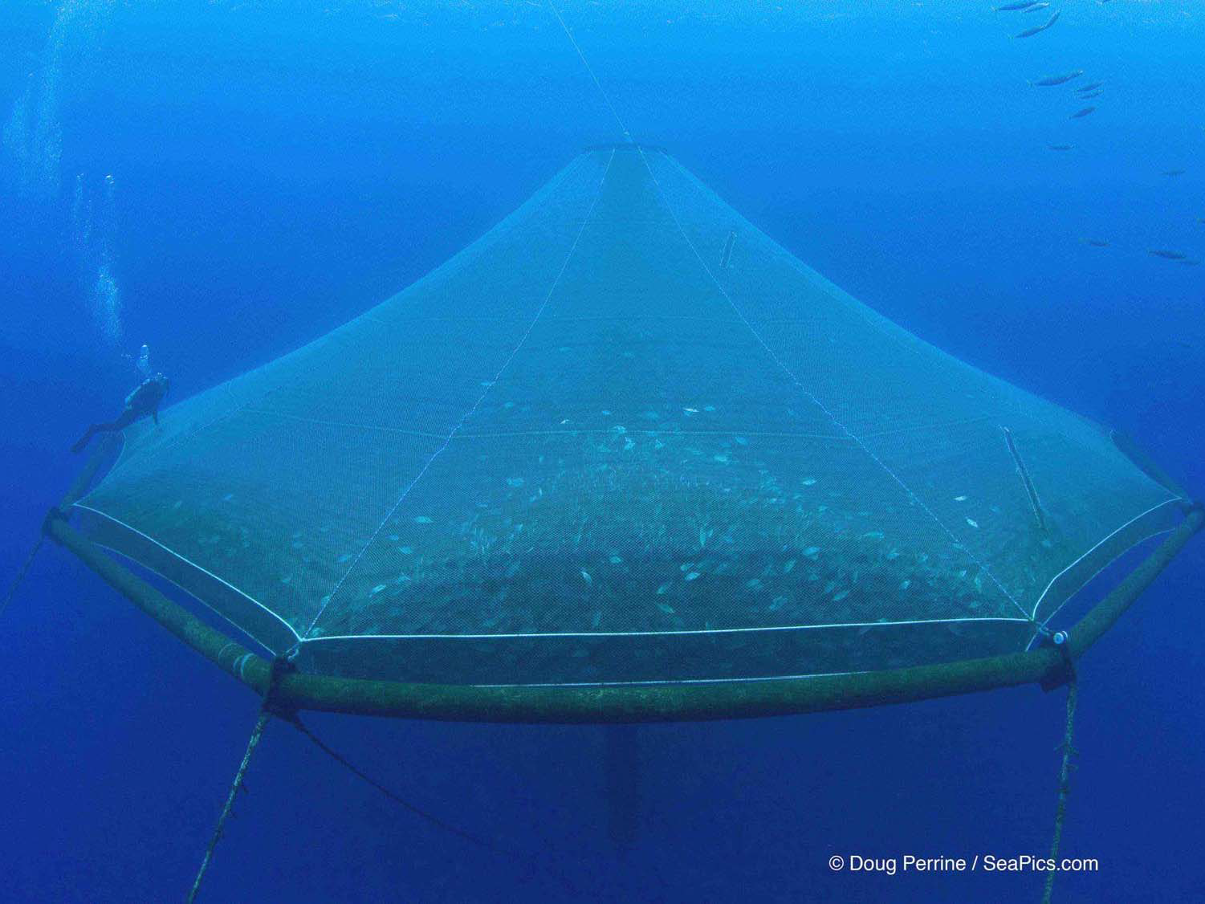

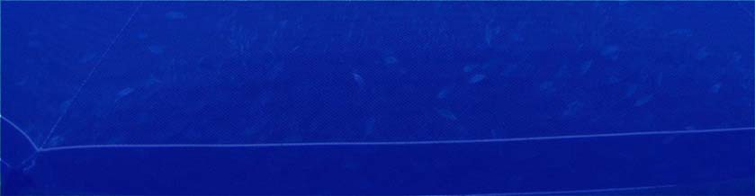

1. Collaborative
Kona Blue Water Farms, LLC
First integrated offshore fish farm and hatchery 2004 ‐ 2009
Genesis: Advanced Technology Program (NIST) John Corbin, Cates International,
Hawaii Hi‐tech tax credits (Act 221), Ocean Spar
3000 cu m Sea Station™ net pen
12

Slide 13


1. Collaborative:
The Velella Beta‐test
TIME Magazine’s “25 Best Inventions 2012” Superb FAD for Kona fishermen
© Tom Carey

Slide 14
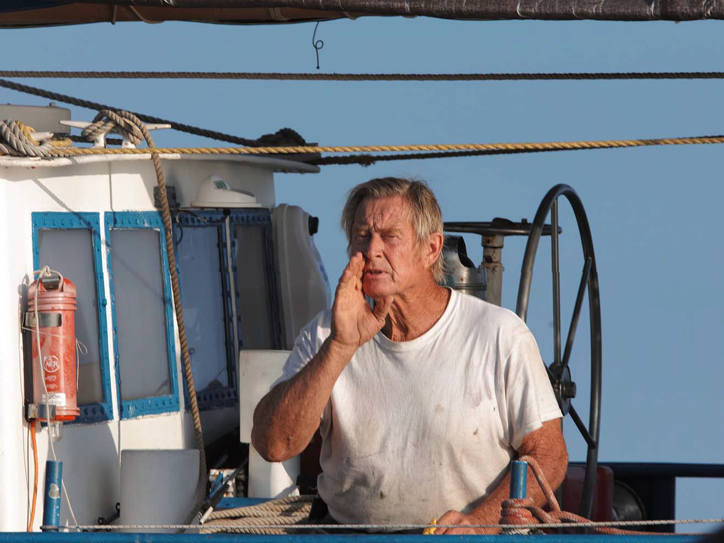

The Velella Beta‐test
1. Collaborative
In collaboration with …
Illinois Soybean Association
National Science Foundation Ocean Farm Technologies, Inc. International Copper Association Lockheed Martin
NOAA
University of Hawaii Hilo Capt. Bill Austin and crew

Slide 15
Take‐aways -
1. Collaborative
2. Critical commercial path
3. Mission driven
4. Omnivorous
5. Nimble

Slide 16
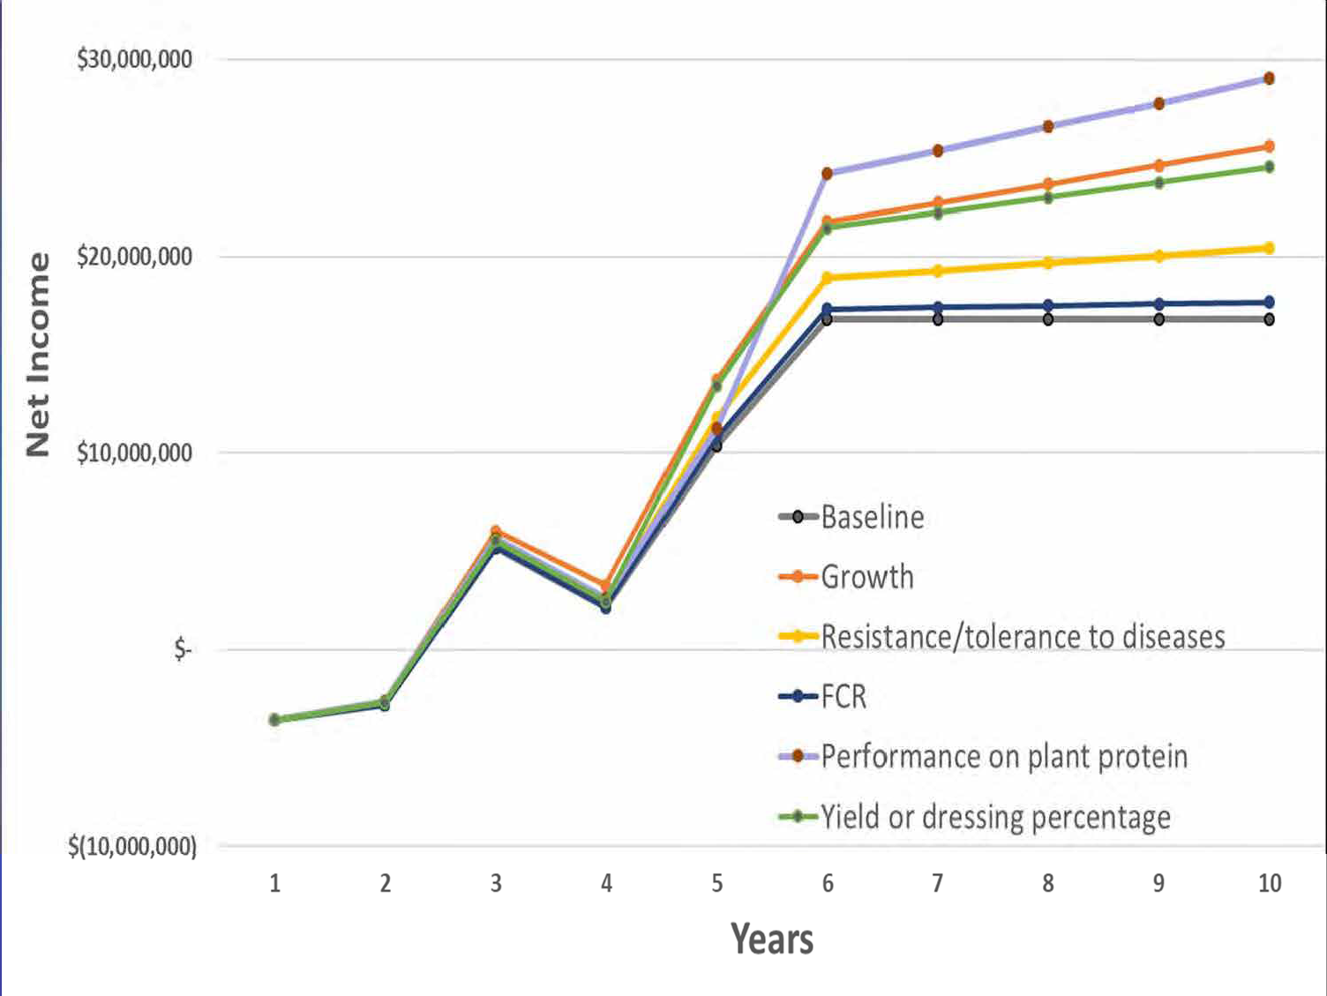
Selective breeding benefits to a Financial Model template:
2. Critical commercial path
(in collaboration with Lorenzo Juarez, under NOAA SBIR)
Four best traits combined: Yr 10 Net ~ $37 million
= 118% increase

Slide 17

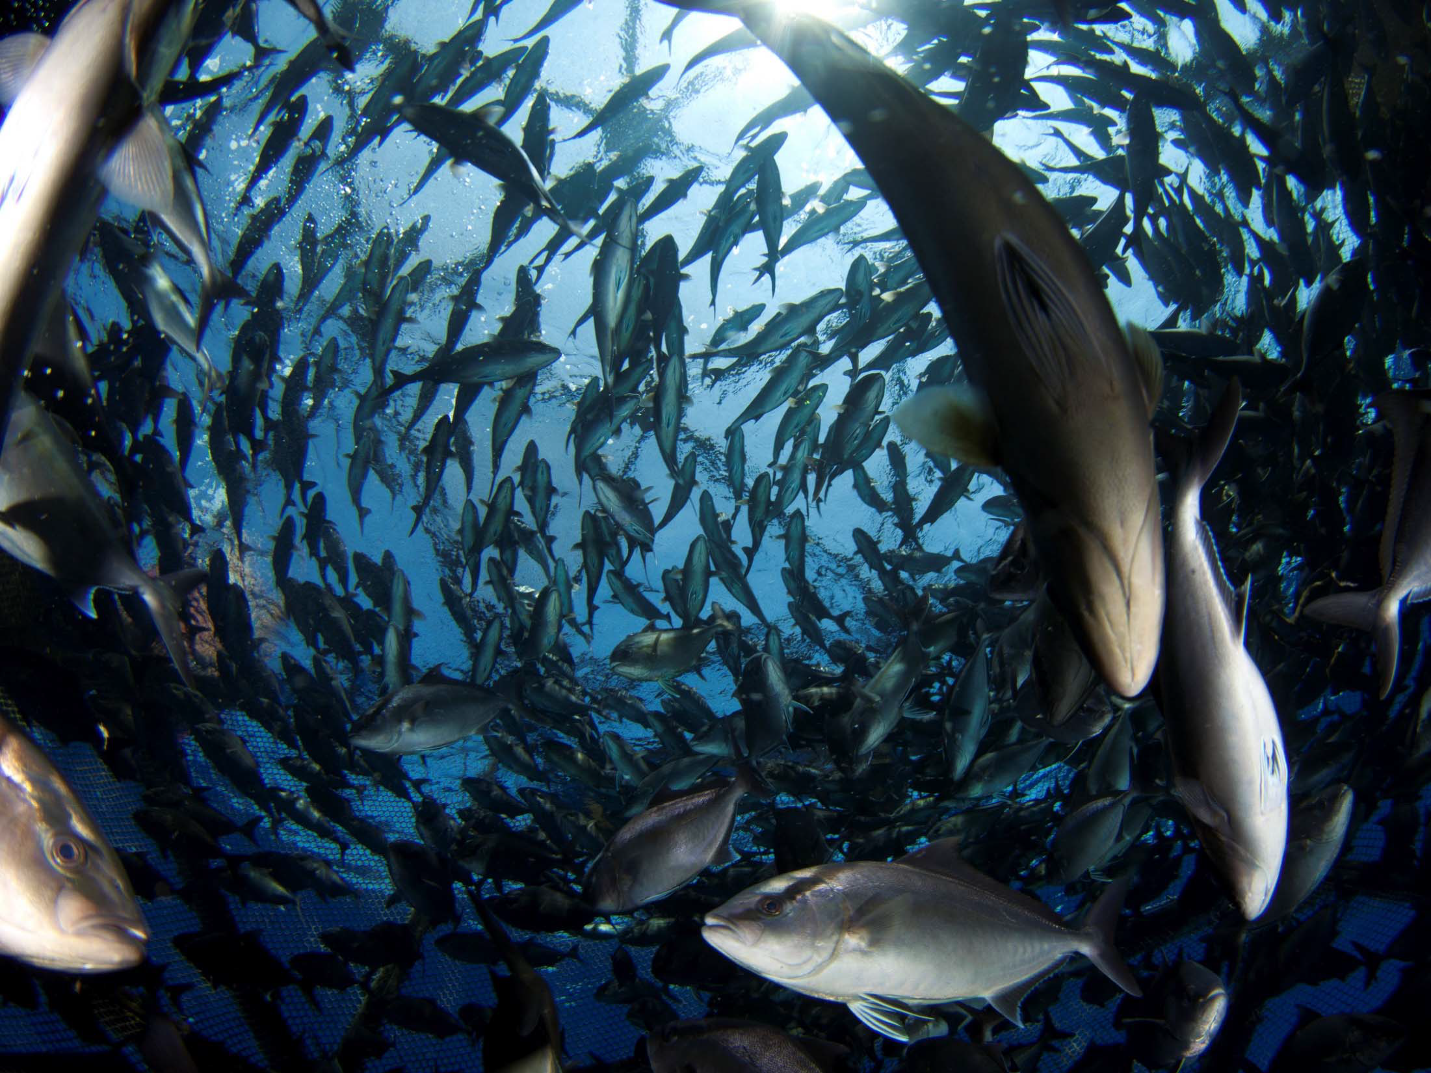
Selective Breeding ROI:
2. Critical commercial path
10 year investment ~ $5 million
= 32% ROI
(in collaboration with Lorenzo Juarez, under NOAA SBIR)

Slide 18
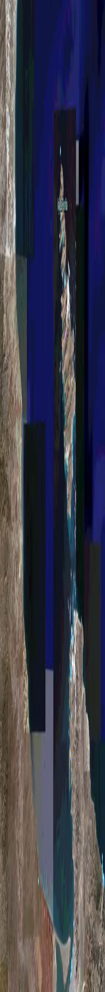
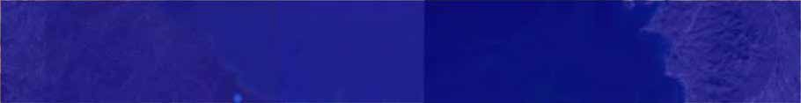

Commercial spin‐offs
2. Critical commercial path
5 miles Scale
“Concession”
‐ 4 miles offshore
BAHIA DE LA PAZ
Genesis: Michael Bullock, Matias Arjona, Rex Ito, Government of Mexico …
LA PAZ
18

Slide 19
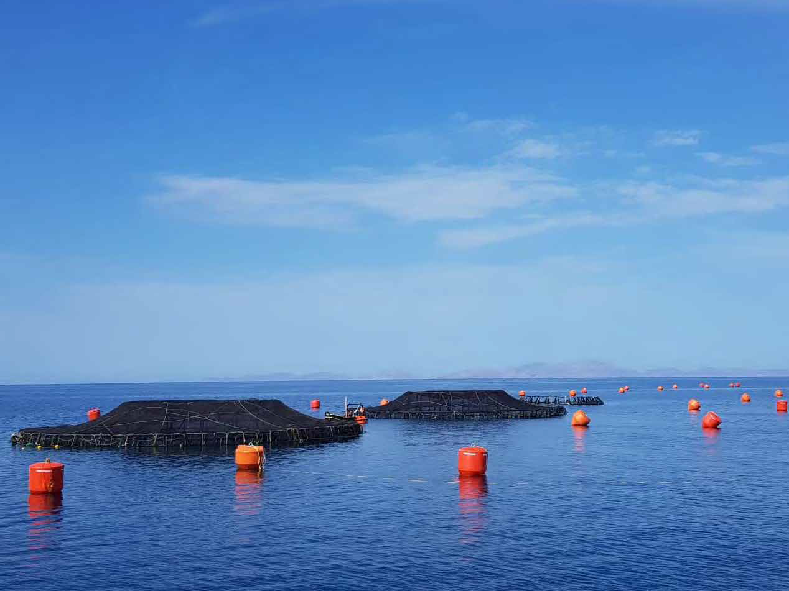
Kampachi Mexico
2. Critical commercial path
Submersible Polar‐Cirkel‐style surface pens

Slide 20
Take aways
1. Collaborative
2. Critical commercial path
3. Mission driven
4. Omnivorous
5. Nimble

Slide 21
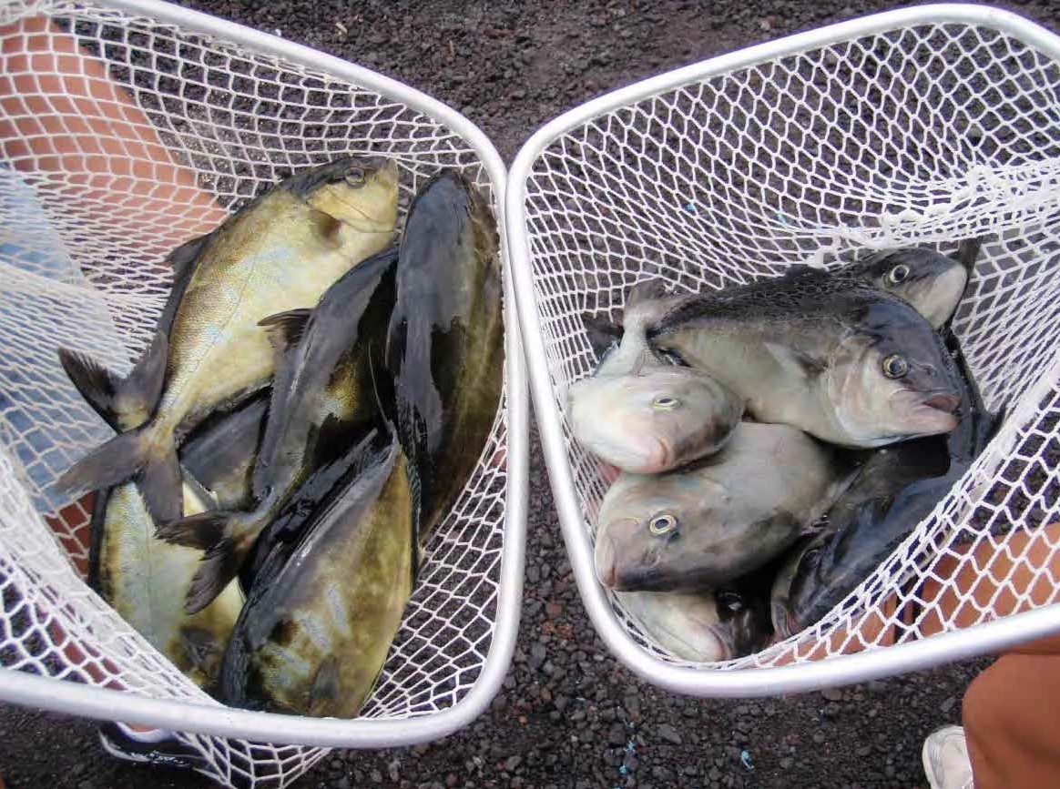
Nebraska Soybean Board‐ supported research (2006 ‐ 2017)
3. Mission driven
In collaboration with U Nebraska Lincoln, Dr Tom Clemente
Fish‐In : Fish‐Out < 1:1
Control Diet
SPC‐based Diet
21

Slide 22

NOAA Saltonstall‐Kennedy‐supported research (2011 ‐ 2012), in collaboration with Dr Rick Barrows, USDA‐ARS
3. Mission driven
400.0
350.0
Total Fishmeal Replacement with
Food‐grade Poultry Meal, plus Spirulina
300.0
Average Fish weight (g)
250.0
Diet 1
Diet 2
Diet 3
diet 4
200.0
Diet 4 = Zero fishmeal diet
150.0
100.0
50.0
0.0
4/16/13
4/23/13
4/30/13
5/7/13
5/14/13
5/21/13
5/28/13
6/4/13
6/11/13
6/18/13
6/25/13
7/2/13
Date
22

Slide 23
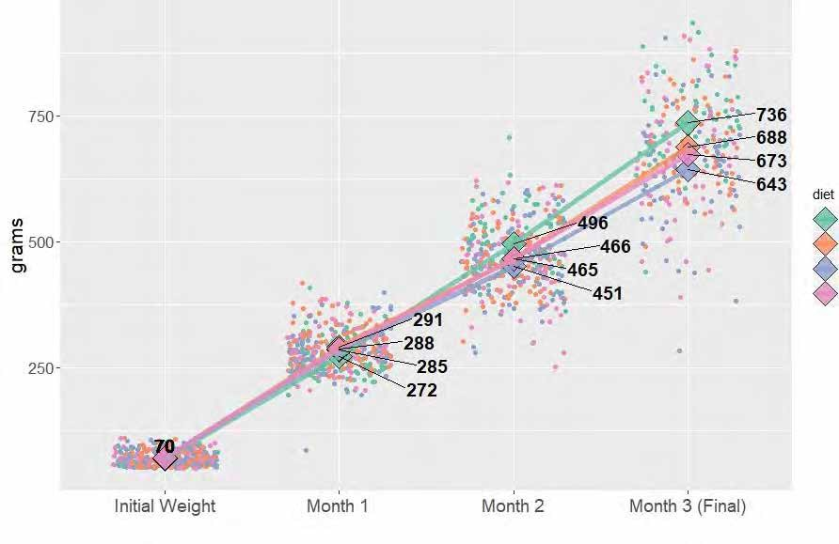
Total Fishmeal Replacement with
3. Mission driven
Feed‐grade Poultry Meal, plus trace mineral mix
Mineral Mix Diets 1 – 3 v Commercial control
NOAA – SK, in collaboration with F3 – Future of Fish Feed, and Dr Rick Barrows (ret.)
S. rivoliana; four tank replicates per treatment, n = 20 fish per tank
a
a
FISH WEIGHTS
CONTROL
Min. Mix 1
Min. Mix 2
Min. Mix 3

Slide 24
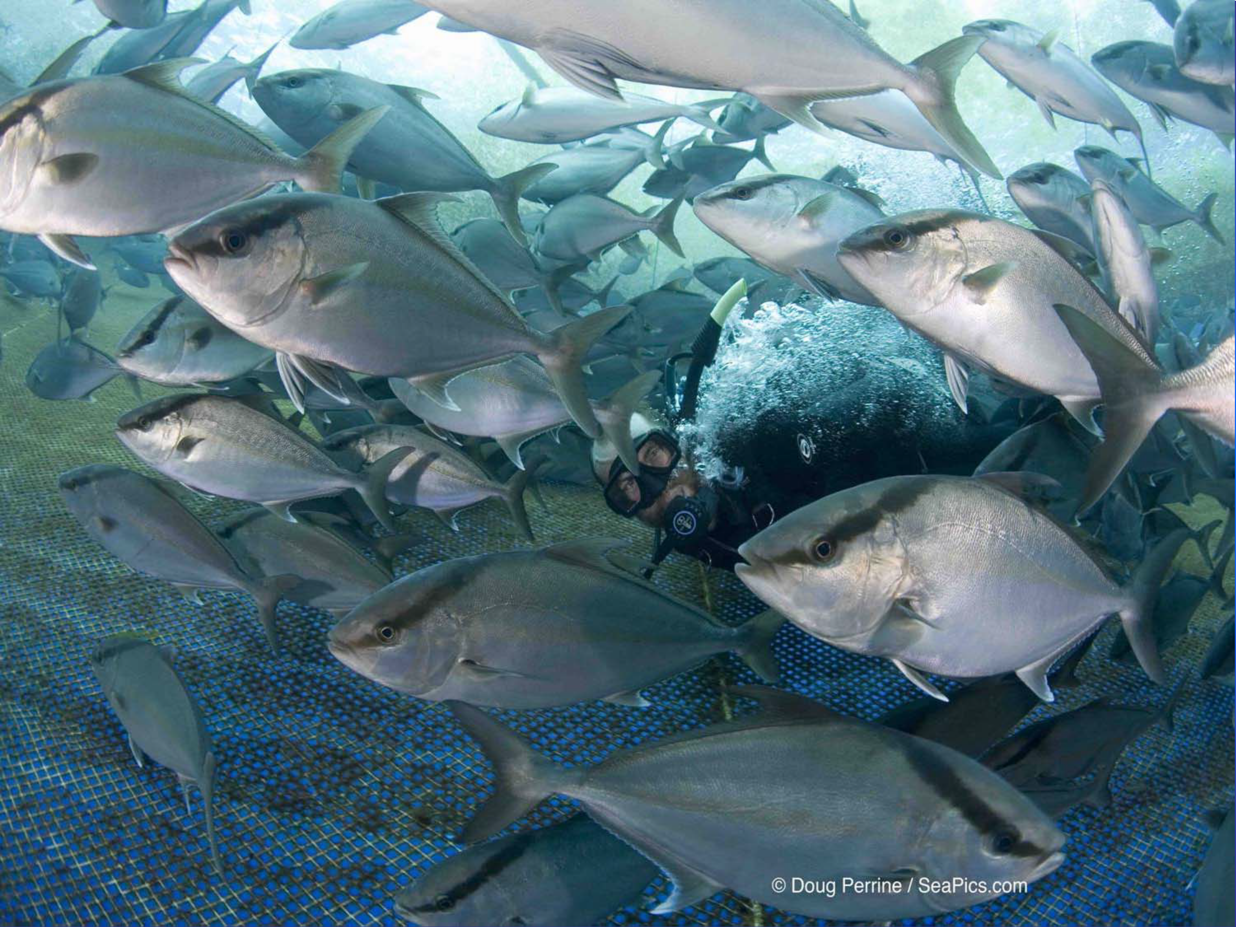
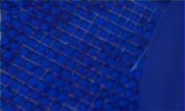
NOAA – SK 2018 ‐ 2020, in collaboration with F3 – Future of Fish Feed, and Dr Rick Barrows (ret.)
3. Mission driven
Final Trial : Total Fishoil Replacement ?
Veramaris + canola/flax mix @ 8.3% (c.f. fish oil)
Truly Fish‐free feeds?
OCEAN ERA

Slide 25
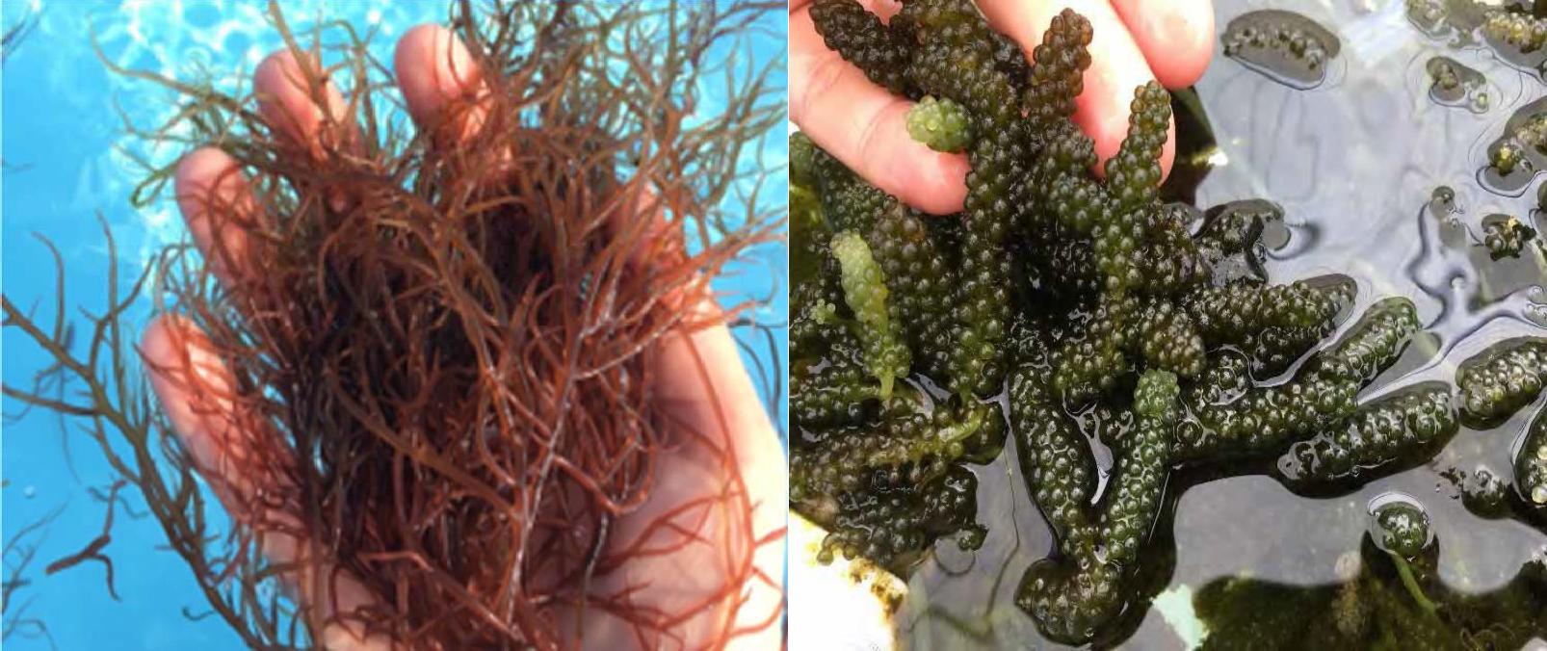
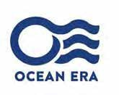
Mission Driven
3. Mission driven
Offshore macroalgae:
economic incentive / ecological imperative
Food, feed, fertilizer, fuels, and footprint (C)

Slide 26
Take‐away
1. Collaborative
2. Critical commercial path
3. Mission driven
4. Omnivorous
5. Nimble

Slide 27
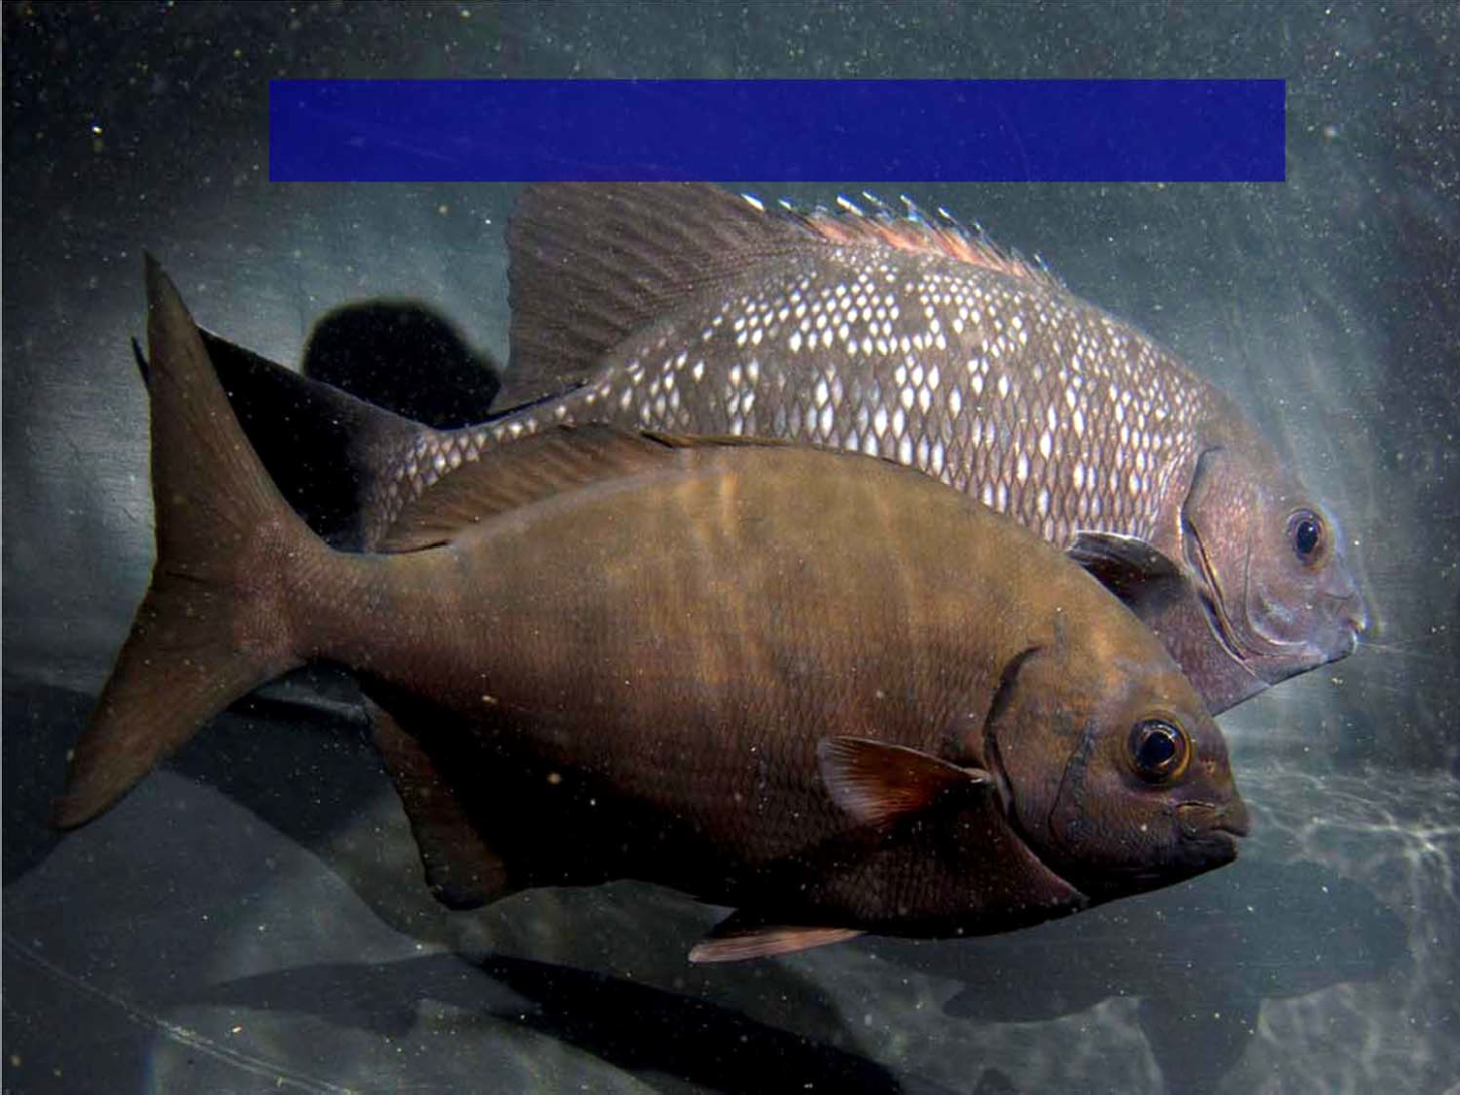
Kyphosids: rudderfish/chubs, nenue
4. Omnivorous
NOAA Saltonstall‐Kennedy‐supported research (2016 ‐ 2018)

Slide 28
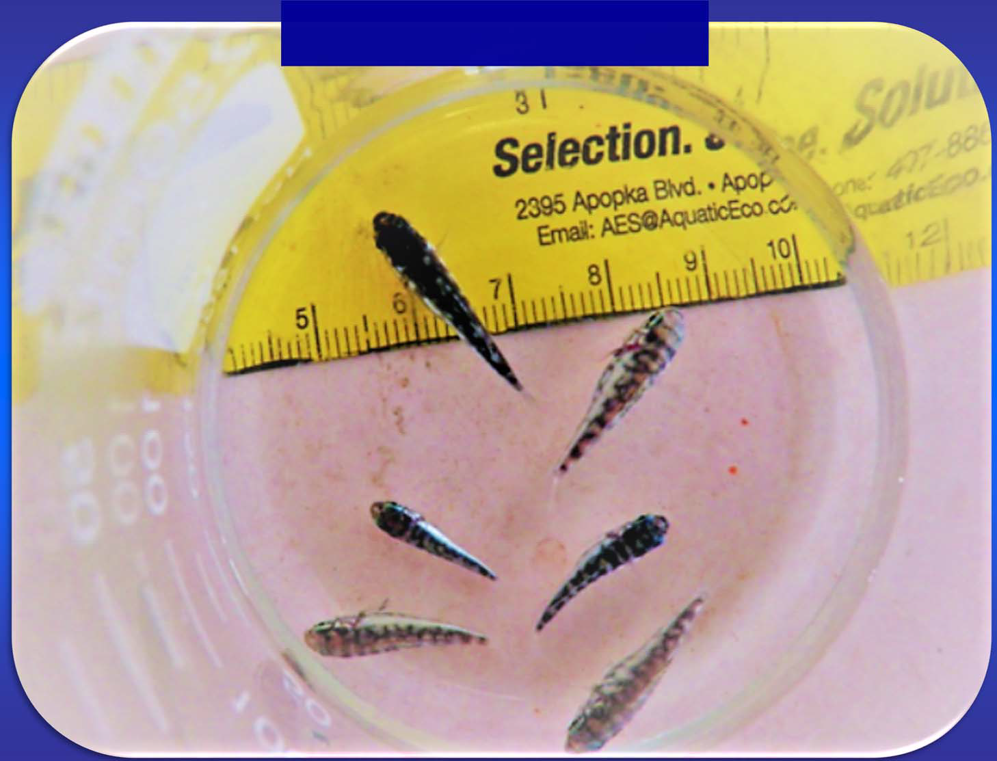
2018 Larval Rearing
4. Omnivorous
In collaboration with the late Syd Kraul, Pacific Planktonics, LLC
USDA SBIR‐supported research (2017 ‐ 2018)

Slide 29
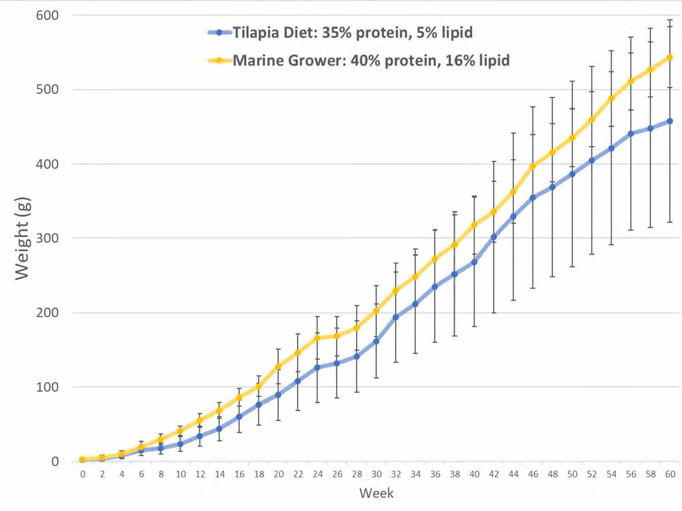


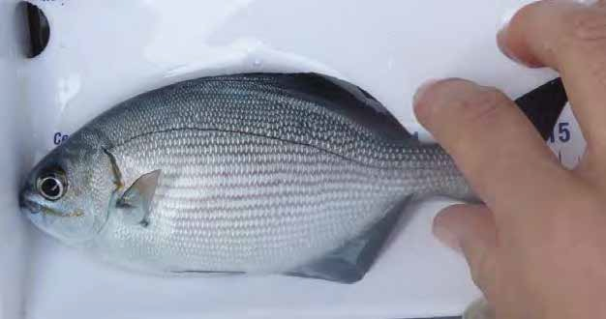



Tilapia Diet FCR = 2.6 Marine Grower FCR = 2.5
4. Omnivorous
400 g in 10 mos
1.3 g daily
24% fat
2.88g

Slide 30
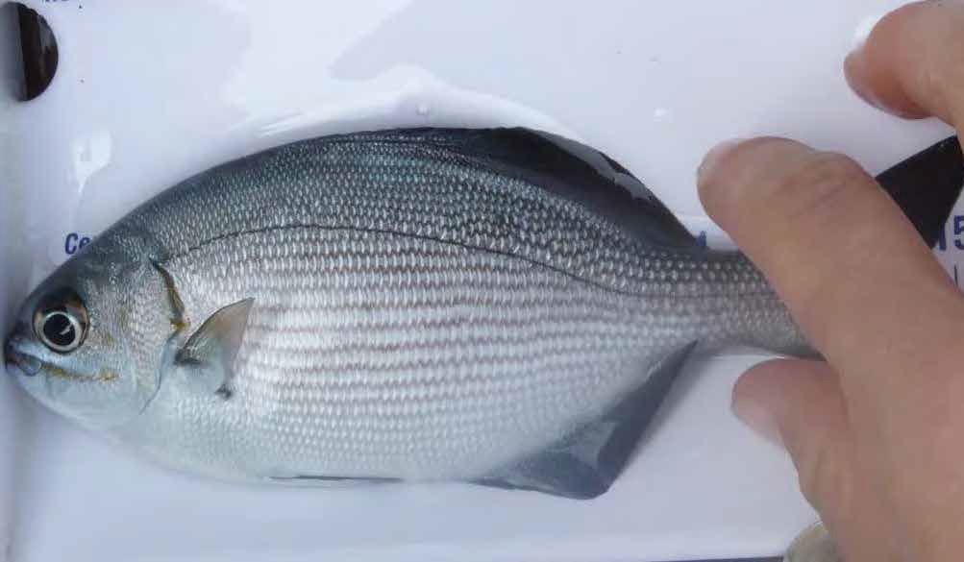


ARPA‐E KRuMBS
4. Omnivorous
Co‐opt kyphosid microbiome to improve macroalgae biodigestion

Slide 31
Take away
1. Collaborative
2. Critical commercial path
3. Mission driven
4. Omnivorous
5. Nimble

Slide 32
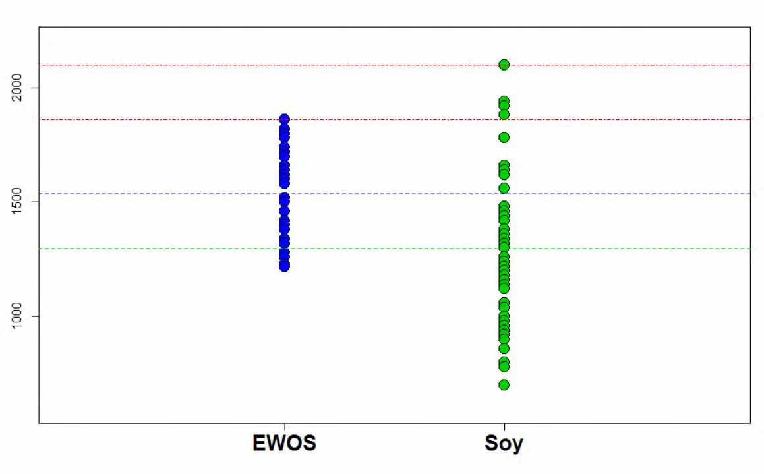
Selective Breeding for feed assimilation
5. Nimble
2016 – 17 Soy (SPC) growth trial
Penultimate Fish Weight
Four largest fish on soy
Weight (g)
Genesis : Nebraska Soy Association, University of Nebraska Lincoln, Jim Parsons (Troutlodge), NOAA SBIR, Center for Aquaculture Technologies
Control

Slide 33
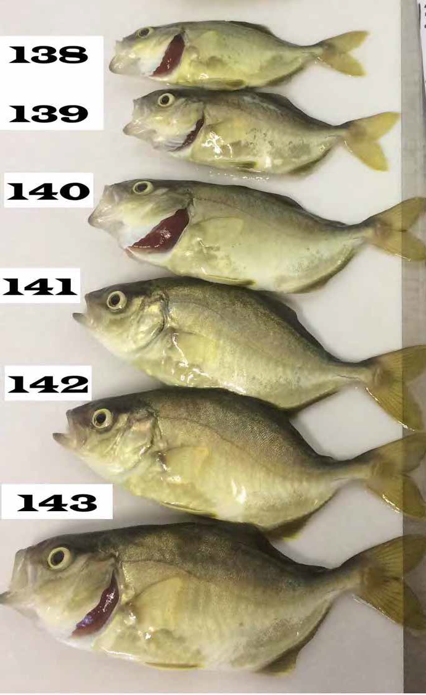


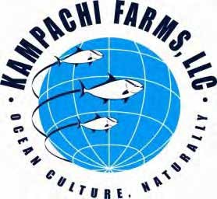

Selective breeding for growth, spinal deformities, etc:
5. Nimble
6 SNPs linked to lordosis; one strongly significant.
In collaboration with Center for Aquaculture
Technologies, under NOAA SBIR
OCEAN ERA
33

Slide 34
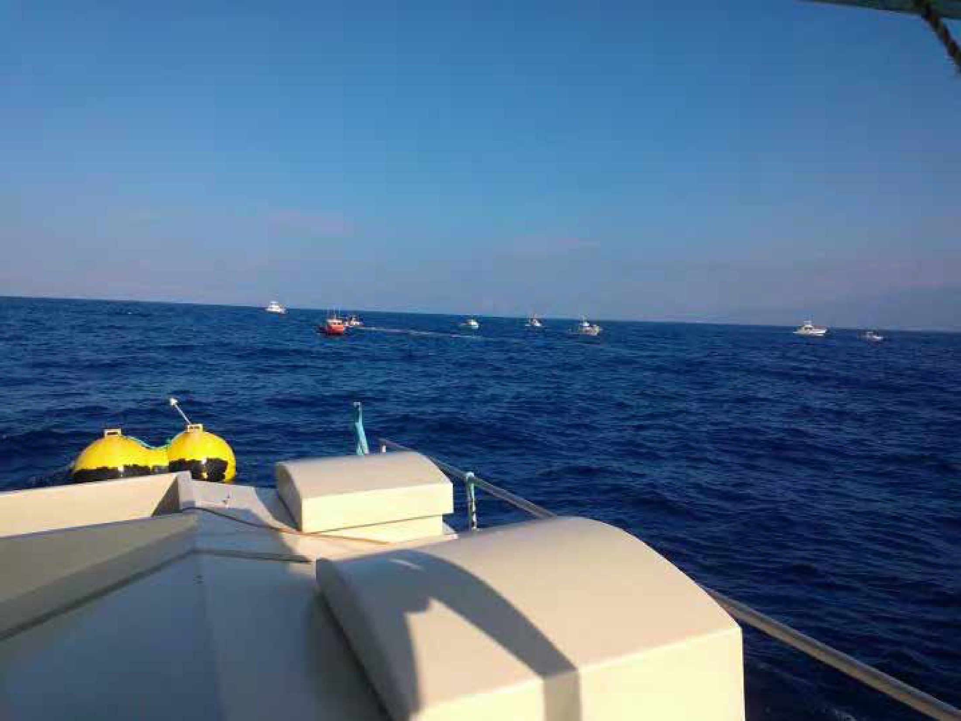


Velella Gamma (Kona)
5. Nimble
“Best fishing in my life!” ‐ local Kona fisherman

Slide 35
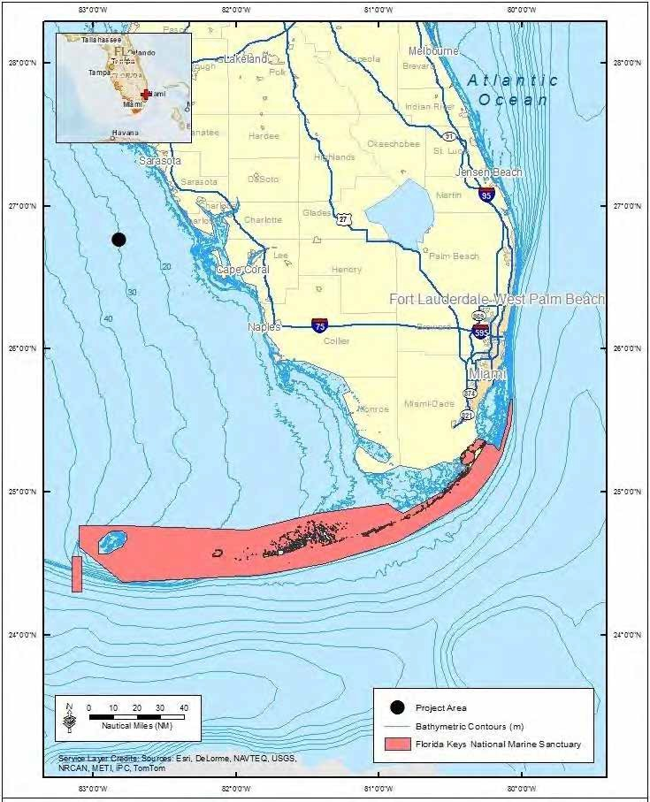


Nimble
5. Nimble
Velella Epsilon
SPM net pen
Gulf of Mexico ‐ demonstration permit application in process
Support from NOAA SeaGrant, in collaboration with UFL SeaGrant, RSMAS (Dr. Dan Benetti), Mote (Dr Kevan Main), Cargill
Seeking strategic partners
35

Slide 36
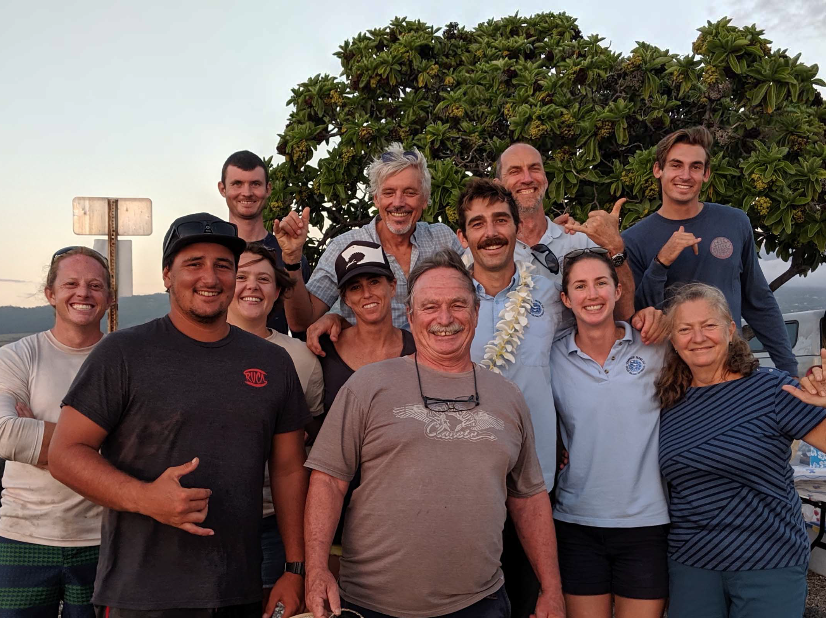
What’s next?
1. Collaborative
2. Critical commercial path
3. Mission driven
4. Omnivorous
Thank you
Cell: (808) 989 2438
5. Nimble

